Slide 1
PRAMAAN प्रमाण
unsigned preview
analysed for liveness
Proof, not a verdict.
signed capture
stored in the packet
Face liveness and presentation-attack detection for the MOSIP Registration Client, desktop and Android, that leaves evidence a server can re-check.
PRAMAAN links them
four locks, then signed evidence
MOSIP Decode 2026 · Problem Statement 04
Team: Bhavya Garg · github.com/GargBhavya-tech/pramaan
A working engine, not yet measured on real attacks
Notes:
PRAMAAN, which means proof. Face liveness and presentation attack detection for the MOSIP Registration Client, for MOSIP Decode 2026, problem statement four. The idea in one picture: the preview that gets analysed and the capture that gets stored are two separate paths that nothing links. PRAMAAN links them and keeps the proof. One honest note first: this is a working engine that has not yet been measured on real attacks.

Slide 2
The gap nobody names
The preview is unsigned. The capture is signed. Nothing links them.
Camera /
SBI device
unsigned preview
Liveness check passes on face A
signed capture
Registration packet stores face B
Attacker controls the preview
Capture swap
Whoever controls the preview can pass liveness with one face and enrol another.
Android never sees it
The client gets only the signed capture; the device app shows the stream.
Injection and insiders
A virtual camera or deepfake is outside ISO/IEC 30107. An operator can log in with a supervisor's photo.
No audit trail
A client-side pass or fail cannot be re-checked by the server later, or re-scored with a better model.
PRAMAAN · MOSIP Decode 2026 · PS04
2 / 10
Notes:
The preview is unsigned. The capture that is stored is signed. Nothing links the two. So whoever controls the preview can pass liveness with one face while another face is enrolled. On Android the client never even sees the preview. A virtual camera or a deepfake is outside the standard that covers presentation attacks. A corrupt operator can log in with a supervisor's photo. And a pass or fail made on the client cannot be re-checked by the server later.

Slide 3
What is different: from a verdict to proof
Six ideas. Each one replaces a shortcut the naive approach takes.
THE NAIVE APPROACH
PRAMAAN
SEE SLIDE
Liveness is judged on the preview; the capture is stored separately.
Preview and capture are bound: four locks prove the signed capture is the face that was watched.
1
5
The client says pass or fail, and the server has to trust it.
Signed evidence a server can re-check, or re-score with a better model years later.
2
6
One model, or a blink check.
Six cues that fail differently, fused. A cue that cannot run abstains; it never fails anyone.
3
6
A fixed challenge (blink, smile) that a recording or deepfake can follow.
A random challenge: a 20.7-bit flash code and a random onset, different every session.
4
6
Camera only: a virtual camera or injected video is invisible.
Device identity, the OS's camera registrations and a stream fingerprint.
5
4
Elderly, disabled and darker-skinned residents fail blink and pulse checks.
Those cues only ever vote for life; Hindi, icons and speech; a dual-control exception path.
6
A1
PRAMAAN · MOSIP Decode 2026 · PS04
3 / 10
Notes:
This is the main point. Six ideas, each replacing a shortcut. One: judge the preview but store a separate capture, versus binding the two with four locks. Two: a pass or fail the server must trust, versus signed evidence it can re-check or re-score. Three: one model, versus six cues that fail differently. Four: a challenge a recording can follow, versus a random one with a twenty point seven bit flash code. Five: camera only, versus also checking the device identity, the operating system's camera list and the stream fingerprint. Six: checks that fail elderly, disabled and darker skinned residents for innocent reasons, versus cues that only ever vote for life. Each of these is built and tested; none is claimed beyond what the claim sheet allows.

Slide 4
Architecture: two paths leave the device
Device trust boundary
L0 key in software; L1 in hardware
Station: Registration Client (desktop) or SBI app (Android)
3
4
6
2
5
LivenessEngine
source integrity, injection veto
one usable face, quality gate
passive model: asks nothing
attack cues, each may abstain
fusion: accept / challenge / reject
random challenge
fails closed; no score to the screen
Server, any time later
verifyEvidence: one command
rescanEvidence: a newer model
transparency log
Camera
the sensor
unsigned
preview
SbiFrameSource
frames and the signed capture, one object
SBI device service
127.0.0.1, ports 4501-4600
signs every capture, the session nonce inside
optional: Liveness Profile
1
CaptureBinder
four locks: nonce, chain, same face, time
signed
capture
sync
Registration packet
face BIR: bdb untouched
others = signed evidence
2
EvidencePackager
signed JWS: decision, cues, model hashes, binding level
6
Station screens
one sentence and an icon
1
Binding
2
Signed evidence
3
Differing cues
4
Random challenge
5
Injection defence
6
Inclusion
PRAMAAN · MOSIP Decode 2026 · PS04
4 / 10
Notes:
Two paths leave the device. The preview, dashed and red, is unsigned and goes to the engine for analysis. The capture, solid and green, is signed by the device with our session nonce inside, and goes to the binder. The binder is what links them: four locks decide whether the signed capture is the face that was watched. Only then is evidence packaged, signed, stored in the face record's others map and sent to the server, which can re-check it or re-score it later. The numbered badges are the six ideas from the previous slide, placed on the part of the system where each one lives. On Android the engine runs inside the device app, because the client never sees the preview there.

Slide 5
How idea 1 works: four locks stop the capture swap
1 Start
The client makes a random 32-character nonce for this session.
2 Preview
Every frame it analyses is hashed into a chain.
3 Challenge
A random prompt, at a random time.
4 Capture
The nonce goes to the device as the transaction ID; the device signs it inside the capture.
5 Decide
Four locks must all hold before anything is accepted.
THE FOUR LOCKS
1 Nonce
Checks: the signed capture echoes this session's nonce
Stops: an old or foreign capture replayed
2 Chain
Checks: a hash chain over the analysed frames links to the device's capture chain
Stops: frames dropped, inserted or reordered
3 Same face
Checks: the face in the signed capture matches the face tracked in the preview
Stops: THE CAPTURE SWAP
4 Time
Checks: the capture is recent compared with the last verified frame
Stops: a capture taken long after the analysis
The attack, and what happens
Pass liveness with face A, then return a signed capture of face B. Lock 3 fails and the session ends with REJECT_BINDING. Each swap is a test: BindingAttacksTest, 8 cases, all passing.
Real response from the reference device (signed data)
"transactionId": "0123456789abcdef0123456789abcdef"
"streamTagHead": "158b9f4cdc6ca35c7d22a3bd7b0535..."
Locks 1 to 4 need no device change. The optional Liveness Profile adds a signed stream and a burst.
PRAMAAN · MOSIP Decode 2026 · PS04
5 / 10
Notes:
Here is how the first idea works. At the start the client makes a random nonce. Every frame it analyses goes into a hash chain. When it asks the device for the capture, it sends the nonce as the transaction ID, and the device signs it inside the capture. Then four locks decide. Lock one, the nonce comes back inside the signed data, which stops an old or foreign capture. Lock two, the hash chain, stops dropped or inserted frames. Lock three, the face in the signed capture must match the face in the preview, and that is the capture swap. Lock four, the capture must be recent. Each of these is a test. The first four locks need no change to the device. The real response on the slide is from our reference device.

Slide 6
Ideas 2 to 4: cues, challenge and evidence
3
Cues that fail differently
4
A random challenge
2
Lasting evidence
CUE
CATCHES
BLIND TO
The screen flashes a random colour code; a live face reflects it. Example (random every session):
Signed JWS in the face BIR
bdb untouched; evidence in others
Passive model
print, screen
what it was not trained on
Moiré
screen recapture
some display pitches (we found them)
step 1 ... step 8, 400 to 450 ms each
Server re-checks
verifyEvidence, one command
Flash reflection
replay, injection
a projected mask; needs a light
6 colours × 8 steps
= 1,679,616 sequences
= 20.7 bits
Scene + light
the wrong room
a replay of the right room
Years later
re-score with a newer model
Stereo depth
flat things
needs a second camera
Random onset for the prompt, and a random action.
At most 3 colour changes a second, no saturated red: checked on 900 sequences.
Honest limit: built and tested on synthetic data; it needs a light facing the resident.
Stream fingerprint
a re-encoding virtual camera
one that copies the encoder
Transparency log
omission is detectable (Merkle)
Every cue has a hole; the holes should not overlap. A cue that cannot run abstains. It is never a failure.
PRAMAAN · MOSIP Decode 2026 · PS04
6 / 10
Notes:
Three more ideas. Idea three: cues that fail differently. The passive model, moire, flash reflection, scene and light consistency, stereo depth and a stream fingerprint each catch something and are blind to something else. The design goal is that the holes do not overlap, and a cue that cannot run abstains instead of failing anyone. Our own red team found that the moire cue is blind at some display pitches, and we show that openly. Idea four: a challenge nobody can pre-record. The screen flashes a random sequence of six colours over eight steps, which is one million six hundred seventy nine thousand six hundred sixteen sequences, or twenty point seven bits, and a live face reflects it. It is limited to three colour changes a second for photosensitivity. It is built and tested on synthetic data and needs a light facing the resident. Idea two: evidence, not a verdict. A signed record in the face record's others map that the server can re-check with one command, re-score years later with a newer model, and that a transparency log makes impossible to quietly omit.

Slide 7
Honest status, impact and next steps
No real attack corpus exists, so no APCER or BPCER is claimed. Zero failures in 60 attacks would still allow a true rate near 6%.
Verified (one command each)
686 automated tests pass (20 skip on a fresh clone: no models)
Each capture-swap attack is a test
Flash code: 20.7 bits; ≤ 3 changes a second
Insider signal: 6 in 40 at 2% gives z ≈ 5.87
Transparency log matches the CT test vectors
Not done, not claimed
No error rate on real attacks; thresholds provisional
Not run on a device, a phone or a certified SBI device
A scaffold, not the Registration Client; no user has tried the screens
We attacked ourselves: 4 of 85 synthetic pitches accepted without a flash cue, 0 with one. Logged, fix proposed, not enabled.
Impact and next
For MOSIP: closes the capture-swap gap on unmodified SBI; leaves proof a server can re-check.
Next: one real experiment (does the flash cue separate a live face from a replay?), a consented corpus, a real device and phone, real users.
Ask: how should an SBI extension be proposed?
Stack: Java (Java 11 bytecode) · ONNX Runtime · JavaFX 11 · MOSIP SBI 1.x · JUnit 5 · Android library
For: registration centres, operators and supervisors, residents, and server operators. Code: github.com/GargBhavya-tech/pramaan (MPL-2.0)
PRAMAAN · MOSIP Decode 2026 · PS04
7 / 10
Notes:
What we verify and what we do not claim. Six hundred eighty six automated tests pass; on a fresh clone twenty skip because the face models are not in the repository. We have not measured an error rate on real attacks because no real corpus exists. It has not run on a real device or a phone, it is a scaffold, and no user has tried the screens yet. Our own red team found that, on synthetic replays with no flash light, the fusion accepted four of eighty five display pitches, and none with the flash cue; we logged it and did not turn on the proposed fix. Next: one real experiment, a consented corpus, a real device, real users. And one question for MOSIP: how should an SBI extension be proposed? Thank you.

Slide 8
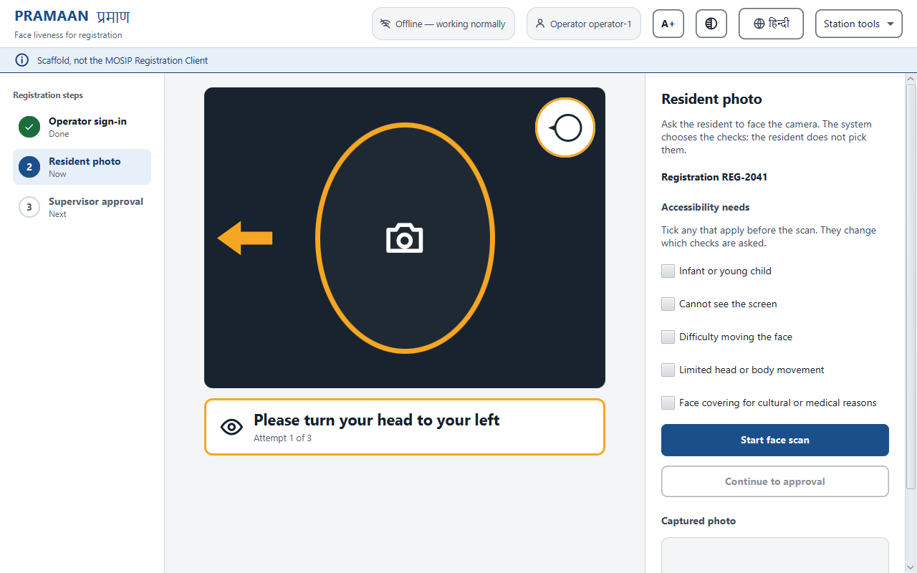
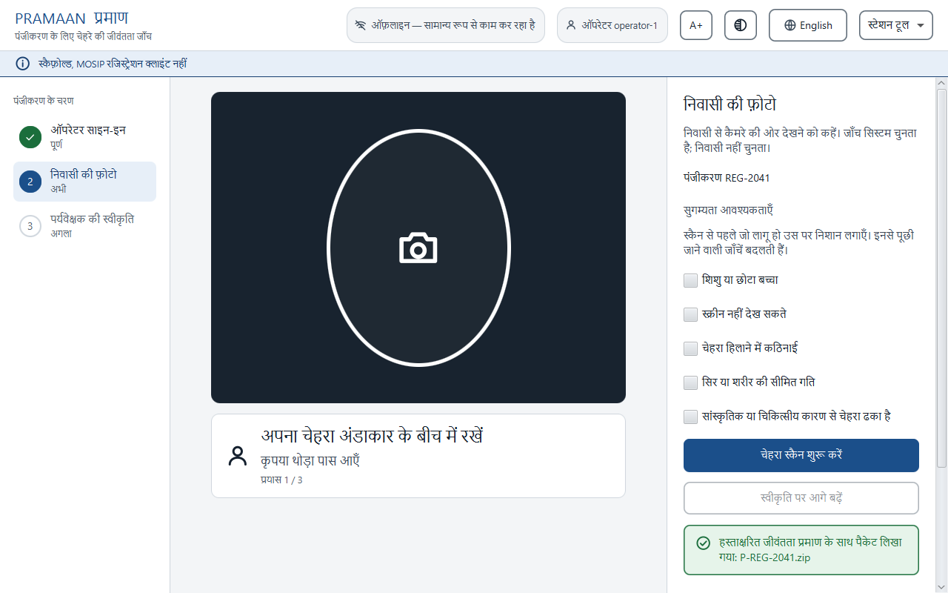
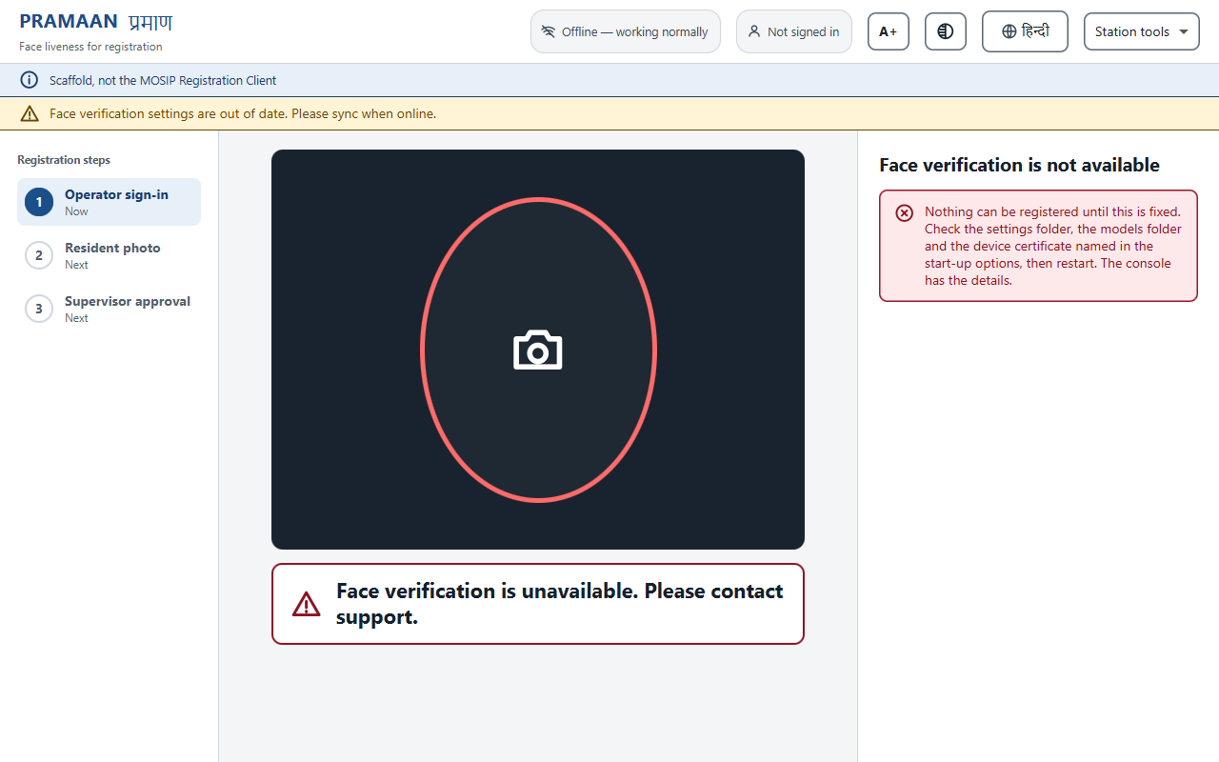
Appendix: the station, as built
Rendered from the real code, offscreen. One plain sentence, an icon, no score. No live camera in these images.
Resident capture mid-challenge
A head-turn prompt with an arrow, an icon and one sentence.
Hindi, one click
Larger text and high contrast are also one click each. Machine-drafted Hindi.
Fails closed
If anything does not verify, nothing can be registered and the screen says what to check.
Built to be inclusive: every status is an icon and a word, never colour alone; 44 px targets and a 3 px focus ring; larger-text and high-contrast modes; Hindi; spoken prompts; accessibility profiles; contrast checked at 4.5:1 or better on the palette.
Not done: no operator or resident has used these screens, and no screen reader was tried.
PRAMAAN · MOSIP Decode 2026 · PS04 · Appendix
8 / 10
Notes:
These are the real screens rendered from the actual code, so there is no live camera in them. They are built to be inclusive, but they have not been tried with real people or a screen reader yet.

Slide 9
Appendix: we attacked ourselves
An automated red team searched our own cues. It found two real weaknesses, which are logged, not hidden.
FUSED DECISION ON SYNTHETIC SCREEN REPLAYS (SCENE AND MOIRÉ FOOLED, NO FLASH LIGHT)
What we found, and did
R-01: the moiré cue is blind at some display pitches. Disclosed.
R-03: two attacker-controlled cues can sum to an accept when there is no flash light. Disclosed.
R-02: a scene-cue false rejection after exposure changes. Fixed.
Proposed fix for R-03: an accept needs a vote from a cue the display cannot fake. Not enabled: it would raise false rejections at stations without a light, which cannot be priced without a real corpus.
Display pitch
Without the flash cue
With the flash cue
0.80
ACCEPT (p 0.986)
CHALLENGE (p 0.459)
1.00
ACCEPT (p 0.989)
CHALLENGE (p 0.526)
1.20
ACCEPT (p 0.994)
CHALLENGE (p 0.657)
2.00
ACCEPT (p 0.949)
REJECT (p 0.185)
Of 85 pitches: 4 accepted without the flash cue, 0 with it, 3 left to the challenge.
Synthetic data, the passive scorer assumed fooled, the challenge not modelled. Reproduce: ./gradlew :harness:fusedRedTeam
PRAMAAN · MOSIP Decode 2026 · PS04 · Appendix
9 / 10
Notes:
Our own automated red team searched the recapture parameters for what fools our cues. On synthetic screen replays, with the passive model assumed fooled and no flash light, four of eighty five display pitches were accepted; with the flash cue, none. We logged it as R-03, with R-01, the blind pitches of the moire cue, and R-02, which we fixed. We proposed a fix and deliberately did not turn it on, because it would raise false rejections that we cannot price without real data.

Slide 10
Appendix: stack, standards and licences
Stack
Java, compiled to Java 11 bytecode (JDK 24 build)
Gradle (Kotlin DSL)
ONNX Runtime 1.20, pinned on purpose
JavaFX 11, the Registration Client's version
Jackson, JUnit 5
Android library (AAR) for Mode D
MOSIP SBI 1.x; models: YuNet, MiniFASNet, MediaPipe, SFace
Standards followed as targets
ISO/IEC 30107-1 and -3: APCER and BPCER per attack type, with intervals; ACER not reported
ISO/IEC 19794-5: the face image
ISO/IEC 29794-5 and OFIQ: quality
ISO/IEC 19795-10: demographic differentials
CEN/TS 18099: injection attacks
Not certified: no iBeta or FIDO test
Licences
Code: MPL-2.0, like MOSIP's repositories
YuNet: MIT
MiniFASNet, MediaPipe, SFace: Apache-2.0
SFace: development use only until its training-data terms are answered
JPEG 2000 reader: conditional; reuse MOSIP's copy in the client
Every dependency and model has a row in docs/licences.md
PRAMAAN · MOSIP Decode 2026 · PS04 · Appendix
10 / 10
Notes:
The stack is Java, ONNX Runtime pinned to 1.20, JavaFX 11 as in the Registration Client, and the MOSIP SBI. We follow the ISO and CEN standards as design targets; we are not certified. The code is MPL two point zero like MOSIP; every dependency and model has a licence row, and SFace is development use only until its training data question is answered.

