Slide 1
Preparing the Database Environment

Slide 2

Objectives
After completing this lesson, you should be able to:
Describe your role as a database administrator (DBA) and explain typical tasks and tools
Plan an Oracle Database installation
Use Optimal Flexible Architecture (OFA)
Install the Oracle software by using Oracle Universal Installer (OUI)

Slide 3

Tasks of an Oracle Database Administrator
The approach for designing, implementing, and maintaining an Oracle database involves the following tasks:
Evaluating the database server hardware
Installing the Oracle software
Planning the database and security strategy
Creating, migrating, and opening the database
Backing up the database
Enrolling system users and planning for their Oracle Network access
Implementing the database design
Recovering from database failure
Monitoring database performance
Notes:
Tasks of an Oracle Database Administrator
A DBA is typically responsible for installing the Oracle software and creating the database. As a DBA, you may be responsible for creating database storage structures, such as tablespaces. In addition, you may create the schema or set of objects to hold application data.
You must ensure that the database is available for users. You accomplish this by starting up the database, backing up the database on a regular basis, and monitoring the performance of the database. These tasks should be performed within the framework of a security strategy.
As you proceed through the lessons in this course, you learn how to perform each of these tasks. You can also refer to the Oracle Database Administrator’s Guide for additional information about each of the tasks outlined in the slide.
In this lesson, you focus on installation. For this core task, consider the following subtasks:
Understanding how the installation fits into the overall technical architecture of an organization
Reviewing (and updating) capacity plans
Choosing the database software (required version and options)
Ensuring that system requirements are met for all chosen elements

Slide 4
Tools for Administering an Oracle Database
Oracle Universal Installer
Database Configuration Assistant
Database Upgrade Assistant
Oracle Net Manager
Oracle Enterprise Manager
SQL*Plus
Recovery Manager
Oracle Secure Backup
Data Pump
SQL*Loader
Notes:
Tools for Administering an Oracle Database
You can use the following tools for installation and upgrade:
Oracle Universal Installer (OUI): Installs your Oracle software and options; can automatically launch the Database Configuration Assistant to create a database
Database Configuration Assistant (DBCA): Creates a database from Oracle-supplied templates, enabling you to copy a preconfigured seed database (Alternatively, you can create your own database and templates.)
Database Upgrade Assistant (DBUA): Guides you through the upgrade of your existing database to a new Oracle release
Oracle Net Manager: Configures network connectivity for your Oracle databases and applications

Slide 5
Notes Only
Notes:
Tools for Administering an Oracle Database (continued)
The following tools are used to manage your Oracle instance and database:
Oracle Enterprise Manager (EM): Combines a graphical console, agents, common services, and tools to provide an integrated and comprehensive system management platform for managing Oracle products. After you have installed the Oracle software, created or upgraded a database, and configured the network, you can use EM as the single interface for managing your database. In addition to providing a Web-based user interface for executing SQL commands, it interfaces with other Oracle components that are used to administer your database (for example, Recovery Manager and Scheduler).
The main EM tools that are used to administer an Oracle database are:
Enterprise Manager Database Console: To administer one database
Enterprise Manager Grid Control: To administer many databases at the same time
SQL*Plus: Standard command-line interface for managing your database
Recovery Manager (RMAN): Oracle tool that provides a complete solution for the backup, restoration, and recovery needs of the entire database or of specific database files
Oracle Secure Backup: Provides tape backup management for the Oracle ecosystem, which includes:
Oracle database protection to tape through integration with Recovery Manager
Seamless support of Oracle Real Application Clusters (RAC)
Central administration of distributed clients and media servers, including Oracle Application Servers, Oracle Collaboration Suites, Oracle home, and binaries
Data Pump: Enables the high-speed transfer of data from one database to another (For example, you may want to export a table and import it into another database.)
SQL*Loader: Enables the loading of data from an external file into an Oracle database; one of several Oracle utilities that you can use to load data into database tables
Command-line tools:
To administer Enterprise Manager:
emctl start | status | set | stop dbconsole
To administer the listener:
lsnrctl help | start | status | stop dbconsole

Slide 6

Installation: System Requirements
Memory requirements:
1 GB for the instance with Database Control
Disk space requirements:
1.5 GB of swap space
400 MB of disk space in the /tmp directory
Between 1.5 GB and 3.5 GB for the Oracle software
1.2 GB for the preconfigured database (optional)
2.4 GB for the flash recovery area (optional)
Operating system (see documentation)
Notes:
Installation: System Requirements
A standard installation can be completed on a computer with 1 GB of RAM and 1.5 GB of swap space or larger.
Depending on the activity level of the machine on which you are installing the Oracle Database software, the standard installation can complete in 20 minutes or less.
Some installation details:
Oracle Database 11g ships only one seed database template.
Duplicated files are removed.
Many other products and demonstrations are installable from additional CDs.
The hardware requirements listed in the slide are minimal requirements across all platforms. Your installation may have additional requirements (especially disk space).
Note: An Enterprise Edition installation type that includes a standard seed database is referred to as a “standard installation.”

Slide 7
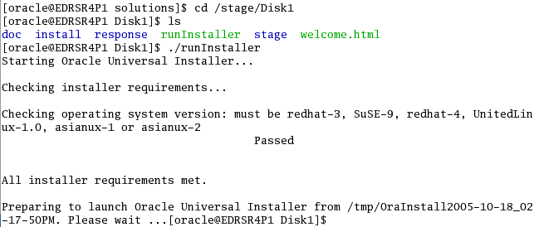
Checking the System Requirements
Adequate temporary space
64-bit versus
32-bit issues
Correct operating system (OS)
OS patch level
System packages
System and kernel parameters
X Server permissions
Sufficient swapping
Nonempty ORACLE_HOME
Notes:
Checking the System Requirements
The Oracle Database 11g installation automates most of the prerequisite checks to verify the following:
Minimum temporary space requirements for installation and configuration are checked. Those requirements are validated during the installation process.
64-bit installations are prevented from being installed into Oracle homes with 32-bit software already installed (and vice versa).
Oracle Database 11g is certified against several versions of the Linux platform.
All required OS patches are installed.
All required system and kernel parameters are set correctly.
The DISPLAY environment variable is set and the user has sufficient permissions to display to the specified DISPLAY.
The system has a sufficient swapping set.
The Oracle home for the new installation either is empty or is one of a handful of supported releases on top of which Oracle Database 11g can be installed. The installation process also verifies that those releases are registered in the Oracle inventory.

Slide 8

Optimal Flexible Architecture (OFA)
OFA is designed to:
Organize large amounts of software
Facilitate routine administrative tasks
Facilitate switching between multiple Oracle databases
Manage and administer database growth
Notes:
Optimal Flexible Architecture (OFA)
OFA is a method for configuring the Oracle database and other databases. OFA takes advantage of the capabilities of the OS and disk subsystems to create an easy-to-administer configuration that allows maximum flexibility for growing and high-performance databases. The methods described here are the basics of OFA.
OFA is designed to:
Organize large amounts of complicated software and data on the disk to avoid device bottlenecks and poor performance
Facilitate routine administrative tasks (such as software and data backup) that are often vulnerable to data corruption
Facilitate switching between multiple Oracle databases
Manage and administer database growth
Help eliminate fragmentation of free space in the data dictionary, isolate other fragmentation, and minimize resource contention
For details about the goals and implementation of OFA, see the Oracle Installation Guide for UNIX Systems.

Slide 9



Optimal Flexible Architecture: Naming Scheme
Mount points:
/u01
/disk01
Directories:
/u01/app/oracle
/u01/app/applmgr
Files:
Control files: controln.ctl
Redo log files: redon.log
Data files: tn.dbf
Notes:
Optimal Flexible Architecture: Naming Scheme
At the core of OFA is a scheme that provides naming standards for your mount points (which are often the physical disks), the directories and subdirectories on those mount points, and the files themselves.
Mount point syntax: Name all mount points by using the /pm syntax, where p is a string constant and m is a unique fixed-length key (typically a two-digit number) that is used to distinguish each mount point. Examples of OFA-compliant mount points are /u01 and /u02.
Home directories syntax: Name all home directories by using the /pm/h/u syntax, where pm is a mount point name, h is a standard directory name, and u is the name of the owner of the directory. Examples of OFA-compliant home directories are:
/u01/app/oracle
/u01/home/oracle
Software directories syntax: Store each version of the Oracle software in a directory matching the pattern /pm/h/u/product/v. Here, product is a literal and v is a variable for the version number. This syntax helps to enable the OFA feature of simultaneously executing multiple versions of application software. An OFA-compliant installation of Oracle Database 11g version 11.1.0 is the following:
/u01/app/oracle/product/11.1.0/db_1

Slide 10
Notes Only
Notes:
Using Optimal Flexible Architecture
Subdirectories syntax: To facilitate the organization of administrative data, you should store database-specific administration files in subdirectories matching the pattern /h/admin/d/a/. Here, h is the Oracle software owner’s home directory, admin is a literal, d is the database name, and a is a subdirectory for each of the database administration files. The following is a list of these administration file subdirectories:
adhoc: Ad hoc SQL scripts for a particular database
arch: Archived redo log files
adump: Audit files (Set the AUDIT_FILE_DEST initialization parameter to the adump directory. Clean out this subdirectory periodically.)
Create: Programs used to create the database
Exp: Database export files
Logbook: Files recording the status and history of the database
Pfile: Instance parameter files
Note: bdump and udump no longer exist in $ORACLE_BASE/admin. Their contents have been modified and moved to the DIAGNOSTIC_DEST/diag/db_name/sid/ subdirectories. The cdump destination has been moved to DIAGNOSTIC_DEST/diag/rdbms/db_name/sid/cdump.
Database file syntax: The following naming convention for database files ensures that they are easily identifiable:
Control files: /pm/q/d/controln.ctl
Redo log files: /pm/q/d/redon.log
Data files: /pm/q/d/tn.dbf
The variables used in these file names are:
pm: Mount point name (as described previously)
q: String distinguishing the Oracle data from all other files (commonly named ORACLE or oradata)
d: Value of the initialization parameter DB_NAME (the database name)
t: Oracle tablespace name
n: Two-digit string
Note: Do not store files in the /pm/q/d/path other than control files, redo log files, and data files associated with the d database.

Slide 11

Setting Environment Variables
ORACLE_BASE: Base of the Oracle directory structure for OFA
ORACLE_HOME: Directory containing the Oracle software
ORACLE_SID: Initial instance name (default: ORCL)
NLS_LANG: Language, territory, and client character set settings
Notes:
Setting Environment Variables
There are many Oracle environment variables. Those mentioned here are important to the successful installation and use of an Oracle database. None of these are required to be set, but you can avoid future problems by setting them before the installation.
ORACLE_BASE: Specifies the base of the Oracle directory structure for OFA. Use is optional; if used, it can facilitate future installations and upgrades. This is a directory path, as shown in the following example:
/u01/app/oracle
ORACLE_HOME: Specifies the directory containing the Oracle software. This is a directory path, as shown in the following example:
$ORACLE_BASE/product/11.1.0/db_1
ORACLE_SID: The initial instance name (default: ORCL). This is a string of numbers and letters that must begin with a letter. Oracle Corporation suggests that a maximum of eight characters be used for system identifiers.

Slide 12
Notes Only
Notes:
Setting Environment Variables (continued)
NLS_LANG: Specifies the initial National Language Support (NLS) settings for a session in the form of language_territory.character set, as in the following example:
AMERICAN_DENMARK.WE8MSWIN1252
This sets the session to use the AMERICAN language for Oracle messages, alphabetical sorting sequence, day names, and month names. The territory is DENMARK, which sets the time format, date format, and numeric and monetary conventions. The character set of WE8MSWIN1252 instructs Oracle Net to convert character information to this character set. This is an environment variable in UNIX and a registry setting in Windows. You can query the actual NLS settings of your current session as follows:
select * from nls_session_parameters;
For more information about valid languages, territories, character sets, and language support, see the Oracle Database Globalization Support Guide.
Note: A Windows installation defaults the NLS_LANG values in the registry, where the language part originates from the keyboard language. The result is that the default installation on Windows with non-American keyboards will get the non-American value in the NLS_LANG setting. This, in turn, will default the NLS_SORT session variable to be different from “binary,” which makes it difficult for the optimizer to use character-based indexes for sessions from this node.

Slide 13
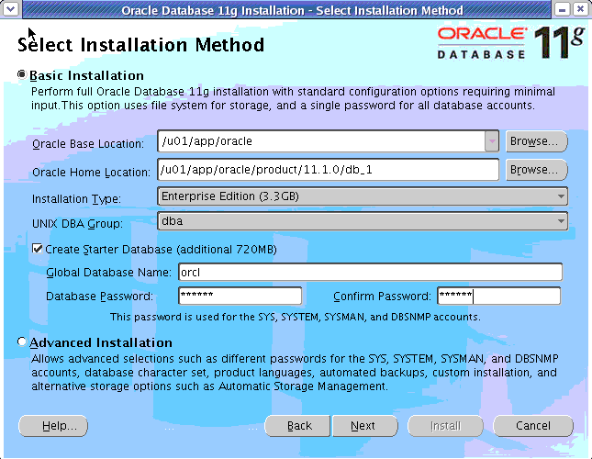
Oracle Universal Installer (OUI)
Notes:
Oracle Universal Installer (OUI)
Oracle Universal Installer (OUI) is a Java application that performs component-based installations and enables different levels of integrated bundle, suite, and Web-based installations as well as complex logic in a single package. The installation engine is easily portable across all Java-enabled platforms, and platform-specific issues can be encapsulated from the overall installation process.
OUI provides the following capabilities for addressing software management and distribution:
Automatic dependency resolution and complex logic handling
Installation from the Web
Component and suite installations
Implicit deinstallation
Support for multiple Oracle homes
NLS or globalization support
Support for distributed installations
Unattended “silent” installations that use response files
In Windows: To start OUI, insert the Oracle Database installation disk, navigate to the client directory, and double-click setup.exe. On the Welcome page, select your installation type: Instant Client, Administrator, Runtime, or Custom.

Slide 14
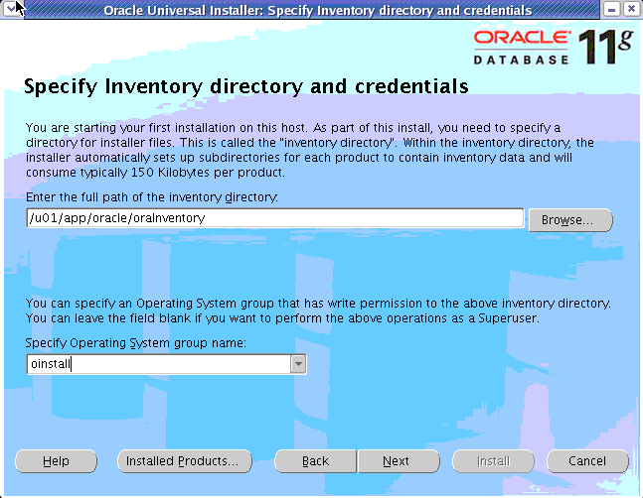
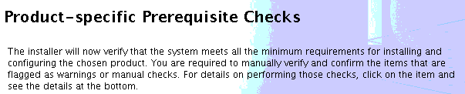
Installing the Oracle Software
Notes:
Installing the Oracle Software
To install the Oracle software by using OUI:
1. Log on to your computer as a member of the administrative group that is authorized to install the Oracle software and to create and manage the database.
2. Insert the distribution CD for the database into your CD drive, or navigate to the Oracle database staging location.
3. Start OUI. In an XTerm window on Linux, enter ./runInstaller. The Oracle Universal Installer page appears.
Navigate the OUI pages and specify the preinstallation settings according to your installation plan.
With the initial information, OUI executes prerequisite checks.

Slide 15
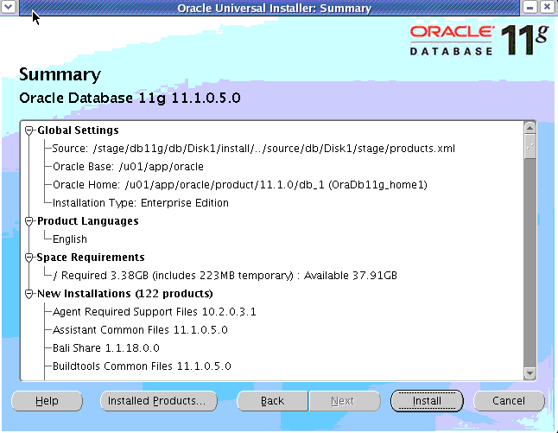
Database Configuration Options
Notes:
Database Configuration Options
Your installation process continues:
5. Navigate through the OUI pages and specify your database configuration options. OUI displays a summary of your installation choices.
6. Click Install to begin your installation of the Oracle software.
If you chose to create a starter database as part of the installation, OUI invokes all of these configuration assistants:
Oracle Net Configuration Assistant: This configures basic network components during installation, including:
Listener names and protocol addresses
Naming methods that the client will use to resolve connect identifiers to connect descriptors
Net service names in a tnsnames.ora file
Directory server usage
Oracle Database Configuration Assistant (DBCA): This creates the starter database that you selected. When this configuration assistant finishes, you can unlock accounts and change passwords.

Slide 16
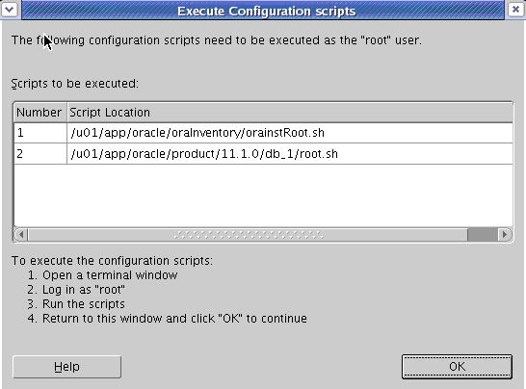
Executing Configuration Scripts
Notes:
Executing Configuration Scripts
Your installation process continues:
7. When prompted during a Linux or UNIX installation, execute additional configuration scripts as the root user. In an XTerm window, enter:
$ su
# password: oracle <root password, does not appear in the window>
# cd /u01/app/oracle/oraInventory
# ./orainstRoot.sh
# cd /u01/app/oracle/product/11.1.0/db_1
# ./root.sh
Accept the default for the local bin directory during a Linux or UNIX installation. When the scripts are finished, exit all related accounts and windows to allow the installation to complete.
When your installation process comes to an end, note the URLs for future use.

Slide 17
Advanced Installation Options
Database storage options:
File system
Automatic Storage Management
Raw devices
Database management options:
Enterprise Manager Grid Control
Enterprise Manager Database Control
Database backup and recovery options
Email notification options
Oracle Portable Clusterware
Cloning
Notes:
Advanced Installation Options
With OUI, you can create configurations that use Automatic Storage Management.
You can install and configure the Oracle Enterprise Manager (EM) framework. Oracle Enterprise Manager Database Control is installed in the same Oracle home as the database and is configured to run on a stand-alone OC4J instance. You have to perform a separate installation to get EM central management capabilities.
If you choose to use EM Database Control, you can optionally configure the database to use the Oracle-recommended default backup strategy.
If you choose to use EM Database Control during the installation, you can configure Enterprise Manager to send email alerts to an email address that you specify. These alerts can include issues such as disk space reaching a critical limit or a database shutting down unexpectedly.
The Oracle Database 11g installation supports RAC features, particularly the installation of clusterware.
Oracle homes can be cloned by using the Enterprise Configuration Management too, which enables users to create clone requests and then schedule and process them. This tool is available through EM Grid Control.
Note: These options are available only when creating a database. If you perform the installation without creating the database, these options are unavailable. When you create the database by using the DBCA, you have the opportunity to select these options.

Slide 18


Installation Option: Silent Mode
To install and configure Oracle products with OUI in silent mode, perform the following steps:
Create the oraInst.loc file (if it does not already exist).
Prepare a response file based on file templates that are delivered with the Oracle software.
Record a response file: .runInstaller –record -destinationFile <filename>
Run OUI in silent or suppressed mode.
If required, run NetCA and the DBCA in silent mode.
Notes:
Installation Option: Silent Mode
To install and configure Oracle products by using OUI in silent or suppressed mode:
1. Prepare a response file. File templates for each product and installation type are provided, such as enterprise.rsp, standard.rsp, and netca.rsp.
2. You can use OUI in interactive mode to record a response file that you can edit and then use to complete silent-mode or suppressed-mode installations. Create the response file under Linux and UNIX with the following command:
.runInstaller –record -destinationFile <filename>
In the syntax, –destinationFile is the file location.
3. Run OUI in silent or suppressed mode. Run the $ORACLE_BASE/oraInventory/orainstRoot.sh and $ORACLE_HOME/root.sh at the end of the installation.
4. If you completed a software-only installation, run Oracle Net Configuration Assistant (NetCA) and the Database Configuration Assistant (DBCA) in silent or noninteractive mode if required.
For more information, see your OS-specific Oracle Database Installation Guide.

Slide 19
Summary
In this lesson, you should have learned how to:
Describe your role as a DBA and explain tasks and tools
Plan your installation, starting with the appropriate documentation
Perform preinstallation tasks, such as checking system requirements
Install the Oracle software by using OUI

Slide 20
Practice 2 Overview: Preparing the Database Environment
This practice covers installing the Oracle software by using Oracle Universal Installer.
Note: Completing this practice is critical for all subsequent practices.

