Slide 1
Configuring the Oracle Network Environment

Slide 2
Objectives
After completing this lesson, you should be able to:
Use Enterprise Manager to:
Create additional listeners
Create Oracle Net Service aliases
Configure connect-time failover
Control the Oracle Net Listener
Use tnsping to test Oracle Net connectivity
Identify when to use shared servers and when to use dedicated servers
Notes:
Resources
Oracle Database Net Services Administrator’s Guide
Oracle Database Net Services Reference

Slide 3





Oracle Net Services
Application
Oracle Net
RDBMS
Oracle Net
TCP/IP network
Client or middle tier
Listener
Database server
Oracle Net
configuration files
Oracle Net
configuration files
Notes:
Oracle Net Services
Oracle Net Services enables network connections from a client or middle-tier application to the Oracle server. After a network session is established, Oracle Net acts as the data courier for both the client application and the database server. It is responsible for establishing and maintaining the connection between the client application and database server, as well as exchanging messages between them. Oracle Net (or something that simulates Oracle Net, such as Java Database Connectivity) is located on each computer that needs to talk to the database server.
On the client computer, Oracle Net is a background component for application connections to the database.
On the database server, Oracle Net includes an active process called the Oracle Net Listener, which is responsible for coordinating connections between the database and external applications.
The most common use of Oracle Net Services is to allow incoming database connections. You can configure additional net services to allow access to external code libraries (EXTPROC) and to connect the Oracle instance to non-Oracle data sources (such as Sybase, Informix, DB2, and SQL Server) through Oracle Heterogeneous Services.

Slide 4


Oracle Net Listener
Enterprise
Manager
Database
Control
Listener
Oracle databases
Oracle Net
configuration files
<Grid_home>/network/admin/listener.ora
./sqlnet.ora
Notes:
Oracle Net Listener
The Oracle Net Listener (or simply the listener) is the gateway to the Oracle instance for all nonlocal user connections. A single listener can service multiple database instances and thousands of client connections.
Enterprise Manager is one of the ways to access the listener. You can control the configuration of the actual listener as well as general parameters such as password protection and log file locations.
Advanced administrators can also configure Oracle Net Services by manually editing the configuration files, if necessary, with a standard operating system (OS) text editor such as vi or gedit.
Note: When the Grid Infrastructure for Standalone Server is installed, the Oracle Net Listener is started from its software installation directory, known as <Grid_home>. A listener is required to run from this software installation to provide connection capabilities to the ASM instance. This is also used by default to listen for all database instances that are installed on the same server.

Slide 5


Establishing Net Connections
To make a client or middle-tier connection, Oracle Net requires the client to know the:
Host where the listener is running
Port that the listener is monitoring
Protocol that the listener is using
Name of the service that the listener is handling
Names resolution
Notes:
Establishing Net Connections
For an application to connect to a service through an Oracle Net Listener, the application must have information about that service, including the address or host where the listener resides, the protocol that the listener accepts, and the port that the listener monitors. After the listener is located, the final piece of information that the application needs is the name of the service to which it wants to connect.
Oracle Net names resolution is the process of determining this connection information.

Slide 6

Establishing a Connection
Incoming connection request
Listener
Notes:
Establishing a Connection
After Oracle Net names resolution is complete, a connection request is passed from the user or middle-tier application (hereafter referred to as the user process) to the listener. The listener receives a CONNECT packet and checks whether that CONNECT packet is requesting a valid Oracle Net service name.
If the service name is not requested (as in the case of a tnsping request), the listener acknowledges the connect request and does nothing else. If an invalid service name is requested, the listener transmits an error code to the user process.

Slide 7
User Sessions
Server
process
User session
PGA
User process
Listener
Notes:
User Sessions
If the CONNECT packet requests a valid service name, the listener spawns a new process to deal with the connection. This new process is known as the server process. The listener connects to the process and passes the initialization information, including the address information for the user process. At this point, the listener no longer deals with the connection and all work is passed to the server process.
The server process checks the user’s authentication credentials (usually a password), and if the credentials are valid, a user session is created.
Dedicated server process: With the session established, the server process now acts as the user’s agent on the server. The server process is responsible for:
Parsing and running any SQL statements issued through the application
Checking the database buffer cache for data blocks required to perform SQL statements
Reading necessary data blocks from data files on the disk into the database buffer cache portion of the System Global Area (SGA), if the blocks are not already present in the SGA
Managing all sorting activity. The Sort Area is a memory area that is used to work with sorting; it is contained in a portion of memory that is associated with the Program Global Area (PGA).
Returning results to the user process in such a way that the application can process the information
Reading auditing options and reporting user processes to the audit destination

Slide 8
Tools for Configuring and Managing the Oracle Network
Enterprise Manager Net Services Administration page
Oracle Net Manager
Oracle Net Configuration Assistant
Command line
Notes:
Tools for Configuring and Managing the Oracle Network
Use the following tools and applications to manage your Oracle Network configuration:
Enterprise Manager: Provides an integrated environment for configuring and managing Oracle Net Services. Use Enterprise Manager to configure Oracle Net Services for any Oracle home across multiple file systems and to administer listeners.
Oracle Net Manager: Provides a graphical user interface (GUI) through which you can configure Oracle Net Services for an Oracle home on a local client or a server host. Oracle Net Manager enables you to configure Oracle Net Services for an Oracle home on a local client or server host. You can use Oracle Net Manager to configure the following network components:
Naming: Define simple names, connect identifiers, and map them to connect descriptors to identify the network location and identification of a service. Oracle Net Manager supports configuration of connect descriptors in local tnsnames.ora files or a centralized directory service.
Naming methods: Configure the different ways in which connect identifiers are resolved into connect descriptors
Profiles: Configure preferences for enabling and configuring Oracle Net features on the client or server
Listeners: Create and configure listeners to receive client connections

Slide 9
Notes:
Tools for Configuring and Managing the Oracle Network (continued)
Oracle Net Configuration Assistant: Is launched by Oracle Universal Installer when you install the Oracle software. The Oracle Net Configuration Assistant enables you to configure the listening protocol address and service information for an Oracle database. During a typical database installation, Oracle Net Configuration Assistant automatically configures a listener called LISTENER that has a TCP/IP listening protocol address for the database. If you do a custom installation, Oracle Net Configuration Assistant prompts you to configure a listener name and protocol address of your choice. Use the Oracle Net Configuration Assistant for initial network configuration after database installation. Thereafter, you can use the Oracle Enterprise Manager and Oracle Net Manager to configure and administer your networks.
Command line: Is used to start, stop, and view the status of the listener process. It is an OS user (in this course, oracle) that starts or stops the listener. If the listener is not started, you cannot use Enterprise Manager.

Slide 10
Listener Control Utility
Oracle Net listeners can be controlled with the lsnrctl command-line utility (or from EM).
$ . oraenv
ORACLE_SID = [orcl] ? +ASM
$ lsnrctl
LSNRCTL for Linux: Version 11.2.0.1.0 - Production on 30-JUN-2009 00:47:01
Copyright (c) 1991, 2009, Oracle. All rights reserved.
Welcome to LSNRCTL, type "help" for information.
LSNRCTL> help
The following operations are available
An asterisk (*) denotes a modifier or extended command:
start stop status
services version reload
save_config trace spawn
change_password quit exit
set* show*
Notes:
Listener Control Utility
When an instance starts, a listener process establishes a communication pathway to the Oracle database. The listener is then able to accept database connection requests.
The listener control utility enables you to control the listener. With lsnrctl, you can:
Start the listener
Stop the listener
Check the status of the listener
Reinitialize the listener from the configuration file parameters
Dynamically configure many listeners
Change the listener password
The basic command syntax for this utility is:
LSNRCTL> command [listener_name]
When the lsnrctl command is issued, the command acts on the default listener (named LISTENER) unless a different listener name is specified or the SET CURRENT_LISTENER command is executed. If the listener name is LISTENER, the listener_name argument can be omitted. The valid commands for lsnrctl are shown in the slide.
Note: The lsnrctl utility is located in both the Grid Infrastructure home and the Oracle database home. It is important to set the environment variables to the appropriate home before using it.

Slide 11
Listener Control Utility Syntax
Commands from the listener control utility can be issued from the command line or from the LSNRCTL prompt.
Command-line syntax:
Prompt syntax:
$ lsnrctl <command name>
$ lsnrctl start
$ lsnrctl status
LSNRCTL> <command name>
LSNRCTL> start
LSNRCTL> status
Notes:
Listener Control Utility Syntax
The lsnrctl commands can be issued from within the utility (prompt syntax) or from the command line. The following two commands have the same effect but use command-line syntax and prompt syntax, respectively:
Command-line syntax:
$ lsnrctl start
Prompt syntax:
$ lsnrctl
LSNRCTL for Linux: Version 11.2.0.1.0 - Production on 30-JUN-2009 01:00:01
Copyright (c) 1991, 2009, Oracle. All rights reserved.
Welcome to LSNRCTL, type "help" for information.
LSNRCTL> start
The command-line syntax is typically used to execute an individual command or scripted commands. If you plan to execute several consecutive lsnrctl commands, the prompt syntax is more efficient. Note that the listener_name argument is omitted, and the stop command would thus affect the listener named LISTENER. Prompt syntax must be used if your listener is password protected.

Slide 12
Notes:
Listener Control Utility Syntax (continued)
Remember that if your listener is named something other than LISTENER, you must either include the listener name with the command or use the SET CURRENT_LISTENER command. Suppose that your listener is named custom_lis. Here are two examples of stopping a listener named custom_lis by using prompt syntax:
LSNRCTL> stop custom_lis
Connecting to (DESCRIPTION=(ADDRESS=(PROTOCOL=TCP)(HOST=host01)(PORT=5521)))
The command completed successfully
This produces the same results as the following:
LSNRCTL> set cur custom_lis
Current Listener is custom_lis
LSNRCTL> stop
Connecting to (DESCRIPTION=(ADDRESS=(PROTOCOL=TCP)(HOST=host01)(PORT=5521)))
The command completed successfully
Note: In the preceding syntax, current_listener has been abbreviated to cur.
Using command-line syntax produces the same results:
$ lsnrctl stop custom_lis LSNRCTL for Linux: Version 11.2.0.1.0 - Production on 30-JUN-2009 01:01:53 Copyright (c) 1991, 2009, Oracle. All rights reserved.
Connecting to (DESCRIPTION=(ADDRESS=(PROTOCOL=TCP)(HOST=host01)(PORT=5521)))
The command completed successfully

Slide 13
Using SRVCTL to Start and Stop the Listener
If Oracle Restart is configured to monitor your listener, you should use SRVCTL to manage that listener.
Example syntax:
$ srvctl -h
$ srvctl start listener
$ srvctl stop listener
$ srvctl start listener –l mylistener
$ srvctl status listener
Notes:
Using SRVCTL to Start and Stop the Listener
You can start, stop, and view the status any listener that is managed by Oracle Restart with SRVCTL. Examples include:
To display help with the commands available in SRVCTL: srvctl –h
To start the default listener: srvctl start listener
To stop the default listener: srvctl stop listener
To start a listener named mylistener: srvctl start listener –l mylistener
To display the status of the default listener: srvctl status listener

Slide 14
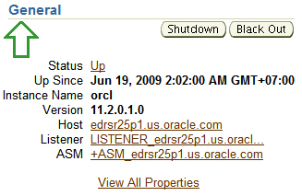
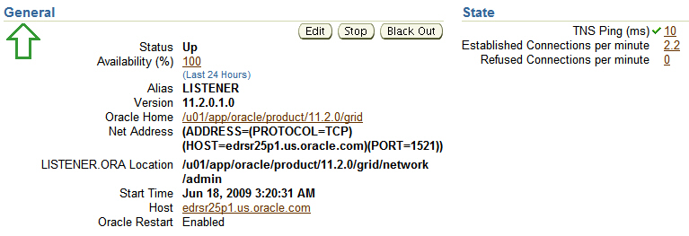
Listener Home Page
Notes:
Listener Home Page
Click the Listener link on the Enterprise Manager Database Home page to access the Listener Home page.
On this page, you can see:
Listener status and availability in the last 24 hours
Listener version and Oracle home
First listening address for the listener
Location of the configuration files that are used to start the listener
Listener start time and host information
Oracle Restart status
To start the listener, go to the Database Home page and click the listener name to open the Listener Home page. Click Stop to stop the listener if it is running, or click Start to start the listener if it is not running. Log on to the host as the OS user who can start and stop the listener.

Slide 15
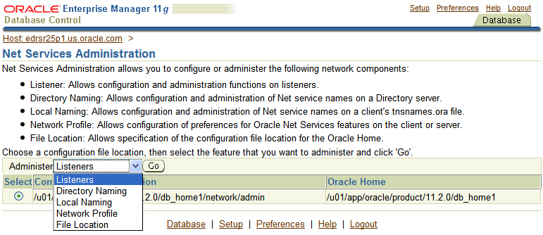
Net Services Administration Page
Notes:
Net Services Administration Page
The Net Services Administration page enables you to configure Oracle Net Services for any Oracle home across multiple file systems. It also provides common administration functions for listeners. You can use Net Services Administration to configure and administer the following:
Listeners: Add, remove, start, and stop a listener, as well as change its tracing and logging characteristics. You can also look at a listener’s control status report.
Directory naming: Define simple names and connect identifiers, and map them to connect descriptors to identify the network location and identification of a service. Save database services, Net Services, and Net Service aliases in a centralized directory service.
Local naming: Save Net Service names in the tnsnames.ora file.
Profiles: Configure the sqlnet.ora parameters.
File location: Change the location of the configuration files of Net Services.

Slide 16
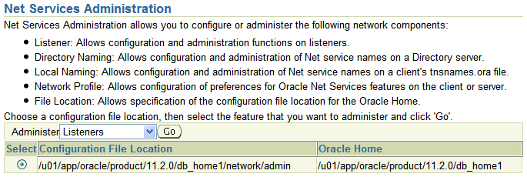
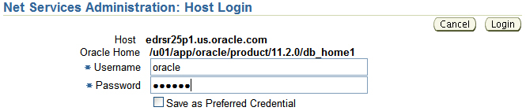
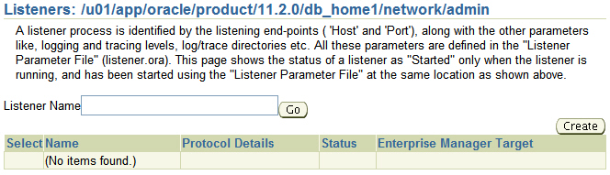
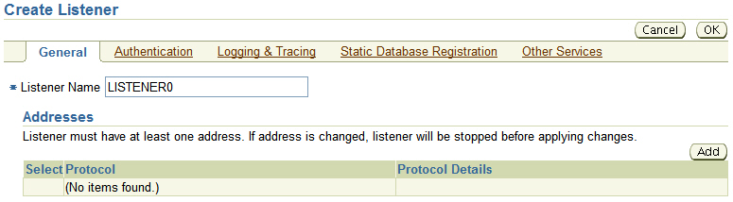
Creating a Listener
1
2
3
4
Notes:
Creating a Listener
To create an Oracle Net Listener, click Net Services Administration in the Related Links region of the Listener properties page. Then perform the following steps:
1. Select Listeners from the Administer drop-down list, and click Go.
2. If you have not entered preferred credentials for the host, the Host Login page appears. Enter the username and password, and then click Login.
3. Click Create.
4. Enter a listener name. The name must be unique for this server. Click Add to add a listener address. Each listener must have at least one listener address.

Slide 17
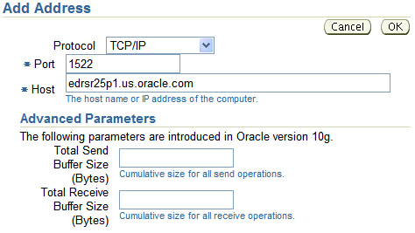
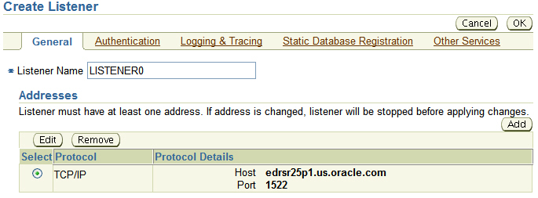
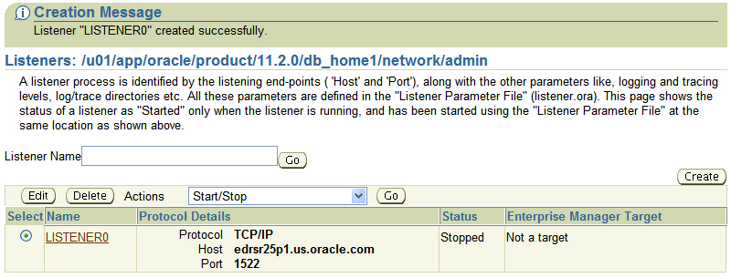
Adding Listener Addresses
8
5
6
9
7
10
Notes:
Adding Listener Addresses
The workflow to create a listener continues with the creation of the listener address:
5. Select the network protocol. TCP/IP is the most commonly used and is the default. Other choices are Internal Process Communication (IPC)—normally used for connecting to local applications (resident on the database server)—or external code libraries (EXTPROC), and TCP/IP with SSL.
Note: The EXTPROC protocol is configured by using the Other Services tab.
6. Enter the port that you want the listener to monitor. Oracle Net’s default port is 1521. If you choose to use a port other than 1521, additional configuration is required for the listener or for the instance.
7. Enter the name or IP address of the server that the listener will run on.
8. All other configuration steps are optional for the listener. Click OK to save the address. The only required configuration is the listening address and name.
9. On the Create Listener page, review the information about the address you just created and click OK to save your changes.
10. To start the new listener, select Start/Stop from the Actions drop-down list and then click Go.

Slide 18
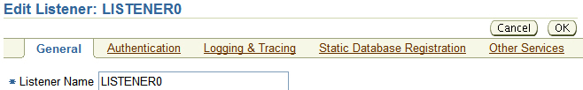
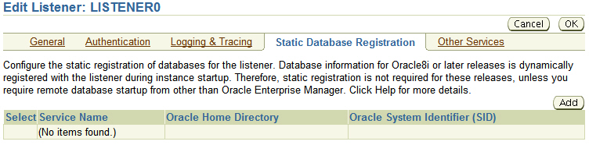
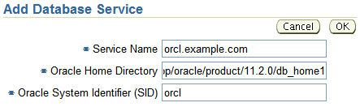
Database Service Registration
Notes:
Database Service Registration
For a listener to forward client connections to an instance, the listener must know the name of the instance and where the instance’s ORACLE_HOME is located. The listener can find this information in two ways:
Dynamic service registration: Oracle8i and later instances automatically register with the default listener on database startup. No additional listener configuration is required for the default listener.
Static service registration: Earlier releases of the Oracle database do not automatically register with the listener and, therefore, require that the listener configuration file contain a list of all database services that the listener will serve. You may still choose to use static service registration with newer releases if:
Your listener is not on the default port of 1521, and you do not want to configure your instance to register with a nondefault port
Your application requires static service registration
To add a static database service, click Static Database Registration on the Edit Listener page, and then click the Add button. Enter the service name (same as the global database name <DB_NAME>.<DB_DOMAIN>), ORACLE_HOME path, and SID (same as the instance name). Click OK. For the changes to take effect, you must reload (use the RELOAD command) or restart your listener.

Slide 19
Notes:
Database Service Registration (continued)
Service Names
The SERVICE_NAMES initialization parameter specifies one or more names by which clients can connect to the instance. The instance registers its service names with the listener. When a client requests a service, the listener determines which instances offer the requested service and routes the client to the appropriate instance.
You can specify multiple service names to distinguish among different uses of the same database, as in this example:
SERVICE_NAMES = sales.example.com, eurosales.example.com
You can also use service names to identify a single service that is available from two different databases through the use of replication.
If you do not qualify the names in this parameter with a domain, Oracle qualifies them with the value of the DB_DOMAIN parameter. If DB_DOMAIN is not specified, no domain will be applied to the nonqualified SERVICE_NAMES values.
While processing a client connection request, the listener tries to match the value of this parameter with the value of the SERVICE_NAME parameter in the client connect descriptor. If the client connect descriptor uses the SID parameter, the listener does not attempt to map the values. The value for this parameter is typically obtained from the combination of the DB_NAME and DB_DOMAIN parameters (DB_NAME.DB_DOMAIN) in the initialization parameter file, but the value can also contain any valid name used by clients to identify the service.

Slide 20
Naming Methods
Oracle Net supports several methods of resolving connection information:
Easy connect naming: Uses a TCP/IP connect string
Local naming: Uses a local configuration file
Directory naming: Uses a centralized LDAP-compliant directory server
External naming: Uses a supported non-Oracle naming service
Client/application server
Oracle Net
Oracle Net configuration files
Notes:
Naming Methods
Oracle Net provides support for the following naming methods:
Easy connect naming: The easy connect naming method enables clients to connect to an Oracle database server by using a TCP/IP connect string consisting of a host name and optional port and service name as follows:
CONNECT username/password@host[:port][/service_name]
The easy connect naming method requires no configuration.
Local naming: The local naming method stores connect descriptors (identified by their net service name) in a local configuration file named tnsnames.ora on the client.
Directory naming: To access a database service, the directory naming method stores connect identifiers in a centralized directory server that is compliant with the Lightweight Directory Access Protocol (LDAP).
External naming: The external naming method stores net service names in a supported non-Oracle naming service. Supported third-party services include:
Network Information Service (NIS) External Naming
Distributed Computing Environment (DCE) Cell Directory Services (CDS)

Slide 21

Easy Connect
Is enabled by default
Requires no client-side configuration
Supports only TCP/IP (no SSL)
Offers no support for advanced connection options such as:
Connect-time failover
Source routing
Load balancing
SQL> CONNECT hr/hr@db.us.oracle.com:1521/dba11g
No Oracle Net configuration files
Notes:
Easy Connect
With Easy Connect, you supply all information that is required for the Oracle Net connection as part of the connect string. Easy Connect connection strings take the following form:
<username>/<password>@<hostname>:<listener port>/<service name>
The listener port and service name are optional. If the listener port is not provided, Oracle Net assumes that the default port of 1521 is being used. If the service name is not provided, Oracle Net assumes that the database service name and host name provided in the connect string are identical.
Assuming that the listener uses TCP to listen on port 1521 and the SERVICE_NAMES=db and DB_DOMAIN=us.oracle.com instance parameters, the connect string shown in the slide can be shortened:
SQL> connect hr/hr@db.us.oracle.com
Note: The SERVICE_NAMES initialization parameter can accept multiple comma-separated values. Only one of those values must be db for this scenario to work.

Slide 22
Local Naming
Requires a client-side Names Resolution file
Supports all Oracle Net protocols
Supports advanced connection options such as:
Connect-time failover
Source routing
Load balancing
SQL> CONNECT hr/hr@orcl
Oracle Net
configuration files
Notes:
Local Naming
With local naming, the user supplies an alias for the Oracle Net service. Oracle Net checks the alias against a local list of known services and, if it finds a match, converts the alias into host, protocol, port, and service name.
One advantage of local naming is that the database users need to remember only a short alias rather than the long connect string required by Easy Connect.
The local list of known services is stored in the following text configuration file:
<oracle_home>/network/admin/tnsnames.ora
This is the default location of the tnsnames.ora file, but the file can be located elsewhere using the TNS_ADMIN environment variable.
Local naming is appropriate for organizations in which Oracle Net service configurations do not change often.

Slide 23

Directory Naming
Requires LDAP with Oracle Net Names Resolution information loaded:
Oracle Internet Directory
Microsoft Active Directory Services
Supports all Oracle Net protocols
Supports advanced connection options
LDAP directory
SQL> CONNECT hr/hr@orcl
Oracle Net
configuration files
Notes:
Directory Naming
With directory naming, the user supplies an alias for the Oracle Net service. Oracle Net checks the alias against an external list of known services and, if it finds a match, converts the alias into host, protocol, port, and service name. Like local naming, database users need to remember only a short alias.
One advantage of directory naming is that the service name is available for users to connect with as soon as a new service name is added to the LDAP directory. With local naming, the database administrator (DBA) must first distribute updated tnsnames.ora files containing the changed service name information before users can connect to new or modified services.
Directory naming is appropriate for organizations in which Oracle Net service configurations change frequently.

Slide 24
External Naming Method
Uses a supported non-Oracle naming service
Includes:
Network Information Service (NIS) External Naming
Distributed Computing Environment (DCE) Cell Directory Services (CDS)
Non-Oracle naming service
Oracle Net
Notes:
External Naming Method
The external naming method stores Net Service names in a supported non-Oracle naming service. Supported third-party services include:
Network Information Service (NIS) External Naming
Distributed Computing Environment (DCE) Cell Directory Services (CDS)
Conceptually, external naming is similar to directory naming.

Slide 25
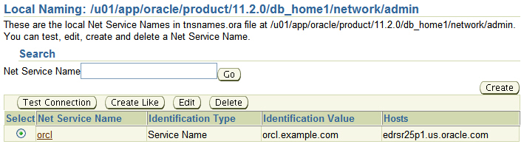
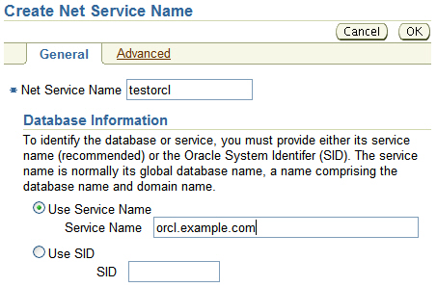
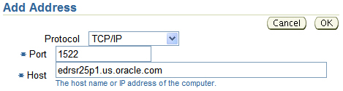

Configuring Service Aliases
Notes:
Configuring Service Aliases
To create a local Oracle Net Service alias, select Local Naming from the Administer drop-down list on the Net Services Administration page and click Go. Then click Create.
You can configure service aliases for directory naming by selecting Directory Naming instead of Local Naming.
Note: If directory naming has not already been configured, you cannot select the Directory Naming option. Directory naming is discussed in the Oracle Enterprise Identity Management course as well as in the Oracle Advanced Security Administration manual.
On the Create Net Service Name page, enter a unique name in the Net Service Name field. (This is the name that users enter when they want to use this alias.) Enter the service name or system identifier (SID) of the database that you want to connect to, and click the Add button to enter the address for the service name.
For the address, enter the protocol, port, and host used by the listener for the service to which you want to connect.

Slide 26
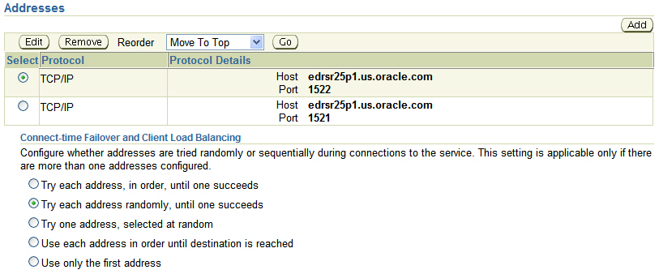
Advanced Connection Options
Oracle Net supports the following advanced connection options with local and directory naming:
Connect-time failover
Load balancing
Source routing
Notes:
Advanced Connection Options
When a database service is accessible by multiple listener protocol addresses, you can specify the order in which the addresses are to be used. The addresses can be chosen randomly or tried sequentially. In cases in which more than one listener is available, such as Oracle Real Application Clusters (RAC) configurations, Oracle Net can take advantage of listener failover and load balancing as well as Oracle Connection Manager source routing.
With connect-time failover enabled, the alias has two or more listener addresses listed. If the first address is not available, the second is tried. Oracle Net keeps trying addresses in the listed order until it reaches a listener that is functioning or until all addresses have been tried and failed. Transparent Application Failover (TAF) is a client-side feature that allows clients to reconnect to surviving databases in the event of a database instance failure. Notifications are used by the server to trigger TAF callbacks on the client side.
With load balancing enabled, Oracle Net picks an address at random from the list of addresses. The run-time connection load-balancing feature improves connection performance by balancing the number of active connections among multiple dispatchers. In a RAC environment, connection pool load balancing also has the capability to balance the number of active connections among multiple instances.

Slide 27
Notes:
Advanced Connection Options (continued)
Source routing is used with Oracle Connection Manager, which serves as a proxy server for Oracle Net traffic, enabling Oracle Net traffic to be routed securely through a firewall. Oracle Net treats the addresses as a list of relays, connecting to the first address and then requesting to be passed from the first to the second until the destination is reached. It differs from failover or load balancing in that all addresses are used each time a connection is made.

Slide 28
Testing Oracle Net Connectivity
The tnsping utility that tests Oracle Net service aliases:
Ensures connectivity between the client and the Oracle Net Listener
Does not verify that the requested service is available
Supports Easy Connect Names Resolution:
Supports local and directory naming:
tnsping host01.example.com:1521/orcl
tnsping orcl
Notes:
Testing Oracle Net Connectivity
tnsping is the Oracle Net equivalent of the TCP/IP ping utility. It offers a quick test to verify that the network path to a destination is good. For example, enter tnsping orcl in a command-line window.
The utility validates that the host name, port, and protocol reach a listener. It does not actually check whether the listener handles the service name. The tnsping utility also reveals the location of the configuration files. In a system with multiple ORACLE_HOME locations, this can be helpful.

Slide 29
User Sessions: Dedicated Server Process
User sessions
Server process
Server process
Server process
Listener
Notes:
User Sessions: Dedicated Server Process
With dedicated server processes, there is a one-to-one ratio of server processes to user processes. Each server process uses system resources, including CPU cycles and memory.
In a heavily loaded system, the memory and CPU resources that are used by dedicated server processes can be prohibitive and can negatively affect the system’s scalability. If your system is being negatively affected by the resource demands of the dedicated server architecture, you have the following options:
Increasing system resources by adding more memory and additional CPU capability
Using the Oracle Shared Server Process architecture

Slide 30






User Sessions: Shared Server Processes
Server process
Server process
Server process
User sessions
Dispatchers
Listener
Notes:
User Sessions: Shared Server Processes
Each service that participates in the shared server process architecture has at least one dispatcher process (and usually more). When a connection request arrives, the listener does not spawn a dedicated server process. Instead, the listener maintains a list of dispatchers that are available for each service name, along with the connection load (number of concurrent connections) for each dispatcher.
Connection requests are routed to the lightest loaded dispatcher that is servicing a given service name. Users remain connected to the same dispatcher for the duration of a session.
Unlike dedicated server processes, a single dispatcher can manage hundreds of user sessions.
Dispatchers do not actually handle the work of user requests. Instead, they pass user requests to a common queue located in the shared pool portion of the SGA.
Shared server processes take over most of the work of dedicated server processes, pulling requests from the queue and processing them until they are complete.
Because a single user session may have requests processed by multiple shared server processes, most of the memory structures that are usually stored in the PGA must be in a shared memory location (by default, in the shared pool). However, if the large pool is configured or if SGA_TARGET is set for automatic memory management, these memory structures are stored in the large pool portion of the SGA.

Slide 31
SGA and PGA
Oracle Shared Server: User session data is held in the SGA.
Remember to consider shared server memory requirements when sizing the SGA.
System Global Area (SGA)
PGA
Cursor
State
Sort Area
Hash Area
Stack
space
Create Bitmap Area
User Session Data
Bitmap Merge Area
UGA
Notes:
SGA and PGA
The contents of the SGA and PGA differ when dedicated servers or shared servers are used:
Text and parsed forms of all SQL statements are stored in the SGA.
The cursor state contains run-time memory values for the SQL statement, such as rows retrieved.
User-session data includes security and resource usage information.
The stack space contains local variables for the process.
Technical Note
The change in the SGA and PGA is transparent to the user; however, if you are supporting multiple users, you need to increase the LARGE_POOL_SIZE initialization parameter. Each shared server process must access the data spaces of all sessions so that any server can handle requests from any session. Space is allocated in the SGA for each session’s data space. You limit the amount of space that a session can allocate by setting the PRIVATE_SGA resource limit in the Database Services region of the General page of the user’s profile.

Slide 32


Shared Server: Connection Pooling
The client application has been idle past the specified time, and an incoming client requests a connection.
Idle client
Active client
Database server
The maximum number of connections is configured to 255.
New client
This client connection is the 256th connection into the server. Connection pooling is turned on so that this connection can be accepted.
Notes:
Shared Server: Connection Pooling
The connection-pooling feature enables the database server to time out an idle session and use the connection to service an active session. The idle logical session remains open, and the physical connection is automatically reestablished when the next request comes from that session. Therefore, Web applications can allow larger numbers of concurrent users to be accommodated with existing hardware. Connection pooling is configurable through the shared server.
In this example, the Oracle database server has been configured with 255 connections. One of the clients has been idle past the specified time. Connection pooling makes this connection available to an incoming client connection, which is the 256th connection. When the idle client has more work to do, the connection is reestablished for that client with another client’s idle connection.

Slide 33


When Not to Use a Shared Server
Certain types of database work must not be performed using shared servers:
Database administration
Backup and recovery operations
Batch processing and bulk load operations
Data warehouse operations
Dispatcher
Dedicated server process
Notes:
When Not to Use a Shared Server
The Oracle Shared Server architecture is an efficient process and memory use model, but it is not appropriate for all connections. Because of the common request queue and the fact that many users may share a dispatcher response queue, shared servers do not perform well with operations that must deal with large sets of data, such as warehouse queries or batch processing.
Backup and recovery sessions that use Oracle Recovery Manager (discussed in later lessons) also deal with very large data sets and must make use of dedicated connections.
Many administration tasks must not (and cannot) be performed by using shared server connections. These include starting up and shutting down the instance, creating tablespaces and data files, maintaining indexes and tables, analyzing statistics, and many other tasks that are commonly performed by the DBA. All DBA sessions must choose dedicated servers.

Slide 34
Configuring Communication Between Databases
Sending data or messages between sites requires network configuration on both sites.
You must configure the following:
Network connectivity (for example, TNSNAMES.ora)
Database links
CREATE DATABASE LINK <remote_global_name>
CONNECT TO <user> IDENTIFIED BY <pwd>
USING '<connect_string_for_remote_db>';
Notes:
Configuring Communication Between Databases
A database link is a schema object in one database that enables you to access objects on another database. The other database need not be an Oracle database system. However, to access non-Oracle systems, you must use Oracle Heterogeneous Services.
To create a private database link, you must have the CREATE DATABASE LINK system privilege. To create a public database link, you must have the CREATE PUBLIC DATABASE LINK system privilege. You must also have the CREATE SESSION system privilege on the remote Oracle database.
When an application uses a database link to access a remote database, Oracle Database establishes a database session in the remote database on behalf of the local request. The CONNECT TO clause that is used in creating a database link determines how the connection is established on the remote database. You can create fixed user, current user, and connected user database links. Current user links are available only through the Oracle Advanced Security option. The example in the slide shows the syntax to create a fixed user database link.
After you create a database link, you can use it to refer to tables and views on the other database. In SQL statements, you can refer to a table or view on the other database by appending @dblink to the table or view name. You can query a table or view on the other database or use any INSERT, UPDATE, DELETE, or LOCK TABLE statement for the table.

Slide 35
Connecting to Another Database
REMOTE_ORCL =
(DESCRIPTION =
(ADDRESS = (PROTOCOL = TCP) (HOST = host02.example.com) (PORT = 1521))
(CONNECT_DATA =
(SERVER = DEDICATED)
(SERVICE_NAME = orcl.example.com)
)
)
tnsnames.ora
CONNECT hr/hr@orcl;
CREATE DATABASE LINK remote
CONNECT TO HR IDENTIFIED BY HR
USING 'REMOTE_ORCL';
SELECT * FROM employees@remote
SQL*Plus
Notes:
Connecting to Another Database
The slide shows the tnsnames.ora entry that is needed before creating a database link. The example shows a fixed user database link called REMOTE that is connecting to the user HR by using the connect string REMOTE_ORCL. After you create a database link, you can use it to refer to tables and views on the other database.
The description of the view is as follows:
SQL> DESC DBA_DB_LINKS
Name Null? Type
-------------------- -------- ----------------------------
OWNER NOT NULL VARCHAR2(30)
DB_LINK NOT NULL VARCHAR2(128)
USERNAME VARCHAR2(30)
HOST VARCHAR2(2000)
CREATED NOT NULL DATE
SQL> select owner, db_link, username from dba_db_links;
OWNER DB_LINK USERNAME
----------- ------------------- ---------
HR REMOTE.EXAMPLE.COM HR

Slide 36
Quiz
Which configuration files are used to configure the listener?
listener.ora
listener.conf
tnsnames.ora
tnsnames.conf
sqlnet.ora
sqlnet.conf
Notes:
Answers: 1, 5

Slide 37
Quiz
When using the shared server process architecture, the PGA is relocated into the SGA.
True
False
Notes:
Answer: 2

Slide 38
Summary
In this lesson, you should have learned how to:
Use Enterprise Manager to:
Create additional listeners
Create Oracle Net Service aliases
Configure connect-time failover
Control the Oracle Net Listener
Use tnsping to test Oracle Net connectivity
Identify when to use shared servers and when to use dedicated servers

Slide 39
Practice 6 Overview: Working with Oracle Network Components
This practice covers the following topics:
Configuring local Names Resolution to connect to another database
Creating a second listener for connect-time failover

