Slide 1
Managing Storage Structures

Slide 2
Objectives
After completing this lesson, you should be able to:
Describe the storage of table row data in blocks
Define the purpose of tablespaces and data files
Create and manage tablespaces
Obtain tablespace information

Slide 3
Storage Structures
Logical
Physical
Database
Tablespace
OS file
Segment
Extent
Oracle data block
OS block
Notes:
Storage Structures
A database is divided into logical storage units called tablespaces. Each tablespace has many logical Oracle data blocks. The DB_BLOCK_SIZE parameter specifies how large a logical block is. A logical block can range from 2 KB to 32 KB in size. The default size is 8 KB. An Oracle data block is the smallest unit of logical I/O.
A specific number of contiguous logical blocks form an extent. A set of extents that are allocated for a certain logical structure form one segment.
The most commonly used block size should be picked as the standard block size. In many cases, this is the only block size that you need to specify. Typically, DB_BLOCK_SIZE is set to either 4 KB or 8 KB. If you do not set a value for this parameter, the default data block size is operating system specific, which is generally adequate. You cannot change the block size after database creation except by re-creating the database.
If the database block size is different from the operating system block size, ensure that the database block size is a multiple of the operating system block size.

Slide 4
How Table Data Is Stored
Columns
Blocks
Table A
Table B
Rows
Segment
Segment
Table
Tablespace
Row piece
Extent
Notes:
How Table Data Is Stored
When a table is created, a segment is created to hold its data. A tablespace contains a collection of segments.
Logically, a table contains rows of column values. A row is ultimately stored in a database block in the form of a row piece. It is called a row piece because, under some circumstances, the entire row may not be stored in one place. This happens when an inserted row is too large to fit into a single block (chained row) or when an update causes an existing row to outgrow the available free space of the current block (migrated row). Row pieces are also used when a table has more than 255 columns. In this case the pieces may be in the same block (intra-block chaining) or across multiple blocks.

Slide 5
Database Block: Contents
Block header
Growth
Free space
Row data
Notes:
Database Block: Contents
Block header: The block header contains the segment type (such as table or index), data block address, table directory, row directory, and transaction slots of approximately 23 bytes each, which are used when modifications are made to rows in the block. The block header grows downward from the top.
Row data: This is the actual data for the rows in the block. Row data space grows upward from the bottom.
Free space: Free space is in the middle of the block, enabling the header and the row data space to grow when necessary. Row data takes up free space as new rows are inserted or as columns of existing rows are updated with larger values. Examples of events that cause header growth:
Row directories that need more row entries
More transaction slots required than initially configured
Initially, the free space in a block is contiguous. However, deletions and updates may fragment the free space in the block. The free space in the block is coalesced by the Oracle server when necessary.

Slide 6
Tablespaces and Data Files
The Oracle database stores data logically in tablespaces and physically in data files.
Tablespaces:
Can belong to only one database
Consist of one or more data files
Are further divided into logical units of storage
Data files:
Can belong to only one tablespace and one database
Are a repository for schema object data
Database
Tablespace
Data files
Notes:
Tablespaces and Data Files
Databases, tablespaces, and data files are closely related but have important differences.
An Oracle database consists of one or more logical storage units—its tablespaces—that collectively store all the database’s data.
Each tablespace in an Oracle database consists of one or more data files, which are physical structures that conform to the operating system on which the Oracle software runs.
A database’s data is collectively stored in the data files that constitute each tablespace of the database. An Oracle database must have a minimum of two tablespaces (the required SYSTEM and SYSAUX tablespaces), each with one data file. Another database can have three tablespaces, each consisting of two data files (for a total of six data files). A single database can have as many as 65,534 data files. If a tablespace consists for its lifetime of exactly one (and only one) data file, it is defined as a bigfile tablespace. This is a special case that is useful for data warehouse applications.
A tempfile is a file that belongs to a temporary tablespace; it is created with the TEMPFILE option. Temporary tablespaces cannot contain permanent database objects such as tables, and are typically used for sorting.

Slide 7

Space Management in Tablespaces
Locally managed tablespace:
Free extents are managed in the tablespace.
A bitmap is used to record free extents.
Each bit corresponds to a block or group of blocks.
The bit value indicates free or used extents.
Use of locally managed tablespaces is recommended.
Dictionary-managed tablespace:
Free extents are managed by Oracle.
Appropriate tables are updated when extents are allocated or unallocated.
These tablespaces are supported only for backward compatibility.
Notes:
Space Management in Tablespaces
Tablespaces allocate space in extents. Tablespaces can be created to use one of the following two methods of keeping track of free and used space:
Locally managed tablespaces: The extents are managed in the tablespace via bitmaps. Each bit in the bitmap corresponds to a block or a group of blocks. When an extent is allocated or freed for reuse, the Oracle server changes the bitmap values to show the new status of the blocks.
Dictionary-managed tablespaces: The extents are managed by the data dictionary. The Oracle server updates the appropriate tables in the data dictionary whenever an extent is allocated or unallocated. This is for backward compatibility; it is recommended that you use locally managed tablespaces.

Slide 8
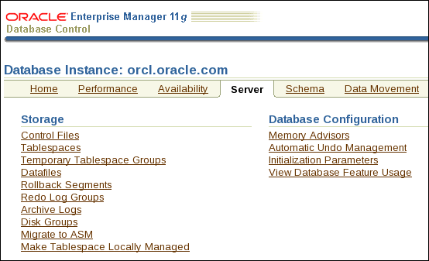
Exploring the Storage Structure
Click the links to view detailed information.
Notes:
Exploring the Storage Structure
Logical data structures are stored in the physical files of the database. You can easily view the logical structures of your database through Enterprise Manager (EM). Detailed information about each structure can be obtained by clicking the links in the Storage region of the Server page.

Slide 9
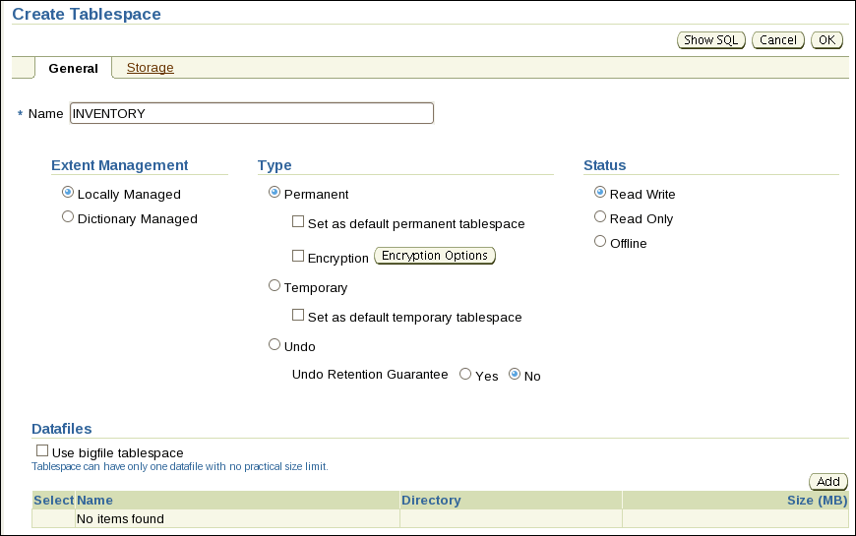
Creating a New Tablespace
Notes:
Creating a New Tablespace
1. Click the Server tab, and then click Tablespaces under the Storage heading.
2. Click Create. Note: If you want to create a tablespace that is like an existing tablespace, select an existing tablespace and then select Create Like from the Actions menu. Click Go. The Create Tablespace page appears.
3. Enter a name for the tablespace.
4. Under the Extent Management heading, select Locally Managed. The extents of a locally managed tablespace are managed efficiently in the tablespace by the Oracle database server. For a dictionary-managed tablespace, you must manage extents more actively, and data dictionary access is required for tracking them. Dictionary-managed option is provided only for backward compatibility; Oracle does not recommend their use.
Under the Type heading, select Permanent. Permanent tablespaces store permanent database objects that are created by the system or users.
6. Under the Status heading, select Read Write. Read Write status means that users can read and write to the tablespace after it is created. This is the default.
7. In the Datafiles region of the page, click Add to add data files to the tablespace.

Slide 10
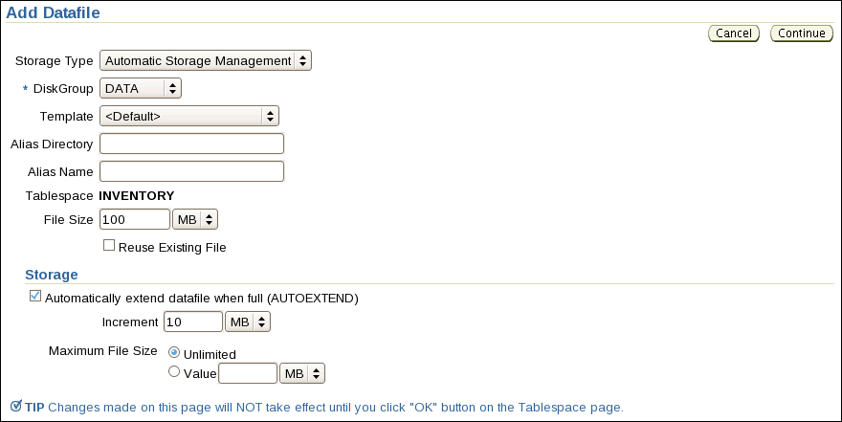
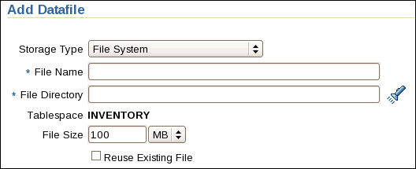
Creating a New Tablespace
Choose the appropriate Storage Type
Notes:
Creating a New Tablespace (continued)
A tablespace must have at least one file. Choose the appropriate storage type, depending on your environment. Bigfile tablespaces are used with extremely large databases, in which ASM or other logical volume managers support the striping or redundant array of independent disks (RAID) and dynamically extensible logical volumes.
8. On the Add Datafiles page select the desired storage type and enter the required information. For ASM choose the desired disk group. For File System enter a file name and file directory for the datafile.
9. Enter the desired file size.
10. In the Storage region, select “Automatically extend datafile when full (AUTOEXTEND)” and then specify an amount in the Increment field. This causes the data file to extend automatically each time it runs out of space. It is limited, of course, by the physical media on which it resides. Leave Maximum File Size as Unlimited or enter a maximum size. Click Continue to return to the Create Tablespace page.
12. Back on the Create Tablespace page you can click the Storage tab to make modifications to the storage options for this tablespace if desired. In most cases, you can just accept all the defaults on the Storage page. Click OK to create the tablespace.
Note: These steps show you how to quickly create a tablespace for most situations. You may need to change some options depending on your particular requirements.

Slide 11
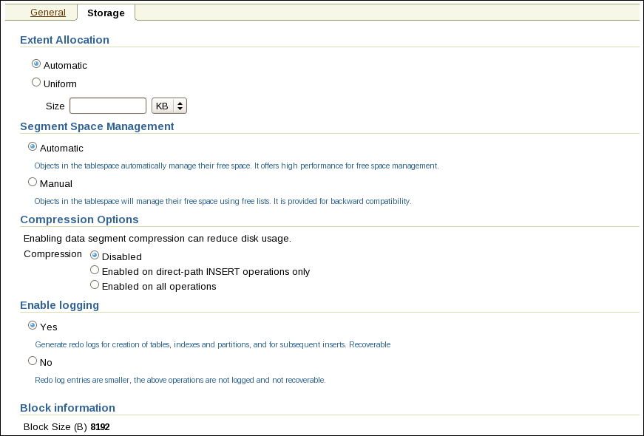
Storage for Tablespaces
Notes:
Storage for Tablespaces
Extent Allocation: The extents in a locally managed tablespace can be allocated in one of these two ways:
Automatic: Also called autoallocate, it specifies that the sizes of the extents in the tablespace are system managed. You cannot specify Automatic for a temporary tablespace.
Uniform: It specifies that the tablespace is managed with uniform extents of a size that you specify. The default size is 1 MB. All extents of temporary tablespaces are uniform. You cannot specify Uniform for an undo tablespace.
Segment Space Management: Segment space management in a locally managed tablespace can be specified as:
Automatic: The Oracle database uses bitmaps to manage the free space in segments. The bitmap describes the status of each data block in a segment with respect to the amount of space in the block that is available for inserting rows. As more or less space becomes available in a data block, the new state is reflected in the bitmap. With bitmaps, the Oracle database manages free space more automatically. As a result, this form of space management is called Automatic Segment Space Management (ASSM).

Slide 12
Notes:
Storage for Tablespaces (continued)
Manual: This specifies that you want to use free lists for managing free space in segments. Free lists are lists of data blocks that have space available for inserting rows. This form of managing space in segments is called manual segment space management because of the need to specify and tune the PCTUSED, FREELISTS, and FREELIST GROUPS storage parameters for schema objects created in the tablespace. This is supported for backward compatibility; it is recommended that you use ASSM.
Compression Options: Data segment compression is disabled by default. Enabling data segment compression can save disk space usage, reduce memory use in the buffer cache, and speed up query execution during reads. There is, however, a cost in CPU overhead for data loading and DML. It is especially useful in online analytical processing (OLAP) systems, where there are lengthy read-only operations, but can also be used in online transaction processing (OLTP) systems.
For more details about when to use compression clause, see the Oracle Database Administrator’s Guide.
Logging: The logging clause sets the default logging value for any segment created in the tablespace. Changes made to objects in the tablespace are written to the redo log. If logging is not enabled, any direct loads using SQL*Loader and direct load INSERT operations are not written to the redo log, and the objects are thus unrecoverable in the event of data loss. When an object is created without logging enabled, you must back up those objects if you want them to be recoverable. Choosing not to enable logging can have a significant impact on the ability to recover objects in the future. Use with caution. For more details about the logging clause, see the Oracle Database SQL Reference.
Note: If FORCE LOGGING mode is in effect for the database, it takes precedence over the tablespace logging setting. The database can be put into FORCE LOGGING mode at the time of database creation or after database creation using the alter database force logging command.
Block Information: This region shows the block size that is used for the tablespace being created. It is displayed here as a read-only value. If you set any of the alternate block size initialization parameters (DB_nK_CACHE_SIZE), those other values would be listed here as an option.
For more information about defining other block sizes, see the Oracle Database Administrator’s Guide.

Slide 13
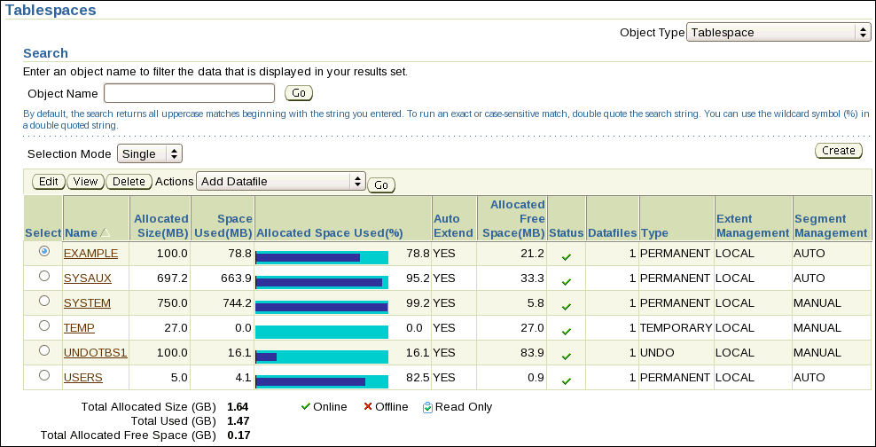
Tablespaces in the Preconfigured Database
SYSTEM
SYSAUX
TEMP
UNDOTBS1
USERS
EXAMPLE (optional)
Notes:
Tablespaces in the Preconfigured Database
The following tablespaces are created in the preconfigured database in this course:
SYSTEM: The SYSTEM tablespace is used by the Oracle server to manage the database. It contains the data dictionary and tables that contain administrative information about the database. These are all contained in the SYS schema and can be accessed only by the SYS user or other administrative users with the required privilege.
SYSAUX: This is an auxiliary tablespace to the SYSTEM tablespace. Some components and products that used the SYSTEM tablespace or their own tablespaces in earlier releases of Oracle Database now use the SYSAUX tablespace. Every Oracle Database 10g (or later release) database must have a SYSAUX tablespace. In Enterprise Manager (EM), you can see a pie chart of the contents of this tablespace. To do this, click Tablespaces on the Administration page. Select SYSAUX and click Edit. Then click the Occupants tab. After creation, you can monitor the space usage of each occupant in the SYSAUX tablespace by using EM. If you detect that a component is taking too much space in the SYSAUX tablespace, or if you anticipate that it will, you can move the occupant into a different tablespace by selecting one of the occupants and clicking Change Tablespace.

Slide 14
Notes:
Tablespaces in the Preconfigured Database (continued)
TEMP: Your temporary tablespace is used when you execute a SQL statement that requires the creation of temporary segments (such as a large sort or the creation of an index). Just as each user is assigned a default tablespace for storing created data objects, each user is assigned a temporary tablespace. The best practice is to define a default temporary tablespace for the database, which is assigned to all newly created users unless otherwise specified. In the preconfigured database, the TEMP tablespace is specified as the default temporary tablespace. This means that if no temporary tablespace is specified when the user account is created, Oracle Database assigns this tablespace to the user.
UNDOTBS1: This is the undo tablespace used by the database server to store undo information. If a database uses Automatic Undo Management, then it can only use a single undo tablespace at any given time. This tablespace is created at database creation time.
USERS: This tablespace is used to store user objects and data. If no default tablespace is specified when a user is created then the USERS tablespace is the default tablespace for all objects created by that user. For the SYS and SYSTEM users, the default permanent tablespace is SYSTEM.
EXAMPLE: This tablespace contains the sample schemas that can be installed when you create the database. The sample schemas provide a common platform for examples. Oracle documentation and courseware contain examples based on the sample schemas.
Note: To simplify administration, it is common to have a tablespace for indexes alone.

Slide 15
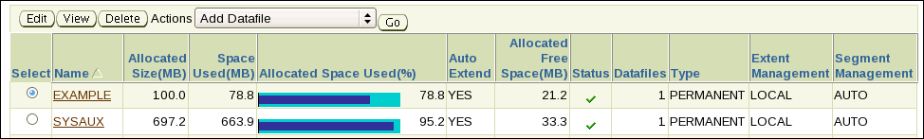
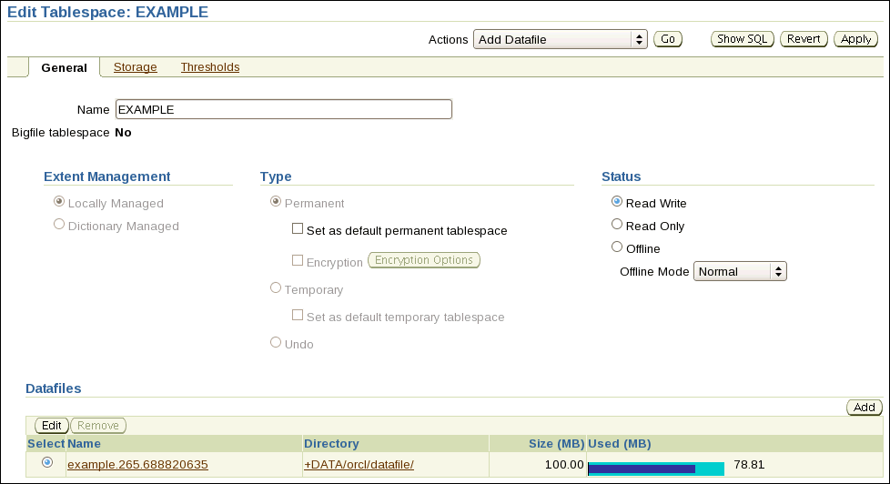
Altering a Tablespace
Notes:
Altering a Tablespace
After you create a tablespace, you can alter it in several ways as the needs of your system change.
Renaming: Enter a new name for the tablespace and click Apply.
Changing the status: A tablespace can be in one of three different statuses or states. Any of the following three states may not be available because their availability depends on the type of tablespace.
Read Write: The tablespace is online and can be read from and written to.
Read Only: Specify read-only to place the tablespace in transition read-only mode. In this state, existing transactions can be completed (committed or rolled back), but no further data manipulation language (DML) operations are allowed on objects in the tablespace. The tablespace is online while in the read-only state. You cannot make the SYSTEM or SYSAUX tablespaces read-only. Note: The undo and temporary tablespaces cannot be made read-only.

Slide 16
Notes:
Altering a Tablespace (continued)
Offline: You can take an online tablespace offline so that this portion of the database is temporarily unavailable for general use. The rest of the database is open and available for users to access data. When you take it offline, you can use the following options:
Normal: A tablespace can be taken offline normally if no error conditions exist for any of the data files of the tablespace. Oracle Database ensures that all data is written to disk by taking a checkpoint for all data files of the tablespace as it takes them offline.
Temporary: A tablespace can be taken offline temporarily even if there are error conditions for one or more files of the tablespace. Oracle Database takes the data files (which are not already offline) offline, performing checkpointing on them as it does so. If no files are offline, but you use the Temporary clause, media recovery is not required to bring the tablespace back online. However, if one or more files of the tablespace are offline because of write errors, and you take the tablespace offline temporarily, the tablespace requires recovery before you can bring it back online.
Immediate: A tablespace can be taken offline immediately without Oracle Database taking a checkpoint on any of the data files. When you specify Immediate, media recovery for the tablespace is required before the tablespace can be brought online. You cannot take a tablespace offline immediately if the database is running in NOARCHIVELOG mode.
For Recover: The FOR RECOVER setting has been deprecated. The syntax is supported for backward compatibility.
Note: System tablespaces may not be taken offline.
Changing the size: You can add space to an existing tablespace by either adding data files to the tablespace or changing the size of an existing data file.
To add a new data file to the tablespace, click Add. Then enter the information about the data file on the Add Datafile page. Note: You cannot add additional data files to bigfile tablespaces.
To change the size of an existing data file, select the data file in the Datafiles region of the Edit Tablespace page by clicking the name of the data file, or select the data file and click Edit. Then, on the Edit Datafile page, you can change the size of the data file. You can make the tablespace either larger or smaller. However, you cannot make a data file smaller than the used space in the file; if you try to do so, you get the following error:
ORA-03297: file contains used data beyond requested RESIZE value
Storage options: Click Storage to change the logging behavior of the tablespace.
Thresholds: Click Thresholds to change the point at which a warning or critical level of space usage is reached on the tablespace. You have three options:
Use Database Default Thresholds: This uses preset defaults, and you have the option of setting these defaults.
Specify Thresholds: This enables you to set thresholds for this particular tablespace.
Disable Thresholds: This turns off space usage alerts for this tablespace.
Note: Space utilization is checked only every 10 minutes by default, so it may take a few minutes for a threshold alert to register.

Slide 17
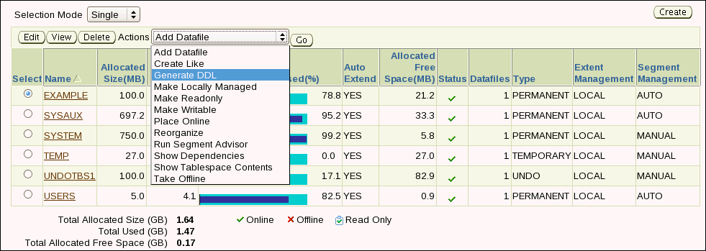
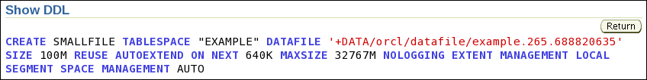
Actions with Tablespaces
Notes:
Actions with Tablespaces
Using the Actions menu, you can perform a variety of tasks with your tablespaces. Select a tablespace and then select the action that you want to perform.
Add Datafile: Adds a data file to the tablespace, which makes the tablespace larger
Create Like: Creates another tablespace by using the tablespace as a template
Generate DDL: Generates the data definition language (DDL) statement that creates the tablespace. This can then be copied and pasted into a text file for use as a script or for documentation purposes.
Make Locally Managed: Converts the tablespace to locally managed if the tablespace is currently dictionary managed. This conversion is one-way only; you cannot convert the tablespace back to dictionary managed. You can use the PL/SQL package DBMS_SPACE_ADMIN.TABLESPACE_MIGRATE_FROM_LOCAL to convert to dictionary managed if needed.
Make Readonly: Stops all writes to the tablespace. Current transactions are allowed to complete, but no new DML or other write activities are allowed to start on the tablespace. This appears only if the tablespace is currently not read-only.
Make Writable: Allows DML and other write activities to be initiated on objects in the tablespace. This appears only if the tablespace is currently not writable.

Slide 18
Notes:
Actions with Tablespaces (continued)
Place Online: Brings a currently offline tablespace online
Reorganize: Starts the Reorganization Wizard, which you can use to move objects around in the tablespace to reclaim space that otherwise may not be used. This is a task that should be performed during off-peak usage of the objects in the tablespace.
Run Segment Advisor: Starts the Segment Advisor, which you can use to determine whether an object has space available for reclamation on the basis of the level of space fragmentation in the object. At the tablespace level, advice is generated for every segment in the tablespace.
Show Dependencies: Shows objects on which this tablespace depends, or objects that depend on this tablespace
Show Tablespace Contents: Shows information about all the segments in the tablespace, including a graphical map of all of the extents
Take Offline: Makes a currently online tablespace unavailable. The tablespace is not deleted or dropped; it is just unavailable.

Slide 19
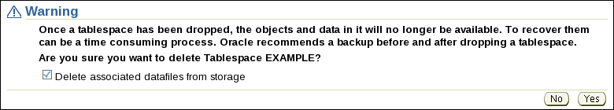
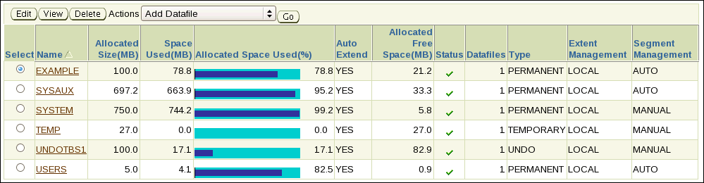
Dropping Tablespaces
Notes:
Dropping Tablespaces
You can drop a tablespace and its contents (the segments contained in the tablespace) from the database if the tablespace and its contents are no longer required. You must have the DROP TABLESPACE system privilege to drop a tablespace.
When you drop a tablespace, the file pointers in the control file of the associated database are removed. If you are using Oracle-managed files (OMF), the underlying operating system files are also removed. Otherwise, without OMF, you can optionally direct the Oracle server to delete the operating system files (data files) that constitute the dropped tablespace. If you do not direct the Oracle server to delete the data files at the same time that it deletes the tablespace, you must later use the appropriate commands of your operating system if you want them to be deleted.
You cannot drop a tablespace that contains active segments. For example, if a table in the tablespace is currently being used or if the tablespace contains undo data that is needed to roll back uncommitted transactions, you cannot drop the tablespace. The tablespace can be online or offline, but it is best to take the tablespace offline before dropping it.

Slide 20

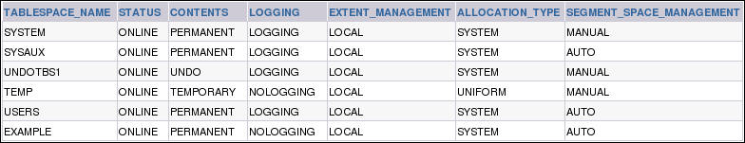
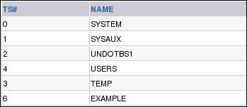
Viewing Tablespace Information
Notes:
Viewing Tablespace Information
Click View to see information about the selected tablespace. On the View Tablespace page, you can also click Edit to alter the tablespace.
Tablespace and data file information can also be obtained by querying the following:
Tablespace information:
DBA_TABLESPACES
V$TABLESPACE
Data file information:
DBA_DATA_FILES
V$DATAFILE
Note: The V$DBFILE view displays all data files in the database. This view is retained for historical compatibility. Use of V$DATAFILE is recommended instead.
Temp file information:
DBA_TEMP_FILES
V$TEMPFILE

Slide 21
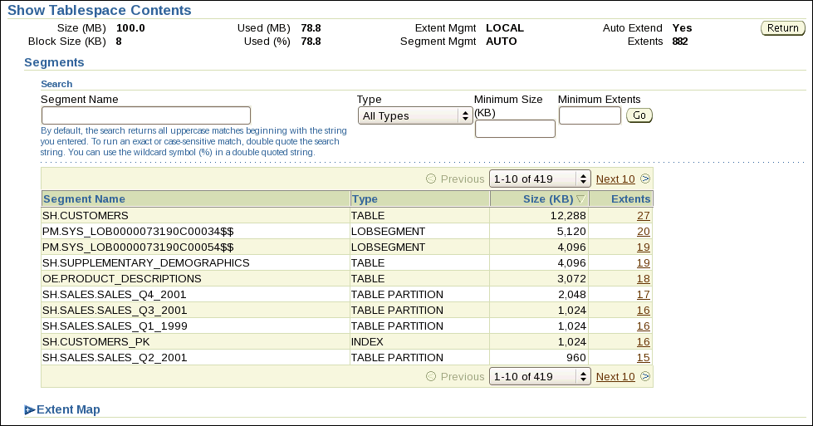
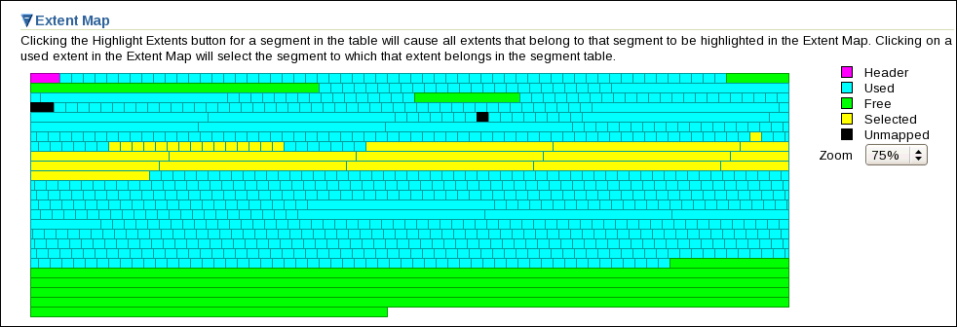
Viewing Tablespace Contents
Notes:
Viewing Tablespace Contents
From either the main Tablespaces page or the page for a particular tablespace, select Show Tablespace Contents from the Actions drop-down list and click Go. On the Show Tablespace Contents page, detailed information about the tablespace is displayed, including a list of the segments in the tablespace, the type of each segment, the segment size, and the number of extents in each segment. Any of these four values can be used to sort the list by clicking the column header, or to filter the list by entering values in the Search region. For a dictionary-managed tablespace, additional columns are displayed:
Max Extents
Next
Percent Increase
To see a list of extents, click the link in the Extents column.
To view extents in a graphical way, expand the “Extent map” and move the cursor over individual extents. The following information is displayed:
Name of the segment to which the extent belongs
Extent ID
Block ID
Extent size in blocks
Data file in which the extent is stored

Slide 22
Oracle-Managed Files (OMF)
Specify file operations in terms of database objects rather than file names.
Parameter | Description
DB_CREATE_FILE_DEST | Defines the location of the default file system directory for data files and temporary files
DB_CREATE_ONLINE_LOG_DEST_n | Defines the location for redo log files and control file creation
DB_RECOVERY_FILE_DEST | Default location for the fast recovery area
Example:
SQL> ALTER SYSTEM SET DB_CREATE_FILE_DEST = '+DATA';
SQL> CREATE TABLESPACE tbs_1;
Notes:
Oracle-Managed Files (OMF)
Oracle-managed files eliminates the need for you to directly manage the operating system files in an Oracle database. You specify operations in terms of database objects rather than file names. The database internally uses standard file system interfaces to create and delete files as needed for the following database structures:
Tablespaces
Redo log files
Control files
Archived logs
Block change tracking files
Flashback logs
RMAN backups
A database can have a mixture of Oracle-managed and unmanaged files. The file system directory specified by either of these parameters must already exist; the database does not create it. The directory must also have permissions for the database to create the files in it.
The example shows that after DB_CREATE_FILE_DEST is set, the DATAFILE clause can be omitted from a CREATE TABLESPACE statement. The data file is created in the location specified by DB_CREATE_FILE_DEST. When you create a tablespace as shown, default values are assigned to all parameters.

Slide 23
Notes:
Oracle-Managed Files (OMF) (continued)
Oracle-managed files have a specific naming format. For example, on Linux and Unix based systems the following format is used:
<destination_prefix>/o1_mf_%t_%u_.dbf
Do not rename an Oracle-managed file. The database identifies an Oracle-managed file based on its name. If you rename the file, the database is no longer able to recognize it as an Oracle-managed file and will not manage the file accordingly. The following example sets the default location for datafile creations to /u01/oradata and then creates a tablespace tbs_1 with a datafile in that location.
SQL> ALTER SYSTEM SET DB_CREATE_FILE_DEST = '/u01/oradata';
SQL> CREATE TABLESPACE tbs_1;
By default, Oracle-managed data files, including those for the SYSTEM and SYSAUX tablespaces, are 100MB and autoextensible.
Note: By default, ASM uses OMF files, but if you specify an alias name for an ASM data file at tablespace creation time or when adding an ASM data file to an existing tablespace, then that file will not be OMF.

Slide 24
Enlarging the Database
You can enlarge the database in the following ways:
Creating a new tablespace
Adding a data file to an existing smallfile tablespace
Increasing the size of a data file
Providing for the dynamic growth of a data file
Database
SYSTEM
tablespace
INVENTORY
tablespace
Notes:
Enlarging the Database
These activities can be performed with Enterprise Manager or with SQL statements. The size of the database can be described as the sum of all of its tablespaces.

Slide 25
Quiz
A database can have a mixture of Oracle-managed and unmanaged files.
True
False
Notes:
Answer: 1

Slide 26
Quiz
Bigfile Tablespaces must have 1 file of at least 100 MB.
True
False
Notes:
Answer: 2

Slide 27
Summary
In this lesson, you should have learned how to:
Describe the storage of table row data in blocks
Create and manage tablespaces
Obtain tablespace information

Slide 28
Practice 7 Overview: Managing Database Storage Structures
This practice covers the following topics:
Creating tablespaces
Gathering information about tablespaces

