Slide 1
Administering User Security

Slide 2
Objectives
After completing this lesson, you should be able to:
Create and manage database user accounts:
Authenticate users
Assign default storage areas (tablespaces)
Grant and revoke privileges
Create and manage roles
Create and manage profiles:
Implement standard password security features
Control resource usage by users
Notes:
Objectives
The following terms relate to administering database users and assist you in understanding the objectives:
A database user account is a way to organize the ownership of and access to database objects.
A password is an authentication by the Oracle database.
A privilege is a right to execute a particular type of SQL statement or to access another user’s object.
A role is a named group of related privileges that are granted to users or to other roles.
Profiles impose a named set of resource limits on database usage and instance resources and manage account status and password management rules.
A quota is a space allowance in a given tablespace. This is one of the ways by which you can control resource usage by users.

Slide 3

Database User Accounts
Each database user account has:
A unique username
An authentication method
A default tablespace
A temporary tablespace
A user profile
An initial consumer group
An account status
A schema:
Is a collection of database objects that are owned by a database user
Has the same name as the user account
Notes:
Database User Accounts
To access the database, a user must specify a valid database user account and successfully authenticate as required by that user account. Each database user has a unique database account. Oracle recommends this to avoid potential security holes and provide meaningful data for certain audit activities. However, users may sometimes share a common database account. In these rare cases, the operating system and applications must provide adequate security for the database. Each user account has:
A unique username: Usernames cannot exceed 30 bytes, cannot contain special characters, and must start with a letter.
An authentication method: The most common authentication method is a password, but Oracle Database 11g supports password, global, and external authentication methods (such as biometric, certificate, and token authentication).
A default tablespace: This is a place where a user creates objects if the user does not specify some other tablespace. Note that having a default tablespace does not imply that the user has the privilege of creating objects in that tablespace, nor does the user have a quota of space in that tablespace in which to create objects. Both of these are granted separately.
A temporary tablespace: This is a place where temporary objects, such as sorts and temporary tables, are created on behalf of the user by the instance. No quota is applied to temporary tablespaces.

Slide 4
Notes:
Database User Accounts (continued)
A user profile: This is a set of resource and password restrictions assigned to the user.
An initial consumer group: This is used by the Resource Manager.
An account status: Users can access only “open” accounts. The account_status may be in various combinations of “locked” and “expired.”
Schemas: A schema is a collection of database objects that are owned by a database user. Schema objects are the logical structures that directly refer to the database’s data. Schema objects include such structures as tables, views, sequences, stored procedures, synonyms, indexes, clusters, and database links. In general, schema objects include everything that your application creates in the database.
Note: A database user is not necessarily a person. It is a common practice to create a user that owns the database objects of a particular application, such as HR. The database user can be a device, an application, or just a way to group database objects for security purposes. The personal identifying information of a person is not needed for a database user.

Slide 5
Predefined Administrative Accounts
SYS account:
Is granted the DBA role, as well as several other roles.
Has all privileges with ADMIN OPTION
Is required for startup, shutdown, and some maintenance commands
Owns the data dictionary and the Automatic Workload Repository (AWR)
SYSTEM account is granted the DBA, MGMT_USER, and AQ_ADMINISTRATOR_ROLE roles.
DBSNMP account is granted the OEM_MONITOR role.
SYSMAN account is granted the MGMT_USER, RESOURCE and SELECT_CATALOG_ROLE roles.
These accounts are not used for routine operations.
Notes:
Predefined Administrative Accounts
The SYS and SYSTEM accounts have the database administrator (DBA) role granted to them by default. In addition, the SYS account has all privileges with ADMIN OPTION and owns the data dictionary. To connect to the SYS account, you must use the AS SYSDBA clause for a database instance and AS SYSASM for an Automatic Storage Management (ASM) instance. Any user that is granted the SYSDBA privilege can connect to the SYS account by using the AS SYSDBA clause. Only “privileged” users who are granted the SYSDBA, SYSOPER, or SYSASM privileges are allowed to start up and shut down instances. The SYSTEM account does not have the SYSDBA privilege. SYSTEM is also granted the AQ_ADMINISTRATOR_ROLE and MGMT_USER roles. The SYS and SYSTEM accounts are required accounts in the database. They cannot be dropped.
The DBSNMP account is used by the management agent of Enterprise Manager to monitor and manage the database. The SYSMAN account is used to perform Oracle Enterprise Manager administration tasks. Neither DBSNMP nor SYSMAN have the SYSDBA privilege.
Best practice tip: Applying the principle of least privilege, these accounts are not used for routine operations. Users who need DBA privileges have separate accounts with the required privileges granted to them. For example, Jim has a low-privilege account called jim and a privileged account called jim_dba. This method allows the principle of least privilege to be applied, eliminates the need for account sharing, and allows individual actions to be audited.

Slide 6
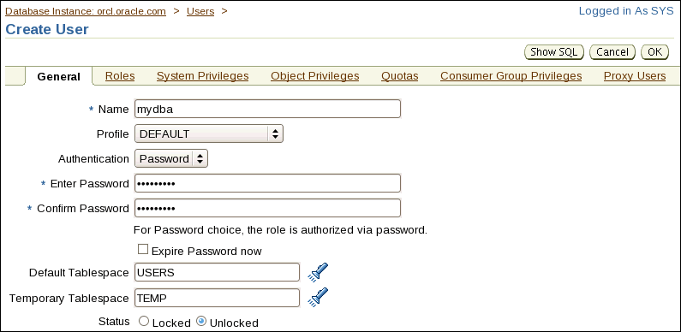
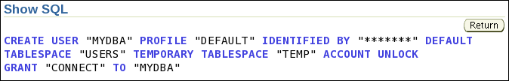
Creating a User
Select Server > Users, and then click the Create button.
Notes:
Creating a User
On the Users page of Enterprise Manager, you manage the database users who are allowed to access the current database. You use this page to create, delete, and modify the settings of a user.
To create a database user:
1. In Enterprise Manager Database Control, click the Server tab and then click Users in the Security section.
2. Click the Create button.
Provide the required information. Mandatory items (such as Name) are marked with an asterisk (*). The name specified must follow the same rules as those used for creating database objects. The pages that follow in this lesson give you more information about authentication. Profiles are covered later in this lesson.
Assign a default tablespace and a temporary tablespace to each user. If users do not specify a tablespace when creating an object, the object will be created in the default tablespace assigned to the object owner. This enables you to control where their objects are created. If you do not choose a default tablespace, the system-defined default permanent tablespace is used. The case is similar for the temporary tablespace: if you do not specify a tablespace, the system-defined temporary tablespace is used.
Note: Click Show SQL to see the supporting SQL syntax. For full SQL syntax for creating users, please see the Oracle® Database SQL Language Reference manual.

Slide 7
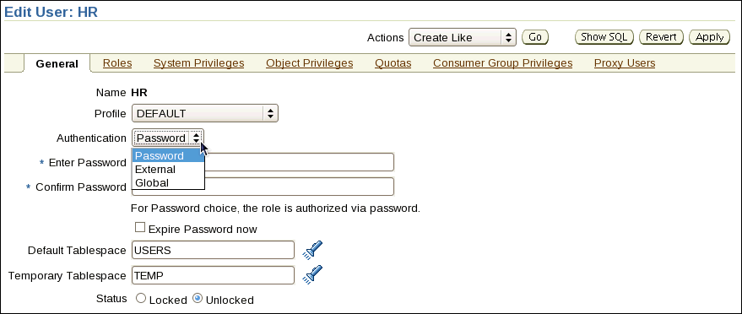

Authenticating Users
Password
External
Global
Notes:
Authenticating Users
Authentication means verifying the identity of someone or something (a user, device, or other entity) that wants to use data, resources, or applications. Validating that identity establishes a trust relationship for further interactions. Authentication also enables accountability by making it possible to link access and actions to specific identities. After authentication, authorization processes can allow or limit the levels of access and action that are permitted to that entity.
When you create a user, you must decide on the authentication technique to use, which can be modified later.
Password: This is also referred to as authentication by the Oracle database. Create each user with an associated password that must be supplied when the user attempts to establish a connection. When setting up a password, you can expire the password immediately, which forces the user to change the password after first logging in. If you decide on expiring user passwords, make sure that users have the ability to change the password. Some applications do not have this functionality. All passwords created in Oracle Database 11g are case-sensitive by default. These passwords may also contain multibyte characters and are limited to 30 bytes. Each password created in a database that is upgraded to Oracle Database 11g remains case-insensitive until the password is changed.
Passwords are always automatically and transparently encrypted using the Advanced Encryption Standard (AES) algorithm during network (client/server and server/server) connections before sending them across the network.

Slide 8
Notes:
Authenticating Users (continued)
External: This is authentication by a method outside the database (operating system, Kerberos, or Radius). The Advanced Security Option is required for Kerberos or Radius. Users can connect to the Oracle database without specifying a username or password. The Advanced Security Option (which is a strong authentication) allows users to be identified through the use of biometrics, x509 certificates, and token devices. With external authentication, your database relies on the underlying operating system, network authentication service, or external authentication service to restrict access to database accounts. A database password is not used for this type of login. If your operating system or network service permits, you can have it authenticate users. If you use operating system authentication, set the OS_AUTHENT_PREFIX initialization parameter and use this prefix in Oracle usernames. The OS_AUTHENT_PREFIX parameter defines a prefix that the Oracle database adds to the beginning of each user’s operating system account name. The default value of this parameter is OPS$ for backward compatibility with the previous versions of the Oracle software. The Oracle database compares the prefixed username with the Oracle usernames in the database when a user attempts to connect. For example, suppose that OS_AUTHENT_PREFIX is set as follows:
OS_AUTHENT_PREFIX=OPS$
If a user with an operating system account named tsmith needs to connect to an Oracle database and be authenticated by the operating system, the Oracle database checks whether there is a corresponding database user OPS$tsmith and, if so, allows the user to connect. All references to a user who is authenticated by the operating system must include the prefix, as seen in OPS$tsmith.
Note: The text of the OS_AUTHENT_PREFIX initialization parameter is case-sensitive on some operating systems. See the Oracle documentation that is specific to your operating system for more information about this initialization parameter.
Global: With the Oracle Advanced Security option, global authentication enables users to be identified through the use of Oracle Internet Directory.
For more information about advanced authentication methods, see the Oracle Database Security course.

Slide 9
Administrator Authentication
Operating system security:
DBAs must have the OS privileges to create and delete files.
Typical database users should not have the OS privileges to create or delete database files.
Administrator security:
For SYSDBA, SYSOPER, and SYSASM connections:
DBA user by name is audited for password file and strong authentication methods
OS account name is audited for OS authentication
OS authentication takes precedence over password file authentication for privileged users
Password file uses case-sensitive passwords
Notes:
Administrator Authentication
Operating system security: In UNIX and Linux, DBAs by default belong to the oinstall OS group, which has the required privileges to create and delete database files.
Administrator security: Connections for the privileged users SYSDBA, SYSOPER, and SYSASM are authorized only after verification with the password file or with the OS privileges and permissions. If OS authentication is used, the database does not use the supplied username and password. OS authentication is used if there is no password file, if the supplied username or password is not in that file, or if no username and password are supplied. The password file in Oracle Database 11g uses case-sensitive passwords by default.
However, if authentication succeeds by means of the password file, the connection is logged with the username. If authentication succeeds by means of the operating system, it is a CONNECT / connection that does not record the specific user.
Note: If you are a member of the OSDBA or OSOPER group for the operating system and you connect as SYSDBA or SYSOPER, you will be connected with the associated administrative privileges regardless of the username and password that you specify. For SYSASM you must not specify any username or password (for example, sqlplus / as SYSASM).
In Oracle Database 11g, a privileged user may use strong authentication methods: Kerberos, SSL, or directory authentication if the Advanced Security Option is licensed.

Slide 10
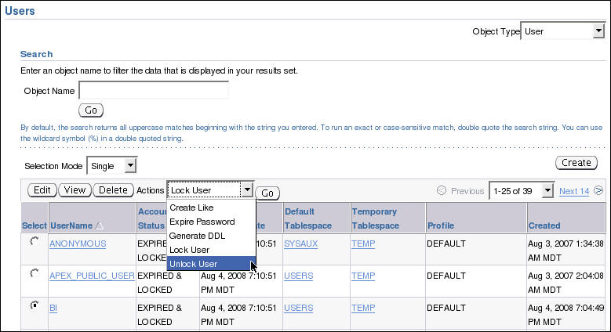

Unlocking a User Account and Resetting the Password
Select the user, select Unlock User, and click Go.
Notes:
Unlocking a User Account and Resetting the Password
During installation and database creation, you can unlock and reset many of the Oracle-supplied database user accounts. If you did not choose to unlock the user accounts at that time, you can unlock the user by selecting the user on the Users page, selecting Unlock User from the Actions list, and clicking Go. This does not change the password in any way. If the password was expired at the time that you unlocked the user, it will remain expired until you edit the user and change the password.
To unlock the user and reset the password, perform the following steps on the Edit Users page:
1. Enter the new password in the Enter Password and Confirm Password fields.
2. Select the Unlocked check box.
3. Click Apply to reset the password and unlock the user account.

Slide 11

Privileges
There are two types of user privileges:
System: Enables users to perform particular actions in the database
Object: Enables users to access and manipulate a specific object
HR_DBA
Object privilege:
Update employees
System privilege:
Create session
Notes:
Privileges
A privilege is a right to execute a particular type of SQL statement or to access another user’s object. The Oracle database enables you to control what the users can and cannot do in the database.
Privileges are divided into two categories:
System privileges: Each system privilege allows a user to perform a particular database operation or class of database operations. For example, the privilege to create tablespaces is a system privilege. System privileges can be granted by the administrator or by someone who has been given explicit permission to administer the privilege. There are more than 170 distinct system privileges. Many system privileges contain the ANY clause.
Object privileges: Object privileges allow a user to perform a particular action on a specific object, such as a table, view, sequence, procedure, function, or package. Without specific permission, users can access only their own objects. Object privileges can be granted by the owner of an object, by the administrator, or by someone who has been explicitly given permission to grant privileges on the object.

Slide 12
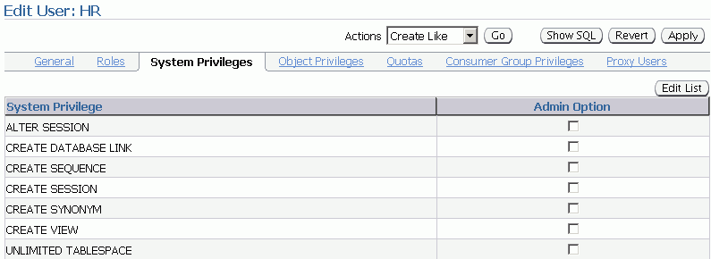
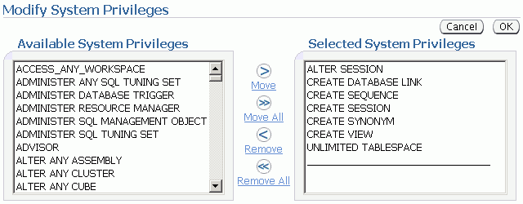
System Privileges
Notes:
System Privileges
To grant system privileges, click the Systems Privileges tab on the Edit User page. Select the appropriate privileges from the list of available privileges, and move them to the Selected System Privileges list by clicking the Move arrow.
Granting a privilege with the ANY clause means that the privilege crosses schema lines. For example, if you have the CREATE TABLE privilege, you can create a table—but only in your own schema. The SELECT ANY TABLE privilege allows you to select from tables owned by other users. The SYS user and users with the DBA role are granted all of the ANY privileges; they can therefore do anything to any data object. The scope of the ANY system privileges can be controlled using the Oracle Database Vault Option.
Selecting the Admin Option check box enables the user to administer the privilege and grant the system privilege to other users.
The SQL syntax for granting system privileges is:
GRANT <system_privilege> TO <grantee clause> [WITH ADMIN OPTION]
Carefully consider security requirements before granting system permissions. Some system privileges are usually granted only to administrators:
RESTRICTED SESSION: This privilege allows you to log in even if the database has been opened in restricted mode.

Slide 13
Notes:
System Privileges (continued)
SYSDBA and SYSOPER: These privileges allow you to shut down, start up, and perform recovery and other administrative tasks in the database. SYSOPER allows a user to perform basic operational tasks, but without the ability to look at user data. It includes the following system privileges:
STARTUP and SHUTDOWN
CREATE SPFILE
ALTER DATABASE OPEN/MOUNT/BACKUP
ALTER DATABASE ARCHIVELOG
ALTER DATABASE RECOVER (Complete recovery only. Any form of incomplete recovery, such as UNTIL TIME|CHANGE|CANCEL|CONTROLFILE, requires connecting as SYSDBA.)
RESTRICTED SESSION
The SYSDBA system privilege additionally authorizes incomplete recovery and the deletion of a database. Effectively, the SYSDBA system privilege allows a user to connect as the SYS user.
SYSASM: This privilege allows you to start up, shut down and administer an ASM instance.
DROP ANY object: The DROP ANY privilege allows you to delete objects that other schema users own.
CREATE, MANAGE, DROP, and ALTER TABLESPACE: These privileges allow for tablespace administration, including creating, dropping, and changing tablespace attributes.
CREATE LIBRARY: The Oracle database allows developers to create and call external code (for example, a C library) from PL/SQL. The library must be named by a LIBRARY object in the database. The CREATE LIBRARY privilege allows a user to create an arbitrary code library that is executable from PL/SQL.
CREATE ANY DIRECTORY: As a security measure, the operating system directory where the code resides must be linked to a virtual Oracle directory object. With the CREATE ANY DIRECTORY privilege, you can potentially call insecure code objects. The CREATE ANY DIRECTORY privilege allows a user to create a directory object (with read and write access) to any directory that the Oracle software owner can access. This means that the user can access external procedures in those directories. The user can attempt to directly read and write any database file, such as data files, redo log, and audit logs. Ensure that your organization has a security strategy that prevents misuse of powerful privileges such as this one.
GRANT ANY OBJECT PRIVILEGE: This privilege allows you to grant object permissions on objects that you do not own.
ALTER DATABASE and ALTER SYSTEM: These very powerful privileges allow you to modify the database and the Oracle instance (for example, renaming a data file or flushing the buffer cache).

Slide 14
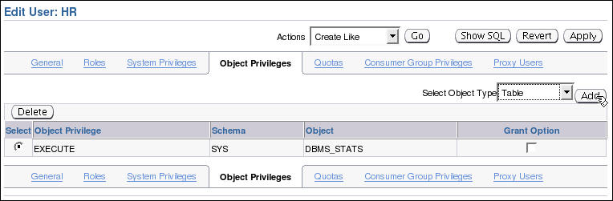
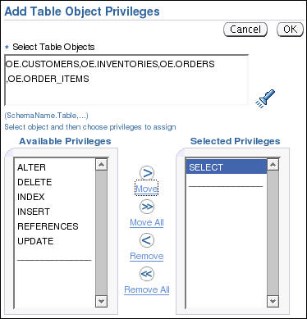
Object Privileges
1
2
To grant object privileges:
Choose the object type.
Select objects.
Select privileges.
Search and select objects.
3
Notes:
Object Privileges
To grant object privileges, click the Object Privileges tab on the Edit User page. Select the type of object on which you want to grant privileges, and then click the Add button. Choose the objects by either entering <username.object name> or selecting them from the list.
Then select the appropriate privileges from the Available Privileges list and click the Move button. When you have finished selecting privileges, click OK.
On the Edit User page, select the Grant check box if this user is allowed to grant other users the same access.
The SQL syntax for granting object privileges is:
GRANT <object_privilege> ON <object> TO <grantee clause> [WITH GRANT OPTION]

Slide 15

Revoking System Privileges with ADMIN OPTION
DBA
Joe
Emily
User
GRANT
Privilege
Object
DBA
Joe
Emily
REVOKE
REVOKE CREATE TABLE FROM joe;
Notes:
Revoking System Privileges with ADMIN OPTION
System privileges that have been granted directly with a GRANT command can be revoked by using the REVOKE SQL statement. Users with ADMIN OPTION for a system privilege can revoke the privilege from any other database user. The revoker does not have to be the same user who originally granted the privilege.
There are no cascading effects when a system privilege is revoked, regardless of whether it is given the ADMIN OPTION.
The SQL syntax for revoking system privileges is:
REVOKE <system_privilege> FROM <grantee clause>
The slide illustrates the following situation.
Scenario
1. The DBA grants the CREATE TABLE system privilege to Joe with ADMIN OPTION.
2. Joe creates a table.
3. Joe grants the CREATE TABLE system privilege to Emily.
4. Emily creates a table.
5. The DBA revokes the CREATE TABLE system privilege from Joe.
Result
Joe’s table still exists, but Joe cannot create new tables. Emily’s table still exists, and she still has the CREATE TABLE system privilege.

Slide 16
Revoking Object Privileges with GRANT OPTION
Bob
Joe
Emily
GRANT
REVOKE
Bob
Joe
Emily
Notes:
Revoking Object Privileges with GRANT OPTION
Cascading effects can be observed when revoking a system privilege that is related to a data manipulation language (DML) operation. For example, if the SELECT ANY TABLE privilege is granted to a user, and if that user has created procedures that use the table, all procedures that are contained in the user’s schema must be recompiled before they can be used again.
Revoking object privileges also cascades when given with GRANT OPTION. As a user, you can revoke only those privileges that you have granted. For example, Bob cannot revoke the object privilege that Joe granted to Emily. Only the grantee or a user with the privilege called GRANT ANY OBJECT PRIVILEGE can revoke object privileges.
Scenario
1. Joe is granted the SELECT object privilege on EMPLOYEES with GRANT OPTION.
2. Joe grants the SELECT privilege on EMPLOYEES to Emily.
3. The SELECT privilege is revoked from Joe. This revoke is cascaded to Emily as well.

Slide 17

Benefits of Roles
Easier privilege management
Dynamic privilege management
Selective availability of privileges
Notes:
Benefits of Roles
Easier privilege management: Use roles to simplify privilege management. Rather than granting the same set of privileges to several users, you can grant the privileges to a role and then grant that role to each user.
Dynamic privilege management: If the privileges associated with a role are modified, all users who are granted the role acquire the modified privileges automatically and immediately.
Selective availability of privileges: Roles can be enabled and disabled to turn privileges on and off temporarily. This allows the privileges of the user to be controlled in a given situation.

Slide 18

Assigning Privileges to Roles and Assigning Roles to Users
Users
Jenny
David
Rachel
Roles
HR_MGR
HR_CLERK
Delete
employees.
Create
Job.
Update
employees.
Privileges
Insert
employees.
Select
employees.
Notes:
Assigning Privileges to Roles and Assigning Roles to Users
In most systems, it is time consuming and error prone to grant necessary privileges to each user individually. The Oracle software provides for easy and controlled privilege management through roles. Roles are named groups of related privileges that are granted to users or to other roles. Roles are designed to ease the administration of privileges in the database and, therefore, improve security.
Role characteristics
Privileges are granted to and revoked from roles as though the role were a user.
Roles are granted to and revoked from users or other roles as though they were system privileges.
A role can consist of both system and object privileges.
A role can be enabled or disabled for each user who is granted the role.
A role can require a password to be enabled.
Roles are not owned by anyone, and they are not in any schema.
In the slide example, the SELECT and UPDATE privileges on the employees table and the CREATE JOB system privilege are granted to the HR_CLERK role. DELETE and INSERT privileges on the employees table and the HR_CLERK role are granted to the HR_MGR role. The manager is granted the HR_MGR role and can now select, delete, insert, and update the employees table.

Slide 19
Predefined Roles
Role | Privileges Included
CONNECT | CREATE SESSION
RESOURCE | CREATE CLUSTER, CREATE INDEXTYPE, CREATE OPERATOR, CREATE PROCEDURE, CREATE SEQUENCE, CREATE TABLE, CREATE TRIGGER, CREATE TYPE
SCHEDULER_ ADMIN | CREATE ANY JOB, CREATE EXTERNAL JOB, CREATE JOB, EXECUTE ANY CLASS, EXECUTE ANY PROGRAM, MANAGE SCHEDULER
DBA | Most system privileges; several other roles. Do not grant to nonadministrators.
SELECT_ CATALOG_ROLE | No system privileges; HS_ADMIN_ROLE and over 1,700 object privileges on the data dictionary
Notes:
Predefined Roles
There are several roles that are defined automatically for Oracle databases when you run database creation scripts. CONNECT is granted automatically to any user that is created with Enterprise Manager. For security reasons, the CONNECT role has contained only the CREATE SESSION privilege since version 10.2.0 of the Oracle Database.
Note: Be aware that granting the RESOURCE role includes granting the UNLIMITED TABLESPACE privilege.
Functional Roles
Other roles that authorize you to administer special functions are created when that functionality is installed. For example, XDBADMIN contains the privileges required to administer the Extensible Markup Language (XML) database if that feature is installed. AQ_ADMINISTRATOR_ROLE provides privileges to administer advanced queuing. HS_ADMIN_ROLE includes the privileges needed to administer heterogeneous services.
You must not alter the privileges granted to these functional roles without the assistance of Oracle Support because you may inadvertently disable the needed functionality.

Slide 20
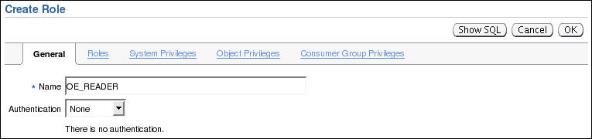
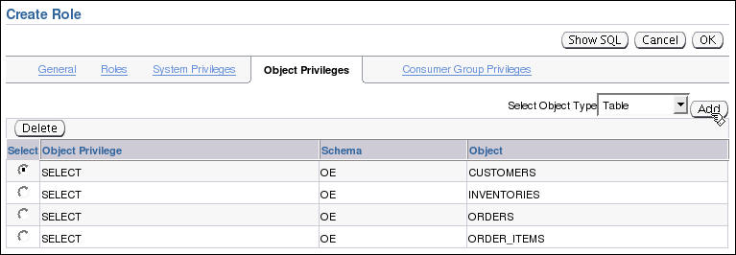
Creating a Role
Add privileges and roles from the appropriate tab.
Add privileges and roles from the appropriate tab.
Add privileges and roles from the appropriate tab.
Select Server > Roles.
Click OK when finished.
Notes:
Creating a Role
A role is a named group of related privileges that are granted to users or to other roles. A DBA manages privileges through roles.
To create a role, perform the following steps:
1. In Enterprise Manager Database Control, click the Server tab and then click Roles under the Security heading.
2. Click the Create button.
3. On the General tab, enter a name for the role.
4. Optionally, add the system privileges, object privileges, and other roles as required. The role can be edited at a later time to modify these settings if necessary.
5. Click OK when finished.

Slide 21
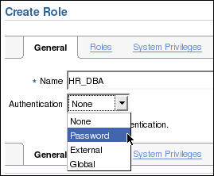
Secure Roles
Roles can be nondefault and enabled when required.
Roles can be protected through authentication.
Roles can also be secured programmatically.
SET ROLE vacationdba;
CREATE ROLE secure_application_role
IDENTIFIED USING <security_procedure_name>;
Notes:
Secure Roles
Roles are usually enabled by default, which means that if a role is granted to a user, then that user can exercise the privileges given to the role. Default roles are assigned to the user at connect time.
It is possible to:
Make a role nondefault. When the role is granted to a user, deselect the DEFAULT check box. The user must now explicitly enable the role before the role’s privileges can be exercised.
Have a role require additional authentication. The default authentication for a role is None, but it is possible to have the role require additional authentication before it can be set.
Create secure application roles that can be enabled only by executing a PL/SQL procedure successfully. The PL/SQL procedure can check things such as the user’s network address, the program that the user is running, the time of day, and other elements needed to properly secure a group of permissions.
Administer roles easily using the Oracle Database Vault option. Secure application roles are simplified, and traditional roles can be further restricted.

Slide 22
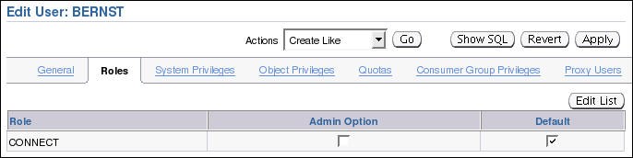
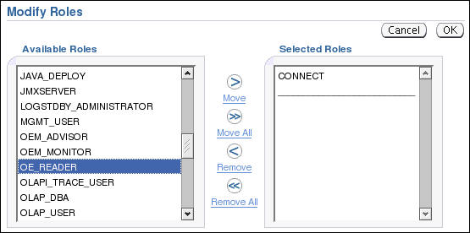
Assigning Roles to Users
Notes:
Assigning Roles to Users
You can use roles to administer database privileges. You can add privileges to a role and grant the role to a user. The user can then enable the role and exercise the privileges granted by the role. A role contains all privileges that are granted to that role and all privileges of other roles that are granted to it.
By default, Enterprise Manager automatically grants the CONNECT role to new users. This allows users to connect to the database and create database objects in their own schemas.
To assign a role to a user:
1. In Enterprise Manager Database Control, click the Server tab and then click Users under the Security heading.
2. Select the user and click the Edit button.
3. Click the Roles tab, and then click the Edit List button.
4. Select the desired role under Available Roles and move it under Selected Roles.
5. When you have assigned all appropriate roles, click the OK button.

Slide 23
Quiz
All passwords created in Oracle Database 11g are not case-sensitive by default.
True
False
Notes:
Answer: 2

Slide 24
Quiz
A database role:
Can be enabled or disabled
Can consist of system and object privileges
Is owned by its creator
Cannot be protected by a password
Notes:
Answers: 1, 2

Slide 25
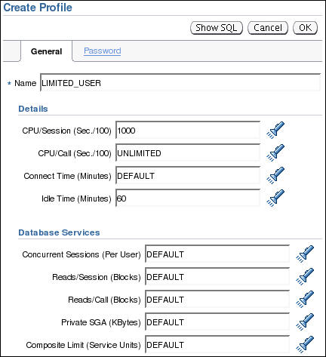
Profiles and Users
Users are assigned only one profile at a time.
Profiles:
Control resource consumption
Manage account status and password expiration
Note: RESOURCE_LIMIT must be set to TRUE before profiles can impose resource limitations.
Notes:
Profiles and Users
Profiles impose a named set of resource limits on database usage and instance resources. Profiles also manage the account status and place limitations on users’ passwords (length, expiration time, and so on). Every user is assigned a profile and may belong to only one profile at any given time. If users have already logged in when you change their profile, the change does not take effect until their next login.
The DEFAULT profile serves as the basis for all other profiles. As illustrated in the slide, limitations for a profile can be implicitly specified (as in CPU/Session), can be unlimited (as in CPU/Call), or can reference whatever setting is in the DEFAULT profile (as in Connect Time).
Profiles cannot impose resource limitations on users unless the RESOURCE_LIMIT initialization parameter is set to TRUE. With RESOURCE_LIMIT at its default value of FALSE, profile resource limitations are ignored. Profile password settings are always enforced
Profiles enable the administrator to control the following system resources:
CPU: CPU resources may be limited on a per-session or per-call basis. A CPU/Session limitation of 1,000 means that if any individual session that uses this profile consumes more than 10 seconds of CPU time (CPU time limitations are in hundredths of a second), that session receives an error and is logged off:
ORA-02392: exceeded session limit on CPU usage, you are being logged off

Slide 26
Notes:
Profiles and Users (continued)
A per-call limitation does the same thing, but instead of limiting the user’s overall session, it prevents any single command from consuming too much CPU. If CPU/Call is limited and the user exceeds the limitation, the command aborts. The user receives an error message such as the following:
ORA-02393: exceeded call limit on CPU usage
Network/Memory: Each database session consumes system memory resources and (if the session is from a user who is not local to the server) network resources. You can specify the following:
Connect Time: Indicates for how many minutes a user can be connected before being automatically logged off
Idle Time: Indicates for how many minutes a user’s session can remain idle before being automatically logged off. Idle time is calculated for the server process only. It does not take into account application activity. The IDLE_TIME limit is not affected by long-running queries and other operations.
Concurrent Sessions: Indicates how many concurrent sessions can be created by using a database user account
Private SGA: Limits the amount of space consumed in the System Global Area (SGA) for sorting, merging bitmaps, and so on. This restriction takes effect only if the session uses a shared server. (Shared servers are covered in the lesson titled “Configuring the Oracle Network Environment.”)
Disk I/O: This limits the amount of data a user can read at the per-session level or per-call level. Reads/Session and Reads/Call place a limitation on the total number of reads from both memory and the disk. This can be done to ensure that no I/O-intensive statements overuse memory and disks.
Profiles also allow a composite limit. Composite limits are based on a weighted combination of CPU/Session, Reads/Session, Connect Time, and Private SGA. Composite limits are discussed in more detail in the Oracle Database Security Guide.
To create a profile, click the Server tab and then click Profiles under the Security heading. On the Profiles page, click the Create button.
Note: Resource Manager is an alternative to many of the profile settings. For more details about Resource Manager, see the Oracle Database Administrator’s Guide.

Slide 27





Implementing Password Security Features
Password complexity verification
Password history
User
Setting up profiles
Password aging
and expiration
Account locking
Note: Do not use profiles that cause the SYS, SYSMAN, and DBSNMP passwords to expire and the accounts to be locked.
Notes:
Implementing Password Security Features
Oracle password management is implemented with user profiles. Profiles can provide many standard security features.
Account locking: Enables automatic locking of accounts for a set duration when users fail to log in to the system in the specified number of attempts
FAILED_LOGIN_ATTEMPTS: Specifies the number of failed login attempts before the lockout of the account
PASSWORD_LOCK_TIME: Specifies the number of days for which the account is locked after the specified number of failed login attempts
Password aging and expiration: Enables user passwords to have a lifetime, after which the passwords expire and must be changed
PASSWORD_LIFE_TIME: Determines the lifetime of the password in days, after which the password expires
PASSWORD_GRACE_TIME: Specifies a grace period in days for changing the password after the first successful login after the password has expired
Note: Expiring passwords and locking the SYS, SYSMAN, and DBSNMP accounts prevent Enterprise Manager from functioning properly. The applications must catch the “password expired” warning message and handle the password change; otherwise, the grace period expires and the user is locked out without knowing the reason.

Slide 28
Notes:
Implementing Password Security Features (continued)
Password history: Checks the new password to ensure that the password is not reused for a specified amount of time or a specified number of password changes. These checks can be implemented by using one of the following:
PASSWORD_REUSE_TIME: Specifies that a user cannot reuse a password for a given number of days
PASSWORD_REUSE_MAX: Specifies the number of password changes that are required before the current password can be reused
Recall that the values of the profile parameters are either set or inherited from the DEFAULT profile.
If both password history parameters have a value of UNLIMITED, Oracle Database ignores both. The user can reuse any password at any time, which is not a good security practice.
If both parameters are set, password reuse is allowed—but only after meeting both conditions. The user must have changed the password the specified number of times, and the specified number of days must have passed since the old password was last used.
For example, the profile of user ALFRED has PASSWORD_REUSE_MAX set to 10 and PASSWORD_REUSE_TIME set to 30. User ALFRED cannot reuse a password until he has reset the password 10 times and until 30 days have passed since the password was last used.
If one parameter is set to a number and the other parameter is specified as UNLIMITED, then the user can never reuse a password.
Password complexity verification: Makes a complexity check on the password to verify that it meets certain rules. The check must ensure that the password is complex enough to provide protection against intruders who may try to break into the system by guessing the password.
The PASSWORD_VERIFY_FUNCTION parameter names a PL/SQL function that performs a password complexity check before a password is assigned. Password verification functions must be owned by the SYS user and must return a Boolean value (TRUE or FALSE). A model password verification function is provided in the utlpwdmg.sql script found in the following directories:
Unix and Linux platforms: $ORACLE_HOME/rdbms/admin
Windows platforms: %ORACLE_HOME%\rdbms\admin

Slide 29
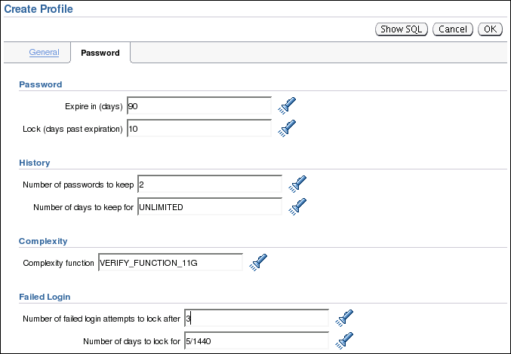
Creating a Password Profile
Notes:
Creating a Password Profile
To create a password profile, click the Server tab and then click Profiles under the Security heading. On the Profiles page, click the Create button. Click the Password tab to set the password limits.
You can choose common values for each of the settings from a list of values (click the flashlight icon to browse), or you can enter a custom value.
All time periods are expressed in days but can also be expressed as fractions. There are 1,440 minutes in a day; 5/1,440 is therefore five minutes.
Enterprise Manager can also be used to edit existing password profiles.
If the utlpwdmg.sql script has been run, the VERIFY_FUNCTION and VERIFY_FUNCTION_11G functions are available. If you have created your own complexity function, the name of that function may be entered. The function name does not appear in the Select list. If the function produces run-time errors, the user is unable to change the password.
Dropping a Password Profile
In Enterprise Manager, you cannot drop a profile that is used by users. However, if you drop a profile with the CASCADE option (for example, in SQL*Plus), all users who have that profile are automatically assigned the DEFAULT profile.

Slide 30

Supplied Password Verification Function: VERIFY_FUNCTION_11G
The VERIFY_FUNCTION_11G function insures that the password is:
At least eight characters
Different from the username, username with a number, or username reversed
Different from the database name or the database name with a number
A string with at least one alphabetic and one numeric character
Different from the previous password by at least three letters
Tip: Use this function as a template to create your own customized password verification.
Notes:
Supplied Password Verification Function: VERIFY_FUNCTION_11G
The Oracle server provides two password complexity verification functions named VERIFY_FUNCTION and VERIFY_FUNCTION_11g. These functions are created with the <oracle_home>/rdbms/admin/utlpwdmg.sql script. The VERIFY_FUNCTION is provided for those who prefer the password function provided with previous versions. The password complexity verification function must be created in the SYS schema. It can be used as a template for your customized password verification.
In addition to creating VERIFY_FUNCTION, the utlpwdmg script also changes the DEFAULT profile with the following ALTER PROFILE command:
ALTER PROFILE default LIMIT PASSWORD_LIFE_TIME 180 PASSWORD_GRACE_TIME 7 PASSWORD_REUSE_TIME UNLIMITED PASSWORD_REUSE_MAX UNLIMITED FAILED_LOGIN_ATTEMPTS 10 PASSWORD_LOCK_TIME 1 PASSWORD_VERIFY_FUNCTION verify_function_11g;
Remember that when users are created, they are assigned the DEFAULT profile unless another profile is specified.

Slide 31
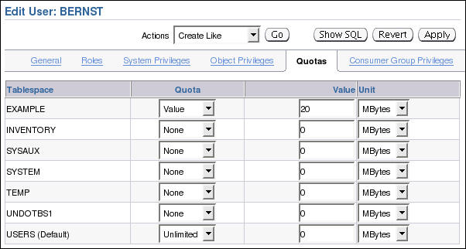
Assigning Quotas to Users
Users who do not have the UNLIMITED TABLESPACE system privilege must be given a quota before they can create objects in a tablespace.
Quotas can be:
A specific value in megabytes or kilobytes
Unlimited
Notes:
Assigning Quotas to Users
A quota is a space allowance in a given tablespace. By default, a user has no quota on any of the tablespaces. You have three options for providing a quota for a user on a tablespace.
Unlimited: Allows the user to use as much space as is available in the tablespace
Value: Number of kilobytes or megabytes that the user can use. This does not guarantee that the space is set aside for the user. This value can be larger or smaller than the current space that is available in the tablespace.
UNLIMITED TABLESPACE system privilege: Overrides all individual tablespace quotas and gives the user unlimited quota on all tablespaces, including SYSTEM and SYSAUX. This privilege must be granted with caution. Note: Be aware that granting the RESOURCE role includes granting this privilege.
You must not provide a quota to users on the SYSTEM or SYSAUX tablespaces. Typically, only the SYS and SYSTEM users are able to create objects in the SYSTEM or SYSAUX tablespaces.
You do not need a quota on an assigned temporary tablespace or any undo tablespaces. You do not need to have quota to be able to insert, update, and delete data in an Oracle database. The only users that need quota, are the accounts that own the database objects. It is typical when installing application code, that the installer creates database accounts to own the objects. Only these accounts need quota. Other database users can be granted permission to use these objects without quota.

Slide 32
Notes:
Assigning Quotas to Users (continued)
The Oracle instance checks the quota when a user creates or extends a segment.
For activities that are assigned to a user schema, only those activities that use space in a tablespace count against the quota. Activities that do not use space in the assigned tablespace do not affect the quota (such as creating views or using temporary tablespaces).
The quota is replenished when objects owned by the user are dropped with the PURGE clause or when the objects owned by the user in the recycle bin are purged.

Slide 33
Applying the Principle of Least Privilege
Protect the data dictionary:
Revoke unnecessary privileges from PUBLIC.
Use access control lists (ACL) to control network access.
Restrict the directories accessible by users.
Limit users with administrative privileges.
Restrict remote database authentication:
O7_DICTIONARY_ACCESSIBILITY=FALSE
REMOTE_OS_AUTHENT=FALSE
Notes:
Applying the Principle of Least Privilege
The principle of least privilege means that a user must be given only those privileges that are required to efficiently complete a task. This reduces the chances of users modifying or viewing data (either accidentally or maliciously) that they do not have the privilege to modify or view.
Protect the data dictionary: The O7_DICTIONARY_ACCESSIBILITY parameter is set by default to FALSE. You must not allow this to be changed without a very good reason because it prevents users with the ANY TABLE system privileges from accessing the data dictionary base tables. It also ensures that the SYS user can log in only as SYSDBA.
Revoke unnecessary privileges from PUBLIC: Several packages are extremely useful to applications that need them, but require proper configuration to be used securely. PUBLIC is granted execute privilege on the following packages: UTL_SMTP, UTL_TCP, UTL_HTTP, and UTL_FILE. In Oracle Database 11g, network access is controlled by an access control list (ACL) that may be configured to allow certain users access to specific network services. Network access is denied by default. An ACL must be created to allow network access. File through UTL_FILE access is controlled at two levels: at the OS level with permissions on files and directories, and in the database by DIRECTORY objects that allow access to specific file system directories. The DIRECTORY object may be granted to a user for read or for read and write. Execute privileges on other PL/SQL packages should be carefully controlled.

Slide 34
Notes:
Applying the Principle of Least Privilege (continued)
The more powerful packages that may potentially be misused include:
UTL_SMTP: Permits arbitrary email messages to be sent by using the database as a Simple Mail Transfer Protocol (SMTP) mail server. Use the ACL to control which machines may be accessed by which users.
UTL_TCP: Permits outgoing network connections to be established by the database server to any receiving or waiting network service. Thus, arbitrary data can be sent between the database server and any waiting network service. Use the ACL to control access.
UTL_HTTP: Allows the database server to request and retrieve data via HTTP. Granting this package to a user may permit data to be sent via HTML forms to a malicious Web site. Limit access by using the ACL.
UTL_FILE: If configured improperly, allows text-level access to any file on the host operating system. When properly configured, this package limits user access to specific directory locations.
Restrict access to OS directories: The DIRECTORY object inside the database enables DBAs to map directories to OS paths and to grant privileges on those directories to individual users.
Limit users with administrative privileges: Do not provide database users more privileges than necessary. Nonadministrators must not be granted the DBA role. To implement least privilege, restrict the following types of privileges:
Grants of system and object privileges
SYS-privileged connections to the database, such as SYSDBA and SYSOPER
Other DBA-type privileges, such as DROP ANY TABLE
Restrict remote database authentication: The REMOTE_OS_AUTHENT parameter is set to FALSE by default. It must not be changed unless all clients can be trusted to authenticate users appropriately. With the advent of Secure External Password Store (available in Oracle Database 10g Release 2), there are few compelling reasons ever to allow remote OS authentication.
In the remote authentication process:
The database user is authenticated externally
The remote system authenticates the user
The user logs in to the database without further authentication
Note: Always test your applications thoroughly if you have revoked privileges.

Slide 35


Protect Privileged Accounts
Privileged accounts can be protected by:
Using password file with case-sensitive passwords
Enabling strong authentication for administrator roles
SYSDBA
Notes:
Setting Database Administrator Authentication
Users with SYSDBA, SYSOPER, or SYSASM privileges must always be authenticated. When connecting locally, the user is authenticated by the local OS by being a member of a privileged OS group. If connecting remotely, a password file is used to authenticate privileged users. If the password file is configured, it will be checked first. In Oracle Database 11g, these passwords are case-sensitive. Oracle Database 11g provides other methods that make remote administrator authentication more secure and centralize the administration of these privileged users.
When a database is created using the Database Configuration Assistant, the password file is case-sensitive. If you upgrade from earlier database versions, be sure to make the password file case-sensitive for remote connections:
orapwd file=orapworcl entries=5 ignorecase=N
If your concern is that the password file might be vulnerable or that the maintenance of many password files is a burden, strong authentication can be implemented. The Advanced Security option is required if you want to use strong authentication methods. For more information about strong authentication, see the Oracle Database Advanced Security Administrator’s Guide.

Slide 36
Quiz
Applying the principle of least privilege is not enough to harden the Oracle database.
True
False
Notes:
Answer: 1

Slide 37
Quiz
With RESOURCE_LIMIT set at its default value of FALSE, profile password limitations are ignored.
True
False
Notes:
Answer: 2

Slide 38
Summary
In this lesson, you should have learned how to:
Create and manage database user accounts:
Authenticate users
Assign default storage areas (tablespaces)
Grant and revoke privileges
Create and manage roles
Create and manage profiles:
Implement standard password security features
Control resource usage by users

Slide 39
Practice 8 Overview: Administering Users
This practice covers the following topics:
Creating a profile to limit resource consumption
Creating two roles:
HRCLERK
HRMANAGER
Creating four new users:
One manager and two clerks
One schema user for the next practice session

