Slide 1
Proactive Maintenance

Slide 2
Objectives
After completing this lesson, you should be able to do the following:
  Set warning and critical alert thresholds
  Use server-generated alerts
  Collect and use baseline metrics
  Manage the Automatic Workload Repository (AWR)
  Use the Automatic Database Diagnostic Monitor
  Describe the advisory framework

Slide 3
Proactive Maintenance
Automatic
Automated
tasks
Proactive
Server
alerts
Advisory
framework
Automatic
Workload Repository
Efficient
Data warehouse
of the database
Automatic collection
of important statistics
Direct memory
access
Notes:
Proactive Maintenance
Proactive maintenance is made easy by the sophisticated infrastructure of the Oracle database. The main elements are as follows:
The Automatic Workload Repository (AWR) is a built-in repository in each Oracle database. At regular intervals, the Oracle database makes a snapshot of all its vital statistics and workload information and stores them in the AWR. The captured data can be analyzed by you, by the database itself, or by both.
By analyzing the information that is stored in the AWR, the database can identify the need to perform routine maintenance tasks, such as performing regular backups to maximize availability or refreshing statistics, which are used to optimize the execution of SQL statements.
For problems that cannot be resolved automatically and require administrators to be notified (such as running out of space), the Oracle database provides server-generated alerts. The Oracle database can monitor itself and send out alerts to notify you of any problem. The alerts not only notify you of the problem, they also provide recommendations on how the reported problem can be resolved.
Recommendations are generated from a number of advisors, each of which is responsible for a subsystem. For example, there are memory and SQL advisors.

Slide 4
Introduction of Concepts and Related Tasks
> Baseline
Alert
AWR
ADDM
Advisors
AutoTasks
  Thresholds and metric baselines
  Enabling metric baselining
  Server-generated alerts
  Creating and testing an alert
  Automatic Workload Repository (AWR)
  Managing the AWR
  Automatic Database Diagnostic Monitor (ADDM)
  Advisory framework
  Automated maintenance tasks

Slide 5

Introducing Terminology
  Baseline: Data gathered of a “normal running database” for performance comparison
  Metric: Rate of change in a cumulative statistic
  Threshold: A boundary value against which metric values are compared
Notes:
Introducing Terminology
Baseline data should include:
Application statistics (transaction volumes, response time)
Database statistics
Operating system statistics
Disk I/O statistics
Network statistics

Slide 6
Cyclic Nature of Workloads
Value
End of day 1
End of day 2
End of day 3
…
Metric
OLTP
DW
Time
Notes:
Cyclic Nature of Workloads
The workloads running on most of the information technology (IT) systems are cyclic by nature.
For example, everyday between 7 a.m. and 7 p.m., you are running your online transaction processing (OLTP) workload, and then your data warehouse (DW) workload for the rest of the day. This cycle begins again the following day.
The cyclic nature of a workload is represented in the slide.

Slide 7
Overview of Thresholds and Metric Baselines: Fixed Thresholds
End of day 1
End of day 2
End of day 3
Fixed
thresholds
Value
Critical
Warning
Metric
OLTP
DW
Time
Deviations missed
Notes:
Overview of Thresholds and Metric Baselines: Fixed Thresholds
Server-generated alerts use fixed arithmetic thresholds as a basis for signaling alerts. The threshold values are determined and set by users on the basis of the understanding (or estimates) of expected system behavior. Each metric on each system must be individually considered, imposing a significant administrative overhead when the number of metrics or systems is growing. The graphic in the slide illustrates this situation for a particular metric.
Fixed thresholds for performance metrics are particularly error prone on systems with predictably varying workloads: OLTP daytime and Warehousing window evenings.
In this case, there is no single threshold that is appropriate for both workload profiles, so fixing a threshold tends to generate either false alerts or missed alerts. As you can see in the graph, the workload deviations appearing during the third period are not captured.

Slide 8
Overview of Thresholds and Metric Baselines: Adaptive Thresholds
End of
baseline
Critical
Adaptive thresholds
Value
Normal
Warning
Metric
Grouping
Time
Deviations captured
Notes:
Overview of Thresholds and Metric Baselines: Adaptive Thresholds
Adaptive thresholds use statistical measures of central tendency and variability to characterize normal system behavior and trigger alerts when observed behavior deviates significantly from the norm.
As a database administrator (DBA), you can designate a period of system time as a metric baseline. The idea is to compute metric statistics over the baseline period, which should represent the period of normal activity of your system. These statistics are computed according to a selected grouping scheme; for example, every hour or everyday inside the baseline. After the computation is done for the baseline period for a particular metric, you can specify critical and warning thresholds relative to the computed norm. After you activate the baseline, the thresholds are automatically set for each time group according to the previously computed norm for the same period of time. This allows for the thresholds to be dynamically adapted to the normal behavior for each time group.
Adaptive thresholds have a number of advantages over fixed thresholds, including:
Automatic computation based on minimal or default configuration.
Adaptive since they are based on prior observations of the metric on the system.
Superior alert accuracy based on statistical significance of observed values.

Slide 9
Metric Baselines and Thresholds: Concepts
Time
grouped
Metric threshold
Automatically
computed
baseline
statistics
Baseline period
Adaptive
Fixed
Static
baseline
Moving
window
Percent of
MAX
Significance
level
Notes:
Metric Baselines and Thresholds: Concepts
Metric baselines are of two types:
Static baselines are composed of one single user-defined interval of time. This type of metric baseline is most useful when you definitely know a past period of time that characterizes your current workload.
Moving window baselines are based on a simple functional relationship relative to a reference time. They are defined as a specific number of days from the past. This type of metric baseline is most useful when your global workload is changing often.
Metric baseline periods can have a grouping scheme associated with them that determines whether metric time series within the baseline are aggregated at a finer level than over the entire baseline period.

Slide 10
Metric Baseline and Threshold
Full Notes Page
Notes:
Metric Baselines and Thresholds: Concepts (continued)
Metric baselines can be used to establish alert thresholds that are both statistically significant and adaptive to expected variations across time groups. To be able to determine those statistical variations, the system computes metric variation statistics automatically. Two types of adaptive thresholds are supported:
Significance-level thresholds: Alert thresholds can be dynamically set by the system to values representing statistical significance as measured by the active baseline. Alerts that are generated by observed metric values exceeding these thresholds are assumed to be unusual events and, therefore, are possibly indicative of (or associated with) problems.
Percent of maximum thresholds: Allows you to set metric thresholds relative to the trimmed maximum value measured over the baseline period and time group. This is most useful when a static baseline has captured some period of specific workload processing and you want to signal when the next occurrence of this processing exceeds some fraction of the baseline period value. “Percent of maximum thresholds” are not looking for statistically unusual values, but rather values close to or exceeding peaks observed over the baseline period.

Slide 11
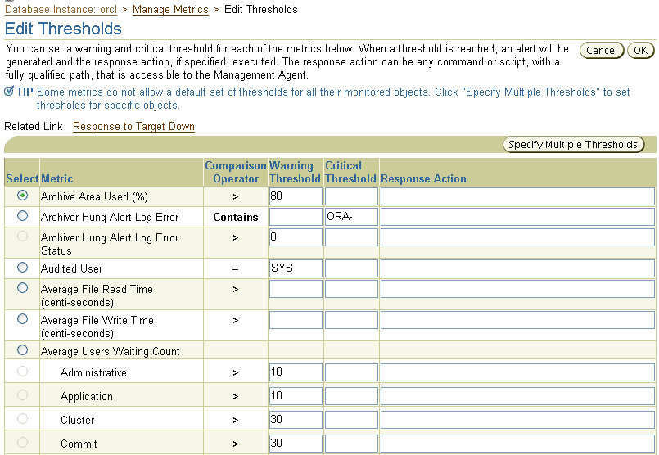
Editing Thresholds
Notes:
Editing Thresholds
To edit a threshold select Manage Metrics in the Related Links section of the database home page. Click Edit Threshold. Enter your desired Warning and Critical Threshold values. The appropriate alerts appear when the database reaches your specified values. If required, you can specify an additional response action.

Slide 12
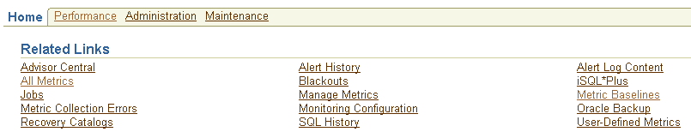
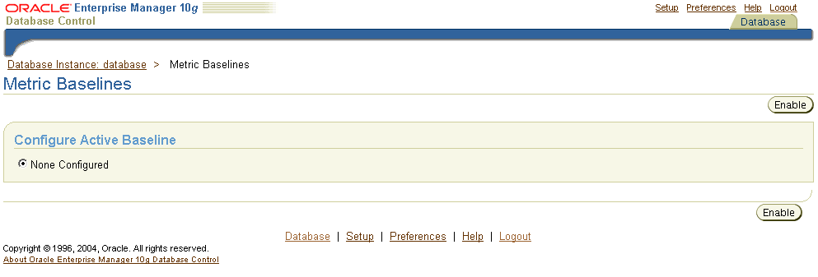
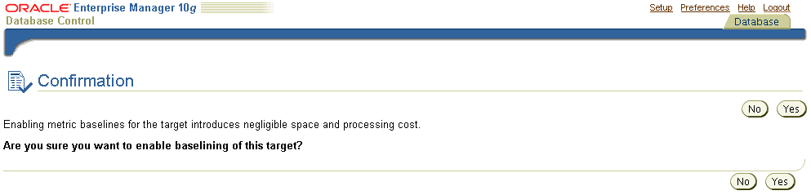
Enabling Metric Baselining
Notes:
Enabling Metric Baselining
Before you can successfully use metric baselines and adaptive thresholds, you must enable them in Enterprise Manager. Internally, Enterprise Manager causes the system metrics to be flushed and submits a job once a day, which is used to compute moving-window baseline statistics, and submits one job once every hour to set thresholds after a baseline is activated.
You can enable metric baselining from the Database Home page by clicking the Metric Baselines link in the Related Links section. When on the Metric Baselines page, click Enable, and on the Confirmation page, click Yes.
Note: Enabling metric baselines for your database introduces negligible space and processing cost.

Slide 13
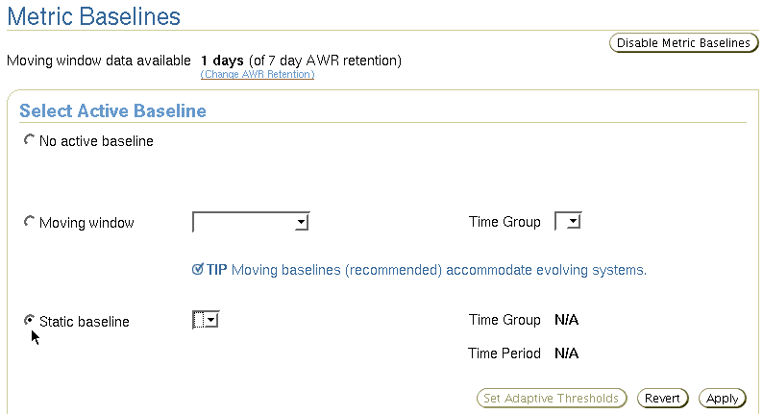
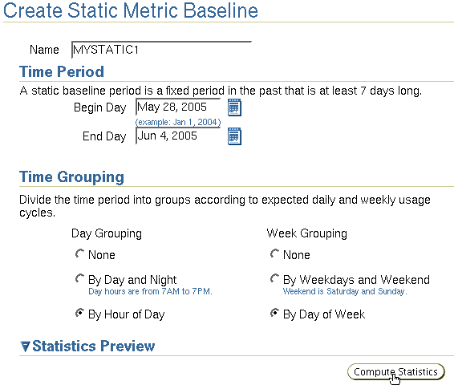

Creating Static Metric Baselines
Notes:
Creating Static Metric Baselines
1. Use the Create Static Metric Baseline page to create a new static metric baseline.
2. Specify a name and seven-day time period. Then select the Time Grouping scheme:
By Hour of Day: Creates 24 hourly groups
By Day and Night: Creates two groups—day hours (7 a.m. to 7 p.m.) and night hours (7 p.m. to 7 a.m.)
By Day of Week: Creates seven daily groups
By Weekdays and Weekend: Creates two groups—weekdays (Monday through Friday) together and weekends (Saturday and Sunday) together.
You can combine these options. For instance, grouping by Day and Night and Weekdays and Weekend produces four groups.
3. Click Compute Statistics to compute statistics on all the metrics referenced by the baseline. Enterprise Manager computes statistics only once, which is when the baseline is created.
4. If an alert message appears in the Model Fit column, either there is insufficient data to perform reliable calculations or the data characteristics do not fit the metric baselines model.

Slide 14





Server-Generated Alerts
Baseline
> Alert
AWR
ADDM
Advisors
AutoTasks
Enterprise Manager
Server
alerts
queue.
Oracle
instance
Metric exceeds
threshold.
AWR
Notes:
Server-Generated Alerts
Oracle Database 10g provides alerts to the administrator about problems. It provides alerts via Enterprise Manager Database Console. Optionally, Enterprise Manager can be configured to send an e-mail to the administrator about problem conditions as well as display alert information on the console.
You can also set thresholds on many of the pertinent metrics for your system. Oracle Database 10g proactively notifies you if the database deviates from normal readings enough to reach those thresholds. An early notification of potential problems enables you to respond quickly, and often resolve issues before users even notice them.
A few key metrics that can provide early problem notification are:
Average File Read Time (centiseconds)
Dump Area Used (%)
Response Time (per transaction)
SQL Response Time (%)
Tablespace Used (%)
Wait Time (%)

Slide 15
Server-Generated Alert Types
Metric based
Threshold
(stateful)
alerts
97% Critical
Cleared
85% Warning
Cleared
MMON
DBA_OUTSTANDING_ALERTS
DBA_ALERT_HISTORY
Resumable
Session
Suspended
Recovery Area
Low On
Free Space
Snapshot
Too Old
Nonthreshold (stateless)
alerts
Alert
Event based
Notes:
Server-Generated Alert Types
There are two kinds of server-generated alerts: threshold and nonthreshold.
Most server-generated alerts are configured by setting a warning and critical threshold values on database metrics. You can define thresholds for more than 120 metrics. For example:
Physical Reads Per Sec
User Commits Per Sec
SQL Service Response Time
Except for the Tablespace Space Usage metric, which is database related, the other metrics are instance related. Threshold alerts are also referred to as stateful alerts. These alerts are automatically cleared when an alert condition clears. Stateful alerts appear in DBA_OUTSTANDING_ALERTS and, when cleared, go to DBA_ALERT_HISTORY.
Other server-generated alerts correspond to specific database events such as Snapshot Too Old errors, Recovery Area Low On Free Space, and Resumable Session Suspended. These are non-threshold-based alerts, also referred to as stateless alerts. Stateless alerts go directly to the history table. Clearing a stateless alert makes sense only in the Database Control environment, because Database Control stores stateless alerts in its own repository.

Slide 16
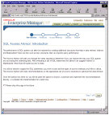





Default Server-Generated Alerts
97% Critical
85% Warning
Tablespace
Database Control:
SYSTEM metrics
Tablespace
space usage
Resumable
Session
Suspended
Recovery Area
Low On
Free Space
Snapshot
Too Old
Notes:
Default Server-Generated Alerts
By default, the following server-generated alerts are enabled:
Tablespace Space Usage (warning 85%, critical 97%)
Snapshot Too Old
Recovery Area Low On Free Space
Resumable Session Suspended
Note: Enterprise Manager Database Control automatically sets thresholds on server metrics with the SYSTEM object type.

Slide 17
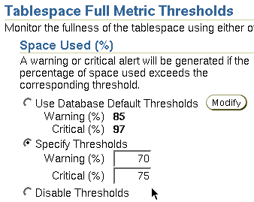
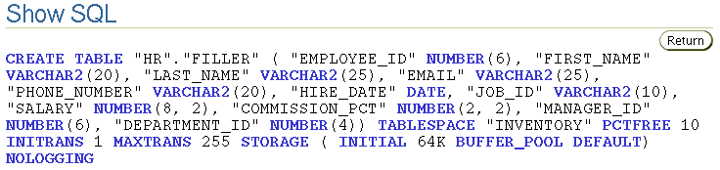
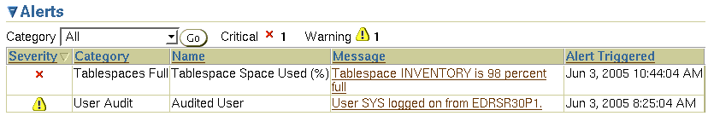
Creating and Testing an Alert
Specify a threshold.
Create a test case.
Check for an alert.
1
2
3
Notes:
Creating and Testing an Alert
Example: You decide that you need to receive a critical alert if the space used in the INVENTORY tablespace exceeds 75%. (This tablespace does not allow its data files to automatically extend.) To create and test the alert, perform the following steps:
1. In Enterprise Manager, navigate to the tablespace administration, and set your desired threshold.
2. Use the “Create like” action to duplicate an existing table, and fill it in SQL*Plus.
3. After you receive an error, that this table is unable to extend, check the Database Instance home page for the associated alert.

Slide 18

Where We Are
  Thresholds and metric baselines
  Enabling metric baselining
  Server-generated alerts
  Creating and testing an alert
  Automatic Workload Repository (AWR)
  Managing the AWR
  Automatic Database Diagnostic Monitor (ADDM)
  Advisory framework
  Automated maintenance tasks

Slide 19
Automatic Workload Repository (AWR)
Baseline
Alert
> AWR
ADDM
Advisors
AutoTasks
  Built-in repository of performance information
  Snapshots of database metrics taken every 60 minutes and retained for 7 days
  Foundation for all self-management functions
In-memory
statistics
60 minutes
MMON
Snapshots
SGA
AWR
Notes:
Automatic Workload Repository (AWR)
The AWR is the infrastructure that provides services to Oracle Database 10g components to collect, maintain, and utilize statistics for problem detection and self-tuning purposes. You can view it as a data warehouse for database statistics, metrics and so on.
By default, every 60 minutes, the database automatically captures statistical information from the SGA and stores it inside the AWR in the form of snapshots. These snapshots are stored on the disk by a background process called MMON (Manageability Monitor). By default, snapshots are retained for seven days. You can modify both the snapshot interval and retention intervals.
The AWR contains hundreds of tables, all belonging to the SYSMAN schema and stored in the SYSAUX tablespace. The Oracle database does not support direct SQL access to the repository. Instead, use Enterprise Manager or the DBMS_WORKLOAD_REPOSITORY package to work with the AWR.

Slide 20
AWR Infrastructure
External clients
EM
SQL*Plus
…
SGA
Efficient
in-memory
statistics
collection
V$
DBA_*
AWR
snapshots
MMON
ADDM
Self-tuning
component
…
Self-tuning
component
Internal clients
Notes:
AWR Infrastructure
The AWR infrastructure consists of two major parts:
An in-memory statistics collection facility that is used by Oracle Database 10g components to collect statistics. These statistics are stored in memory for performance reasons. Statistics stored in memory are accessible through dynamic performance (V$) views.
The AWR snapshots represent the persistent portion of the facility. AWR snapshots are accessible through data dictionary views and Enterprise Manager Database Control.
Statistics are stored in persistent storage for several reasons:
The statistics need to survive instance crashes.
Some analyses need historical data for baseline comparisons.
Memory overflow: When old statistics are replaced by new ones because of memory shortage, the replaced data can be stored for later use.
The memory version of the statistics is transferred to the disk on a regular basis by the MMON background process. With the AWR, the Oracle database provides a way to capture historical statistics data automatically, without the intervention of DBAs.

Slide 21

AWR Snapshot Sets
Relevant period
in the past
DBMS_WORKLOAD_REPOSITORY.CREATE_BASELINE ( -
start_snap_id IN NUMBER ,
end_snap_id IN NUMBER ,
baseline_name IN VARCHAR2);
Notes:
AWR Snapshot Sets
Using snapshot sets is the mechanism for you to tag sets of snapshot data for important periods. A snapshot set is defined on a pair of snapshots; the snapshots are identified by their snapshot sequence numbers (snap_id). Each snapshot set corresponds to one and only one pair of snapshots.
A snapshot set can be identified by either a user-supplied name or a system-generated identifier. You simply create a snapshot set by executing the DBMS_WORKLOAD_REPOSITORY.CREATE_BASELINE procedure and specifying a name and a pair of snapshot identifiers. A snapshot set identifier is assigned to the newly created snapshot set. Snapshot set identifiers are unique for the life of a database.
Snapshot sets are used to retain snapshot data. Therefore, snapshots belonging to snapshot sets are retained until the snapshot sets are dropped.
You set up snapshot sets usually from some representative periods in the past, to be used for comparisons with current system behavior. You can also set up threshold-based alerts by using snapshot sets from Database Control.
You can get snap_ids directly from DBA_HIST_SNAPSHOT or Enterprise Manager Database Control.
Note: For more information about the DBMS_WORKLOAD_REPOSITORY package, see the Oracle Database PL/SQL Packages and Types Reference guide.

Slide 22

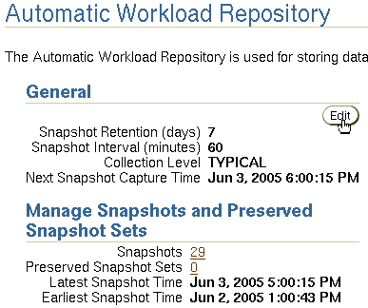
Enterprise Manager and AWR
Notes:
Enterprise Manager and AWR
Select Administration > Database Administration > Statistics Management > Automatic Workload Repository, and click Edit to change the settings.
From the Automatic Workload Repository page, you can:
Edit the workload repository settings
Look at the detailed information about created snapshots and manually create new ones
Create baselines, also called Preserved Snapshot Set
Generate an AWR report

Slide 23
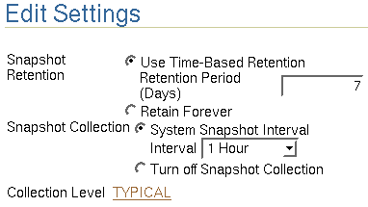
Managing the AWR
  Retention period:
    The default is 7 days.
    Consider storage needs.
  Collection interval:
    The default is
    60 minutes.
    Consider storage needs and performance impact.
  Collection level:
    Basic (disables most of ADDM functionality)
    Typical (recommended)
    All (adds additional SQL tuning information to snapshots)
Notes:
Managing the AWR
AWR settings include retention period, collection interval, and collection level. Remember that decreasing any of these settings impacts the functionality of components that depend on the AWR, including the advisors.
Increasing the settings can provide improved advisor recommendations, but at the cost of the space required to store the snapshots and the performance expended in collecting the snapshot information.
Consider setting collection level to ALL when tuning a new application. The ALL setting collects SQL execution plans and timing statistics that enhance the recommendations of the SQL advisors. When tuning is complete, this setting should be returned to the TYPICAL setting.

Slide 24

Automatic Database Diagnostic Monitor (ADDM)
Baseline
Alert
AWR
> ADDM
Advisors
AutoTasks
  Runs after each AWR snapshot
  Monitors the instance; detects bottlenecks
  Stores results within the AWR
Snapshots
EM
ADDM
ADDM results
AWR
Notes:
Automatic Database Diagnostic Monitor (ADDM)
Unlike the other advisors, the ADDM runs automatically after each AWR snapshot. Each time a snapshot is taken, the ADDM performs an analysis of the period corresponding to the last two snapshots. The ADDM proactively monitors the instance and detects most bottlenecks before they become a significant problem.
In many cases, the ADDM recommends solutions for detected problems and even quantifies the benefits for the recommendations.
Some common problems that are detected by the ADDM include:
CPU bottlenecks
Poor Oracle Net connection management
Lock contention
Input/output (I/O) capacity
Undersizing of Oracle memory structures
High-load SQL statements
High PL/SQL and Java time
High checkpoint load and cause (for example, small log files)
The results of each ADDM analysis are stored inside the AWR and are also accessible through Enterprise Manager.

Slide 25
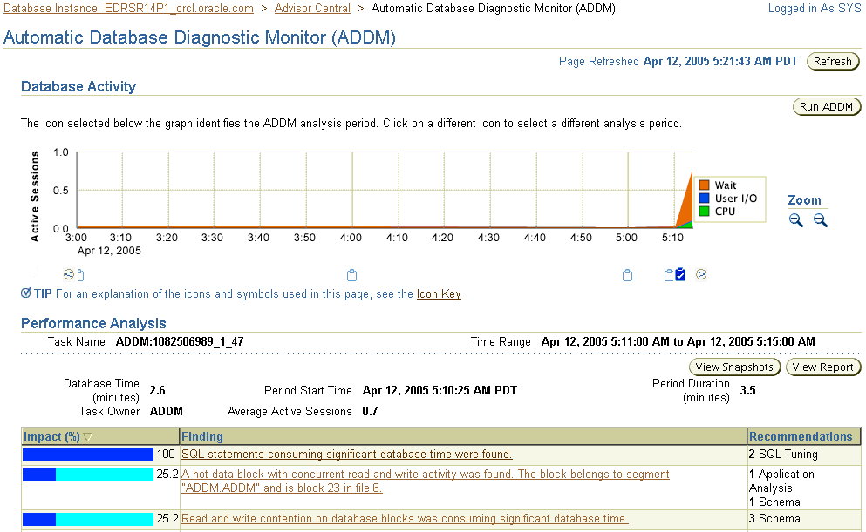
ADDM Findings
1
2
3
Notes:
ADDM Findings
On the Automatic Database Diagnostic Monitor (ADDM) page, you can see the detailed findings for the latest ADDM run. Database Time represents the sum of the nonidle time spent by sessions in the database for the analysis period. A specific Impact percentage is given for each finding. The impact represents the time consumed by the corresponding issue as compared with the database time for the analysis period. In this slide, you see the following:
1. The graphic shows that the number of average active users increased dramatically at this point. Also the major problem was a Wait problem.
2. The icon shows that the ADDM output displayed at the bottom of the page corresponds to this point in time. You can go into the past (to view previous analysis) by clicking the other icons.
3. The findings give you a short summary of what ADDM has found as tunable areas. By clicking a particular issue, you are directed to the Performance Finding Details page.
You can click the View Report button to get details about the performance analysis in the form of a text report.

Slide 26
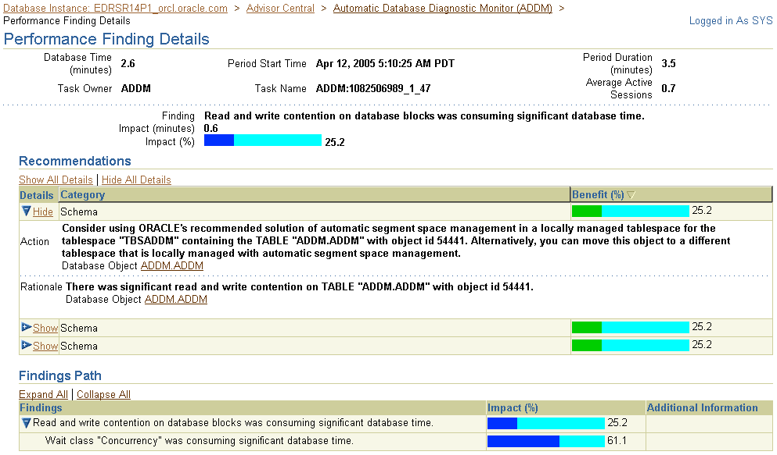
ADDM Recommendations
Notes:
ADDM Recommendations
On the Performance Finding Details page, you are given some recommendations to solve the corresponding issue. Recommendations are grouped into Schema, SQL Tuning, Database Configuration, and many other categories. The Benefit (%) column gives you the maximum reduction in database elapsed time, if the recommendation is implemented.
ADDM considers a variety of changes to a system, and its recommendations can include:
Hardware changes: Adding CPUs or changing the I/O subsystem configuration
Database configuration: Changing initialization parameter settings
Schema changes: Hash-partitioning a table or index, or using Automatic Segment Space Management (ASSM)
Application changes: Using the cache option for sequences or using bind variables
Using other advisors: Running the SQL Tuning Advisor on high-load SQL or running the Segment Advisor on hot objects

Slide 27

Advisory Framework
Baseline
Alert
AWR
ADDM
> Advisors
AutoTasks
SQL Tuning Advisor
PGA
PGA Advisor
Buffer Cache
Advisor
Memory
ADDM
SGA
SQL Access Advisor
Library Cache
Advisor
Segment Advisor
Space
Undo Advisor
Backup
MTTR Advisor
Notes:
Advisory Framework
Advisors are server components that provide you with useful feedback about resource utilization and performance for their respective components.
By building upon the data captured in the AWR, the ADDM enables the Oracle database to diagnose its own performance and determine how identified problems can be resolved. ADDM runs automatically after each AWR statistics capture. It can potentially call other advisors.
Here are the major benefits that are provided by the advisor infrastructure:
It uses a uniform interface for all advisors.
All advisors have a common data source and results storage by using the workload repository.

Slide 28
Advisors
Full Notes Page
Notes:
Advisory Framework (continued)
Automatic Database Diagnostic Monitor (ADDM)
It is a server-based expert that reviews database performance every 60 minutes. ADDM’s goal is to detect possible system bottlenecks early and recommend fixes before system performance degrades noticeably.
Memory Advisors
The Memory Advisor is actually a collection of several advisory functions that help determine the best settings for the shared pool, database buffer cache, and Program Global Area (PGA). In addition to the advisory functions, this page provides a central point of control for the large pool and the Java pool.
Mean-Time-To-Recover (MTTR) Advisor
Using the MTTR Advisor, you can set the length of time required for the database to recover after an instance crash.
Segment Advisor
This advisor looks for tables and indexes that consume more space than they require. The advisor checks for inefficient space consumption at the tablespace or schema level and produces scripts to reduce space consumption where possible.
SQL Access Advisor
This advisor analyzes all SQL statements that are issued within a given period and suggests the creation of additional indexes or materialized views that will improve performance.
SQL Tuning Advisor
This advisor analyzes an individual SQL statement and makes recommendations for improving its performance. Recommendations may include actions such as rewriting the statement, changing the instance configuration, or adding indexes. The SQL Tuning Advisor is not invoked directly. Instead, it is called from within other tools, such as Top SQL or Top Sessions, to help optimize high-impact SQL statements.
Undo Management Advisor
With the Undo Management Advisor, you can determine the undo tablespace size that is required to support a given retention period. Undo management and the use of the advisor is covered in the lesson titled “Managing Undo Data.”

Slide 29


SQL Tuning and Access Advisors
How can I make it run faster?
DBA
Poorly performing
SQL statement
Restructured
SQL statement
Add indexes or materialized views.
Rewrite the SQL statement.
Correct setup flaws.
SQL Tuning
Advisor
Notes:
SQL Tuning and Access Advisors
The goal of SQL analysis is to enable you to identify high-impact SQL statements and make suggestions about how to improve their performance.
SQL statement performance can be improved by adding or changing indexing, by providing staged aggregate data as materialized views, by rewriting the SQL to be more efficient, and by correcting setup flaws (such as improper initialization parameters).
Manually analyzing and tuning SQL statements is a time-consuming process that requires substantial expertise. The SQL tuning and access wizards:
Make it easier to find high-impact SQL statements
Recognize common errors in SQL statement construction
Recommend places where indexes or materialized views can help, and inform the DBA of the cost of adding those objects

Slide 30
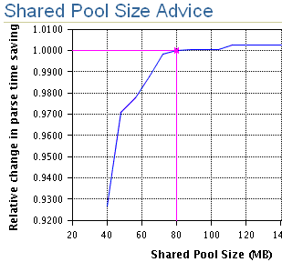
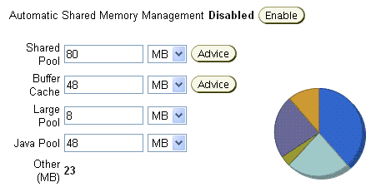
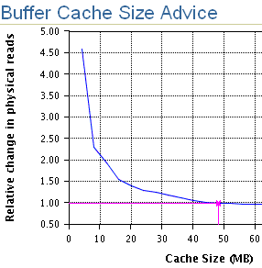
Memory Advisors
  Shared pool
  Database buffer cache
  Program Global Area (PGA)
  Tip: Enable ASMM.
Notes:
Memory Advisors
Sizing the SGA too small severely degrades performance, but it is often difficult to know how much memory is enough. Conversely, by consuming valuable memory resources needlessly and sizing the SGA too large can degrade system performance just as much as sizing it too small.
The memory advisors enable you to find and set your SGA components to the most efficient sizes. Each of the advisors presents you with a graph that shows the benefit of increased memory contrasted with the amount of memory required to achieve that benefit. You must try to size the different cache areas somewhere near the “knee” of the curve (the point at which performance gains either level out or provide minimal performance improvement for the cost of the memory allocation).
Remember to balance the SGA and PGA needs with the overall system memory requirements.
Tip: Let the Oracle instance do the work. Simply specify the total amount of SGA memory available to an instance with the SGA_TARGET parameter. When Automatic Shared Memory Management (ASMM) is enabled, the Oracle database automatically distributes the available memory among various components as required.

Slide 31
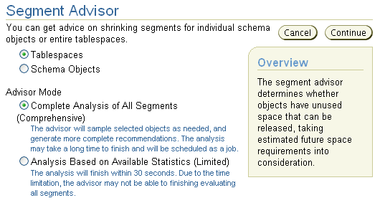
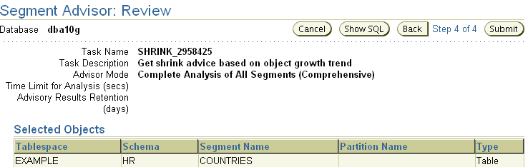
Segment Advisor
  Entire
  tablespace
  Individual
  schema
  objects
Notes:
Segment Advisor
When rows are deleted from a table or when data within a row is updated to a value that consumes less space than the original, the space allocated to that row is returned to the table for future use.
Over time, this results in more space allocated to tables than needed. The Segment Advisor looks for tables or indexes with excess free space and suggests ways to return that space to the rest of the database.
The Segment Advisor can be run by using existing optimizer statistics (limited mode), or it can actually scan the tables and indexes (comprehensive mode) to make the best recommendations. The scope of the analysis can be narrowed to individual tables and indexes or can cover an entire tablespace.
Segment Advisor recommendations usually require that table properties enable row movement. This can be done through Enterprise Manager or by using the following SQL command:
SQL> ALTER TABLE owner.table_name ENABLE ROW MOVEMENT;

Slide 32
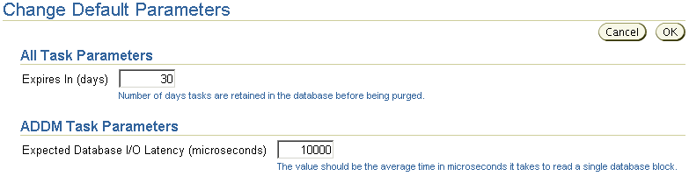
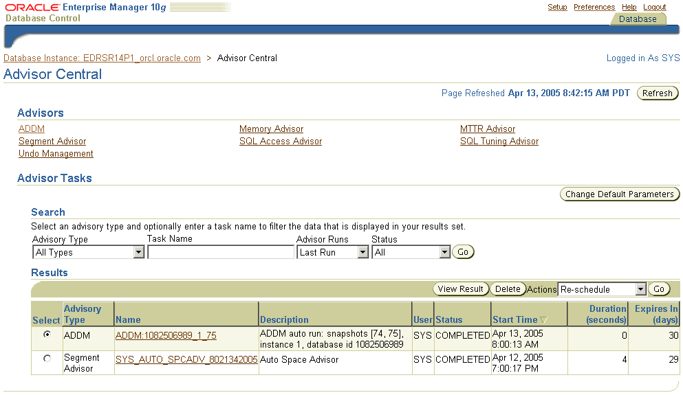
Enterprise Manager and Advisors
Notes:
Enterprise Manager and Advisors
The Advisor Central page is the main page of all advisors. You can reach this page by clicking the Advisor Central link in the list of Related Links of the Database Control Home page. However, this is not the only place in Database Control where advisors can be invoked. It is also possible to have access to advisors in certain contexts.
On the Advisor Central page, you can list all the advisor tasks that are registered in the workload repository. You can also filter this list by advisor type and for predefined time periods.
Some advisors are described in greater detail in the relevant lessons of this course.
Note: Use the Change Default Parameters page to change the default expiration in days for all future tasks. You can also use this page to change some important advisor’s parameters.

Slide 33
The DBMS_ADVISOR Package
Procedure | Description
CREATE_TASK | Creates a new task in the repository
DELETE_TASK | Deletes a task from the repository
EXECUTE_TASK | Initiates execution of the task
INTERRUPT_TASK | Suspends a task that is currently executing
GET_TASK_REPORT | Creates and returns a text report for the specified task
RESUME_TASK | Causes a suspended task to resume
UPDATE_TASK_ATTRIBUTES | Updates task attributes
SET_TASK_PARAMETER | Modifies a task parameter
MARK_RECOMMENDATION | Marks one or more recommendations as accepted, rejected, or ignored
GET_TASK_SCRIPT | Creates a script of all the recommendations that are accepted
Notes:
The DBMS_ADVISOR Package
The DBMS_ADVISOR package contains all constants and procedure declarations for all advisor modules. You can use this package to execute tasks via command line.
To execute advisor procedures, you must be granted the ADVISOR privilege. The ADVISOR privilege permits full access to the advisor procedures and views.
Note: For more information about all the procedures found in the DBMS_ADVISOR package, see the Oracle Database PL/SQL Packages and Types Reference guide.

Slide 34

Automated Maintenance Tasks
  Baseline
  Alert
  AWR
  ADDM
  Advisors
> AutoTasks
  Scheduler initiates jobs.
  Jobs run in default maintenance window.
  Limit maintenance impact on normal operation by using Resource Manager.
Maintenance examples:
  Gathering optimizer statistics
  Gathering segment information
  Backing up database
Notes:
Automated Maintenance Tasks
By analyzing the information stored in the AWR, the database can identify the need to perform routine maintenance tasks, such as optimizer statistics refresh. The automated maintenance tasks infrastructure enables the Oracle database to automatically perform such operations. It uses the Scheduler to run such tasks in a predefined “maintenance window.”
By default, the maintenance window starts at 10 p.m. every night and lasts until 6 a.m. next morning and throughout the weekend. All attributes of the maintenance window are customizable, including start and end time, frequency, days of the week, and so on. Also, the impact of automated maintenance tasks on normal database operations can be limited by associating a Database Resource Manager resource plan to the maintenance window.
The maintenance examples are as follows:
Optimizer statistics are automatically refreshed by using the automatic maintenance task infrastructure.
The Segment Advisor has default jobs, which run in the maintenance window.
When creating a database with the DBCA, you can initiate regular database backups.

Slide 35
Proactive Maintenance
  A review of major elements working together:
Automatic
Automated
tasks
Proactive
Server
alerts
Advisory
framework
Automatic
Workload Repository
Efficient
Notes:
Proactive Maintenance
In this lesson you saw how the four major elements (listed in the slide) are working together. Tasks or “jobs” are automated with the Scheduler. For more on the Scheduler, see the lesson titled “Moving Data”.

Slide 36
Summary
In this lesson, you should have learned how to:
  Set warning and critical alert thresholds
  Use server-generated alerts
  Collect and use baseline metrics
  Manage the Automatic Workload Repository (AWR)
  Use the Automatic Database Diagnostic Monitor
  Describe the advisory framework

Slide 37
Practice Overview:
Proactive Maintenance
This practice covers configuring your database for proactive maintenance by:
  Configuring an alert and testing it
  Enabling metric baselines
  Creating a static metric baseline to compute statistics
  Deleting the baseline

