Slide 1
Database Maintenance

Slide 2
Objectives
After completing this lesson, you should be able to:
Manage optimizer statistics
Manage the Automatic Workload Repository (AWR)
Use the Automatic Database Diagnostic Monitor (ADDM)
Use advisors and checkers
Set alert thresholds
Use server-generated alerts
Use automated tasks

Slide 3
Database Maintenance
Automatic
Automated tasks
Proactive
Reactive
Advisory framework
Server alerts
Critical errors
Automatic Workload Repository
Automatic Diagnostic Repository
Efficient
Data warehouse of the database
Automatic collection of important statistics
Direct memory access
Notes:
Database Maintenance
Proactive database maintenance is made easy by the sophisticated infrastructure of the Oracle database, including the following main elements:
The Automatic Workload Repository (AWR) is a built-in repository in each Oracle database. At regular intervals, the Oracle database makes a snapshot of all its vital statistics and workload information and stores this data in the AWR. The captured data can be analyzed by you, by the database itself, or by both.
Using automated tasks, the database performs routine maintenance operations such as regular backups, refreshing optimizer statistics, and database health checks.
Reactive database maintenance includes critical errors and conditions discovered by database health checkers:
For problems that cannot be resolved automatically and require administrators to be notified (such as running out of space), the Oracle database provides server-generated alerts. The Oracle database by default monitors itself and sends out alerts to notify you of problems. The alerts notify you and often also provide recommendations on how to resolve reported problem.
Recommendations are generated from a number of advisors, each of which is responsible for a subsystem. For example, there are memory, segment, and SQL advisors.

Slide 4

Terminology
Automatic Workload Repository (AWR): Infrastructure for data gathering, analysis, and solutions recommendations
Baseline: A set of AWR snapshots for performance comparison
Metric: Rate of change in a cumulative statistic
Statistics: Data collections used for performance monitoring or SQL optimization
Threshold: A boundary value against which metric values are compared
Notes:
Terminology
The Automatic Workload Repository (AWR) provides services to internal Oracle server components to collect, process, maintain, and use performance statistics for problem detection and self-tuning purposes. Active Session History (ASH) is the history of recent session activity stored in the AWR.
Statistics are collections of data that provide more details about the database and the objects in it. Optimizer statistics are used by the query optimizer to choose the best execution plan for each SQL statement. Database statistics provide information for performance monitoring.
AWR snapshots include database statistics and metrics, application statistics (transaction volumes, response time), operating system statistics, and other measures. A baseline is a set of AWR snapshots collected over a period of time. The baseline is used for performance comparison, either current performance versus the baseline or one baseline compared to another.
The System Moving Window baseline is collected by default in Oracle Database 11g. The System Moving Window baseline is a changing set of snapshots that include the last eight days of snapshots by default. This baseline becomes valid after sufficient data has been collected and the statistics calculation occurs. The statistics calculation is scheduled for every Saturday at midnight by default.

Slide 5
Oracle Optimizer: Overview
The Oracle optimizer determines the most efficient execution plan and is the most important step in the processing of any SQL statement.
The optimizer:
Evaluates expressions and conditions
Uses object and system statistics
Decides how to access the data
Decides how to join tables
Determines the most efficient path
Notes:
Oracle Optimizer: Overview
The optimizer is the part of the Oracle database that creates the execution plan for a SQL statement. The determination of the execution plan is an important step in the processing of any SQL statement and can greatly affect execution time.
The execution plan is a series of operations that are performed in sequence to execute the statement. The optimizer considers many factors related to the referenced objects and the conditions specified in the query. The information necessary to the optimizer includes:
Statistics gathered for the system (I/O, CPU, and so on) as well as schema objects (number of rows, index, and so on)
Information in the dictionary
WHERE clause qualifiers
Hints supplied by the developer
When you use diagnostic tools such as Enterprise Manager, EXPLAIN PLAN, and SQL*Plus AUTOTRACE, you can see the execution plan that the optimizer chooses.
Note: The Oracle optimizer has two names based on its functionality: the query optimizer and the Automatic Tuning Optimizer.

Slide 6
Optimizer Statistics
Optimizer statistics are:
A snapshot at a point in time
Persistent across instance restarts
Collected automatically
SQL> SELECT COUNT(*) FROM hr.employees;
COUNT(*)
----------
214
SQL> SELECT num_rows FROM dba_tables
2 WHERE owner='HR' AND table_name = 'EMPLOYEES';
NUM_ROWS
----------
107
Notes:
Optimizer Statistics
Optimizer statistics include table, column, index, and system statistics. Statistics for tables and indexes are stored in the data dictionary. These statistics are not intended to provide real-time data. They provide the optimizer a statistically correct snapshot of data storage and distribution, which the optimizer uses to make decisions on how to access data.
The statistics that are collected include:
Size of the table or index in database blocks
Number of rows
Average row size and chain count (tables only)
Height and number of deleted leaf rows (indexes only)
As data is inserted, deleted, and modified, these facts change. Because the performance impact of maintaining real-time data distribution statistics is prohibitive, these statistics are updated by periodically gathering statistics on tables and indexes.
Optimizer statistics are collected automatically by an automatic maintenance job that runs during predefined maintenance windows once daily by default. System statistics are operating system characteristics that are used by the optimizer. These statistics are not collected automatically. For details about collecting system statistics, see the Oracle Database Performance Tuning Guide.
Optimizer statistics are not the same as the database performance statistics that are gathered in the AWR snapshot.

Slide 7

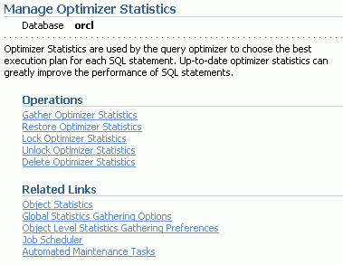
Using the Manage Optimizer Statistics Page
Notes:
Using the Manage Optimizer Statistics Page
To manage optimizer statistics in Enterprise Manager, click the Server tab and then click Manage Optimizer Statistics under the Query Optimizer section. From this page, you can perform the following tasks on statistics:
Gather optimizer statistics manually.
Restore optimizer statistics to a point in the past. The chosen point in time must be within the optimizer statistics retention period, which defaults to 30 days.
Lock optimizer statistics to guarantee that the statistics for certain objects are never overwritten. This is useful if statistics have been calculated for a certain table at a time when well-representative data is present, and you want to always have those statistics. No fluctuations in the table affect the statistics if they are locked.
Unlock optimizer statistics to undo the previously done lock.
Delete optimizer statistics to delete statistics.
Best Practice Tip
Use the automatic maintenance tasks to gather optimizer statistics. To enable the task for gathering optimizer statistics gathering, you must ensure that the STATISTICS_LEVEL initialization parameter is set to TYPICAL or ALL.

Slide 8
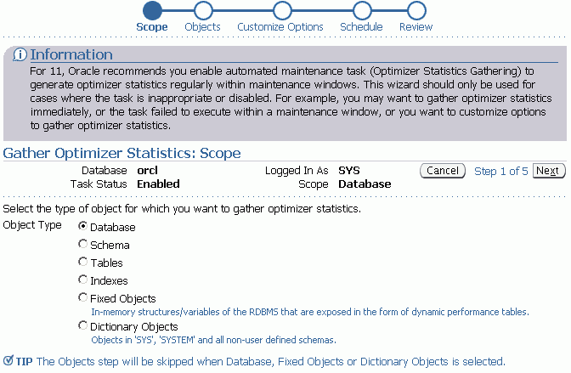
Gathering Optimizer Statistics Manually
Notes:
Gathering Optimizer Statistics Manually
You may need to gather statistics manually at certain times, such as when the contents of a table have changed so much between automatic gathering jobs that the statistics no longer represent the table accurately. This is common for large tables that experience more than a 10 percent change in size in a 24-hour period.
Best practice tip: Collect statistics often enough that the table never changes by more than about 10 percent between collection periods. This may require manual statistics collection or additional maintenance windows.
Statistics can be manually collected by using either Enterprise Manager or the DBMS_STATS package. System statistics can be gathered only by using the DBMS_STATS package.
The Gather Optimizer Statistics menu selection starts a wizard that allows you to select the scope, objects, options, and schedule for a job that will gather optimizer statistics. The wizard submits a DBMS_STATS.GATHER_*_STATS job at the scope you specify: table, schema, or database. In this wizard, you set the preferences for the default values used by the DBMS_STATS package and you schedule this job to run at a time that you determine.
Gathering statistics manually is not recommended because the statistics are gathered more efficiently and with less impact on users during the maintenance windows.
A manual job can also be submitted if the automatic job has failed or been disabled.

Slide 9
Gathering Optimizer Statistics Manually Full Notes Page
Notes:
Gathering Optimizer Statistics Manually (continued)
You can also gather optimizer statistics with the DBMS_STATS package directly:
SQL> EXEC dbms_stats.gather_table_stats('HR','EMPLOYEES');
SQL> SELECT num_rows FROM dba_tables
2 WHERE owner='HR' AND table_name = 'EMPLOYEES';
NUM_ROWS
----------
214
Notice that the number of rows now correctly reflects what was in the table at the time that the statistics were gathered. DBMS_STATS also enables manual collection of statistics for an entire schema or even for the whole database.
System statistics do not change unless the workload significantly changes. As a result, system statistics do not need frequent adjustment. The DBMS_STATS.GATHER_SYSTEM_STATS procedure will collect system statistics over a specified period, or you can start the gathering of system statistics and make another call to stop gathering.
Best practice tip: Use the following command when you create a database:
SQL> EXEC dbms_stats.gather_system_stats('NOWORKLOAD');
The NOWORKLOAD option takes a few minutes (depending on the size of the database) and captures estimates of I/O characteristics such as average read seek time and I/O transfer rate.

Slide 10



Statistic Levels
STATISTICS_LEVEL
BASIC
TYPICAL
ALL
Self-tuning capabilities disabled
Recommended default value
Additional statistics for manual SQL diagnostics
Notes:
Statistic Levels
The STATISTICS_LEVEL initialization parameter controls the capture of a variety of statistics and various advisors, including the automatic maintenance tasks. The automatic maintenance tasks include gathering optimizer statistics. The STATISTICS_LEVEL parameter can be set to the following levels:
BASIC: The computation of AWR statistics and metrics is turned off. The automatic optimizer statistics task is disabled, as are all advisors and server-generated alerts.
TYPICAL: Major statistics are collected that are required for database self-management. They represent what is typically needed to monitor Oracle database behavior. This includes automatic gathering of statistics to reduce the likelihood of poorly performing SQL statements due to stale or invalid statistics.
ALL: All possible statistics are captured. This level of capture adds timed OS statistics and plan execution statistics. These statistics are not needed in most cases and should not be enabled for best performance; they are sometimes needed for specific diagnostics tests.
Oracle recommends that the default value of TYPICAL be set for the STATISTICS_LEVEL initialization parameter. Setting the value to BASIC disables the automatic gathering of optimizer statistics.

Slide 11


Preferences for Gathering Statistics
SCOPE
PREFERENCES
STATEMENT LEVEL
TABLE LEVEL
CASCADE
DEGREE
ESTIMATE_PERCENT
NO_INVALIDATE
METHOD_OPT
GRANULARITY
INCREMENTAL
PUBLISH
STALE_PERCENT
Optimizer statistics gathering task
SCHEMA LEVEL
DATABASE LEVEL
GLOBAL LEVEL
DBA
DBMS_STATS
set | get | delete | export | import
exec dbms_stats.set_table_prefs('SH','SALES','STALE_PERCENT','13');
Notes:
Preferences for Gathering Statistics
The DBMS_STATS.GATHER_*_STATS procedures can be called at various levels to gather statistics for an entire database or for individual objects such as tables. When the GATHER_*_STATS procedures are called, several of the parameters are often allowed to default. The supplied defaults work well for most of the objects in the database, but for some objects or schemas the defaults need to be changed. Instead of running manual jobs for each of these objects, Oracle Database 11g allows you to set values (called preferences) for individual objects, schemas, or databases, or to change the default values with the global-level command.
The preferences specify the parameters that are given to the gather procedures. The SET_*_PREFS procedures create preference values for any object that is not owned by SYS or SYSTEM. The expected use is that the DBA will set the global preferences for any parameters that should be database-wide. These will be applied for any parameter that is allowed to default.
The SET_DATATBASE_PREFS procedure iterates over all the tables and schemas in the database setting the specified preference. SET_SCHEMA_PREFS iterates over the tables in the specified schema. SET_TABLE_PREFS sets the preference value for a single table.
All object preferences—whether set at the database, schema, or table level—are held in a single table. Changing the preferences at the schema level overwrites the preferences that were previously set at the table level.

Slide 12
Notes Only
Notes:
Preferences for Gathering Statistics (continued)
When the various gather procedures execute, they retrieve the object-level preferences that were set for each object. You can view the object-level preferences in the DBA_TAB_STAT_PREFS view. Any preferences that are not set at the object level will be set to the global-level preferences. You can see the global preferences by calling the DBMS_STATS.GET_PREFS procedure for each preference.
You can set, get, delete, export, and import those preferences at the table, schema, database, and global levels. The preference values are expected to be set from global to table levels, applying the preferences to the smallest group last.
Preferences in Oracle Database 11g:
CASCADE determines whether index statistics are collected as part of gathering table statistics.
DEGREE sets the degree of parallelism that is used for gathering statistics.
PUBLISH is used to decide whether to publish the statistics to the dictionary or store them in a private area. This enables the DBA to validate the statistics before publishing them to the data dictionary with the PUBLISH_PENDING_STATS procedure.
STALE_PERCENT is used to determine the threshold level at which an object is considered to have stale statistics. The value is a percentage of the rows modified since the last statistics gathering. The example changes the 10 percent default to 13 percent for SH.SALES only.
INCREMENTAL is used to gather global statistics on partitioned tables in an incremental way.
METHOD_OPT determines the columns and histogram parameters that are used to gather column statistics.
GRANULARITY determines the granularity of statistics to collect (which is pertinent only if the table is partitioned).
NO_INVALIDATE is used to determine whether to invalidate cursors.
ESTIMATE_PERCENT is used to determine the number of rows to sample to obtain good statistics. It is a percentage of the number of rows in the table.
Note: For details about these preferences, see the DBMS_STATS documentation in the Oracle Database PL/SQL Packages and Types Reference.
Preferences may be deleted with the DBMS_STATS.DELETE_*_PREFS procedures at the table, schema, and database levels. You can reset the global preferences to the recommended values with the DBMS_STATS.RESET_PARAM_DEFAULTS procedure.

Slide 13
Automatic Workload Repository (AWR)
Built-in repository of performance information
Snapshots of database metrics taken every 60 minutes and retained for eight days
Foundation for all self-management functions
In-memory statistics
60 minutes
MMON
Snapshots
SGA
AWR
Notes:
Automatic Workload Repository (AWR)
The AWR is the infrastructure that provides services to Oracle Database 11g components to collect, maintain, and utilize statistics for problem detection and self-tuning purposes. You can view it as a data warehouse for database statistics, metrics, and so on.
Every 60 minutes (by default) the database automatically captures statistical information from the SGA and stores it in the AWR in the form of snapshots. These snapshots are stored on the disk by a background process called Manageability Monitor (MMON). By default, snapshots are retained for eight days. You can modify both the snapshot interval and the retention intervals.
The AWR contains hundreds of tables, all belonging to the SYSMAN schema and stored in the SYSAUX tablespace. The Oracle database does not support direct SQL access to the repository. Instead, use Enterprise Manager or the DBMS_WORKLOAD_REPOSITORY package to work with the AWR.

Slide 14
AWR Infrastructure
External clients
EM
SQL*Plus
…
SGA
Efficient in-memory statistics collection
V$
DBA_*
AWR snapshots
MMON
ADDM
Self-tuning component
…
Self-tuning component
Internal clients
Notes:
AWR Infrastructure
The AWR infrastructure has two major parts:
An in-memory statistics collection facility that is used by Oracle Database 11g components to collect statistics. These statistics are stored in memory for performance reasons. Statistics stored in memory are accessible through dynamic performance (V$) views.
The AWR snapshots that represent the persistent portion of the facility. AWR snapshots are accessible through data dictionary views and Enterprise Manager Database Control.
Statistics are stored in persistent storage for several reasons:
The statistics need to survive instance crashes.
Some analyses need historical data for baseline comparisons.
A memory overflow can occur. When old statistics are replaced by new ones because of memory shortage, the replaced data can be stored for later use.
The memory version of the statistics is transferred to disk on a regular basis by the MMON background process. With the AWR, the Oracle database provides a way to capture historical statistics data automatically without DBA intervention.

Slide 15

Baselines
Relevant period in the past
DBMS_WORKLOAD_REPOSITORY.CREATE_BASELINE ( -
start_snap_id IN NUMBER,
end_snap_id IN NUMBER,
baseline_name IN VARCHAR2);
Notes:
Baselines
A baseline is an AWR snapshot set that you have tagged for important periods. A snapshot set is defined on a pair of snapshots; the snapshots are identified by their snapshot sequence numbers (snap_id). Each snapshot set corresponds to one and only one pair of snapshots.
A snapshot set can be identified by either a user-supplied name or a system-generated identifier. You create a snapshot set by executing the DBMS_WORKLOAD_REPOSITORY.CREATE_BASELINE procedure and specifying a name and a pair of snapshot identifiers. A snapshot set identifier is assigned to the newly created snapshot set. Snapshot set identifiers are unique for the life of a database.
Snapshot sets are used to retain snapshot data. Snapshots belonging to snapshot sets are retained until the snapshot sets are dropped.
You set up snapshot sets, usually from some representative periods in the past, to be used for comparisons with current system behavior. You can also set up threshold-based alerts by using snapshot sets from Enterprise Manager Database Control.
You can get snap_ids directly from DBA_HIST_SNAPSHOT or Database Control.
Note: For more information about the DBMS_WORKLOAD_REPOSITORY package, see the Oracle Database PL/SQL Packages and Types Reference.

Slide 16

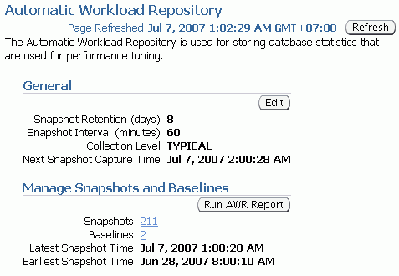
Enterprise Manager and the AWR
Notes:
Enterprise Manager and the AWR
Click the Server tab, and then click Automatic Workload Repository in the Statistics Management section. On the Automatic Workload Repository page, click Edit to change the settings.
From the Automatic Workload Repository page, you can:
Edit the workload repository settings
Look at the detailed information about created snapshots and manually create new ones
Create AWR baselines.
Generate an AWR report

Slide 17
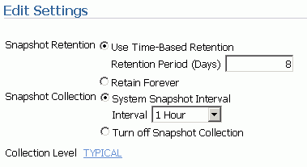
Managing the AWR
Retention period
Default: Eight days
Consider storage needs
Collection interval
Default: 60 minutes
Consider storage needs and performance impact
Collection level
Basic (disables most ADDM functionality)
Typical (recommended)
All (adds additional SQL tuning information to snapshots)
Notes:
Managing the AWR
AWR settings include retention period, collection interval, and collection level. Remember that decreasing any of these settings affects the functionality of components that depend on the AWR, including the advisors.
Increasing the settings can provide improved advisor recommendations—but at the cost of the space that is required to store the snapshots and the performance expended in collecting the snapshot information.
Consider setting collection level to ALL when tuning a new application. The ALL setting collects SQL execution plans and timing statistics that enhance the recommendations of the SQL advisors. When tuning is complete, this setting should be returned to the TYPICAL setting.

Slide 18
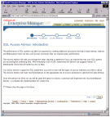


Automatic Database Diagnostic Monitor (ADDM)
Runs after each AWR snapshot
Monitors the instance; detects bottlenecks
Stores results in the AWR
Snapshots
EM
ADDM
ADDM results
AWR
Notes:
Automatic Database Diagnostic Monitor (ADDM)
Unlike the other advisors, the ADDM runs automatically after each AWR snapshot. Each time a snapshot is taken, the ADDM performs an analysis of the period corresponding to the last two snapshots. The ADDM proactively monitors the instance and detects most bottlenecks before they become a significant problem.
In many cases, the ADDM recommends solutions for detected problems and even quantifies the benefits for the recommendations.
Some common problems that are detected by the ADDM:
CPU bottlenecks
Poor Oracle Net connection management
Lock contention
Input/output (I/O) capacity
Undersizing of database instance memory structures
High-load SQL statements
High PL/SQL and Java time
High checkpoint load and cause (for example, small log files)
The results of each ADDM analysis are stored in the AWR and are also accessible through Enterprise Manager.

Slide 19
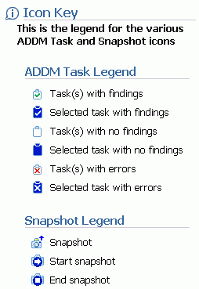
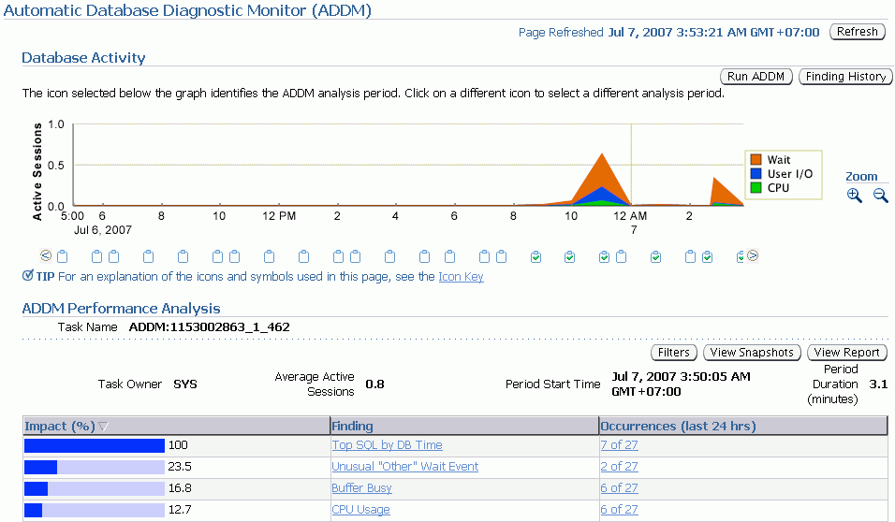
ADDM Findings
1
2
3
Notes:
ADDM Findings
On the Automatic Database Diagnostic Monitor (ADDM) page, you see the detailed findings for the latest ADDM run. Database Time represents the sum of the nonidle time spent by sessions in the database for the analysis period. A specific impact percentage is given for each finding. The impact represents the time consumed by the corresponding issue compared with the database time for the analysis period.
In the slide, note the following:
1. The graphic shows that the number of average active users increased dramatically at this point. In addition, the major problem was a Wait problem.
2. The icon shows that the ADDM output displayed at the bottom of the page corresponds to this point in time. You can go into the past (to view previous analyses) by clicking the other icons.
3. The findings give you a short summary of what the ADDM found as tunable areas. By clicking a particular issue, you are directed to the Performance Finding Details page.
Click the View Report button to get details about the performance analysis in the form of a text report.

Slide 20
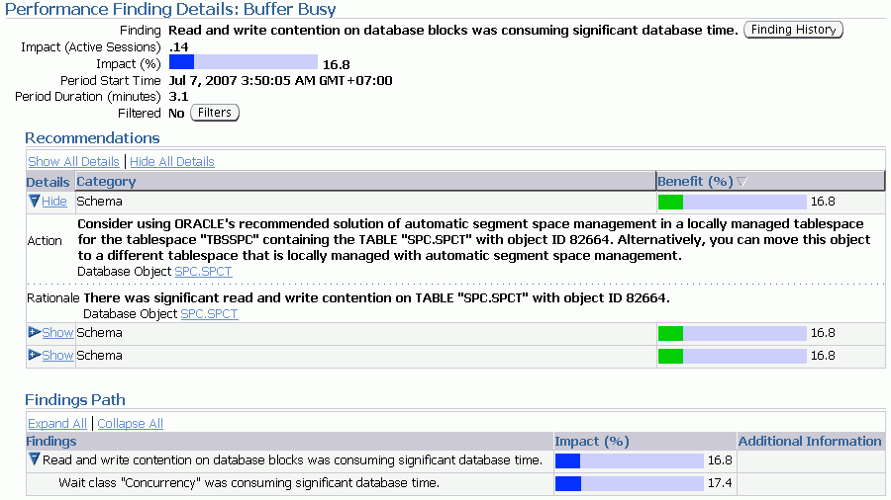
ADDM Recommendations
Notes:
ADDM Recommendations
On the Performance Finding Details page, you are given recommendations for solving the corresponding issue. Recommendations are grouped into Schema, SQL Tuning, Database Configuration, and many other categories. The Benefit(%)column gives you the maximum reduction in database elapsed time if the recommendation is implemented.
The ADDM considers a variety of changes to a system. Its recommendations can include:
Hardware changes: Adding CPUs or changing the I/O subsystem configuration
Database configuration: Changing initialization parameter settings
Schema changes: Hash-partitioning a table or index, or using Automatic Segment Space Management (ASSM)
Application changes: Using the cache option for sequences, or using bind variables
Using other advisors: Running the SQL Tuning Advisor on high-load SQL, or running the Segment Advisor on hot objects

Slide 21
Advisory Framework
ADDM
SQL Tuning Advisor
Buffer Cache
Advisor
PGA
Advisor
SQL Access Advisor
Shared Pool
Advisor
Memory Advisor
Java Pool
Advisor
SGA
Advisor
Streams Pool
Advisor
Segment Advisor
Space
Undo Advisor
Backup
MTTR Advisor
Notes:
Advisory Framework
Advisors provide you with useful feedback about resource utilization and performance for their respective server components. For example, the Memory Advisor provides a recommended value for the MEMORY_TARGET initialization parameter, which controls the total amount of memory used by the Oracle database instance.
By building on the data captured in the AWR, the ADDM enables the Oracle database to diagnose its own performance and determine how identified problems can be resolved. ADDM runs automatically after each AWR statistics capture. It can potentially call other advisors.
Here are the major benefits that are provided by the advisor infrastructure:
All advisors use a uniform interface.
All advisors have a common data source and results storage by using the workload repository.
Not all advisors are shown in the slide (for example, the Data Recovery Advisor and the SQL Repair Advisor are not listed).

Slide 22
Advisors Full Notes Page
Notes:
Advisory Framework (continued)
Automatic Database Diagnostic Monitor (ADDM)
The ADDM is a server-based expert that reviews database performance every 60 minutes. Its goal is to detect possible system bottlenecks early and recommend fixes before system performance degrades noticeably.
Memory Advisors
The Memory Advisor is actually a collection of several advisory functions that help determine the best settings for the total memory used by the database instance. The System Global Area (SGA) has a set of advisors for the shared pool, database buffer cache, Java pool, and streams pool. The Java pool and streams pool advisors are not exposed on the EM Memory Advisor page. There is an advisor for the Program Global Area (PGA). In addition to the advisory functions, this page provides a central point of control for the large pool and the Java pool.
Mean-Time-To-Recover (MTTR) Advisor
Using the MTTR Advisor, you set the length of time required for the database to recover after an instance crash.
Segment Advisor
This advisor looks for tables and indexes that consume more space than they require. The advisor checks for inefficient space consumption at the tablespace or schema level and produces scripts to reduce space consumption where possible.
SQL Access Advisor
This advisor analyzes all SQL statements that are issued in a given period and suggests the creation of additional indexes or materialized views that will improve performance.
SQL Tuning Advisor
This advisor analyzes an individual SQL statement and makes recommendations for improving its performance. Recommendations may include actions such as rewriting the statement, changing the instance configuration, or adding indexes. The SQL Tuning Advisor is not invoked directly. Instead, it is called from within other tools (such as Top SQL or Top Sessions) to help optimize high-impact SQL statements.
Undo Management Advisor
With the Undo Management Advisor, you can determine the undo tablespace size that is required to support a given retention period. Undo management and the use of the advisor are covered in the lesson titled “Managing Undo Data.”
Data Recovery Advisor
This advisor automatically diagnoses persistent data failures, presents repair options to the user, and executes repairs at the user’s request. The purpose of the Data Recovery Advisor is to reduce the mean time to recover (MTTR) and provide a centralized tool for automated data repair.
SQL Repair Advisor
You run the SQL Repair Advisor after a SQL statement fails with a critical error that generates a problem in the Automatic Diagnostic Repository. The advisor analyzes the statement and, in many cases, recommends a patch to repair the statement. If you implement the recommendation, the applied SQL patch circumvents the failure by causing the query optimizer to choose an alternative execution plan for future executions. This is done without changing the SQL statement itself.

Slide 23
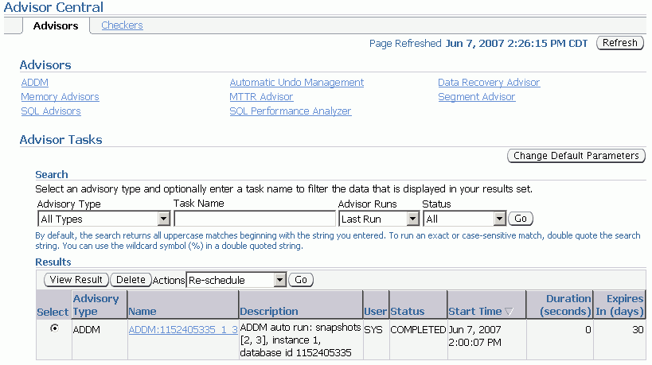
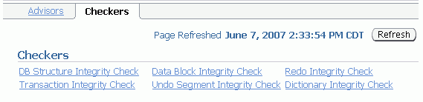
Enterprise Manager and Advisors
Notes:
Enterprise Manager and Advisors
The Advisor Central page is the main page of all advisors. You can reach this page by clicking the Advisor Central link in the list of Related Links on the Database Control Home page. However, this is not the only place in Database Control where advisors can be invoked. It is also possible to have access to advisors in certain contexts.
On the Advisors tab of the Advisor Central page, you can list all the advisor tasks that are registered in the workload repository. You can also filter this list by advisor type and for predefined time periods.
The Checkers tab of the Advisor Central page enables you to schedule various database integrity checkers. You can list all the checker runs by name, type, or time period.
Some advisors are described in greater detail in the lessons titled “Managing Undo Data,” “Performance Management,” and “Backup and Recovery Concepts.”
Note: Use the Change Default Parameters page to change the default expiration (in days) for all future tasks. You can also use this page to change the parameters of some important advisors.

Slide 24
DBMS_ADVISOR Package
Procedure
Description
CREATE_TASK
Creates a new task in the repository
DELETE_TASK
Deletes a task from the repository
EXECUTE_TASK
Initiates execution of the task
INTERRUPT_TASK
Suspends a task that is currently executing
GET_TASK_REPORT
Creates and returns a text report for the specified task
RESUME_TASK
Causes a suspended task to resume
UPDATE_TASK_ATTRIBUTES
Updates task attributes
SET_TASK_PARAMETER
Modifies a task parameter
MARK_RECOMMENDATION
Marks one or more recommendations as accepted, rejected, or ignored
GET_TASK_SCRIPT
Creates a script of all the recommendations that are accepted
Notes:
DBMS_ADVISOR Package
The DBMS_ADVISOR package contains all constants and procedure declarations for all advisor modules. You can use this package to execute tasks from the command line.
To execute advisor procedures, you must be granted the ADVISOR privilege. The ADVISOR privilege permits full access to the advisor procedures and views.
Note: For more information about all the procedures found in the DBMS_ADVISOR package, see the Oracle Database PL/SQL Packages and Types Reference.

Slide 25
Automated Maintenance Tasks
Autotask maintenance process:
Maintenance Window opens.
Autotask background process schedules jobs.
Scheduler initiates jobs.
Resource Manager limits impact of Autotask jobs.
Default Autotask maintenance jobs:
Gathering optimizer statistics
Automatic Segment Advisor
Automatic SQL Advisor
Notes:
Automated Maintenance Tasks
By analyzing the information stored in the AWR, the database can identify the need to perform routine maintenance tasks, such as optimizer statistics refresh. The automated maintenance tasks infrastructure enables the Oracle database to automatically perform such operations. It uses the Scheduler to run such tasks in predefined maintenance windows.
By default, the weekday maintenance windows start at 10:00 PM and lasts 4 hours. On Saturday and Sunday, the maintenance window starts at 6:00 AM and lasts for 20 hours. All attributes of the maintenance windows are customizable, including the start and end time, frequency, days of the week, and so on. In addition, the impact of automated maintenance tasks on normal database operations can be limited by associating a Database Resource Manager resource plan to the maintenance window.
Examples of maintenance:
Optimizer statistics are automatically refreshed by using the automatic maintenance task infrastructure.
The Automatic Segment Advisor has default jobs, which run in the maintenance window.
When creating a database with the DBCA, you can initiate regular database backups.

Slide 26
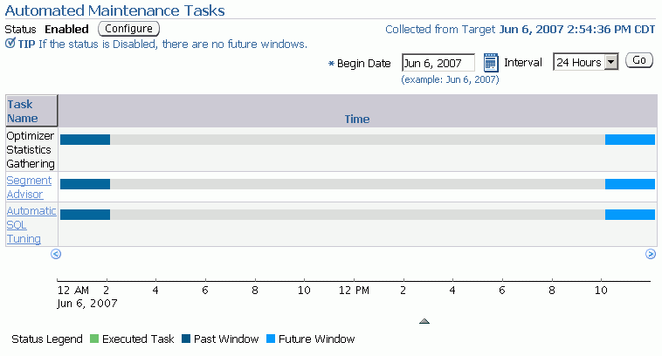
Automated Maintenance Tasks
Notes:
Automated Maintenance Tasks (continued)
Click Automated Maintenance Tasks under the Scheduler heading on the Server page to access the Automated Maintenance Task page, where you can view the automated maintenance task schedule and recent history. From here you can drill down to details on some tasks. Click Configure to go to the Automated Maintenance Tasks Configuration page. A task executes in a window. The graph shows the last window in which a task was executed and the next window in which the task is scheduled to be executed.
Note: The default windows for tasks are shown in the example. When the maintenance window closes, the Scheduler terminates the optimizer statistics gathering job by default. The remaining objects are then processed in the next maintenance window.

Slide 27
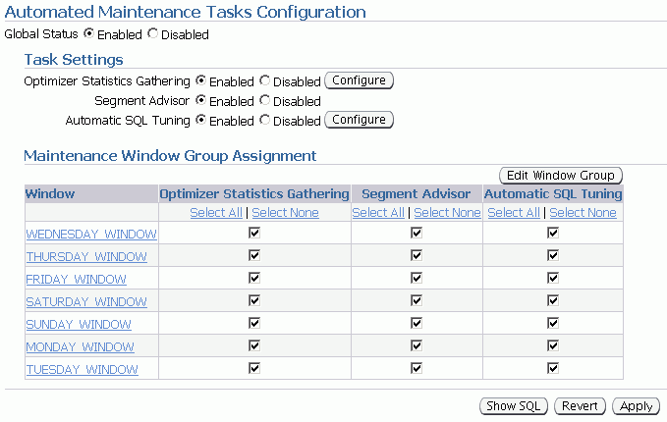
Automated Maintenance Tasks Configuration
Notes:
Automated Maintenance Tasks Configuration
On the Automated Maintenance Tasks Configuration page, you can enable and disable automatic maintenance tasks—all at once, by individual tasks, or by particular windows. You can also configure the settings that are used for optimizer statistics gathering and the job control parameters for the automatic SQL Tuning Advisor.
Select the window name to view or edit the window schedule.
Click Edit Window Group to add and remove windows in the window group.

Slide 28




Server-Generated Alerts
Enterprise Manager
Server alerts queue.
Oracle
instance
Metric exceeds
threshold.
AWR
Notes:
Server-Generated Alerts
Alerts are notifications of when a database is in an undesirable state and needs your attention. By default, the Oracle database provides alerts via Enterprise Manager Database Control. Optionally, Enterprise Manager can be configured to send an email message to the administrator about problem conditions as well as display alert information on the console.
You can also set thresholds on many of the pertinent metrics for your system. Oracle Database 11g proactively notifies you if the database deviates sufficiently from normal readings to reach those thresholds. An early notification of potential problems enables you to respond quickly and, in many cases, resolve issues before users even notice them.
Approximately 60 metrics are monitored by default, among which are:
Broken Job Count
Database Time Spent Waiting (%)
Dump Area Used (%)
SQL Response Time (%) compared to baseline
Tablespace Used (%)
Generic Incident
A few additional key metrics can provide early problem notification:
Average File Read Time (centiseconds)
Response Time (per transaction)
Wait Time (%)

Slide 29
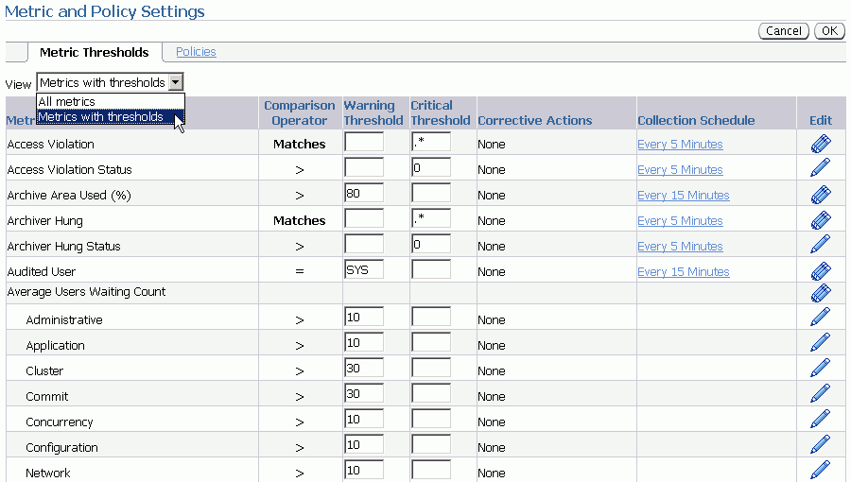
Setting Thresholds
Notes:
Setting Thresholds
To set or edit a threshold for your whole database, click “Metric and Policy Settings” in the Related Links region of the database home page. Enter your desired warning and critical threshold values. The appropriate alerts appear when the database reaches your specified values.
The thresholds that are already set appear in the “Metrics with thresholds” list. By default, approximately 60 metrics have preset thresholds; you may change these as needed. The “All metrics” list shows the metrics that do not have thresholds set.
Click one of the Edit icons to access a page where you can specify additional corrective actions for either warning or critical thresholds.
Click a Collection Schedule link and change the scheduled collection interval. Be aware that each schedule affects a group of metrics.

Slide 30
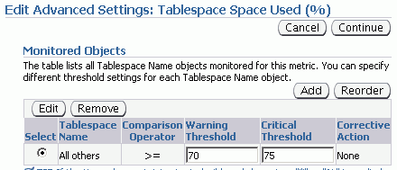

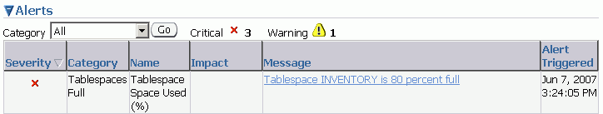
Creating and Testing an Alert
Specify a threshold.
Create a test case.
Check for an alert.
1
2
3
Notes:
Creating and Testing an Alert
You can also set thresholds for a specific object.
Example
You decide that you need to receive a critical alert if the space used in the INVENTORY tablespace exceeds 75%. (This tablespace does not allow its data files to automatically extend.) To create and test the alert, perform the following steps:
1. In Enterprise Manager, navigate to the “Metrics and Policy Settings” page, and then click the Edit icon for the Tablespace Used (%) threshold. Set your desired threshold for the tablespace.
2. Under the Schema tab on the Tables page, create a table to test the alert. Use the “Define using SQL” action to duplicate an existing table. The initial setting of 8 MB in the STORAGE clause causes the table to allocate 80% of the 10 MB INVENTORY tablespace immediately.
3. After you receive an error that this table is unable to extend, check the Database Home page for the associated alert. Tablespace Space Used (%) is collected every 10 minutes by default.
Most alerts contain the name of an associated advisor that can be invoked to give you more detailed advice. For each corresponding alert message, Database Control provides a link to invoke the corresponding advisor.

Slide 31
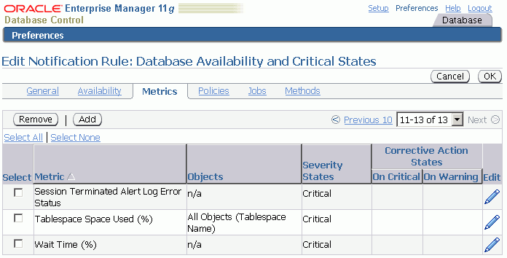
Alerts Notification
Notes:
Alerts Notification
The notification mechanism uses the Enterprise Manager user interface. It is based on the concept of a notification rule that establishes the appropriate notification mechanism for a set of upcoming alerts.
Using Database Control, you edit the notification rules. On the home page, click the Preferences link to display the General page, where you specify the email address at which you want to receive notifications.
On the General page, click the Rules link in the Notification region. Select the “Database Availability and Critical States” rule, and then click the Edit button. This takes you to the “Edit Notification Rule Database Availability and Critical States” page, where you click the Metrics tab and edit the metrics for which you want to receive notifications.

Slide 32
Alerts Notification Full Notes Page
Notes:
Alerts Notification (continued)
As an option, you can specify that Enterprise Manager provide you with direct notification when specific alerts arise. For example, if you specify that you want email notification for critical alerts, and you have a critical threshold set for the system response time for each call metric, you can send an email message containing a message similar to the following:
Host Name=mydb.us.mycompany.com
Metric=Response Time per Call
Timestamp=08-NOV-2005 10:10:01 (GMT -7:00)
Severity=Critical
Message=Response time per call has exceeded the threshold. See the latest ADDM analysis.
Rule Name= Rule
Owner=SYSMAN
The email contains a link to the host name and the latest ADDM analysis.
By default, alerts in critical state (such as DB Down, Generic Alert Log Error Status, and Tablespace Used) are set up for notification. However, to receive these notifications, you must set up your email information by following these steps:
1. On any Database Control page, click the Setup link in the header and footer area.
2. On the Setup page, select Notification Methods.
3. Enter the required information in the Mail Server region of the Notifications Methods page.
There are other methods of notification, including scripts and Simplified Network Management Protocol (SNMP) traps. The latter can be used to communicate with third-party applications.
To receive notifications:
1. On any Database Control page, click the Preferences link in the header and footer area.
2. On the Preferences page, select General. Enter your email address in the E-mail Addresses region.
3. You can optionally edit notification rules (for example, to change the severity state for receiving notification). To do so, click Notification Rules. The Notification Rules page appears. Note: For more information about configuring notification rules, see the Oracle Enterprise Manager Advanced Configuration documentation.

Slide 33

Reacting to Alerts
If necessary, you should gather more input (for example, by running ADDM or another advisor).
Investigate critical errors.
Take corrective measures.
Acknowledge alerts that are not automatically cleared.
Notes:
Reacting to Alerts
When you receive an alert, follow the recommendations that it provides. Or you can consider running the ADDM (or another advisor as appropriate) to obtain more detailed diagnostics of system or object behavior.
Alerts and incidents are generated for critical errors. Critical errors usually generate incidents that are collected into problems. You use the Support Workbench to investigate and possibly report the problem to Oracle Support.
Most alerts (such as “Out of Space”) are cleared automatically when the cause of the problem disappears. However, other alerts (such as Generic Alert Log Error) are sent to you for notification and must be acknowledged by you. After taking the necessary corrective measures, you acknowledge an alert by clearing or purging it. Clearing an alert sends the alert to the Alert History, which is viewable from the home page under Related Links. Purging an alert removes it from the Alert History.
To clear an alert such as Generic Alert Log Error, click the Alert Log link on the home page under Diagnostic Summary. The Alert Log Errors page appears. Select the alert to clear, and then click Clear. To purge an alert, select it and click Purge. You can also click the Clear Every Open Alert button or the Purge Every Alert button.

Slide 34
Alert Types and Clearing Alerts
Metric based
Threshold (stateful) alerts
97% Critical
Cleared
85% Warning
Cleared
MMON
DBA_OUTSTANDING_ALERTS
DBA_ALERT_HISTORY
Resumable Session Suspended
Recovery Area Low On Free Space
Snapshot Too Old
Nonthreshold (stateless) alerts
Alert
Event based
Notes:
Alert Types and Clearing Alerts
There are two kinds of server-generated alerts: threshold and nonthreshold.
Most server-generated alerts are configured by setting a warning and critical threshold values on database metrics. You can define thresholds for more than 120 metrics, including the following:
Physical Reads Per Sec
User Commits Per Sec
SQL Service Response Time
Except for the Tablespace Space Usage metric, which is database related, the other metrics are instance related. Threshold alerts are also referred to as stateful alerts, which are automatically cleared when an alert condition clears. Stateful alerts appear in DBA_OUTSTANDING_ALERTS and, when cleared, go to DBA_ALERT_HISTORY.
Other server-generated alerts correspond to specific database events such as ORA-* errors, “Snapshot too old” errors, Recovery Area Low On Free Space, and Resumable Session Suspended. These are non-threshold-based alerts, also referred to as stateless alerts. Stateless alerts go directly to the history table. Clearing a stateless alert makes sense only in the Database Control environment because Database Control stores stateless alerts in its own repository.

Slide 35
Summary
In this lesson, you should have learned how to:
Use statistics
Manage the Automatic Workload Repository
Use the Automatic Database Diagnostic Monitor
Describe the advisory framework
Set alert thresholds
Use server-generated alerts
Use automated tasks

Slide 36
Practice 12 Overview: Proactive Maintenance
This practice covers proactively managing your database with ADDM, including:
Setting up an issue for analysis
Reviewing your database performance
Implementing a solution

