Slide 1
Performance Management

Slide 2
Objectives
After completing this lesson, you should be able to:
Use Enterprise Manager to monitor performance
Use Automatic Memory Management (AMM)
Use the Memory Advisor to size memory buffers
View performance-related dynamic views
Troubleshoot invalid and unusable objects

Slide 3

Performance Monitoring
> Perf Mon
Tuning Adv
Access Adv
Memory
Stats
Invalid Obj
Memory
allocation
issues
Input/output
device
contention
Resource
contention
?
Application
code problems
DBA
Network
bottlenecks
Notes:
Performance Monitoring
To administer Oracle Database 11g and keep it running smoothly, the database administrator (DBA) must regularly monitor its performance to locate bottlenecks and correct problem areas.
A DBA can look at hundreds of performance measurements, covering everything from network performance and disk input/output (I/O) speed to the time spent working on individual application operations. These performance measurements are commonly referred to as database metrics.
Note: For more information about Oracle database performance, see the Oracle Database 11g: Performance Tuning course.

Slide 4
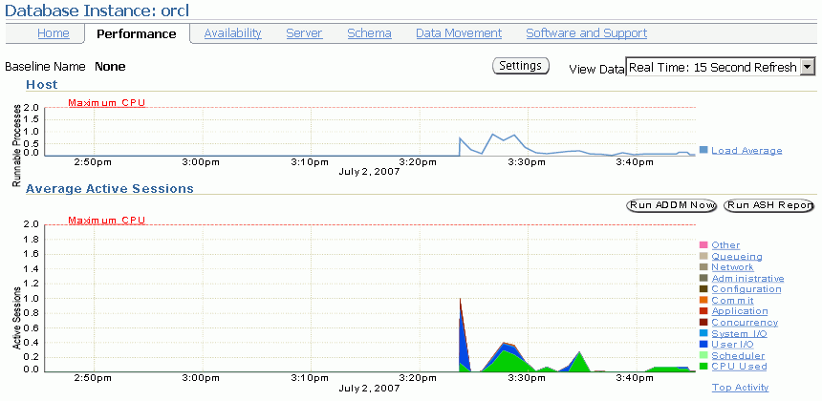
Enterprise Manager Performance Page
Notes:
Enterprise Manager Performance Page
The Performance page in Enterprise Manager is the portal to a powerful set of performance monitoring and tuning tools. The first set of graphs on this page summarizes processes and active session activity. The Average Active Sessions graph shows the level of CPU usage and the resources that are causing the most wait events.
In the slide, you see that there was a recent increase in CPU usage and waits for User I/O, System I/O, and Concurrency. You can click these categories to see more details about the waits. The I/O data is divided into types of I/O (for example, log file read, control file write, and so on).

Slide 5
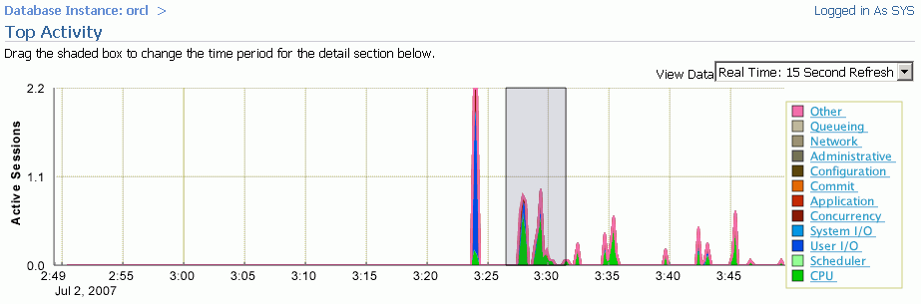
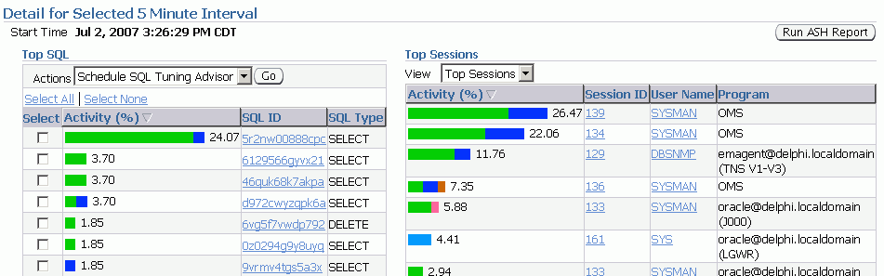
Active Session Page
Notes:
Enterprise Manager Performance Page (continued)
When you drill down to a particular wait category, you can view details of specific five-minute intervals and also see the Top Working SQL and the Top Working Sessions associated with that particular wait event during that time. This enables you to perform after-the-fact analysis of system slowdowns and determine potential causes.

Slide 6
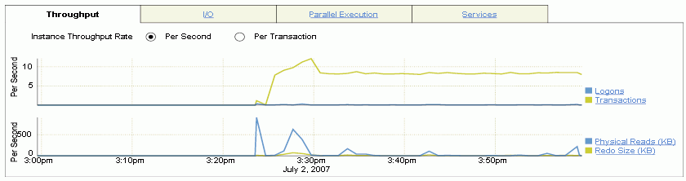
Performance Page: Throughput
Notes:
Performance Page: Throughput
You can see graphs of Instance throughput and Instance Disk I/O by clicking the Throughput and I/O tabs on the main Performance page. The Throughput tab has been selected in the slide.

Slide 7
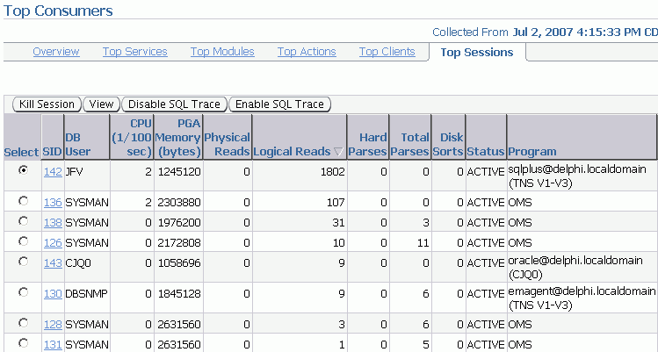
Performance Monitoring: Top Sessions
Notes:
Performance Monitoring: Top Sessions
Click Top Consumers in the Additional Monitoring Links section will take you to the Top Consumers page.
The Top Consumers Overview page shows in graphical format:
Top services
Top modules (by Service)
Top Actions (by Service and Module)
Top Clients
On the Top Consumers page, click the Top Sessions tab to see critical statistics of the sessions using the most resources
CPU
PGA Memory
Logical Reads
Physical Read
Hard Parse count,
Sort count.
If you click a column name, the associated statistic is the ordering value for the list.
The table on this page lists the sessions sorted by logical reads. This shows that the user JFV in session 142 is producing the greatest number of logical reads at this particular time.

Slide 8
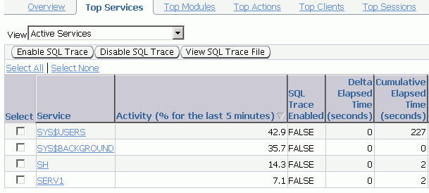
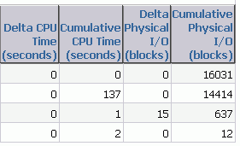
Performance Monitoring: Top Services
Notes:
Performance Monitoring: Top Services
In multitier systems where there is an application server that is pooling database connections, viewing sessions may not provide the information you need to analyze performance. Grouping sessions into service names enables you to monitor performance more accurately.
In the example in the slide, there are three services: inventory, orcl, and hr. Regardless of the session that was used for a particular request, if it connected via one of these services, the performance data of the session is captured under that service name. Of the application services shown (SH and SERV1), it is clear from this listing that the SH service was more active during this five-minute interval.

Slide 9
Managing Memory Components
Perf Mon
Tuning Adv
Access Adv
> Memory
Stats
Invalid Obj
Automatic Memory Management (AMM)
Enables you to specify total memory allocated to instance (including both SGA and PGA)
Automatic Shared Memory Management (ASMM):
Enables you to specify total SGA memory through one initialization parameter
Enables the Oracle server to manage the amount of memory allocated to the shared pool, Java pool, buffer cache, streams pool, and large pool
Manually setting shared memory management:
Sizes the components through multiple individual initialization parameters
Uses the Memory Advisor to make recommendations
Notes:
Managing Memory Components
Oracle Database 11g enables you to specify the total memory allocated to the instance. Memory will be dynamically reallocated between the System Global Area (SGA) and Program Global Area (PGA) as needed. This method is called Automatic Memory Management (AMM) and is available on only those platforms that support dynamic release of memory. This simplifies your memory management tasks.
Memory advisors are available to help you set the initialization parameters on various levels. Which advisor is available depends on the level on which you are specifying the memory parameters. If you enable AMM, only the Memory Size Advisor is available.
Automatic Shared Memory Management (ASMM) enables you to manage the SGA as a whole. The SGA comprises several components. The sizes of many of these components are dynamically adjusted for best performance within the limits of the initialization parameters. When the AMM is enabled, the ASMM is automatically enabled. If the ASMM is enabled but not the AMM, the SGA Size Advisor is available.
You can manage the size of individual components manually by setting the initialization parameter for each component. If the Oracle server notifies you of a performance problem that is related to the size of an SGA or PGA component, you can use the Memory Advisor for the component to determine appropriate new settings. The Memory Advisor can model the effect of parameter changes.

Slide 10

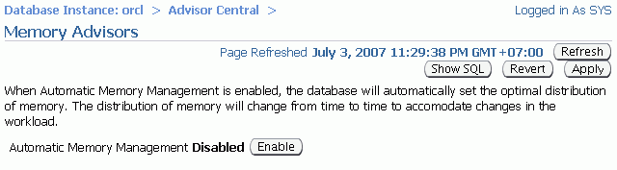
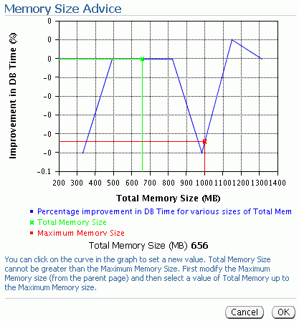
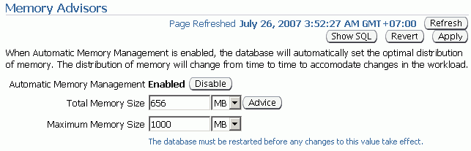
Enabling Automatic Memory Management (AMM)
Click Enable to enable Automatic Memory Management.
Use the Memory Size Advisor.
Notes:
Enabling Automatic Memory Management (AMM)
If you did not enable Automatic Memory Management (AMM) when you configured your database, you can enable it by performing the following steps:
1. On the Database home page, click the Server tab.
2. Click Memory Advisors in the Database Configuration region.
The Memory Advisors page appears.
3. Click Enable for Automatic Memory Management.
The Enable Automatic Memory Management page appears.
4. Set the values for Total Memory Size and Maximum Memory Size for Automatic Memory Management. Note: If you change the Maximum Memory Size, the database instance must be restarted.
5. Click OK.
You can increase the size at a later time by increasing the value of the Total Memory Size field or the MEMORY_TARGET initialization parameter. However, you cannot set it higher than the value specified by the Maximum Memory Size field or the MEMORY_MAX_TARGET parameter. For more information, see the Oracle Database Administrator’s Guide.
After AMM is enabled, the Memory Size Advisor is available to help you adjust the maximum and target memory sizes.
Note: Oracle recommends that you use Automatic Memory Management to simplify memory management tasks.

Slide 11
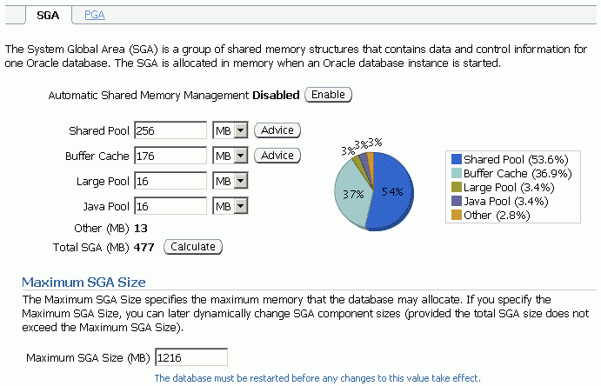
Enabling Automatic Shared Memory Management (ASMM)
Click Enable to enable Automatic Shared Memory Management.
Notes:
Enabling Automatic Shared Memory Management (ASMM)
Automatic Shared Memory Management is automatically enabled if you have enabled AMM. If you have not enabled AMM or did not enable ASMM when you configured your database, you can enable Automatic Shared Memory Management by performing the following steps:
1. On the Database home page, click the Server tab.
2. Click Memory Advisors in the Database Configuration region.
The Memory Advisors page appears.
3. Scroll down to the SGA section. Click Enable for Automatic Shared Memory Management.
The Enable Automatic Shared Memory Management page appears.
4. Specify the total SGA size. Click OK.
You can increase the total SGA size at a later time by increasing the value of the Total SGA Size field or the SGA_TARGET initialization parameter. However, you cannot set it higher than the value specified by the Maximum SGA Size field or the SGA_MAX_SIZE parameter. For more information, see the Oracle Database Administrator’s Guide.
When AMM is disabled, the PGA advisor is accessible. The PGA advisor is recommended for setting the PGA memory value. Click the PGA tab to access the PGA property page. Click Advice to invoke the PGA Advisor.
Note: Oracle recommends that you use Automatic Shared Memory Management to simplify your memory management tasks.

Slide 12
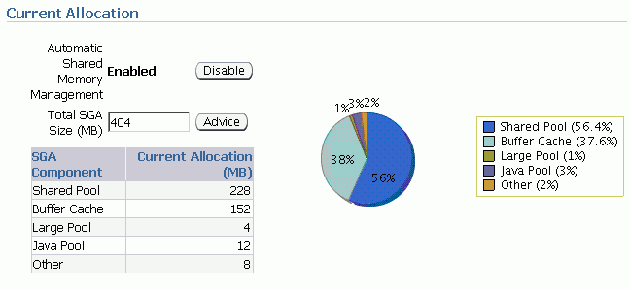
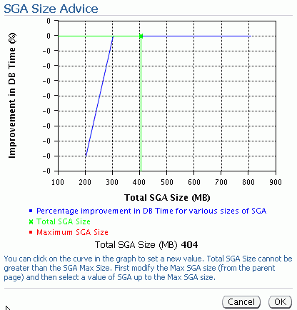
Automatic Shared Memory Advisor
Notes:
Automatic Shared Memory Advisor
When ASMM is enabled, you cannot set the initialization parameters for the specific components of shared memory that ASMM manages.After ASMM is enabled, the SGA Size Advisor is available to help you choose the best value for total SGA size.
If ASMM is enabled, you should not initially set initialization parameters for the specific components for which it manages memory. If, after seeing the effects of the ASMM allocations, you decide that you want to adjust certain component allocations, you can specify values for those components. Those values are treated as minimum memory sizes for their respective components. Doing this limits the amount of memory available for automatic adjustment, but the capability is available if your environment requires special sizing that is not accommodated by ASMM.
The initialization parameters of concern are the following:
SHARED_POOL_SIZE
LARGE_POOL_SIZE
JAVA_POOL_SIZE
DB_CACHE_SIZE
STREAMS_POOL_SIZE
To adjust these parameters while ASMM is enabled, you must use the ALTER SYSTEM command.

Slide 13
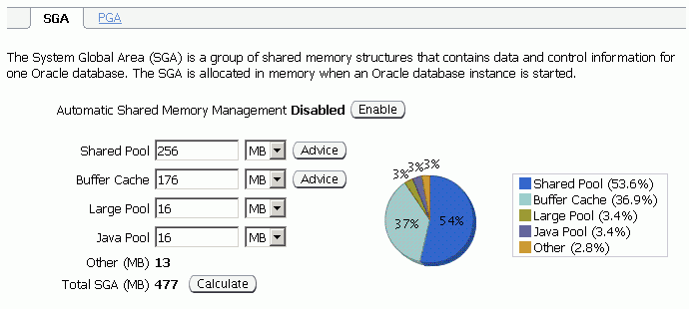
Setting Shared Memory Components Manually
Notes:
Setting Shared Memory Components Manually
If you do not use Automatic Shared Memory Management, you must provide values for each component of the SGA on installation and database creation.
To adjust the memory parameters:
1. Access the Memory Advisors page by clicking the Memory Advisors link in the Database Configuration region.
2. Invoke any of the advisors by clicking Advice beside the component specification.
Click Help to view online help for additional information about how the advisor works.
3. In the component specification fields, enter new values based on advisor results or your own monitoring.

Slide 14
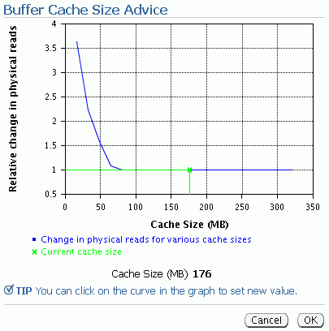
Using Memory Advisors
Notes:
Using Memory Advisors
The component-level memory advisors help you tune the size of your memory structures. You can use these advisors only when automatic memory management and automatic shared memory management are disabled.
The Memory Advisor comprises three advisors available from Enterprise Manager that give you recommendations on the following memory structures:
Shared pool in the System Global Area (SGA)
Buffer cache in the SGA
You can invoke the memory advisors by performing the following steps:
1. Click Advisor Central in the Related Links region on the Database home page.
2. Click Memory Advisor on the Advisor Central page. The Memory Advisors page provides a breakdown of memory usage for the SGA. Note: The Automatic Shared Memory Management setting must be disabled to run the individual component advisors.
3. Click Advice next to the Shared Pool value or Buffer Cache value to invoke the respective advisors.

Slide 15
Dynamic Performance Statistics Full Notes Page
Notes:
Using Memory Advisors (continued)
All the parts of the Memory Advisor can be accessed through SQL*Plus by viewing the associated V$* views. There are four advisor views for the individual components of the SGA that are automatically tunable.
To help you size the most important SGA components, a number of component advisors have been introduced in the Oracle database. They are:
V$DB_CACHE_ADVICE: Contains rows that predict the number of physical reads and time for the cache size corresponding to each row
V$SHARED_POOL_ADVICE: Displays information about estimated parse time in the shared pool for different pool sizes
V$JAVA_POOL_ADVICE: Displays information about estimated class load time into the Java pool for different pool sizes
V$STREAMS_POOL_ADVICE: Displays information about the estimated count of spilled or unspilled messages and the associated time spent in the spill or unspill activity for different Streams pool sizes
Note: For more information about these views, see the Oracle Database Reference.
Sample SQL statement to access a memory advisor:
SQL> SELECT size_for_estimate, estd_physical_read_factor
> FROM V$DB_CACHE_ADVICE;
SIZE_FOR_ESTIMATE ESTD_PHYSICAL_READ_FACTOR
----------------- -------------------------
16 4.0296
32 2.4861
48 1.7561
64 1.0993
80 1.0017
96 1
112 1
128 1
144 1
160 1
176 1
192 1
208 1
224 1
240 1
256 1
272 1
288 1
304 1
320 1

Slide 16
Dynamic Performance Statistics
…
Access Adv
Memory
> Stats
Invalid Obj
Systemwide
Session specific
Service specific
V$SYSSTAT
statistic#
name
class
value
stat_id
V$SESSTAT
sid
statistic#
value
V$SERVICE_STATS
service_name_hash
service_name
stat_id
stat_name
value
V$SYSTEM_EVENT
event
total_waits
total_timeouts
time_waited
average_wait
time_waited_micro
V$SESSION_EVENT
sid
event
total_waits
total_timeouts
time_waited
average_wait
max_wait
time_waited_micro
event_id
V$SERVICE_EVENT
service_name
service_name_hash
event
event_id
total_waits
total_timeouts
time_waited
average_wait
time_waited_micro
Cumulative stats
Wait events
Notes:
Dynamic Performance Statistics
Statistics must be available for the effective diagnosis of performance problems. The Oracle server generates many types of statistics for different levels of granularity.
At the systemwide level, session level, and service level, both wait events and accumulated statistics are computed. In the slide, the top row of views shows the cumulative statistics. The bottom row shows the wait event views.
When analyzing a performance problem in any of these scopes, you typically look at the change in statistics (delta value) over the period of time you are interested in. All the possible wait events are cataloged in the V$EVENT_NAME view. All statistics are cataloged in the V$STATNAME view; approximately 480 statistics are available in Oracle Database.

Slide 17
Dynamic Performance Statistics Full Notes Page
Notes:
Dynamic Performance Statistics (continued)
Displaying Systemwide Statistics
Example:
SQL> SELECT name, class, value FROM v$sysstat;
NAME CLASS VALUE
------------------------------- ------ ----------
...
table scans (short tables) 64 135116
table scans (long tables) 64 250
table scans (rowid ranges) 64 0
table scans (cache partitions) 64 3
table scans (direct read) 64 0
table scan rows gotten 64 14789836
table scan blocks gotten 64 558542
...
Systemwide statistics are classified by the tuning topic and the debugging purpose. The classes include general instance activity, redo log buffer activity, locking, database buffer cache activity, and so on.

Slide 18
Troubleshooting and Tuning Views
Instance/Database
V$DATABASE
V$INSTANCE
V$PARAMETER
V$SPPARAMETER
V$SYSTEM_PARAMETER
V$PROCESS
V$BGPROCESS
V$PX_PROCESS_SYSSTAT
V$SYSTEM_EVENT
Disk
V$DATAFILE
V$FILESTAT
V$LOG
V$LOG_HISTORY
V$DBFILE
V$TEMPFILE
V$TEMPSEG_USAGE
V$SEGMENT_STATISTICS
Contention
V$LOCK
V$UNDOSTAT
V$WAITSTAT
V$LATCH
Memory
V$BUFFER_POOL_STATISTICS
V$LIBRARYCACHE
V$SGAINFO
V$PGASTAT
Notes:
Troubleshooting and Tuning Views
The slide lists some of the views that can help you determine the cause of performance problems or analyze the current status of your database.
For a complete description of these views, see the Oracle Database Reference.

Slide 19





Invalid and Unusable Objects
Perf Mon
Tuning Adv
Access Adv
Memory
Stats
> Invalid Obj
Effect on performance:
PL/SQL code objects are recompiled.
Indexes are rebuilt.
Notes:
Invalid and Unusable Objects
Invalid PL/SQL objects and unusable indexes have an impact on performance. Invalid PL/SQL object must be recompiled before they can be used. This requires the compile time to added to the first action that attempts to access the PL/SQL package, procedure, or function. If the PL/SQL does not recompile successfully, the operation fails with an error. Unusable indexes are ignored by the optimizer. If proper performance of a SQL statement depends on a index that has been marked unusable, the performance does not improve until the index is rebuilt.
Invalid PL/SQL objects: The current status of PL/SQL objects can be viewed by querying the data dictionary. You can find invalid PL/SQL objects with:
SELECT object_name, object_type FROM DBA_OBJECTS
WHERE status = 'INVALID';
By default, the Owner’s Invalid Object Count metric is checked every 24 hours. If the number of objects for an individual owner exceeds two, an alert is issued.
If you find PL/SQL objects with a status of INVALID, the first question that you need to answer is “Has this object ever been VALID?” An application developer often neglects to clean up code that does not work. If the PL/SQL object is invalid because of a code error, there is little that can be done until that error is fixed. If the procedure was valid at some time in the past and has recently become invalid, you have two options for fixing the problem:

Slide 20
Invalid and Unusable Objects Full Notes Page
Notes:
Invalid and Unusable Objects (continued)
Do nothing. Most PL/SQL objects automatically recompile if needed when they are called. Users experience a slight delay while the objects recompile. (In most cases, this delay is not even noticeable.)
Manually recompile the invalid object.
Invalid PL/SQL objects can be manually recompiled by using Enterprise Manager or through SQL commands:
ALTER PROCEDURE HR.add_job_history COMPILE;
Manually recompiling PL/SQL packages requires two steps:
ALTER PACKAGE HR.maintainemp COMPILE;
ALTER PACKAGE HR.maintainemp COMPILE BODY;
Unusable indexes: Invalid indexes can be found by querying the DBA_INDEXES data dictionary view:
SELECT index_name, table_name FROM DBA_INDEXES
WHERE status = 'UNUSABLE';
For partitioned indexes, the status is held in the DBA_IND_PARTITIONS view.
Unusable indexes are made valid by rebuilding them to recalculate the pointers. Rebuilding an unusable index re-creates the index in a new location and then drops the unusable index. This can be done either by using Enterprise Manager or through SQL commands:
ALTER INDEX HR.emp_empid_pk REBUILD;
ALTER INDEX HR.emp_empid_pk REBUILD ONLINE;
ALTER INDEX HR.email REBUILD TABLESPACE USERS;
If the TABLESPACE clause is left out, the index is rebuilt in the same tablespace where it already exists. The REBUILD ONLINE clause enables users to continue updating the index’s table while the rebuild takes place. (Without the ONLINE keyword, users must wait for the rebuild to finish before performing DML on the affected table. If the index is unusable, it is not used during the rebuild even if the ONLINE keyword is used.)
Enterprise Manager uses the Reorganize action to repair an UNUSABLE index.
Note: Rebuilding an index requires that free space be available for the rebuild. Verify that there is sufficient space before attempting the rebuild. Enterprise Manager automatically checks space requirements.

Slide 21
Summary
In this lesson, you should have learned how to:
Use Enterprise Manager to monitor performance
Use Automatic Memory Management
Use the Memory Advisor to size memory buffers
View performance-related dynamic views
Troubleshoot invalid and unusable objects

Slide 22
Practice 13 Overview: Monitoring and Improving Performance
This practice covers the following topics:
Detecting and repairing unusable indexes
Using the Performance page in Enterprise Manager

