Slide 1
Backup and Recovery Concepts

Slide 2
Objectives
After completing this lesson, you should be able to:
Identify the types of failure that can occur in an Oracle database
Describe ways to tune instance recovery
Identify the importance of checkpoints, redo log files, and archive log files
Configure the flash recovery area
Configure ARCHIVELOG mode

Slide 3
Part of Your Job
The administrator’s duties are to:
Protect the database from failure wherever possible
Increase the mean time between failures (MTBF)
Protect by redundancy
Decrease the mean time to recover (MTTR)
Minimize the loss of data
Notes:
Part of Your Job
The goal of the database administrator (DBA) is to ensure that the database is open and available when users need it. To achieve that goal, the DBA (working with the system administrator):
Anticipates and works to avoid common causes of failure
Works to increase the mean time between failures (MTBF) that negatively affect availability
Ensures that hardware is as reliable as possible, that critical components are protected by redundancy, and that operating system maintenance is performed in a timely manner. The Oracle database provides advanced configuration options to increase MTBF, including:
Real Application Clusters (discussed in the Oracle Database 11g: Real Application Clusters course)
Streams (discussed in the Oracle Database 11g: Implement Streams course)
Decreases the mean time to recover (MTTR) by practicing recovery procedures in advance and configuring backups so that they are readily available when needed
Minimizes the loss of data. DBAs who follow accepted best practices can configure their databases so that no committed transaction is ever lost. Entities that assist in guaranteeing this include:
Archive log files (discussed later in this lesson)
Standby databases and Oracle Data Guard (discussed in the Oracle Database 11g: Data Guard Administration course)

Slide 4


Categories of Failure
Failures can generally be divided into the following categories:
Statement failure
User process failure
Network failure
User error
Instance failure
Media failure
Notes:
Categories of Failure
Statement failure: A single database operation (select, insert, update, or delete) fails.
User process failure: A single database session fails.
Network failure: Connectivity to the database is lost.
User error: A user successfully completes an operation, but the operation (dropping a table or entering bad data) is incorrect.
Instance failure: The database instance shuts down unexpectedly.
Media failure: One or more of the database files are lost (that is, the files have been deleted or the disk has failed).

Slide 5
Statement Failure
Typical Problems | Possible Solutions
Attempts to enter invalid data into a table | Work with users to validate and correct data.
Attempts to perform operations with insufficient privileges | Provide appropriate object or system privileges.
Attempts to allocate space that fail | Enable resumable space allocation. Increase owner quota. Add space to tablespace.
Logic errors in applications | Work with developers to correct program errors.
Notes:
Statement Failure
When a single database operation fails, DBA involvement may be necessary to correct errors with user privileges or database space allocation. DBAs may also need to assist in trouble-shooting, even for problems that are not directly in their task area. This can vary greatly from one organization to another. For example, in organizations that use off-the-shelf applications (that is, organizations that have no software developers), the DBA is the only point of contact and must examine logic errors in applications.
To understand logic errors in applications, you can use LogMiner (select Enterprise Manager > Availability > View and Manage Transactions, or access from the command line) to examine the redo of transactions.

Slide 6

User Process Failure
Typical Problems | Possible Solutions
A user performs an abnormal disconnect. A user’s session is abnormally terminated. A user experiences a program error that terminates the session. | A DBA’s action is not usually needed to resolve user process failures. Instance background processes roll back uncommitted changes and release locks. Watch for trends.
Notes:
User Process Failure
User processes that abnormally disconnect from the instance may have uncommitted work in progress that needs to be rolled back. The Process Monitor (PMON) background process periodically polls server processes to ensure that their sessions are still connected. If PMON finds a server process whose user is no longer connected, PMON recovers from any ongoing transactions; it also rolls back uncommitted changes and releases any locks that are held by the failed session.
A DBA’s intervention should not be required to recover from user process failure, but the administrator must watch for trends. One or two users disconnecting abnormally is not a cause for concern. A small percentage of user process failures may occur from time to time.
But consistent and systemic failures indicate other problems. A large percentage of abnormal disconnects may indicate a need for user training (which includes teaching users to log out rather than just terminate their programs). It may also be indicative of network or application problems.

Slide 7
Network Failure
Typical Problems | Possible Solutions
Listener fails. | Configure a backup listener and connect-time failover.
Network Interface Card (NIC) fails. | Configure multiple network cards.
Network connection fails. | Configure a backup network connection.
Notes:
Network Failure
The best solution to network failure is to provide redundant paths for network connections. Backup listeners, network connections, and network interface cards reduce the chance that network failures will affect system availability.

Slide 8



User Error
Using Flashback technology:
Viewing past states of data
Winding data back and forth in time
Assisting users in error analysis and recovery
For error analysis:
Oracle Flashback Query (SELECT … AS OF…)
Oracle Flashback Versions Query (SELECT … VERSIONS BETWEEN…)
Oracle Flashback Transaction Query
For error recovery:
Oracle Flashback Transaction Backout
Oracle Flashback Table
Oracle Flashback Drop
Notes:
User Error
The Oracle database provides Oracle Flashback technology: a group of features that support viewing past states of data—and winding data back and forth in time—without requiring restoring the database from backup. With this technology, you help users analyze and recover from errors. For users who have committed erroneous changes, use the following to analyze the errors:
Flashback Query: View committed data as it existed at some point in the past. The SELECT command with the AS OF clause references a time in the past through a time stamp or SCN.
Flashback Version Query: View committed historical data for a specific time interval. Use the VERSIONS BETWEEN clause of the SELECT command (for performance reasons with existing indexes).
Flashback Transaction Query: View all database changes made at the transaction level
Possible solutions to recover from user error:
Flashback Transaction Backout: Rolls back a specific transaction and dependent transactions
Flashback Table: Rewinds one or more tables to their contents at a previous time without affecting other database objects
Flashback Drop: Reverses the effects of dropping a table by returning the dropped table from the recycle bin to the database along with dependent objects such as indexes and triggers

Slide 9

User Error
Typical Causes | Possible Solutions
User inadvertently deletes or modifies data. | Roll back transaction and dependent transactions or rewind table.
User drops a table. | Recover table from recycle bin.
Oracle LogMiner
Notes:
User Error (continued)
Users may inadvertently delete or modify data. If they have not yet committed or exited their program, they can simply roll back.
You can use Oracle LogMiner to query your online redo logs and archived redo logs through an Enterprise Manager or SQL interface. Transaction data may persist in online redo logs longer than it persists in undo segments; if you have configured archiving of redo information, redo persists until you delete the archived files. Oracle LogMiner is discussed in the Oracle Database: Utilities reference.
Users who drop a table can recover it from the recycle bin by flashing back the table to before the drop. Flashback technologies are discussed in detail in the Oracle Database 11g: Administration Workshop II course.
If the recycle bin has already been purged, or if the user dropped the table with the PURGE option, the dropped table can still be recovered by using point-in-time recovery (PITR) if the database has been properly configured. PITR is discussed in the Oracle Database 11g: Administration Workshop II course and in the Oracle Database Backup and Recovery Advanced User’s Guide.

Slide 10
Instance Failure
Typical Causes | Possible Solutions
Power outage | Restart the instance by using the STARTUP command. Recovering from instance failure is automatic, including rolling forward changes in the redo logs and then rolling back any uncommitted transactions. Investigate the causes of failure by using the alert log, trace files, and Enterprise Manager.
Hardware failure
Failure of one of the critical background processes
Emergency shutdown procedures
Notes:
Instance Failure
Instance failure occurs when the database instance is shut down before synchronizing all database files. An instance failure can occur because of hardware or software failure or through the use of the emergency SHUTDOWN ABORT and STARTUP FORCE shutdown commands.
Administrator involvement in recovering from instance failure is usually limited to restarting the instance and working to prevent future occurrences.

Slide 11
Understanding Instance Recovery: Checkpoint (CKPT) Process
CKPT is responsible for:
Signaling DBWn at checkpoints
Updating data file headers with checkpoint information
Updating control files with checkpoint information
SGA
Database
buffer cache
DBWn
Database Writer process
Control files
CKPT
Checkpoint process
Data files
Notes:
Understanding Instance Recovery: Checkpoint (CKPT) Process
To understand instance recovery, you need to understand the functioning of certain background processes.
Every three seconds (or more frequently), the CKPT process stores data in the control file to document the modified data blocks that DBWn has written from the SGA to disk. This is called a “checkpoint.” The purpose of a checkpoint is to identify that place in the online redo log file where instance recovery is to begin (which is called the “checkpoint position”).
In the event of a log switch, the CKPT process also writes this checkpoint information to the headers of data files.
Checkpoints exist for the following reasons:
To ensure that modified data blocks in memory are written to the disk regularly so that data is not lost in case of a system or database failure
To reduce the time required for instance recovery (Only the online redo log file entries following the last checkpoint need to be processed for recovery.)
To ensure that all committed data has been written to data files during shutdown
The checkpoint information written by the CKPT process includes checkpoint position, system change number (SCN), location in the online redo log file to begin recovery, information about logs, and so on.
Note: The CKPT process does not write data blocks to the disk or redo blocks to the online redo log files.

Slide 12
Understanding Instance Recovery: Redo Log Files and LogWriter
Redo log files:
Record changes to the database
Should be multiplexed to protect against loss
LogWriter writes:
At commit
When one-third full
Every three seconds
Before DBWn writes
SGA
Redo log buffer
LGWR
LogWriter
Redo log
group 1
Redo log
group 2
Redo log
group 3
Notes:
Background Processes and Recovery: Redo Log Files and LogWriter
Redo log files record changes to the database as a result of transactions and internal Oracle server actions. (A transaction is a logical unit of work consisting of one or more SQL statements run by a user.) Redo log files protect the database from the loss of integrity because of system failures caused by power outages, disk failures, and so on. Redo log files must be multiplexed to ensure that the information stored in them is not lost in the event of a disk failure.
The redo log consists of groups of redo log files. A group consists of a redo log file and its multiplexed copies. Each identical copy is said to be a member of that group, and each group is identified by a number. The LogWriter (LGWR) process writes redo records from the redo log buffer to all members of a redo log group until the files are filled or a log switch operation is requested. It then switches and writes to the files in the next group. Redo log groups are used in a circular fashion.
Best practice tip: If possible, multiplexed redo log files should reside on different disks.

Slide 13

Understanding Instance Recovery: Archiver (ARCn) Process
Archiver (ARCn):
Is an optional background process
Automatically archives online redo log files when ARCHIVELOG mode is set for the database
Preserves the record of all changes made to the database
SGA
Redo log buffer
LGWR
LogWriter
Copies of Redo log
files
Redo log
files
ARCn
Archiver process
Notes:
Understanding Instance Recovery: The Archiver (ARCn) Process
ARCn is an optional background process. However, it is crucial to the recovery of a database after the loss of a disk. When an online redo log group gets filled, the Oracle instance begins writing to the next online redo log group. The process of switching from one online redo log group to another is called a log switch. The ARCn process initiates archiving of the filled log group at every log switch. It automatically archives the online redo log group before the log group can be reused so that all the changes made to the database are preserved. This enables recovery of the database to the point of failure even if a disk drive is damaged.
One of the important decisions that a DBA must make is whether to configure the database to operate in ARCHIVELOG mode or in NOARCHIVELOG mode.
In NOARCHIVELOG mode, the online redo log files are overwritten each time a log switch occurs.
In ARCHIVELOG mode, inactive groups of filled online redo log files must be archived before they can be used again.
Note: ARCHIVELOG mode is essential for most backup strategies (and is very easy to configure).

Slide 14
Understanding Instance Recovery
Automatic instance or crash recovery:
Is caused by attempts to open a database whose files are not synchronized on shutdown
Uses information stored in redo log groups to synchronize files
Involves two distinct operations:
Rolling forward: Data files are restored to their state before the instance failed.
Rolling back: Changes that are made but not committed are returned to their original state.
Notes:
Instance Recovery
The Oracle database automatically recovers from instance failure. All that the DBA needs to do is start the instance normally. The instance mounts the control files and then attempts to open the data files. When it discovers that the data files have not been synchronized during shutdown, the instance uses information contained in the redo log groups to roll the data files forward to the time of shutdown. Then the database is opened and (because the undo tablespace is also rolled forward) any uncommitted transactions are rolled back.

Slide 15
Phases of Instance Recovery
Instance
1. Data files out of sync
2. Roll forward (redo)
3. Committed and
noncommitted data in files
4. Database opened
5. Roll back (undo)
6. Committed data in files
SGA
Background
processes
Database
SCN:
74-101
SCN:140
SCN:143
SCN:
102-143
SCN:129
SCN:143
Undo
SCN: 99
Control files
Redo log group
Data files
Notes:
Phases of Instance Recovery
For an instance to open a data file, the system change number (SCN) contained in the data file’s header must match the current SCN that is stored in the database’s control files.
If the numbers do not match, the instance applies redo data from the online redo logs, sequentially “redoing” transactions until the data files are up-to-date. After all data files have been synchronized with the control files, the database is opened and users can log in.
When redo logs are applied, all transactions are applied to bring the database up to the state as of the time of failure. This usually includes transactions that are in progress but have not yet been committed. After the database has been opened, those uncommitted transactions are rolled back. At the end of the rollback phase of instance recovery, the data files contain only committed data.

Slide 16
Tuning Instance Recovery
During instance recovery, the transactions between the checkpoint position and the end of redo log must be applied to data files.
You tune instance recovery by controlling the difference between the checkpoint position and the end of redo log.
Checkpoint position
End of redo log
Instance recovery
Transactions
Notes:
Tuning Instance Recovery
Transaction information is recorded in the redo log groups before the instance returns commit complete for a transaction. The information in the redo log groups guarantees that the transaction can be recovered in case of a failure. The transaction information also needs to be written to the data file. The data file write usually happens at some time after the information is recorded in redo log groups because the data file write process is much slower than the redo writes. (Random writes for data files are slower than serial writes for redo log files.)
Every three seconds, the checkpoint process records information in the control file about the checkpoint position in the redo log. Therefore, the Oracle database knows that all redo log entries recorded before this point are not necessary for database recovery. In the graphic in the slide, the striped blocks have not yet been written to the disk.
The time required for instance recovery is the time required to bring data files from their last checkpoint to the latest SCN recorded in the control file. The administrator controls that time by setting an MTTR target (in seconds) and through the sizing of redo log groups. For example, for two redo groups, the distance between the checkpoint position and the end of the redo log group cannot be more than 90% of the smallest redo log group.

Slide 17
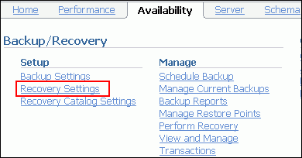
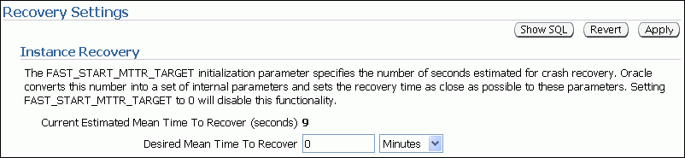
Using the MTTR Advisor
Specify the desired time in seconds or minutes.
The default value is 0 (disabled).
The maximum value is 3,600 seconds (one hour).
Notes:
Using the MTTR Advisor
For assistance in setting the MTTR target, select either of the following:
Enterprise Manager > Advisor Central (in the Related Links section) > MTTR Advisor
Enterprise Manager > Availability > Recovery Settings
The MTTR Advisor converts the FAST_START_MTTR_TARGET value into several parameters to enable instance recovery in the desired time (or as close to it as possible).
Explicit setting of the FAST_START_MTTR_TARGET parameter to 0 disables automatic checkpoint tuning. Explicit setting of the FAST_START_MTTR_TARGET parameter to a value other than 0 also enables the MTTR Advisor. (When specified, FAST_START_MTTR_TARGET is overridden by LOG_CHECKPOINT_INTERVAL.)
The FAST_START_MTTR_TARGET parameter must be set to a value that supports the service level agreement for your system. A small value for the MTTR target increases I/O overhead because of additional data file writes (affecting the performance). However, if you set the MTTR target too large, the instance takes longer to recover after a crash.

Slide 18
Media Failure
Typical Causes | Possible Solutions
Failure of disk drive | 1. Restore the affected file from backup. 2. Inform the database about a new file location (if necessary). 3. Recover the file by applying redo information (if necessary).
Failure of disk controller
Deletion or corruption of database file
Notes:
Media Failure
Oracle Corporation defines media failure as any failure that results in the loss or corruption of one or more database files (data, control, or redo log file).
Recovering from media failure requires that you restore and recover the missing files. To ensure that your database can be recovered from media failure, follow the best practices outlined in the next few pages.

Slide 19
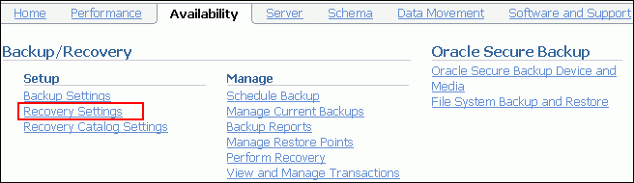
Configuring for Recoverability
To configure your database for maximum recoverability, you must:
Schedule regular backups
Multiplex control files
Multiplex redo log groups
Retain archived copies of redo logs
Notes:
Configuring for Recoverability
To provide the best protection for your data, you must:
Schedule regular backups Most media failures require that you restore the lost or damaged file from backup.
Multiplex control files All control files associated with a database are identical. Recovering from the loss of a single control file is not difficult; recovering from the loss of all control files is much more challenging. Guard against losing all control files by having at least three copies.
Multiplex redo log groups To recover from instance or media failure, redo log information is used to roll data files forward to the last committed transaction. If your redo log groups rely on a single redo log file, the loss of that file means that data is likely to be lost. Ensure that there are at least two copies of each redo log group; if possible, each copy should be under different disk controllers.
Retain archived copies of redo logs If a file is lost and restored from backup, the instance must apply redo information to bring that file up to the latest SCN contained in the control file. With the default setting, the database can overwrite redo information after it has been written to the data files. Your database can be configured to retain redo information in archived copies of the redo logs. This is known as placing the database in ARCHIVELOG mode.
You can perform configuration tasks in Enterprise Manager or with the command line.

Slide 20
Configuring the Flash Recovery Area
Flash recovery area:
Strongly recommended for simplified backup storage management
Space on disk (separate from working database files)
Location specified by the USE_DB_RECOVERY_FILE_DEST parameter
Large enough for backups, archived logs, flashback logs, mirrored control files, and mirrored redo logs
Automatically managed according to your retention policy
Configuring the flash recovery area means determining location, size, and retention policy.
Notes:
Configuring the Flash Recovery Area
The flash recovery area is a space that is set aside on the disk to contain archived logs, backups, flashback logs, mirrored control files, and mirrored redo logs. A flash recovery area simplifies backup storage management and is strongly recommended. You should place the flash recovery area on a disk that is separate from the working set of database files. Otherwise, the disk becomes a single point of failure for your database.
The amount of disk space to allocate for the flash recovery area depends on the size and activity levels of your database. As a general rule, the larger the flash recovery area, the more useful it is. Ideally, the flash recovery area should be large enough for copies of your data and control files and for flashback, online redo, and archived logs needed to recover the database with the backups kept based on the retention policy. (In short, the flash recovery area should be at least twice the size of the database so that it can hold one backup and several archived logs.)
Space management in the flash recovery area is governed by a backup retention policy. A retention policy determines when files are obsolete, which means that they are no longer needed to meet your data recovery objectives. The Oracle database automatically manages this storage by deleting files that are no longer needed.

Slide 21
Multiplexing Control Files
To protect against database failure, your database should have:
Two copies of the control file (three preferred)
Each copy on a separate disk
At least one copy on a separate disk controller
To add a control file manually:
1. Alter the SPFILE with the ALTER SYSTEM SET control_files command.
2. Shut down the database.
3. Move OS copy of file to a new location.
4. Open the database.
Control files
Notes:
Multiplexing Control Files
A control file is a small binary file that describes the structure of the database. It must be available for writing by the Oracle server whenever the database is mounted or opened. Without this file, the database cannot be mounted, and recovery or re-creation of the control file is required. Your database must have a minimum of two control files (the default of three is preferred) on different disks to minimize the impact of a loss of one control file.
If your database is created with the Database Configuration Assistant (DBCA) using Oracle Managed Files (OMF), you have two control files. If you do not use OMF, there are three control files.
The loss of a single control file causes the instance to fail because all control files must be available at all times. However, recovery is a simple matter of copying one of the other control files. The loss of all control files is slightly more difficult to recover from but is not usually catastrophic.

Slide 22
Multiplexing Control Files Full Notes Page
Notes:
Multiplexing Control Files (continued)
Adding a Control File
In an OMF database, all control files must be re-created (so the following steps do not apply).
In other databases, adding a control file is a manual operation:
1. Alter the SPFILE with the following command:
ALTER SYSTEM SET control_files = '/u01/app/oracle/oradata/orcl/control01.ctl' , '/u01/app/oracle/oradata/orcl/control02.ctl' , '/u01/app/oracle/oradata/orcl/control03.ctl' SCOPE=SPFILE;
2. Shut down the database.
3. Use the operating system to copy an existing control file to the location you select for your new file.
4. Open the database.

Slide 23
Redo Log Files
Multiplex redo log groups to protect against media failure and loss of data. This increases database I/O. It is suggested that redo log groups have:
At least two members (files) per group
Each member on a separate disk drive
Each member on a separate disk controller
Disk 1
Member 1
Member 2
Member 1
Disk 2
Member 2
Member 1
Member 2
Group 1
Group 2
Group 3
Note: Multiplexing redo logs may impact overall database performance.
Notes:
Redo Log Files
Redo log groups are made up of one or more redo log files. Each log file in a group is a duplicate of the others. Oracle Corporation recommends that redo log groups have at least two files per group, with the files distributed on separate disks or controllers so that no single equipment failure destroys an entire log group.
The loss of an entire current log group is one of the most serious media failures because it can result in loss of data. The loss of a single member of a multiple-member log group is trivial and does not affect database operation (other than causing an alert to be published in the alert log). Recovery from the loss of an entire log group requires advanced recovery techniques and is discussed in the course titled Oracle Database 11g: Administration Workshop II.
Remember that multiplexing redo logs may heavily influence database performance because a commit cannot complete until the transaction information has been written to the logs. You must place your redo log files on your fastest disks served by your fastest controllers. If possible, do not place any other database files on the same disks as your redo log files (unless you are using Automatic Storage Management [ASM]). Because only one group is written to at a given time, there is no harm in having members from several groups on the same disk.

Slide 24
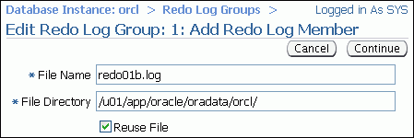
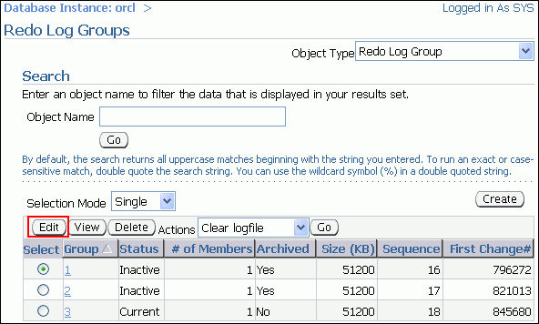
Multiplexing the Redo Log
Notes:
Multiplexing the Redo Log
You can multiplex your redo log by adding a member to an existing log group. To add a member to a redo log group (with open database and no impact on user performance), perform the following steps:
1. Select Enterprise Manager > Server > Redo Log Groups.
2. Select a group and click the Edit button, or click the group number link. The Edit Redo Log Group page appears.
3. In the Redo Log Members region, click Add. The Add Redo Log Member page appears.
4. Enter the file name and the file directory. Click Continue.
Note: It is recommended that you store members on separate drives to protect against total loss of the redo log entries in the event of a disk failure.
Repeat these steps for every existing group.
When you add the redo log member to a group, the group’s status is marked INVALID (as can be seen in the V$LOGFILE view). This is the expected state because a member of the group has not yet been written to. When a log switch occurs and the invalid group becomes the current group, the status changes to CURRENT.

Slide 25
Archive Log Files
To preserve redo information, create archived copies of redo log files by performing the following steps.
1. Specify archive log file-naming convention.
2. Specify one or more archive log file locations.
3. Switch the database to ARCHIVELOG mode.
Online redo log files
Archive log files
Notes:
Archive Log Files
The instance treats the online redo log groups as a circular buffer in which to store transaction information, filling one group and then moving on to the next. After all groups have been written to, the instance begins overwriting information in the first log group.
To configure your database for maximum recoverability, you must instruct the database to make a copy of the online redo log group before allowing it to be overwritten. These copies are known as archived logs.
To facilitate the creation of archive log files:
1. Specify a naming convention for your archive logs.
2. Specify a destination or destinations for storing your archive logs. One of the destinations is probably your flash recovery area.
3. Place the database in ARCHIVELOG mode.
Note: Steps 1 and 2 are not necessary if you are using a flash recovery area.
The destination must exist before placing the database in ARCHIVELOG mode. When a directory is specified as a destination, there should be a slash at the end of the directory name.

Slide 26
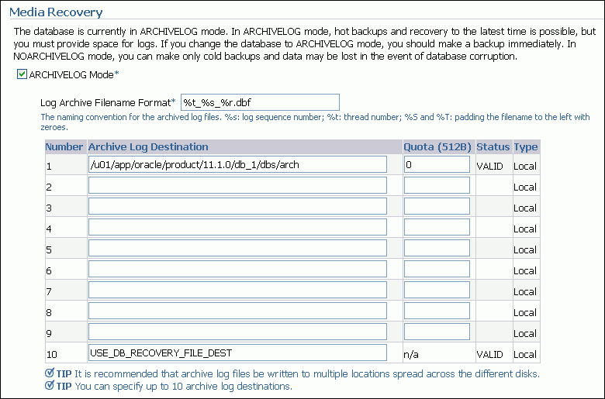
Archive Log File: Naming and Destinations
If USE_DB_RECOVERY_FILE_DEST is deleted,
the flash recovery area is not used.
Notes:
Archive Log File: Naming and Destinations
To configure archive log file names and destinations, select Enterprise Manager > Availability > Configure Recovery Settings.
Each archive log file must have a unique name to avoid overwriting older log files. Specify the naming format as shown in the slide. To help create unique file names, Oracle Database 11g allows several wildcard characters in the name format:
%s: Includes the log sequence number as part of the file name
%t: Includes the thread number as part of the file name
%r: Includes the resetlogs ID to ensure that the archive log file name remains unique (even after certain advanced recovery techniques that reset log sequence numbers)
%d: Includes the database ID as part of the file name
The format must include %s, %t, and %r. The use of %d is optional, but it must be included if multiple databases share the same archive log destination.
Archive log files can be written to as many as ten different destinations. Destinations may be local (a directory) or remote (an Oracle Net alias for a standby database).

Slide 27
Archiving Log File Naming and Destinations Full Notes Page
Notes:
Archive Log File: Naming and Destinations (continued)
The default destination (number 10) sends archive log files to a location determined by the DB_RECOVERY_FILE_DEST initialization parameter. DB_RECOVERY_FILE_DEST is also known as the RECOVERY AREA parameter. This destination is visible at the bottom of the Recovery Settings properties page as Flash Recovery Area Location.
Note: If you do not want archives sent to this location, delete USE_DB_RECOVERY_FILE_DEST.
To change recovery settings, you must be connected as SYSDBA or SYSOPER.

Slide 28
Enabling ARCHIVELOG Mode
To place the database in ARCHIVELOG mode, perform the following steps in Enterprise Manager:
1. Select the ARCHIVELOG Mode check box and click Apply.
The database can be set to ARCHIVELOG mode only from the MOUNT state.
2. Restart the database (with SYSDBA privileges).
3. (Optional) View the archive status.
4. Back up your database.
Note: Databases in ARCHIVELOG
mode have access to the full
range of backup and recovery
options.
sqlplus / as sysdba
shutdown immediate
startup mount
alter database archivelog;
alter database open;
archive log list
Notes:
Enabling ARCHIVELOG Mode
1. In Enterprise Manager, select Availability > Configure Recovery Settings > ARCHIVELOG Mode. The equivalent SQL command is:
SQL> ALTER DATABASE ARCHIVELOG;
This command can be issued only while the database is in the MOUNT state. The instance must therefore be restarted to complete this last step.
2. In Enterprise Manager, you are prompted for operating system and database credentials during the restart of the database. The database credentials must be for a user with the SYSDBA privileges.
3. After the instance is restarted, the changes that you have made to the archive processes, log format, and log destinations are in effect. In SQL*Plus, you can see them with the ARCHIVE LOG LIST command.
4. Back up your database after switching to ARCHIVELOG mode because your database is only recoverable from the last backup taken in that mode.
With the database in NOARCHIVELOG mode (the default), recovery is possible only until the time of the last backup. All transactions made after that backup are lost.
In ARCHIVELOG mode, recovery is possible until the time of the last commit. Most production databases are run in ARCHIVELOG mode.

Slide 29
Summary
In this lesson, you should have learned how to:
Identify the types of failure that can occur in an Oracle database
Describe ways to tune instance recovery
Identify the importance of checkpoints, redo log files, and archive log files
Configure the flash recovery area
Configure ARCHIVELOG mode

Slide 30
Practice 14 Overview: Configuring for Recoverability
This practice covers the following topics:
Verifying control files
Configuring a default flash recovery area
Multiplexing redo log groups
Placing your database in ARCHIVELOG mode
Ensuring that redundant archive logs are created

