Slide 1
Performing Database Backups

Slide 2
Objectives
After completing this lesson, you should be able to:
Create consistent database backups
Back up your database without shutting it down
Create incremental backups
Automate database backups
Manage backups and view backup reports
Monitor the flash recovery area

Slide 3

Backup Solutions: Overview
Backups can be performed by using:
Recovery Manager
Oracle Secure Backup
User-managed backup
Target database
Data files
Image copies
Archive log files
Backup pieces
Redundant archive log files
Backup data
Flash recovery area
Notes:
Backup Solutions: Overview
As you will see in the remainder of this lesson, Recovery Manager (RMAN) is the recommended method of backing up your Oracle database.
Oracle Secure Backup complements existing functionality by adding backup to tape and network backup capabilities.
User-managed backups are based on scripts that a DBA must write. This option is being phased out because it is more labor intensive.

Slide 4

Oracle Secure Backup
Oracle Secure Backup and RMAN provide an end-to-end backup solution for Oracle environments:
Centralized tape backup management for file system data and the Oracle database
Most well-integrated media management layer for RMAN backups
Backup of any data anywhere on the network
A single technical support resource for the entire backup solution expedites problem resolution.
This ensures reliable data protection at lower cost and complexity.
Notes:
Oracle Secure Backup
Oracle’s current backup and recovery product for the database is Recovery Manager. Oracle Secure Backup complements existing functionality in the following ways:
Complete backup solution: Oracle Secure Backup provides data protection for the database and nondatabase data to protect the entire Oracle environment.
Media management: Oracle Secure Backup provides the media management layer for RMAN database backups to tape. Before Oracle Secure Backup, customers had to purchase expensive third-party media management products offering integration with RMAN tape backups.
Backup anywhere on the network: Oracle Secure Backup backs up data from multiple network-attached computer systems to tertiary storage resources on the network. Oracle Secure Backup supports diverse configurations of servers, clients, Network Attached Storage (NAS) servers, and tertiary storage devices and protects network storage environments.
The combination of RMAN and Oracle Secure Backup provides an end-to-end backup solution that is entirely within the Oracle product stack. This solution makes better customer support possible because Oracle Corporation is responsible for the entire backup solution.

Slide 5
User-Managed Backup
A user-managed scenario:
Is a manual process of tracking backup needs and status
Typically uses your own written scripts
Requires that database files be put in the correct mode for backup
Relies on operating system commands to make backups of files
Notes:
User-Managed Backup
A user-managed backup can be performed interactively. However, most often it entails the writing of scripts to perform the backup. There are several scenarios that can be run, and scripts must be written to handle them.
Some of the actions that scripts must take:
Querying v$datafile to determine the data files that need to be backed up and their current state
Querying v$logfile to identify the online redo log files
Querying v$controlfile to identify the control file to back up
Placing each tablespace in online backup mode
Querying v$backup to see what data files are part of a tablespace that has been placed in online backup mode
Issuing operating system copy commands to copy the data files to the backup location
Bringing each tablespace out of online backup mode

Slide 6


Terminology
Backup strategy may include:
Entire database (whole)
Portion of the database (partial)
Backup type may indicate inclusion of:
All data blocks within your chosen files (full)
Only information that has changed since a previous backup (incremental)
Cumulative (changes up to last level 0)
Differential (changes up to last incremental)
Backup mode may be:
Offline (consistent, cold)
Online (inconsistent, hot)
Database
Control files
Online redo log files
Data files
Notes:
Terminology
Whole database backup: Includes all data files and at least one control file (Remember that all control files in a database are identical.)
Partial database backup: May include zero or more tablespaces and zero or more data files; may or may not include a control file
Full backup: Makes a copy of each data block that contains data and that is within the files being backed up
Incremental backup: Makes a copy of all data blocks that have changed since a previous backup. The Oracle database supports two levels of incremental backup (0 and 1). A level 1 incremental backup can be one of two types: cumulative or differential. A cumulative backup backs up all changes since the last level 0 backup. A differential backup backs up all changes since the last incremental backup (which could be either a level 0 or level 1 backup).
Offline backups (also known as “cold” or consistent backup): Are taken while the database is not open. They are consistent because, at the time of the backup, the system change number (SCN) in data file headers matches the SCN in the control files.
Online backups (also known as “hot” or inconsistent backup): Are taken while the database is open. They are inconsistent because, with the database open, there is no guarantee that the data files are synchronized with the control files. To be used, inconsistent backups require recovery.

Slide 7
Terminology
Backups may be stored as:
Image copies
Backup sets
Data file #1
Data file #1 | Data file #2
Data file #3 | Data file #4
Data file #5 | Data file #6
Data file #2
Data file #3
Backup set
(Binary, compressed files in Oracle proprietary format)
Data file #4
Data file #5
Data file #6
Image copies
(Duplicate data and log files in OS format)
Notes:
Terminology (continued)
Image copies: Are duplicates of data or archived log files (similar to simply copying the files by using operating system commands)
Backup sets: Are collections of one or more binary files that contain one or more data files, control files, server parameter files, or archived log files. With backup sets, empty data blocks are not stored, thereby causing backup sets to use less space on the disk or tape. Backup sets can be compressed to further reduce the space requirements of the backup.
Image copies must be backed up to the disk. Backup sets can be sent to the disk or directly to the tape.
The advantage of creating a backup as an image copy is improved granularity of the restore operation. With an image copy, only the file or files need to be retrieved from the tape. With backup sets, the entire backup set must be retrieved from the tape before you extract the file or files that are needed.
The advantage of creating backups as backup sets is better space usage. In most databases, 20% or more of the data blocks are empty blocks. Image copies back up every data block, even if the data block is empty. Backup sets significantly reduce the space required by the backup. In most systems, the advantages of backup sets outweigh the advantages of image copies.

Slide 8
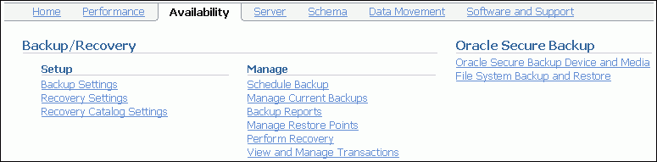
Recovery Manager (RMAN)
Powerful control and scripting language
Integrated with Enterprise Manager
Published API that enables interface with most popular backup software
Backing up data, control, archived log, and server parameter files
Backing up files to the disk or tape
Notes:
Recovery Manager (RMAN)
RMAN is the component of the Oracle database that is used to perform backup and recovery operations. It can make consistent and inconsistent backups, perform incremental and full backups, and back up either the whole database or a portion of it.
RMAN uses its own powerful job control and scripting language, as well as a published API that interfaces RMAN with many popular backup software solutions.
RMAN can store backups on the disk for quick recovery or place them on the tape for long-term storage. For RMAN to store backups on the tape, you must either use Oracle Secure Backup or configure an interface to the tape device known as a Media Management Library (MML).
Enterprise Manager supplies a graphical interface to the most commonly used RMAN functionality. Advanced backup and recovery operations are accessible through RMAN’s command-line client. For more information about advanced RMAN capabilities, see the course titled Oracle Database 11g: Administration Workshop II or consult the Oracle Backup and Recovery Advanced User’s Guide.

Slide 9
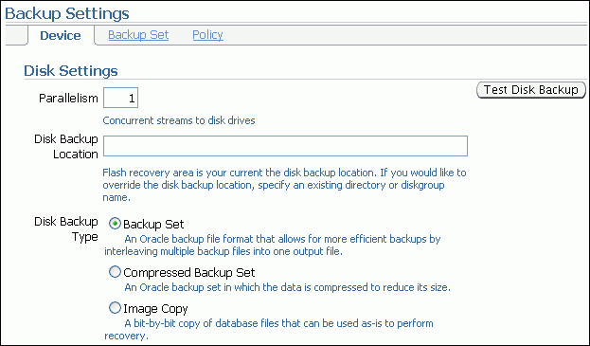
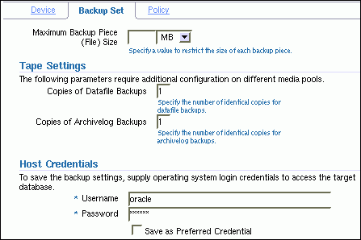
Configuring Backup Settings
Notes:
Configuring Backup Settings
Select Enterprise Manager > Availability > Backup Settings. Here you can manage the persistent backup settings that are used for creating backups. There are separate settings for the disk and the tape. Tape settings depend on the media management library capabilities. Disk settings include:
Parallelism: How many separate streams of backup information do you want to create? The best setting for parallelism depends on your hardware. As hardware resources increase, the appropriate degree of parallelism also increases. Generally, you want to set your parallelism to the number of disks that your disk backup location is striped over. For tape backup, you want to set your parallelism to the same number of tape drives that you have.
Disk backup location: Where should backups be stored? The default is the flash recovery area. If you change this, click Test Disk Backup to verify that RMAN can write to the new location.
Disk backup type: Select Backup Set, Compressed Backup Set, or Image Copy.
Click the Backup Set tab to set the maximum file size of backup pieces and to specify redundancy for tape backups. Host credentials are required for Enterprise Manager to save changes to the backup settings.

Slide 10
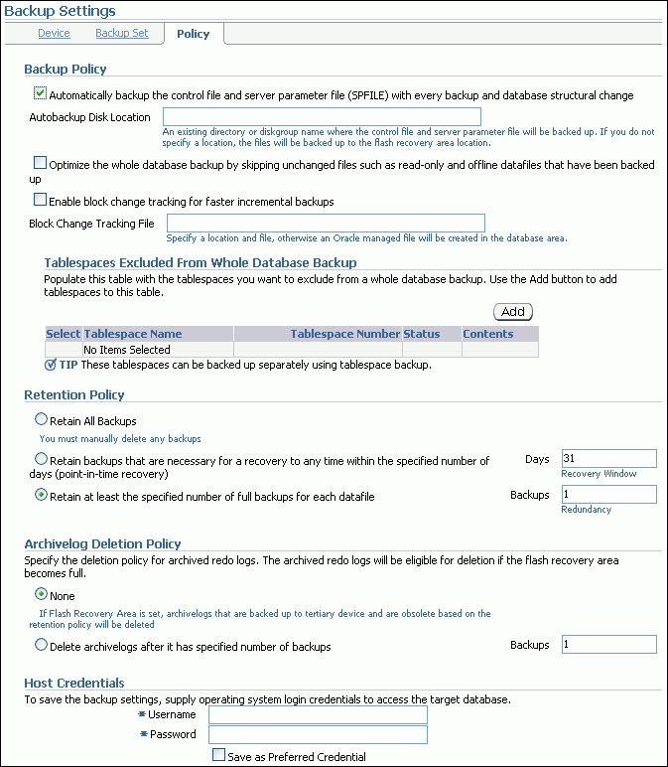
Configuring Backup Settings
Best practice
Backup
pieces
Change
tracking
file
Recovery area
Data files
Notes:
Configuring Backup Settings (continued)
Click the Policy tab to:
Automatically back up the control file and server parameter file (SPFILE) with each backup. You can also specify a location for these backups if you do not want them to go to the flash recovery area.
Optimize backups by not backing up files that exactly match a file that is already part of the retained backups. This setting enables you to skip read-only and offline data files.
Enable block change tracking and specify a location for the tracking file. If you intend to create incremental backups, this setting can decrease the time required to choose which blocks to include in the incremental backup.
Exclude tablespaces from a whole database backup. Some administrators choose not to back up tablespaces containing data or objects that can be easily re-created (such as indexes or data that is batch-loaded frequently).
Specify a retention policy: How long should RMAN keep your backups? If you are using the flash recovery area to store backups, RMAN automatically deletes old backups to make room for new ones (if the retention policy allows it). By default, only the last backup is retained. The retention policy can be specified as a number of backups or a number of days.

Slide 11
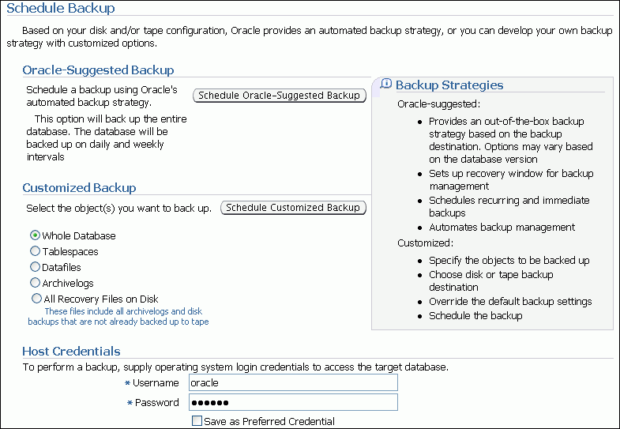
Scheduling Backups: Strategy
Notes:
Scheduling Backups: Strategy
Select Enterprise Manager > Availability > Schedule Backup. Select either the Oracle-Suggested Backup strategy or your own customized strategy. The Oracle-Suggested Backup strategy makes a one-time whole-database backup, which is performed online. This is a baseline incremental level 0 backup. The automated backup strategy then schedules incremental level 1 backups for each successive day.
By clicking Schedule Customized Backup, you gain access to a wider range of configuration options. Select the objects that you want to back up—the whole database (the default) or individual tablespaces, data files, archived logs, or any Oracle backups currently residing on the disk (to move them to the tape).
Both strategies enable you to set up encrypted backups.

Slide 12
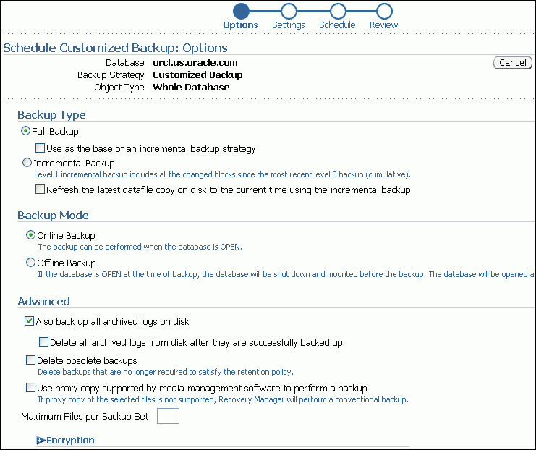
Scheduling Backups: Options
Notes:
Scheduling Backups: Options
Select full or incremental backup type. If you are performing a full database backup, you can select “Use as the base of an incremental backup strategy” to make the full database backup an incremental level 0 backup. If you are using image copies, you can select “Refresh the latest datafile copy on disk to the current time using the incremental backup” to update the existing backup rather than create a new image copy.
Select Online Backup if you want to perform this task while users are continuing to use the database. If users do not need access, select “Offline Backup,” which is performed with a mounted instance.
Select “Delete obsolete backups” to remove any backups that fall outside the retention policy that you configured earlier. RMAN automatically removes obsolete backups if you are backing up to the flash recovery area. Details about the advanced options and encryption are discussed in the course titled Oracle Database 11g: Administration Workshop II and in the backup and recovery documentation.

Slide 13
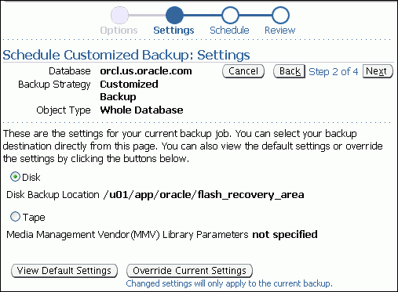
Scheduling Backups: Settings
Notes:
Scheduling Backups: Settings
Select whether the backup is to go to the disk or to the tape.
To create a one-time backup (in addition to your regularly scheduled backups), click Override Current Settings and specify your backup settings.

Slide 14
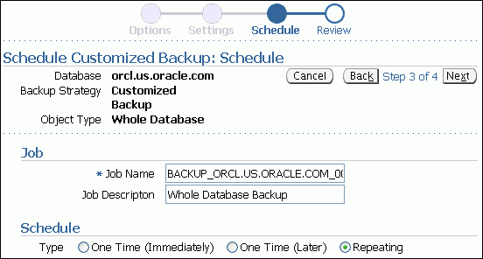
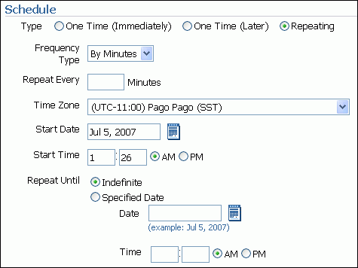
Scheduling Backups: Schedule
Notes:
Scheduling Backups: Schedule
Choose how you want the backup to be scheduled—either as a one-time job or as an automated, recurring process.
To configure a database for maximum recoverability, Oracle suggests regularly scheduled backups. Automating backups can simplify the administrator’s workload.
When you select Repeating, the page displays additional scheduling details.

Slide 15
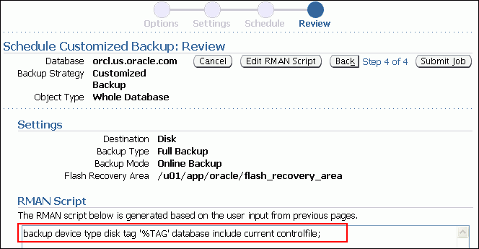
Scheduling Backups: Review
Notes:
Scheduling Backups: Review
RMAN uses its own command syntax and scripting language.
Using this page, you can customize the RMAN scripts (if needed) or copy them for recording purposes.

Slide 16
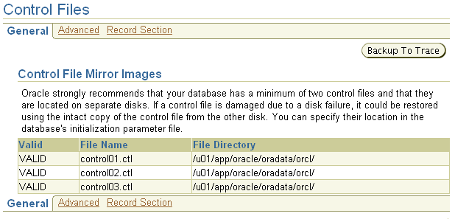
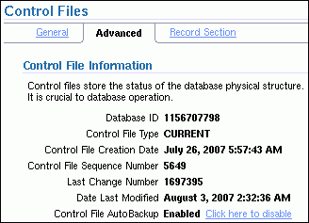
Backing Up the Control File to a Trace File
Control files have an additional backup option.
Control file trace backups may be used to recover from loss of all control files.
Notes:
Backing Up the Control File to a Trace File
Select Enterprise Manager > Server > Control Files to manage your database’s control files. Control files have an additional backup option; they may be backed up to a trace file. A control file trace backup contains the SQL statement required to re-create the control files in the event that all control files are lost.
Although it is very unlikely that a properly configured database (with multiple copies of the control file placed on separate disks and separate controllers) would lose all control files at the same time, it is possible. Therefore, the administrator should back up the control file to a trace file after each change to the physical structure of the database (adding tablespaces or data files, or adding additional redo log groups).
Trace copies of the control file can be created by using Enterprise Manager (as shown in the slide) or with the following SQL command:
SQL> ALTER DATABASE BACKUP CONTROLFILE TO TRACE;
The trace backup is created in the location specified by the USER_DUMP_DEST initialization parameter (for example, /u01/app/oracle/diag/rdbms/orcl/orcl/trace with a file name such as orcl_vktm_8400.trc).
You can view information from within the control file on the Advanced tab of the Control Files page.

Slide 17
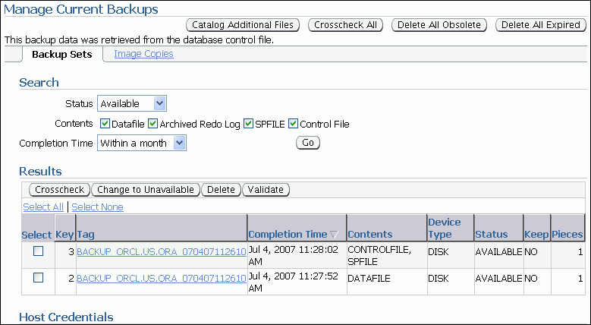
Managing Backups
Notes:
Managing Backups
Select Enterprise Manager > Availability > Manage Current Backup to manage your existing backups. On this page, you can see when a backup was completed, where it was created (disk or tape), and whether it is still available.
At the top of the Manage Current Backups page, four buttons enable you to work with existing backups:
Catalog Additional Files: Although RMAN (working through Enterprise Manager) is the recommended way to create backups, you might have image copies or backup sets that were created by some other means or in some other environment with the result that RMAN is not aware of them. This task identifies those files and adds them to the catalog.
Crosscheck All: RMAN can automatically delete obsolete backups, but you can also delete them by using operating system commands. If you delete a backup without using RMAN, the catalog does not know whether the backup is missing until you perform a cross-check between the catalog and what is really there.
Delete All Obsolete: This deletes backups older than the retention policy.
Delete All Expired: This deletes the catalog listing for any backups that are not found when the cross-check is performed.

Slide 18
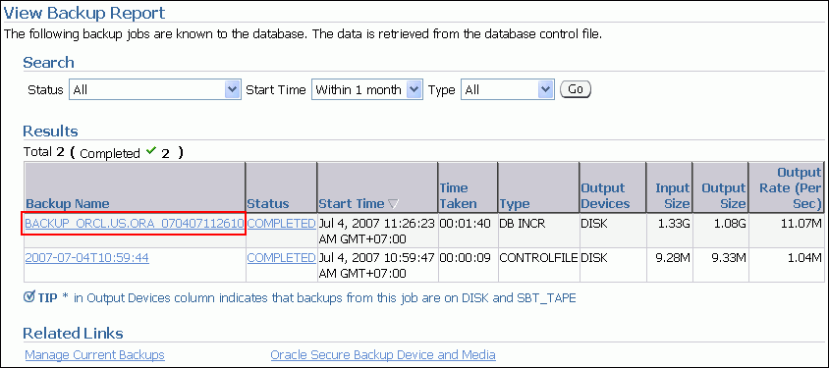
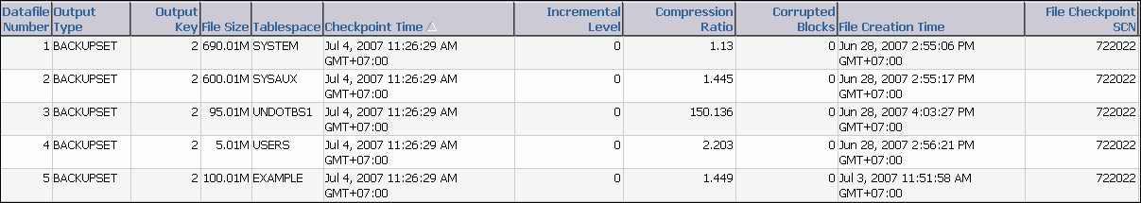
Viewing Backup Reports
Notes:
Viewing Backup Reports
Information about backup jobs can also be viewed by selecting Enterprise Manager > Availability > Backup Reports. The content is based on the control file. The backup report contains summary information as well as detailed information about the input and output of a specific job, including timing, SCN, sizing, compression, corruption (if any), and so on.

Slide 19
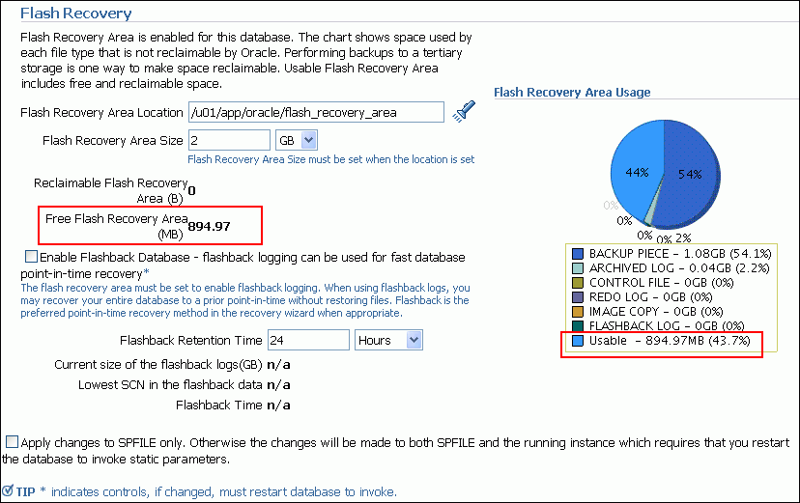
Monitoring the Flash Recovery Area
Notes:
Monitoring the Flash Recovery Area
If you have configured your archived logs to be written to this location, it is important to monitor this space to ensure that it does not reach its capacity. If the instance is unable to create an archived log because of lack of space, it pauses until the administrator corrects the situation.
Select Enterprise Manager > Availability > Recovery Settings. On this page, you can:
Verify how much of the flash recovery area has been consumed
Specify the location of the flash recovery area
Specify the size of the flash recovery area
Configure Flashback Database
Specify the retention time
The retention time determines when files are obsolete (that is, when they are no longer needed to meet your data recovery objectives). The Oracle database automatically manages this storage, deleting files that are no longer needed. When you back up the recovery area, RMAN can fail over to other archived redo log destinations if the archived redo log in the flash recovery area is inaccessible or corrupted.
Periodically copying backups to tape frees space in the flash recovery area for other files, but retrieving files from tape causes longer database restoration and recovery times.

Slide 20




Using the RMAN Command Line
1
$ rman target /
RMAN> CONFIGURE …
RMAN> BACKUP DATABASE PLUS ARCHIVELOG;
2
3
Copies of
Control file
Control files
Archived log file
SPFILE
Data files
Notes:
Using the RMAN Command Line
1. In a terminal session, start RMAN and connect to the target database.
2. Execute configuration commands:
CONFIGURE DEFAULT DEVICE TYPE TO disk;
CONFIGURE DEVICE TYPE DISK BACKUP TYPE TO COPY;
CONFIGURE CONTROLFILE AUTOBACKUP ON;
3. A whole database backup is a copy of all data files and the control file. You can optionally include the server parameter file (SPFILE) and archived redo log files. Using RMAN to make an image copy of all the database files simply requires mounting or opening the database, starting RMAN, and entering the BACKUP command shown in the slide.
Optionally, you can supply the DELETE INPUT option when backing up archive log files. That causes RMAN to remove the archive log files after backing them up. This is useful especially if you are not using a flash recovery area, which would perform space management for you, deleting files when space pressure grows. In that case, the command in the slide would look like the following:
RMAN> BACKUP DATABASE PLUS ARCHIVELOG DELETE INPUT;
You can also create a backup (either a backup set or image copies) of previous image copies of all data files and control files in the database by using the following command:
RMAN> BACKUP COPY OF DATABASE;

Slide 21
Summary
In this lesson, you should have learned how to:
Create consistent database backups
Back up your database without shutting it down
Create incremental backups
Automate database backups
Manage backups and view backup reports
Monitor the flash recovery area

Slide 22
Practice 15 Overview: Creating Database Backups
This practice covers the following topics:
Backing up your database while the database is open for user activity
Scheduling automatic nightly incremental backups for your database

