Slide 1
Performing Database Recovery

Slide 2
Objectives
After completing this lesson, you should be able to:
Determine the need for performing recovery
Access different interfaces (such as Enterprise Manager and command line)
Describe and use available options, such as Recovery Manager (RMAN) and the Data Recovery Advisor
Perform recovery:
Control file
Redo log file
Data file

Slide 3

Opening a Database
To open a database:
All control files must be present and synchronized
All online data files must be present and synchronized
At least one member of each redo log group must be present
STARTUP
OPEN
MOUNT
NOMOUNT
SHUTDOWN
Notes:
Opening a Database
As a database moves from the shutdown stage to being fully open, it performs internal consistency checks with the following stages:
NOMOUNT: For an instance to reach the NOMOUNT (also known as STARTED) status, the instance must read the initialization parameter file. No database files are checked while the instance enters the NOMOUNT state.
MOUNT: As the instance moves to the MOUNT status, it checks whether all control files listed in the initialization parameter file are present and synchronized. If even one control file is missing or corrupt, the instance returns an error (noting the missing control file) to the administrator and remains in the NOMOUNT state.
OPEN: When the instance moves from the MOUNT state to the OPEN state, it does the following:
Checks whether all redo log groups known to the control file have at least one member present. Any missing members are noted in the alert log.

Slide 4
Opening a Database Full Notes Page
Notes:
Opening a Database (continued)
Verifies that all data files known to the control file are present unless they have been taken offline. Offline files are not checked until the administrator tries to bring them online. The administrator may take a data file offline and open the instance if the data file does not belong to the SYSTEM or UNDO tablespaces. If any files are missing, an error noting the first missing file is returned to the administrator and the instance remains in the MOUNT state. When the instance finds files that are missing, only the first file causing a problem appears in the error message. To find all files that need recovery, the administrator can check the v$recover_file dynamic performance view to get a complete list of the files that need attention:
SQL> startup
ORACLE instance started.
Total System Global Area 171966464 bytes
Fixed Size 775608 bytes
Variable Size 145762888 bytes
Database Buffers 25165824 bytes
Redo Buffers 262144 bytes
Database mounted.
ORA-01157: cannot identify/lock data file 4 - see DBWR trace file
ORA-01110: data file 4: '/oracle/oradata/orcl/users01.dbf'
SQL> SELECT name, error
2 FROM v$datafile
3 JOIN v$recover_file
4 USING (file#);
NAME ERROR
----------------------------------- ------------------
/oracle/oradata/orcl/users01.dbf FILE NOT FOUND
/oracle/oradata/orcl/example01.dbf FILE NOT FOUND
Verifies that all data files that are not offline or read-only are synchronized with the control file. If necessary, instance recovery is automatically performed. However, if a file is out of synchronization to the extent that it cannot be recovered by using the online redo log groups, then the administrator must perform media recovery. If any files require media recovery, an error message noting the first file requiring recovery is returned to the administrator and the instance remains in the MOUNT state:
ORA-01113: file 4 needs media recovery
ORA-01110: data file 4: '/oracle/oradata/orcl/users01.dbf'
Again, v$recover_file gives a complete list of files that need attention. Files that are present and require media recovery are listed, but no error message is displayed.

Slide 5
Keeping a Database Open
After the database is open, it fails in the case of the loss of:
Any control file
A data file belonging to the system or undo tablespaces
An entire redo log group (As long as at least one member of the group is available, the instance remains open.)
Notes:
Keeping a Database Open
After a database is open, instance failure can be caused by media failure: for example, by the loss of a control file, the loss of an entire redo log group, or the loss of a data file belonging to the SYSTEM or UNDO tablespaces.
In many cases, the failed instance does not completely shut down but is unable to continue to perform work. Recovering from these types of media failure must be done with the database down. As a result, the administrator must use the SHUTDOWN ABORT command before beginning recovery efforts.
The loss of data files belonging to other tablespaces does not cause instance failure, and the database can be recovered while open, with work continuing in other tablespaces.
These errors can be detected by inspecting the alert log file or by using the Data Recovery Advisor.

Slide 6
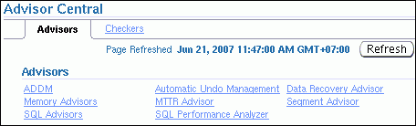
Data Recovery Advisor
Fast detection, analysis, and repair of failures
Down-time and run-time failures
Minimizing disruptions for users
User interfaces:
Enterprise Manager GUI (several paths)
RMAN command line
Supported database configurations:
Single instance
Not RAC
Supporting failover to standby, but not analysis and repair of standby databases
Notes:
Functionality of the Data Recovery Advisor
The Data Recovery Advisor automatically gathers data failure information when an error is encountered. In addition, it can proactively check for failures. In this mode, it can potentially detect and analyze data failures before a database process discovers the corruption and signals an error. (Note that repairs are always under human control.)
Data failures can be very serious. For example, if your current log files are missing, you cannot open your database. Some data failures (like block corruptions in data files) are not catastrophic because they do not take the database down or prevent you from opening the Oracle instance. The Data Recovery Advisor handles both cases: the one when you cannot start up the database (because required database files are missing, inconsistent, or corrupted) and the one when file corruptions are discovered during run time.
The preferred way to address serious data failures is as follows:
1. Fail over to a standby database if you are in a Data Guard configuration. This allows users to come back online as soon as possible.
2. Repair the primary cause of the data failure (fortunately, this does not affect your users).

Slide 7
Notes Only
Notes:
Functionality of the Data Recovery Advisor (continued)
User Interfaces
The Data Recovery Advisor is available from Enterprise Manager (EM) Database Control and Grid Control. When failures exist, there are several ways to access the Data Recovery Advisor. The following examples all begin on the Database Instance home page:
Availability tabbed page > Perform Recovery > Advise and Recover
Active Incidents link > on the Support Workbench “Problems” page: Checker Findings tabbed page > Launch Recovery Advisor
Database Instance Health > click specific link (for example, ORA 1578) in the Incidents section > Support Workbench, Problems Detail page > Data Recovery Advisor
Database Instance Health > Related Links section: Support Workbench > Checker Findings tabbed page: Launch Recovery Advisor
Related Link: Advisor Central > Advisors tabbed page: Data Recovery Advisor
Related Link: Advisor Central > Checkers tabbed page: Details > Run Detail tabbed page: Launch Recovery Advisor
You can also use the Data Recovery Advisor by using the RMAN command line:
rman target / nocatalog
rman> list failure all;
Supported Database Configurations
In the current release, the Data Recovery Advisor supports single-instance databases. Oracle Real Application Clusters databases are not supported.
The Data Recovery Advisor cannot use blocks or files transferred from a standby database to repair failures on a primary database. Furthermore, you cannot use the Data Recovery Advisor to diagnose and repair failures on a standby database. However, the Data Recovery Advisor does support failover to a standby database as a repair option (as mentioned above).

Slide 8

Loss of a Control File
If a control file is lost or corrupted, the instance normally aborts. You must then perform the following steps:
1. Shut down the instance (if it is still open).
2. Restore the missing control file by copying an existing control file.
3. Start the instance.
Control files
Notes:
Loss of a Control File
Recovering from the loss of a control file (if at least one control file remains) can be accomplished by performing the following steps:
1. If the instance has not already failed, shut it down by using SHUTDOWN ABORT.
2. Copy one of the remaining control files to the missing file’s location. If the media failure is due to the loss of a disk drive or controller, copy one of the remaining control files to some other location and update the instance’s parameter file to point to the new location. Alternatively, you can delete the reference to the missing control file from the initialization parameter file. Remember that Oracle recommends having at least two control files at all times.
3. Start the instance.
Recovering from the loss of all control files is covered in the course titled Oracle Database 11g: Administration Workshop II.

Slide 9
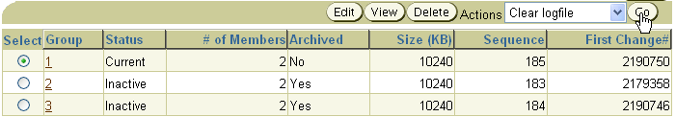
Loss of a Redo Log File
If a member of a redo log file group is lost and if the group still has at least one member, note the following results:
Normal operation of the instance is not affected.
You receive a message in the alert log notifying you that a member cannot be found.
You can restore the missing log file by copying one of the remaining files from the same group.
Notes:
Loss of a Redo Log File
Recovering from the loss of a single redo log group member should not affect the running instance.
To perform this recovery:
1. Determine whether there is a missing log file by examining the alert log.
2. Restore the missing file by copying one of the remaining files from the same group.
3. If the media failure is due to the loss of a disk drive or controller, rename the missing file.
4. If the group has already been archived, or if you are in NOARCHIVELOG mode, you may choose to solve the problem by clearing the log group to re-create the missing file or files. Select the appropriate group and then select the Clear Logfile action. You can also clear the affected group manually with the following command:
SQL> ALTER DATABASE CLEAR LOGFILE GROUP #;
Note: Database Control does not allow you to clear a log group that has not been archived. Doing so breaks the chain of redo information. If you must clear an unarchived log group, you should immediately take a full backup of the whole database. Failure to do so may result in a loss of data if another failure occurs. To clear an unarchived log group, use the following command:
SQL> ALTER DATABASE CLEAR UNARCHIVED LOGFILE GROUP #;

Slide 10



Loss of a Data File in NOARCHIVELOG Mode
If the database is in NOARCHIVELOG mode and if any data file is lost, perform the following tasks:
1. Shut down the instance if it is not already down.
2. Restore the entire database—including all data and control files—from the backup.
3. Open the database.
4. Have users reenter all changes that were made since the last backup.
User
User
User
User
User
Notes:
Loss of a Data File in NOARCHIVELOG Mode
The loss of any data file from a database in NOARCHIVELOG mode requires complete restoration of the database, including control files and all data files.
With the database in NOARCHIVELOG mode, recovery is possible only up to the time of the last backup. So users must reenter all changes made since that backup.
To perform this type of recovery:
1. Shut down the instance if it is not already down.
2. Click Perform Recovery on the Maintenance properties page.
3. Select Whole Database as the type of recovery.
If you have a database in NOARCHIVELOG mode that has an incremental backup strategy, RMAN first restores the most recent level 0 and then RMAN recovery applies the incremental backups.

Slide 11
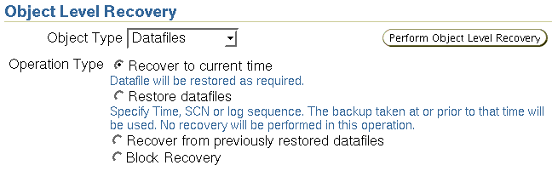

Loss of a Noncritical Data File in ARCHIVELOG Mode
If a data file is lost or corrupted, and if that file does not belong to the SYSTEM or UNDO tablespace, you restore and recover the missing data file.
Users
Notes:
Loss of a Noncritical Data File in ARCHIVELOG Mode
With the database in ARCHIVELOG mode, the loss of any data file not belonging to the SYSTEM or UNDO tablespaces affects only the objects that are in the missing file. The rest of the database remains available for users to continue work.
To restore and recover the missing data file:
1. Click Perform Recovery on the Maintenance properties page.
2. Select Datafiles as the recovery type, and then select “Restore to current time.”
3. Add all data files that need recovery.
4. Determine whether you want to restore the files to the default location or (if a disk or controller is missing) to a new location.
5. Submit the RMAN job to restore and recover the missing files.
Because the database is in ARCHIVELOG mode, recovery is possible up to the time of the last commit and users are not required to reenter any data.

Slide 12
Loss of a System-Critical Data File in ARCHIVELOG Mode
If a data file is lost or corrupted, and if that file belongs to the SYSTEM or UNDO tablespace, perform the following tasks:
1. The instance may or may not shut down automatically. If it does not, use SHUTDOWN ABORT to bring the instance down.
2. Mount the database.
3. Restore and recover the missing data file.
4. Open the database.
Users
Notes:
Loss of a System-Critical Data File in ARCHIVELOG Mode
Data files belonging to the SYSTEM tablespace or containing UNDO data are considered system critical. A loss of one of these files requires the database to be restored from the MOUNT state (unlike other data files that may be restored with the database open).
To perform this recovery:
1. If the instance is not already shut down, shut it down.
2. Mount the database.
3. Click Perform Recovery on the Maintenance properties page.
4. Select Datafiles as the recovery type, and then select “Restore to current time.”
5. Add all data files that need recovery.
6. Determine whether you want to restore the files to the default location or (if a disk or controller is missing) to a new location.
7. Submit the RMAN job to restore and recover the missing files.
8. Open the database. Users are not required to reenter data because the recovery is up to the time of the last commit.

Slide 13



Data Recovery Advisor
1. Assess data failures.
Health Monitor
2. List failures by severity.
Data
Recovery
Advisor
3. Advise on repair.
4. Choose and execute repair.
5. Perform proactive checks.
DBA
Notes:
Data Recovery Advisor
The automatic diagnostic workflow in Oracle Database 11g performs workflow steps for you. With the Data Recovery Advisor you only need to initiate an advise and a repair.
1. Health Monitor automatically executes checks and logs failures and their symptoms as “findings” into the automatic diagnostic repository (ADR). For details about Health Monitor, see the Diagnostics eStudy.
2. The Data Recovery Advisor consolidates findings into failures. It lists the results of previously executed assessments with failure severity (critical or high).
3. When you ask for repair advice on a failure, the Data Recovery Advisor maps failures to automatic and manual repair options, checks basic feasibility, and presents you with the repair advice.
4. You can execute a repair manually, or you can request the Data Recovery Advisor to do it for you.
5. In addition to the automatic, primarily “reactive” checks of Health Monitor and the Data Recovery Advisor, Oracle recommends using the VALIDATE command as a “proactive” check.

Slide 14
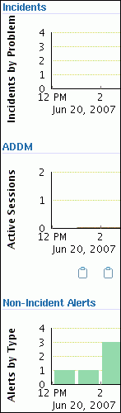
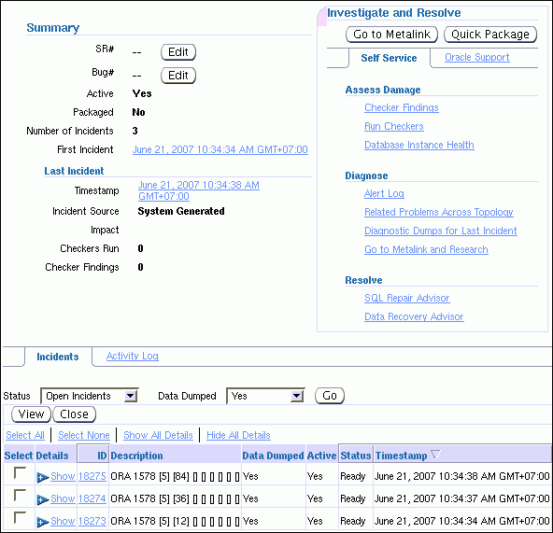
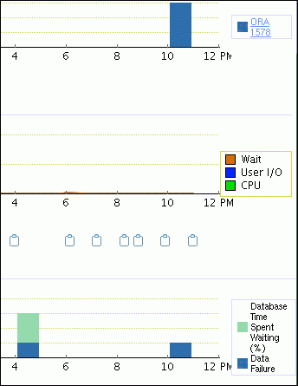
Assessing Data Failures
1
Database instance health
. . .
3
Problem details
2
Error link
Notes:
Assessing Data Failures
The example in the slide shows one of several possible ways to see the interaction of Health Monitor and the Data Recovery Advisor.

Slide 15
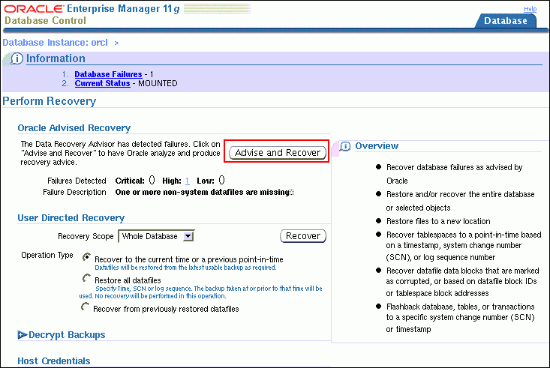
Data Failures
Notes:
Data Failures
Data failures are detected by checks, which are diagnostic procedures that asses the health of the database or its components. Each check can diagnose one or more failures, which are then mapped to a repair.
Checks can be reactive or proactive. When an error occurs in the database, reactive checks are automatically executed. You can also initiate proactive checks (for example, by executing the VALIDATE DATABASE command).
In Enterprise Manager, select Availability > Perform Recovery or click the Perform Recovery button if you find your database in a “down” or “mounted” state.

Slide 16

Data Failure: Examples
Inaccessible components: Missing data files at the OS level, incorrect access permissions, offline tablespace
Physical corruptions: Block checksum failures, invalid block header field values
Logical corruptions: Inconsistent dictionary; corrupt row piece, index entry, or transaction
Inconsistencies: Control file older or newer than the data files and online redo logs
I/O failures: Limit on the number of open files exceeded, inaccessible channels, network or I/O error
Notes:
Data Failure: Examples
The Data Recovery Advisor can analyze failures and suggest repair options for a growing list of issues.

Slide 17
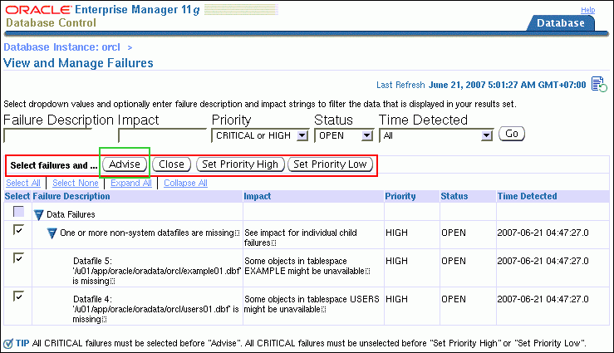
Listing Data Failures
Notes:
Listing Data Failures
On the Perform Recovery page, click “Advise and Repair.”
This “View and Manage Failures” page is the home page for the Data Recovery Advisor. The example in the screenshot shows how the Data Recovery Advisor lists data failures and details. Activities that you can initiate include advising, setting priorities, and closing failures.
The underlying RMAN LIST FAILURE command can also display data failures and details. Failure assessments are not initiated here; they are executed and stored in the ADR.
Failures are listed in decreasing priority order: CRITICAL, HIGH, LOW. Failures with the same priority are listed in order of increasing time stamps.

Slide 18
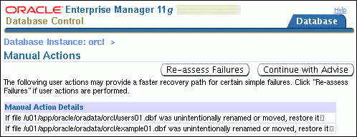
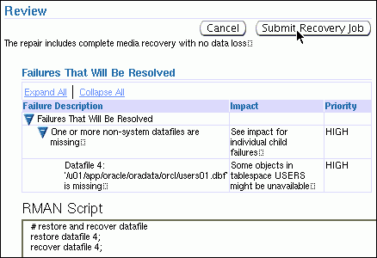
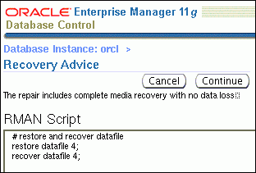
Advising on Repair
(1) After manual repair
(2) Automatic repair
1
2a
2b
Notes:
Advising on Repair
On the “View and Manage Failures” page, the Data Recovery Advisor generates a manual checklist after you click the Advise button. Two types of failures can appear.
Failures that require human intervention: An example is a connectivity failure when a disk cable is not plugged in.
Failures that are repaired faster if you can undo a previous erroneous action: For example, if you renamed a data file by error, it is faster to rename it back to its previous name than to initiate RMAN restoration from backup.
You can initiate the following actions:
Click “Re-assess Failures” after you perform a manual repair. Resolved failures are implicitly closed; any remaining failures are displayed on the “View and Manage Failures” page.
Click “Continue with Advise” to initiate an automated repair. When the Data Recovery Advisor generates an automated repair option, it generates a script that shows how RMAN plans to repair the failure. Click Continue if you want to execute the automated repair. If you do not want the Data Recovery Advisor to automatically repair the failure, you can use this script as a starting point for your manual repair.

Slide 19
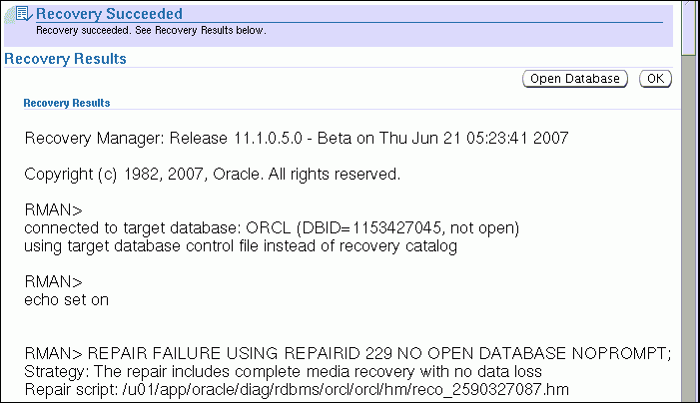
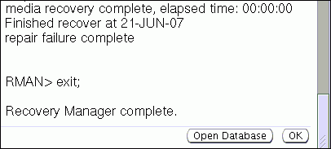

Executing Repairs
. . .
in less than 1 second
Notes:
Executing Repairs
The Data Recovery Advisor displays these pages. In the example, a successful repair is completed in less than one second.

Slide 20


Data Recovery Advisor Views
Querying dynamic data dictionary views
V$IR_FAILURE: Listing of all failures, including closed ones (result of the LIST FAILURE command)
V$IR_MANUAL_CHECKLIST: Listing of manual advice (result of the ADVISE FAILURE command)
V$IR_REPAIR: Listing of repairs (result of the ADVISE FAILURE command)
V$IR_FAILURE_SET: Cross-reference of failure and advise identifiers
Notes:
Data Recovery Advisor Views
Usage Example
Suppose that you need to display all failures that were detected on June 21, 2007.
SELECT * FROM v$ir_failure
WHERE trunc (time_detected) = '21-JUN-2007';
See the Oracle Database Reference for details about the dynamic data dictionary views used by the Data Recovery Advisor.

Slide 21
Summary
In this lesson, you should have learned how to:
Determine the need for performing recovery
Access different interfaces (such as Enterprise Manager and command line)
Describe and use available options, such as Recovery Manager (RMAN) and the Data Recovery Advisor
Perform recovery:
Control file
Redo log file
Data file

Slide 22
Practice 16 Overview: Performing Database Recovery
This practice covers recovering from the loss of a:
Control file
Redo log file
Noncritical data file
System-critical data file

