Slide 1
Performing Flashback

Slide 2
Objectives
After completing this lesson, you should be able to:
  Describe Flashback Database
  Restore the table content to a specific point in the past with Flashback Table
  Recover from a dropped table
  View the contents of the database as of any single point in time with Flashback Query
  See versions of a row over time with Flashback Versions Query
  View transaction history or a row with Flashback Transaction Query

Slide 3
Flashback Technology: Benefits
> Overview
Database
Table
Drop
Query
Versions
Transaction
  The Flashback technology is a revolutionary advance in recovery.
  Traditional recovery techniques are slow:
    The entire database or a file has to be restored, and not just the incorrect data.
    Every change in the database log must be examined.
  Flashback is fast:
    Changes are indexed by row and by transaction.
    Only the changed data is restored.
  Flashback commands are easy:
    No complex multiple-step procedures are involved.
Notes:
Flashback Technology: Benefits
The Oracle Database 10g architecture leverages the unique technological advances in the area of database recovery from the loss of data due to human errors. The Flashback technology provides a set of new features to view and rewind data back and forth in time.
The Flashback technology revolutionizes recovery by simply operating on the changed data. The time it takes to recover from the error is equal to the amount of time it takes to make the error. When applicable, the Flashback technology provides significant benefits over media recovery in terms of ease of use, availability, and restoration time.

Slide 4
When to Use the Flashback Technology
Object Level | Scenario Examples | Flashback Technology | Uses | Affects Data
Database | Truncate table; Undesired multitable changes made | Database | Flashback logs | TRUE
Table | Drop table | Drop | Recycle bin | TRUE
 | Update with the wrong WHERE clause | Table | Undo data | TRUE
 | Compare current data with data from the past | Query | Undo data | FALSE
 | Compare versions of a row | Version | Undo data | FALSE
Tx | Investigate several historical states of data | Transaction | Undo data | FALSE
Notes:
When to Use the Flashback Technology
The Flashback technology must be used when a logical corruption occurs in the Oracle database, and you need to recover data quickly and easily. As with human errors, it is difficult to identify the objects and rows that are affected by an erroneous transaction. With the Flashback technology, you can diagnose how errors are introduced into the database, and then you can repair the damage. You can view the transactions that have contributed to specific row modifications, view the entire set of versions of a given row during some time period, or just view data as it appeared at a specific time in the past. The table in the slide shows typical uses of the Flashback technology.
Flashback Database uses the flashback logs to perform flashback. Flashback Drop uses the recycle bin. All others use undo data.
Not all flashback features modify the database. Some are simply methods to query other versions of data. Those are tools for you to use to investigate a problem and aid in recovery. The results of those flashback queries can help you do one of these two things:
Determine which type of database-modifying flashback operation to perform to fix the problem
Feed the result set of these queries into an INSERT, UPDATE, or DELETE statement that enables you to easily repair the erroneous data.

Slide 5
Flashing Back Any Error
  Flashback Database brings the database to an earlier point in time by undoing all changes made since that time.
  Flashback Table recovers a table to a point in time in the past without having to restore from a backup.
  Flashback Drop restores accidentally dropped tables.
Notes:
Flashing Back Any Error
Oracle Database 10g introduces expanded database flashback capabilities. If a major error occurs that makes unisolated changes, such as a batch job being run twice in succession, you can request a flashback operation that quickly recovers the entire database to a previous point in time. This eliminates the need to restore backups and perform a point-in-time recovery. In addition to flashback operations at the database level, it is also possible to flash back a single table or recover a table dropped in error.

Slide 6




Flashback Database: Overview
Overview
> Database
Table
Drop
Query
Versions
Transaction
The Flashback Database operation:
  Works like a rewind button for the database
  Can be used in cases of logical data corruptions made by users
Users generate errors.
The database is corrupted.
Press the
rewind button.
The database is “rewound.”
Notes:
Flashback Database: Overview
With Flashback Database, you can quickly bring your database to an earlier point in time by undoing all the changes that have taken place since that time. This operation is fast, because you do not need to restore backups. You can use this feature to back out changes that have resulted in logical data corruptions.
If you have experienced a loss of media or physical corruption in your database, you must use traditional recovery methods.

Slide 7


Flashback Database:
Reducing Restore Time
Incomplete Recovery
Repaired
database
Restore files
Generate logs
Apply logs
forward
Backup
User error
Flashback Database
User
error
Repaired
database
Flashback logs
Backup
Apply Flashback logs backward
Notes:
Flashback Database: Reducing Restore Time
Flashback Database is faster than traditional point-in-time recovery that uses restored files and redo log files. As a database grows in size, the length of time required to restore all the data files to perform a traditional point-in-time recovery becomes prohibitive. With Flashback Database, the time to recover a database is now proportional to the number of changes that need to be backed out, and not to the size of the database, because you do not have to restore data files.
Flashback Database is implemented by using a type of log file called Flashback Database logs. The Oracle database periodically logs before images of data blocks in the Flashback Database logs. Block images can be reused to quickly back out the data file changes to any time at which flashback logs are captured just before the desired target time. Then changes from the redo log files are applied to fill in the gap. The Flashback Database logs are automatically created and managed in the flash recovery area.

Slide 8
Flashback Database: Considerations
  When the Flashback Database operation completes, the database must be opened by using one of these methods:
    In read-only mode to verify that the correct target time or SCN has been used
    With the RESETLOGS parameter to allow for updates
  The opposite of flash back is recover.
Notes:
Flashback Database: Considerations
In situations where you cannot use the Flashback Database feature, you must use an incomplete recovery operation to return the database to a specific time. After the Flashback Database operation is complete, you can open the database in read-only mode to verify that the correct target time or system change number (SCN) has been used. If not, you can flash back the database again or perform a recovery to roll forward the database. So to undo a Flashback Database operation, you must recover the database forward.
Note: The flashback retention target is not an absolute guarantee that flashback is available. If space is needed for required files in the flash recovery area, then flashback logs may be deleted automatically.

Slide 9

Flashback Database: Limitations
You cannot use Flashback Database in the following situations:
  The control file has been restored or re-created.
  A tablespace has been dropped.
  A data file has been shrunk.
Flashback target time
Drop tablespace
Shrink data file
Re-create control file
Present
Notes:
Flashback Database: Limitations
You cannot use Flashback Database to recover a data file that has been dropped since the Flashback target time. The dropped data file is added to the control file and marked offline, but it is not flashed back. Flashback Database cannot flash back a data file if it has been shrunk since the Flashback target time. Any such data files must be taken offline before performing the flashback operation.

Slide 10
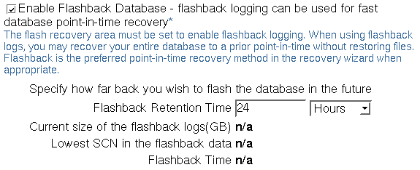
Enabling Flashback Database
Notes:
Enabling Flashback Database
Flashback Database can be enabled in Enterprise Manager, using the Recovery Settings link on the Maintenance tabbed page. Turn on the checkmark in the Flash Recovery region of the page, and specify the retention time, which is how far back in the past you wish to be able to flash back the database to.

Slide 11





Flashback Table: Overview
Overview
Database
> Table
Drop
Query
Versions
Transaction
  Flashback Table recovers tables to a
  specific point in time.
  Flashback Table is an in-place operation.
  The database stays online.
Erroneous
DMLs
Flashed back
tables
User
Notes:
Flashback Table: Overview
Using Flashback Table, you can recover a set of tables to a specific point in time without having to perform traditional point-in-time recovery operations.
A Flashback Table operation is done in-place, while the database is online, by rolling back only the changes that are made to the given tables and their dependent objects.
A Flashback Table statement is executed as a single transaction. All tables must be flashed back successfully, or the entire transaction is rolled back.
Note: You can use Flashback Versions Query and Flashback Transaction Query to determine the appropriate flashback time.

Slide 12
Flashback Table
  Using Flashback Table, you can recover a table or tables to a specific point in time without restoring a backup.
  Data is retrieved from the undo tablespace to perform a Flashback Table operation.
  The FLASHBACK TABLE privilege is required to perform flashback of a table.
  Row movement must be enabled on the table that you are performing the flashback operation on.
Notes:
Flashback Table
With Flashback Table, you can recover a table or tables to a specific point in time without restoring a backup. When you use this feature, the data in tables and their associated objects (indexes, constraints, triggers, and so on) is restored. The data used to satisfy a Flashback Table request is retrieved from the undo tablespace.
You can use Flashback Versions Query and Flashback Transaction Query to determine the appropriate flashback time. For more information about using these features, refer to Oracle Database Concepts.
Flashback Table provides a way for users to easily and quickly recover from accidental modifications without a database administrator’s (DBA’s) involvement. You must grant the FLASHBACK TABLE or FLASHBACK ANY TABLE system privilege to any user that uses the Flashback Table feature. In addition, you must grant the SELECT, INSERT, DELETE, and ALTER object privileges to the user.
You can use Enterprise Manager to flash back a table. The wizard guides you through the process.

Slide 13
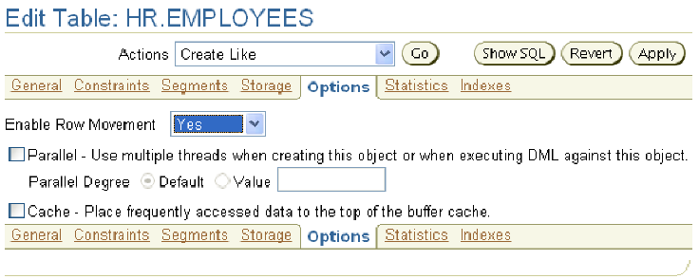
Enabling Row Movement on a Table
ALTER TABLE employees ENABLE ROW MOVEMENT;
Notes:
Enabling Row Movement on a Table
You must enable row movement on a table to be able to flash back the table. When you enable row movement, the Oracle server can move a row in the table. You can use Enterprise Manager to enable row movement.
Using Enterprise Manager, you can enable row movement on a table by performing the following steps:
1. Select Tables in the Schema region on the Administration property page. Enter the schema name to search for the table, and click Go.
2. Click the table name of the table for which you want to enable row movement. You are now on the View Table page.
3. Click Edit, which takes you to the Edit Table page.
4. Click the Options tab, where you can change the Enable Row Movement setting for the table.
5. Set Enable Row Movement to Yes, and click Apply.
The update confirmation message is displayed.

Slide 14
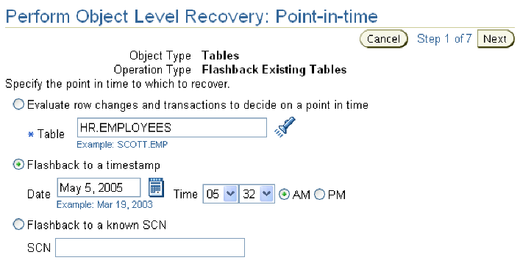
Performing Flashback Table
FLASHBACK TABLE hr.employees TO TIMESTAMP
TO_TIMESTAMP('2005-05-05 05:32:00',
'YYYY-MM-DD HH24:MI:SS');
Notes:
Performing Flashback Table
You can flash back a table through Enterprise Manager by performing the following steps:
1. Select Perform Recovery in the Backup/Recovery region on the Maintenance property page. The Perform Recovery page appears.
2. In the Object Level Recovery section, select Tables from the Object Type drop-down list.
3. Select Flashback Existing Tables as the Operation Type. Click Perform Object Level Recovery. The Perform Object Level Recovery: Point-in-time page is displayed.
4. Select “Flashback to a timestamp” or “Flashback to a known SCN” and then specify a timestamp or SCN to flashback to, and click Next.
5. Click Add Tables to add tables to the list for the flashback operation. Click Next.
6. The Dependency Options page appears if there are dependent tables. Select the desired option for dealing with dependent tables. Typically, you would choose “Cascade,” to ensure a consistent flashback. Click Next.

Slide 15
Performing Flashback Table
Notes Only Page
Notes:
Performing Flashback Table (continued)
7. The Perform Object Level Recovery: Review page appears. Review the information, and click Submit. The Confirmation page appears.
Note: You can also flash back tables from the Tables link in the Schema region of the Administration page.

Slide 16
Flashback Table: Considerations
  The FLASHBACK TABLE command executes as a single transaction, acquiring exclusive DML locks.
  Statistics are not flashed back.
  Current indexes and dependent objects are maintained.
  Flashback Table operations:
    Cannot be performed on system tables
    Cannot span DDL operations
    Are written to the alert log file
    Generate undo and redo data
Notes:
Flashback Table: Considerations
The entire FLASHBACK TABLE statement is executed within a single transaction. All or none of the specified tables are flashed back.
Flashback Table acquires exclusive data manipulation language (DML) locks on all the tables that are specified in the statement over the period of time when the operation is in progress.
Statistics of impacted objects are not flashed back.
All existing indexes are maintained. Dropped indexes are not re-created. Dependent on-commit materialized views are also maintained automatically.
A FLASHBACK TABLE statement is written to the alert log file.
Tables specified in the FLASHBACK TABLE statement are flashed back, provided none of the table constraints are violated. If any constraints are violated during flashback execution, the operation is aborted and the tables are left in the same state as they were just before the FLASHBACK TABLE statement invocation.
You cannot perform Flashback Table to a particular time that is older than the time of the execution of a data definition language (DDL) operation that altered the structure of or shrunk a table that would be involved in the flashback operation. This restriction does not apply to DDL statements that only change storage attributes of the tables.
Flashback Table cannot be performed on system tables, remote tables, and fixed tables.

Slide 17



Flashback Drop: Overview
Overview
Database
Table
> Drop
Query
Versions
Transaction
Recycle
Bin
DROP TABLE employees;
FLASHBACK TABLE
employees
TO BEFORE DROP;
Mistake was
made
Notes:
Flashback Drop: Overview
With the Flashback Drop feature, you can undo the effects of a DROP TABLE statement without resorting to traditional point-in-time recovery. This is made possible because of the recycle bin, which can be queried via the DBA_RECYCLEBIN view.

Slide 18
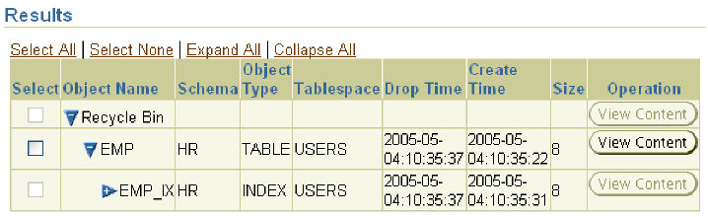
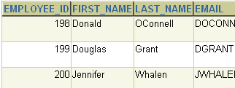
Flashing Back Dropped Tables
Through Enterprise Manager
Dependent bitmap index
will also be flashed back.
Notes:
Flashing Back Dropped Tables Through Enterprise Manager
To flash back dropped tables with the Database Control Console, select Perform Recovery in the Backup/Recovery region of the Maintenance page. Select Tables for the Object Type in the Type region, and choose Flashback Dropped Tables in the Operation Type region. After this is done, click Perform Object Level Recovery.
You should now see the Perform Object Level Recovery: Dropped Objects Selection page, where you can select dropped tables from the recycle bin. You can also query the content of dropped tables by clicking View Content. Select the tables that you want to recover, and click Next.
The Perform Object Level Recovery: Rename page appears, where you can rename the table if a table with the same name currently exists in the same schema. Click Next to continue. On the Perform Object Level Recovery: Review page, you can review the details of your operation as well as display the corresponding SQL statements. After you are ready, click Submit. You should now see the Confirmation page. Click OK to go back to the Maintenance page.
Note: You can also flash back dropped tables from the Tables link of the Schema region of the Administration page. On the Tables page, click the Recycle Bin button.

Slide 19
Flashback Drop: Considerations
  Flashback Drop does not work for tables that:
    Reside in the SYSTEM tablespace
    Use fine-grained auditing or Virtual Private Database
    Reside in a dictionary managed tablespace
    Have been purged, either by manual purging or automatic purging under space pressure
  The following dependencies are not protected:
    Bitmap-join indexes
    Materialized view logs
    Referential integrity constraints
    Indexes dropped before tables
Notes:
Flashback Drop: Considerations
Flashback Drop only works for tables in non-SYSTEM, locally managed tablespaces (LMT). However, dependent objects that reside in dictionary-managed tablespaces are flashed back as part of the flashback operation of the LMT-dwelling parent object.
Tables with fine-grained auditing (FGA) or Virtual Private Database (VPD) policies defined on them are not eligible for a Flashback Drop operation. Also, you cannot flash back a dropped table if it has been purged. It could have been purged manually with the PURGE statement or automatically as the result of a need for space for other objects in the tablespace.
When you perform Flashback Drop on a table, all objects dependent on that table are also flashed back from the recycle bin. There are exceptions to this: Bitmap-join indexes, referential integrity constraints, and materialized view logs are not flashed back, even though their parent table is.
Note: If you drop an index before its associated table, recovery of the index is not supported when you flash back the dropped table.

Slide 20
Flashback Time Navigation
Overview
Database
Table
Drop
> Query
Versions
Transaction
  Flashback Query:
    Query all data at a specified point in time.
  Flashback Versions Query:
    See all versions of a row between two times.
    See the transactions that changed the row.
  Flashback Transaction Query:
    See all changes made
    by a transaction.
Time
Tx3
Tx2
Flashback
Tx1
Notes:
Flashback Time Navigation
The Flashback technology offers the capability to query past versions of schema objects, query historical data, and perform change analysis. Every transaction logically generates a new version of the database. With the Flashback technology, you can navigate through these versions to find an error and its cause:
Flashback Query: Query all data as it existed at a specific point in time.
Flashback Versions Query: See all versions of rows between two times and the transactions that changed the row.
Flashback Transaction Query: See all changes made by a transaction.

Slide 21
Flashback Query: Overview
Employees
Unwanted
updates
Employees
t1
t2
SELECT employee_id, salary FROM employees
AS OF TIMESTAMP t1
WHERE employee_id = 200
Notes:
Flashback Versions Query: Overview
With the Flashback Query feature, you can perform queries on the database as of a certain time. By using the AS OF clause of the SELECT statement, you can specify the timestamp for which to view the data. This is useful for analyzing a data discrepancy.
Note: The AS OF clause can be followed by either TIMESTAMP or SCN.

Slide 22
Flashback Query: Example
Employees
Employees
Employees
salary = 4400
salary = 4840
salary = 4400
11:00
11:10
UPDATE employees SET salary =
  (SELECT salary FROM employees
  AS OF TIMESTAMP TO_TIMESTAMP
  ('2005-05-04 11:00:00', 'yyyy-mm-dd hh24:mi:ss')
  WHERE employee_id = 200)
WHERE employee_id = 200
Notes:
Flashback Versions Query: Example
If a raise has been erroneously given to a particular employee recently, you can update the salary again, assigning the salary provided by a subquery that returns the flashed back value.

Slide 23
Flashback Versions Query:
Overview
Overview
Database
Table
Drop
Query
> Versions
Transaction
Tx0
Tx1
Tx2
Employees
Employees
Employees
200
t1
t2
SELECT versions_xid, salary FROM employees
VERSIONS BETWEEN TIMESTAMP t1 and t2
WHERE employee_id = 200;
Tx0
Tx1
Tx2
Notes:
Flashback Versions Query: Overview
With the Flashback Query feature, you can perform queries on the database as of a certain time span or range of user-specified system change numbers (SCN). The Flashback Versions Query feature enables you to use the VERSIONS clause to retrieve all the versions of the rows that exist between two points in time or two SCNs.
The rows returned by Flashback Versions Query represent a history of changes for the rows across transactions. Flashback Versions Query retrieves only committed occurrences of the rows. Uncommitted row versions within a transaction are not shown. The rows returned also include deleted and subsequently reinserted versions of the rows.
You can use Flashback Versions Query to retrieve row history. It provides you with a way to audit the rows of a table and retrieve information about the transactions that affected the rows. You can then use the returned transaction identifier to perform transaction mining by using LogMiner or to perform a Flashback Versions Query, which is covered later in this lesson.
Note: In the example, VERSIONS_XID is a pseudocolumn that returns the transaction identifier of the corresponding version of a row.

Slide 24
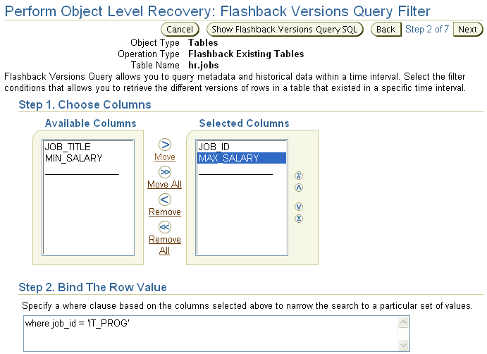
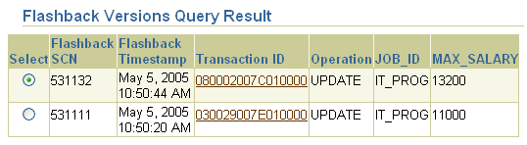
Flashback Versions Query Through Enterprise Manager
Notes:
Flashback Versions Query Through Enterprise Manager
Flashback Versions Query can also be performed through Enterprise Manager. On the Maintenance page, select Perform Recovery.
On the Perform Recovery page, select Tables for the Object Type and select Flashback Existing Tables for the Operation Type. Click Perform Object Level Recover. On the Perform Object Level Recovery: Point-in-Time page, select “Evaluate row changes and transactions to decide on a point in time,” and specify the name of the target table.
Select the columns that you want to view in the Available Columns box, and then enter a search clause in the Bind The Row Value box. Select “Show all row history,” and then click Next.

Slide 25
Flashback Versions Query: Considerations
  The VERSIONS clause cannot be used to query:
    External tables
    Temporary tables
    Fixed tables
    Views
  The VERSIONS clause cannot span DDL commands.
  Segment shrink operations are filtered out.
Notes:
Flashback Versions Query: Considerations
The VERSIONS clause cannot be used to query the following special tables:
External tables
Temporary tables
Fixed tables
You cannot use the VERSIONS clause to query a view. However, a view definition can use the VERSIONS clause.
The VERSIONS clause in a SELECT statement cannot produce versions of rows across the DDL statements that change the structure of the corresponding tables. This means that the query stops producing rows after it reaches a time in the past when the table structure was changed.
Certain maintenance operations, such as a segment shrink, may move table rows across blocks. In this case, the version query filters out such phantom versions because the row data remains the same.

Slide 26



Flashback Transaction Query:
Overview
Overview
Database
Table
Drop
Query
Versions
> Transaction
FLASHBACK_TRANSACTION_QUERY
DBA
Erroneous
DML
Undo
SQL
User
Notes:
Flashback Transaction Query: Overview
Flashback Transaction Query is a diagnostic tool that you can use to view changes made to the database at the transaction level. This enables you to diagnose problems in your database and perform analysis and audits of transactions.
You can use the FLASHBACK_TRANSACTION_QUERY view to determine all the necessary SQL statements that can be used to undo the changes made either by a specific transaction or during a specific period of time.

Slide 27
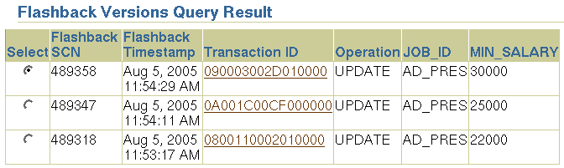
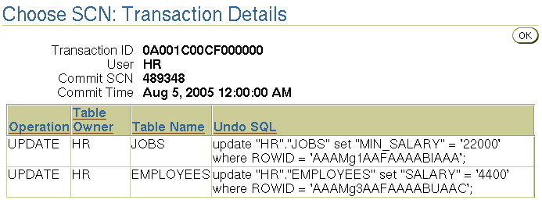
Flashback Transaction Query Through Enterprise Manager
Notes:
Flashback Transaction Query Through Enterprise Manager
This feature is used in conjunction with the Flashback Versions Query feature with the help of the Perform Recovery Wizard. On the Perform Object Level Recovery: Choose SCN page, click the corresponding Transaction ID link in the Flashback Versions Query Result region.
In the above example, a Flashback Versions query is done on the JOBS table to retrieve the three versions of the JOBS row for JOB_ID = 'AD_PRES'. Then, one of the transaction IDs is clicked, showing all the changes that were part of that transaction. Notice that, besides the JOBS table update, there was also an update to the EMPLOYEES table in that transaction.

Slide 28
Flashback Transaction Query: Considerations
  DDLs are seen as dictionary updates.
  Dropped objects appear as object numbers.
  Dropped users appear as user identifiers.
Notes:
Flashback Transaction Query: Considerations
Within the database, DDL operations are nothing but a series of space management operations and changes to the data dictionary. Flashback Transaction Query on a transaction underlying a DDL displays the changes made to the data dictionary.
When Flashback Transaction Query involves tables that have been dropped from the database, the table names are not reflected. Instead, object numbers are used.
If the user who executed a transaction is dropped, Flashback Transaction Query of that transaction displays the corresponding user ID only, and not the username.
Note: When there is not enough undo data for a specific transaction, a row with a value of UNKNOWN in the OPERATION column of FLASHBACK_TRANSACTION_QUERY is returned.

Slide 29
Summary
In this lesson, you should have learned how to:
  Describe Flashback Database
  Restore the table content to a specific point in the past with Flashback Table
  Recover from a dropped table
  View the contents of the database as of any single point in time with Flashback Query
  See versions of a row over time with Flashback Versions Query
  View transaction history or a row with Flashback Transaction Query

Slide 30
Practice Overview:
Using Flashback
This practice covers the following topics:
  Using Flashback to recover a dropped table
  Performing Flashback Versions Query

