Slide 1
Moving Data

Slide 2


Objectives
After completing this lesson, you should be able to do the following:
  Use SQL*Loader to load data from a non-Oracle database (or user files)
  Explain the general architecture of Data Pump
  Use Data Pump Export and Import
  Describe the use of external tables for data population
  Use the scheduler to automate tasks

Slide 3
SQL*Loader: Overview
Loader control file
Input data files
Parameter file
(optional)
SQL*Loader
Rejected
Field processing
Discarded
Accepted
Record selection
Bad
file
Selected
Oracle server
Discard file
(optional)
Rejected
Inserted
Log file
Notes:
SQL*Loader: Overview
SQL*Loader loads data from external files into tables of an Oracle database. It has a powerful data parsing engine that puts little limitation on the format of the data in the data file. The files that are used by SQL*Loader are as follows:
Input data files: SQL*Loader reads data from one or more files (or operating system equivalents of files) that are specified in the control file. From SQL*Loader’s perspective, the data in the data file is organized as records. A particular data file can be in fixed record format, variable record format, or stream record format. The record format can be specified in the control file with the INFILE parameter. If no record format is specified, the default is stream record format.
Control file: The control file is a text file that is written in a language that SQL*Loader understands. The control file tells SQL*Loader where to find the data, how to parse and interpret the data, where to insert the data, and so on. Although not precisely defined, a control file can be said to have three sections.
The first section contains sessionwide information, for example:
Global options, such as bind size, rows, and records to skip
INFILE clauses to specify where the input data is located
Data to be loaded

Slide 4
SQL*Loader Overview
Full Notes Page
Notes:
SQL*Loader: Overview (continued)
The second section consists of one or more INTO TABLE blocks. Each of these blocks contains information about the table (such as the table name and the columns of the table) into which the data is to be loaded.
The third section is optional and, if present, contains input data.
Log file: When SQL*Loader begins execution, it creates a log file. If it cannot create a log file, execution terminates. The log file contains a detailed summary of the load, including a description of any errors that occurred during the load.
Bad file: The bad file contains records that are rejected, either by SQL*Loader or by the Oracle database. Data file records are rejected by SQL*Loader when the input format is invalid. After a data file record is accepted for processing by SQL*Loader, it is sent to the Oracle database for insertion into a table as a row. If the Oracle database determines that the row is valid, the row is inserted into the table. If the row is determined to be invalid, the record is rejected and SQL*Loader puts it in the bad file.
Discard file: This file is created only when it is needed, and only if you have specified that a discard file should be enabled. The discard file contains records that are filtered out of the load because they do not match any record-selection criteria specified in the control file.
For more information about SQL*Loader, refer to the Oracle Database Utilities documentation.

Slide 5

SQL*Loader Control File
The SQL*Loader control file instructs SQL*Loader about:
  Location of the data to be loaded
  The data format
  Configuration details:
    Memory management
    Record rejection
    Interrupted load handling details
  Data manipulation details
Notes:
SQL*Loader Control File
The SQL*Loader control file is a text file that contains data definition language (DDL) instructions. DDL is used to control the following aspects of a SQL*Loader session:
Where SQL*Loader finds the data to load
How SQL*Loader expects that data to be formatted
How SQL*Loader configures (memory management, selection and rejection criteria, interrupted load handling, and so on) as it loads the data
How SQL*Loader manipulates the data being loaded

Slide 6
SQL*Loader Control File
Full Notes Page
Notes:
SQL*Loader Control File (continued)
1 -- This is a sample control file
2 LOAD DATA
3 INFILE ’SAMPLE.DAT’
4 BADFILE ’sample.bad’
5 DISCARDFILE ’sample.dsc’
6 APPEND
7 INTO TABLE emp
8 WHEN (57) = ’.’
9 TRAILING NULLCOLS
10 (hiredate SYSDATE,
deptno POSITION(1:2) INTEGER EXTERNAL(3)
NULLIF deptno=BLANKS,
job POSITION(7:14) CHAR TERMINATED BY WHITESPACE
NULLIF job=BLANKS "UPPER(:job)",
mgr POSITION(28:31) INTEGER EXTERNAL
TERMINATED BY WHITESPACE, NULLIF mgr=BLANKS,
ename POSITION(34:41) CHAR
TERMINATED BY WHITESPACE "UPPER(:ename)",
empno POSITION(45) INTEGER EXTERNAL
TERMINATED BY WHITESPACE,
sal POSITION(51) CHAR TERMINATED BY WHITESPACE
"TO_NUMBER(:sal,’$99,999.99’)",
comm INTEGER EXTERNAL ENCLOSED BY ’(’ AND ’%’
":comm * 100"
)
The explanation of a sample control file by line numbers is as follows:
1. Comments can appear anywhere in the command section of the file, but they must not appear within the data. Precede any comment with two hyphens. All text to the right of the double hyphen is ignored, until the end of the line.
2. The LOAD DATA statement tells SQL*Loader that this is the beginning of a new data load. If you are continuing a load that has been interrupted in progress, use the CONTINUE LOAD DATA statement.
3. The INFILE keyword specifies the name of a data file containing data that you want to load.
4. The BADFILE keyword specifies the name of a file into which rejected records are placed.
5. The DISCARDFILE keyword specifies the name of a file into which discarded records are placed.
6. The APPEND keyword is one of the options that you can use when loading data into a table that is not empty. To load data into a table that is empty, use the INSERT keyword.
7. The INTO TABLE keyword enables you to identify tables, fields, and data types. It defines the relationship between records in the data file and tables in the database.
8. The WHEN clause specifies one or more field conditions that each record must match before SQL*Loader loads the data. In this example, SQL*Loader loads the record only if the 57th character is a decimal point. That decimal point delimits dollars and cents in the field and causes records to be rejected if SAL has no value.
9. The TRAILING NULLCOLS clause tells SQL*Loader to treat any relatively positioned columns that are not present in the record as null columns.
10. The remainder of the control file contains the field list, which provides information about column formats in the table that is being loaded.

Slide 7
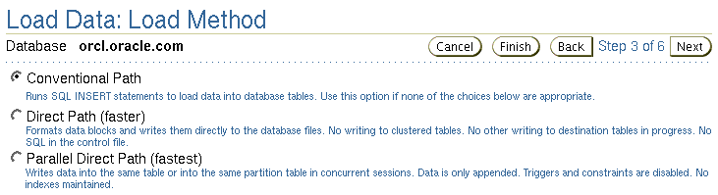
Loading Methods
Notes:
Loading Methods
SQL*Loader provides three methods for loading data:
Conventional path
Direct path
Parallel direct path
Conventional Path Load
Conventional path load builds an array of rows to be inserted and uses the SQL INSERT statement to load the data. During conventional path loads, input records are parsed on the basis of field specifications, and an array of records is built and inserted into the table specified in the control file. Records that do not conform to the field specifications are rejected, and those records that do not satisfy the selection criteria are discarded.
Conventional path loads can be used to load data into both the clustered and unclustered tables. Redo generation is controlled by the logging attribute for the table that is being loaded.

Slide 8
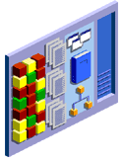
Loading Methods
Array
insert
Conventional
Direct
path
SGA
High-water mark
Table
Block writes
Space used only by conventional load
Notes:
Loading Methods (continued)
Direct Path Load
A direct path load builds blocks of data in memory and saves these blocks directly into the extents allocated for the table being loaded. Online redo log file entries are not generated unless the database is in ARCHIVELOG mode. Direct path loads use the field specifications to build whole Oracle blocks of data, and write the blocks directly to Oracle data files above the high-water mark. The high-water mark is the highest point to which data has been written into the table so far. A direct path load bypasses the database buffer cache and accesses the System Global Area (SGA) only for extent management and adjustment of the high-water mark.

Slide 9
Comparing Direct and Conventional
Path Loads
Conventional Load
Uses COMMIT to make
changes permanent
Redo entries always
generated
Enforces all constraints
INSERT triggers fire
Can load data into
clustered tables
Other users can make
changes to tables
Direct Path Load
Uses data saves
Generates redo only under
specific conditions
Enforces only PRIMARY KEY,
UNIQUE, and NOT NULL
INSERT triggers do not fire
Cannot load data into
clustered tables
Other users cannot
make changes to tables
Notes:
Comparing Direct and Conventional Path Loads
Method of Saving Data
Conventional path loads use SQL processing and a database COMMIT operation for saving data. The insertion of an array of records is followed by a COMMIT operation. Each data load may involve several transactions.
Direct path loads use data saves to write blocks of data to Oracle data files. The following features differentiate a data save from COMMIT:
During a data save, only full database blocks are written to the database.
The blocks are written after the high-water mark of the table.
After a data save, the high-water mark is moved.
Internal resources are not released after a data save.
A data save does not end the transaction.
Indexes are not updated at each data save.
Note: Direct path and parallel direct path loads are so similar regarding DML activities that they are not separated in this comparison.

Slide 10
Comparing Direct and Conventional
Path Loads Full Notes Page
Notes:
Comparing Direct and Conventional Path Loads (continued)
Logging Changes
Conventional path loading generates redo entries similar to any DML statement. When using a direct path load, redo entries are not generated if:
The database is in NOARCHIVELOG mode
The database is in ARCHIVELOG mode, but logging is disabled. Logging can be disabled by setting the NOLOGGING attribute for the table or by using the UNRECOVERABLE clause in the control file.
Enforcing Constraints
During a conventional path load, all enabled constraints are enforced in the same way that they are during any DML operation.
During direct path loads, the constraints are handled as follows:
NOT NULL constraints are checked when arrays are built.
FOREIGN KEY and CHECK constraints are disabled, and they can be enabled at the end of the run by using the appropriate commands in the control file. The FOREIGN KEY constraints are disabled because they reference other rows or tables, and the CHECK constraints are disabled because they may use SQL functions. If only a small number of rows are to be inserted into a large table, use conventional loads.
PRIMARY KEY and UNIQUE constraints are checked during and at the end of the run, and they may be disabled if they are violated.
Firing the INSERT Triggers
The WHILE INSERT triggers are fired during conventional loads; they are disabled before a direct path load and reenabled at the end of the run. They may remain disabled if a referenced object is not accessible at the end of the run. Consider using conventional path loads to load data into tables with the INSERT triggers.
Loading into Clustered Tables
Direct Loads cannot be used to load rows into clustered tables. Clustered tables can be loaded with conventional path loads only.
Locking
While a direct path load is in progress, other transactions cannot make changes to the tables that are being loaded. The only exception to this rule is when several parallel direct load sessions are used concurrently.

Slide 11
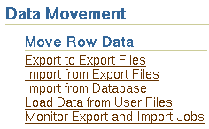
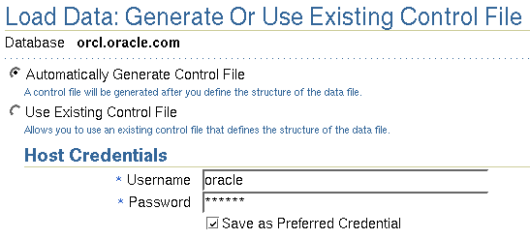
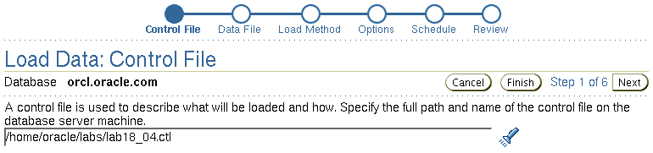
Loading Data with SQL*Loader
Notes:
Loading Data with SQL*Loader
Use the Load Data from User Files Wizard to load data from a flat file into an Oracle database. To display the wizard, select Enterprise Manager Maintenance > Data Movement > Move Row Data > Load Data from User Files. The wizard guides you through the required steps.

Slide 12
Where We Are
  Move data from non-Oracle sources into the Oracle database:
    SQL*Loader
  Move data between Oracle databases:
    Data Pump Export
    Data Pump Import
  Move data via platform-independent files:
    External table population
  Automate maintenance tasks:
    Scheduler

Slide 13
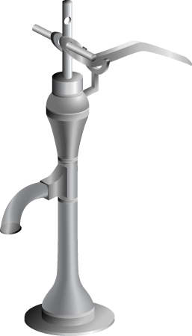
Data Pump: Overview
As a server-based facility for high-speed data and metadata movement, data pump:
  Is callable via DBMS_DATAPUMP
  Provides the following tools:
    expdp
    impdp
    Web-based interface
  Provides data access methods:
    Direct path
    External tables
  Detaches from and reattaches to long-running jobs
  Restarts Data Pump jobs
Notes:
Data Pump: Overview
Data Pump enables very high-speed data and metadata loading and unloading of Oracle databases. The Data Pump infrastructure is callable via the DBMS_DATAPUMP PL/SQL package. Thus, custom data movement utilities can be built by using Data Pump.
Oracle Database 10g provides the following tools:
Command-line export and import clients, called expdp and impdp respectively
A Web-based export and import interface that is accessible from Database Control
Data Pump automatically decides the data access methods to use; these can be either direct path or external tables. Data Pump uses direct path load and unload when a table’s structure allows it and when maximum single-stream performance is desired. However, if there are clustered tables, referential integrity constraints, encrypted columns, or a number of other items, Data Pump uses external tables rather than direct path to move the data.
The ability to detach from and reattach to long-running jobs without affecting the job itself enables you to monitor jobs from multiple locations while they are running. All stopped Data Pump jobs can be restarted without loss of data as long as the meta information remains undisturbed. It does not matter whether the job is stopped voluntarily or involuntary due to a crash.
Note: Data Pump is an integral feature of Oracle Database 10g and is, therefore, available in all configurations. However, parallelism is available in Enterprise Edition only.

Slide 14
Data Pump Export and Import: Benefits
  Fine-grained object and data selection
  Explicit specification of database version
  Parallel execution (Enterprise Edition only)
  Estimation of the export job space consumption
  Network mode in a distributed environment
  Remapping capabilities during import
  Data sampling and metadata compression
Notes:
Data Pump Export and Import: Benefits
The EXCLUDE, INCLUDE, and CONTENT parameters are used for fine-grained object and data selection.
You can specify the database version for objects to be moved (using the VERSION parameter) to create a dump file set that is compatible with a previous release of the Oracle database that supports Data Pump. This parameter is only reserved for future releases.
You can use the PARALLEL parameter to specify the maximum number of threads of active execution servers operating on behalf of the export job.
You can estimate how much space an export job would consume (without actually performing the export) by using the ESTIMATE_ONLY parameter.
Network mode enables you to export from a remote database directly to a dump file set. This can be done by using a database link to the source system.
During import, you can change the target data file names, schemas, and tablespaces.
In addition, Oracle Database 10g enables you to specify a percentage of data to be sampled and unloaded from the source database when doing a Data Pump export. This can be done by specifying the SAMPLE parameter.
You can use the COMPRESSION parameter to indicate whether the metadata should be compressed in the export dump file so that it consumes less disk space. If you compress the metadata, it is automatically uncompressed during import.

Slide 15
Data Pump Export and Import: Overview
expdp
client
Database
link
Source
Target
Data Pump
job
Server
process
Database
Database
Master
table
Dump
file set
Dump
file set
Master
table
“Network mode”
Server
process
Data Pump
job
impdp
client
Notes:
Data Pump Export and Import: Overview
Data Pump Export is a utility for unloading data and metadata into a set of operating system files called dump file sets. Data Pump Import is used to load metadata and data stored in an export dump file set into a target system.
The Data Pump API accesses its files on the server rather than on the client.
These utilities can also be used to export from a remote database directly to a dump file set, or to load the target database directly from a source database with no intervening files. This is known as network mode. This mode is particularly useful to export data from a read-only source database.
At the heart of every Data Pump operation is the master table (MT), which is a table created in the schema of the user running a Data Pump job. The MT maintains all aspects of the job. The MT is built during a file-based export job and is written to the dump file set as the last step. Conversely, loading the MT into the current user’s schema is the first step of a file-based import operation and is used to sequence the creation of all objects imported.
Note: The MT is the key to Data Pump’s restart capability in the event of a planned or unplanned stopping of the job. The MT is dropped when the Data Pump job finishes normally.

Slide 16
Data Pump Utility: Interfaces and Modes
  Data Pump Export and Import interfaces:
    Command line
    Parameter file
    Interactive command line
    Database Control
  Data Pump Export and Import modes:
    Full
    Schema
    Table
    Tablespace
    Transportable tablespace
Notes:
Data Pump Utility: Interfaces and Modes
You can interact with Data Pump Export and Import by using one of the following interfaces:
The command-line interface enables you to specify most of the export parameters directly on the command line.
The parameter file interface enables you to specify all command-line parameters in a parameter file. The only exception is the PARFILE parameter.
The interactive-command interface stops logging to the terminal and displays the export or import prompts, where you can enter various commands. This mode is enabled by pressing [Ctrl] + [C] during an export operation that is started with the command-line interface or the parameter file interface. Interactive-command mode is also enabled when you attach to an executing or stopped job.
You can also access the Web interface. On the Database Control home page, click the Maintenance tab, and then select one of the following links from the Utilities section: Export to Files, Import from Files, or Import from Database.
Data Pump Export and Import provide different modes for unloading and loading different portions of the database. The mode is specified on the command line by using the appropriate parameter. The available modes are listed in the slide and are the same as with original export and import utilities.

Slide 17
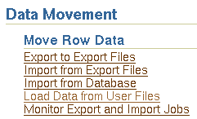
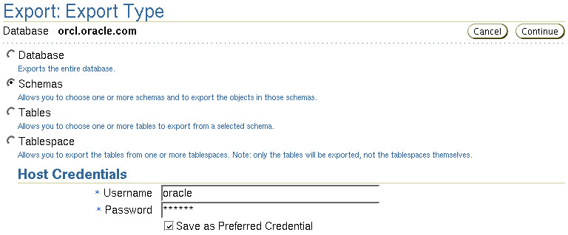
Data Pump Export

Slide 18
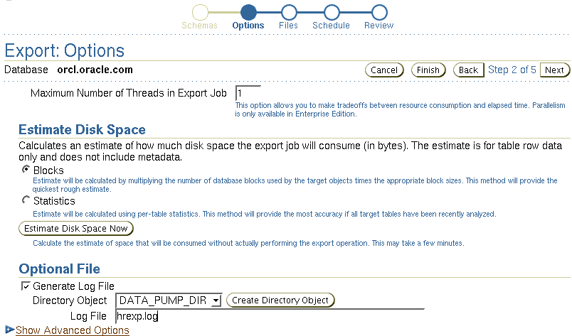
Export Options: Files
Notes:
Export Options: Files
There are three types of files that are managed by Data Pump jobs:
Dump files for data and metadata that is to be moved
Log files for messages
SQL files for the output of a SQLFILE operation
Because Data Pump is server based and not client based, Data Pump files are accessed relative to Oracle directory paths. Absolute paths are not supported for security reasons.

Slide 19
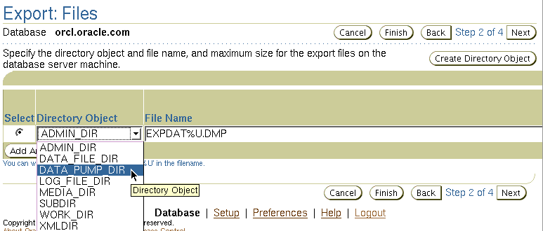
Data Pump File Locations
The order of precedence of file locations:
  Per-file directory
  DIRECTORY parameter
  DATA_PUMP_DIR environment variable
  DATA_PUMP_DIR default directory object
Notes:
Data Pump File Locations
The slide shows you the order of precedence used by Data Pump clients to locate these files:
Per-file directory objects may be specified for each dump file, log file, and SQL file. If specified, they are separated from the file name by a colon (:).
The Data Pump Export and Import clients provide a DIRECTORY parameter, which specifies the name of a directory object. These directory objects describe the location in which the files are accessed.
You can alternatively define an environment variable, DATA_PUMP_DIR, to specify the directory object name rather than use the DIRECTORY parameter. The Data Pump clients look for this environment variable if no explicit directory object is specified.
There is a default directory object created for every database. This directory object is named DATA_PUMP_DIR. Access to the DATA_PUMP_DIR directory is granted automatically to the EXP_FULL_DATABASE and IMP_FULL_DATABASE roles.

Slide 20
Data Pump Files Location
Full Notes Page
Notes:
Data Pump File Locations (continued)
You do not need to manually create a directory object before using Data Pump Export. There is a default directory object created for every database, whether newly created or upgraded by a script on UNIX or Windows platforms. This directory object is named DATA_PUMP_DIR. Access to the DATA_PUMP_DIR directory is granted automatically to the EXP_FULL_DATABASE and IMP_FULL_DATABASE roles. The DATA_PUMP_DIR directory is created in one of the following locations:
<ORACLE_BASE>/admin/DB_UNIQUE_NAME
<ORACLE_HOME>/admin/DB_UNIQUE_NAME
The exact directory path specification for DATA_PUMP_DIR varies, depending on the value of the ORACLE_BASE and ORACLE_HOME system environment variables and on the existence of the DATA_PUMP_DIR subdirectory. If ORACLE_BASE is defined on the target system, then that value is used. Otherwise, the value of ORACLE_HOME is used. If for some reason, the DATA_PUMP_DIR subdirectory is not found, the following default path is used: ORACLE_HOME/rdbms/log.
Note: In all cases, you must have the appropriate access privileges to the directory object for the operation attempted. For export, you need WRITE access for all files; for import, you need read access for dump files and write access for log files and SQL files.

Slide 21
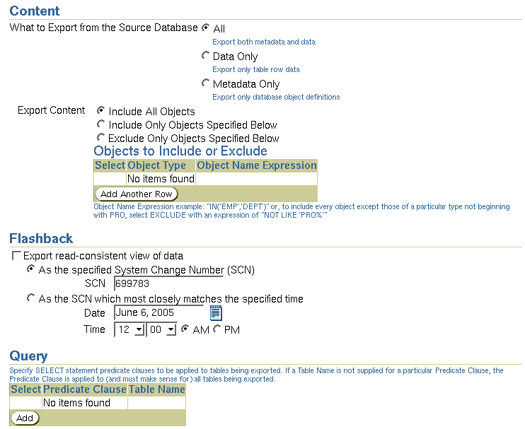
Advanced Export Options: Filtering
Notes:
Advanced Export Options: Filtering
The Data Pump job can include or exclude virtually any type of object.
The EXCLUDE parameter enables any database object type to be excluded from an export or import operation. The optional name qualifier enables you to have finer selectivity within each object type that is specified.
The INCLUDE parameter includes only the specified object types and objects in an operation.
The CONTENT parameter enables you to request for the current operation just the metadata, just the data, or both.
The QUERY parameter operates in a similar manner as the original export utility, with two significant enhancements: It can be qualified with a table name so that it applies to only that table, and it can be used during import as well.

Slide 22
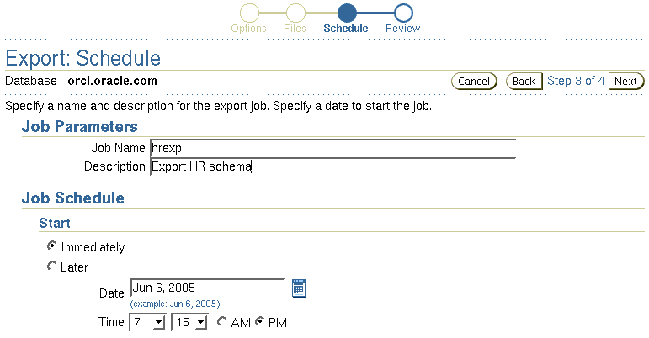
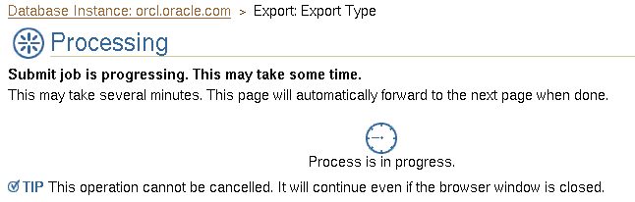
Scheduling and Running a Job
Notes:
Scheduling and Running a Job
Data Pump jobs (created through this wizard) are scheduled as repeatable jobs by Enterprise Manager Database Control.

Slide 23
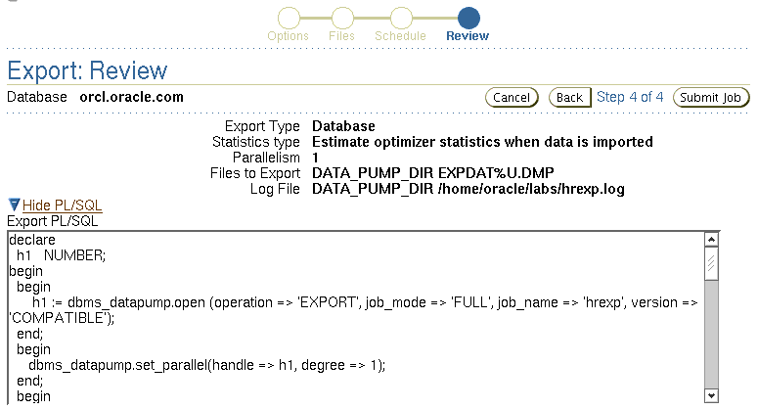
Export: Review
Data Pump File Naming and Size
Notes:
Export: Review—Data Pump File Naming and Size
The DUMPFILE parameter specifies the names and (optionally) directories of disk-based dump files. Multiple file specifications may be provided as a comma-separated list or in separate DUMPFILE parameter specifications. File names may contain the substitution variable %U, which implies that multiple files may be generated. %U is expanded in the resulting file names into a two-character, fixed-width, monotonically increasing integer starting at 01. If no DUMPFILE is specified, expdat.dmp is used by default. By default, created dump files are autoextensible.
If FILESIZE is specified, each file is FILESIZE bytes in size and nonextensible. If more dump space is required and a template with %U has been supplied, a new file is automatically created with FILESIZE bytes; otherwise, the client receives a message to add a new file.
If a template with %U is specified, the number of files initially created is equal to the PARALLEL parameter.
Preexisting files that match the resulting file names are not overwritten; they result in an error and cause the job to be aborted.
Note: If multiple dump file templates are provided, they are used to generate dump files in a circular fashion.

Slide 24

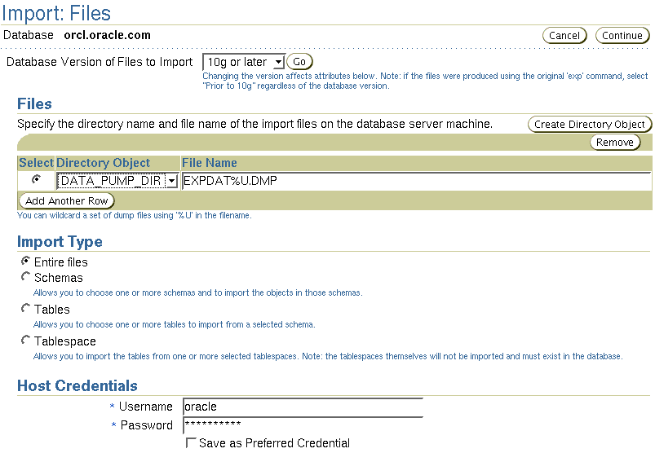
Data Pump: Importing from Files
Notes:
Data Pump: Importing from Files
Data Pump Import is a utility for loading an export dump file set into a target system. The dump file set is made up of one or more disk files that contain table data, database object metadata, and control information. The files are written in a proprietary, binary format. During an import operation, the Data Pump Import utility uses these files to locate each database object in the dump file set.
You can interact with Data Pump Import by using a command line, a parameter file, or an interactive-command mode:
You can use the impdp command and specify parameters directly on the command line.
You can enter command-line parameters in a file (excluded is the PARFILE parameter, because parameter files cannot be nested).
In interactive-command mode, the current job continues running, but logging to the terminal is stopped and the Import prompt is displayed. You can, for example, attach additional jobs to an executing or stopped job.

Slide 25
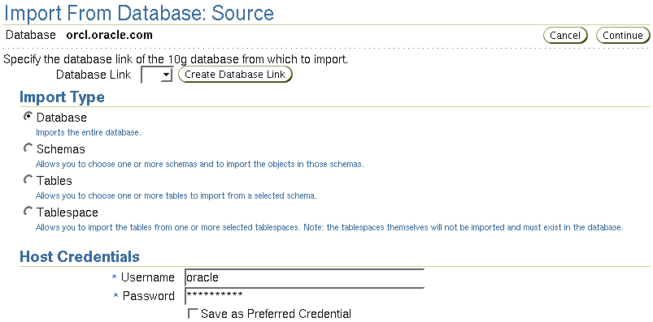
Importing from the Database
Notes:
Importing from the Database
Import can also be used to load a target database directly from a source database with no intervening dump files. This enables export and import operations to run concurrently, minimizing total elapsed time. This is known as a “network import.”
Note: Do not invoke import as SYSDBA.

Slide 26
Data Pump Import Transformations
You can remap:
  Data files by using REMAP_DATAFILE
  Tablespaces by using REMAP_TABLESPACE
  Schemas by using REMAP_SCHEMA
REMAP_DATAFILE = 'C:\oradata\tbs6.f':'/u1/tbs6.f'
Notes:
Data Pump Import Transformations
Because object metadata is stored as XML in the dump file set, it is easy to apply transformations when DDL is being formed during import. Data Pump Import supports several transformations:
REMAP_DATAFILE is useful when moving databases across platforms that have different file-system semantics.
REMAP_TABLESPACE allows objects to be moved from one tablespace to another.
REMAP_SCHEMA provides the old FROMUSER /TOUSER capability to change object ownership.

Slide 27
Data Pump Import Transformations
Using TRANSFORM, you can also :
  Exclude from tables and indexes:
    STORAGE and TABLESPACE clauses
    STORAGE clause only
  Re-create object identifiers of abstract data types
  Change extent allocations and file size
TRANSFORM =
SEGMENT_ATTRIBUTES|STORAGE|OID|PCTSPACE:{y|n|v}[:object type]
Notes:
Data Pump Import Transformations (continued)
The TRANSFORM parameter enables you to alter the object creation DDL for specific objects or for all applicable objects being loaded. Specify the TRANSFORM parameter as shown in the slide. The possible options are:
SEGMENT_ATTRIBUTES: If the value is specified as Y, segment attributes (physical attributes, storage attributes, tablespaces, and logging) are included.
STORAGE: If the value is specified as Y, the STORAGE clauses are included.
OID: You can use this parameter to determine whether the object ID (OID) of abstract data types is reused or created anew. If the value is specified as N, the generation of the export OID clause for object types is suppressed. This is useful when you need to duplicate schemas across databases by using export and import, but you cannot guarantee that the object types will have identical OID values in those databases.
PCTSPACE: You can use the PCTSPACE parameter to reduce the amount of space required for tablespaces by performing a shrink operation on tablespace storage allocation. The value supplied for this transformation must be a number greater than zero. It represents the percentage multiplier used to alter extent allocations and the size of data files.

Slide 28
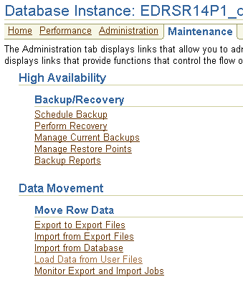
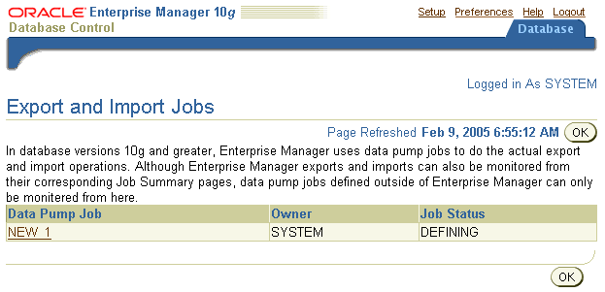
Using Enterprise Manager to Monitor Data Pump Jobs
Notes:
Using Enterprise Manager to Monitor Data Pump Jobs
You can use the Enterprise Manager graphical user interface (GUI) to monitor all Data Pump jobs, including those created by using the expdp or impdp command-line interfaces or by using the DBMS_DATAPUMP package.
You can view the current status of the job and also change the status to EXECUTE, STOP, or SUSPEND.
To access the Export and Import Jobs page, click the Monitor Export and Import Jobs link in the Move Row Data section of the Maintenance page.

Slide 29
Where We Are
  Move data from non-Oracle sources into the Oracle database:
    SQL*Loader
  Move data between Oracle databases:
    Data Pump Export
    Data Pump Import
  Move data via platform-independent files:
    External table population
  Automate maintenance tasks:
    Scheduler

Slide 30


External Table Population: Overview
  Unloading data to external files
  Handling complex ETL situations
CREATE TABLE
… AS SELECT
INSERT … SELECT
Unloading
Loading
External files
(Proprietary format)
Tables
Tables
Notes:
External Table Population: Overview
An external table is composed of proprietary format (Direct Path API) flat files that are operating system independent. You may use the CREATE TABLE AS SELECT command to populate an external table. DML operations are not allowed on an external table. An external table may not have indexes.
As you can see in the graphic and in the context of external tables, “loading data” refers to the act of data being read from an external table and loaded into a table in the database. “Unloading data” refers to the act of reading data from a table in the database and inserting it into an external table. The Data Pump access driver enables these operations for external tables.
The major benefit of this functionality is to enable you to unload tables to external files and use the generated files to load your target system. In this way, you can transform and load large volumes of data into a platform-independent file for data propagation or storage, either serially or in parallel.
Although Data Pump Export and Import tools can also use the external table access driver, they cannot handle all the complex extract, transform, load (ETL) cases. For example, manually creating an external table can be used to unload the result of a complex join between many source tables. The generated files can then be used to load and transform the corresponding data into the target system by using SQL commands directly.

Slide 31
External Table Population Operation
  It uses the ORACLE_DATAPUMP access driver.
  Data cannot be modified.
  Resulting files can be read only with the ORACLE_DATAPUMP access driver.
  You can combine generated files from different sources for loading purposes.
ORACLE_DATAPUMP
DPAPI
external files
Oracle database
Notes:
External Table Population Operation
During the external table populate operation, also called “unload operation,” the data flow goes from the subquery to the SQL engine where data is processed. As data is extracted, it is transparently converted from its Oracle internal representation into an equivalent Oracle native external representation (DPAPI). This process is achieved via a CREATE TABLE AS SELECT statement. In this case, the source is Oracle data produced by the SELECT clause of the command, and the destination is the ORACLE_DATAPUMP access driver. So you cannot use an external table population operation with the ORACLE_LOADER access driver.
After an external table has been created and the data files populated by the CREATE TABLE AS SELECT statement, no rows may be added, updated, or deleted from the external table. Any attempt to modify the data in the external table fails.
The data files created for the external table can be moved and used as the data files for another external table in the same database or different database. However, they can only be read by the ORACLE_DATAPUMP access driver. Also, data files populated by different external tables can all be specified in the LOCATION clause of another external table. This provides an easy way of aggregating data from multiple sources. The only restriction is that the metadata for all of the external tables must be exactly the same.
Note: The metadata is not part of the created files, and you can use the GET_DDL function of the DBMS_METADATA package to extract the metadata information.

Slide 32
External Table Parallel Population
  Multiple files can be created.
  There is exactly one parallel execution server per file.
  The PARALLEL and LOCATION clauses influence the degree of parallelism.
Coordinator
Parallel
execution
servers
Generated
files
emp1.exp
emp2.exp
emp3.exp
Notes:
External Table Parallel Population
Because the external table can be large, you can use a parallel populate operation to unload your data to an external table. This parallel operation is performed when the external table is declared PARALLEL, as in the next example.
As opposed to a parallel query from an external table, the degree of parallelism of a parallel populate operation is constrained by the number of concurrent files that can be written to by the access driver. So, as shown in the diagram, there is never more than one parallel execution server writing into one file at a particular point in time.
The number of files in the LOCATION clause must match the specified degree of parallelism because each input/output (I/O) server process requires its own file. Any extra files that are specified are ignored. If there are not enough files for the specified degree of parallelism, the degree of parallelization is lowered to match the number of files in the LOCATION clause.

Slide 33
External Table Population: Example
CREATE TABLE emp_ext
(first_name, last_name, department_name)
ORGANIZATION EXTERNAL
(
TYPE ORACLE_DATAPUMP
DEFAULT DIRECTORY ext_dir
LOCATION ('emp1.exp','emp2.exp','emp3.exp')
)
PARALLEL
AS
SELECT e.first_name,e.last_name,d.department_name
FROM employees e, departments d
WHERE e.department_id = d.department_id AND
d.department_name in
('Marketing', 'Purchasing');
Notes:
External Table Population: Example
This example shows you how the new external table population operation can help to export a selective set of records resulting from the join of the EMPLOYEES and DEPARTMENTS tables. The example shows how all employees working in the Marketing and Purchasing departments can be unloaded in parallel. It is assumed that the EXT_DIR directory is already created.
For the most part, the new ORACLE_DATAPUMP access driver uses the same parameters as the ORACLE_LOADER access driver.
Note: For more information about the ORACLE_DATAPUMP access driver parameters, see the Oracle Database Utilities guide.

Slide 34
Where We Are
  Move data from non-Oracle sources into the Oracle database:
    SQL*Loader
  Move data between Oracle databases:
    Data Pump Export
    Data Pump Import
  Move data via platform-independent files:
    External table population
  Automate maintenance tasks:
    Scheduler

Slide 35
Scheduler Components and Concepts
Resource
consumer group
Resource
plan
Window
group
Job class
Job chain
Window
Program
Job
Schedule
Arguments
Arguments
Time
Event
Notes:
Scheduler Components and Concepts
The Scheduler offers a modularized approach for managing tasks within the Oracle database. By breaking down a task into its components, such as time, location, and database object, the Scheduler offers you an easier way to manage your database environment. The Scheduler uses three basic components:
A job specifies what needs to executed and when. For example, the “what” could be a PL/SQL procedure, a native binary executable, a Java application, or a shell script. You can specify the program (what) and schedule (when) as part of the job definition, or you can use an existing program or schedule instead. You can use arguments for a job to customize its run-time behavior.
A schedule specifies when and how many times a job is executed. A schedule can be based on time or an event. You can define a schedule for a job by using a series of dates, an event, or a combination of the two, along with additional specifications to denote repeating intervals. You can store the schedule for a job separately and then use the same schedule for multiple jobs.
A program is a collection of metadata about a particular executable, script, or procedure. An automated job executes some task. Using a program enables you to modify the job task, or the “what,” without modifying the job itself. You can define arguments for a program, enabling users to modify the run-time behavior of the task.

Slide 36
Scheduler Components and Concepts
Full Notes Page
Notes:
Scheduler Components and Concepts (continued)
Each Scheduler component resides in a database schema. Scheduler components follow the naming rules for database relational objects, so the names must be unique in the SQL namespace.
The Scheduler also has the following concepts that enable database administrators to control the more advanced aspects of scheduling, such as prioritizing jobs. These are used when you want to ensure that limited resources are allocated appropriately among currently running jobs, thus aligning job scheduling with your business needs:
A job chain is a set of interrelated programs. In a job chain, after one or more programs in the job chain are started, the execution of subsequent programs typically depends on the completion (successful or not) of one or more of the other programs in the job chain. The programs in the job chain can also wait on other events or for a fixed period of time before executing.
A job class defines a category of jobs that share common resource usage requirements and other characteristics. At any given time, each job can belong to only a single job class. A job class is a way of grouping jobs into larger entities.
A resource consumer group can be associated with a job class to determine the resources that are allocated to the jobs in the job class. At any given time, a user session or job class belongs to only one resource consumer group. Resource consumer groups assist you in the management of database resources, because they provide methods for:
Prioritizing jobs
Setting job characteristics or behavior that must be the same for a group of jobs, such as how long to retain the job history information
A resource plan enables users to prioritize resources (most notably CPU) among resource consumer groups.
A window is represented by an interval of time with a well-defined beginning and end, such as “from 12 a.m. to 6 a.m.” and is used to activate different resource plans for the database. This means that you can change resource allocation during a time period, such as time of day or time of the sales year. You can use a saved schedule to specify the interval of time for a window.
A window group represents a list of windows, and allows for easier management of windows. You can use a window or window group as the schedule for a job to ensure that the job runs only when a window and its associated resource plan are active. For example, the NIGHT window and the WEEKEND window can be combined into the OFFHOURS window group.

Slide 37
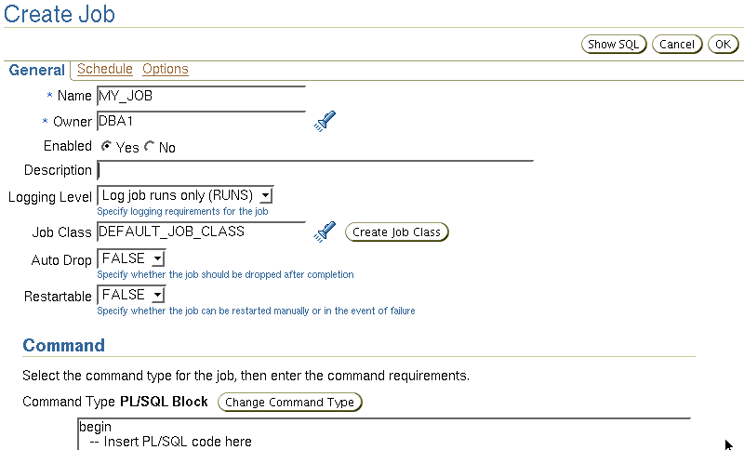
Creating a Job
Event
Date/Time
Program
Schedule
Job
attributes
Job
Arguments
Notes:
Creating a Job
A job is a combination of a schedule and a description of what to do, along with any additional arguments that are required by the job.
The program or “Command” can be a precreated PL/SQL or Java program, an anonymous PL/SQL block, or an executable that is run from the operating system’s command line.
The schedule for a job can be a predefined schedule (created with the DBMS_SCHDULER.CREATE_SCHEDULE procedure) or defined as part of the job creation. The schedule specifies attributes about when the job is run, such as:
A start time, which defines when the job is picked for execution and an end time, which specifies the time after which the job is no longer valid and is not scheduled any more
An expression specifying a repeating interval for the job
A complex schedule created by combining existing schedules
A condition or change in state, called an event, that must be met before the job is started
There are many attributes that you can set for a job. Attributes control how the job executes. It is discussed later in this lesson.

Slide 38
Creating a Time-Based Job
Example:
Create a job that calls a backup script every night at 11:00 p.m., starting tonight.
BEGIN
DBMS_SCHEDULER.CREATE_JOB(
job_name=>'HR.DO_BACKUP',
job_type => 'EXECUTABLE',
job_action => '/home/usr/dba/rman/nightly_incr.sh',
start_date=> SYSDATE,
repeat_interval=>'FREQ=DAILY;BYHOUR=23',
/* next night at 11:00 PM */
comments => 'Nightly incremental backups');
END;
/
Notes:
Creating a Time-Based Job
Use the CREATE_JOB procedure of the DBMS_SCHEDULER package to create a job. Jobs are created disabled by default, and they become active and scheduled only when they are explicitly enabled. All job names are of the form [schema.]name.
You must use SYSTIMESTAMP and specify a time zone so that when time changes because of daylight saving time, your job adjusts its execution time automatically.
By default, a job is created in the current schema. You can create a job in another schema by specifying the name of the schema, as shown in the example in the slide. Jobs are executed with the privileges of the job owner (in whose schema the job is created). The national language support (NLS) environment of the job when it runs is that which is present at the time the job is created.
The job_type parameter indicates the type of task to be performed by the job. The possible values are:
PLSQL_BLOCK: An anonymous PL/SQL block
STORED_PROCEDURE: A named PL/SQL, Java, or external procedure
EXECUTABLE: A command that can be executed from the operating system command line
The job_action parameter is the name of the procedure to run, the name of a script or operating system command, or an anonymous PL/SQL code block, depending on the value of the job_type parameter.

Slide 39
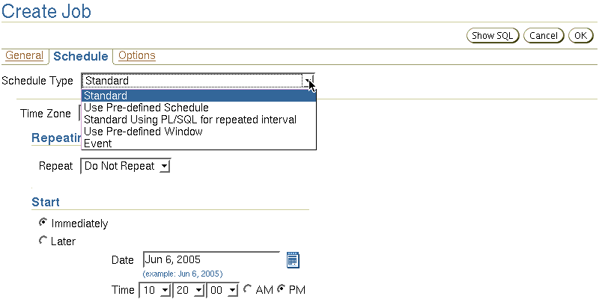
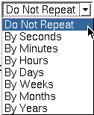
Setting the Repeat Interval for a Job
Notes:
Setting the Repeat Interval for a Job
To schedule repeat intervals for a job, you can specify datetime expressions as shown in the slide. A datetime expression yields a value of one of the datetime data types, such as DATE or TIMESTAMP WITH TIME ZONE.
When using datetime expressions, the specified expression determines the next time that the job should run. If no repeat interval is specified, the job runs only once on the specified start date.
Note: The Scheduler does not guarantee that a job executes on the exact time because the system may be overloaded and thus resources may be unavailable.

Slide 40
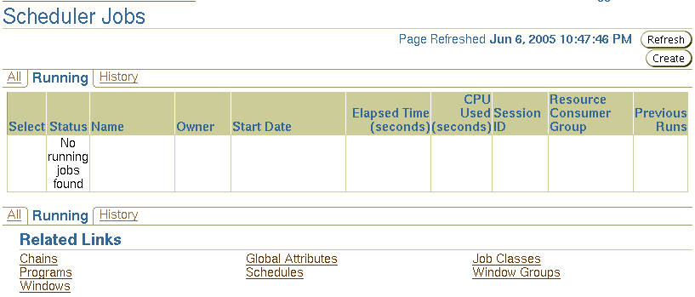
Managing Jobs
DBMS_SCHEDULER
  COPY_JOB
  CREATE_JOB
  DISABLE
  DROP_JOB
  ENABLE
  RUN_JOB
  SET_ATTRIBUTE
  STOP_JOB
Notes:
Managing Jobs
Enterprise Manager assists you with the various job management tasks. Alternatively, you can use the following procedures of the DBMS_SCHEDULER package:
COPY_JOB: To copy a job
CREATE_JOB: To create a job
DISABLE: To disable a job
DROP_JOB: To drop a job
ENABLE: To enable a job
RUN_JOB: To run a job
SET_ATTRIBUTE: To alter a job
STOP_JOB: To stop a job

Slide 41
Summary
In this lesson, you should have learned how to:
  Use SQL*Loader to load data from a non-Oracle database (or user files)
  Explain the general architecture of Data Pump
  Use Data Pump Export and Import
  Monitor a Data Pump job
  Describe the use of external tables for data population
  Use the scheduler to automate tasks

Slide 42
Practice Overview:
Moving Data
This practice covers the following topics:
  Using the Data Pump Export Wizard to select database objects to be exported
  Monitoring a Data Pump Export job
  Using the Data Pump Import Wizard to import tables in your database
  Using the Load Data Wizard to load data into your database
  Loading data by using the command line

