Slide 1
DATA ANALYST CAPSTONE PROJECT
Solar Production Forecasting
with Machine Learning
From weather signal to next-day forecast: modeling, temporal validation, and deployment on a Streamlit dashboard.
26,676
12
36
daily observations, 2020 to 2026
French regions covered
Input features
Solar Production Forecasting · Machine Learning · Streamlit Dashboard
01

Slide 2
01 · CONTEXT
Why forecast solar production?
Solar output is entirely weather dependent: without a forecast, every gap between expected and actual production has a direct cost.
!
Total intermittency
Selling electricity
Battery management
Avoid unfavorable buybacks or underpriced sales on wholesale markets.
Optimize charge/discharge cycles and extend storage system lifespan.
Unlike nuclear or gas, solar production cannot be dispatched on demand: it depends entirely on tomorrow's radiation.
A reliable next-day forecast means anticipating production before it happens, instead of just reacting to it.
Preventive maintenance
Grid management
Detect yield anomalies (dirty or faulty panels) and plan interventions.
Anticipate high production days to reduce reliance on gas.
Solar Production Forecasting · Machine Learning · Streamlit Dashboard
02

Slide 3
02 · DATA & METHOD
Data & Method
Three data sources joined by region and day, a 5-step pipeline, with time-respecting validation (no shuffling).
26,676 rows
12 regions
SDES
Meteo-France
RTE, solar production
Installed capacity (MW)
Radiation, temperature, humidity, wind... by region and day, 2020 to 2026.
Half-hourly production aggregated into daily TWh by region.
Installed photovoltaic capacity by region, used to normalize production.
METHODOLOGY
1
2
3
4
5
Feature
engineering
Baseline &
raw regression
Temporal
validation
GridSearchCV
Final model
selection
Lags J-1/J-2/J-3, 7 day rolling means, seasonality (sin/cos).
Naive persistence vs. regression without feature engineering.
TimeSeriesSplit (5 folds), pipeline refit on every fold.
Hyperparameter search (RMSE) across all models.
R2/MAE/RMSE train vs test comparison, prioritizing stability.
Solar Production Forecasting · Machine Learning · Streamlit Dashboard
03

Slide 4












02 · DATA & METHOD
The full pipeline, end to end
1 · DATA COLLECTION
2 · PREPARATION & ANALYSIS
3 · MODELING & COMPUTATION
Meteo-France
Regional mapping
Machine Learning
Weather data, 2020 to 2026.
Grid points mapped to regions.
Regression modeling.
RTE France
Data harmonization
Radiation forecast
Solar production, 2020 to 2026.
Common period: 2020 to 2026.
Predicts next-day visible radiation.
Installed PV capacity
Data integration
Production estimate
Capacity by region (SDES).
Weather + production + capacity.
Radiation → kWh/m² at 20% efficiency.
GeoJSON
Consolidated dataset
12 French regions.
Region x day, 2020 to 2026.
Exploratory analysis
Correlations, trends, seasonality.
Solar Production Forecasting · Machine Learning · Streamlit Dashboard
04

Slide 5
03 · EXPLORATORY ANALYSIS
What explains solar production
Correlations between weather variables and production per capacity, across 26,676 observations.
Correlation Matrix | Meteorological Variables vs Solar Production
0.93
Visible radiation
Snowfall
1.00
0.27
-0.23
0.07
-0.18
-0.11
-0.18
0.13
-0.14
-0.17
-0.21
Strongest correlation with production.
Rainfall
0.27
1.00
0.01
0.27
0.15
0.27
-0.30
0.35
-0.07
-0.20
-0.33
Avg Temp
-0.23
0.01
1.00
-0.14
0.92
0.77
0.65
-0.42
0.60
0.80
0.62
Wind Speed
0.07
0.27
-0.14
1.00
-0.14
-0.07
-0.30
0.17
-0.12
-0.18
-0.31
Spec. Humidity
-0.18
0.15
0.92
-0.14
1.00
0.90
0.42
-0.11
0.48
0.59
0.41
-0.75
Relative humidity
Atm. Radiation
-0.11
0.27
0.77
-0.07
0.90
1.00
0.16
0.19
0.28
0.35
0.14
Visible Rad.
-0.18
-0.30
0.65
-0.30
0.42
0.16
1.00
-0.79
0.80
0.94
0.93
Negative correlation (cloudier sky).
Rel. Humidity
0.13
0.35
-0.42
0.17
-0.11
0.19
-0.79
1.00
-0.47
-0.76
-0.75
Total ET
-0.14
-0.07
0.60
-0.12
0.48
0.28
0.80
-0.47
1.00
0.75
0.76
Potential ET
-0.17
-0.20
0.80
-0.18
0.59
0.35
0.94
-0.76
0.75
1.00
0.87
Prod / Capacity
-0.21
-0.33
0.62
-0.31
0.41
0.14
0.93
-0.75
0.76
0.87
1.00
0.87
Potential evapotranspiration
Snowfall
Rainfall
Avg Temp
Wind Speed
Spec. Humidity
Atm. Radiation
Visible Rad.
Rel. Humidity
Total ET
Potential ET
Prod / Capacity
Strong positive correlation, tied to sunshine.
Solar Production Forecasting · Machine Learning · Streamlit Dashboard
05

Slide 6
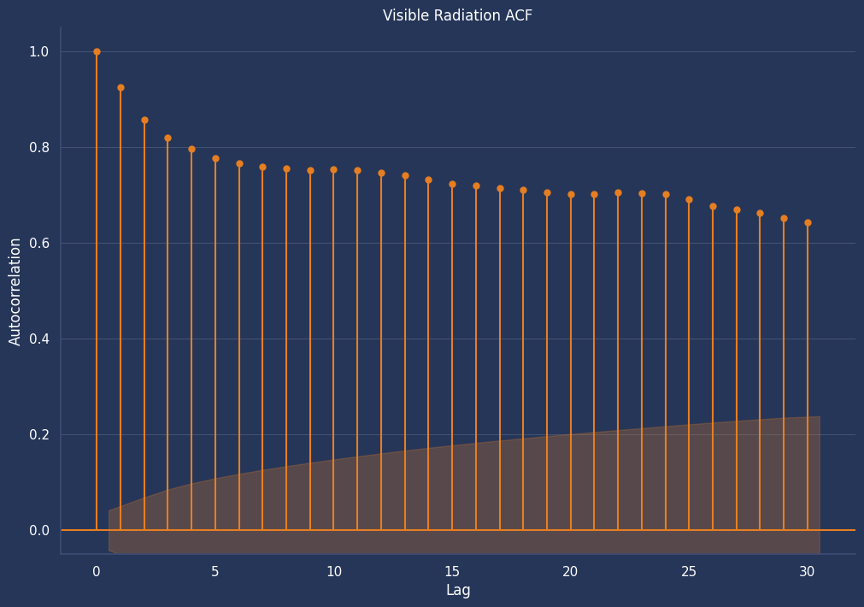
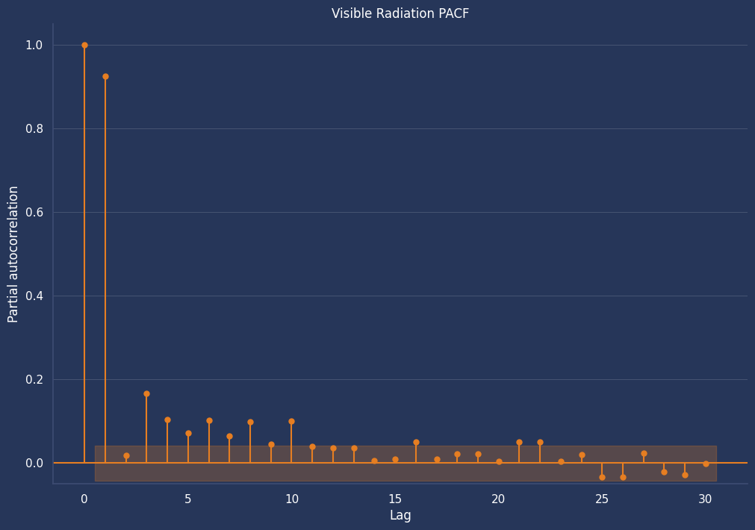
04 · MODELING
Why lags matter: ACF & PACF
Today's radiation strongly explains tomorrow's, but most of the signal is already captured by J-1.
Solar Production Forecasting · Machine Learning · Streamlit Dashboard
06

Slide 7
05 · MODEL CHOICE
From baseline to final model
8 models evaluated, from the naive baseline to XGBoost. Ridge chosen as final model.
Linear regression
Model | R2 | MAE (J/cm²) | RMSE (J/cm²)
Naive baseline (persistence) | 0.708 | 316 | 437
LR, no feature engineering | 0.761 | 301 | 395
LR, with lags (J-1/J-2/J-3) | 0.778 | 288 | 381
LR, lags + seasonality | 0.792 | 279 | 368
Lasso (L1) | 0.788 | 282 | 372
Ridge (L2), FINAL MODEL | 0.789 | 282 | 371
Random Forest | 0.800 | 274 | 362
XGBoost | 0.801 | 272 | 360
1
Baseline run, no feature engineering. R2 = 0.761
2
Add lags & rolling means
J-1, J-2, J-3 plus rolling means. R2 = 0.778
3
Add seasonality
Calendar encodings (sin/cos of day of year). R² = 0.792
4
GridSearchCV x TimeSeriesSplit
Lasso, Ridge, RF, XGBoost tuned on 5 expanding-window folds.
5
Ridge (L2) selected
−15% error vs baseline (RMSE 437 → 371), with a far smaller train-test gap than RF/XGBoost.
Solar Production Forecasting · Machine Learning · Streamlit Dashboard
07

Slide 8
05 · MODEL CHOICE
Why Ridge, not Random Forest or XGBoost?
RF and XGBoost gain only marginally more test R2, with a much wider train/test gap.
Model | R2 train (CV) | R2 test (CV) | Train-test gap
Ridge, chosen | 0.767 | 0.742 | 0.025
Random Forest | 0.855 | 0.740 | 0.115
XGBoost | 0.818 | 0.748 | 0.069
Ridge stays stable fold to fold (gap of about 0.02). RF and XGBoost barely gain more in test for a 3 to 5x larger gap: we prioritize robustness.
A physical limit, corrected
Ridge, like any linear model, has no awareness that radiation can't be negative: it can predict slightly below 0 on low-radiation winter days. Predictions are therefore clipped to 0 (np.clip) before display and export, a correction that can only reduce error, never increase it.
Solar Production Forecasting · Machine Learning · Streamlit Dashboard
08

Slide 9
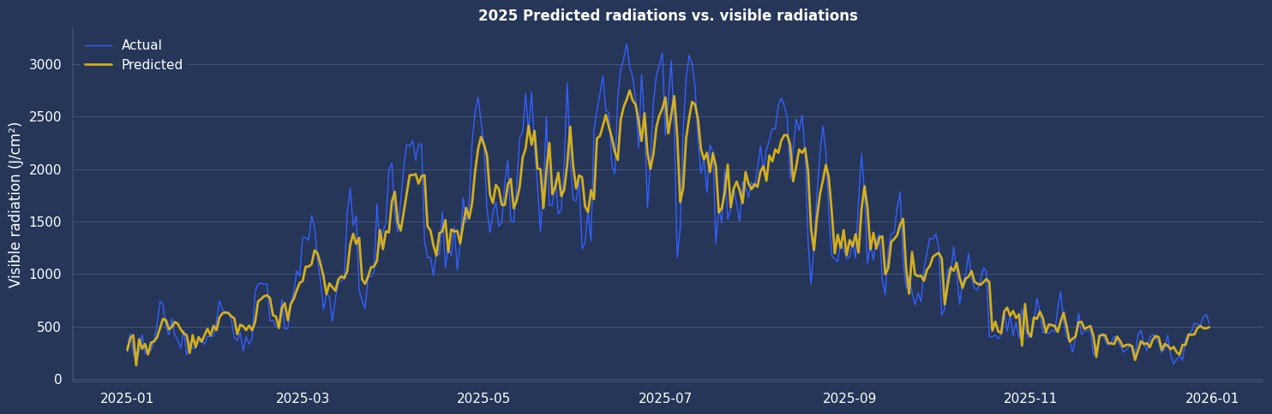
06 · RESULTS
Forecast vs reality: final model (Ridge)
2025 predicted vs. actual radiation, a representative year from the 2021-2026 out-of-fold evaluation (22,150 predictions).
Solar Production Forecasting · Machine Learning · Streamlit Dashboard
09

Slide 10
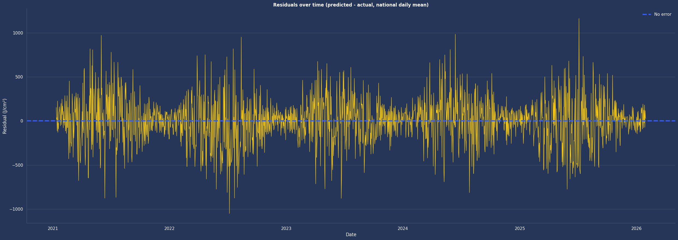
06 · RESULTS
Forecast vs reality: residual analysis
Residuals over the full 2021-2026 test period (predicted minus actual, national daily mean): errors stay centered near zero.
Solar Production Forecasting · Machine Learning · Streamlit Dashboard
10

Slide 11
07 · LIMITATIONS & NEXT STEPS
What's left to improve
The current model's known limitations, and the paths considered to go further.
LIMITATIONS
NEXT STEPS
A single horizon (J+1)
Extended forecasts, J+2/J+3/J+7
No J+2/J+7 forecast for longer-term planning.
For longer-term energy planning.
Observed weather, not forecasts
Use weather forecasts as inputs
The model uses measured weather for today; a real J+1 forecast would need Météo-France forecast data.
Move from a retrospective model to an operational forecast.
Radiation as a proxy
Predict actual production
Production is a theoretical 20% conversion per m², not RTE's actual output.
Target RTE output (TWh or capacity factor) directly. This also enables anomaly detection.
Solar Production Forecasting · Machine Learning · Streamlit Dashboard
11

Slide 12
SUMMARY
From raw data to a production forecasting dashboard
26,676 observations, 12 regions, 6 years of Meteo-France x RTE x SDES data
Time-respecting validation (TimeSeriesSplit + GridSearchCV). Ridge chosen for its stability: −15% error vs "tomorrow = today" (R² ≈ 0.79)
Streamlit dashboard in production: interactive EDA and next-day forecasts
Thank you for your attention.
Now, a walkthrough of the Streamlit dashboard, followed by questions.
Solar Production Forecasting · Machine Learning · Streamlit Dashboard
12

