Slide 1
DATA ANALYST CAPSTONE PROJECT
Next-Day Solar Radiation Forecasting as a Proxy for Solar Production
From weather signal to next-day forecast: modeling, temporal validation, and deployment on a Streamlit dashboard.
26,676
12
36
daily observations, 2020 to 2026
French regions covered
Input features
Solar Production Forecasting · Machine Learning · Streamlit Dashboard
01

Slide 2
01 · CONTEXT
Why forecast solar production?
Solar output is entirely weather dependent: without a forecast, every gap between expected and actual production has a direct cost.
!
A fast-growing, intermittent source
Selling electricity
Battery management
Avoid unfavorable buybacks or underpriced sales on wholesale markets.
Optimize charge/discharge cycles and extend storage system lifespan.
32.6 TWh
produced in 2025,
×2.6 since 2020
30.4 GW
installed end of 2025,
+5.9 GW in one year
48 GW
PPE3 target for 2030,
55–80 GW by 2035
Unlike nuclear or gas, solar can't be dispatched on demand: it depends on tomorrow's radiation. The more the fleet grows, the more producers and grid operators need a reliable next-day forecast.
Preventive maintenance
Grid management
Detect yield anomalies (dirty or faulty panels) and plan interventions.
Anticipate high production days to reduce reliance on gas.
Sources: RTE eCO2mix · RTE, Bilan électrique 2025 · PPE3 decree, February 2026
Solar Production Forecasting · Machine Learning · Streamlit Dashboard
02

Slide 3
01 · PROJECT FRAMING
Specifications, planning & budget
Scoped like a request from a business team: a 4-week project, 3 people part-time, 21 May → 18 June 2026.
Specifications
Backward schedule · presentation on 18 June
CLIENT
Solar producer or grid operator
21 May
28 May
4 Jun
11 Jun
Scoping & data collection
NEED
Anticipate next-day solar production, per region
Preparation, spatial join & EDA
Modeling & validation
SCOPE
12 mainland regions · J+1 horizon · daily data 2020-2026
Dashboard & deployment
Phases overlapped: first models on the raw dataset, then on the full one.
DELIVERABLES
Forecasting model · Streamlit dashboard · documentation
Budget · estimate
CONSTRAINTS
Public data only · no infrastructure budget
30 days
3 people, half-time, 4 weeks
≈ €13.5k
at €450/day (assumption)
€0
infrastructure & data
SUCCESS CRITERION
Outperform the naive “tomorrow = today” forecast · result: −15% error
Production version would add weather forecasts, paid hosting and quarterly maintenance.
Solar Production Forecasting · Machine Learning · Streamlit Dashboard
03

Slide 4












02 · DATA & METHOD
The full pipeline, end to end
1 · DATA COLLECTION
2 · PREPARATION & ANALYSIS
3 · MODELING & COMPUTATION
Meteo-France
Regional mapping
Machine Learning
Weather data, 2020 to 2026.
Grid points mapped to regions.
Regression modeling.
RTE France
Data harmonization
Radiation forecast
Solar production, 2020 to 2026.
Common period: 2020 to 2026.
Predicts next-day visible radiation.
Installed PV capacity
Data integration
Production estimate
Capacity by region (SDES).
Weather + production + capacity.
Radiation → kWh/m² at 20% efficiency.
GeoJSON
Consolidated dataset
12 French regions.
Region x day, 2020 to 2026.
Exploratory analysis
Correlations, trends, seasonality.
Solar Production Forecasting · Machine Learning · Streamlit Dashboard
04

Slide 5
03 · EXPLORATORY ANALYSIS
What explains solar production
Correlations between weather variables and production per capacity, across 26,676 observations.
Correlation Matrix | Meteorological Variables vs Solar Production
0.93
Visible radiation
Snowfall
1.00
0.27
-0.23
0.07
-0.18
-0.11
-0.18
0.13
-0.14
-0.17
-0.21
Strongest correlation with production.
Rainfall
0.27
1.00
0.01
0.27
0.15
0.27
-0.30
0.35
-0.07
-0.20
-0.33
Avg Temp
-0.23
0.01
1.00
-0.14
0.92
0.77
0.65
-0.42
0.60
0.80
0.62
Wind Speed
0.07
0.27
-0.14
1.00
-0.14
-0.07
-0.30
0.17
-0.12
-0.18
-0.31
Spec. Humidity
-0.18
0.15
0.92
-0.14
1.00
0.90
0.42
-0.11
0.48
0.59
0.41
-0.75
Relative humidity
Atm. Radiation
-0.11
0.27
0.77
-0.07
0.90
1.00
0.16
0.19
0.28
0.35
0.14
Visible Rad.
-0.18
-0.30
0.65
-0.30
0.42
0.16
1.00
-0.79
0.80
0.94
0.93
Negative correlation (cloudier sky).
Rel. Humidity
0.13
0.35
-0.42
0.17
-0.11
0.19
-0.79
1.00
-0.47
-0.76
-0.75
Total ET
-0.14
-0.07
0.60
-0.12
0.48
0.28
0.80
-0.47
1.00
0.75
0.76
Potential ET
-0.17
-0.20
0.80
-0.18
0.59
0.35
0.94
-0.76
0.75
1.00
0.87
Prod / Capacity
-0.21
-0.33
0.62
-0.31
0.41
0.14
0.93
-0.75
0.76
0.87
1.00
0.87
Potential evapotranspiration
Snowfall
Rainfall
Avg Temp
Wind Speed
Spec. Humidity
Atm. Radiation
Visible Rad.
Rel. Humidity
Total ET
Potential ET
Prod / Capacity
Strong positive correlation, tied to sunshine.
Solar Production Forecasting · Machine Learning · Streamlit Dashboard
05

Slide 6
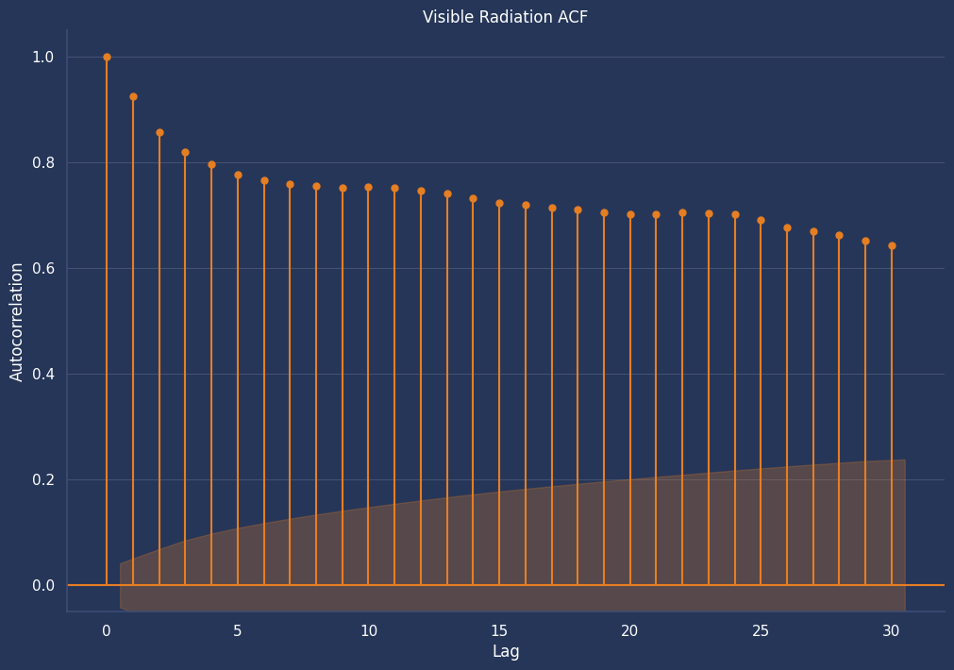
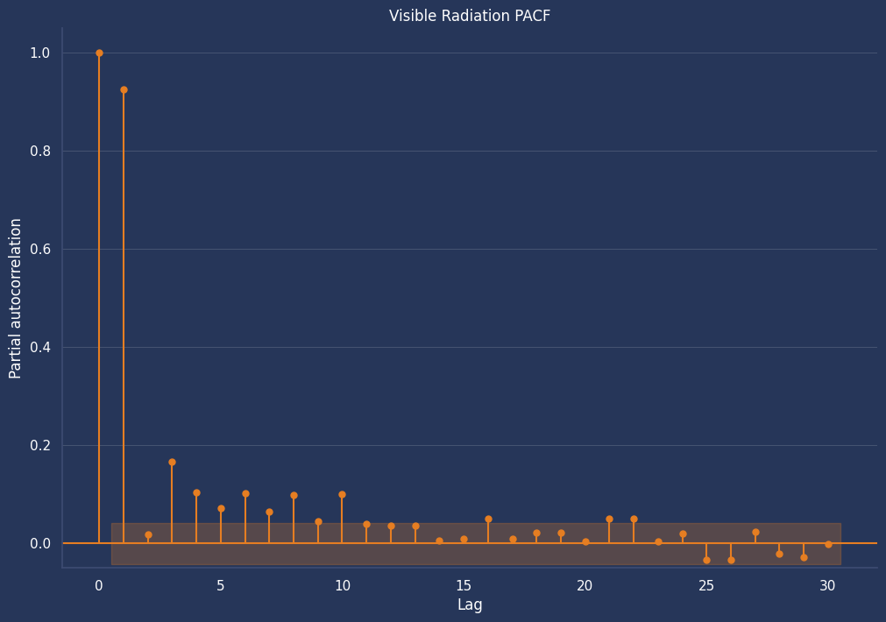
04 · MODELING
Past radiation matters: ACF & PACF
Today’s radiation strongly explains tomorrow’s: the signal is concentrated in J‑1, with a last significant value at J‑3.
Solar Production Forecasting · Machine Learning · Streamlit Dashboard
06

Slide 7
05 · MODEL CHOICE
From baseline to final model
8 models evaluated, from the naive baseline to XGBoost, scored on unseen 2024–2026 data. Ridge chosen as final model.
Linear regression
Model | R² | MAE (J/cm²) | RMSE (J/cm²)
Naive baseline (persistence) | 0.708 | 316 | 437
LR, no feature engineering | 0.761 | 301 | 395
LR, with lags (J-1/J-2/J-3) | 0.778 | 288 | 381
LR, lags + seasonality | 0.792 | 279 | 368
Lasso (L1) | 0.788 | 282 | 372
Ridge (L2), FINAL MODEL | 0.789 | 282 | 371
Random Forest | 0.800 | 274 | 362
XGBoost | 0.801 | 272 | 360
1
Baseline run, no feature engineering. R² = 0.761
2
Add lags & rolling means
J-1, J-2, J-3 plus rolling means. R² = 0.778
3
Add seasonality
Calendar encodings (sin/cos of day of year). R² = 0.792
4
GridSearchCV x TimeSeriesSplit
Lasso, Ridge, RF, XGBoost tuned on 5 expanding-window folds.
5
Ridge (L2) selected
−15% error vs baseline (RMSE 437 → 371), with a far smaller train-test gap than RF/XGBoost.
Solar Production Forecasting · Machine Learning · Streamlit Dashboard
07

Slide 8
05 · MODEL CHOICE
Why Ridge, not Random Forest or XGBoost?
5-fold cross-validation inside the training period (2020–2023): RF and XGBoost score the same test R² as Ridge (within 0.01), with a much wider train/test gap.
Model | R² train (CV) | R² test (CV) | Train-test gap
Ridge, chosen | 0.767 | 0.742 | 0.025
Random Forest | 0.855 | 0.740 | 0.115
XGBoost | 0.818 | 0.748 | 0.069
Ridge stays stable (train-test gap of about 0.02). RF and XGBoost score the same in test (within 0.01) with a 3 to 5x larger gap: we prioritize robustness.
A physical limit, corrected
Ridge, like any linear model, has no awareness that radiation can't be negative: it can predict slightly below 0 on low-radiation winter days. Predictions are therefore clipped to 0 (np.clip) before display and export, a correction that can only reduce error, never increase it.
Solar Production Forecasting · Machine Learning · Streamlit Dashboard
08

Slide 9
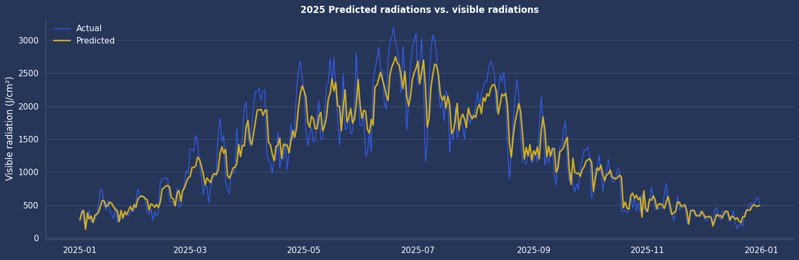
06 · RESULTS
Forecast vs reality: final model (Ridge)
2025 predicted vs. actual radiation, a representative year from the 2021-2026 out-of-fold evaluation (22,150 predictions).
Solar Production Forecasting · Machine Learning · Streamlit Dashboard
09

Slide 10
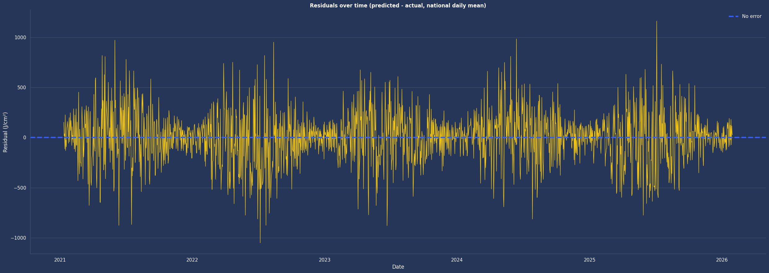
06 · RESULTS
Forecast vs reality: residual analysis
Residuals over the full 2021-2026 test period (predicted minus actual, national daily mean): errors stay centered near zero. They are larger in spring and summer in absolute terms, but summer is the best-predicted season in relative terms (21% vs 32% in winter).
Solar Production Forecasting · Machine Learning · Streamlit Dashboard
10

Slide 11
07 · GOVERNANCE
Governance, compliance & monitoring
Public, aggregated data, open licences, and how the model would be followed in production.
1
GDPR
2
Data licences
No personal data: weather, production and capacity are public and aggregated by region, and the dashboard collects no user data.
Even at the 8 km grid scale, weather data stays non-personal. GDPR would only apply with individual households’ meter data, outside the project’s scope.
Etalab Open Licence (Météo-France, SDES), RTE eCO2mix terms of use and ODbL (OpenStreetMap): all sources credited in the README.
Copies of the raw files kept, since Météo-France changed its file layout after our download.
3
Technology choices
4
Production monitoring
Python stack (pandas, scikit-learn, Streamlit). Raw Météo-France files strained memory: chunked loading, and only 2020–2026 kept.
At larger scale (2010–2019, or the 8 km grid), Polars or DuckDB would be needed. Docker and Hugging Face give a free, reproducible deployment.
Weekly MAE compared with the naive baseline, with an alert if the error drifts above a set threshold.
Quarterly retraining, data-drift checks, and versioned code and data (Git).
Solar Production Forecasting · Machine Learning · Streamlit Dashboard
11

Slide 12
07 · LIMITATIONS & NEXT STEPS
What's left to improve
The current model's known limitations, and the paths considered to go further.
LIMITATIONS
NEXT STEPS
A single horizon (J+1)
Extended forecasts, J+2/J+3/J+7
No J+2/J+7 forecast for longer-term planning.
For longer-term energy planning.
Observed weather, not forecasts
Use weather forecasts as inputs
The model uses measured weather for today; a real J+1 forecast would need Météo-France forecast data.
Move from a retrospective model to an operational forecast.
Radiation as a proxy
Predict actual production
Production is a theoretical 20% conversion per m², not RTE's actual output.
Once precise installed-capacity data is available (SDES publishes it quarterly only), or using recent production levels to track the fleet’s growth.
Solar Production Forecasting · Machine Learning · Streamlit Dashboard
12

Slide 13
SUMMARY
From raw data to a production forecasting dashboard
26,676 observations, 12 regions, 6 years of Meteo-France x RTE x SDES data
Time-respecting validation (TimeSeriesSplit + GridSearchCV). Ridge chosen for its stability: −15% error vs "tomorrow = today" (R² ≈ 0.79 on 2024–2026 data)
Business impact: ~70 MWh/year of forecast error avoided for a 10,000 m² plant
Streamlit dashboard in production: interactive EDA and next-day production estimates derived from the radiation forecast
Thank you for your attention.
Any questions?
Solar Production Forecasting · Machine Learning · Streamlit Dashboard
13

