Slide 1
SPEED DATING ANALYSIS
What Drives a Match?
Investigating what actually drives attraction and decisions from real speed-dating experiments, and whether it differs by gender.
8,378 dates recorded
551 participants
21 experiment waves · Six attributes rated face-to-face · Logistic regression by gender

Slide 2
01 · OVERVIEW
The Question
Participants met for four-minute speed dates, rated each other on six attributes, and decided whether they'd want to meet again. They also stated upfront what they thought they were looking for.
8,378
RAW DATE RECORDS
551
UNIQUE PARTICIPANTS
The central question: what actually drives people's decisions, and does it differ by gender?
6
RATED ATTRIBUTES PER DATE
DATA PREP
Raw file has 195 columns, trimmed to what's needed for EDA and modeling. Rating scales differ by wave (1-10 vs. 100-pt allocation) and are normalized so every wave is comparable.
THE SIX ATTRIBUTES
Attractiveness
Sincerity
Intelligence
Fun
Ambition
Shared Interests
Speed dating experiment · Attraction, preferences & machine learning
02

Slide 3
02 · EXPLORATORY ANALYSIS
Who Are the Daters?
Gender Distribution
AGE · FEMALE
AGE · MALE
26.1
26.6
median 26 · n = 274
median 27 · n = 277
551
RACIAL COMPOSITION
SUBJECTS
European
55.8%
Asian
25%
Latino
7.7%
Other
6.8%
Black
4.8%
Speed dating experiment · Attraction, preferences & machine learning
03

Slide 4
02 · EXPLORATORY ANALYSIS
Do People Say Yes?
Personal 'Yes' Rate by Gender
OVERALL MUTUAL MATCH RATE
WHAT IT MEANS
Men say 'yes' noticeably more often than women, confirming that women are more selective in speed dating.
Mutual matches are rare overall.
We test whether this gender gap is real in the hypothesis section next.
16.5%
MATCHED
of dates end with both people saying yes
Speed dating experiment · Attraction, preferences & machine learning
04

Slide 5
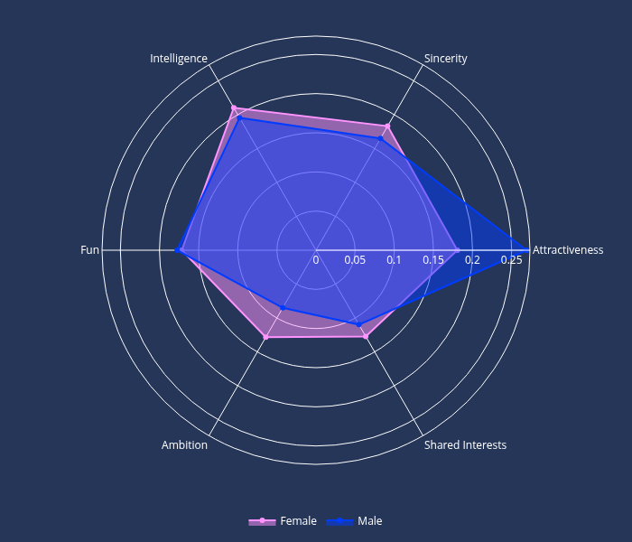
02 · EXPLORATORY ANALYSIS
Stated Preferences by Gender
Stated attributes Preferences by Gender
WHAT IT MEANS
Men state that attractiveness is their top priority by a clear margin, nearly double their weight on ambition or shared interests.
Women spread preferences more evenly across intelligence, sincerity, attractiveness and fun.
Ambition and shared interests rank lowest for both genders, but as we'll see, stated importance and actual behavior diverge sharply here.
Speed dating experiment · Attraction, preferences & machine learning
05

Slide 6
02 · EXPLORATORY ANALYSIS
What Correlates with a 'Yes'?
Attr
Sinc
Intel
Fun
Amb
Shar
Dec
WHAT IT MEANS
Attr
1.00
0.40
0.39
0.59
0.36
0.48
0.49
Attractiveness has the strongest link to saying yes (r = 0.49).
Fun (0.41) and shared interests (0.40) also correlate positively with the decision.
Sincerity, intelligence and ambition show much weaker links (r ≈ 0.18–0.22).
This pattern is confirmed later once all six attributes are combined in the machine learning model.
Sinc
0.40
1.00
0.66
0.49
0.46
0.40
0.21
Intel
0.39
0.66
1.00
0.49
0.63
0.40
0.22
Fun
0.59
0.49
0.49
1.00
0.49
0.62
0.41
Amb
0.36
0.46
0.63
0.49
1.00
0.43
0.18
Shar
0.48
0.40
0.40
0.62
0.43
1.00
0.40
Dec
0.49
0.21
0.22
0.41
0.18
0.40
1.00
Speed dating experiment · Attraction, preferences & machine learning
06

Slide 7
03 · HYPOTHESIS TESTING
Is It Real or Just Noise?
Mann-Whitney U tests · α = 0.05 · Cohen's d for effect size
Chi-square test · Cramér’s V for effect size
DECISION RATE
STATED PREFERENCES
MISSING DATA
48.1%
Male 'yes' rate
Attractiveness
d = 0.76, p < 0.001: men value it far more
GROUP
N
YES RATE
Complete
7,040
43.1%
Partial
1,146
41.5%
37.4%
Female 'yes' rate
Ambition
d = -0.71, p < 0.001: women value it far more
All-missing
192
3.1%
Complete vs. partial: p = 0.329
Complete vs. all-missing: p < 0.001
Cohen's d = 0.428 · p < 0.001
Fun & intelligence: not significant.
Impute partially-missing rows with mean.
Drop fully-missing rows before modeling.
Reject H₀: a real gender gap in who says yes.
Reject H₀: men and women state different priorities.
Speed dating experiment · Attraction, preferences & machine learning
07

Slide 8
04 · MACHINE LEARNING
Building the Model
APPROACH
WHAT IT MEANS
1
Drop fully-missing rows
Both models comfortably beat a ~0.35 baseline F1-score, roughly double.
This confirms the six ratings carry real predictive signal.
Train/test gaps stay under 1.2 points: no sign of overfitting.
8,186 rows remain for modeling
2
Split by gender
female and male models fit separately
3
Train / test split
honest evaluation on unseen data
4
Fit logistic regression
6 ratings predict the decision
5
Compare to baseline
vs. a dummy 'always no' classifier
Speed dating experiment · Attraction, preferences & machine learning
08

Slide 9
04 · MACHINE LEARNING
What Actually Drives a Match?
Logistic Regression Coefficients (standardized)
THE KEY DIVERGENCE
0.86
Shared interests ranks LAST in stated importance, yet it's a top-3 real predictor of a 'yes' for both genders.
Attractiveness
1.27
0.48
Fun
0.57
0.51
Shared Interests
0.53
-0.08
Intelligence
0.17
-0.23
Attractiveness is the strongest predictor for both genders, even more so for men. Sincerity, intelligence and ambition contribute little once the others are in the model.
Sincerity
-0.10
-0.31
Ambition
-0.20
-0.4
-0.2
0.0
0.2
0.4
0.6
0.8
1.0
1.2
1.4
Female
Male
Speed dating experiment · Attraction, preferences & machine learning
09

Slide 10
05 · CONCLUSION
What Drives a Match?
Attractiveness is the closest thing to a universal factor, significant in stated importance, and by far the strongest predictor of an actual 'yes' for both men and women.
The more interesting finding is where stated and actual behavior diverge: shared interests ranks last in what people say they want, yet it's among the strongest real predictors of a match. What people say they want and what actually moves their decision aren't always the same thing.
1.27
0.86
Male attractiveness coefficient
Female attractiveness coefficient
74%
72%
Male model F1-score
Female model F1-score
1
Trust behavior over stated preference
Attractiveness, fun & shared interests consistently drive real decisions.
Thank you
2
Model each gender separately
Preference patterns and predictive power differ enough to warrant it.
Speed dating experiment · Attraction, preferences & machine learning
10

