Slide 1

MANIPAL UNIVERSITY JAIPUR
Department of Computer and Communications Engineering
TEAM NAME
Team Name
TEAM ID
HXXXX
PROBLEM STATEMENT ID
AI-04
PROBLEM STATEMENT TITLE
RAG Evaluation Pipeline
THEME / DOMAIN
36-HOUR HACKATHON • 24–25 OCTOBER 2026
Artificial Intelligence
BUILD / INNOVATE / CREATE
CATEGORY
▶ Live demo: rag-autopsy.vercel.app
Software
Note: A run on uploaded documents takes more time, so we built Demo mode. We recommend using Demo mode to see how ARENA works and the kind of results it gives.
hypnexismuj.com | @hypnexis.muj | hypnexis2026@muj.manipal.edu
Notes:
We took AI-04, the RAG evaluation pipeline. Our project is called ARENA, Automated Retrieval & Evaluation Nexus Architecture: instead of giving a RAG system a score, it finds out why each wrong answer is wrong, proves it, and tests the fix.

Slide 2
ARENA
Team Name | Team ID
PROBLEM STATEMENT
OUR SOLUTION
RAG chatbots answer from documents, but when an answer is wrong, teams can't tell why.
Three very different causes: the right passage was never retrieved, the model invented facts, or it answered something the documents can't answer.
Existing tools (RAGAS, TruLens) give scores, like “faithfulness 0.71”: a fever reading, not a diagnosis.
LLM-as-judge verdicts are opinions: no proof, no fix, no check that a fix worked.
Result: chunk size, top-k and prompts are tuned by trial and error, and wrong answers ship to users.
Test set from your own docs: every question is tied to the exact gold sentence that answers it.
Diagnoses every failure: retrieval / generation / abstention, with a sub-cause and a confidence.
Proves retrieval failures: swap the gold chunk in and re-ask the same model.
Prescribes a config fix and re-tests it: before / after in one click.
THE PROOF: GOLD-CHUNK COUNTERFACTUAL
Retrieved context
✗ “There is no mention of a CarePlus plan”
Gold chunk only
✓ “The transfer fee is INR 500”
Retrieval failure,
proven
Notes:
The problem: when a RAG answer is wrong there are three different root causes, and today's tools only give you a score. Our solution generates test questions from your own documents, keeps the exact gold sentence for each, and diagnoses every failure. The key idea is the counterfactual at the bottom right: same model, same question, but we hand it only the gold chunk. If it now answers correctly, retrieval failed. That is proof, not a judge's opinion.

Slide 3
TECHNICAL APPROACH
Team Name | Team ID
SYSTEM ARCHITECTURE
CORE TECHNOLOGIES
1
Ingest
PDF / DOCX / MD → chunks → bge embeddings → ChromaDB
Backend: Python 3.11, FastAPI, Pydantic, asyncio; React + Tailwind dashboard
Retrieval: ChromaDB, bge-small embeddings, BM25 + RRF, bge-reranker
Local checkers (no LLM): LettuceDetect, HHEM-2.1 / MiniCheck
LLMs: Gemini (generator) + Groq gpt-oss-120b (judge), any OpenAI-compatible API
2
Test-set generator
typed questions + exact gold evidence, 5 quality filters
3
RAG under test
top-50 ranked retrieval (dense / hybrid / rerank) → answer
4
3-tier diagnostic cascade
T1 local checks · T2 grounding + judge · T3 counterfactual
UNIQUE POINTS
5
Weighted consensus
root cause + sub-cause + confidence + review flag
Causal proof, not a judge's opinion: the gold-chunk counterfactual.
Cost-aware cascade: 81% of questions settled with zero LLM calls (0.36 calls / question).
Closed loop: diagnosis → prescription → verified fix.
6
Prescribe & re-test
config patch → re-run failures → before / after diff
Notes:
Six stages. Ingest and index the documents. Generate a test set where every question carries its gold evidence. Run the RAG under test, always keeping the top 50 ranked chunks so we can see where the right chunk landed. Then the cascade: cheap local models first, an LLM judge only if they can't decide, and the counterfactual only when still contested. A weighted vote gives the root cause and confidence, and each cause maps to a config fix we re-test automatically.

Slide 4
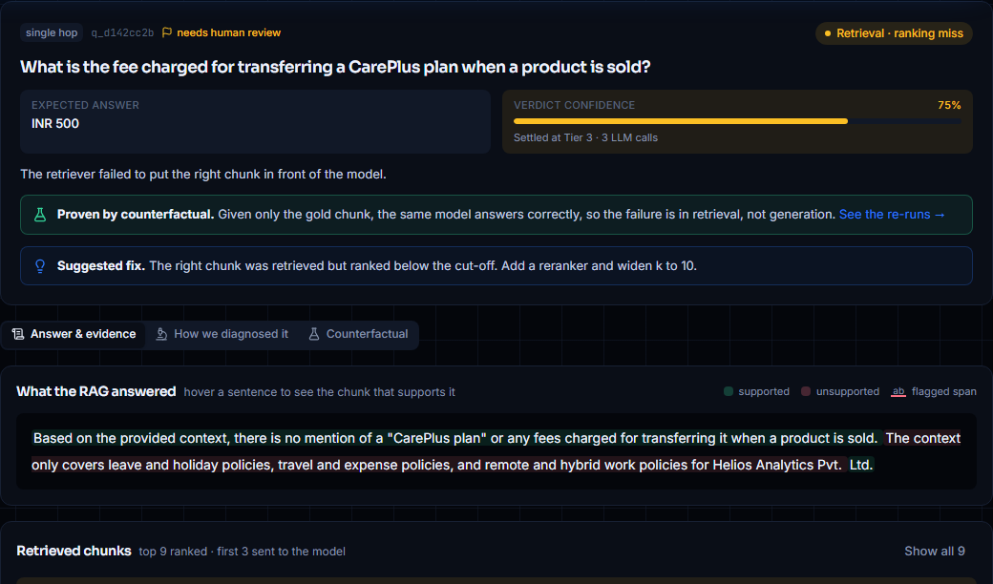
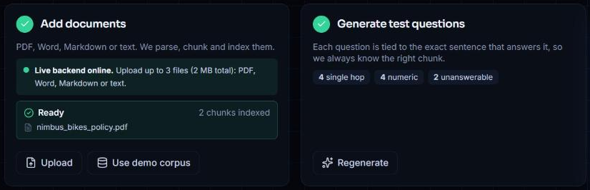
USER EXPERIENCE & DESIGN
Team Name | Team ID
USER INTERFACE
USER FLOW
DESIGN GOAL
Upload: PDF, Word, Markdown or text on the live site, with progress and file confirmation
Overview: 4 scorecards with 95% CIs, root-cause mix, LLM cost
Autopsy: answer sentences green / red, ranked chunks with gold outlined
Tabs: evidence · lens votes · counterfactual proof
1
Upload your documents (PDF, Word, MD) or try the demo
Any engineer sees, in under a minute, why each answer failed and exactly what to change.
2
Run evaluation: every failure gets a root cause
▶ Upload live: rag-autopsy.vercel.app
3
Apply the prescribed fix and compare before vs after
Notes:
Users upload their own documents right on the live site, or try the demo corpus. The upload step confirms each file and shows live progress while questions are written. One screen. The top row is the health of the RAG with confidence intervals. Pick a failure on the left and you get its autopsy: the answer coloured sentence by sentence, the ranked chunks with the gold one outlined, every lens's vote, and the counterfactual proof. The flow is three steps: documents in, evaluation run, apply the fix.

Slide 5
FEASIBILITY AND VIABILITY
Team Name | Team ID
TECHNICAL FEASIBILITY
ECONOMIC FEASIBILITY
OPERATIONAL VIABILITY
Working prototype, end to end: ingest → test set → diagnosis → verified fix
Runs on a CPU laptop: 16 GB RAM, local models < 2 GB
Modular: a new check is one file; swap in any OpenAI-compatible LLM
25 unit tests, LLM mocked
₹0 prototype: free tiers and open models only
0.36 LLM calls per question, 81% settled locally
Every call is disk-cached: re-runs are free; the full demo replays in 51 s
Costs scale with questions, not with users
Deployed: dashboard on Vercel; backend via a secure Cloudflare tunnel; uploads capped at 3 files / 2 MB
Data stays with the team's backend; only prompts reach the LLM API
Risks: API rate limits, judge bias, imperfect generated questions
Mitigations: rate-limit-aware retries + cache; format-tolerant parsing of model output; judge from a different model family; evidence-verified questions + human-review flags
Notes:
It is deployed: the dashboard runs on Vercel and visitors can upload their own documents, which go through a secure tunnel to our backend, with limits that protect the API quota. It already works end to end on a CPU laptop with free-tier APIs. The cascade keeps cost low: 0.36 LLM calls per question, and caching makes re-runs free. Main risks are rate limits, judge bias and imperfect generated questions, and each has a mitigation built in.

Slide 6
IMPACT AND BENEFITS
Team Name | Team ID
1
SOCIAL IMPACT
2
ENVIRONMENTAL IMPACT
Fewer confident wrong answers in high-stakes chatbots (health, legal, education, government). Abstention testing teaches systems to say “I don't know”.
81% of checks run on small local models instead of large LLMs; caching removes repeated compute, so each evaluation uses less energy.
3
TECHNICAL IMPACT
4
EDUCATIONAL IMPACT
Turns RAG tuning into diagnosis. On our demo the prescribed fix repaired 10 of 12 failures and broke none (accuracy 0 → 1.0 on the failed set).
Makes RAG failure modes visible and explainable: where retrieval or generation breaks, shown on real evidence. No black-box framework.
Notes:
Socially, fewer confident wrong answers in chatbots people rely on. Environmentally, most checks run on small local models and nothing is computed twice. Technically, the fix loop is measurable: 10 of 12 failures fixed, none broken. Educationally, it makes RAG failures visible and explainable.

Slide 7
BUSINESS MODEL & SUSTAINABILITY
Team Name | Team ID
TARGET USERS
REVENUE & COST MODEL
SUSTAINABILITY
AI / ML teams shipping RAG chatbots and copilots
Enterprises with internal knowledge assistants (HR, support, legal)
Universities & researchers evaluating LLM systems
Open core: free self-hosted CLI + dashboard
Pro SaaS: hosted runs, CI regression gates, team dashboards (per seat / per evaluation)
Enterprise: on-prem, custom lenses, SSO
Main cost is LLM calls, kept low by the cascade + cache
CI / CD gate: every RAG change gets an autopsy before deploy
Adapters for any RAG endpoint (question in → answer + contexts out)
Community lenses and consensus weights learned from user labels
Notes:
Users are teams shipping RAG products. The model is open core: free self-hosted tool, a paid hosted version with CI gates and team dashboards, and an enterprise on-prem tier. The long-term play is becoming the regression test every RAG change has to pass before deploy.

Slide 8
RESEARCH AND REFERENCES
Team Name | Team ID
KEY TECH & RESEARCH SOURCES
Lewis et al., 2020: Retrieval-Augmented Generation for Knowledge-Intensive NLP Tasks (NeurIPS)
Es et al., 2023: RAGAS: Automated Evaluation of Retrieval Augmented Generation
Tang, Laban & Durrett, 2024: MiniCheck: Efficient Fact-Checking of LLMs on Grounding Documents (EMNLP)
Kovács & Recski, 2025: LettuceDetect: A Hallucination Detection Framework for RAG Applications
Vectara: HHEM-2.1-Open hallucination evaluation model (Hugging Face)
Xiao et al., 2023: C-Pack: BGE embedding and reranker models (BAAI)
Cormack, Clarke & Büttcher, 2009: Reciprocal Rank Fusion (SIGIR); Robertson & Zaragoza, 2009: BM25
Efron & Tibshirani, 1993: An Introduction to the Bootstrap (confidence intervals)
Tools: FastAPI, ChromaDB, sentence-transformers, rank_bm25, React, Tailwind CSS, Google Gemini API, Groq API
Notes:
The core building blocks and the research they come from.

Slide 9


SCAN FOR THE SOURCE CODE
SCAN FOR THE LIVE DEMO
THANK YOU
GitHub repo
rag-autopsy.vercel.app
README, architecture diagram and setup
Explore the demo or upload your own docs
Team Name | Team ID | krishjariwala678@gmail.com
Live demo rag-autopsy.vercel.app Code github.com/GargeeTripathi/rag-autopsy
CREATE / AN / IMPACT
Notes:
Thank you. The live demo is at rag-autopsy.vercel.app (scan the QR code), and the code, with a full README and architecture diagram, is on GitHub at github.com/GargeeTripathi/rag-autopsy (second QR code). Happy to take questions.

