Slide 1
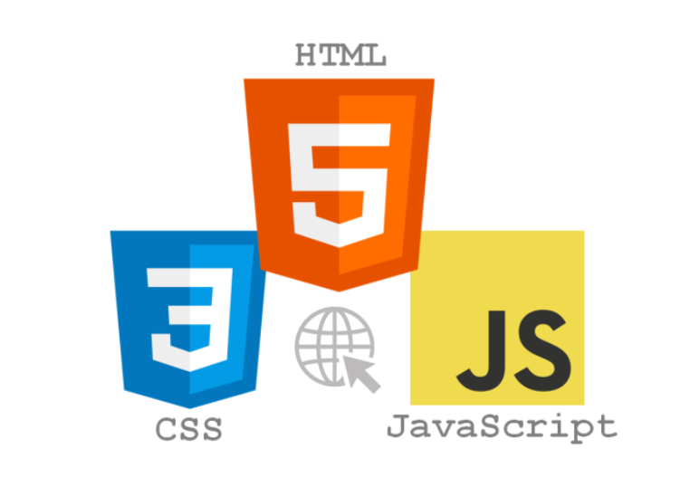

Slide 2

What is HTML?

Slide 3
HTML, or Hypertext Markup Language, is a markup language for the web that defines the structure of web pages.

Slide 4
HTML: HyperText Markup Language
HTML (HyperText Markup Language) is the most basic building block of the Web. It defines the meaning and structure of web content. Other technologies besides HTML are generally used to describe a web page's appearance/presentation (CSS) or functionality/behavior (JavaScript).
Read More : https://developer.mozilla.org/en-US/docs/Web/HTML

Slide 5

What’s HyperText?
"Hypertext" refers to links that connect web pages to one another, either within a single website or between websites. Links are a fundamental aspect of the Web. By uploading content to the Internet and linking it to pages created by other people, you become an active participant in the World Wide Web.

Slide 6
What’s Markup?
HTML uses "markup" to annotate text, images,
and other content for display in a Web browser.
HTML markup includes special "elements" such as
<head>, <title>, <body>, <header>, <footer>, <article>, <section>,
<p>, <div>, <span>, <img>, <aside>,
<audio>, <canvas>, <datalist>, <details>,
<embed>, <nav>, <output>, <progress>,
<video>, <ul>, <ol>, <li> and many others.

Slide 7
Anatomy of an HTML document
<!DOCTYPE html> — doctype. It is a required preamble. In the mists of time, when HTML was young (around 1991/92), doctypes were meant to act as links to a set of rules that the HTML page had to follow to be considered good HTML, which could mean automatic error checking and other useful things. However these days, they don't do much and are basically just needed to make sure your document behaves correctly. That's all you need to know for now.
<html></html> — the <html> element. This element wraps all the content on the entire page and is sometimes known as the root element.
<head></head> — the <head> element. This element acts as a container for all the stuff you want to include on the HTML page that isn't the content you are showing to your page's viewers. This includes things like keywords and a page description that you want to appear in search results, CSS to style our content, character set declarations, and more.
<meta charset="utf-8"> — This element sets the character set your document should use to UTF-8 which includes most characters from the vast majority of written languages. Essentially, it can now handle any textual content you might put on it. There is no reason not to set this and it can help avoid some problems later on.
<title></title> — the <title> element. This sets the title of your page, which is the title that appears in the browser tab the page is loaded in. It is also used to describe the page when you bookmark/favorite it.
<body></body> — the <body> element. This contains all the content that you want to show to web users when they visit your page, whether that's text, images, videos, games, playable audio tracks, or whatever else.
Read more on meta tags : https://www.w3schools.com/tags/tag_meta.asp

Slide 8
HTML Vs. HTML5
HTML stands for Hyper Text Markup Language. It is used to design web pages using a markup language. HTML is the combination of Hypertext and Markup language. Hypertext defines the link between the web pages. A markup language is used to define the text document within tag which defines the structure of web pages. This language is used to annotate (at the note for computer) text so that a machine can understand it and manipulate text accordingly. Most of the markup (e.g. HTML) languages are human readable. The language uses tags to define what manipulation has to be done on the text. It is used for structuring and presenting the content on the web pages. HTML5 is the fifth version of HTML. Many elements are removed or modified from HTML5.
Read More : https://www.geeksforgeeks.org/difference-between-html-and-html5/

Slide 9
My cat is very grumpy (I don’t have a cat ☺ )
HTML consists of a series of elements, which you use to enclose, or wrap, different parts of the content to make it appear a certain way, or act a certain way. The enclosing tags can make a word or image hyperlink to somewhere else, can italicize words, can make the font bigger or smaller, and so on. For example, take the following line of content:
My cat is grumpy
If we wanted the line to stand by itself, we could specify that it is a paragraph by enclosing it in paragraph tags:
<p>My cat is very grumpy</p>

Slide 10
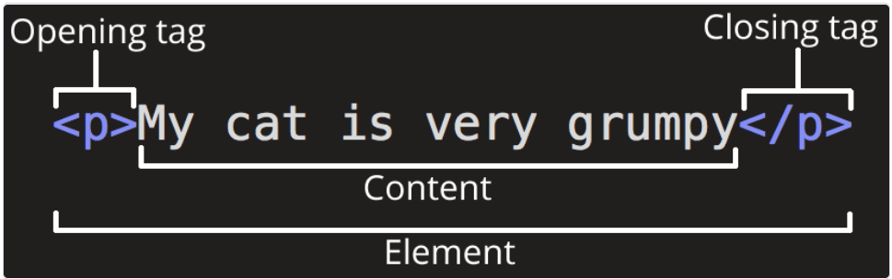
Anatomy of an HTML element Let's explore this paragraph element a bit further.

Slide 11
The main parts of our element are as follows:
The opening tag: This consists of the name of the element (in this case, p), wrapped in opening and closing angle brackets. This states where the element begins or starts to take effect — in this case where the paragraph begins.
The closing tag: This is the same as the opening tag, except that it includes a forward slash before the element name. This states where the element ends — in this case where the paragraph ends. Failing to add a closing tag is one of the standard beginner errors and can lead to strange results.
The content: This is the content of the element, which in this case, is just text.
The element: The opening tag, the closing tag, and the content together comprise the element.

Slide 12
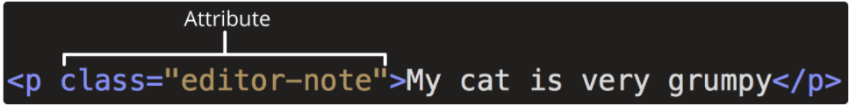
Elements can also have attributes that look like the following:
Attributes contain extra information about the element that you don't want to appear in the actual content. Here, class is the attribute name and editor-note is the attribute value. The class attribute allows you to give the element a non-unique identifier that can be used to target it (and any other elements with the same class value) with style information and other things.
An attribute should always have the following:
A space between it and the element name (or the previous attribute, if the element already has one or more attributes).
The attribute name followed by an equal sign.
The attribute value wrapped by opening and closing quotation marks.
Note: Simple attribute values that don't contain ASCII whitespace (or any of the characters " ' ` = < > ) can remain unquoted, but it is recommended that you quote all attribute values, as it makes the code more consistent and understandable.

Slide 13
Rest we have covered in Vscode ☺

