Slide 1
DATA INNOVATION SUMMIT 2026 · STOCKHOLM, SWEDEN
Key Takeaways
3 days · 9 parallel tracks · Sessions from Meta, Google,NVIDIA, Spotify & more
May 6 – 8, 2026 · Presenting to: Data Engineers & Managers
3
9+
7
1
Days
Tracks
Companies Deep-Dived
Overarching Theme
Notes:
Welcome. I attended the Data Innovation Summit in Stockholm, May 6–8. Over 3 days I covered sessions on data engineering, AI platforms, and agentic systems. Today I'll walk through the highlights and what they mean for our team.

Slide 2
THE SUMMIT AT A GLANCE
3 Days. Multiple Tracks. One Theme.
Day 1 · May 6
Day 2 · May 7
Day 3 · May 8
Parallel tracks M1–M9 M1: AI & MLM2: DE & DataOpsM3: Platform & Architecture I attended: DE, Platform & AI/ML
Parallel tracks M1–M9 continue Keynote: Google Agentic Data CloudSessions: Agentic readiness, Data quality, Knowledge fabrics I attended: Platform & AI/ML
Industry tracks i1–i5 i1: Finance & Telecomi2: Manufacturing & Energyi3: Retail, E-Commerce & Logistics I attended: Retail track (i3)
Notes:
Days 1 and 2 had parallel sessions in M1–M9 rooms. I focused on DE/DataOps (M2), Platform (M3), and AI/ML (M1). Day 3 switched to industry-specific tracks — I was in the Retail track (i3).

Slide 3
""There is no AI strategywithout a data strategy""
(But there is no need for either without a business strategy)
— DIS 2026 Opening Keynote
Notes:
This slide from the Day 1 keynote set the tone for everything that followed. Every session at the summit circled back to this idea: AI strategy requires a data strategy, and data strategy requires a business strategy. Without the business layer, the rest is theatre.

Slide 4
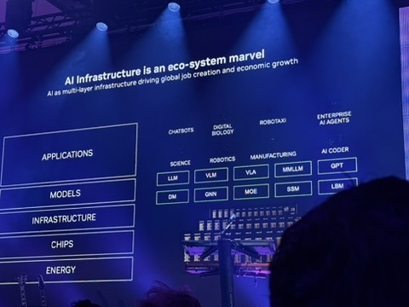
NVIDIA · DAY 1 CLOSING KEYNOTE
AI is Accelerating Faster Than You Think
→ AI capability doubles every 7 months — faster than Moore's Law
→ Data centers are becoming AI Factories — token generators
→ AI Infrastructure is a 5-layer ecosystem:Energy → Chips → Infrastructure → Models → Applications
→ Use lightweight open-source models where frontier models aren't needed — save cost in tokens
→ Agent-to-agent communication is the next frontier after post-training
Notes:
NVIDIA's Day 1 closing keynote. AI capability is doubling every 7 months — faster than Moore's Law ever was. Data centers are evolving into token generators, or AI Factories. The AI infrastructure ecosystem is a 5-layer stack: Energy → Chips → Infrastructure → Models → Applications. Each layer is its own market.

Slide 5
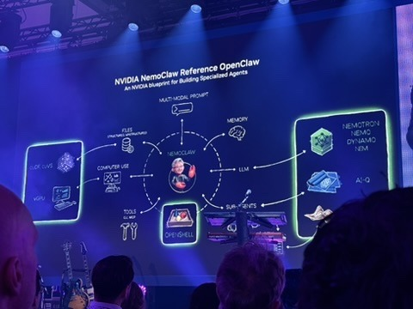
NVIDIA · NEMOCLAW / OPENCLAW
Blueprint for Specialized AI Agents
→ NemoClaw = reference architecture for building specialized agentic systems
→ Integrates: memory, tools, sub-agents, multi-modal prompts
→ Model outputs via Nemotron, Nemo, Dynamo, NIM
→ Sub-agents communicate via OpenShell
→ Key lesson: design for agent orchestration, not single model calls
Notes:
NemoClaw is NVIDIA's open reference architecture for building specialized AI agents. It integrates multi-modal prompts, memory, computer use tools, GPU access, sub-agents running OpenShell, and outputs through Nemotron / Nemo / Dynamo / NIM models. The key design principle: think in orchestration and agent composition, not single LLM calls.

Slide 6
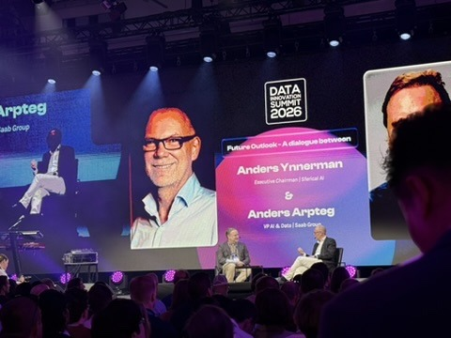
SFERICAL AI · DAY 1 KEYNOTE
The Physical Reality of AI
Dialogue: Anders Ynnerman (Sferical AI) & Anders Arpteg (Saab VP AI & Data)
→ AI infrastructure requires massive physical investment
→ Scale reality: 1,252 GPUs · 158 kW per rack · liquid cooling
→ AI is transforming from a software problem to an energy + infrastructure problem
→ Awareness of physical constraints is key to realistic AI planning
→ Not every company needs frontier-scale infra — right-size your compute
Notes:
A dialogue between Anders Ynnerman (Executive Chairman, Sferical AI) and Anders Arpteg (VP AI & Data, Saab Group). They discussed the physical reality of AI — the infrastructure constraints that are often ignored in AI hype. 1,252 GPUs. 158kW per rack. Liquid cooling is not optional at this scale. AI is not just a software problem.

Slide 7
SIEMENS · AI & ML STAGE (M1)
Industrial AI: Reshaping Industry End-to-End
🏭 Full Industrial Value Chain
🎯 Business-Critical Value
⚙️ Smarter Adaptive Operations
AI transforms design, engineering, production, operations, energy and buildings — not just one layer
More competitive, resilient and sustainable operations through AI — speed, flexibility, quality
Real-time decision-making · Faster problem-solving · Quality-driven factories
🔬 The Right Foundation
Industrial data + domain expertise + AI capabilities + partner ecosystem = real-world impact
Notes:
Siemens presented on how Industrial AI is reshaping industries end to end. The key argument: AI delivers real value when it is grounded in industrial data and domain expertise. Reliability and precision are non-negotiable in industrial settings. This is different from consumer AI — the stakes are factories, energy grids, and transportation systems. For us as data engineers, the lesson is that domain context matters enormously when deploying AI in any production-critical setting.

Slide 8
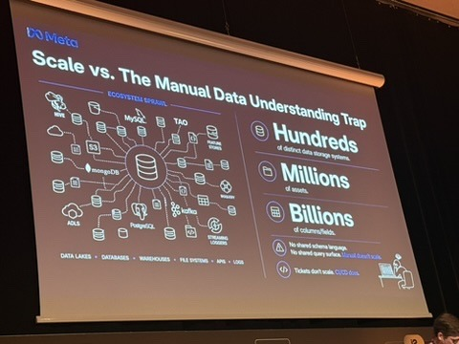
META · DE & DATAOPS STAGE (M2)
Understanding Data at Scale
The Manual Data Understanding Trap
100s
M+
B+
Distinct datastorage systems
Data assetsin scope
Columnsand fields
→ No shared schema language across systems
→ Tickets don't scale. Manual understanding fails at this level.
→ Solution: Privacy Aware Infrastructure (PAI) — automated, continuous
→ Adopted a shift-left approach: privacy embedded early in dev lifecycle
Notes:
Meta's session was in the DE & DataOps track (M2). The scale problem they face is extreme: hundreds of distinct storage systems (MySQL, TAO, ADLS, Postgres, Kafka, etc.), millions of data assets, billions of columns. No shared schema language. Tickets don't scale. Manual data understanding is fundamentally broken. Their answer: Privacy Aware Infrastructure — an automated, continuous data understanding system.

Slide 9
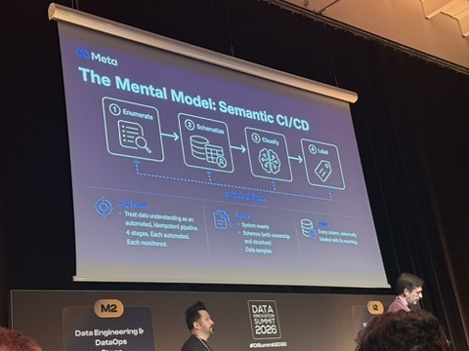
META · THE MENTAL MODEL
Semantic CI/CD Pipeline
Treat data understanding as an automated, idempotent pipeline
Step 1
Step 2
Step 3
Step 4
Enumerate
→
Schematize
→
Classify
→
Use
Discover all assets & schemas
One canonical dataSchema
Regex + ML classifiers
Privacy & access actions
→ Each stage is automated and monitored
→ Classification: heuristics (regex for emails, etc.) + ML classifiers
→ A decade of investment — millions of assets catalogued daily
Notes:
Meta's mental model: treat data understanding as an automated, idempotent pipeline — exactly like CI/CD for code. Four stages: Enumerate (discover all assets, schemas), Schematize (project native schemas into one canonical dataSchema), Classify (heuristics like regex + ML classifiers), Use (apply privacy actions). This pipeline runs continuously. Each stage is monitored and automated.

Slide 10
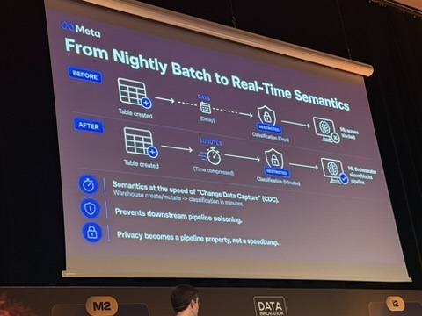
META · KEY INNOVATION
From Nightly Batch to Real-Time
→ Powered by Change Data Capture (CDC)
→ Before: days of delay between table creation and classification
→ After: classification in minutes
→ Privacy becomes a pipeline property, not a post-hoc check
→ Prevents downstream pipeline poisoning before it starts
→ ML access control applied automatically at classification
Notes:
The key innovation: moving from nightly batch classification (days of delay) to real-time semantics powered by CDC. After a table is created, classification now happens in minutes instead of days. Privacy becomes a pipeline property — not a speedbump. This prevents downstream pipeline poisoning. ML access control is applied automatically at classification time. Blog post: engineering.fb.com/2025/04/28/security/how-meta-understands-data-at-scale/

Slide 11
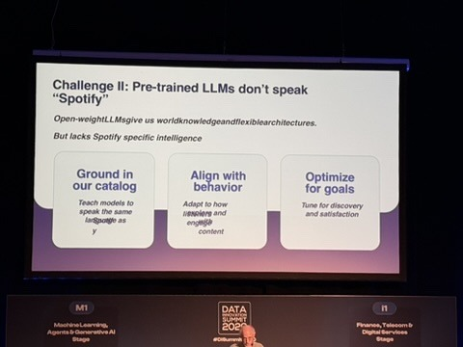
SPOTIFY · AI & ML STAGE (M1)
Personalization at 100M+ Users
The evolution of AI-powered recommendations
Era 1
Era 2
Era 3 (Now)
Human Curated → Editorial playlists
→
Prediction Models → Discover Weekly
→
Generative AI
Spotify DJ · Prompt to Playlist · Taste Profile
→ Challenge: pre-trained LLMs don't speak "Spotify"
→ Fix: ground in catalog, align with behavior, optimize for goals
Notes:
Spotify's session was in the AI & ML track (M1). They power personalization for 100M+ users across a massive catalog. The evolution: human-curated playlists → ML prediction models → Generative AI. Key challenge: pre-trained LLMs don't speak 'Spotify' — they have world knowledge but lack catalog-specific intelligence. Solution: ground in catalog, align with behavior, optimize for goals. New features: DJ, Prompt to Playlist, Taste Profile.

Slide 12
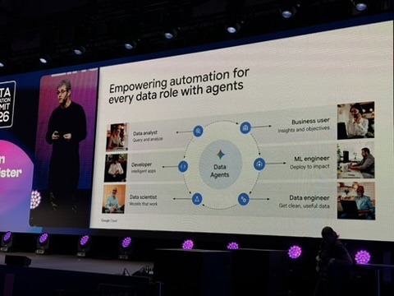
GOOGLE CLOUD · DAY 2 KEYNOTE
The Agentic Data Cloud
From systems of intelligence → systems of action
→ Data Agents empower every role in the data org
→ Moving from reactive dashboards to proactive action
→ Grounding agents in enterprise semantic knowledge, not raw data
→ Team transformation: from solo performer → orchestrator
→ Demo shown: Agent Catalog in Google Cloud Console
→ Moving from human scale to agent scale across clouds
Notes:
Google's Day 2 keynote introduced the Agentic Data Cloud. The central shift: from data as a system of intelligence (reactive dashboards you query) to a system of action (agents that proactively act). Data Agents serve every role: data analysts query and analyze, developers build intelligent apps, data scientists get models that work, ML engineers deploy to impact, business users get insights from objectives.

Slide 13
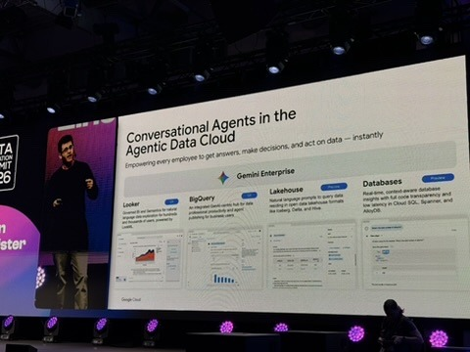
GOOGLE CLOUD · CONVERSATIONAL AGENTS
Natural Language Across the Data Stack
→ Gemini Enterprise integrated across Google's data tooling
→ Looker: natural language for BI and dashboards
→ BigQuery: AI-powered analytics for data practitioners
→ Lakehouse: NL queries against Delta, Delta, Hive data
→ Full code transparency in conversational DB insights
→ Goal: any employee gets answers instantly — no query skills needed
Notes:
Google's conversational agents are Gemini Enterprise integrated across the full data stack. Looker gets natural language BI for business users. BigQuery gets AI analytics for practitioners. Lakehouse gets NL prompts against Delta/Hive data. The promise: any employee can get answers and make decisions instantly without needing SQL or query skills.

Slide 14
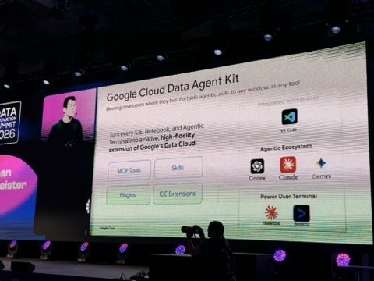
GOOGLE CLOUD · DEVELOPER TOOLS
Google Cloud Data Agent Kit
Meeting developers where they live — every IDE, every terminal
🔧 MCP Tools
⚡ Skills
Model Context Protocol integration with Data Cloud
Portable agentic capabilities, any window
🔌 Plugins
💻 IDE Extensions
Ecosystem extensions for productivity
VS Code, JetBrains, any IDE
Notes:
Google Cloud Data Agent Kit: turns every IDE, Notebook, and terminal into a native extension of Google's Data Cloud. It provides MCP Tools (Model Context Protocol integration), Skills (portable agentic capabilities), Plugins (ecosystem extensions), and IDE Extensions (VS Code and others). The agentic ecosystem includes Codex, Claude, and Gemini — open choice. Meeting developers where they live.

Slide 15
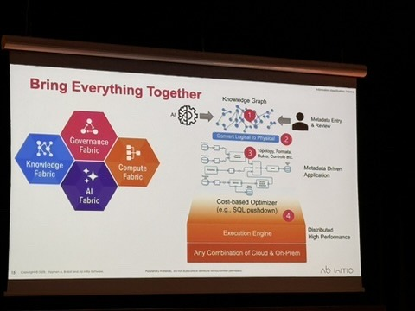
AB INITIO · DAY 2 — AGENTIC READINESS
The Four Fabrics Framework
Is your enterprise ready for an agentic future?
Knowledge Fabric
Governance Fabric
= Metadata fabric. Enterprise semantic layer. The foundation everything runs on.
Rules, policies, lineage, compliance controls across systems.
Compute Fabric
AI Fabric
The execution engine. Distributed high-performance processing.
GenAI-powered data management. MCP is critical here.
Notes:
The Ab Initio session (Day 2) framed agentic readiness around four 'fabrics'. Knowledge Fabric = the metadata layer, your enterprise semantic graph. Governance Fabric = rules, policies, lineage, compliance. Compute Fabric = the execution engine, distributed processing. AI Fabric = GenAI-powered data management using SLMs. MCP is called out as a critical component of the AI fabric. Key insight: everything is metadata-driven.

Slide 16
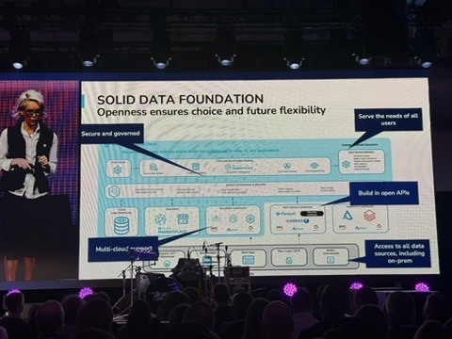
MARIA WISS · DAY 1 KEYNOTE
How AI-Ready Is Your Data?
3 prerequisites before jumping into AI:
32%
25%
Structured datathat is AI-ready
Unstructured datathat is AI-ready
→ Business alignment first — be specific about what an agent will do
→ Solid data foundation — multicloud, open APIs, governance in place
→ Agentic enterprise components — orchestration, monitoring, evaluation
Notes:
Maria Wiss shared the most sobering statistic of the conference: only 32% of structured data and 25% of unstructured data is currently AI-ready. Before jumping into AI projects, organizations need: 1) Strict business alignment — be specific about what an agent will do. 2) Solid data foundation — multicloud support, open APIs, governance. 3) The components of the agentic enterprise in place.

Slide 17
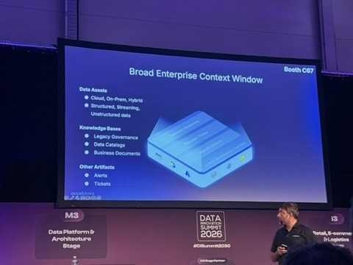
ACCELDATA · PLATFORM & ARCHITECTURE (M3)
Enterprise Context Window
What AI agents need to actually be useful
→ Data Assets: Cloud, On-Prem, Hybrid · Structured, Streaming, Unstructured
→ Knowledge Bases: Legacy governance, data catalogs, business documents
→ Operational Artifacts: Alerts, tickets, runbooks
→ MCP (Model Context Protocol) is the connectivity layer that wires everything
→ Without this context, agents hallucinate or miss business-critical constraints
Notes:
Acceldata presented the concept of a Broad Enterprise Context Window — essentially what you need to give AI agents enough context to be useful in an enterprise setting. Three categories: Data Assets (cloud, on-prem, hybrid; structured, streaming, unstructured), Knowledge Bases (legacy governance, data catalogs, business documents), and Other Artifacts (alerts, tickets). MCP is the connectivity layer that wires these together.

Slide 18
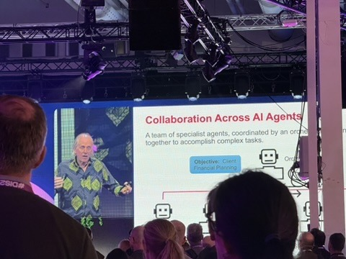
DAY 3 PANEL · RETAIL TRACK (I3)
What Actually Works in Practice
→ You don't fail because of the technology — you fail because of data
→ Fix data, be relevant, get product data correct first
→ Know which Customer Data Platform (CDP) you need — or build your own
→ Choose AI vendors carefully — set clear rules on who does what
→ People need data literacy; tech people need business literacy
→ Involve everyone in experimentation — let them play with AI tools
→ Elgiganten example: personalization through testing, learning, improving
Notes:
The Day 3 retail panel was the most grounding session of the conference. Real practitioners from companies like Elgiganten sharing what actually works in the field. The main message: you don't fail because of the technology. You fail because your data is wrong, your people aren't aligned, and your AI use cases aren't specific enough. Fix the data. Choose the right CDP. Involve everyone. Educate constantly.

Slide 19
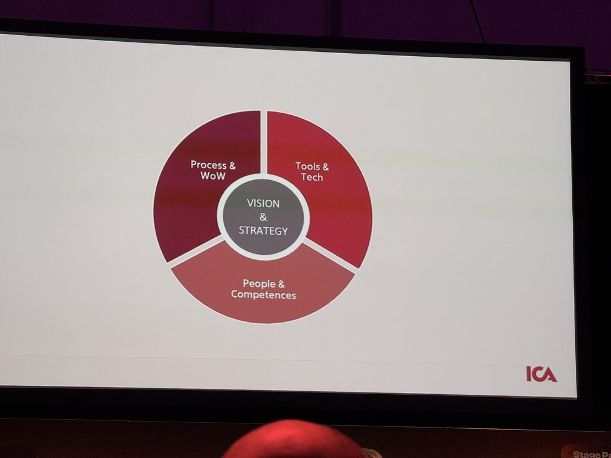
ICA · ANALYTICS & DECISION INTELLIGENCE (M5)
Taking a 100-Year-Old Company Into the Data Future
"It is not just about the data — we need the people on board!"
→ A century of customer knowledge — but the methods have changed dramatically
→ The real challenge is the change journey, not the technology itself
→ Learning which tool to use when is a critical skill — not every tool fits every problem
→ People alignment is the actual barrier to data investment paying off
→ Hands-on methods and organizational learning beat top-down mandates
→ You need data literacy and the willingness to let people experiment
Notes:
Annie from ICA presented on the Analytics and Decision Intelligence stage, M5. ICA is a 100-year-old Swedish grocery company. Their message: it is not just about the data or the technology — the people side of the change journey is what makes or breaks success. Knowing which tool to use is a skill in itself. People alignment is the actual blocker, not technology. This resonates with the retail panel on day 3 and is directly relevant to us: even the best pipelines fail if teams are not aligned.

Slide 20
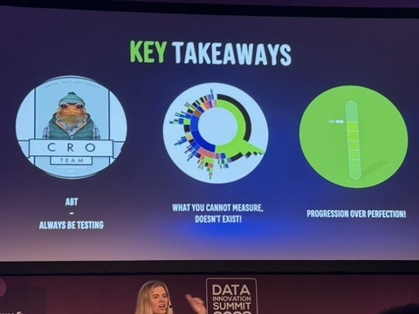
DAY 3 PANEL · RETAIL TRACK
Three Mantras to Take Home
ABT Always Be Testing
"What you cannot measure doesn't exist"
Progress > Perfection
Small iterations · Fail fast · Learn
Track what matters · Instrument everything
Ship · Observe · Improve Don't wait for perfect
Notes:
Three mantras from the Day 3 panel that I'm bringing back. ABT: Always Be Testing — small iterations, fail fast, learn. What you cannot measure doesn't exist — if you're not tracking it, it's not improving. Progression over Perfection — don't wait for perfect data or the perfect model. Ship, observe, iterate. These three apply directly to our data engineering work.

Slide 21
FOR OUR TEAM
What This Means for Data Engineers
01
Fix the data before adding AI
AI amplifies good data and bad data equally. Clean, classified data is the prerequisite — not an afterthought. (Meta, Day 3 Panel)
02
Invest in metadata — it's the foundation of every agentic system
Knowledge fabric = metadata fabric. Cataloging, lineage, and semantic classification are not nice-to-haves. (Ab Initio, Meta)
03
MCP is becoming the integration standard — evaluate it now
Model Context Protocol appeared in every agentic architecture at the summit. Assess it for our stack. (Google, Acceldata, Ab Initio)
04
Right-size your models — frontier isn't always the answer
Use lightweight open-source models where they're sufficient. Frontier models cost more in tokens and infra. (NVIDIA)
05
Build data literacy — it's now everyone's job
Data engineers need business context. Business users need data literacy. This cultural gap is the real blocker. (Panel)
Notes:
Five actionable takeaways for our team. Each maps directly to sessions at DIS 2026. 1: Fix data quality — AI amplifies both good and bad data equally. 2: Invest in metadata now — it's the foundation of every agentic system we saw. 3: Watch MCP — it appeared in every architecture. 4: Right-size models — don't default to frontier. 5: Build data AND business literacy across the team.

Slide 22
DATA INNOVATION SUMMIT 2026 · STOCKHOLM
Thank You
Questions? Full session notes available on request.
Notes:
Thank you! Happy to discuss any session in detail. Full notes from each session are available. The conference overall reinforced that the data engineering fundamentals — quality, lineage, cataloging, observability — matter more than ever in an agentic world.

