Slide 1
AI-Driven Nutrient Prediction for Healthier Food Choices
HAN CHOU LIN
GARGI GHOSH

Slide 2
Why is this research important?
MOTIVATION
Nutrition labels are often ignored
AI can estimate nutrients from food images
Goal: improve healthier food choices
Existing labels fail to influence purchasing decisions
AI can automatically estimate nutrients from food images
Traditional Nutrition Labels
Image-Based Food Recognition
Deep Learning Models
Hybrid AI Models
AI-Assisted Consumer Decision Making

Slide 3
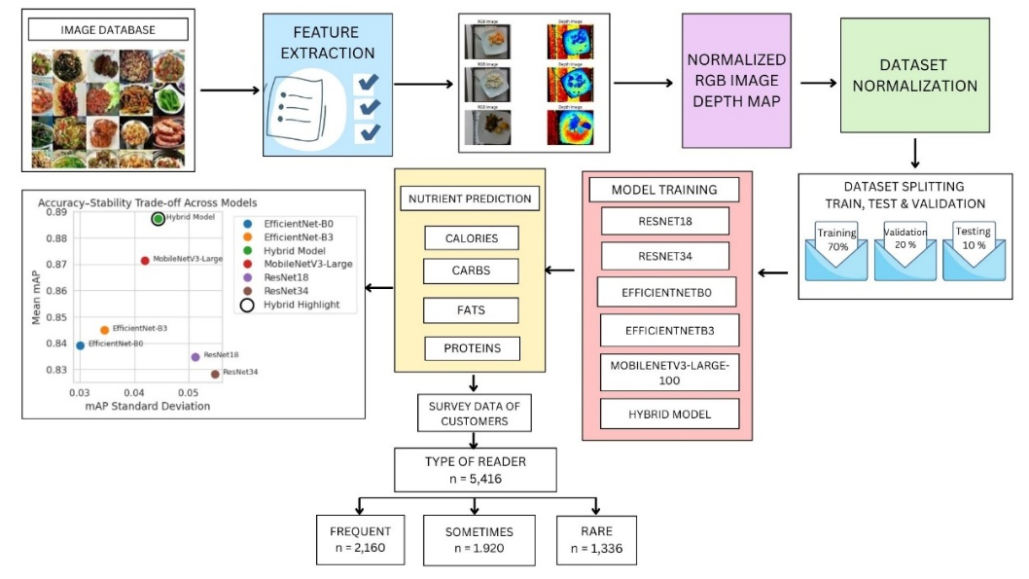
PIPELINE
Our research pipeline consists of three major stages. First, food images are preprocessed and used to train several deep learning models. Second, the best-performing features are combined using our Hybrid architecture to generate accurate nutrient predictions. Finally, these predictions are evaluated not only using performance metrics but also through consumer behavior analysis to understand how AI-generated nutritional information influences healthier purchasing decisions

Slide 4
RESULTS
Models: ResNet18/34, EfficientNet-B0/B3, MobileNetV3-Large, Hybrid
Feature fusion of MobileNetV3 + EfficientNet-B0
Model | Calories mAP | Mass mAP | Fat mAP | Carb mAP | Protein mAP | mAP | Mean mAP
Resnet18 | 0.8574 | 0.8903 | 0.8221 | 0.7539 | 0.8495 | 0.8346601 | 0.8347
Resnet 34 | 0.8567 | 0.8972 | 0.7886 | 0.7590 | 0.8392 | 0.8281043 | 0.8281
EfficientNet b0 | 0.8450 | 0.8536 | 0.8492 | 0.7862 | 0.8610 | 0.8390277 | 0.8390
EfficientNet b3 | 0.8324 | 0.8615 | 0.8426 | 0.7973 | 0.8905 | 0.8448587 | 0.8449
MobileNetV3-large-100 | 0.8771 | 0.9020 | 0.8850 | 0.7980 | 0.8941 | 0.8712518 | 0.8713
Hybrid Model | 0.8847 | 0.9284 | 0.8795 | 0.8434 | 0.9276 | 0.8871221 | 0.8826

Slide 5
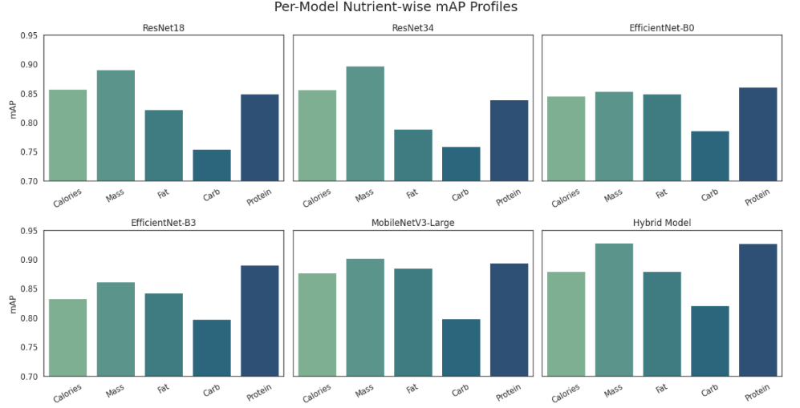
ENERGY AND FIBRE INTAKE COMPARISON
Nutrient density of fibre, potassium, and calcium expressed per 1000 kcal across reading frequency groups. Frequent readers demonstrated significantly higher nutrient density for all three nutrients compared to sometimes and rare readers (p < 0.001), indicating superior dietary quality.

Slide 6
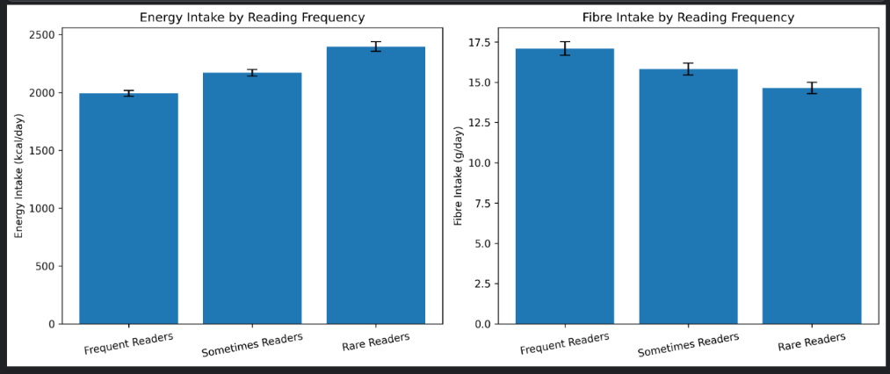
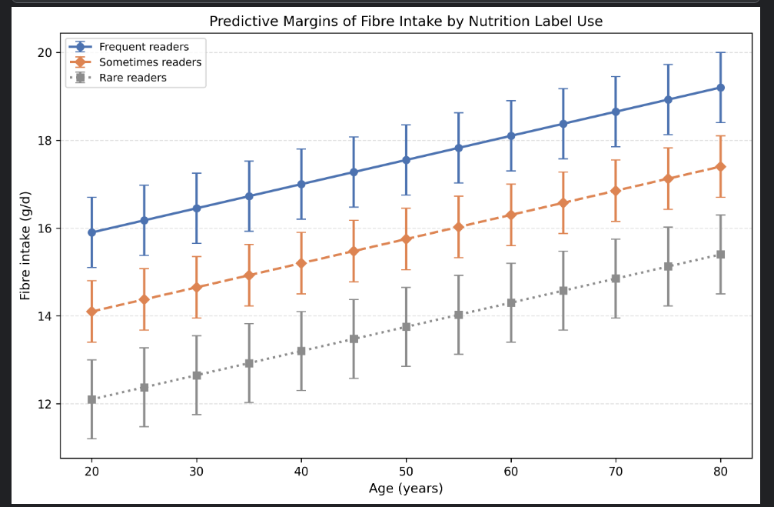
Predictive margins of daily fibre intake across age groups stratified by nutrition label reading frequency. Lines represent adjusted mean fibre intake (g/day), and vertical bars indicate 95% confidence intervals. Across all age categories, frequent nutrition label readers consistently exhibited higher predicted fibre intake compared with sometimes and rarely readers.

Slide 7
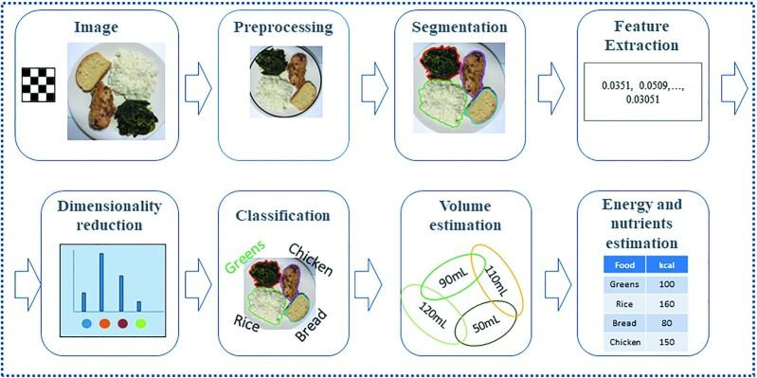
CONSUMER STUDY
AI nutrient predictions increased trust, transparency and healthier purchase intent
Biggest impact on users who rarely read nutrition labels

Slide 8
CONCLUSION
Nutrition Label Reading
Nutrition Awareness
Nutrition Awareness
Transparency
Trust
AI-generated nutrient predictions improved product transparency.
Participants reported greater trust in food products with AI-generated nutritional information.
Nutrient predictions positively influenced purchase intention.
Consumers who rarely read nutrition labels showed the greatest improvement in decision-making.
AI-based nutrition information can effectively complement traditional nutrition labels.
AI-generated nutritional information encourages healthier and more informed food choices.

Slide 9
THANK YOU

