Slide 1


Solar Powered Seed
Sowing Machine

Slide 2



Problem Statement
IN TRADITIONAL AGRICULTURAL PRACTICES, THE PROCESS OF SEED SOWING IS OFTEN LABOUR INTENSIVE AND TIME-CONSUMING.
FARMERS FACE CHALLENGES IN ACHIEVING UNIFORM SEED DISTRIBUTION.

Slide 3
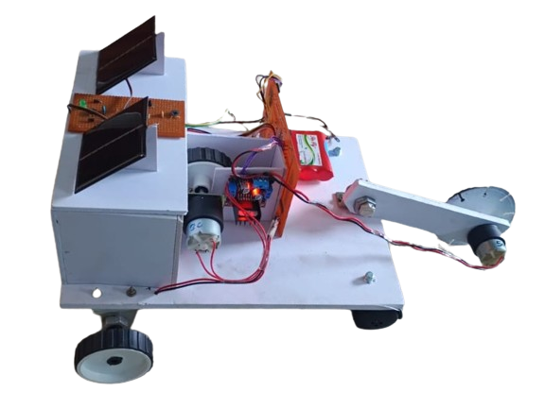
Solution:
TO OVERCOME THE SEED PLANTING PROBLEM THERE IS NEED TO DEVELOP THE SEED SOWING MACHINE WHICH CAN BE IMPLEMENTED FOR ALL TYPES OF CROPS , MINIMIZE THE WORKING COST, TIME FOR DIGGING OPERATION ON CLEAN ENERGY.

Slide 4
About us
Farmers should use latest technological advancements for the various agricultural practices like digging, sowing, irrigation etc. The main work of sowing operation is to sow seeds at required depth with specific spacing between the two sowed seeds. This can be achieved with the help of seed sowing machine which will dig the furrow and sow the seeds with cultivator. After the seeds being placed in the furrow land, it will cover the sowed seeds with soil. Seed sowing machine saves time and labour requirement, thus saving a lot of money along with the assurance of proper seed broadcasting.

Slide 5
Questions asked by designer
to stakeholders (Farmers):
1)For what purpose do you want to use this device?
2)How do you want the device to be?
3)How big do you want this device to be?
4)Under what condition do you want this device to work?
5)What should be the budget?

Slide 6
6)What type of user do you have?
7)What additional feature do you want in this device?
8)How semi-automatic / automatic the device should be?
9)What type of electricity supply do you want in your device?
10)What should be age group which will use this device?

Slide 7
Responses
1)We want this device for sowing purpose.
2)This device should be capable for sowing seeds.
3)Size should be 16inch x 14inch.
4)This device should be durable and easy to use.
5)Cost should be 8000.

Slide 8
6)This device will be mainly used by farmers.
7)We want extra feature for spraying pesticides and water
8)We want this device should be semi-automatic.
9)I want solar panel for electricity purpose.
10)This device is used by 15 -60 year person.

Slide 9

Our History
01
SOLAR SEED SOWING MACHINE(2016)
02
SOLAR POWERED SEED SOWING MACHINE(2018)
NITAVE RANJIT VILAS
JAGTAP POOJA NARAYAN
KALASH SINGHAL
GAURAV PRAJAPATI
03
AUTOMATIC SOLAR SEED SOWING MACHINE(2020)
04
SOLAR OPERATED SEED SOWING MACHINE(2021)
GIRISH
KARTHIK
SHARVIL JOGLEKAR
AKHILESH DESAI
VEDANT BHIRUD

Slide 10
BLOCK DIAGRAM
SOLAR PANEL
MPPT SNUBBER CHARGE CONTROL
BATTERY
RESET
POWER SUPPLY
B.T RECEIVER
HC-05
MICROCONTROLLER
OSCILLATOR UNIT
MOTOR DRIVER
SOWING MOTOR(M3)
M1
CULTIVATING MOTOR(M4)
MOTOR DRIVES
M2

Slide 11

WORKING
The seed sowing machine is controlled by MCU (micro controller unit).
The seed sowing machine which contains the solar panel which collects the solar power and it is given to the charge controller then to the battery (12v). The battery is used to save the power.
The DC motor is used for this machine and the power to DC motor is given by battery and DC motor is connected to the rear wheel of the machine using transmission system.
The main part is IR sensor which is used track the path of the moving machine and the IR sensor is controlled by the MCU.
The seed is sowing is controlled by the revolution of the wheel for example (one seed for one revolution). This machine will dig the soil and sow the seed and cover the soil after sowing the seed.

Slide 12
Features
Our product having a removable cultivator which can be easily replace by cutter.
We are also having a container which will use to spraying water and pesticides on crops.
Our product having a rotatory wheel which will store seeds and also it will sow that seeds on furrow.

Slide 13
REFERENCES
https://www.researchgate.net/publication/318988073_SOLAR_SEED_SOWING_MACHINE
https://www.researchgate.net/publication/342656182_Solar_Powered_Seed_Sowing_Machine
https://www.researchgate.net/publication/346253025_Design_and_Fabrication_of_Automatic_Solar_Seed_Sowing_Machine
https://www.irjet.net/archives/V8/i2/ IRJET-V8I209.pdf

