Slide 1
Wireless Sensor Networks Project
Session 2020-2021
Semester II
Fetal Health Classification
By-
Gargi Mishra
20/10/MT/017
M.Tech Computer Science and Technology
SCSS, JNU
Submitted to-
Dr. Poonam Agarwal

Slide 2
Fetal Health
Classify fetal health in order to prevent child and maternal mortality.
CTG (Cardiotocography) is used during pregnancy to monitor fetal heart rate and uterine contractions.

Slide 3
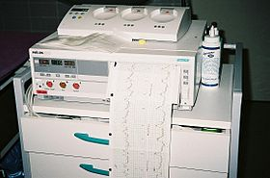
Cardiotocography (CTG)
Methods:
External CTG
Internal CTG
[Source] https://en.wikipedia.org/wiki/Cardiotocography

Slide 4
External CTG
The fetal heart rate and the activity of the uterine muscle are detected by two transducers placed on the mother's abdomen, with one above the fetal heart to monitor heart rate, and the other at the fundus of the uterus to measure frequency of contractions.[1]
Doppler ultrasound provides the information, which is recorded on a paper strip.[1]

Slide 5
Internal CTG
Internal cardiotocography uses an electronic transducer connected directly to the fetus. A wire electrode, sometimes called a spiral or scalp electrode, is attached to the fetal scalp through the cervical opening and is connected to the monitor.[2]
Internal monitoring provides a more accurate and consistent transmission of the fetal heart rate, as unlike external monitoring, it is not affected by factors such as movement.[2]
Internal monitoring may be used when external monitoring is inadequate, or if closer surveillance is needed.[2]

Slide 6
Use of Sensors in CTG
Doppler ultrasonography is medical ultrasonography that employs the Doppler effect to generate imaging of the movement of tissues and body fluids, and their relative velocity to the probe.[3]
It utilised an Xbee Arduino based sensor network for distance calculation which is used by a ‘differential localization algorithm for location estimation’. Creating a XBee based network is advantageous when required to monitor real-time sensor data.[4]

Slide 7
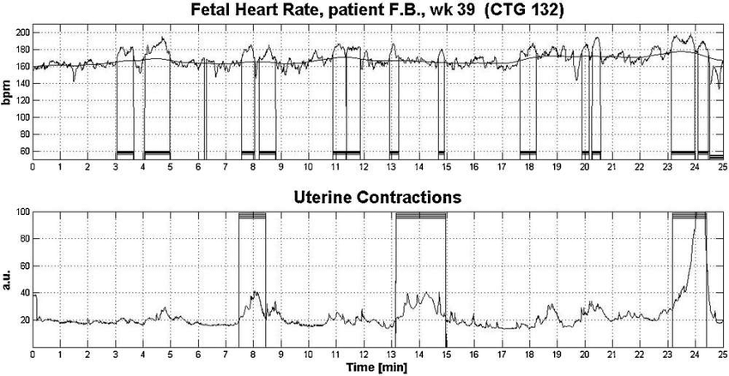
[Source] https://www.researchgate.net/figure/CTG-trace-in-which-the-software-recognised-all-kinds-of-accelerations-a-deceleration_fig4_284086787

Slide 8
Our Dataset
The dataset consists of measurements of fetal heart rate (FHR) and uterine contraction (UC) features on cardiotocograms classified by expert obstetricians.[5]
Dataset Info: 2126 fetal cardiotocograms (CTGs) were automatically processed and the respective diagnostic features measured. The CTGs were also classified by three expert obstetricians and a consensus classification label assigned to each of them. Classification was both with respect to a morphologic pattern (A, B, C. ...) and to a fetal state (N, S, P). Therefore the dataset can be used either for 10-class or 3-class experiments.[5]

Slide 9
Attributes of Dataset
LB - FHR baseline (beats per minute)
AC - # of accelerations per second
FM - # of fetal movements per second
UC - # of uterine contractions per second
DL - # of light decelerations per second
DS - # of severe decelerations per second
DP - # of prolongued decelerations per second
ASTV - percentage of time with abnormal short term variability
MSTV - mean value of short term variability
ALTV - percentage of time with abnormal long term variability
MLTV - mean value of long term variability
Width - width of FHR histogram
Min - minimum of FHR histogram
Max - Maximum of FHR histogram
Nmax - # of histogram peaks
Nzeros - # of histogram zeros
Mode - histogram mode
Mean - histogram mean
Median - histogram median
Variance - histogram variance
Tendency - histogram tendency
CLASS - FHR pattern class code (1 to 10)
NSP - fetal state class code (N=normal; S=suspect; P=pathologic)

Slide 10
Objective
In this project we have developed several machine learning models using correlation coefficient among different features of the dataset and also to see the difference between bagging and boosting methods of ensemble.

Slide 11
Correlation
“Correlation” is a statistical term describing the degree to which two variables move in coordination with one-another.
Correlation coefficient: These are indicators of the strength of the linear relationship between two different variables. Its values range between -1.0 and 1.0.

Slide 12
Machine Learning methods
In this project we have developed following models:
Logistic Regression
Support Vector Machine
Decision Tree Classifier
Random Forest Classifier
Gradient Booster Classifier

Slide 13
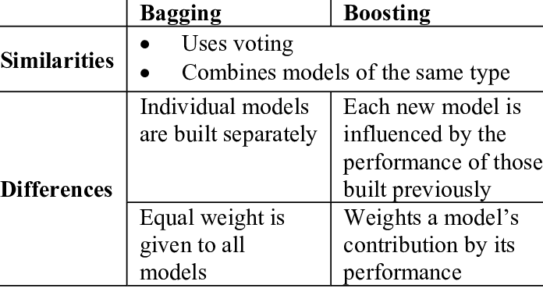
Bagging VS Boosting
[Source] https://www.researchgate.net/figure/Comparison-between-bagging-and-boosting_tbl1_224453264

Slide 14
Let us now look at the project…

Slide 15
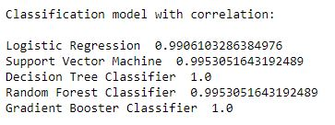
Results

Slide 16
Conclusion
As we see from results, Gradient Booster Classifier performs best among all the models. Hence, we can say that boosting method of ensemble gives best result.
For classification of fetal health, a boosting method like Gradient Booster is recommended.

Slide 17
References
Alfirevic, Zarko; Devane, Declan; Gyte, Gillian M. L.; Cuthbert, Anna (3 February 2017). "Continuous cardiotocography (CTG) as a form of electronic fetal monitoring (EFM) for fetal assessment during labour". Cochrane Database of Systematic Reviews.
"Types of Fetal Heart Monitoring". www.hopkinsmedicine.org.
https://en.wikipedia.org/wiki/Doppler_ultrasonography
Kaisha Andrew, Prasad Gudimetla, Internal Positioning System for Cardiotocograph (CTG) Transducers at Mackay Base Hospital, Procedia Manufacturing, Volume 30, 2019, Pages 365-372, ISSN 2351-9789, https://doi.org/10.1016/j.promfg.2019.02.051.
https://archive.ics.uci.edu/ml/datasets/cardiotocography.

Slide 18
Thank you!

