Slide 1

Minor Project Flask Based Web Application for Portfolio Optimization for US based equity instruments using Monte Carlo Simulations
Ayan Mukherjee (1805027)
Gargi Mondal (1805389)
Sohita Kumari (1805346)
Under the Supervision of;
Dr. Pradeep Kr. Mallick

Slide 2
Aim & Approach - MPT
Portfolio A
Portfolio B
Minimize Risk
Maximize Returns

Slide 3
Aim & Approach
Parameters
Expected Returns
Variance
Risk
Sharpe Ratio

Slide 4
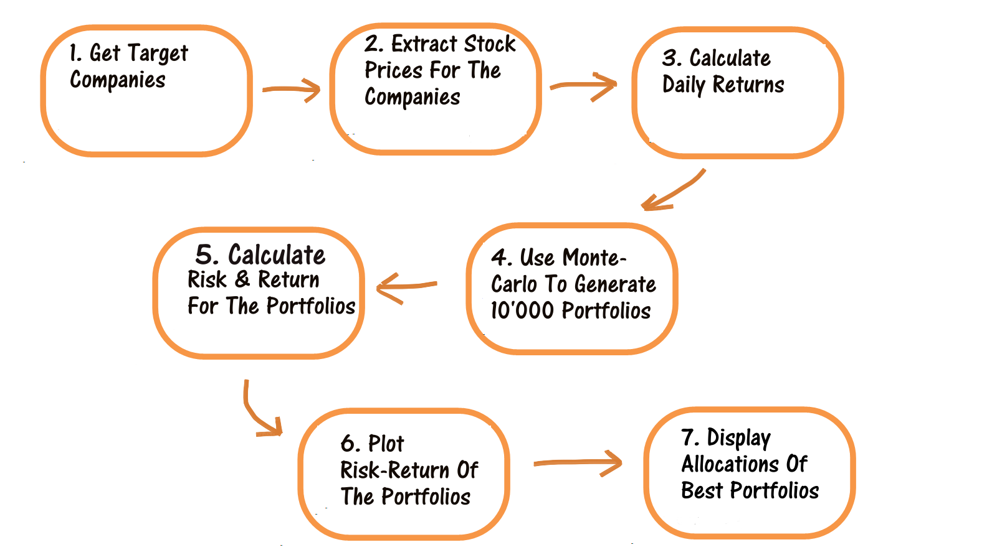
Aim & Approach

Slide 5
Methodology
FrontEnd
BackEnd
Integration
PRODUCT
Python
HTML
CSS
BootStrap
Flask
Framework

Slide 6
Milestones
04
Flask Integration
Feb 21
03
Frontend development using HTML & CSS
Jan 21
02
Python Implementationn using the dataset created
Dec 20
Literature Review & Dataset Creation – A dataset of 300 equity instruments traded in the NYSE was created
Dec 20
01

