Slide 1
DATA@ANZ
Data Analysis
Gargi Podder

Slide 2
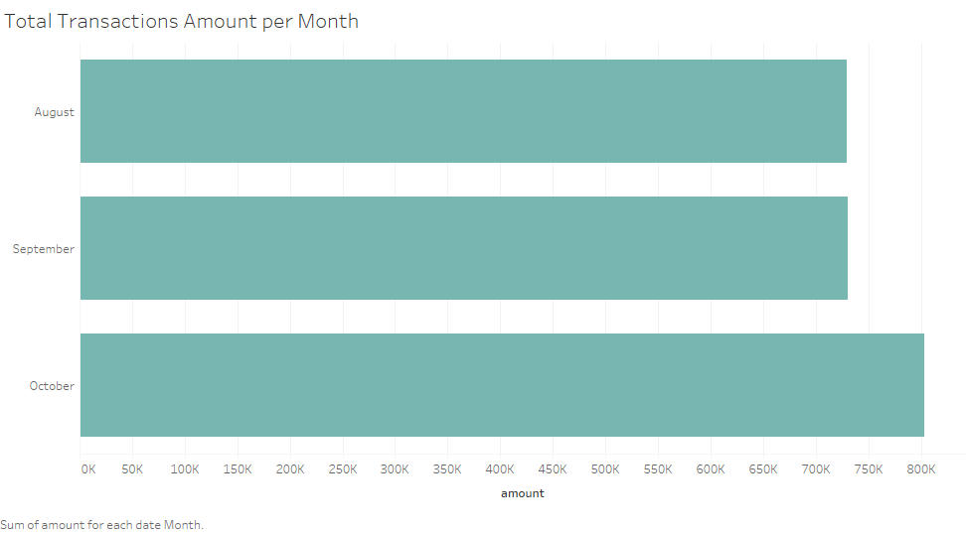

Slide 3
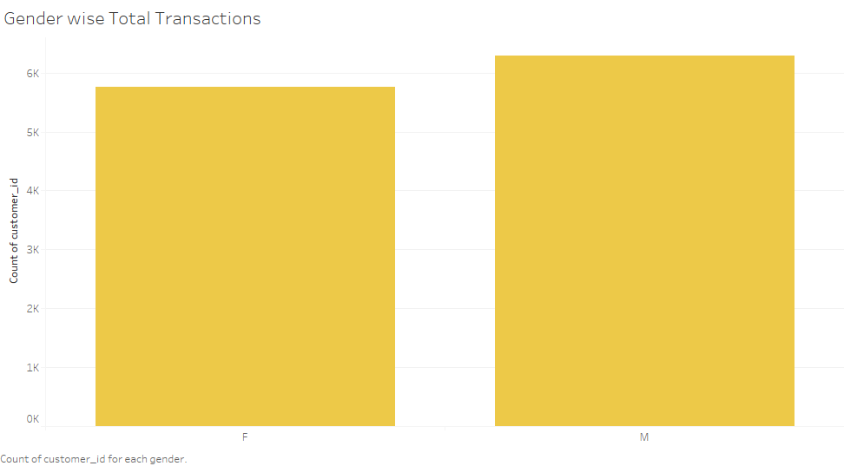

Slide 4
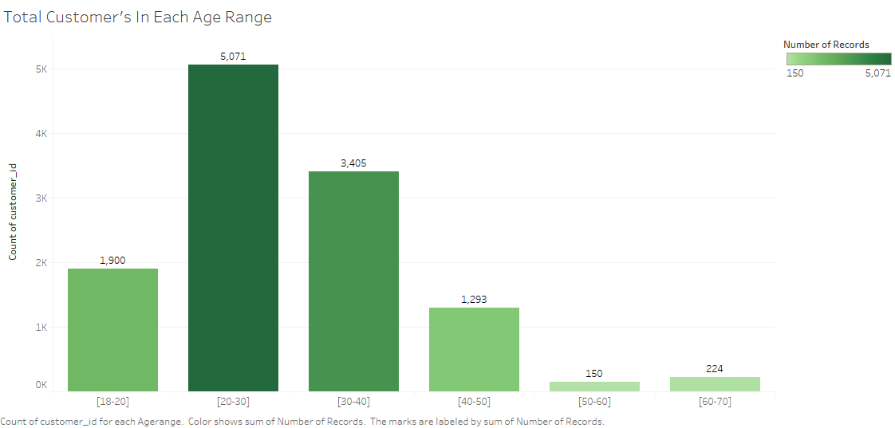

Slide 5
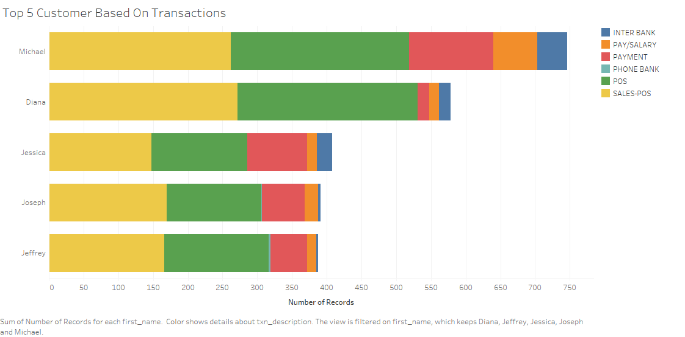

Slide 6
