Slide 1

Note: The data and information in this document is reflective of a hypothetical situation and client. This document is to be used for KPMG Virtual Internship purposes only.
Sprocket Central Pty Ltd
Data analytics approach
Gargi Podder

Slide 2
Note: The data and information in this document is reflective of a hypothetical situation and client. This document is to be used for KPMG Virtual Internship purposes only.
Agenda
Introduction
Data Exploration
Model Development
Interpretation

Slide 3
Note: The data and information in this document is reflective of a hypothetical situation and client. This document is to be used for KPMG Virtual Internship purposes only.
Introduction
Identification and Recommendation of Top 1000 Customers to Target
Sprocket Central Pty Ltd specialises in high quality bike and accessible cycling accessories to riders
Their marketing team is looking forward to boost their sales analysing their customer trends and behaviour.
Analysing the three datasets aim is to identify top 1000 customers whom the marketing team target to increase business revenue.

Slide 4
Note: The data and information in this document is reflective of a hypothetical situation and client. This document is to be used for KPMG Virtual Internship purposes only.
Introduction
Identification and Recommendation of Top 1000 Customers to Target
Outline of the Analysis
Age distributions of ‘Old’ and ‘New’ customers.
Wealth segment of customers based on age range.
Job industry distributions.
Owning car by State wise distributions.
Past 3 year’s bike related purchases of the customers.
RFM analysis and customer segmentation.

Slide 5
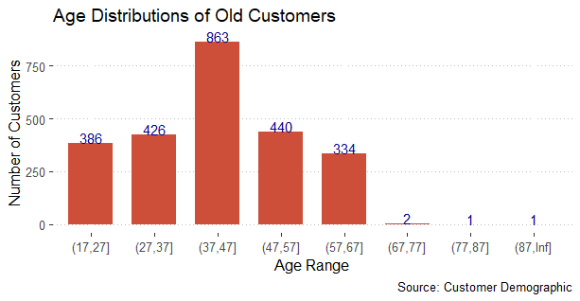
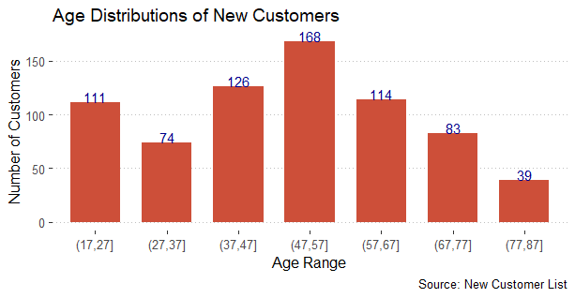
Note: The data and information in this document is reflective of a hypothetical situation and client. This document is to be used for KPMG Virtual Internship purposes only.
Data Exploration
Age distributions of Old and New Customers
Most of the old customers age is between 37-47. Where as combining two highest number of customers in New customer’s list most of the customer are between 37-57.
There is an steep decrease of old customer’s after 67 years.
There is an acknowledgeable number of customers in new customer list around the old age such as 77-87.

Slide 6
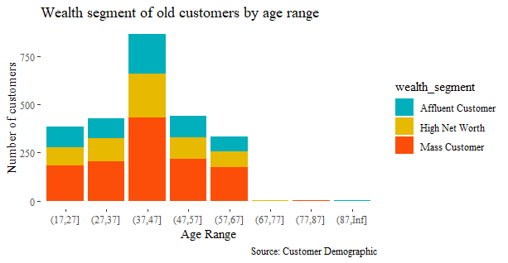
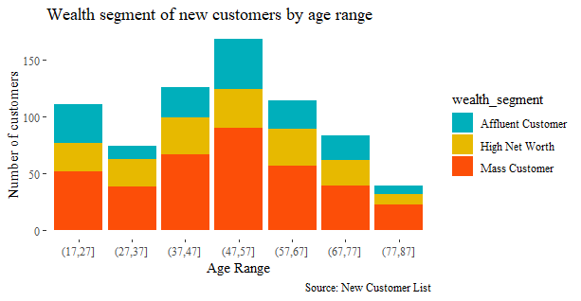
Note: The data and information in this document is reflective of a hypothetical situation and client. This document is to be used for KPMG Virtual Internship purposes only.
Data Exploration
Wealth segment of ‘Old’ & ‘New’ customers by Age range
In all age range “Mass Customer” is higher than others.
In 37-47 age range old customer’s wealth segment is mostly high than others.
New customer’s wealth segment is higher in 47-57.

Slide 7
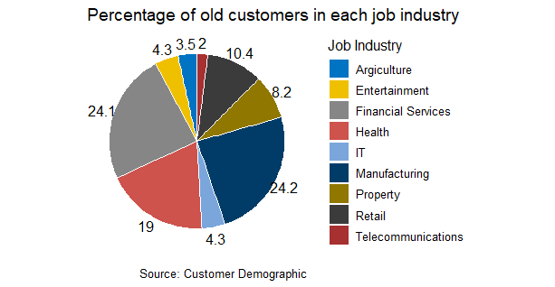
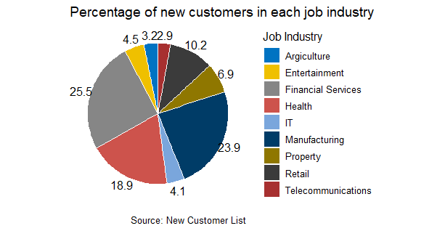
Note: The data and information in this document is reflective of a hypothetical situation and client. This document is to be used for KPMG Virtual Internship purposes only.
Data Exploration
Job Industry Distribution
25.5% of new customers are in Financial Services
Large number of new customers are coming from Financial Services, Manufacturing, Telecommunications.
Similar trend can be found in old customers too.

Slide 8
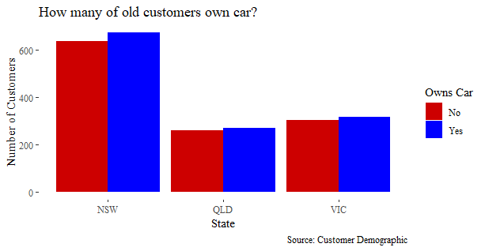
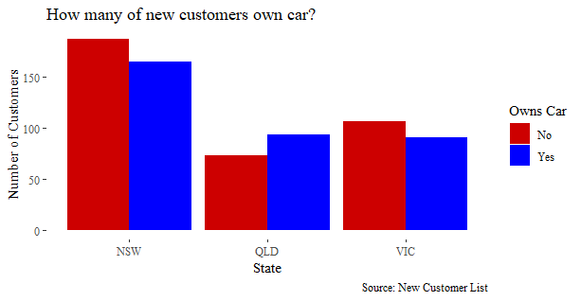
Note: The data and information in this document is reflective of a hypothetical situation and client. This document is to be used for KPMG Virtual Internship purposes only.
Data Exploration
Owning Car by State wise Distribution
In Old customers New South Wales has maximum customers.
Most of the customer has car.
New customers from New South Wales has more people not owning a car.
Old customers from QLD and VIC has nearly equal ration of owning and not owning car.

Slide 9
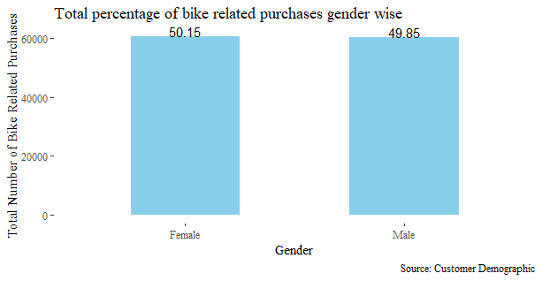
Note: The data and information in this document is reflective of a hypothetical situation and client. This document is to be used for KPMG Virtual Internship purposes only.
Data Exploration
Past 3 Year Bike related purchases based on Gender
Over the last three year females have brought 50.15% bikes to 49.85% of bike purchases by male.
Females has taken up majority of bike sales
Quantitively Females have brought 10,000 more bikes than Males.

Slide 10
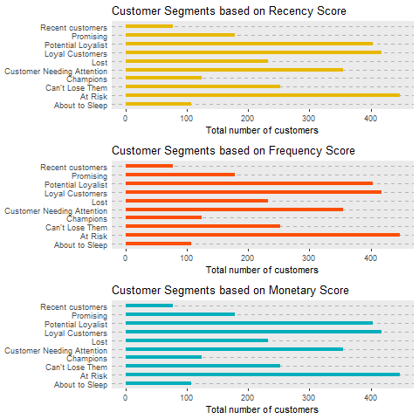
Note: The data and information in this document is reflective of a hypothetical situation and client. This document is to be used for KPMG Virtual Internship purposes only.
Model Development
RFM Analysis
RFM analysis is behaviour based analysis to target which customers a company should target to increase its value and revenue.
RFM is used to segment customers based on their transactions history such as:
How recently a customer has purchased(Recency)
How frequent they purchase(Frequency)
How much a customer total spends(Monetary)
It is based on the marketing axiom that 80% of your business comes from 20% of your customers. RFM helps to identify customers who are more likely to respond to promotions by segmenting them into various categories.

Slide 11
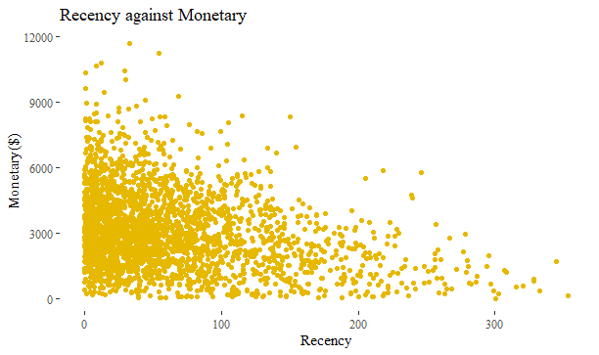
Note: The data and information in this document is reflective of a hypothetical situation and client. This document is to be used for KPMG Virtual Internship purposes only.
Model Development
Scatter Plot on Recency and Monetary
Customers who have bought recently generated more revenue than those customers who bought a while ago.
Customers who have bought before 200 days ago generated low revenue.
The customers who visited in the recent past are more likely to return compared to those who visited long time ago as most of those would be lost customers.

Slide 12
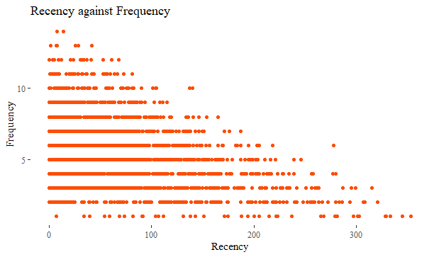
Note: The data and information in this document is reflective of a hypothetical situation and client. This document is to be used for KPMG Virtual Internship purposes only.
Model Development
Scatter Plot based on Recency and Frequency
Customers with low frequency have bought a while ago.
Most recent purchases has high frequency.
Those who visited recently are most likely to come again compared to lost customers.

Slide 13
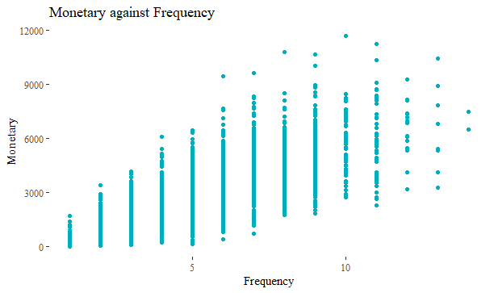
Note: The data and information in this document is reflective of a hypothetical situation and client. This document is to be used for KPMG Virtual Internship purposes only.
Model Development
Scatter Plot based on Monetary and Frequency
Monetary value increase as Frequency of visits increases.
Customers who visit more frequently are loyal and champion customers.

Slide 14
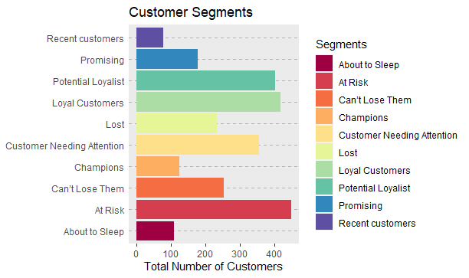
Note: The data and information in this document is reflective of a hypothetical situation and client. This document is to be used for KPMG Virtual Internship purposes only.
Model Development
Customer Title Distributions

Slide 15
Note: The data and information in this document is reflective of a hypothetical situation and client. This document is to be used for KPMG Virtual Internship purposes only.
Model Development
Summary of Customers in each Segment
Customer Segments | Total Customers
At Risk | 448
Loyal Customers | 417
Potential Loyalist | 403
Customer Needing Attention | 355
Can’t Lose Them | 253
Lost | 232
Promising | 178
Champions | 124
About to Sleep | 108
Recent Customers | 78

Slide 16
Note: The data and information in this document is reflective of a hypothetical situation and client. This document is to be used for KPMG Virtual Internship purposes only.
Model Development
Top 1000 Customers to Target
Rank | Customer Segments | Total Customers | Cumulative | Customer Selection
1 | Champions | 124 | 124 | 124
2 | Loyal Customers | 417 | 541 | 417
3 | Can’t Lose Them | 253 | 794 | 251
4 | Recent Customers | 78 | 872 | 78
5 | Potential Loyalist | 403 | 1275 | 128
6 | Promising | 178 | 1453 | 0
7 | Customer Needing Attention | 355 | 1808 | 0
8 | At Risk | 448 | 2256 | 0
9 | About to Sleep | 108 | 2364 | 0
10 | Lost | 232 | 2596 | 0

Slide 17
Note: The data and information in this document is reflective of a hypothetical situation and client. This document is to be used for KPMG Virtual Internship purposes only.
Interpretation
Customer Target and Methodology
Rank | Customer Segments | Total Customers | Cumulative | Customer Selection
1 | Champions | 124 | 124 | 124
2 | Loyal Customers | 417 | 541 | 417
3 | Can’t Lose Them | 253 | 794 | 251
4 | Recent Customers | 78 | 872 | 78
5 | Potential Loyalist | 403 | 1275 | 128
Based on the RFM analysis target this top 1000 customers.
Follow the distributions of old customers and try to approach the same type customers in new potentials.

Slide 18
Note: The data and information in this document is reflective of a hypothetical situation and client. This document is to be used for KPMG Virtual Internship purposes only.
Appendix

Slide 19
Note: The data and information in this document is reflective of a hypothetical situation and client. This document is to be used for KPMG Virtual Internship purposes only.
Thank You!

