Slide 1
PASSWORD SECURITY & CRACKING ANALYSIS
~Gargi Surse
Internship in Cyber Security and Ethical Hacking

Slide 2
Introduction
Password security is one of the most important aspects of cybersecurity. Weak passwords can be easily guessed or compromised, leading to unauthorized access to systems and sensitive information.
This project focuses on analyzing password strength, understanding password hashing techniques, and evaluating how weak passwords are vulnerable to common attack methods. The project also demonstrates secure password generation and highlights the importance of strong authentication mechanisms.

Slide 3
Tools Used
The following tools and technologies were used in this project:
• Linux Operating System
• Terminal / Command Line Interface
• SHA-256 Hashing Utility
• OpenSSL
• Microsoft Excel
• Python
• GitHub for project documentation and submission

Slide 4
Commands Used
The following commands were used during the project:
echo -n "123456" | sha256sum
- Used to generate SHA-256 hash of a sample password.
echo -n "password" | sha256sum
- Used to generate SHA-256 hash of a sample password.
echo -n "G@rgi#Intern2026" | sha256sum
- Used to generate SHA-256 hash of a strong password.
openssl rand -base64 12
- Used to generate strong random passwords.
python3 password_checker.py
- Used to execute password strength analysis script.

Slide 5
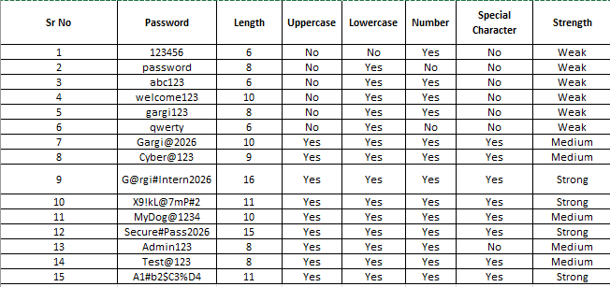
Password Analysis
Passwords were analyzed based on:
• Length
• Uppercase Letters
• Lowercase Letters
• Numbers
• Special Characters
Based on these factors, passwords were categorized as Weak, Medium, and Strong.

Slide 6
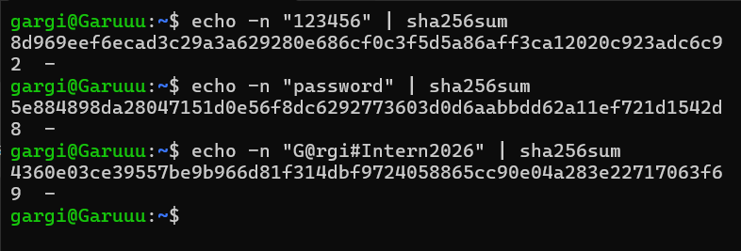
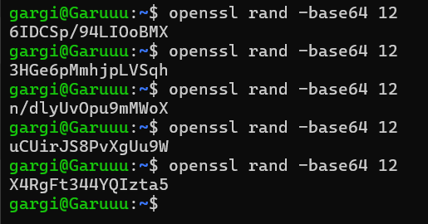
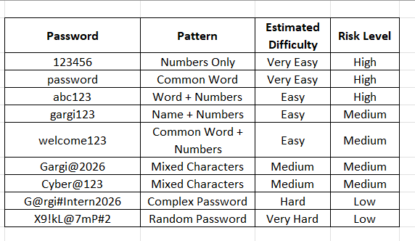
Output Screenshots

Slide 7
Findings
Passwords containing only numbers or common words were weak.
Passwords based on names and predictable patterns were vulnerable.
Passwords containing uppercase letters, lowercase letters, numbers, and special characters were stronger.
SHA-256 hashing converted passwords into secure hash values.
Randomly generated passwords provided better protection against attacks.

Slide 8
Conclusion
This project helped in understanding password security concepts, password hashing techniques, and the importance of strong authentication mechanisms.
The practical implementation improved knowledge about password analysis, password protection methods, and cybersecurity best practices.
The project also provided hands-on experience in using Linux commands, generating secure passwords, and documenting cybersecurity findings professionally.

