Slide 1
Understanding the effect of immune checkpoint genes on immune dysregulation and patient prognosis in The Cancer Genome Atlas (TCGA) pan-cancer cohort with special reference to squamous cell cancers
By
Name: Gargi Majumdar
UID No: 22MBI20007

Slide 2
Introduction
Cancer is a disease in which some of the body’s cells grow uncontrollably and spread to other parts of the body.
Chemotherapy, radiation therapy, and surgery were the conventional therapeutic options; nevertheless, each had drawbacks.
Chemotherapy, radiation therapy destroys these fast-growing cells. But other types of fast-growing healthy cells (such as blood cells and hair cells) also can be damaged along with cancer cells, tiredness and nausea to hair loss and blood clotting problems.
There is a need for alternative treatment.
To identify and destroy cancer cells, the immune system has evolved a complex array of defense mechanisms.
When cancer cells become immune to the antitumor response, they are able to escape

Slide 3
Cancer immunotherapies
Cancer immunotherapies work by altering the immune system to reactivate the antitumor immune response and block the pathways leading to tumor escape.
Types of Immunotherapy
Immune Checkpoint Inhibitors
Adoptive Cell Therapies
Monoclonal Antibodies

Slide 4
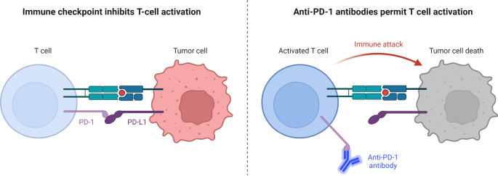
Immune Checkpoint Inhibitor against Tumor Cell.
Through the interaction between PD-1 expressed on the surface of T cells and PD-L1 expressed on the surface of tumor cells, the immunological checkpoint prevents T-cell activation.
Through contact between PD-1 on the surface of T cells and anti-PD-1 antibodies, T cell activation and immunological attack are enabled
How immunotherapy works?
(Marei et al., 2023)

Slide 5
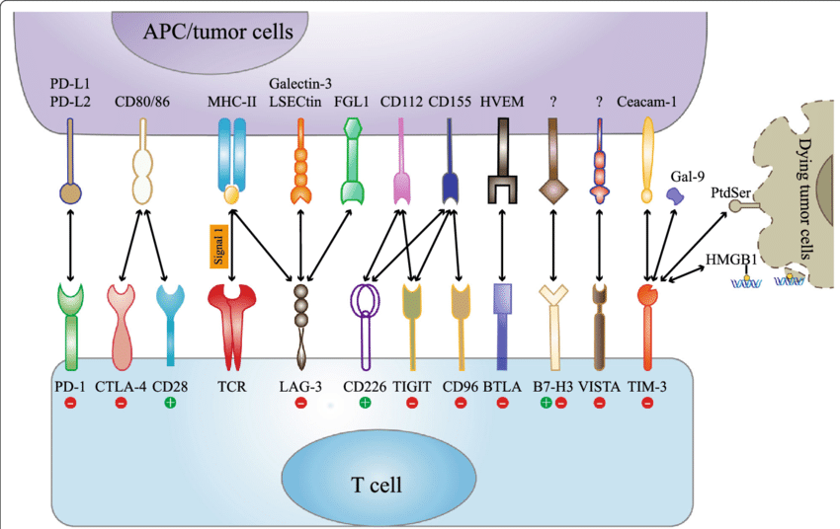
Beyond PD-L1 : The many types of Immune checkpoint molecules - Current and emerging knowledge
PD-L1 and CTLA-4 : Two major types of immune checkpoint blockers (Yau et. al, 2020)
Ligands
A number of anti-PD-L1 and CTLA-4 drugs are in clinical trial
Relatlimab is the first FDA-approved drug to block the activity of LAG-3 (Ascierto et.al., Journal of Clinical Oncology, 2023).
Receptors
Clinical trial ongoing for:
Tifcemalimab (Anti-BTLA), Onvatilimab (Anti-VISTA), CAR T cell immunotherapy (Anti B7-H3)
(Dhasmana, Cancer and Metastasis Reviews , 2023)
Qin et.al., Mol Cancer, 2019

Slide 6
Aim: Patient subgrouping based on the Immune checkpoint genes expression in Pan-cancer setting
A total of 46 Immune Checkpoint genes selected from literature survey/Immport Immune database
Pan-Cancer RNA seq data (FPKM normalised) are obtained from The Cancer Genome Atlas (TCGA)
Immune checkpoint genes expression landscape in different cancer tissues
Creating boxplots Tumor VS Normal sample

Slide 7
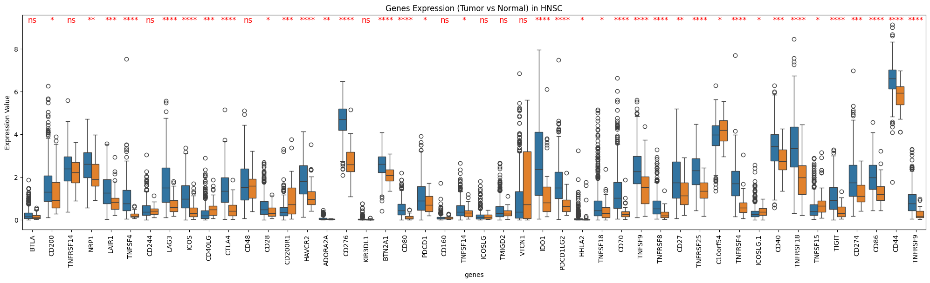

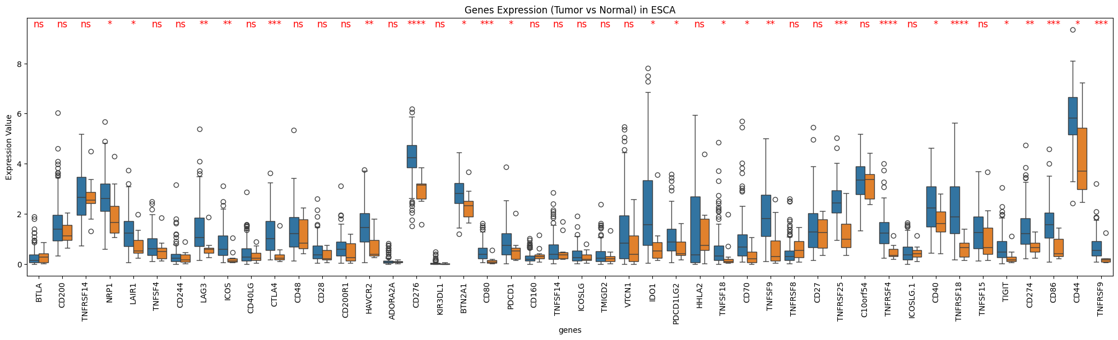
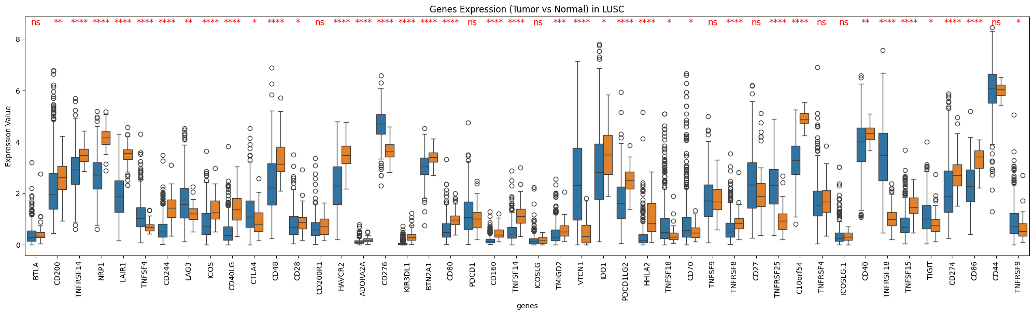
P-value
0.00001: '****',
0.0001: '***',
0.001: '**',
0.05: '*',
0.1: 'ns',
1.0: 'ns'

Slide 8
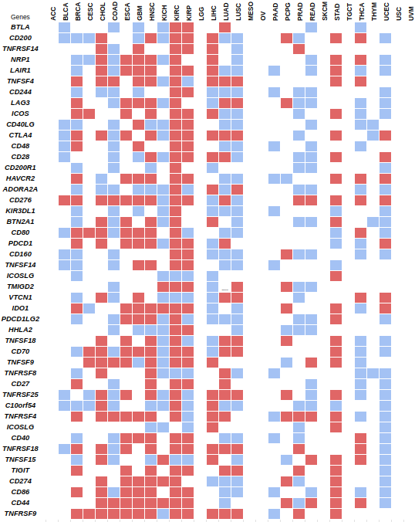
Immune checkpoint gene expression landscape (Pan-cancer scenario)
For each cancer type, expression of the 46 immune checkpoint marker genes between tumors and normal were compared using one-tailed Wilcoxon rank sum test, in cancer types where paired normal samples were available. White color indicates non-significant (p > 0.05) in one-tailed test
Red marking indicates the genes whose expression is significantly more highly expressed in tumor samples compared to normal samples (p < 0.05), and blue marking for vice versa
In squamous cancers such as - HNSC, ESCA etc the major immune checkpoint molecules such as - CD274, CD44, CD86, CTLA4 etc. are significantly more expressed in tumor compared to normal, whereas LUSC shows somewhat of a distinct pattern.
BRCA, COAD, HNSC, LISC, CESC have higher immune cell expression than others.
In specific cancers (ACC, MESO,OV, SKCM, TGCT, THYM, USC, UVM) there is no significant difference in any immune checkpoint gene expression —--- other mechanism of immune evasion ????

Slide 9
Aim: To identify if there is differential survival outcome in patients with high immune-checkpoint GSEA score compared to low immune-checkpoint GSEA
Combining the Immune checkpoint
gene expression for each patient
single sample gene set enrichment
utility of GSVA package
Combined score for each patient gives ssGSEA score
Estimating of the abundances of immune cell types, only in tumor samples using gene expression data (here RNA seq) with the help of cibersortx and creating the boxplots
Tumors samples were divided into Immune-checkpoint gene expression high and low groups by median splitting.
Notes:
Gene Set Variation Analysis (GSVA) is a method used in bioinformatics to analyze genetic data. It helps researchers understand how groups of genes (gene sets) behave across different samples, like healthy versus diseased tissues. ssGSEA looks at the expression levels of these genes in a single sample, compares them to other samples, and calculates a score

Slide 10
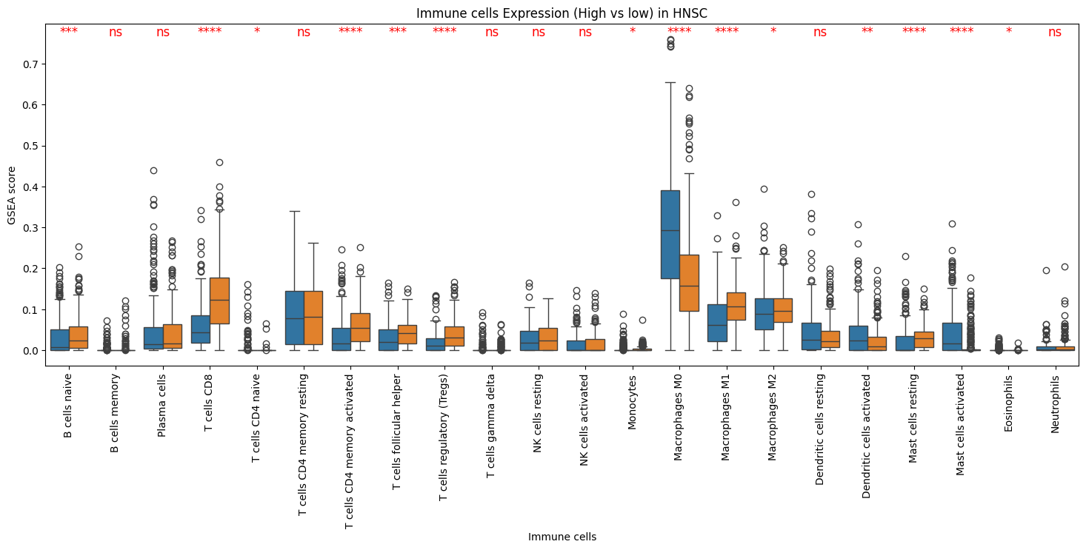

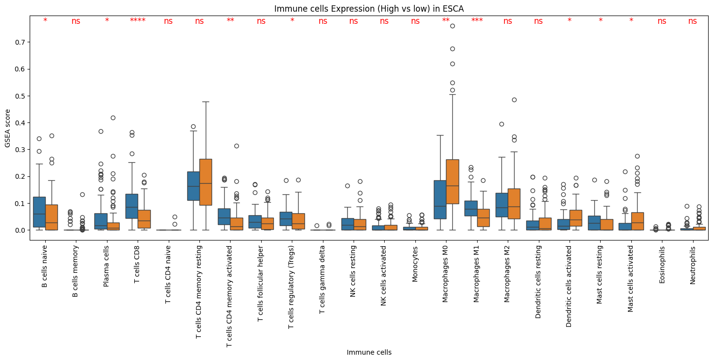
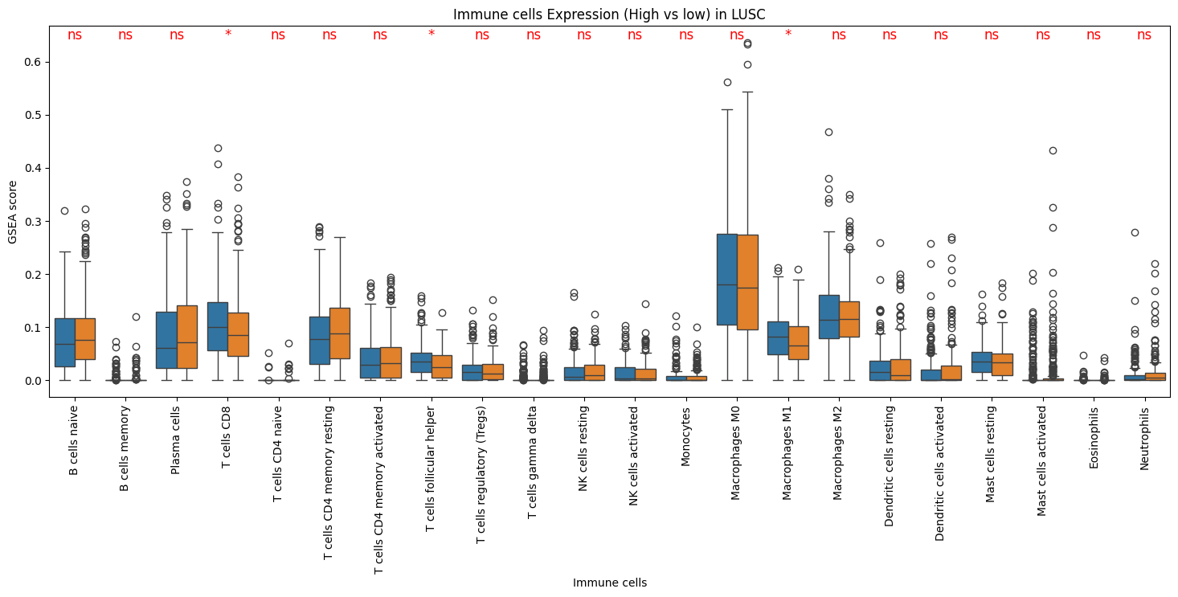
P-value
0.00001: '****',
0.0001: '***',
0.001: '**',
0.05: '*',
0.1: 'ns',
1.0: 'ns'

Slide 11
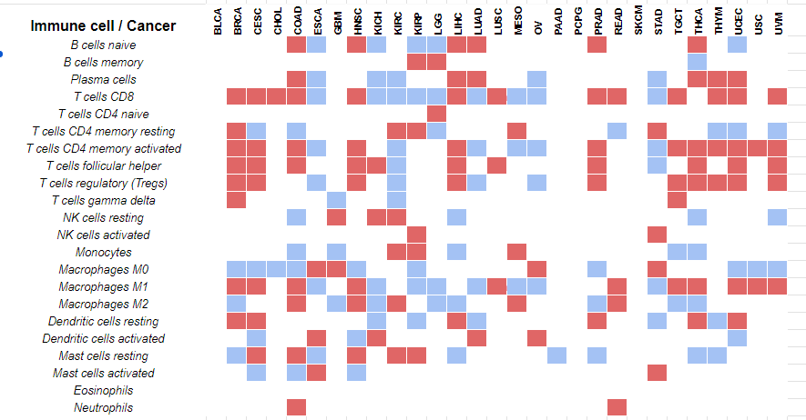
We compared the immune cell infiltration profile in both IC-ssGSEA high and low groups, using CIBERSORT group
Red marking indicates infiltration of a particular immune cell type is significantly higher in ssGSEA high groups compared to ssGSEA low group in a tumor type (Wilcoxon one tailed test p < 0.05)
In the squamous cell cancer types, cells associated with anti-tumor immunity (CD8 T cells, CD4 memory activate d T cells) and antiinflammatory macrophages (M2) were significantly higher in the IC-ssGSEA high group, which is not the case in ESCA and LUSC.
T cells CD8, T cells CD4 memory activated, T cells follicular helper, T cells regulatory (Tregs), Macrophages M1, Macrophages M2 shows immune cells whose infiltration is significantly higher.

Slide 12
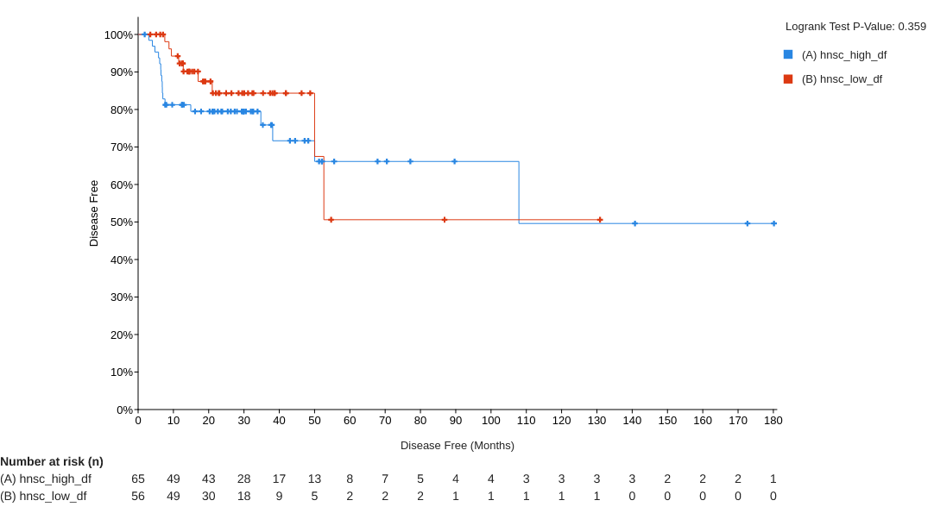
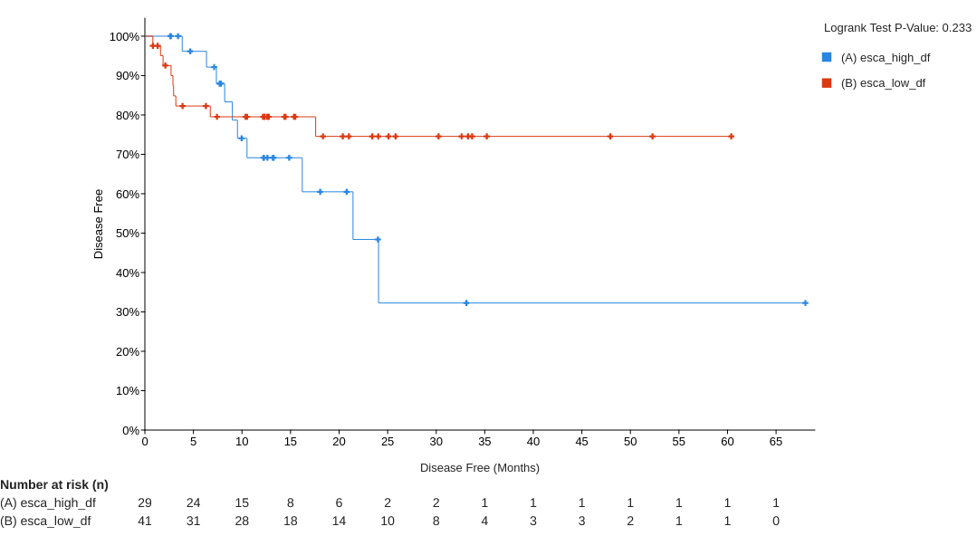
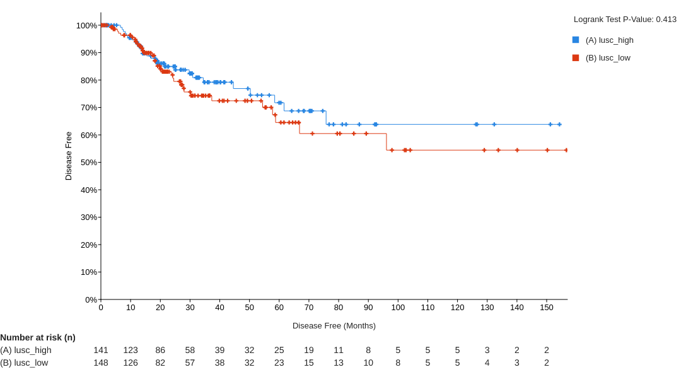
Aim: To identify if there is differential survival outcome in patients with high immune-checkpoint GSEA score compared to low immune-checkpoint GSEA
Based on ssGSEA score, We classified the patients showing low or high value from the median value.
Created the overall survival curve for each cancers (Kaplan Meier) created by cBioportal

Slide 13
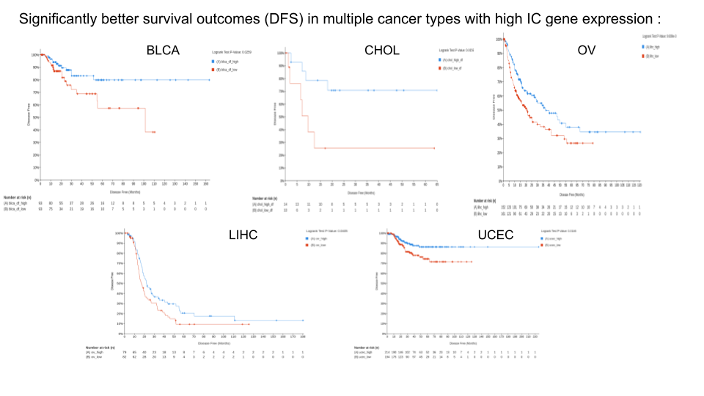
Cancer includes HNSC, ESCA, LUSC there is no such difference.
In Kaplan–Meier survival analysis, Cancer types including BLCA, CHOL, LIHC, UCEC, and Patients in the high-risk group had a considerably better disease-free curve than those in the low-risk group, according to the training cohort's OV (p=0.005).

Slide 14
Conclusion
. Our findings reveal significant tissue-specific variability in immune checkpoint gene expression. Across multiple cancer types including HNSCC, ESCA, KIRC, KIRP, and STAD, we consistently observed elevated expression of crucial immune checkpoint genes such as CD274, CTLA4, IDO1, and LAG3.
we identified distinct tumor environments characterized by immune-inflamed features (e.g., increased CD8 T cells, CD4 memory activated T cells) and anti-inflammatory profiles (e.g., elevated M2 macrophages) in ssGSEA-high versus ssGSEA-low groups.
our analysis revealed significantly improved disease-free survival (DFS) in several cancer types—BLCA, CHOL, LIHC, UCEC, and OV—among patients classified as ssGSEA high.
Except for BLCA, all these cancers exhibited higher proportions of anti-tumor immunity-related cells (such as CD8 T cells and follicular helper cells) in the ssGSEA high group.

Slide 15
Reference
https://www.cancer.gov/about-cancer/understanding/what-is-cancer
Chen, B., Khodadoust, M. S., Liu, C. L., Newman, A. M., & Alizadeh, A. A. (2018). Profiling Tumor Infiltrating Immune Cells with CIBERSORT. Methods in molecular biology (Clifton, N.J.), 1711, 243–259. https://doi.org/10.1007/978-1-4939-7493-1_12
Gao, J., Aksoy, B. A., Dogrusoz, U., Dresdner, G., Gross, B., Sumer, S. O., Sun, Y., Jacobsen, A., Sinha, R., Larsson, E., Cerami, E., Sander, C., & Schultz, N. (2013). Integrative analysis of complex cancer genomics and clinical profiles using the cBioPortal. Science signaling, 6(269), pl1. https://doi.org/10.1126/scisignal.2004088

