Slide 1
QPSK State Discrimination (Overview)
Goal: Minimize error probability in distinguishing coherent states
QPSK constellation: αₖ = √|α|² e^{iθₖ}
Photon detection follows Poisson statistics
Different receivers tested: Bayesian, Cyclic, Bondurant, Heterodyne
Helstrom bound used as quantum performance limit

Slide 2
Code Workflow & Logic
Loop over |α|² (signal energy)
Generate QPSK states
For each trial:
• Simulate photon detection (Poisson)
• Apply receiver logic
Bayesian: update P using likelihood + adapt β
Cyclic: fixed β sequence, only update P
Bondurant: sequential photon-triggered switching
Compute error probability via Monte Carlo

Slide 3
Posterior Evolution via Cyclic Probing
Simulates QPSK coherent state discrimination
Photon arrivals follow Poisson statistics
Likelihood based on displaced photon numbers n_k
Bayesian update applied over time
Tracks posterior probabilities P(α_k | observations)

Slide 4
Code Workflow & Output
Initialize QPSK constellation and uniform prior
Generate photon arrivals using exponential distribution
Time loop: update posterior for photon/no-photon events
Cyclic probing: rotate hypothesis after detection
Extract posterior at fixed times (0.1 spacing)
Export results as CSV table

Slide 5
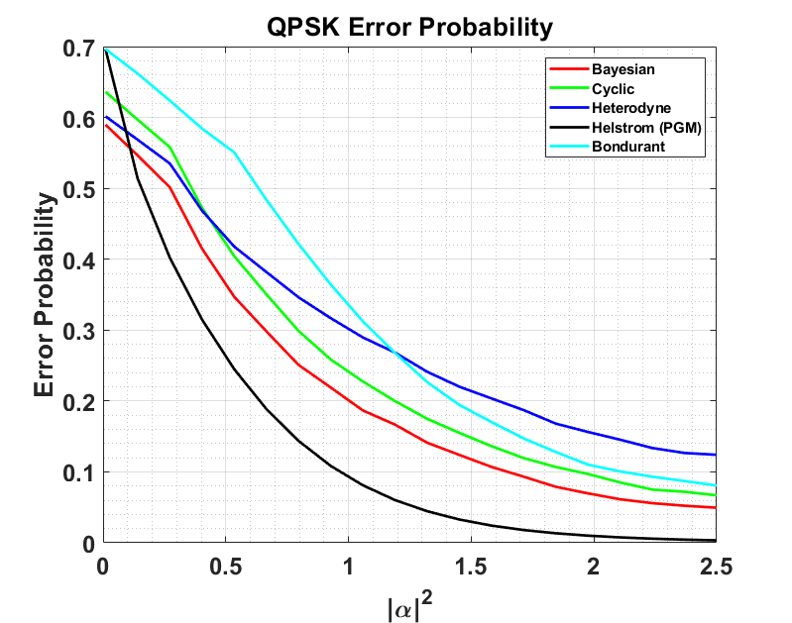
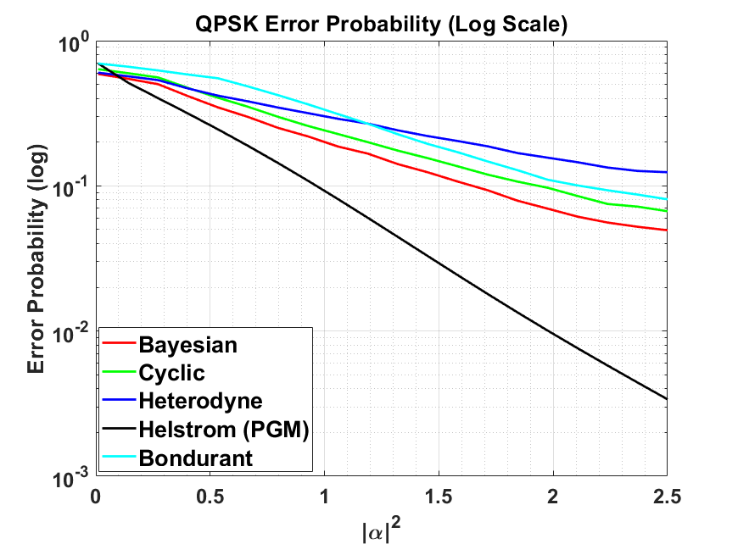
Results: Error Probability vs |α|²
Figure 1
Figure 2

Slide 6
Results: Error Probability vs |α|²
Helstrom Bound is the theoretical lower bound
Bayesian receiver approaches optimal performance
Cyclic and Bondurant are suboptimal
Heterodyne is classical baseline

Slide 7
Results: Posteriori Probabilities
states | T =0.10 | T =0.20 | T =0.30 | T =0.40 | T =0.50 | T=0.60 | T =0.70 | T =0.80 | T =0.90 | T=1.00
alpha1 | 0.107282756 | 0.111821856 | 0.116501294 | 0.121322345 | 0.126286118 | 0.131393549 | 0.136645393 | 0.142042217 | 0.055221532 | 0.057789245
alpha2 | 0.252325033 | 0.254583853 | 0.256748934 | 0.258816784 | 0.260784031 | 0.262647437 | 0.264403902 | 0.266050481 | 0.243268274 | 0.246432386
alpha3 | 0.388067179 | 0.379010439 | 0.370000838 | 0.361044087 | 0.352145819 | 0.343311578 | 0.334546804 | 0.325856821 | 0.45824192 | 0.449345984
alpha4 | 0.252325033 | 0.254583853 | 0.256748934 | 0.258816784 | 0.260784031 | 0.262647437 | 0.264403902 | 0.266050481 | 0.243268274 | 0.246432386
Posteriori Probabilities w.r.t temporal progress of measurement

