Slide 1
Capstone Project JPX Tokyo Stock Exchange Prediction Challenge
Gari zabaleta

Slide 2
End-to-end ML Project Methodology
Data collection and problema statement
Exploratory Data analysis (EDA)
Data Wrangling and Feature Engineering
Model Selection
Hyperparameter optimization
Results and conclusions

Slide 3

Data collection and problema statement
The competition will involve building portfolios from the stocks eligible for predictions (around 2,000 stocks). Specifically, each participant ranks the stocks from highest to lowest expected returns and is evaluated on the difference in returns between the top and bottom 200 stocks.
The participants have access to financial data from the Japanese market, such as stock information and historical stock prices to train and test your model.
The competitor with the highest Sharpe Ratio will result the winner of the challenge. To do that
the Target of the closing price (Close) between the next day and the 2 days later for each stock on each date must be predicted

Slide 4
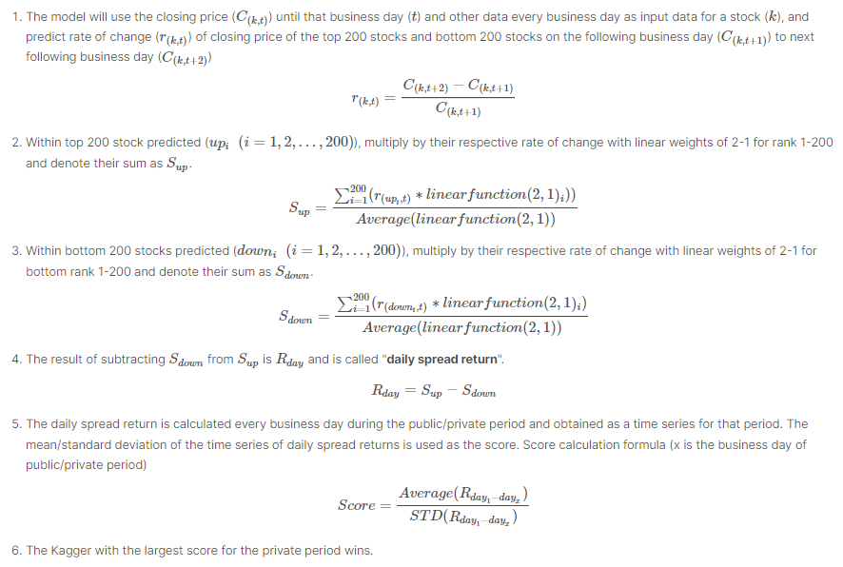
Data collection and problema statement
Competitor with the largest Sharpe ratio score for the private period wins

Slide 5
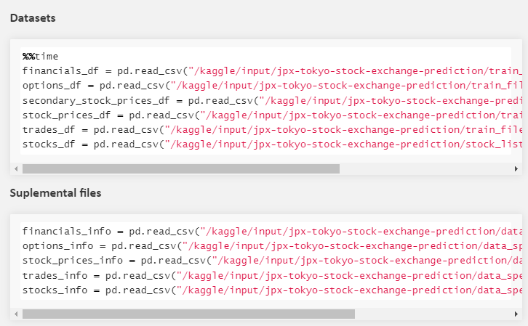
Data collection and problema statement
Stock financials
Options data
Secondary stock prices
Stock prices
Trade volume data
Stocks metadata
Dataset description files

Slide 6
Exploratory Data Analysis (EDA)
Fundamental analysis:
A method of assessing the intrinsic value of a security by analyzing various macroeconomic and microeconomic factors.
Out of scope of this project since it requires too much domain expertise
Technical analysis:
It is a trading discipline employed to evaluate investments and identify trading opportunities in price trends and patterns seen on charts.
Model based on Stock Prices and Stock metadata

Slide 7
Exploratory Data Analysis (EDA)
Sample value | Type | Addendum | Description
RowId | 20170104_1301 | string | Unique ID of price records
Date | 2017-01-04 0:00:00 | date | Trade date
SecuritiesCode | 1301 | Int64 | Local securities code
Open | 2734 | float | first traded price on a day
High | 2755 | float | highest traded price on a day
Low | 2730 | float | lowest traded price on a day
Close | 2742 | float | last traded price on a day
Volume | 31400 | Int64 | number of traded stocks on a day
AdjustmentFactor | 1 | float | to calculate theoretical price/volume when split/reverse-split happens (NOT including dividend/allotment of shares/)
SupervisionFlag | FALSE | boolean | Flag of Securities Under Supervision & Securities to Be Delisted\nhttps://www.jpx.co.jp/english/listing/market-alerts/supervision/00-archives/index.html )
ExpectedDividend | NaN | float | Expected dividend value for ex-right date. This value is recorded 2 business days before ex-dividend date.
Target | 0.00073 | float | Change ratio of adjusted closing price between t+2 and t+1 where t+0 is TradeDate
stock_prices.csv
RangeIndex: 2332531 entries, 0 to 2332530
Data columns (total 12 columns)

Slide 8
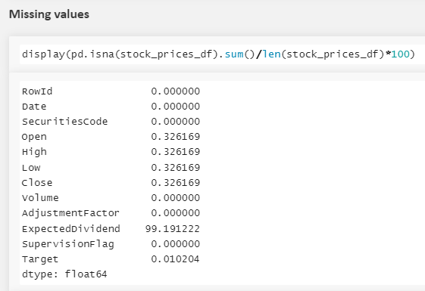
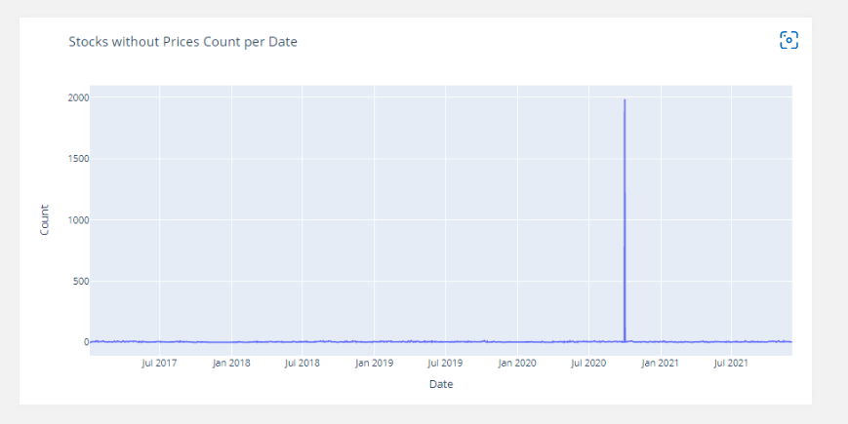
Exploratory Data Analysis (EDA)
2020-10-01 is the day with the most amount of missing data

Slide 9
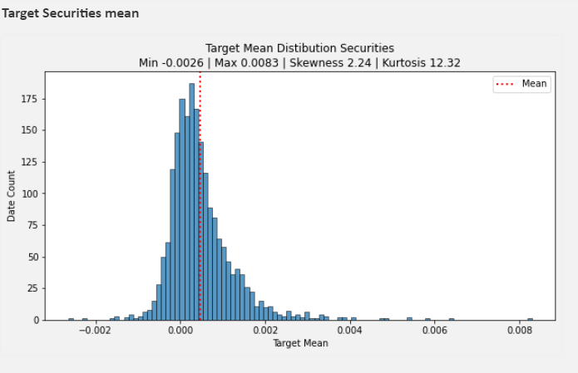
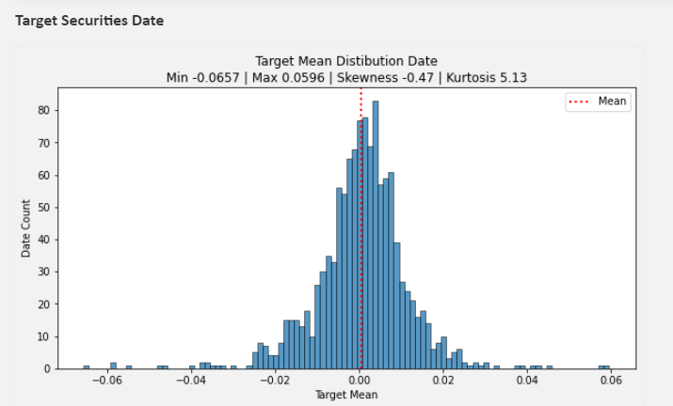
Exploratory Data Analysis (EDA)
Note Kurtosis »> 3, it means that the tails of the distribution are way bigger than the normal distribution. In this case a higher Kurtosis will mean higher volatility in the stock performances (some stocks will perform much better than others), which will impact negatively in the Sharpe value.
Note A Kurtosis bigger than 3 will mean that there will be volatity in the same stock performance for different dates.

Slide 10
Exploratory Data Analysis (EDA)
Sample value | Type | Addendum
SecuritiesCode | 1301 | Int64 | Local Securities Code
EffectiveDate | 20211230 | date | the effective date
Name | KYOKUYO CO.,LTD. | string | Name of security
Section/Products | First Section (Domestic) | string | Section/Product
NewMarketSegment | Prime Market | string | New market segment effective from 2022-04-04 (as of 15:30 JST on Mar 11 2022)\nref. https://www.jpx.co.jp/english/equities/market-restructure/market-segments/index.html
33SectorCode | 50 | Int64 | 33 Sector Name\n\nref. https://www.jpx.co.jp/english/markets/indices/line-up/files/e_fac_13_sector.pdf
33SectorName | Fishery, Agriculture and Forestry | string | 33 Sector Name\n\nref. https://www.jpx.co.jp/english/markets/indices/line-up/files/e_fac_13_sector.pdf
17SectorCode | 1 | Int64 | 17 Sector Code\nref. https://www.jpx.co.jp/english/markets/indices/line-up/files/e_fac_13_sector.pdf
17SectorName | FOODS | string | 17 Sector Name\nref. https://www.jpx.co.jp/english/markets/indices/line-up/files/e_fac_13_sector.pdf
NewIndexSeriesSizeCode | 7 | Int64 | TOPIX New Index Series code\n\nref. https://www.jpx.co.jp/english/markets/indices/line-up/files/e_fac_12_size.pdf
NewIndexSeriesSize | TOPIX Small 2 | string | TOPIX New Index Series Name\n\nref. https://www.jpx.co.jp/english/markets/indices/line-up/files/e_fac_12_size.pdf
TradeDate | 20211230 | date | Trade date to calculate MarketCapitalization
Close | 3080 | float | Close price to calculate MarketCapitalization
IssuedShares | 1.09E+07 | float | Issued shares
MarketCapitalization | 33659111640 | float | Market capitalization on Dec 3 2021
Universe0 | TRUE | boolean | a flag of prediction target universe (top 2000 stocks by market capitalization)
stock_list.csv
RangeIndex: 4417 entries, 0 to 4416
Data columns (total 16 columns):

Slide 11
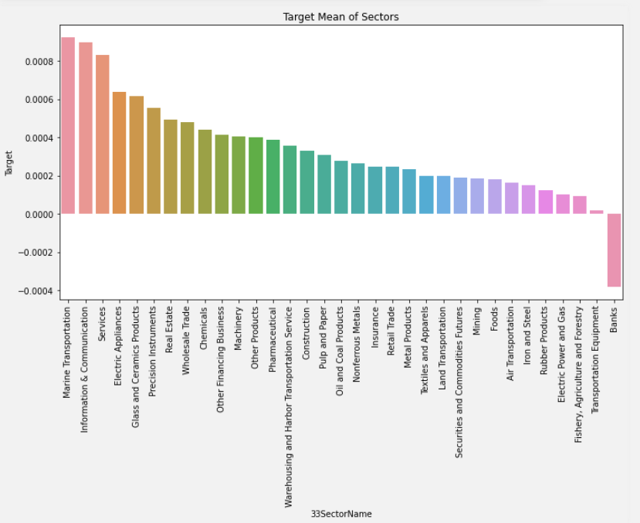
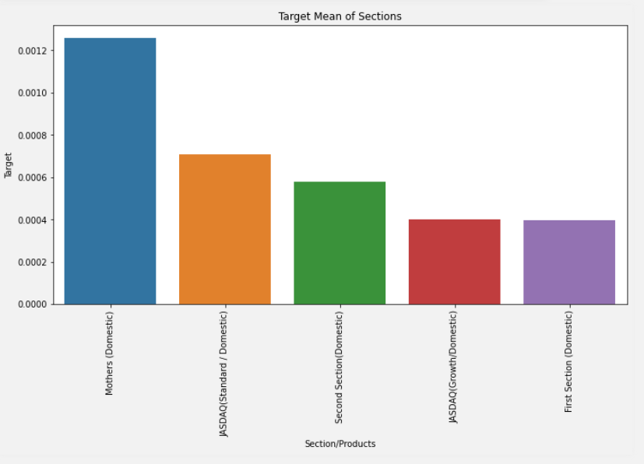
Exploratory Data Analysis (EDA)
stocks2000_df = stocks_df[stocks_df["Universe0"]]
df_prices = merge_metadata(stock_prices_df, stocks2000_df)

Slide 12
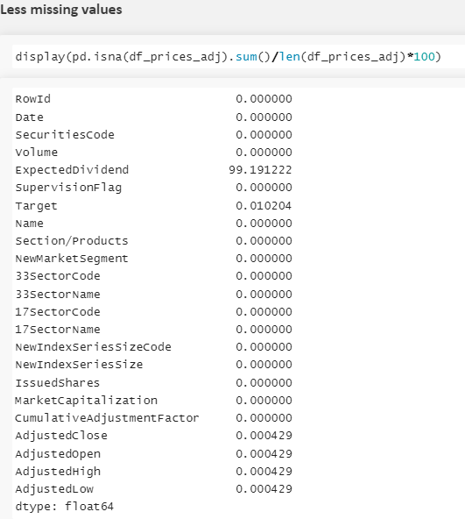

Data Wrangling and Feature Engineering
Data Wrangling
Adjust OHLC prices (Split- Reverse/split)
Imput missing values
Generate adjusted OHLC prices
Generate adjusted OHLC prices using AdjustmentFactor attribute. This should reduce historical price gap caused by split/reverse-split.
Furthermore, adjust_price() also imputs the missing data using a linear backpropagation method

Slide 13
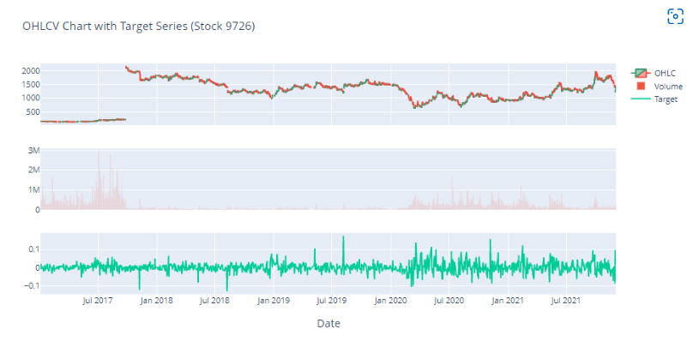
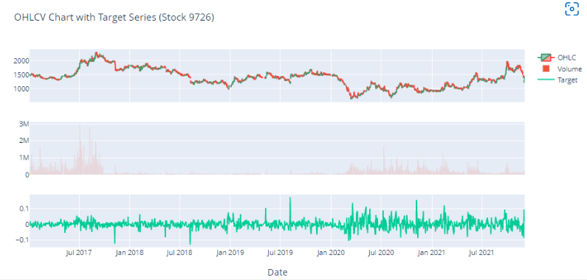
Data Wrangling and Feature Engineering
Before adjustment
After adjustment
Reverse split
Continuity in price

Slide 14
Data Wrangling and Feature Engineering
Feature Engineering
From adjusted Closed prices
Price changes
Moving average
Exponential moving average
Volatility
One hot encoding

Slide 15
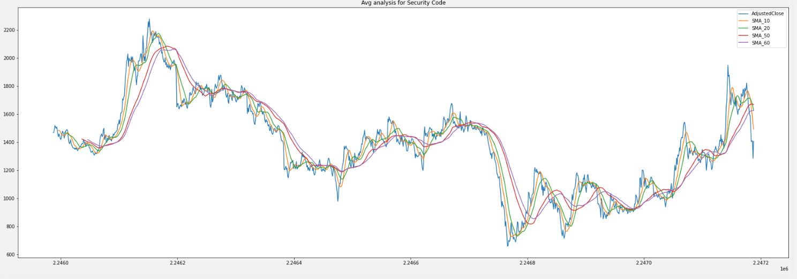

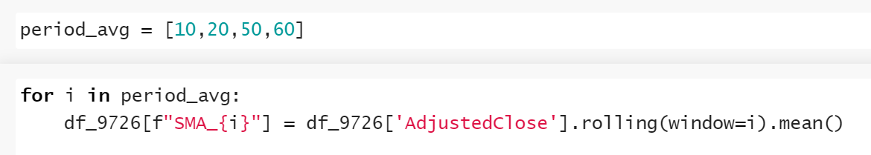
Data Wrangling and Feature Engineering
Price changes
Price change in percentage for different rolling days.
Simple Moving Average (SMA)
A simple moving average (SMA) is an arithmetic moving average calculated by adding recent prices and then dividing that figure by the number of time periods in the calculation average

Slide 16
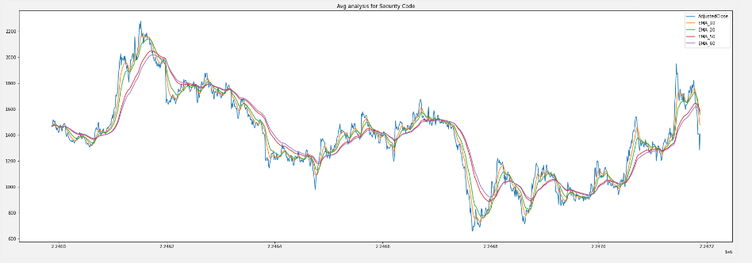
Data Wrangling and Feature Engineering
Exponential Moving Average (EMA)
An exponential moving average (EMA) is a type of moving average (MA) that places a greater weight and significance on the most recent data points. Compared to SMA, EMA show more sensitivity to recent price changes.

Slide 17
Data Wrangling and Feature Engineering
One Hot encoding Stock Catagorical data
Convert categorial data into numerical data to use in the ML model.
SectorCode33
Section
Air Transportation | Banks | Chemicals | Construction | Electric Appliances | Electric Power and Gas | Fishery, Agriculture and Forestry | Foods | Glass and Ceramics Products | Information & Communication | Insurance | Iron and Steel | Land Transportation | ... | Marine Transportation | Metal Products
0 | 0.0 | 0.0 | 0.0 | 0.0 | 0.0 | 0.0 | 1.0 | 0.0 | 0.0 | 0.0 | 0.0 | 0.0 | ... | 0.0 | 0.0
1 | 0.0 | 0.0 | 0.0 | 0.0 | 0.0 | 0.0 | 1.0 | 0.0 | 0.0 | 0.0 | 0.0 | 0.0 | ... | 0.0 | 0.0
2 | 0.0 | 0.0 | 0.0 | 0.0 | 0.0 | 0.0 | 1.0 | 0.0 | 0.0 | 0.0 | 0.0 | 0.0 | ... | 0.0 | 0.0
3 | 0.0 | 0.0 | 0.0 | 0.0 | 0.0 | 0.0 | 1.0 | 0.0 | 0.0 | 0.0 | 0.0 | 0.0 | ... | 0.0 | 0.0
4 | 0.0 | 0.0 | 0.0 | 0.0 | 0.0 | 0.0 | 1.0 | 0.0 | 0.0 | 0.0 | 0.0 | 0.0 | ... | 0.0 | 0.0
... | ... | ... | ... | ... | ... | ... | ... | ... | ... | ... | ... | ... | ... | ... | ...
2332526 | 0.0 | 0.0 | 0.0 | 0.0 | 0.0 | 0.0 | 0.0 | 0.0 | 0.0 | 0.0 | 0.0 | 0.0 | ... | 0.0 | 0.0
2332527 | 0.0 | 0.0 | 0.0 | 0.0 | 0.0 | 0.0 | 0.0 | 0.0 | 0.0 | 0.0 | 0.0 | 0.0 | ... | 0.0 | 0.0
2332528 | 0.0 | 0.0 | 0.0 | 0.0 | 0.0 | 0.0 | 0.0 | 0.0 | 0.0 | 0.0 | 0.0 | 0.0 | ... | 0.0 | 0.0
2332529 | 0.0 | 0.0 | 0.0 | 0.0 | 0.0 | 0.0 | 0.0 | 0.0 | 0.0 | 0.0 | 0.0 | 0.0 | ... | 0.0 | 0.0
2332530 | 0.0 | 0.0 | 0.0 | 0.0 | 0.0 | 0.0 | 0.0 | 0.0 | 0.0 | 0.0 | 0.0 | 0.0 | ... | 0.0 | 0.0
cat_encoder = OneHotEncoder(handle_unknown='ignore’)
train_set_cat_coded = cat_encoder.fit_transform(df_prices_feat[["33SectorName","17SectorName"]]) train_set_cat_coded.shape
(2332531, 50)
Select features for the model
Once all the features are calculated and the categorical variables are encoded, create all the data for the ML model is ready.

Slide 18
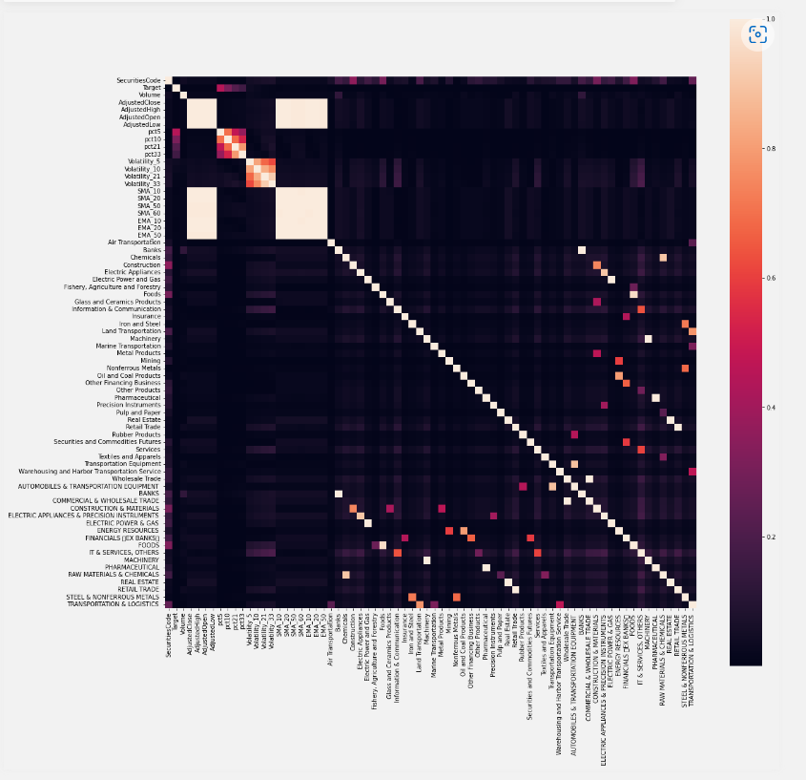
Data Wrangling and Feature Engineering
Correlation Matrix
corr_mat = np.abs(X.corr())
fig, ax = plt.subplots(figsize=(20,20))
sns.heatmap(corr_mat,square = True, ax = ax)
Target variable mostly correlated with price changes,
rest of variables do not show a strong correlation
Data for the model
y= X["Target"].to_numpy()
X=X.drop(["Target"],axis=1)

Slide 19
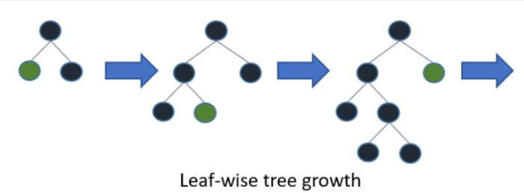
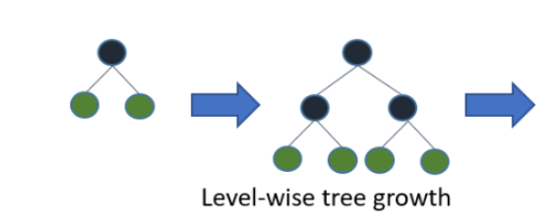
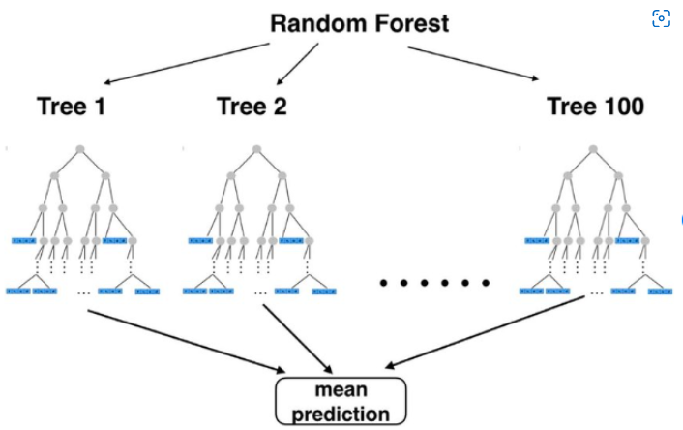
Model Selection
Price target prediction for t+1 and t+2 is a regression problem
Model selection
LGBMRegressor
It is a high-performance gradient boosting framework based on decision tree algorithm, used for ranking, classification and many other machine learning tasks
XGBoost Regressor
It is a high-performance gradient boosting framework based on decision tree algorithm, used for ranking, classification and many other machine learning tasks
Random Forest Regressor
Well-known ensemble learning method for classification, regression and other tasks that operates by constructing a multitude of decision trees at training time. It is included in the scikit-learn package.

Slide 20
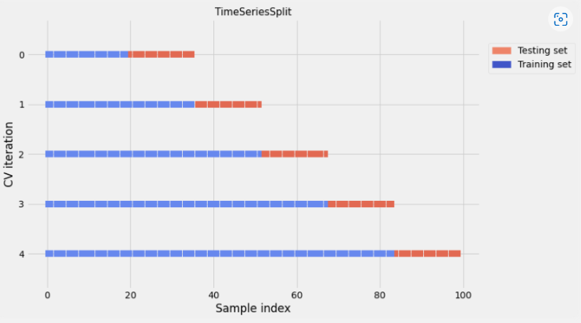
Model Selection
Time based Crossvalidation
For model validation TimeSeriesSplit method will be used.
This guarantees crossvalidation without any data leakage (when test data is included for model trainning).
This is also specially guaranteed by adding a time gap between train and test datasets. This method is included in scikit-learn.
ts_fold = TimeSeriesSplit(n_splits=10,gap=10000)

Slide 21
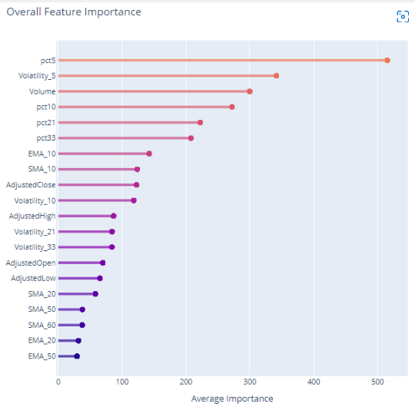
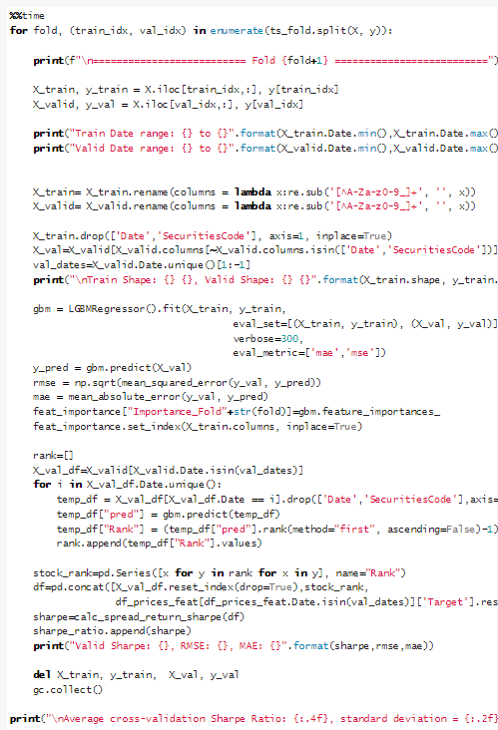
Model Selection
LGBMRegressor
{'model': 'LGBMRegressor', 'Mean Sharpe Ratio': 0.026, 'SD Sharpe Ratio': 0.077}
CPU times: user 6min 4s, sys: 11.4 s, total: 6min 16s

Slide 22
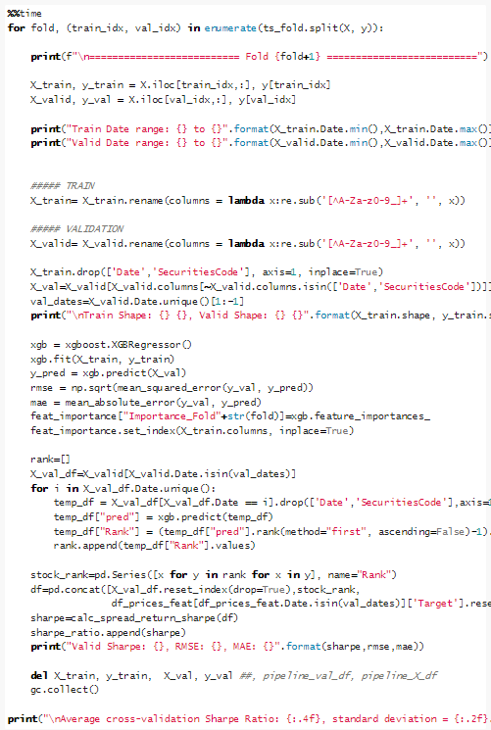
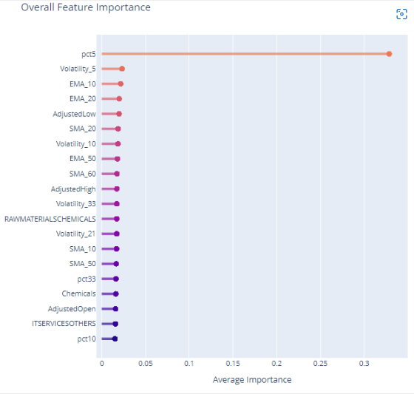
Model Selection
XGBoost Regressor
{'model': 'XGBRegressor', 'Mean Sharpe Ratio': 0.033, 'SD Sharpe Ratio': 0.070}
CPU times: user 3h 45min 28s, sys: 27.1 s, total: 3h 45min 55s

Slide 23
Model Selection
Random Forest Regressor
Random Forest Regressor was tried several time.
The training was extremely slow plus the model would crash several times at the 3-Fold.
Finally, the model was discarded
Model selection argumentation
XGBoost presented a better performance. However, the algorithm need considerably more time to be trained.
Since this project was carried out using solely Kaggle due to the lack of a proper workstation, it was decided to go for the LGBMlight model.
This way, the hyperparameter tuning time was reduced significantly.

Slide 24
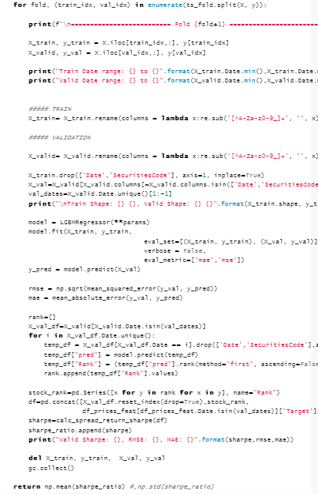
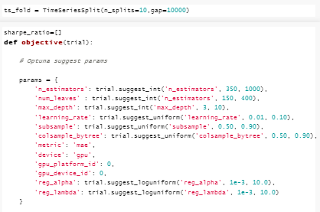
Hyperparameter optimization
Timecossvalidation
Create Optuna experiments with hyperparameters to tune
Use of GPU to speed up the learning process
Optuna maximizes average sharpe ratio for the whole Timecossvalidation

Slide 25
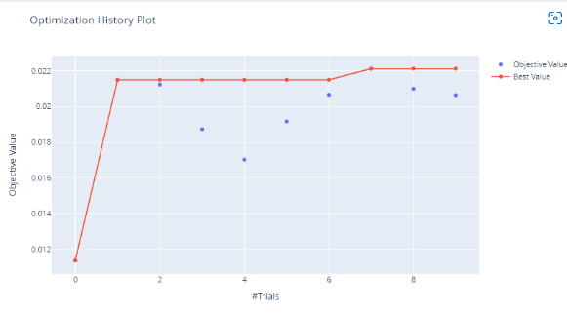
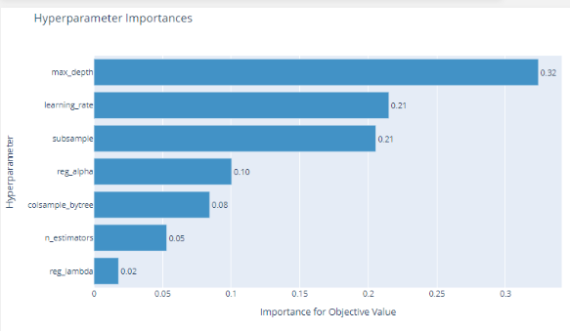
Hyperparameter optimization
The best parameters were calculated at trial 7.
The hyperparameter tuning time took extremely long
The average Sharpe ratio did not improve a lot during the hyperparameter tuning.
It doesn’t seem to be the most effective way of training the model.
Max depth and learning date are the most important Hyperparameters

Slide 26
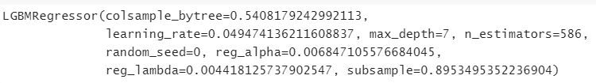
Hyperparameter optimization
Retrain the model using the best hyperparameters
X1 = X.drop(['Date','SecuritiesCode'], axis=1, inplace=False)
model_o.fit(X1,y)

Slide 27
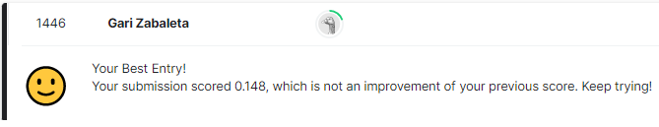
Results and conclusions
API Submission
Use the competition API to calculate the public leaderboard score. Once the competition is finished, this hidden test data will be replaced by test data that will be used to calculate the final private score.
Prediction 2021-12-06
Prediction 2021-12-07
Date | SecuritiesCode | Rank
2021-12-06 | 1301 | 1138
2021-12-06 | 1332 | 358
2021-12-06 | 1333 | 255
2021-12-06 | 1375 | 1565
2021-12-06 | 1376 | 1607
Date | SecuritiesCode | Rank
2021-12-07 | 1301 | 696
2021-12-07 | 1332 | 1913
2021-12-07 | 1333 | 748
2021-12-07 | 1375 | 1272
2021-12-07 | 1376 | 1278
Sharpe day score
0.148 Sharpe score in Kaggle competition. Public Leaderboard position as per 2022.06.23 was 1321/1811.
A Sharpe ratio less than 1 is considered bad.

Slide 28
Results and conclusions
Predicting the stock prices using just the technical analysis (predict future stock prices using past stock prices) is an extremely complicated tasks. For a more accurate prediction, fundamental analysis must be included (use financial info)
For a proper Feature engineering domain knowledge is fundamental
Because of the large size of the datasize memory management was needed (Kaggle notebook crashed several times)
More time efficient Models are preferred when having a tight deadline. Trade-off between accuracy and time (election of LGBMLight over XGBoost)
Kaggle competitions are a great place to practice ML knowledge!
Competition public boards show insane Sharpe ratios, top 50 got a Sharpe ratio >3. From 1 to 1.99 is considered adequate/good, from 2 to 2.99 is considered very good, and greater than 3 is considered excellent. I suspect competitors tend to overfit their models.
In order to get a better Sharpe score, maybe it would have been more efficient to try to minimize the standard deviation of all Sharpe ratios calculated for the time Crossvalidation instead of maximizing the mean Sharpe ratio

Slide 29
Links
Git hub pages
JPX-Tokyo-Stock-Exchange Prediction | jpx-tokyo-stock-exchange-prediction (garizabaleta.github.io)
Linkedin
Garikoitz Zabaleta | LinkedIn

