Slide 1


Acadrix
Student Performance Prediction System
Predict a student's final score early, and turn it into a plan.
Project 1 · AIML Summer Internship 2026 · IIHMF, MNNIT Allahabad
Mohammad Farhan · Tanish Yadav · Garima Jaiswal
Notes:
Introduce the team and the project. Acadrix predicts a final score from five indicators a college already records, and turns it into early warnings for teachers and personal plans for students. Drix, the mascot, is the built-in study assistant.

Slide 2
AGENDA
A walkthrough of the full machine learning pipeline
01
Introduction
Problem statement and objectives
02
Data & Methodology
1,015 student records and the six-step pipeline
03
Preprocessing & EDA
Cleaning, charts and feature selection
04
Models & Results
Three models compared; the best one deployed
05
Demo & Conclusion
The live app, conclusions and future scope
Acadrix · Student Performance Prediction System
02
Notes:
Five parts, following the capstone methodology from problem to deployment.

Slide 3
Introduction
Data & Methodology
Preprocessing & EDA
Models & Results
Demo & Conclusion
PROBLEM STATEMENT
Struggling students are spotted only when results arrive
The warning signs are there all semester: falling attendance, missed assignments, weak internal marks. Colleges record them but rarely act on them in time.
Every prediction maps to a risk level
Low risk
65 and above · on track
Goal: predict each student's final score (0–100) part-way through the semester, so teachers can step in early and students can change course.
Medium risk
50–64.9 · needs support
High risk
below 50 · act now
Acadrix · Student Performance Prediction System
03
Notes:
This is a regression problem: we predict an exact score from 0 to 100, then turn it into a grade and one of three risk levels.

Slide 4
Introduction
Data & Methodology
Preprocessing & EDA
Models & Results
Demo & Conclusion
OBJECTIVES
Six goals, from data to a working app
01
02
03
Predict the final score from five academic indicators
Follow the full ML lifecycle, from data to deployment
Train and compare three models, deploy the best
04
05
06
Flag at-risk students for teachers before exams
Give every student a personal, actionable plan
Deploy a web app that takes inputs and shows predictions
Acadrix · Student Performance Prediction System
04
Notes:
These map to the capstone guidelines: the lifecycle phases, at least three models, and a deployed app that accepts input and shows predictions.

Slide 5
Introduction
Data & Methodology
Preprocessing & EDA
Models & Results
Demo & Conclusion
DATASET DESCRIPTION
1,015 student records, deliberately messy
Column | Range
Attendance % | 0 – 100
Assignment score | 0 – 100
Internal assessment average | 0 – 100
Previous semester score | 0 – 100
Study hours per week | 0 – 30
Sleep, commute, gender, extracurricular, internet | candidates
Final score (target) | 0 – 100
1,015
12
rows
columns
Generated by a seeded script so results are reproducible. Hidden ability and motivation traits drive each student, so features correlate like real academic data.
Built-in mess to clean: about 2% missing values, 15 duplicate rows, 8 impossible values.
Acadrix · Student Performance Prediction System
05
Notes:
Synthetic dataset from ml/generate_dataset.py with seed 42, made messy on purpose so preprocessing has real work. The five academic columns are exactly what the app collects; the lifestyle columns test feature selection.

Slide 6
Introduction
Data & Methodology
Preprocessing & EDA
Models & Results
Demo & Conclusion
METHODOLOGY
Six steps, from raw data to a live app
STEP 1
STEP 2
STEP 3
Collect
Clean
Explore
Generate 1,015 seeded student records
Duplicates, impossible values, missing values, encoding
Histograms, boxplots, scatter plots, heatmap
STEP 4
STEP 5
STEP 6
Select features
Train and compare
Deploy
Keep |r| ≥ 0.15; test engineered features
3 models, 80/20 split, 5-fold cross-validation
Best model served by Flask, live on Render
Acadrix · Student Performance Prediction System
06
Notes:
Steps 1 to 5 run in ml/generate_dataset.py and ml/train.py; step 6 is the Flask backend.

Slide 7
Introduction
Data & Methodology
Preprocessing & EDA
Models & Results
Demo & Conclusion
DATA PREPROCESSING
Cleaning took 1,015 raw rows down to 992 usable ones
1,015
−15
−8
992
raw rows
duplicate rows
impossible values
clean rows
79 gaps filled
3 columns encoded
Scaled when needed
Median for numbers, most common value for categories
yes/no and gender turned into 0/1
StandardScaler for Linear Regression only
Acadrix · Student Performance Prediction System
07
Notes:
Impossible values such as 80 study hours a week or 140% attendance were removed rather than clipped, because they are data-entry errors. Missing values used the median because it is not pulled by skew.

Slide 8
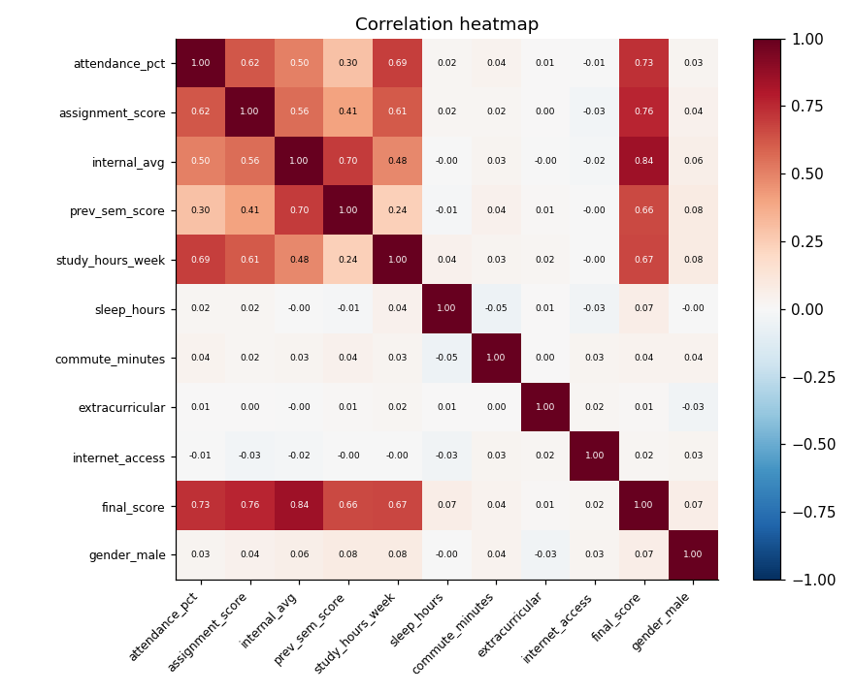
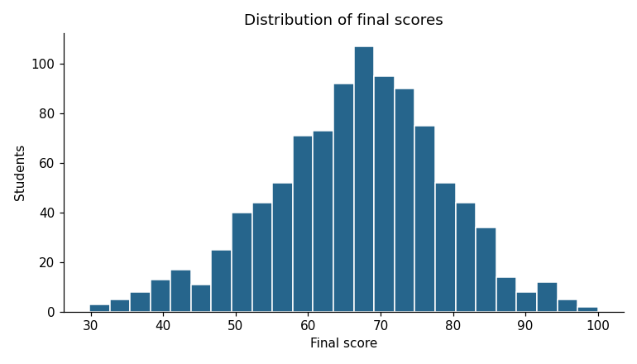
Introduction
Data & Methodology
Preprocessing & EDA
Models & Results
Demo & Conclusion
EXPLORATORY DATA ANALYSIS
Internal marks track the final score most closely
Univariate: scores average 66.6 (range 30–100); most students sit between 55 and 80.
Correlation: internal assessment r = 0.84; sleep, commute and gender all under 0.08.
Acadrix · Student Performance Prediction System
08
Notes:
Left: distribution of final scores. Right: correlation heatmap. The five academic features correlate strongly with the score; lifestyle and demographic columns sit near zero. Boxplots and scatter plots are in the report.

Slide 9
Introduction
Data & Methodology
Preprocessing & EDA
Models & Results
Demo & Conclusion
FEATURE ENGINEERING AND SELECTION
Five academic features kept, five lifestyle columns dropped
Correlation with final score (r) · keep if r ≥ 0.15
Internal assessment
0.84
Engineered features tested
Assignment score
0.76
Engagement index
(attendance + assignment) / 2
CV R² change: −0.0065 · dropped
Attendance
0.73
Study hours / week
0.67
Previous sem score
0.66
Study efficiency
internal ÷ (study hours + 1)
CV R² change: −0.0033 · dropped
Sleep hours
0.07
Gender
0.07
Commute minutes
0.04
Kept only if they raised cross-validated R² by more than 0.005.
Internet, extracurricular
0.02
Acadrix · Student Performance Prediction System
09
Notes:
Selection kept exactly the five features the app collects. The weakest kept feature (0.66) is about ten times stronger than the strongest dropped one (0.07). Both engineered features repeated information already in their parts.

Slide 10
Introduction
Data & Methodology
Preprocessing & EDA
Models & Results
Demo & Conclusion
MODELS USED
One model from each family, trained on the same data
STATISTICAL
BAGGING ENSEMBLE
BOOSTING ENSEMBLE
Linear Regression
Random Forest
XGBoost
Score = a weighted sum of the five inputs, with weights that minimise squared error.
Averages many decision trees, each trained on a random sample of rows and features.
Builds trees one after another, each fixing the errors the earlier trees still make.
Settings: StandardScaler + ordinary least squares
Settings: 300 trees, min 3 samples per leaf
Settings: 400 trees, depth 4, learning rate 0.05, monotone constraints
Evaluated on a held-out 20% test set (199 students) with MAE, MSE, RMSE and R², plus 5-fold cross-validation.
Acadrix · Student Performance Prediction System
10
Notes:
These cover the three main families in the literature. XGBoost's monotone constraints stop it learning that more attendance lowers a score.

Slide 11
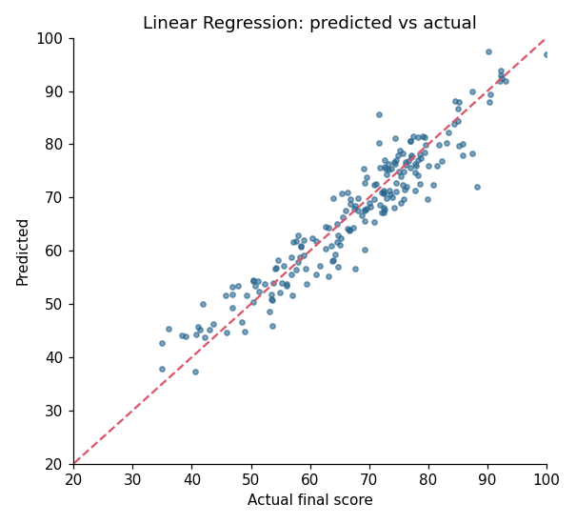
Introduction
Data & Methodology
Preprocessing & EDA
Models & Results
Demo & Conclusion
RESULTS
Linear Regression wins narrowly: R² 0.901, error ±3.3 marks
Model | MAE | RMSE | R² | CV R²
Linear Regression | 3.32 | 4.17 | 0.901 | 0.893
Random Forest | 3.24 | 4.26 | 0.897 | 0.879
XGBoost | 3.33 | 4.28 | 0.896 | 0.889
Why the simplest model won
The score is close to a weighted sum of the inputs plus random noise, so the tree models find little curve to learn. What error is left is mostly that noise.
Points follow the diagonal; the lowest scorers are predicted a little high.
Acadrix · Student Performance Prediction System
11
Notes:
All three models are within 0.006 R². Linear Regression has the best RMSE, R² and cross-validated R², and is the fastest and easiest to explain, so it is deployed. Caveat: students below about 45 are predicted a few marks too high.

Slide 12
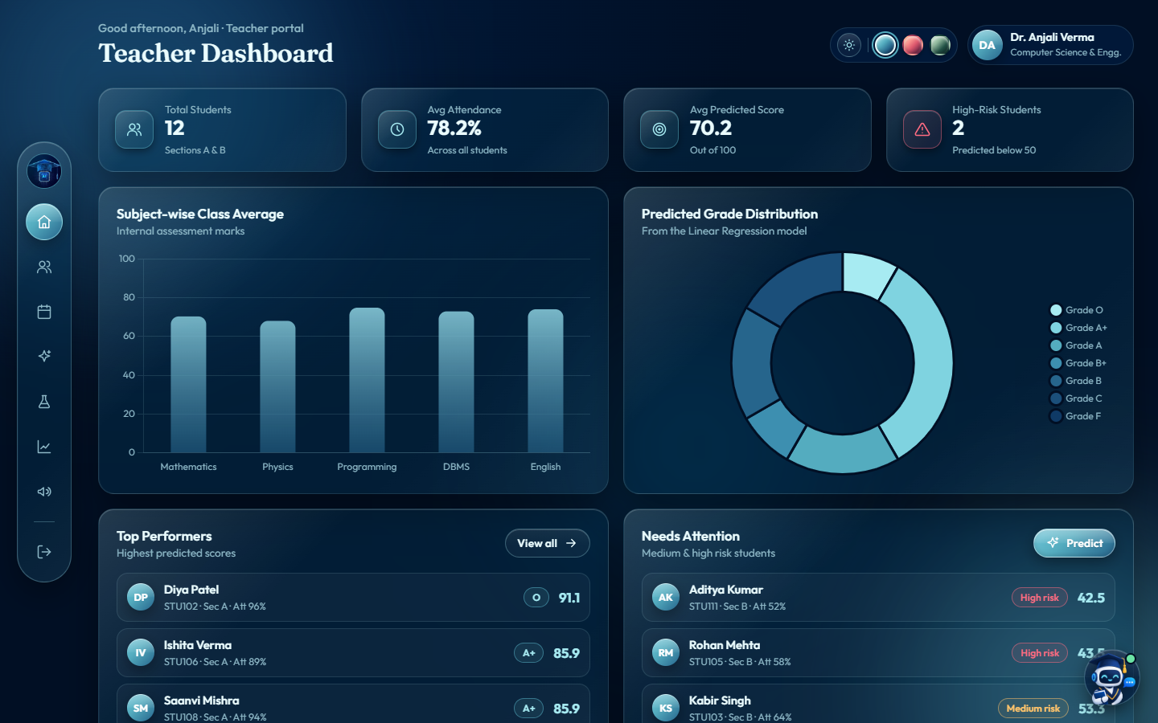
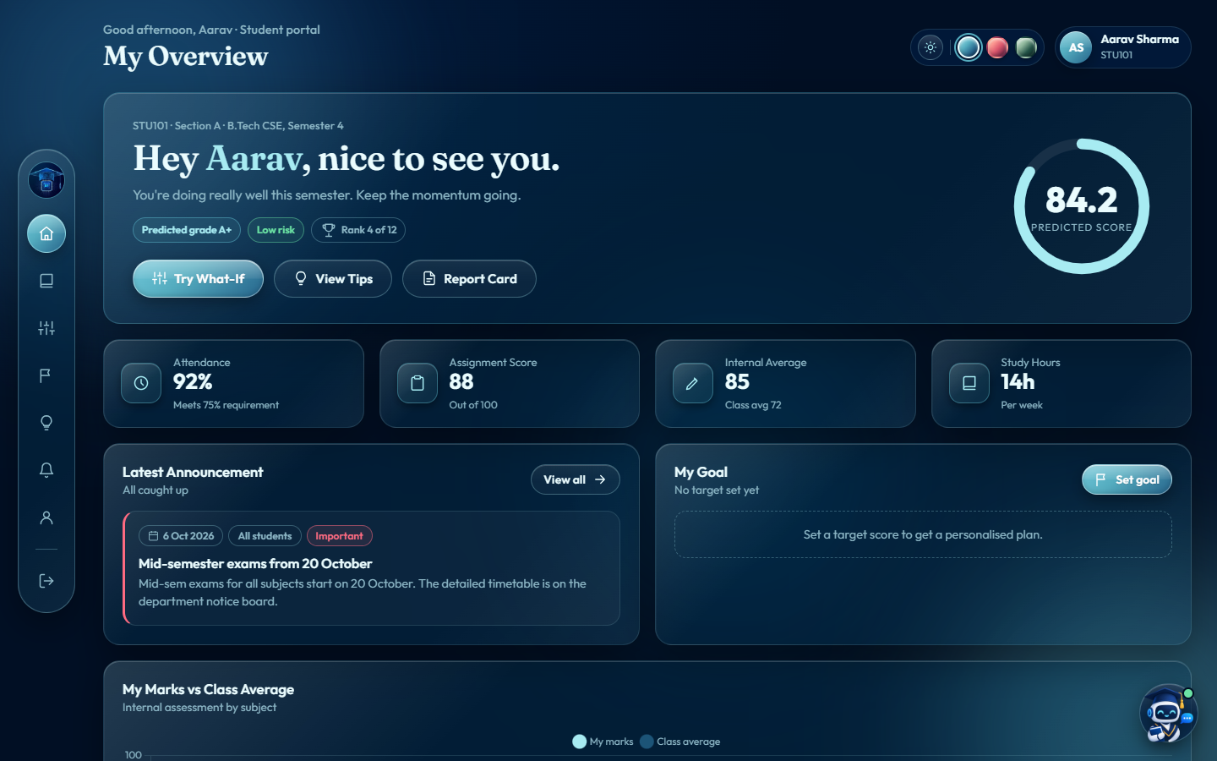
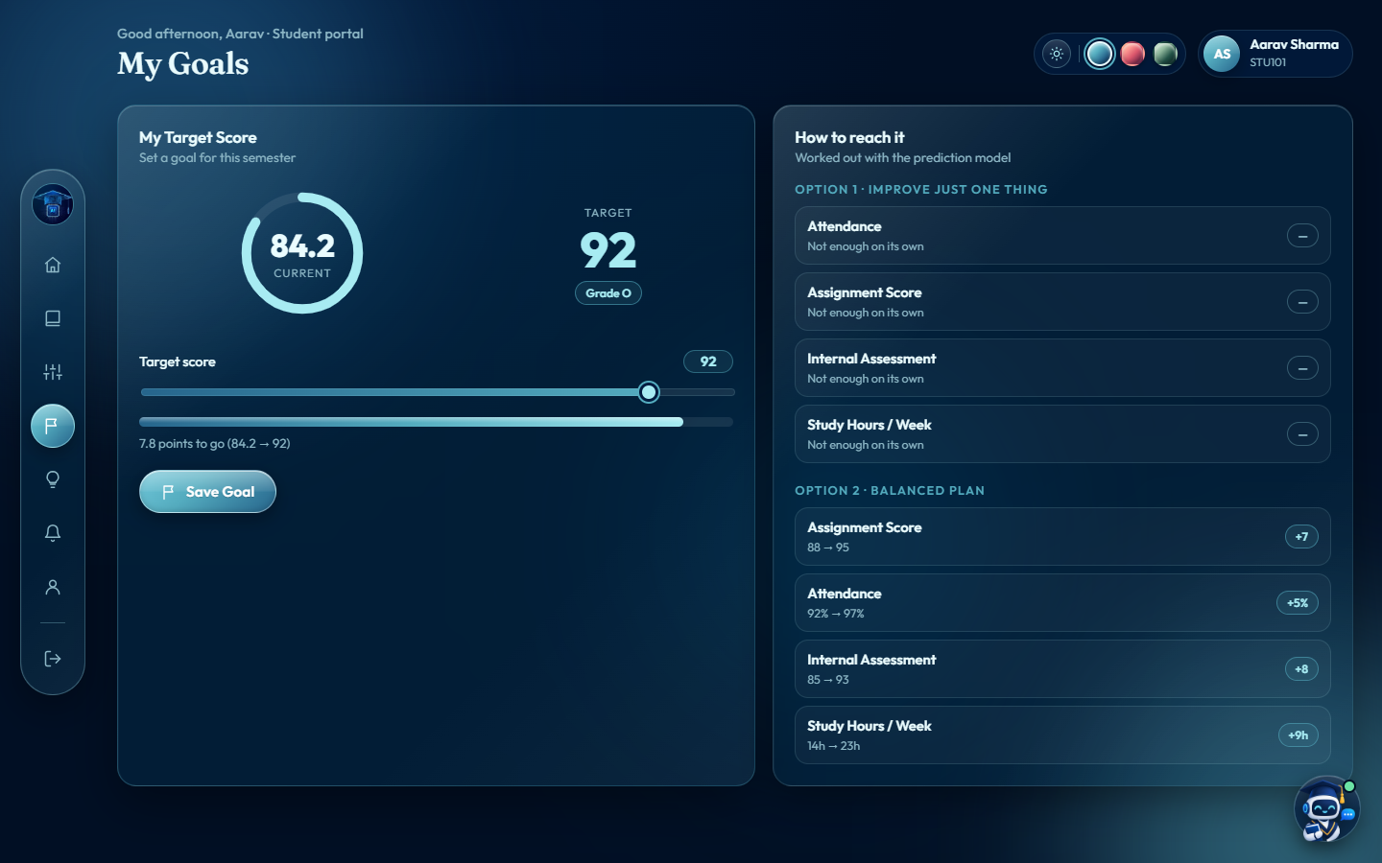
Introduction
Data & Methodology
Preprocessing & EDA
Models & Results
Demo & Conclusion
DEMO SCREENSHOTS
Teachers see who needs help; students get a plan
Student overview: score, grade, risk, rank
Teacher dashboard: class statistics and students flagged high risk
Goal planner: two ways to reach a target
Acadrix · Student Performance Prediction System
12
Notes:
Live at acadrix-da7i.onrender.com. Teacher login: teacher / teacher@123; student login: STU101 / student@123. Also: student management with CSV import/export, attendance register, Model Lab, EDA charts, announcements, report cards, What-If simulator, tips and the Drix assistant. Light and dark mode, three colour themes.

Slide 13
Introduction
Data & Methodology
Preprocessing & EDA
Models & Results
Demo & Conclusion
CONCLUSION
Five indicators predict the final score to within ±3.3 marks
0.901
8 / 8
Live
R² on 199 unseen students
capstone phases completed, data to deployment
two-portal web app on Render
The lesson: simpler was better here
Random Forest and XGBoost matched Linear Regression but did not beat it. The simplest model is the fastest, the most stable and the easiest to explain to a teacher.
Findings agree with published research: internal assessment and prior achievement are the strongest predictors, and attendance matters.
Acadrix · Student Performance Prediction System
13
Notes:
The value is in acting on predictions: early warnings for teachers and specific steps for students.

Slide 14
Introduction
Data & Methodology
Preprocessing & EDA
Models & Results
Demo & Conclusion
FUTURE SCOPE
Next: real data and permanent hosting
Real student records
Better for weak students
Retrain on institutional data with the same five fields
Fix the over-prediction for the lowest scorers
Permanent storage
ERP integration
Paid hosting or PostgreSQL so data survives restarts
Import attendance and marks automatically
Smarter Drix
Explainable AI
Connect a language model for free-form questions
Per-student explanations such as SHAP values
Acadrix · Student Performance Prediction System
14
Notes:
Before real use: remove the public demo accounts and add per-institution sign-up.

Slide 15
THANK YOU
Questions & Discussion
Code: github.com/Garima1223/acadrix-student-performance
Live app: acadrix-da7i.onrender.com
Acadrix · Student Performance Prediction System · AIML Summer Internship 2026
Notes:
Close with the links and invite questions.

