Slide 1
Project Presentation of Co-Op Project at Industry (Module-1)
On
Applications and Challenges of Large Language Models in Real-World Systems
Dimple Khatri | Garima |
2210991517 | 2210991562 |
Supervised By
Rajat Takkar, Chitkara University
Department of Computer Science and Engineering,
Chitkara University, Punjab

Slide 2
Introduction & Objective
Background:
• Large Language Models represent a significant advancement in AI and NLP
• Earlier systems relied on rule-based approaches and traditional ML
• Transformer architectures enable understanding of long-range dependencies
Key Observations:
• Models like GPT and BERT demonstrate strong performance across tasks
• Ability to generalize across tasks is a major strength
• Concerns: biased outputs, hallucinations, lack of transparency
• Rapid adoption from research to real-world applications
2

Slide 3
Related Work
Evolution of Language Models: • Statistical approaches (n-grams) → Deep learning architectures
• RNNs and LSTMs: limited by vanishing gradients and poor scalability
• Transformer architecture marked a turning point
• BERT and GPT: self-attention mechanisms for parallel processing Recent Advances:
• Scaling to billions of parameters with strong generalization
• RLHF: improved alignment with human expectations
• Persistent challenges: bias, computational cost, explainability
3

Slide 4
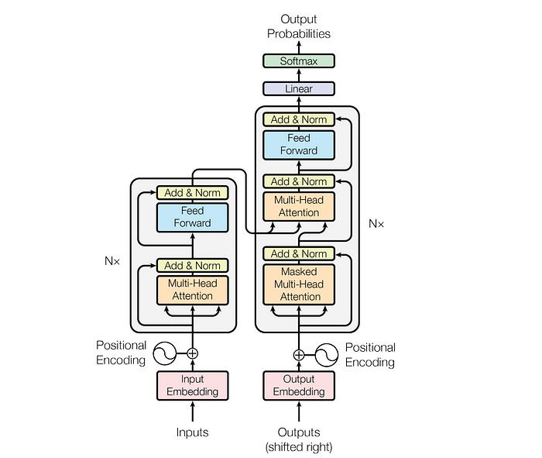
System Architectecture
4

Slide 5
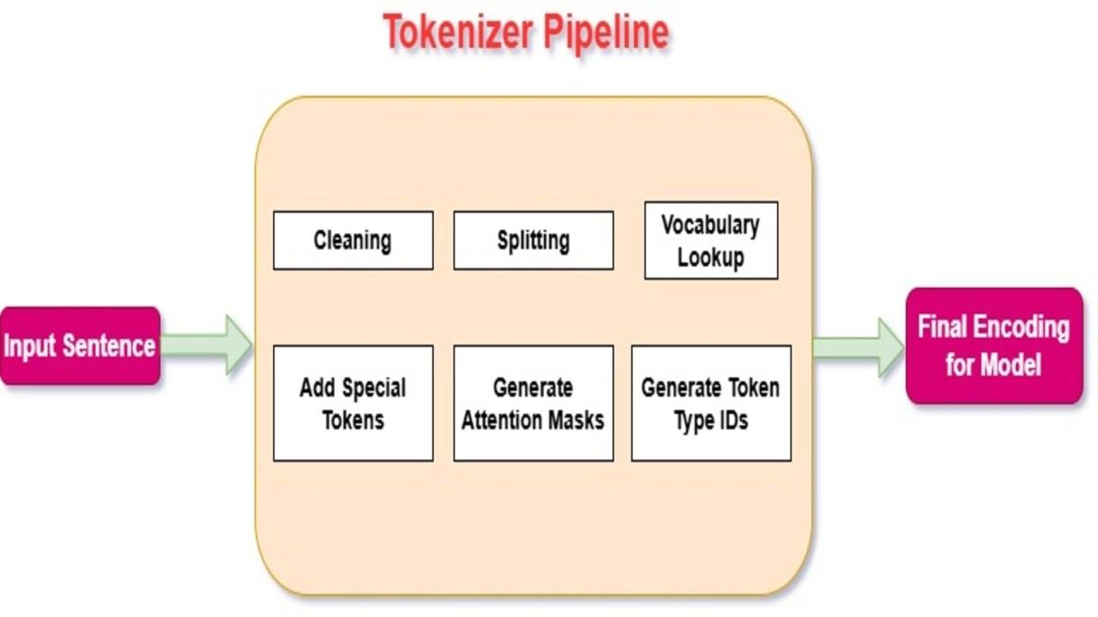
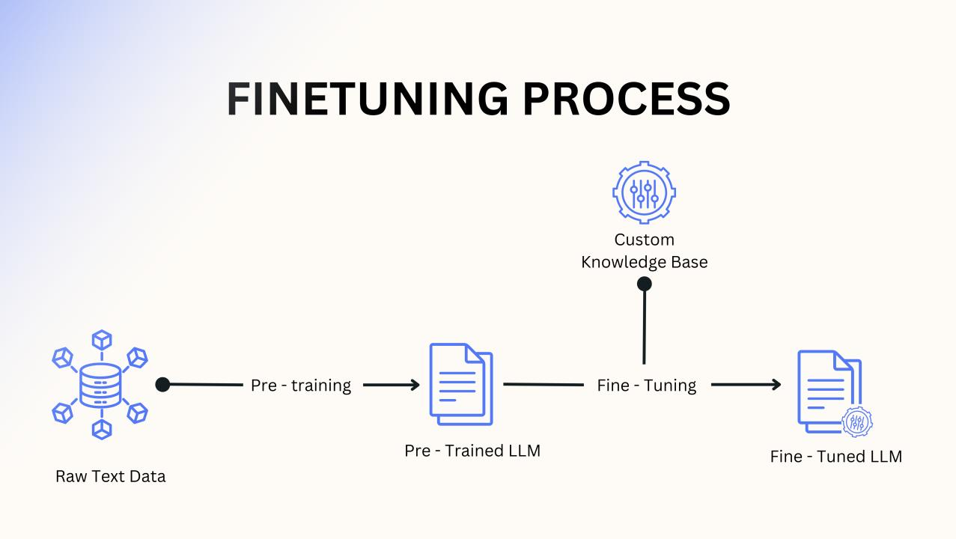
Methodology
Data Preparation:
• Datasets collected and preprocessed to remove noise
• Data converted to numerical representations via tokenization
Training Approach:
• Unsupervised learning for general language patterns
• Fine-tuning with task-specific datasets
• Combining supervised learning with human feedback
Optimization & Evaluation:
• Model pruning and quantization to reduce computational cost
• Metrics: accuracy, BLEU score, human judgment
• Safety mechanisms: bias reduction and content filtering
5

Slide 6

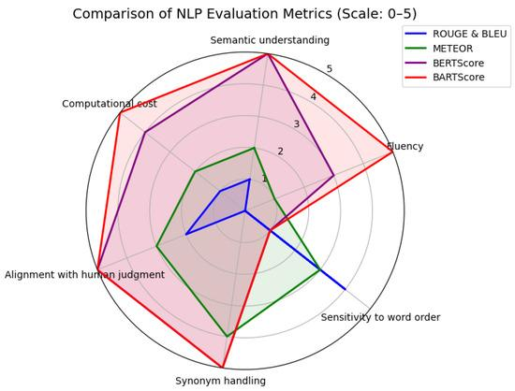
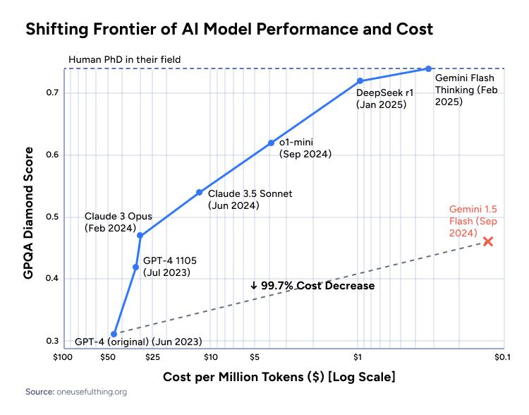
Results
• Few-shot learning significantly improves over zero-shot
• Trade-off: performance vs. efficiency (computational resources)
• Models highly sensitive to input phrasing and structure
• Bias in outputs reflects training data biases
• External knowledge sources improve factual accuracy
6

Slide 7
Discussion & Challenges
Advantages:
• Automation and scalability
• Improved user interaction
• Versatile across multiple tasks
Limitations:
• Hallucination in sensitive fields (healthcare)
• Bias leading to unfair/misleading results
• High computational cost limits accessibility
• Lack of interpretability reduces trust
7

Slide 8
Conclusion & Future Scope
Conclusion
• LLMs significantly improved AI capabilities
• Challenges must be addressed: hallucination, bias, cost
• Need for validation mechanisms and human oversight
Future Scope
• More efficient models for low-resource devices
• Integration with external knowledge bases
• Improved transparency and interpretability
• Domain-specific models for specialized fields
9

Slide 9
Thank You
9

