Slide 1

Factors That Affect Rental Prices in Chicago
Group Members: Joseph Wantroba, Amy Cleveland, Garima Chauhan, Gabriela Hernandez , Kelly Lao

Slide 2
Table of Contents
Overview
Hypothesis
Questions We Asked
Data Exploration & Market Trend
Discussion
Post Mortem

Slide 3

Overview
TBD

Slide 4
Questions We Asked
Is there a correlation between the median rental price and resident income level?
Does having more amenities increase the rental price in the area?
Are there more Airbnb rental available in areas with higher rental?
TBD
TBD

Slide 5
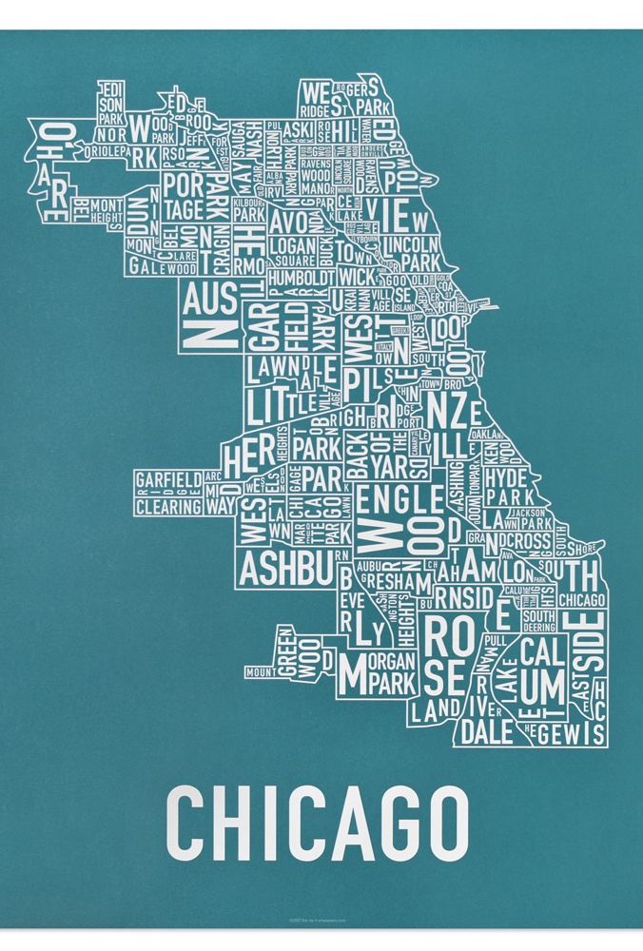
Hypothesis
There are factors affecting the house prices in Chicago.

Slide 6
Market Trend
Zillow Data – Housing Price

Slide 7
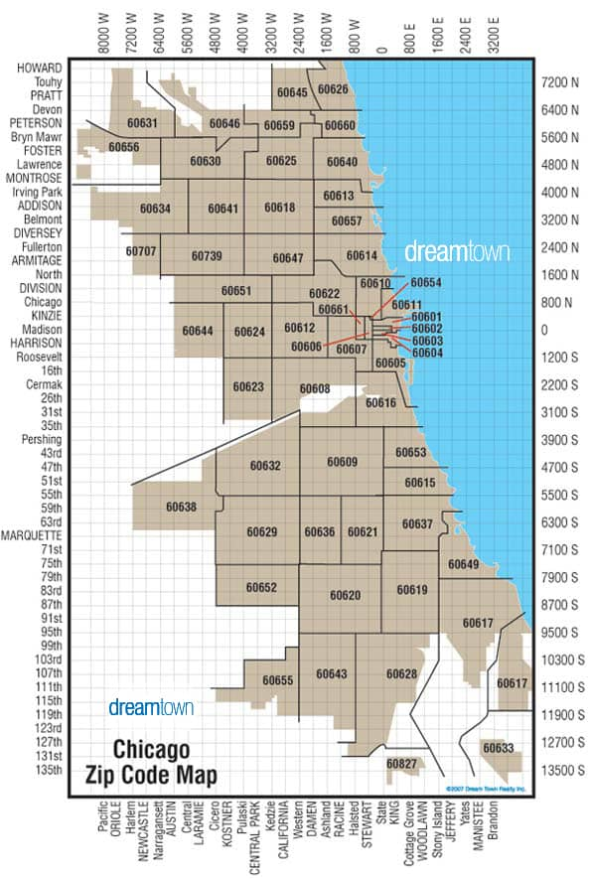
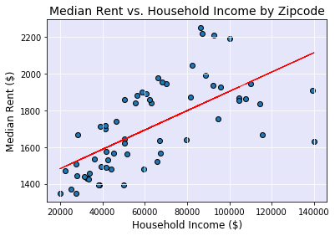
Rent vs. Household Income by Zip Code

Slide 8


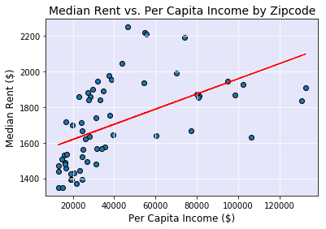
Rent vs. Per Capita Income by Zip Code
Correlation coefficient =

Slide 9

Rent vs. Poverty Rate by Zip Code

Slide 10



Rent vs. Crime Rate by Zip Code

Slide 11




Rent vs. Restaurants by Zip Code

Slide 12



Rent vs. Night Life by Zip Code

Slide 13

Rent vs. Grocery by Zip Code

Slide 14

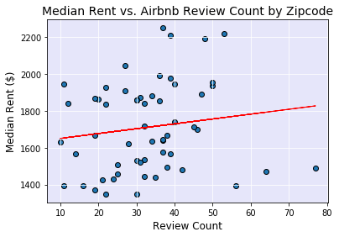

Rent vs. Airbnb Review by Zip Code

Slide 15
Discussion

Slide 16
Post Mortem
If we had more time,

Slide 17


Questions or Comments?

