Slide 1
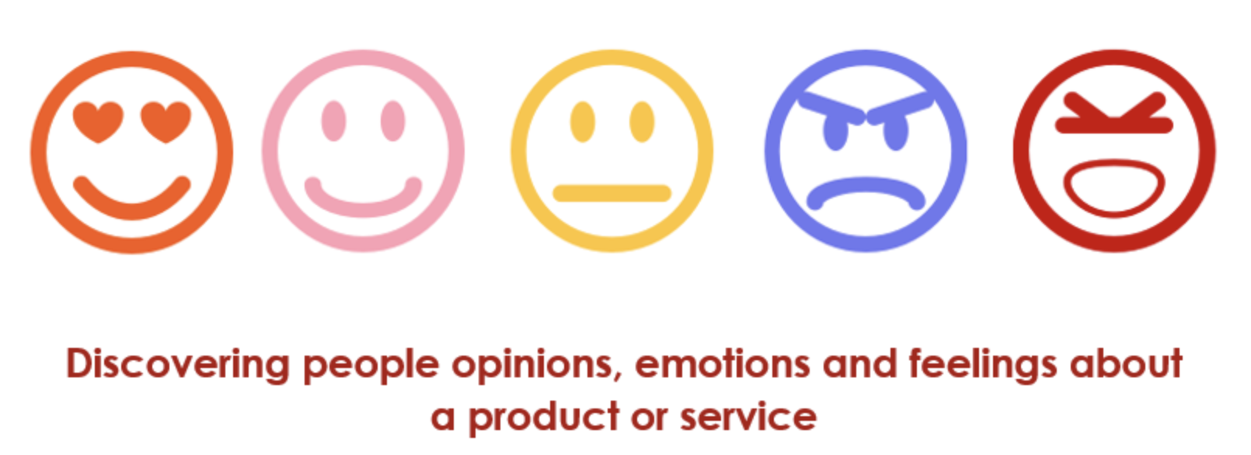
Natural Language Processing

Slide 2
Named Entity Recognition

Slide 3
Named Entity Recognition (NER) sometimes referred to as entity chunking, extraction, or identification is the task of identifying and categorizing key information (entities) in text.
A named entity is a “real-world object” that’s assigned a name – for example, a person, a country, a product or a book title.
NER is a form of natural language processing (NLP), a subfield of artificial intelligence. NLP is concerned with computers processing and analysing natural language, i.e., any language that has developed naturally, rather than artificially, such as with computer coding languages

Slide 4
Named-entity recognition (NER) is a subtask of information extraction that seeks to locate and classify named entities mentioned in unstructured text into pre-defined categories such as person names, organizations, locations, medical codes, time expressions, quantities, monetary values, percentages, etc.
Most research on NER systems has been structured as taking an unannotated block of text, such as this one:
“Jim bought 300 shares of Acme Corp. in 2006”
And producing an annotated block of text that highlights the names of entities:
[Jim]Person bought 300 shares of [Acme Corp.]Organization in [2006]Time.

Slide 5
What Business Questions can be answered ?
NER is used in many fields in Natural Language Processing (NLP), and it can help answering many real-world questions, such as:
Which companies were mentioned in the news article?
Were specified products mentioned in complaints or reviews?
Does the tweet contain the name of a person? Does the tweet contain this person’s location?
Try it out:
https://corenlp.run/
https://spacy.io/

Slide 6
Process flow for NER
Raw Strings
Sentence Segmentation
Token
POS Tagging
Entity Detection

Slide 7
Data Pre-processing
Texts found in online contains unwanted material(such as headers ,footers) that need to be removed before applying linguistic processing
Tokenization is the segmentation of texts into basic units – or tokens – such as words and punctuations
Lemmatization is a process of mapping a word to its canonical form
Regular Expressions are a powerful and flexible method of specifying the patterns

Slide 8
Token
Step one involves detecting a word or string of words that form an entity.
Each word represents a token: “The Empty Roads” is a string of three tokens that represents one entity.

Slide 9
The second step requires the creation of entity categories based on Parts of Speech(PoS).
Here are some common entity categories:
Person
E.g., Elvis Presley, Audrey Hepburn, David Beckham
Organization
E.g., Google, Mastercard, University of Oxford
Time
E.g., 2006, 16:34, 2am
Location
E.g., Trafalgar Square, MoMA, Machu Picchu
Work of art
E.g., Hamlet, Guernica, Exile on Main St.

Slide 10
POS Tagging
It is the process of marking each word in the sentence to its corresponding parts of speech tag based on its context and definition
POS Tag | Example
PRP ( Personal Pronoun) | He ,She
PRP (Possessive Pronoun) | My,his,hers
RB (Adverb) | Very, Silently
VB ( Verb) | Take
FW | Foreign Word
JJ ( Adjective) | Small
NN( Noun) | desk

Slide 11
Spacy for NER
SpaCy is an open-source library for advanced Natural Language Processing in Python.
It is designed specifically for production use and helps build applications that process and “understand” large volumes of text.
It can be used to build information extraction or natural language understanding systems, or to pre-process text for deep learning. Some of the features provided by spaCy are- Tokenization, Parts-of-Speech (PoS) Tagging, Text Classification and Named Entity Recognition.

Slide 12
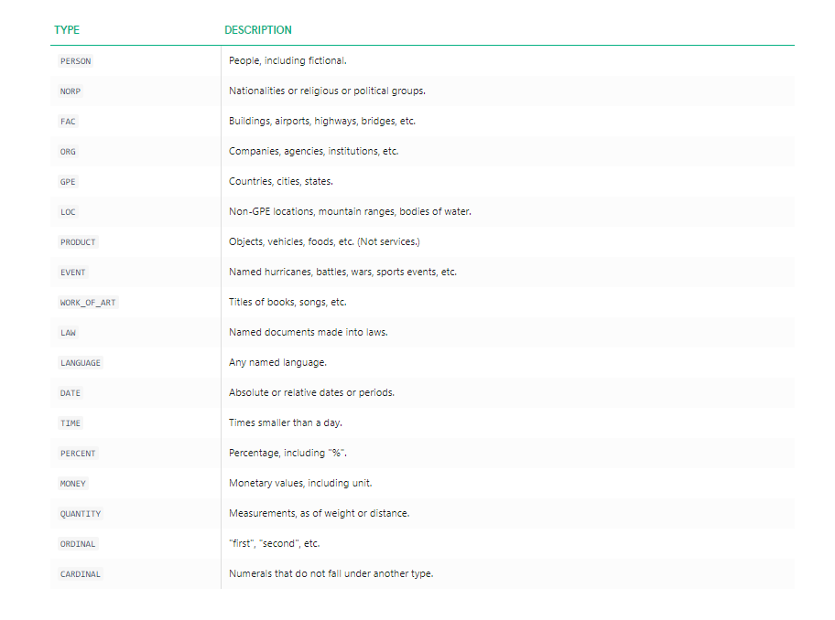
Spacy for NER

Slide 13
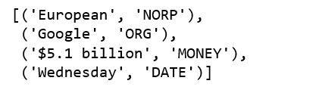
Spacy for NER : Entity
We are using the sentence, “European authorities fined Google a record $5.1 billion on Wednesday for abusing its power in the mobile phone market and ordered the company to alter its practices.”
One of the nice things about Spacy is that we only need to apply nlp once, the entire background pipeline will return the objects.
European is NORP (nationalities or religious or political groups), Google is an organization, $5.1 billion is monetary value and Wednesday is a date object.

Slide 14
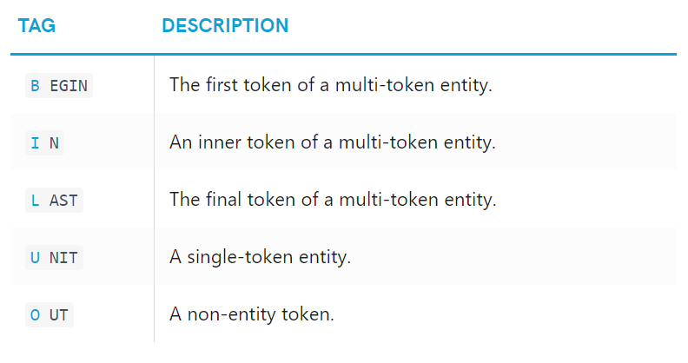
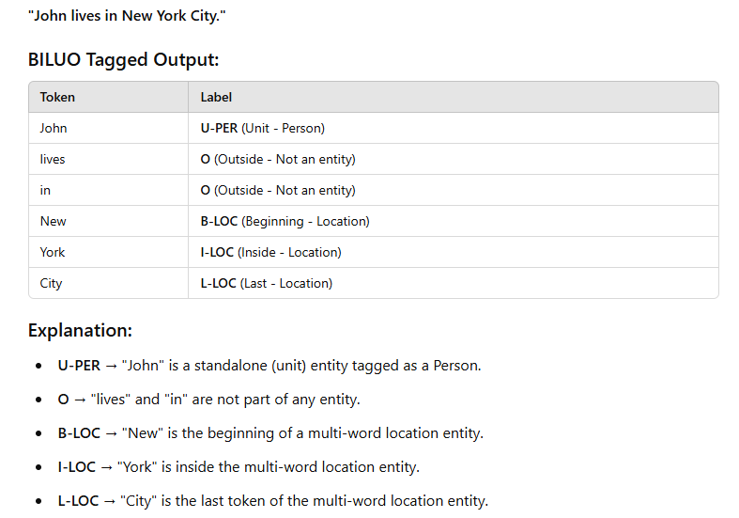
Spacy for NER : Token
During the above example, we were working on entity level, in the following example, we are demonstrating token-level entity annotation using the BILUO tagging scheme to describe the entity boundaries.

Slide 15
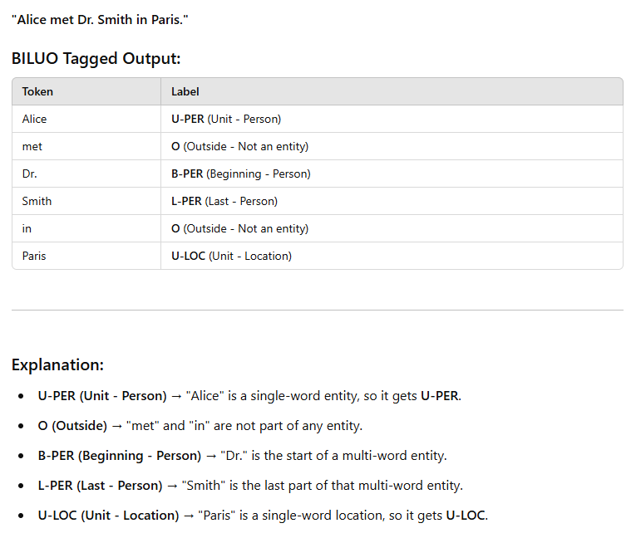

Slide 16
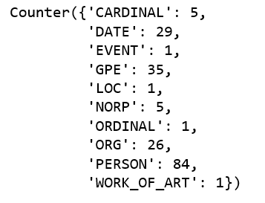
Extracting Named Entity from an article
Extracting named entities from a New York Times article, — “F.B.I. Agent Peter Strzok, Who Criticized Trump in Texts, Is Fired.”
There are 153 entities in the article, and they are represented as 10 unique labels :
The following are three most frequent tokens.

Slide 17
Let’s randomly select one sentence to learn more
Let’s run displacy.render to generate the raw markup.
One miss-classification here is F.B.I.

Slide 18
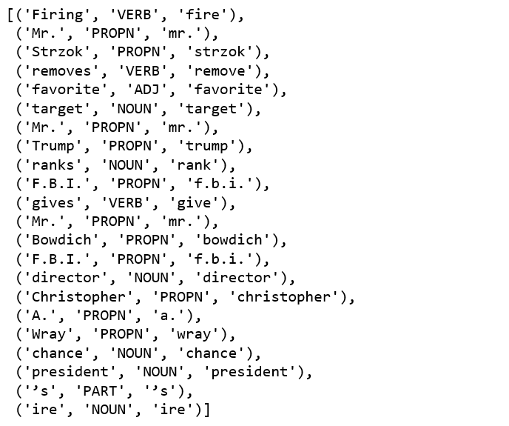
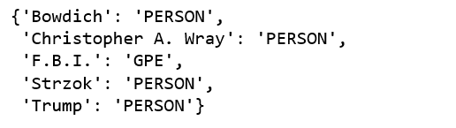
Extract part-of-speech and lemmatize this sentence
Named entity extraction are correct except “F.B.I”.

Slide 19
CRF Model

Slide 20
The Conditional Random Field (CRF) can be used as a sequence labelling technique for performing NER tagging. CRF is used to perform custom NER.
Conditional Random Fields are the class of probabilistic models. There are two terms in the CRF nomenclature that you need to keep in mind, which are as follows:
Random fields: These indicate that the CRF is probability a distribution-based machine learning model.
Conditional: This indicates that the probabilities are conditional probabilities.

Slide 21
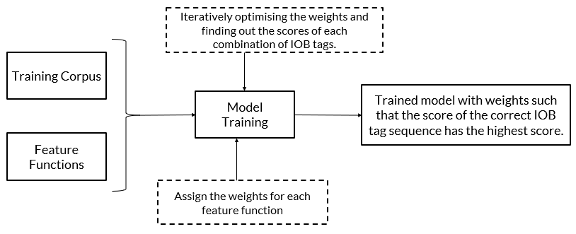

Slide 22
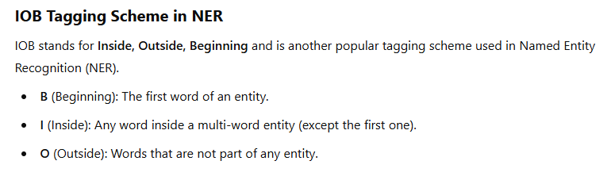
X1= ‘Google Inc. is headquartered in Silicon Valley.’
X2= ‘I went to New York.’
In the training data set, the NER tags such as IOB tags are assigned manually, as shown below.
X1= Google (B-ORG) Inc (I-ORG) is (O) headquartered (O) in (O) Silicon (B-LOC) Valley (I-LOC).
X2= I (O) went (O) to (O) New (B-LOC) York (I-LOC).
Where, ORG and LOC stand for organization and location, respectively.

Slide 23
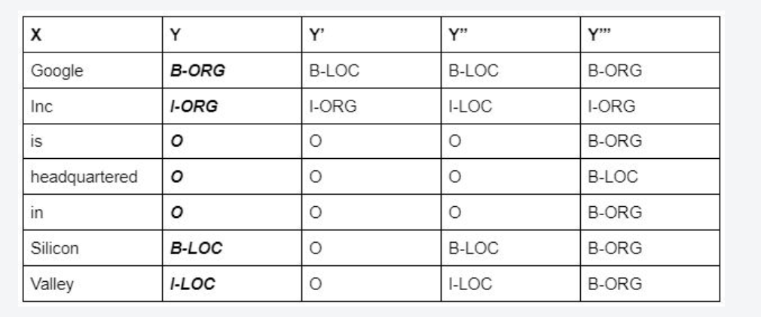
So, for the input sentence ‘X’, there can be multiple combinations of IOB tags possible, and some of them are shown in the above table. The highlighted one is the correct combination, which is tagged manually in the training data set The model needs to train itself or assign the weights in such a way that it assigns the highest score to the correct combination.

Slide 24
Some commonly used features in the CRF technique for NER applications are as follows:
You can build logic on the input word ‘xi’ and on the surrounding words, which could be ‘xi-1’ or ‘xi+1’.
The PoS tag of the word ‘xi’ and surrounding words.
Is a particular word present in a dictionary (dictionary of common names, dictionary of organic chemicals, etc.)
Word shapes:
  26-03-2021 => dd-dd-dddd
  26 Mar 2021 => dd Xxx dddd
  W.H.O => X.X.X
Presence of prefix and suffixes

Slide 25
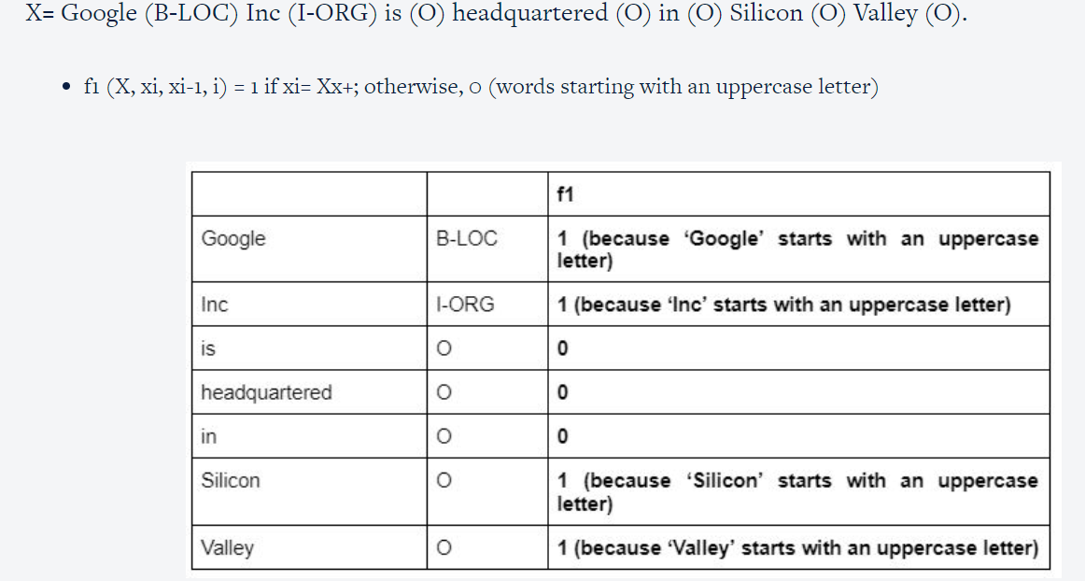

Slide 26
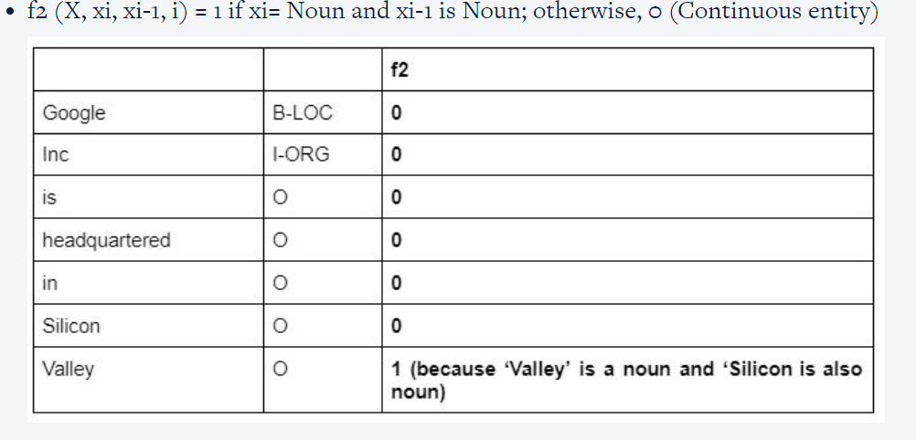

Slide 27
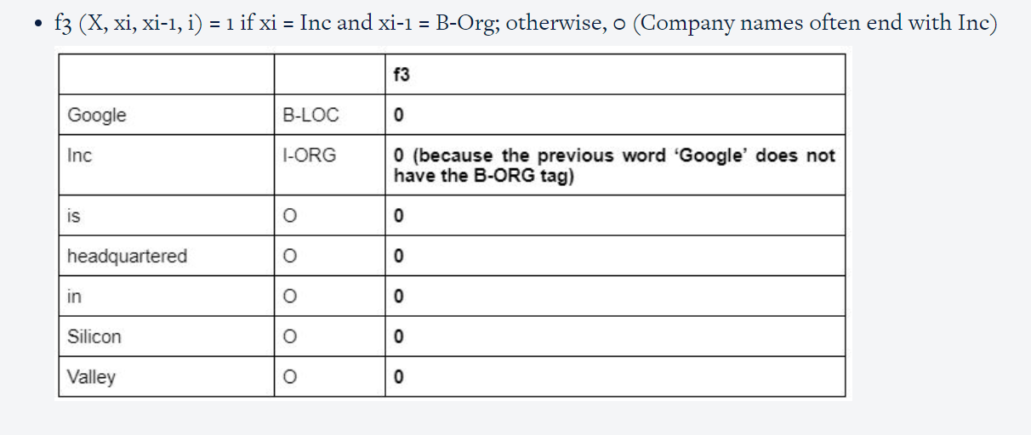

Slide 28
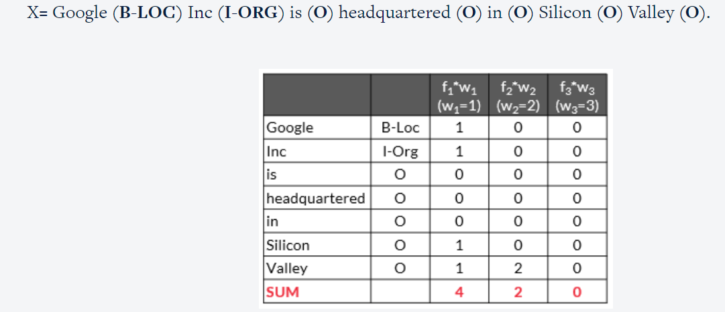

Slide 29
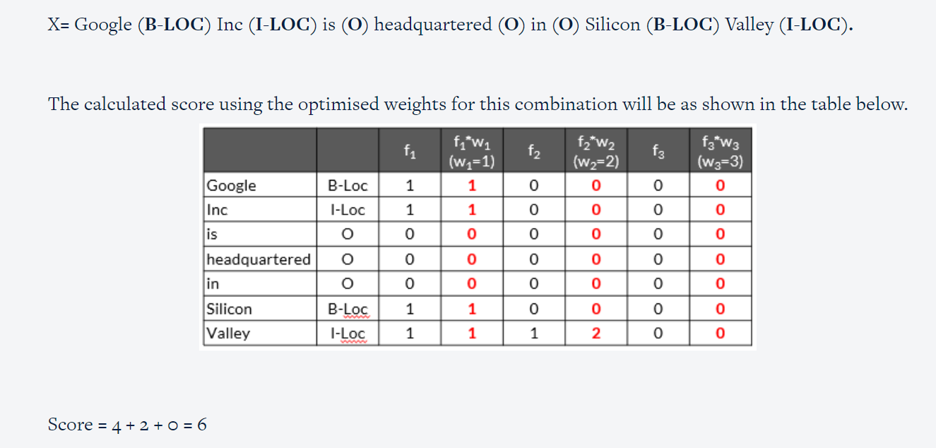

Slide 30
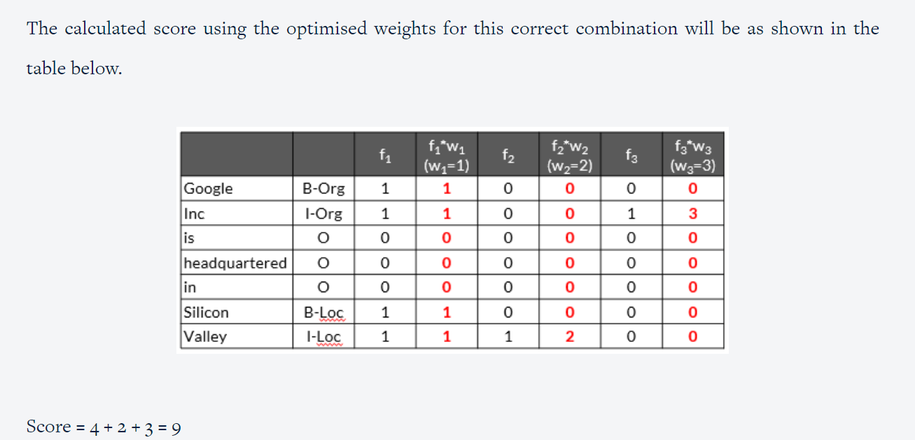

Slide 31
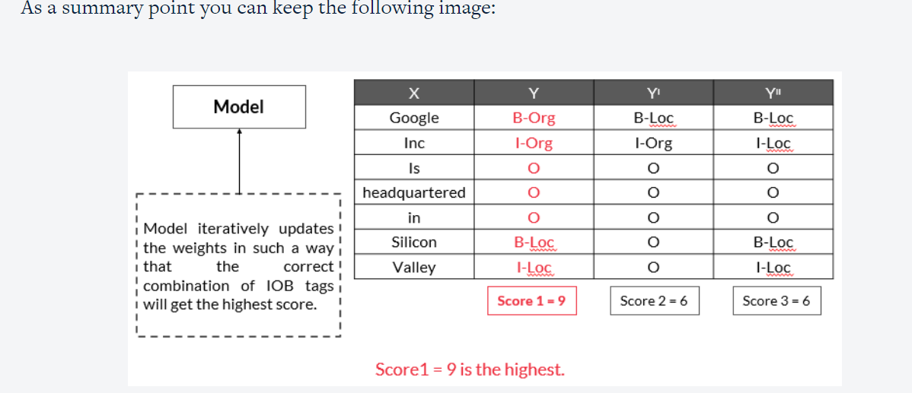

Slide 32

Thank you

