Slide 1
Bike Riders
Data Acquisition & Data Wrangling
Nexthikes Project
By Garima Dugar

Slide 2
Introduction
The dataset is a merged dataset containing information about bike sharing. The purpose of this analysis is to understand patterns, relationships, and outliers in the data.
EDA helps us gain insights into the structure and characteristics of the data, while preprocessing ensures the data is clean and ready for further analysis.
The dataset comprises 610 rows and 15 columns, including various features such as season, temperature, humidity, and counts of casual and registered users.

Slide 3
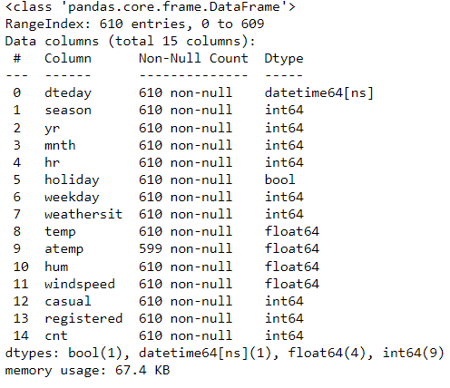
Objectives
Dataset Composition : The majority of columns are of numeric types.
'dteday' is of datetime type, facilitating time-based analysis.
'holiday' is represented as Boolean , providing a binary indicator for holidays.
No duplicate rows were found in the dataset.
The 'dteday' column contains dates ranging from January 1, 2011, to January 28, 2011

Slide 4
Handling Missing Values
Missing Values Detection:
Identified 11 missing values in the 'atemp' column.
'atemp' represents "feels-like" temperature and is crucial for accurate analysis.
Handling Strategy:
Replaced missing values in 'atemp' with the mean value of the column.
Ensures minimal impact on the overall dataset integrity.
Result:
Achieved a complete and clean dataset with no missing values.

Slide 5
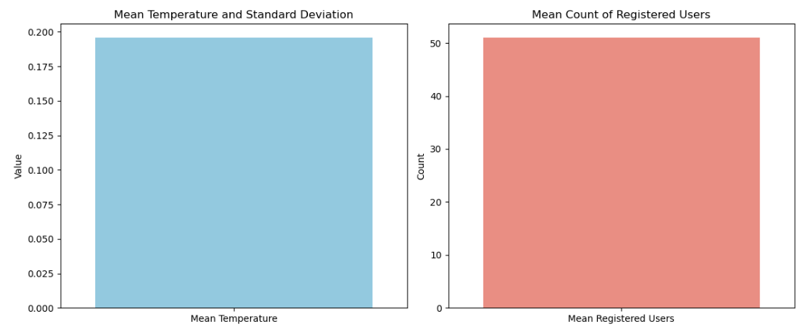
Numeric Summary
The mean temperature is 0.196, with a standard deviation of 0.081. The count of registered users ranges from 0 to 247, with a mean of 51.07.

Slide 6
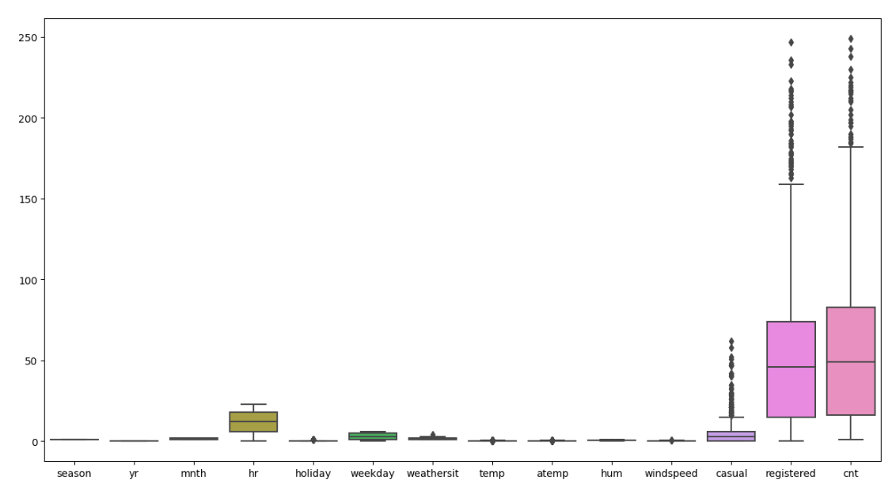
Detecting & Treating Outliers
Outliers were detected in columns 'cnt,' 'registered,' and 'casual.’
Outliers were treated by applying a standard z-score threshold. Values beyond 3 standard deviations were considered outliers and were either transformed or removed.

Slide 7
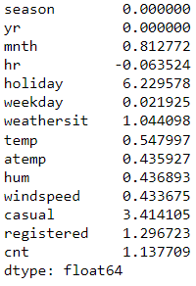
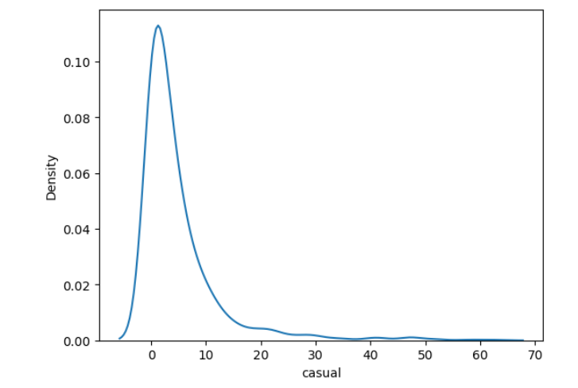
Skewness
The 'casual' column exhibits significant positive skewness, indicating a right-skewed distribution.

Slide 8
Correlation
Temperature and atemp:
Highly positively correlated (0.909940).
This is expected, as these variables are related to the temperature.
Temperature and Humidity:
Have a positive correlation (0.080720).
It indicates a slight positive relationship between temperature and humidity.
Temperature and Windspeed:
Are weakly correlated (0.122625).
There's a slight positive relationship, but it's not very strong.
Count of Casual Users and Registered Users:
Are positively correlated (0.337706).
It's expected, as the total count is the sum of casual and registered users.
Count of Users and Weather Situation:
‘cnt’ s negatively correlated with ‘weathersit’ (-0.126448)
It suggests that adverse weather conditions may have a slight negative impact on the total user count.
Humidity and Windspeed:
Are negatively correlated (-0.385550).
It indicates that as humidity increases, windspeed tends to decrease.
Count of Users and Hour:
Has a positive correlation with ‘hr’ and ‘mnth’
It suggests that the total user count is influenced by the hour and month.

Slide 9
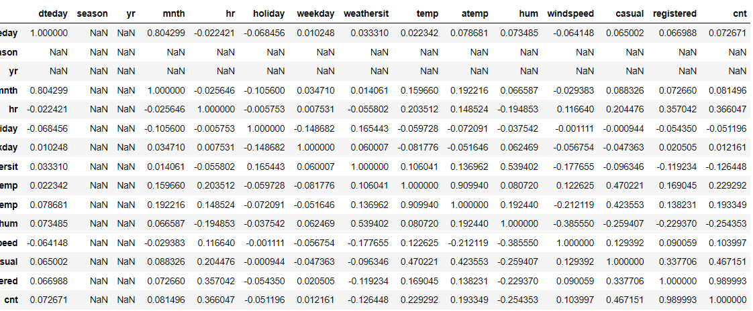

Slide 10
Conclusion
The dataset, comprising bike-sharing information, was cleaned by addressing missing values and ensuring data integrity.
Descriptive statistics and visualizations revealed insights into user counts and weather conditions.
Outliers were identified, suggesting potential anomalies in user behavior.
Correlation analysis highlighted relationships between variables.
The weather conditions, especially temperature, significantly influence bike usage, providing valuable insights for optimizing services

Slide 11
Thank You

