Slide 1
STARMAP
CS F212- DATABASE SYSTEMS
Shaurya Jain - 2022A7PS0154P
Darsh Rathi - 2022A7PS0187P
Nazim Ahmed- 2022A7PS0125P
MD Sadique - 2022A7PS0156P
Garima Garg - 2021B1A7PS1524P

Slide 2
Scope of the Project
The StarMap project is a web application designed to provide an interactive and educational journey through the night sky.
The application uses advanced modeling and visualization libraries in Java to create a dynamic representation of the night sky , and the data of the stars is stored within a MySQL Database.
Users can interact with this virtual cosmos by exploring stars and constellations, participating in quizzes and challenges, and tracking their progress through an achievement system.

Slide 3
Feature List
User Account Creation
User Login
Starry Sky Animations
Interactive Star View with star informations
Achievement collecting system
Question of the Day (Quiz)
Leaderboards based on points which can be collected from achievements and quiz
Star Favoriting Option

Slide 4
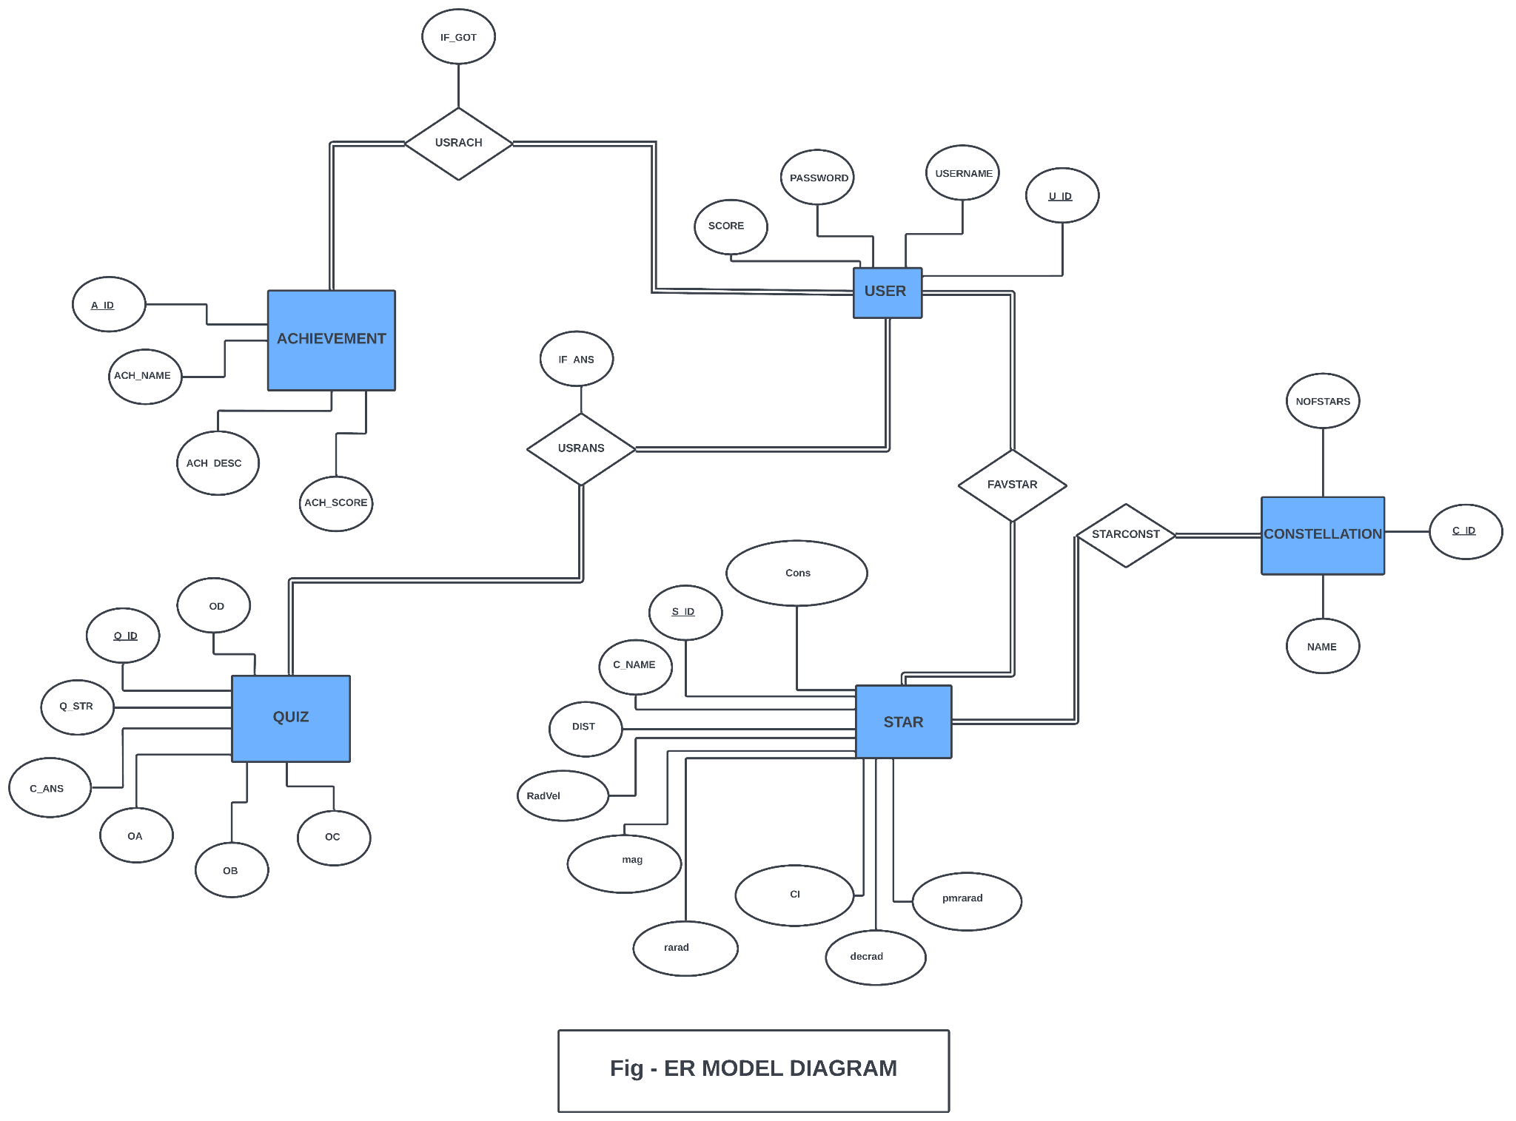

Slide 5
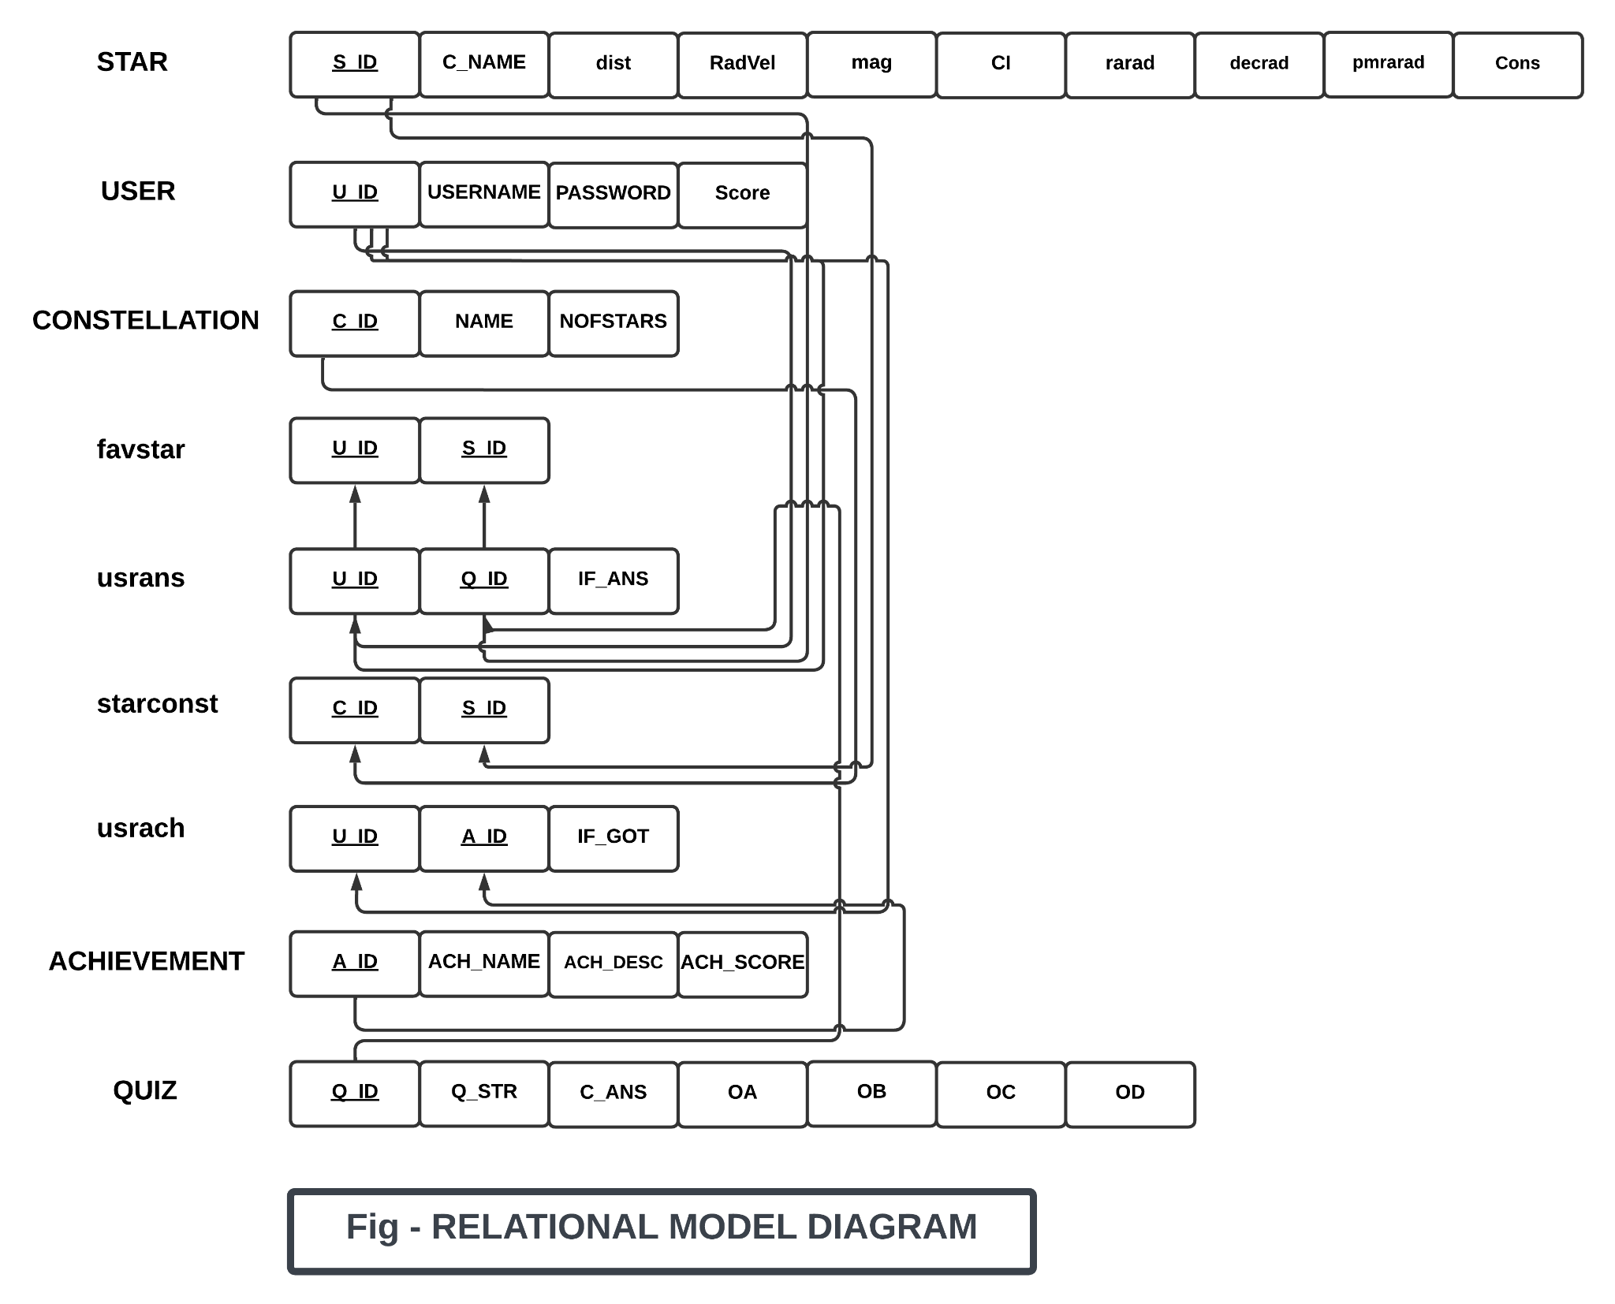

Slide 6
TABLE SCHEMA

Slide 7
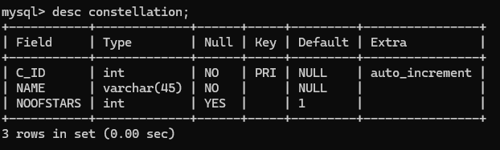
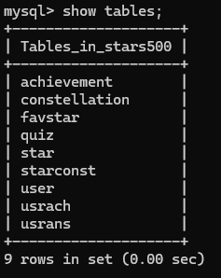
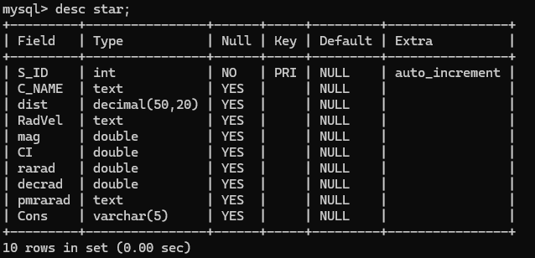

Slide 8
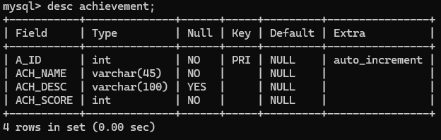
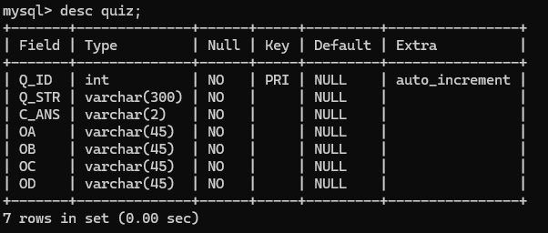

Slide 9
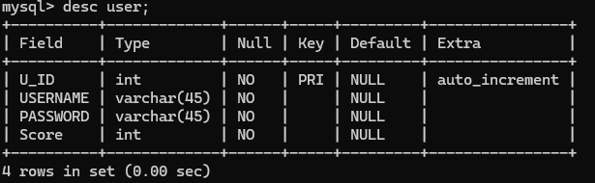
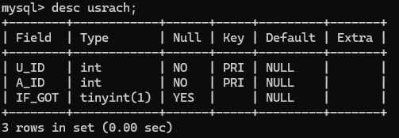
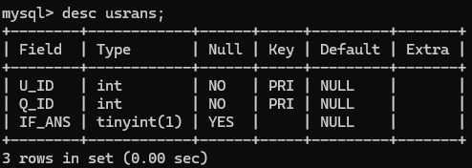

Slide 10
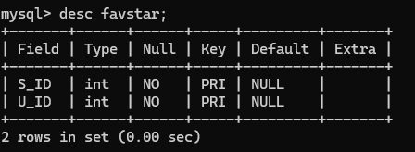
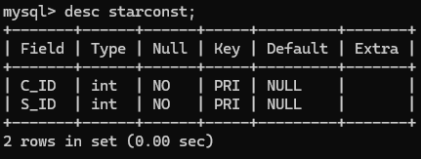

Slide 11
USE OF SQL QUERIES IN STARMAP

Slide 12
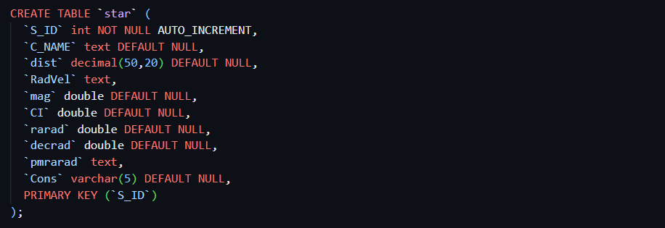
CREATE

Slide 13
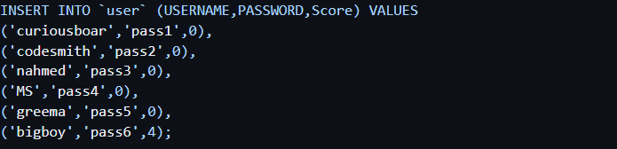
INSERT

Slide 14
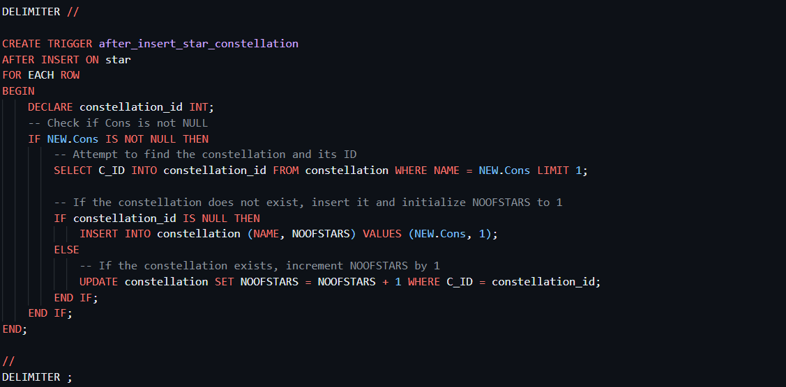
UPDATE

Slide 15
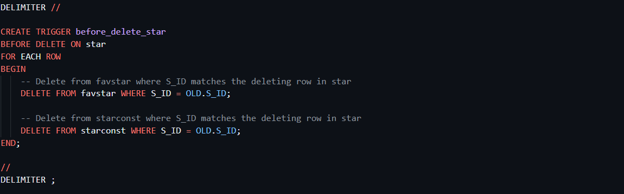
DELETE

Slide 16
COMPLEX QUERIES

Slide 17
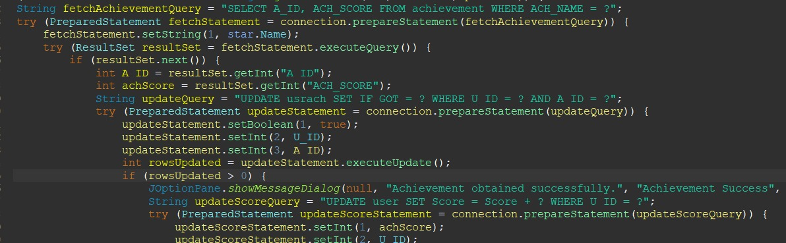
COMPLEX QUERY - 1

Slide 18
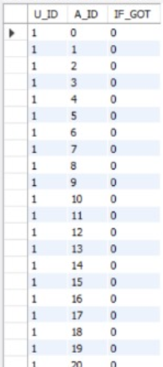
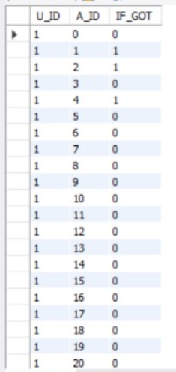
BEFORE & AFTER
Output (after the complex query- when 3 star achievements were made)

Slide 19
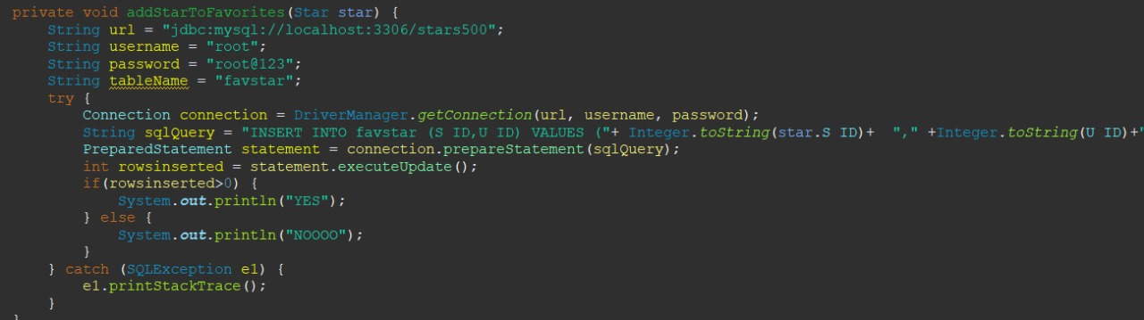
COMPLEX QUERY - 2

Slide 20
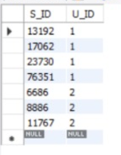
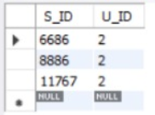
BEFORE & AFTER
Output (after the complex query- when account1 made some favorites)

Slide 21
THANK YOU

