Slide 1

Advance Concepts of Java
Represented By:
Garima Garg(Intern)
Under the Guidance Of:
Rajasekhar Tadepalli

Slide 2
Contents:
Why Java?
OOPS Features
Abstraction
Encapsulation
Inheritance
Polymorphism
Constructors
Types of constructors
Overloading with constructors
super() and this() keywords
Static Keyword
Abstract Classes and Interface
Var-Arguments
Recursive Functions

Slide 3
Why JAVA?
Java is the foundation for virtually every type of application and is the global
standard for developing and delivering:
Embedded and mobile applications
Games
Web-Based Content and Enterprise Software
From laptops to datacenters, game consoles to data scientific supercomputers, cells phones to the Internet to Cloud and Big Data Analytics,
Java is everywhere.
Some basic terms to be known:
JVM(Java Virtual Machine):-Abstract Concept. Provides run time environment for java program.
JRE(Java RunTime Environment):-Exists in Real Life. (JVM+ Software Tools)
JDK(Java Development Kit):-Develop a java program and to run the program.(JVM+ Libraries Tools)

Slide 4

Abstraction
Abstraction is a process of hiding the implementation details and showing only functionality to the user. Another way, it shows only essential things to the user and hides the internal details.
The main advantages of Abstraction are:
We can achieve security as we are not highlighting our internal implementation.(i.e., outside person doesn't aware our internal implementation.)
Enhancement will become very easy because without effecting end user we can able to perform any type of changes in our internal system.
It provides more flexibility to the end user to use system very easily.
It improves maintainability of the application.
It improves modularity of the application.
It improves easiness to use our system.

Slide 5
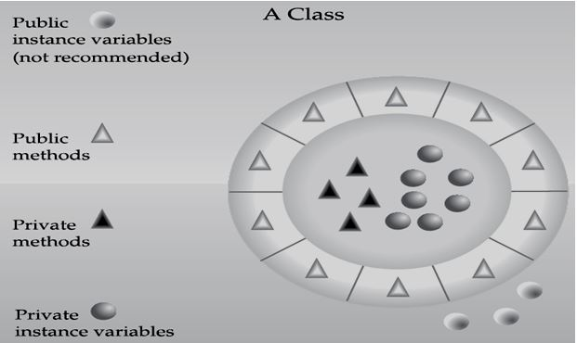
Encapsulation
Encapsulation in Java is a process of wrapping code and data together into a single unit, for example, a capsule which is mixed of several medicines. We can use setter and getter methods to set and get the data in it.
The main advantages of encapsulation are :
We can achieve security.
Enhancement will become very easy.
It improves maintainability and modularity of the application.
It provides flexibility to the user to use system very easily.
The main disadvantage of encapsulation is it increases length of the code and slows down execution
Tightly encapsulated class
A class is said to be tightly encapsulated if and only if every variable of that class declared as private whether the variable has getter and setter methods are not , and whether these methods declared as public or not, these checkings are not required to perform.

Slide 6
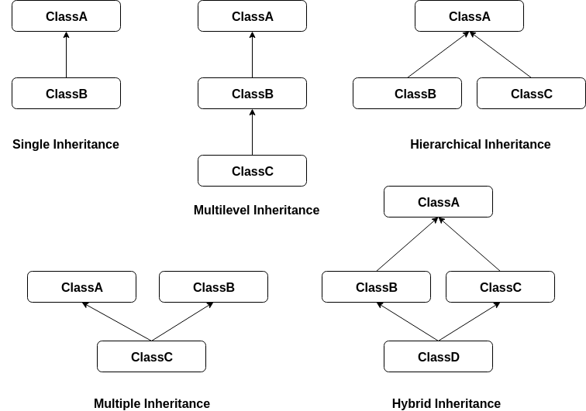
Inheritance
Inheritance in Java is a mechanism in which one object acquires all the properties and behaviors of a parent object. The idea behind inheritance in Java is that you can create new classes that are built upon existing classes.
Note:-
1.Multiple Inheritance can be achieve through interfaces in java.
2.Cyclic Inheritance is not allowed in java.
Inheritance provides reusability

Slide 7
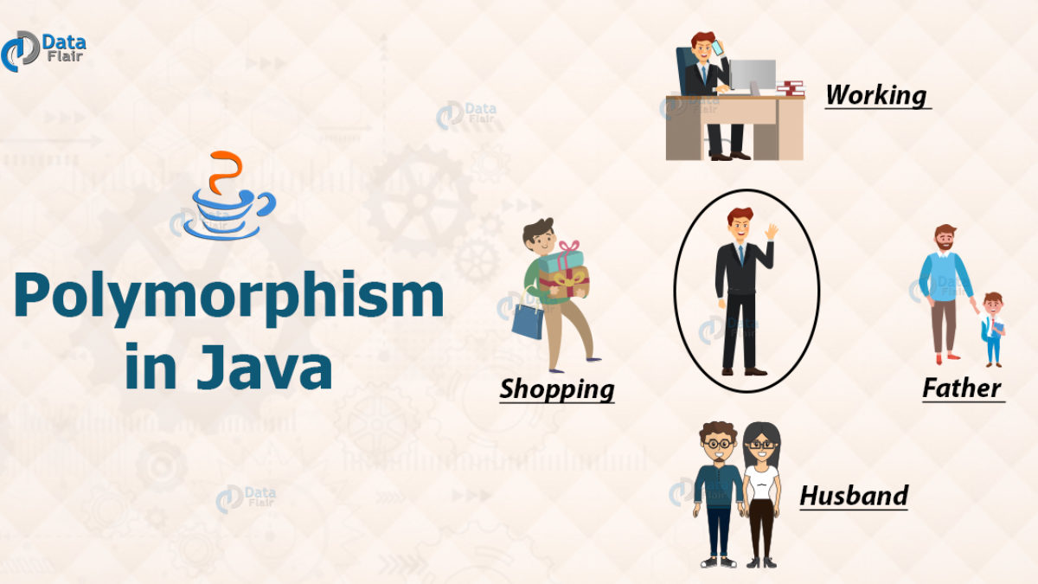
Polymorphism
Polymorphism in Java is a concept by which we can perform a single action in different ways. Polymorphism means many forms.
Compile Time is achieved by Method Overloading.
Run Time is achieved by Method Over-riding

Slide 8
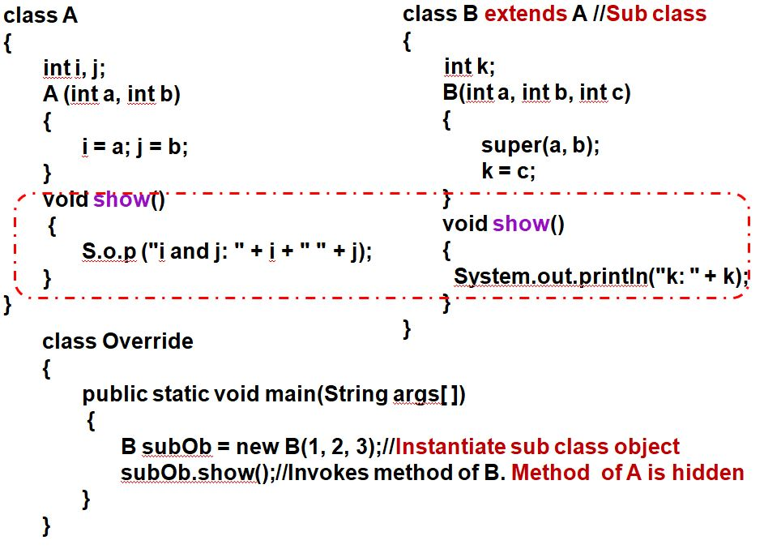
Method Over-riding:-
In any object-oriented programming language, Overriding is a feature that allows a subclass or child class to provide a specific implementation of a method that is already provided by one of its super-classes or parent classes.
When an overridden method is invoked using object of sub-class:
It will always refer to the sub-class method.
Super-class method is hidden
If we want to print the value of i and j then use super keyword in class B void show method.

Slide 9
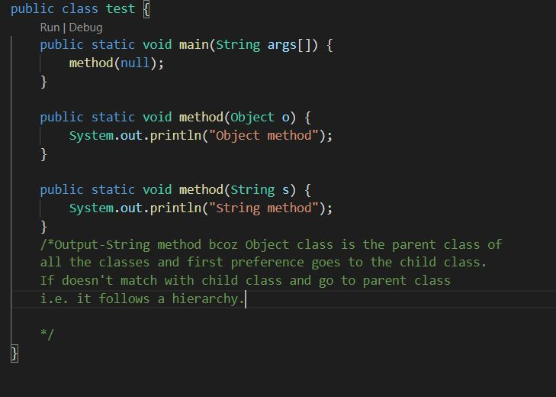
Method Overloading:-
Method Overloading is a feature that allows a class to have more than one method having the same name, if their argument lists are different.
Automatic promotion in overloading:-
In overloading if compiler is unable to find the method with exact match we won't get any compile time error immediately.
First compiler promotes the argument to the next level and checks whether the matched method is available or not if it is available then that method will be considered if it is not available then compiler promotes the argument once again to the next level. This process will be continued until all possible promotions still if the matched method is not available then we will get compile time error. This process is called automatic promotion in overloading.
Note:-First preference is given to child class or method in terms of calling from main method i.e. a proper hierarchy is followed.

Slide 10
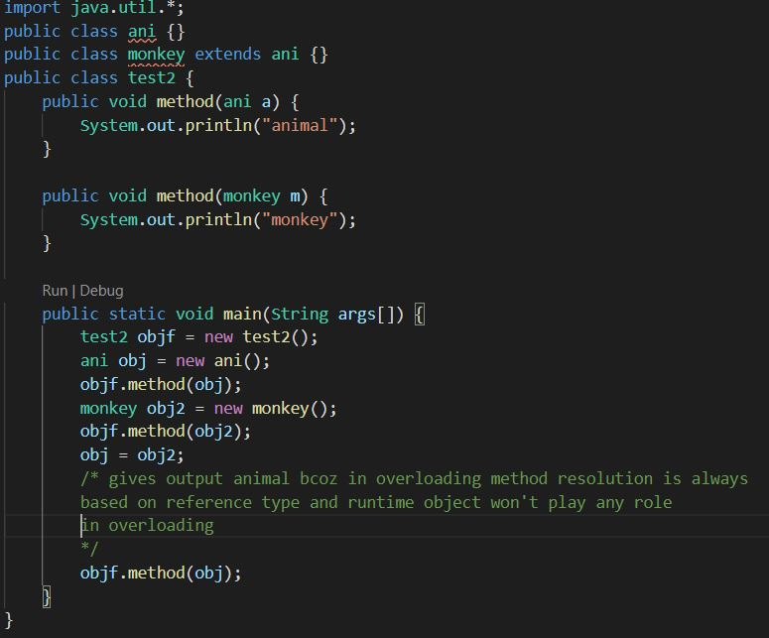
Overloading Example

Slide 11
Constructors:-
When you create a new instance (a new object) of a class using the new keyword, a constructor for that class is called. Constructors are used to initialize the instance variables (fields) of an object.
A constructor in java can not be abstract, final, static and Synchronized.
Types:-
Default constructor:- If we don't define a constructor for a class, a default parameterless constructor is automatically created by the compiler. The default constructor calls the default parent constructor (super()) and initializes all instance variables to default value (zero for numeric types, null for object references, and false for booleans).
Parameterized Constructor:-Constructor that can take value , value is called as Argument
Argument can be of any type i.e. Integer, Character, Array or any Object.
Constructor can take any number of Argument.
Copy Constructor:-A copy constructor in a Java class is a constructor that creates an object using another object of the same Java class. That's helpful when we want to copy a complex object that has several fields, or when we want to make a deep copy of an existing object.

Slide 12
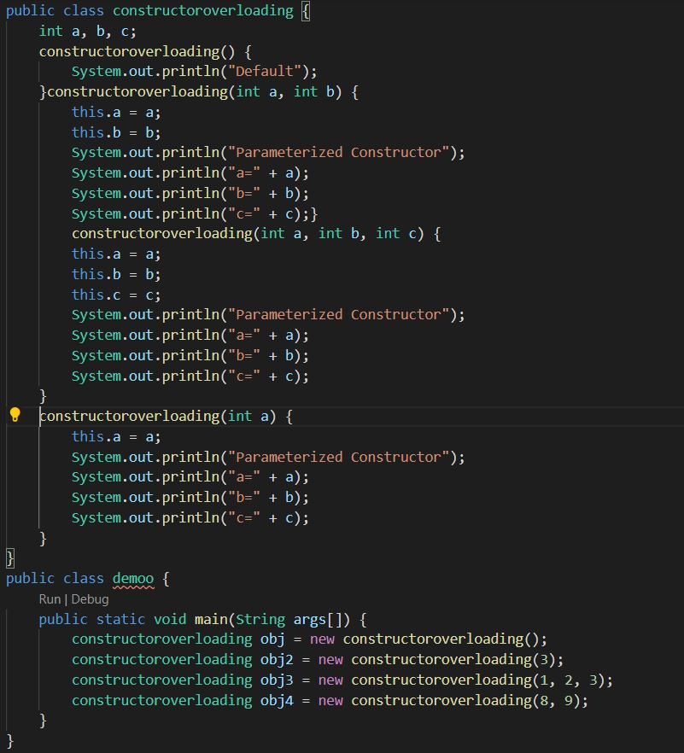
Constructor Overloading:-
Constructor overloading in java allows to have more than one constructor inside one Class. Constructors having the same name with different parameter list is called constructor overloading.
Constructor can be made private, public, protected or default.
Singleton class in Java:- Class whose one instance can be created at any given time in one JVM. It can be achieved only by making constructor as private. It helps to control object creation, limiting the number of objects to only one.
A class can have both private and public constructors but the number of parameters should be different and it is supported because of overloading concept.

Slide 13
super() keyword:-
super is a reserved keyword in java i.e., we can’t use it as an identifier.
super is used to refer super-class’s instance as well as static members.
super is also used to invoke super-class’s method or constructor.
this() keyword:-
this is a reserved keyword in java i.e., we can’t use it as an identifier.
this is used to refer current-class’s instance as well as static members.
this can be used in various contexts as given below:
to refer instance variable of current class
to invoke or initiate current class constructor
can be passed as an argument in the method call
can be passed as argument in the constructor call
can be used to return the current class instance

Slide 14
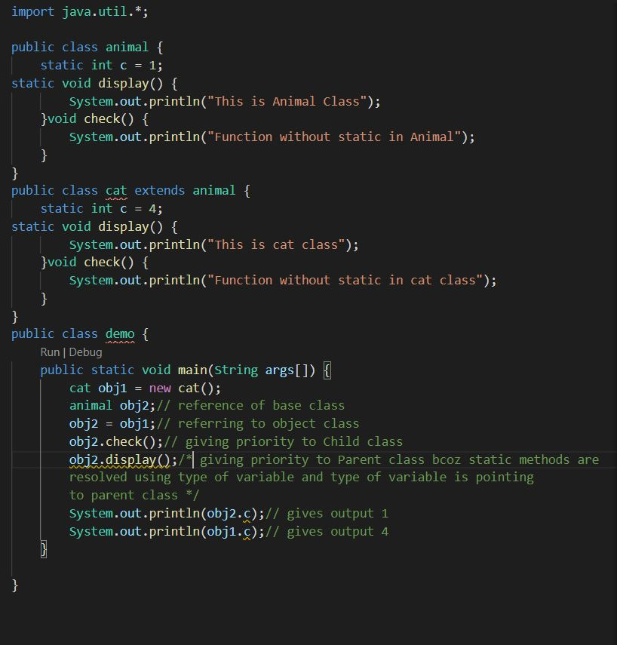
Static Keyword:-
Static members are independent of the objects.
Following members of a class can be static:
1)Variables
2)Methods
3)Initialization block
Other use of static word is for importing the static members of a class
Can we inherit static methods? YES
Can we overload static methods? YES
Can we override static methods in the sub class? YES
How is overriding static method is different from overriding instance/non-static methods?
Static methods are resolved during compile time and Not during runtime.

Slide 15
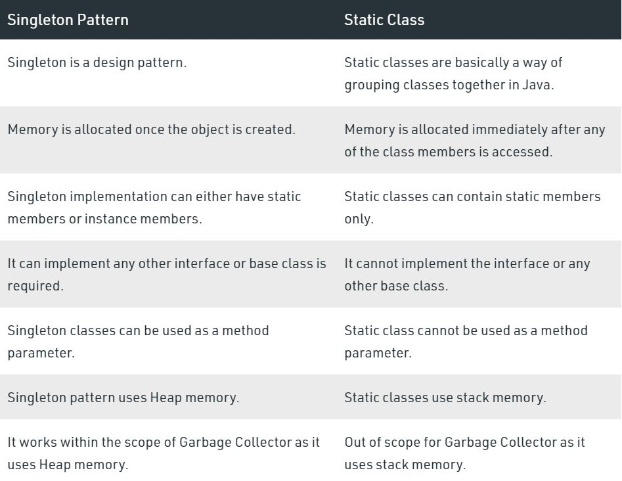
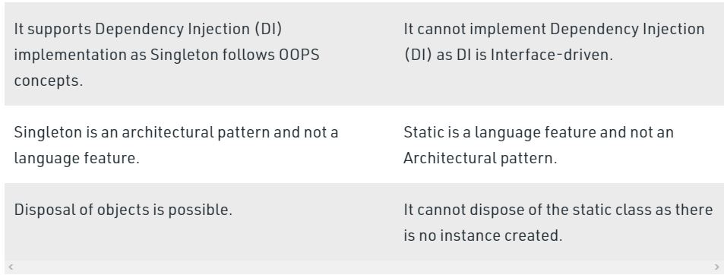

Slide 16
Abstraction
Abstract class
Interface
Variables can be of any type.
Methods can be of any type.
It may or might provides 100% abstraction.
We can have constructors.
Variables can be of public, static and final.
Methods are always public, abstract.
It always provides 100% abstraction.
We cannot have constructors.

Slide 17
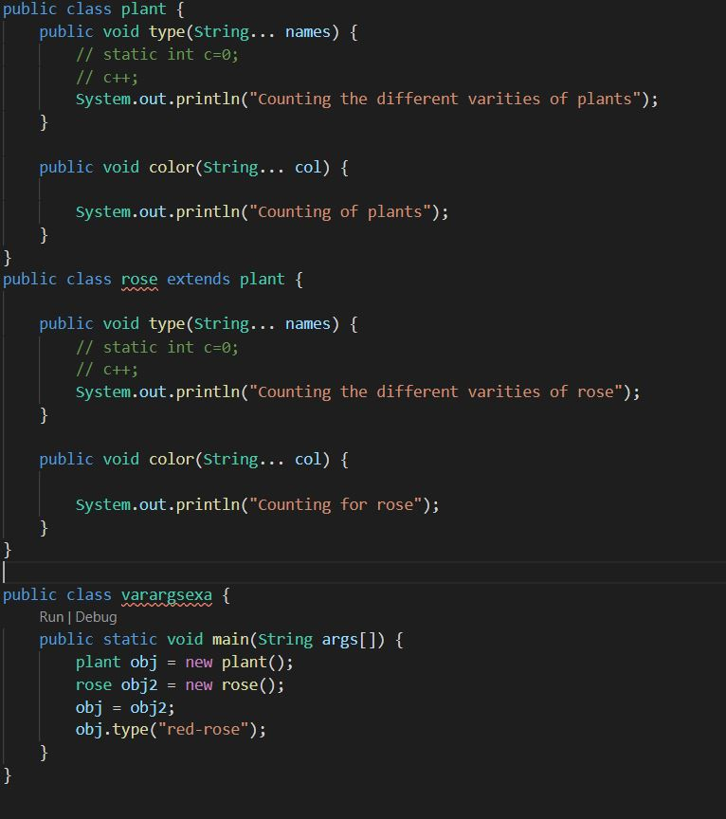
Overriding w.r.t Var-Args
Overriding w.r.t. Var-Args with different arguments of the overridden method is known as Method overloading but not overriding.
We can able to overload methods in two different classes by this concept.
Overriding w.r.t var-args with same var-args of the overridden method is known as overriding.

Slide 18
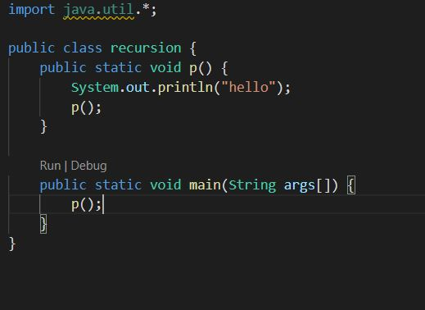
Recursive Functions
Recursion in java is a process in which a method calls itself continuously. A method in java that calls itself is called recursive method.
It makes the code compact but complex to understand.
Run infinite times

