Slide 1
Front End Engineering-I Project
Team Details: Garima(2210990313)
Garima(2210990314)
Garv(2210990315)
Garvit(2210990316)
Faculty Coordinator: Dr. Monika Sethi
:
Chitkara University Institute of Engineering and Technology,
Chitkara University, Punjab

Slide 2
Table of Contents
Introduction
Problem Statement
Technical Details
Key Features
Project Highlights
Conclusion
References/Links used

Slide 3
Introduction
NOTE LOG
The Note log project is a user-friendly website which helps them to keep track of their tasks (just like a To-do list ) .
It is a simple site which requires no sign-in/log-in or any personal details but still records your task, along with time, day and date the note is created, marks the completed tasks, and stores them even if you visit the site after a few days.
This will also help users to remove unwanted tasks , edit and update the list.

Slide 4
Problem Statement
Traditionally , notes are written on a piece of paper, or post-it notes and do act as memory aids. But as technology has evolved with time, we have been able to create notes using online notepads, applications, spreadsheets, word documents and many more. Note logs can be used in personal and professional life both , accessed anytime, anywhere with ease.
But sometimes many note making apps are not well organised and make it difficult to organise notes; sometimes notes are not properly synced which creates frustration among users , and the interface that is used is quite boring for the users.

Slide 5
Solution
Overall, there is a solution to above problem in the form of an online note-taking app that offers effective organisation, with time, day and date of entry of notes and an interesting interface to the user .

Slide 6


Technical Details
The Front-End technologies that are used to implement this project are:
HTML- The Hypertext Markup Language or HTML is standard markup language for documents designed to be displayed in a web browser
CSS- CSS or cascading style sheets is used for styling and formatting HTML documents. It is used to define styles for HTML elements such as fonts, colors, spacing and layout.

Slide 7


3. JAVA SCRIPT- JavaScript is a programming language used to add interactivity and functionality to websites. It is commonly used to create dynamic effects, responsive and interactive web pages
4. VS CODE - Visual Studio Code, is a popular source code editor developed by Microsoft. It is designed to provide a lightweight and versatile coding environment for developers.

Slide 8
Key Features
Including following features has been the utmost priority while designing the project:
1. ORGANISED NOTES: The webpage NOTELOG makes it easy for the
user to organize their notes orderly , with date, day and time of entries.
2. ACCESSIBILITY: Since notes are online, these can be available
Anywhere , anytime with ease.
3. EFFICIENT: Very few resources are required to store and run the webpage.

Slide 9
Contd…
4. EASY TO USE : The application provides an easy to use , user-
friendly interface which provides addition of notes, notepads, list all
the tasks together, sort completed and incomplete tasks in one-single
click.
5. FREE TO USE : The notelog application is completely free to use and
Can be used by anyone for any purpose (household / professional/
Business etc. )

Slide 10
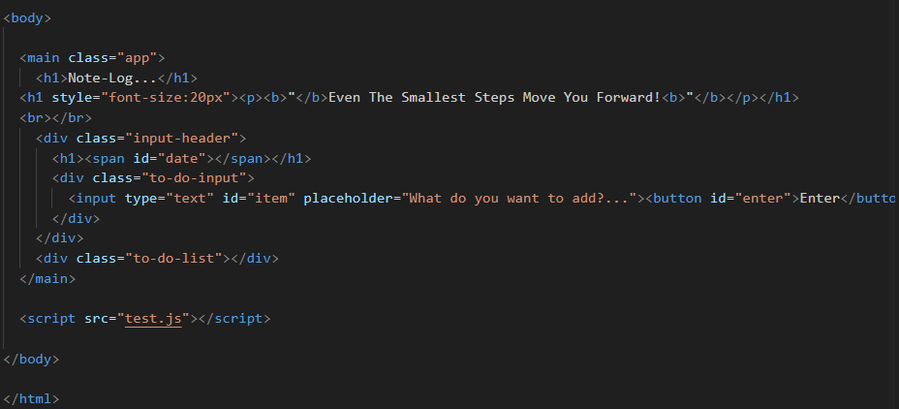
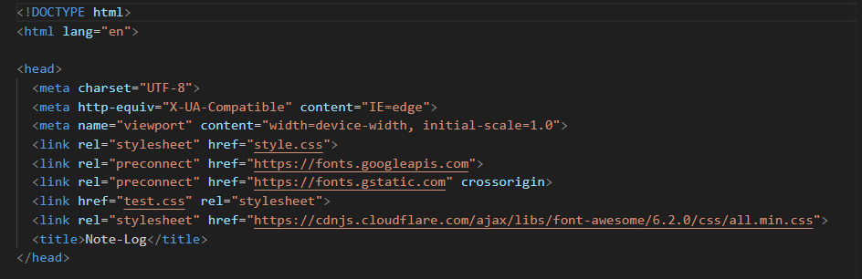
Project Highlights
HTML

Slide 11
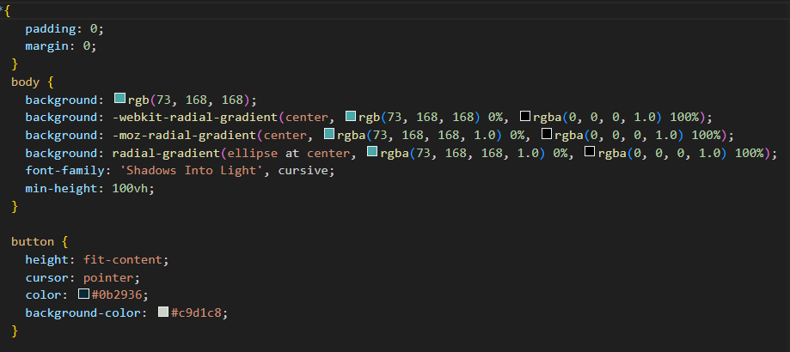
CSS

Slide 12
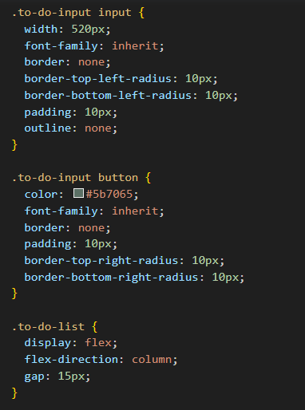
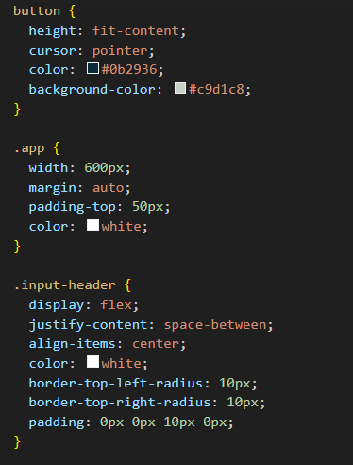

Slide 13
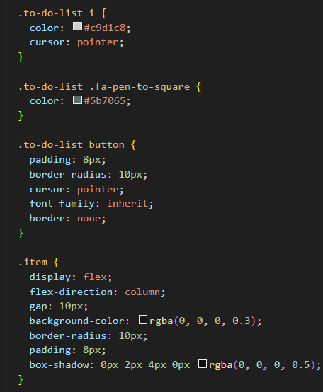
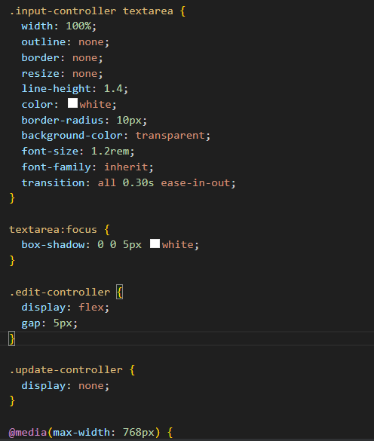
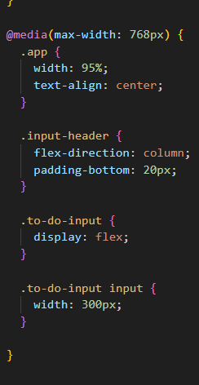

Slide 14
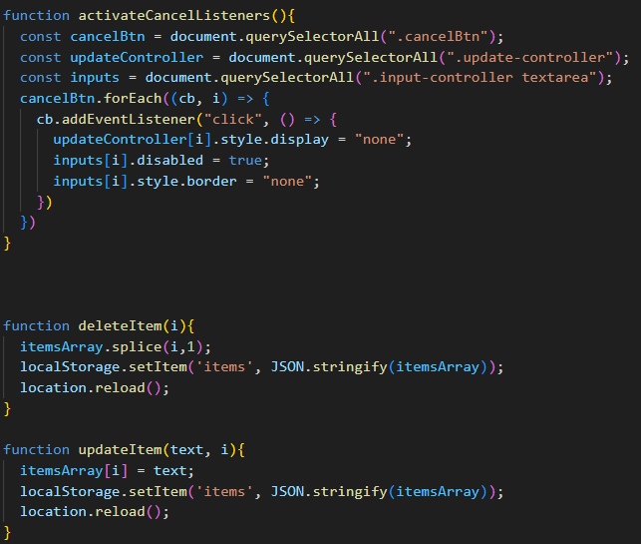
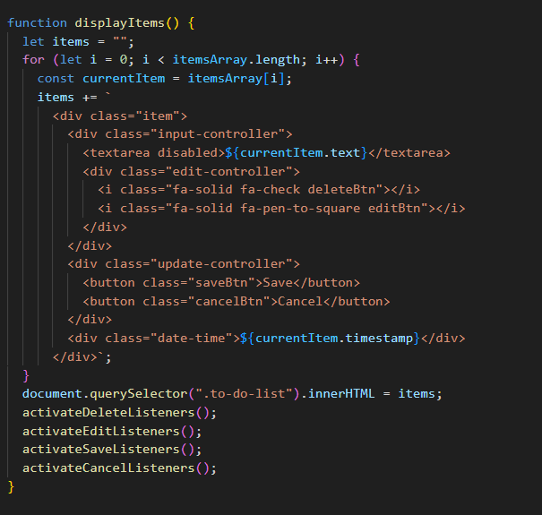
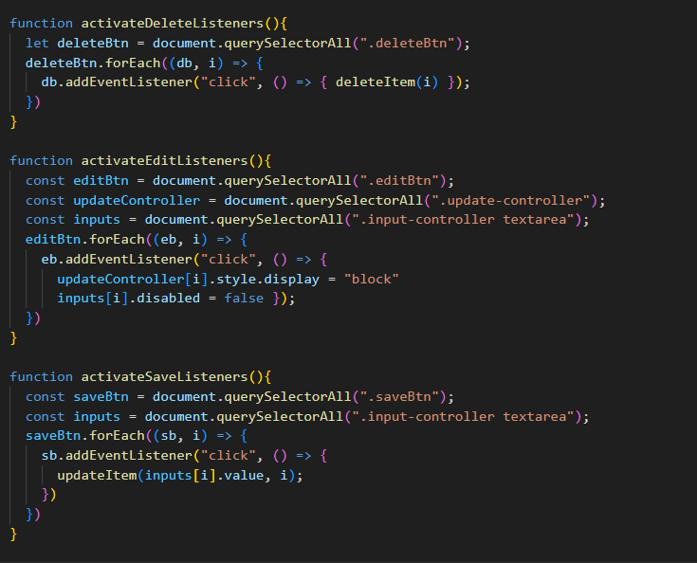
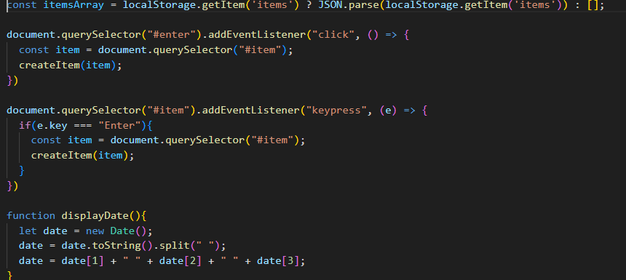
JavaScript

Slide 15
Future Scope
Improvement in security and integrity
Integration with other applications such as calendar, mail, location etc.
Adding features like storage of data, more convenient organization of user data, make the page more customized.
Hosting the web application online to make it accessible to more users.

Slide 16
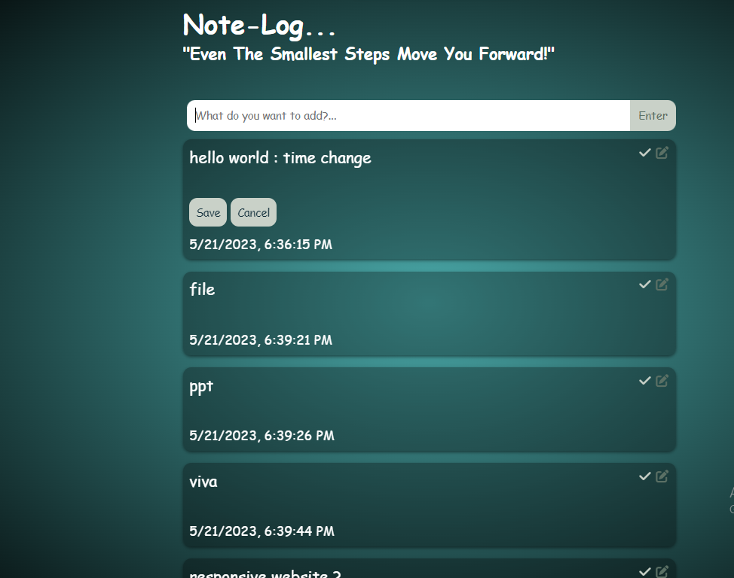
Conclusion
To-do list is an easy to use and handle website which allows users to maintain their day-to day jobs .

Slide 17
References/Links used
https://en.wikipedia.org/wiki/HTML
www.w3 schools.com
https://www.javatpoint.com/css-tutorial
codingnepalweb.com

Slide 18


