Slide 1
Front End Engineering-I Project
Team Details: Garima(2210990313)
Garima(2210990314)
Garv(2210990315)
Garvit(2210990316)
Faculty Coordinator: Dr. Monika Sethi
:
Chitkara University Institute of Engineering and Technology,
Chitkara University, Punjab

Slide 2
Table of Contents
Introduction
Problem Statement
Technical Details
Key Features
Project Highlights
Conclusion
References/Links used

Slide 3
Introduction
NOTE LOG
MADE BY:Garima(2210990313)
Garima(2210990314)
Garv(2210990315)
Garvit(2210990316)
A Note log is a simple prioritized list of the tasks a person must complete. People make a list of everything they need to do, ranked according to priority from the most critical task at the top to the least critical task at the bottom. Note logs are quickly made entries of the tasks or the atomic entities.

Slide 4
Problem Statement
Traditionally , notes are written on a piece of paper, or post-it notes and do act as memory aids. But as technology has evolved with time, we have been able to create notes using online notepads, applications, spreadsheets, word documents and many more. Note logs can be used in personal and professional life both , accessed anytime, anywhere with ease.
But sometimes many note making apps are not well organised and make it difficult to organise notes; sometimes notes are not properly synced which creates frustration among users , and the interface that is used is quite boring for the users.
Overall, there is a solution to above problem in the form of online note-making app that offers effective organisation, with time, day and date of entry of notes and an interesting interface to the user

Slide 5




Technical Details
The Front-End technologies that are used to implement this project are:
HTML
CSS
JAVA SCRIPT
VS CODE

Slide 6
Key Features
ORGANISED NOTES: The webpage NOTELOG makes it easy for the
user to organize their notes orderly , with date, day and time of entries.
ACCESSIBILITY: Since notes are online, these can be available
Anywhere , anytime with ease.
EFFICIENT: Very few resources are required to store and run the webpage.
EASY TO USE : The application provides an easy to use , user-
friendly interface which provides addition of notes, notepads, list all
the tasks together, sort completed and incomplete tasks in one-single
click.
FREE TO USE : The notelog application is completely free to use and
Can be used by anyone for any purpose (household / professional/
Business etc.

Slide 7
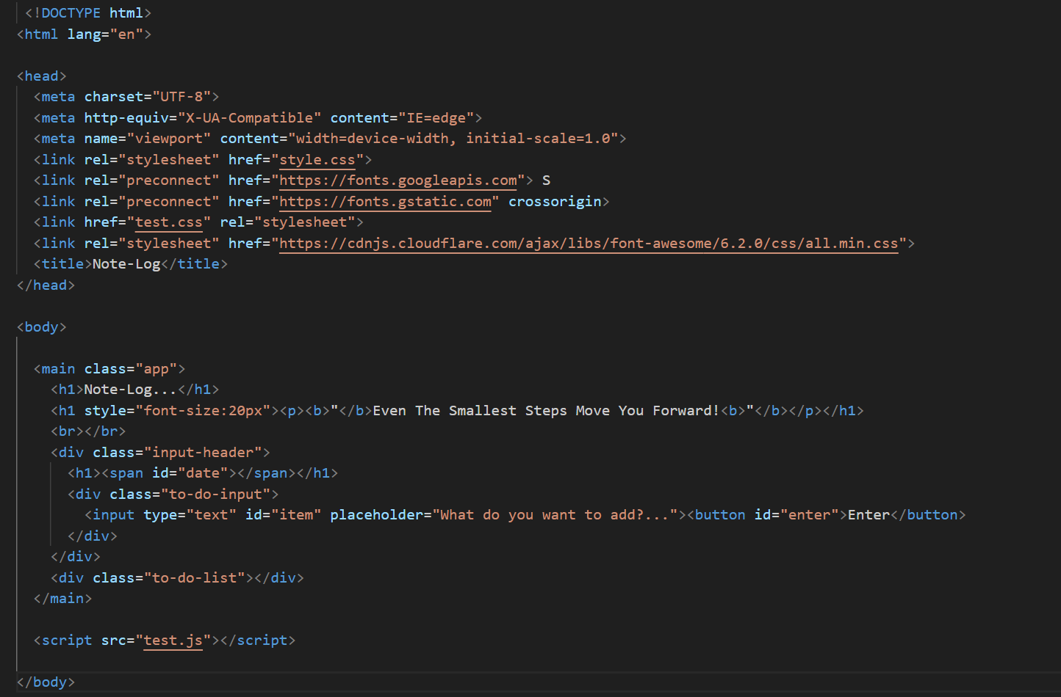
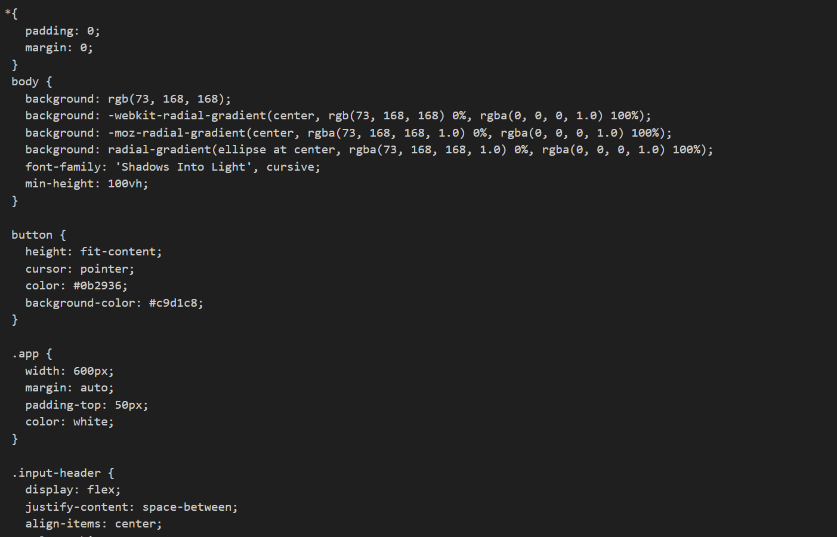
Project Highlights

Slide 8
Conclusion
Improvement in security and integrity
Integration with other applications such as calendar, mail, location etc.
Adding features like storage of data, more convenient organization of user data, make the page more customized.
Hosting the web application online to make it accessible to more users.

Slide 9
References/Links used
https://en.wikipedia.org/wiki/HTML
www.w3 schools.com
https://www.javatpoint.com/css-tutorial
codingnepalweb.com

Slide 10


