Slide 1
Project Presentation of Industry Oriented Hands-on Experience (22CS422)
On
Evaluating the Robustness of Lightweight
Machine Learning Models to Label Noise
Roll No. | Name
Divesh Gupta | 2210990291
Gagan Deep | 2210990310
Garima | 2210900313
Gurnoor Dhaliwal | 2210990344
Supervised By
Dr. Shikha Tuteja
Associate Professor
Department of Computer Science and Engineering
Chitkara University, Punjab

Slide 2
Content
Introduction
Problem Statement - Research Gap
Approach
Dataset / Models
Objective
Baseline
Major Findings - Significance
Key Features
Conclusion

Slide 3

Introduction
The World of Data is Imperfect
Machine learning models are trained on the assumption that data is perfectly labeled
But in reality — this assumption is almost never true
Labels are collected through:
What is Label Noise?
Label Noise refers to incorrect or corrupted class labels present in training data
Unlike feature noise — label noise directly corrupts the target signal
This causes models to:
The problem becomes even more critical in:
🏥 Healthcare — wrong diagnosis predictions
💰 Finance — incorrect risk assessments
📊 Decision Systems — flawed automated decisions
1

Slide 4

Problem Statement - Research Gap
Existing studies on label noise robustness are:
Focused mostly on deep neural networks
Limited to single dataset evaluations
Not covering multiple noise types simultaneously
Missing comparative analysis across diverse classical models
This creates an important and practical research gap:
Which classical ML model remains most robust when training labels are corrupted?
Does robustness depend on the type of noise or the dataset used?
Symmetric Noise
Asymmetric Noise
Class labels are flipped randomly with uniform probability. Represents random corruption across all classes.
Directional or class-dependent corruption. Labels change from one specific class to another, mimicking realistic annotation bias.
2

Slide 5

Approach
We design a controlled robustness evaluation framework that:
Tests 6 classical ML models covering diverse learning paradigms
Injects 2 types of label noise — Symmetric and Asymmetric
Applies 4 noise levels — 0%, 10%, 20%, and 30%
Evaluates on 2 benchmark datasets with contrasting characteristics
Uses 5-fold stratified cross-validation for reliable results
Measures Accuracy, F1-score, relative degradation, and stability
3

Slide 6
Dataset / Models
Dataset | Instances | Features | Characteristics
Breast Cancer Wisconsin | 569 | 30 | Small, clean, numerical, balanced
Adult Income | 48,842 | 14 | Large, mixed features, imbalanced
Two contrasting datasets ensure findings are not dataset-specific
Noise is injected only in training data
Evaluation is always done on clean test data
Model | Category | Why Selected
Logistic Regression | Linear | Simple baseline for comparison
Decision Tree | Tree-based | Known sensitivity to data changes
Random Forest | Ensemble | Aggregation for improved stability
SVM | Margin-based | Strong tabular data performance
KNN | Instance-based | Highly sensitive to noisy labels
LightGBM | Boosting | Powerful modern tabular learner
4

Slide 7
Objective
Primary Objective: To evaluate and compare the robustness of six classical ML models under controlled symmetric and asymmetric label noise
Specific Objectives:
Measure performance degradation at increasing noise levels
Compare the impact of symmetric vs asymmetric noise
Identify the most robust and most sensitive models
Examine whether robustness patterns are consistent across datasets
Determine whether accuracy alone is sufficient to measure robustness
Provide practical guidance for model selection in noisy environments
5

Slide 8
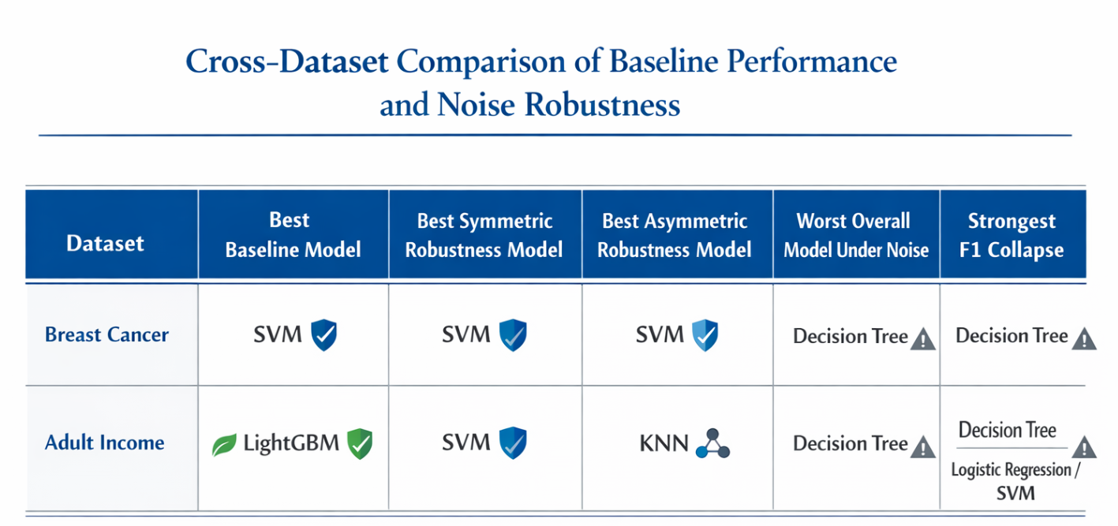
Baseline
6

Slide 9
Major Findings - Significance
SVM is the most robust model under symmetric noise
Only 6.5% drop on Breast Cancer, 1.1% drop on Adult Income at 30% noise
Decision Tree is consistently the least robust model
Relative drops exceeding 24% on both datasets
Symmetric noise is more destructive than asymmetric noise
Higher degradation across all models and both datasets
KNN becomes most robust under asymmetric noise on Adult Income
Only 2.0% relative drop — overtaking SVM in that specific setting
Clean accuracy ≠ Robustness
LightGBM had best baseline but ranked lower than SVM in robustness
F1-score reveals hidden degradation better than accuracy
Especially on imbalanced datasets like Adult Income
This study bridges the gap between theoretical robustness analysis and practical model selection in real-world noisy environments.
7

Slide 10

Key Features
Controlled Experimental Setup
Noise injected only in training labels
Test data kept completely clean throughout
Comprehensive Evaluation Metrics
Accuracy, F1-score, Relative Degradation, Fold-wise Variance
5-Fold Stratified Cross Validation
Ensures reliable and stable performance measurement
Robustness Ranking Analysis
Models ranked by degradation behavior, not just clean accuracy
8

Slide 11
Conclusion
Label noise affects all models but degradation varies significantly across model types, datasets, and noise types
SVM demonstrated the strongest and most consistent robustness under symmetric noise across both datasets
Decision Tree was the most vulnerable model in nearly all experimental settings
Robustness is not universal — it depends on the interaction between model design, data characteristics, and noise type
F1-score is essential — accuracy alone is insufficient to capture the true impact of label noise
Cross-dataset evaluation is necessary — conclusions drawn from a single dataset may not generalize
9

Slide 12
Thank You
12

