Slide 1
ElectroVerse- An ecommerce platform.
Developed by-
Garima (2210990313)
Garima (2210990314)
Gaurav Luthra (2210990317)
Gaurav Kumain (2210990319)
Under the supervision of:
Gautam Mukherjee
CSE Department
Chitkara University, Punjab

Slide 2
Table of Content
Introduction
Problem Statement
Tools & technologies
Frontend Architecture
Backend overview
Features
Future Scope / Improvements
Thank You

Slide 3
Introduction
Ecommerce website allows people to buy and sell physical goods, services, and digital products over the internet rather than at a brick-and-mortar location. Through an e-commerce website, a business can process orders, accept payments, manage shipping and logistics, and provide customer service.
E-commerce has continued to grow in popularity and importance, particularly in light of the COVID-19 pandemic, which has led to a surge in online shopping as people seek to minimize in-person interactions.
All freelancers, as well as small and large businesses, have benefited from e-commerce which enables them to sell their goods and services at a scale that was not possible with traditional offline retail.

Slide 4
Problem Statement
Many ecommerce websites lack a seamless and user-friendly experience for customers.
Issues such as slow loading times, complicated navigation, and limited product information contribute to customer frustration.
Our goal is to design and implement an ecommerce website that prioritizes user experience and accessibility.
By addressing these challenges, we aim to enhance customer satisfaction and drive increased sales.

Slide 5
Tools & Technologies
Backend – Node.js & Express.js
Node.js: JavaScript runtime built on Chrome’s V8 engine, used for server-side development.
Express.js: Lightweight web framework for Node.js that simplifies API creation and routing.
Handles user authentication, product management, and order processing.
Frontend – React.js
A modern JavaScript library for building fast and dynamic user interfaces.
Component-based architecture for reusability and scalability.
Database – MySQL
A reliable, structured relational database system.

Slide 6
Tools & Technologies
Version Control System (e.g., Git): Version control systems are software tools that help track changes to files and manage collaborative development projects.
Role: Used for managing the project's source code, tracking changes, and enabling collaboration among team members.

Slide 7
Frontend Architecture
Navbar – Always visible; provides navigation across the app.
Home – Landing page with featured sections/products.
ProductList – Displays all available products to users.
ProductDetails – Shows selected product details using dynamic routing.
Login & Register – Handles user authentication.
AdminDashboard – Admin panel for managing products and orders.
Profile – Displays user-specific data and actions.
AddProduct – Admin page for adding new products.

Slide 8
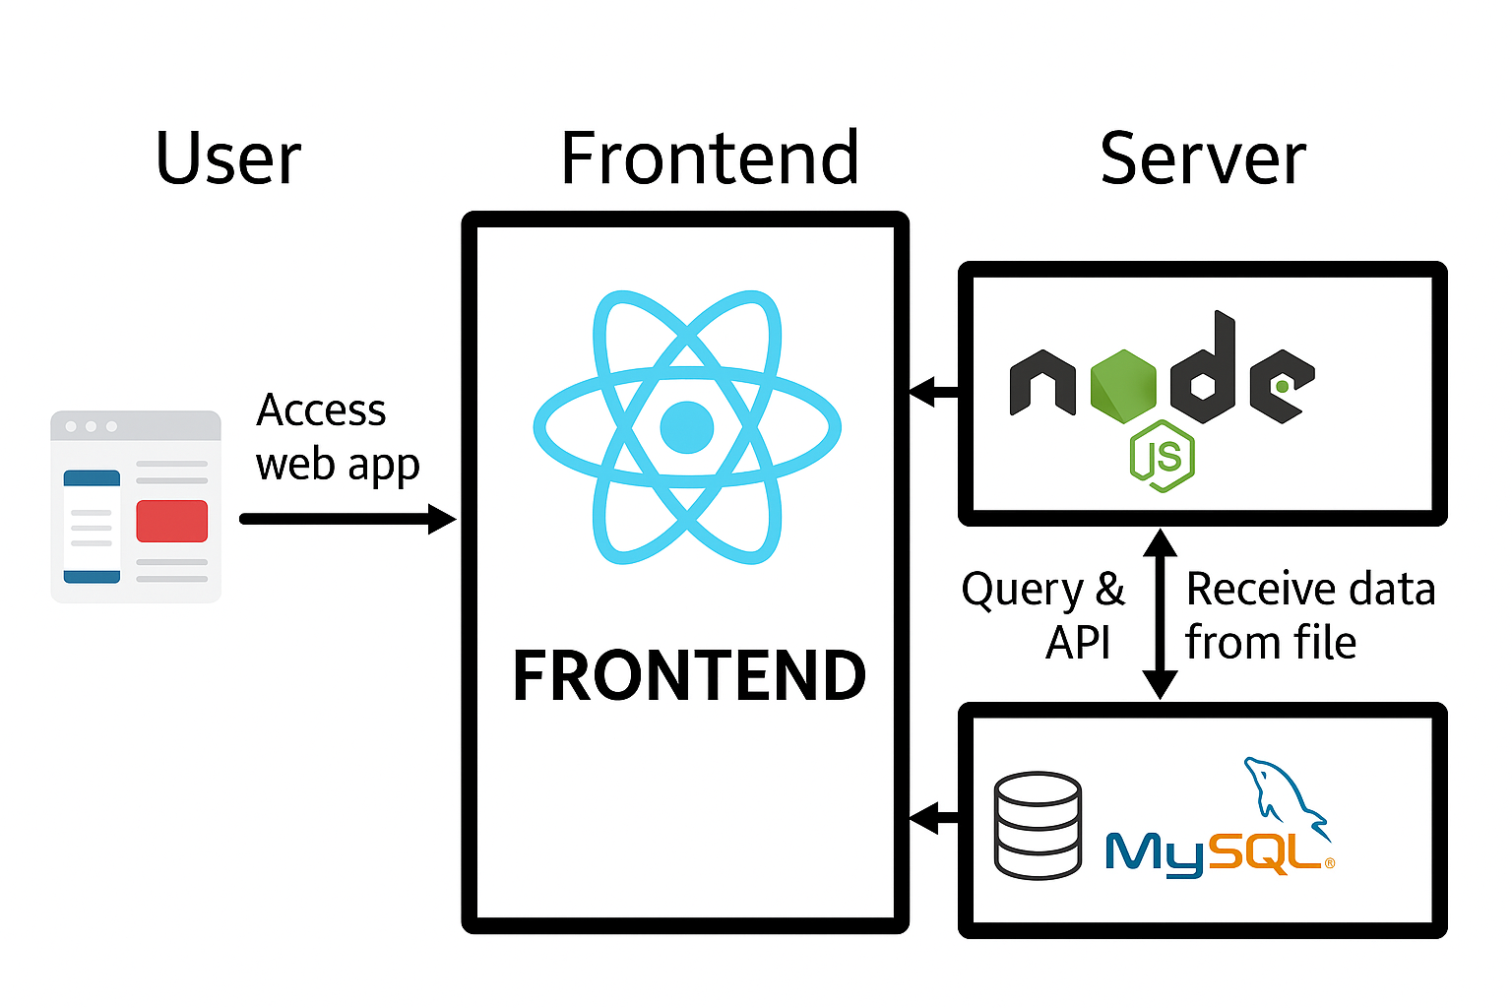
Backend Overview

Slide 9
Features
User Registration & Login – Users can sign up, log in, and access their profiles securely.
Product Browsing – View a list of products with detailed information, including images, prices, and descriptions.
Admin Dashboard – Centralized panel for managing users, orders, and products.
Add, Edit & Delete Products – Admins can add new products, edit product details, and delete products from the catalog.
Admin Authorization – Admin-only routes for managing products and users.

Slide 10
Future scope/Improvements
Advanced Search Filters – Add filtering options such as category, price range, ratings, and brand for better product discovery.
Product Recommendations – Implement AI-based recommendations
Wishlist Feature – Allow users to save products to a wishlist for future purchases.
Multiple Payment Gateways – Integrate additional payment options like PayPal, Stripe, and digital wallets for broader reach.
Improved Search Engine Optimization (SEO)

Slide 11
ThankYou

