Slide 1
Ecommerce Website
Presented by-
Diya Gupta (2210990303)
Garima (2210990313)
Garima (2210990314)
Under the supervision of
Vikas Patel
Parul Gahelot
CSE Department
Chitkara University, Punjab

Slide 2
Table of Content
Introduction
Problem Statement
Motivation of research
Tools & technologies
Code Snapshots
Future Scope
Conclusion
References

Slide 3
Introduction
Ecommerce website allows people to buy and sell physical goods, services, and digital products over the internet rather than at a brick-and-mortar location. Through an e-commerce website, a business can process orders, accept payments, manage shipping and logistics, and provide customer service.
E-commerce has continued to grow in popularity and importance, particularly in light of the COVID-19 pandemic, which has led to a surge in online shopping as people seek to minimize in-person interactions.
All freelancers, as well as small and large businesses, have benefited from e-commerce which enables them to sell their goods and services at a scale that was not possible with traditional offline retail.

Slide 4
Problem Statement
Many ecommerce websites lack a seamless and user-friendly experience for customers.
Issues such as slow loading times, complicated navigation, and limited product information contribute to customer frustration.
The current landscape hinders customer satisfaction and results in high bounce rates.
Our goal is to design and implement an ecommerce website that prioritizes user experience and accessibility.
By addressing these challenges, we aim to enhance customer satisfaction and drive increased sales.

Slide 5
Motivation of Research
Understanding Customers: We want to learn what customers like and want when they shop online .So we aim to create a website better which prioritize users needs and necessities.
Keeping Up with Trends: By looking at what's popular in online shopping right now, we can make sure our website stays up-to-date and competitive.
Making Shopping Easier: Research helps us figure out what parts of our website might be confusing or frustrating for customers, so we can fix them and make shopping easier.
Choosing the Right Products: We want to pick the products that people are most interested in buying, so we do research to find out what those are.
Growing Our Business: Ultimately, by doing research and making improvements based on what we learn, we hope to attract more sellers, sell more products, and make our ecommerce business successful.

Slide 6
Tools & Technologies
REACT JS: React is a JavaScript library for building user interfaces, enabling developers to create reusable UI components and efficiently manage application state.
Role: React simplifies and accelerates the creation of dynamic user interfaces for web applications through its component-based architecture, virtual DOM rendering, and state management capabilities, enhancing both developer productivity and user experience.
CSS (Cascading Style Sheets): CSS is a style sheet language used for describing the presentation of a document written in HTML.
Role: Used for styling the visual aspects of the e-commerce websites, including layout, colours, fonts and animation.
JavaScript: JavaScript is a programming language that enables interactive web pages and web applications.
Role: Used for implementing dynamic and interactive features on the e-commerce website, such as fetching data from APIs, handling user interactions, and creating responsive designs.

Slide 7
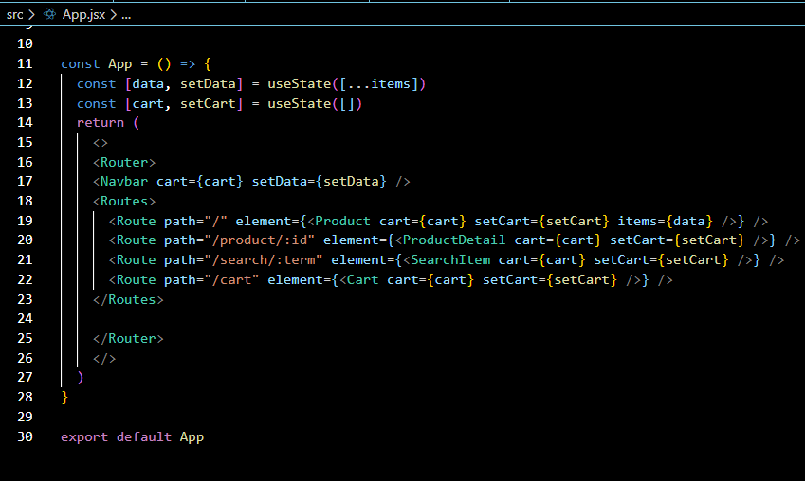
Code Snapshots
This code sets up routes for displaying products, product details, searching for items and managing a shopping cart

Slide 8
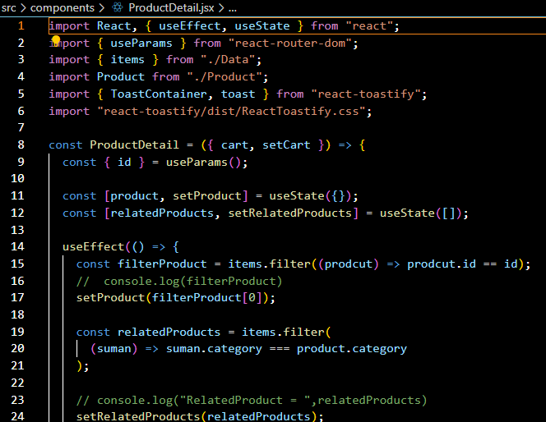
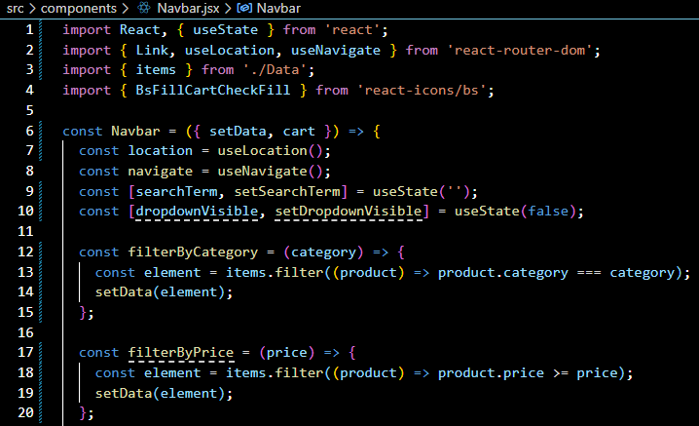
Product Detail:
Navigation bar:

Slide 9
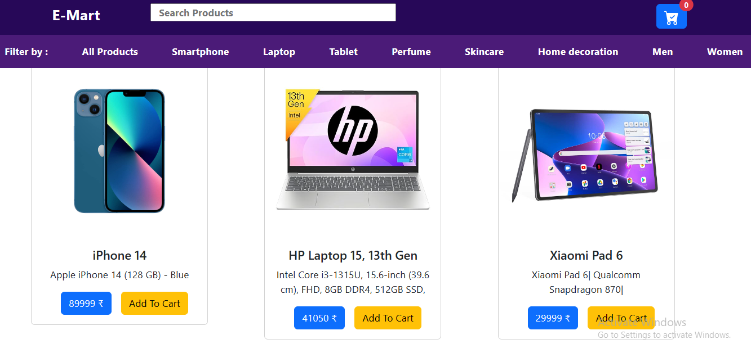
Future Goals and Objectives:
Modification for better GUI
Easy sign-up for users with enhanced protection
Adding a payment gateway
Diversification of product range
Enhanced personalisation and Product recommendation system.

Slide 10
Conclusion/Theme Plan
Key Points:
Throughout this presentation, we've discussed project overview, outlining our objectives and vision for creating a user-friendly, efficient and appealing online shopping platform.
We delved into the technologies and tools used, including HTML, CSS, and JavaScript, to design and develop the website's frontend interface.
We explored the backend functionality powered by JavaScript to enable dynamic interactions and seamless user experiences.

Slide 11
References
https://www.w3schools.com
https://www.youtube.com/watch?si=xG7uMJe-UwDO640H&v=ubw2hdQIl4E&feature=youtu.be
https://amazon.com

Slide 12
Questions???
Any
Questions??

