Slide 1

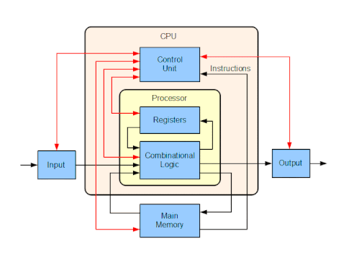
Computer System Architecture
In computer engineering, computer architecture is a set of rules and methods that describe the functionality, organization, and implementation of computer systems. Some definitions of architecture define it as describing the capabilities and programming model of a computer but not a particular implementation. In other definitions computer architecture involves instruction set architecture design, microarchitecture design, logic design, and implementation.

Slide 2
Computer System Architecture
Computer is an electronic machine that makes performing any task very easy. In computer, the CPU executes each instruction provided to it, in a series of steps, this series of steps is called Machine Cycle, and is repeated for each instruction. One machine cycle involves fetching of instruction, decoding the instruction, transferring the data, executing the instruction.
Computer system has five basic units that help the computer to perform operations, which are given below:
Input Unit
Output Unit
Storage Unit
Arithmetic Logic Unit
Control Unit

Slide 3
Computer System Architecture
Input Unit
Input unit connects the external environment with internal computer system. It provides data and instructions to the computer system. Commonly used input devices are keyboard, mouse, magnetic tape etc.
Input unit performs following tasks:
Accept the data and instructions from the outside environment.
Convert it into machine language.
Supply the converted data to computer system.

Slide 4
Computer System Architecture
Output Unit:
It connects the internal system of a computer to the external environment. It provides the results of any computation, or instructions to the outside world. Some output devices are printers, monitor etc.

Slide 5
Computer System Architecture
Storage Unit:
This unit holds the data and instructions. It also stores the intermediate results before these are sent to the output devices. It also stores the data for later use.
The storage unit of a computer system can be divided into two categories:
Primary Storage: This memory is used to store the data which is being currently executed. It is used for temporary storage of data. The data is lost, when the computer is switched off. RAM is used as primary storage memory.
Secondary Storage: The secondary memory is slower and cheaper than primary memory. It is used for permanent storage of data. Commonly used secondary memory devices are hard disk, CD etc.

Slide 6
Computer System Architecture
Arithmetic Logical Unit:
All the calculations are performed in ALU of the computer system. The ALU can perform basic operations such as addition, subtraction, division, multiplication etc. Whenever calculations are required, the control unit transfers the data from storage unit to ALU. When the operations are done, the result is transferred back to the storage unit.

Slide 7
Computer System Architecture
Control Unit:
It controls all other units of the computer. It controls the flow of data and instructions to and from the storage unit to ALU. Thus it is also known as central nervous system of the computer.

Slide 8
Computer System Architecture
Control Unit:
It controls all other units of the computer. It controls the flow of data and instructions to and from the storage unit to ALU. Thus it is also known as central nervous system of the computer.

Slide 9
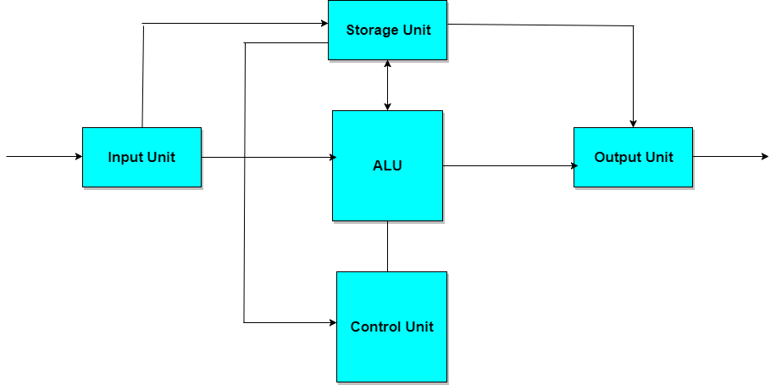
Computer System Architecture
CPU:
It is Central Processing Unit of the computer. The control unit and ALU are together known as CPU. CPU is the brain of computer system. It performs following tasks:
It performs all operations.
It takes all decisions.
It controls all the units of computer.

Slide 10
Register Transfer and Micro Operations
Register is a very fast computer memory, used to store data/instruction in-execution.
A Register is a group of flip-flops with each flip-flop capable of storing one bit of information. An n-bit register has a group of n flip-flops and is capable of storing binary information of n-bits.
A register consists of a group of flip-flops and gates. The flip-flops hold the binary information and gates control when and how new information is transferred into a register. Various types of registers are available commercially. The simplest register is one that consists of only flip-flops with no external gates.
These days registers are also implemented as a register file.

