Slide 1

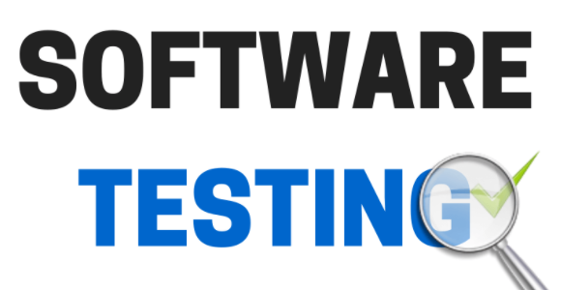
What is Software testing?
Software testing is a process of executing a program or application with the intent of finding the software bugs.

Slide 2
What is Software testing?
Definition of Software testing into the following parts:
1) Process: Testing is a process rather than a single activity.
2) All Life Cycle Activities: Testing is a process that’s take place throughout the Software Development Life Cycle (SDLC).
The process of designing tests early in the life cycle can help to prevent defects from being introduced in the code. Sometimes it’s referred as “verifying the test basis via the test design”.
The test basis includes documents such as the requirements and design specifications.
3) Static Testing: It can test and find defects without executing code. Static Testing is done during verification process. This testing includes reviewing of the documents (including source code) and static analysis. This is useful and cost effective way of testing. For example: reviewing, walkthrough, inspection, etc.
4) Dynamic Testing: In dynamic testing the software code is executed to demonstrate the result of running tests. It’s done during validation process. For example: unit testing, integration testing, system testing, etc.
5) Planning: We need to plan as what we want to do. We control the test activities, we report on testing progress and the status of the software under test.
6) Preparation: We need to choose what testing we will do, by selecting test conditions and designing test cases.

Slide 3
What is Software testing?
Definition of Software testing into the following parts:
7) Evaluation: During evaluation we must check the results and evaluate the software under test and the completion criteria, which helps us to decide whether we have finished testing and whether the software product has passed the tests.
8) Software products and related work products: Along with the testing of code the testing of requirement and design specifications and also the related documents like operation, user and training material is equally important.

Slide 4
Importance of Software Testing in Software Engineering
Software testing is an important part of software development. If software testing is not performed properly, applications can have errors which may lead to rework, costly failure or worse, loss of life.
There are many examples where software bugs have led to loss of life or millions of dollars in losses. Some of them are listed below.
Knights Capital Group lost 440 million dollars in 30 minutes due to an error in their trading algorithm on 1 Aug 2012. The company’s share dropped 75% in two days after the software pushed faulty trades for over 150 different stocks.
Mt. Gox Bitcoin Hack – Mt. Gox which was the largest bitcoin exchange in the world at the time, was hacked in June 2011 and lost approximately 850,000 bitcoins, valued at over half a billion dollars.
The $18 million Mariner 1 Spacecraft was destroyed once it was certain to crash after take off. The failure was traced back to a missing hyphen that let wrong guidance signals to be sent to the rocket.

Slide 5
Growth in Software testing Career Path
Career path in Software testing can be challenging but fulfilling to those who have a keen interest in it.
Testing requires a bit of creativity from the tester in order to find bugs in the software which the developers may have missed.
This requires you to think of ways in which the software can be used, other than the obvious ones that may be listed in the requirements.
Software testers climb higher up the career ladder as they gain experience and expertise, taking up larger responsibilities. Testers can go from junior roles to senior software tester, QA / Test Lead, QA / Test Manager roles and higher.
The roles and responsibilities, expectations at each level is described in detail in our article on the career path in software testing.

