Slide 1
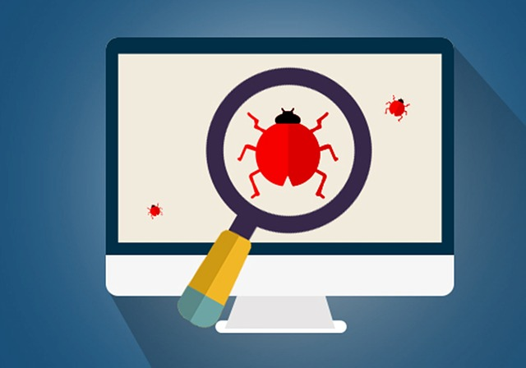
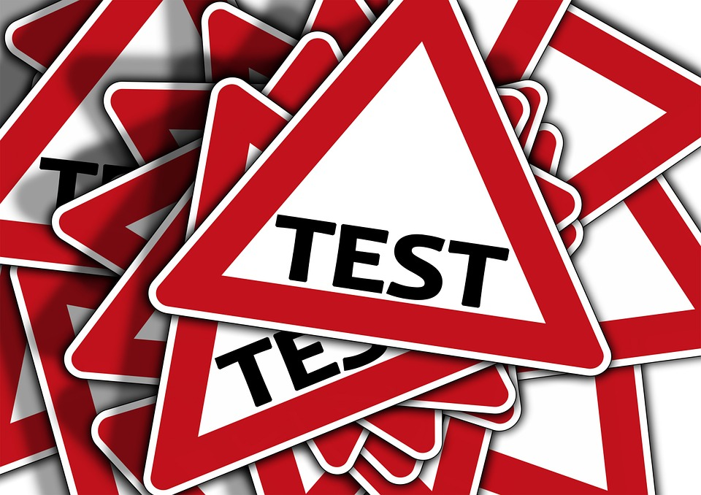
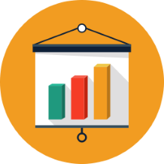
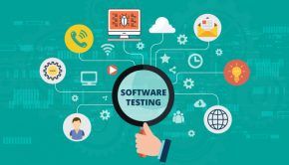

Software Testing

Slide 2
Why is Software testing necessary?
Software testing is necessary because we all make mistakes. Some of those mistakes are unimportant, but some of them are expensive or dangerous. We need to check everything and anything we produce because things can always go wrong – humans make mistakes all the time.
Software testing is very important because of the following reasons:
  Software testing is really required to point out the defects and errors that were made during the development phases.
    Example: Programmers may make a mistake during the implementation of the software. There could be many reasons for this like lack of experience of the programmer, lack of knowledge of the programming language, insufficient experience in the domain, incorrect implementation of the algorithm due to complex logic or simply human error.
  It’s essential since it makes sure that the customer finds the organization reliable and their satisfaction in the application is maintained.
    If the customer does not find the testing organization reliable or is not satisfied with the quality of the deliverable, then they may switch to a competitor organization.
    Sometimes contracts may also include monetary penalties with respect to the timeline and quality of the product. In such cases, if proper software testing may also prevent monetary losses.

Slide 3
Why is Software testing necessary?
  3. It is very important to ensure the Quality of the product. Quality product delivered to the customers helps in gaining their confidence.
    As explained in the previous point, delivering good quality product on time builds the customers confidence in the team and the organization.
  Testing is necessary in order to provide the facilities to the customers like the delivery of high quality product or software application which requires lower maintenance cost and hence results into more accurate, consistent and reliable results.
    High quality product typically has fewer defects and requires lesser maintenance effort, which in turn means reduced costs.
  Testing is required for an effective performance of software application or product.
  It’s important to ensure that the application should not result into any failures because it can be very expensive in the future or in the later stages of the development.
    Proper testing ensures that bugs and issues are detected early in the life cycle of the product or application.
    If defects related to requirements or design are detected late in the life cyle, it can be very expensive to fix them since this might require redesign, re-implementation and retesting of the application.

Slide 4
Why is Software testing necessary?
  It’s required to stay in the business.
    Users are not inclined to use software that has bugs. They may not adopt a software if they are not happy with the stability of the application.
    In case of a product organization or startup which has only one product, poor quality of software may result in lack of adoption of the product and this may result in losses which the business may not recover from.

