Slide 1

Structured Query Language
Er. साहित बराल Feb 20/2021

Slide 2
Structured Query Language
SQL is a database query language used for storing and managing data in Relational DBMS
First Commercial Language
Almost all RDBMS(MySQL, Oracle, Informix, Sybase, MS. Access) use SQL as the standard database query language
SQL is used to perform all types of data operation in RDBMS
SQL also used as database security, backup, user management etc.

Slide 3
Structure Query Language
Database languages provide the tools to implement and manipulate a database. A database language is comprised of Five languages:
DDL – Data Definition Language (CREATE, DROP, ALTER, TRUNCATE, COMMENT, RENAME)
DQL – Data Query Language (SELECT)
DML – Data Manipulation Language (INSERT, UPDATE, DELETE)
DCL – Data Control Language (REVOKE & GRANT)
TCL – Transaction Control Language (COMMIT, ROLL BACK, SAVEPOINT, SET TRANSCATION )

Slide 4
Domain Types in SQL
char(n). Fixed length character string, with user-specified length n.
varchar(n). Variable length character strings, with user-specified maximum length n.
int. Integer (a finite subset of the integers that is machine-dependent).
smallint. Small integer (a machine-dependent subset of the integer domain type).
numeric(p,d). Fixed point number, with user-specified precision of p digits, with n digits to the right of decimal point.
real, double precision. Floating point and double-precision floating point numbers, with machine-dependent precision.
float(n). Floating point number, with user-specified precision of at least n digits.

Slide 5
Data Definition Language
DDL can be used to define the database schema
DDL statements are used to create database, schema, constraints, users, tables etc

Slide 6
Data Definition Language
Examples of DDL commands:
CREATE – is used to create the database or its objects (like table, index, function, views and store procedure)
DROP – is used to delete objects from the database
ALTER – is used to alter the structure of the database
TRUNCATE – is used to remove all records from a table, including all spaces allocated for the records are removed
COMMENT – is used to add comments to the data dictionary
RENAME – is used to rename an object existing in the database

Slide 7
Data Definition Language
Creating Database in MYSQL
Syntax:
CREATE DATABASE <Database Name>;
e.g. CREATE DATABASE College_MIS;
Notes:
SHOW DATABASES;
SHOW TABLES;

Slide 8
Data Definition Language
1. Creating Normal Table
CREATE TABLE statement is used to create a table in SQL
Need to provide all information to SQL about names of column, type of data, size of data etc.
Only define column name and their datatypes (constraint not define)
Notes:
DESC customer1;

Slide 9
Data Definition Language
Syntax:
CREATE TABLE table_name (
column1 datatypes(size),
column2 datatypes(size),
column3 datatypes(size),
………….
………….
column n datatypes(size)
);

Slide 10
Data Definition Language
Let’s create a table of name Employee with data typed {eid, ename, salary, address}
CREATE TABLE Employee (
Eid INT(3),
Ename VARCHAR(20),
Salary INT(10),
Age INT(3),
Address VARCHAR(30)
);
Eid | Ename | Salary | Age | Address

Slide 11
Data Definition Language
2. Constraints
Rules to preserve the data integrity in the application
Rules are imposed on a column of a database
Constraints Types :
NOT NULL
UNIQUE
PRIMARY KEY
CHECK
FOREIGN KEY

Slide 12
Constraints
NOT NULL Constraints
NOT NULL constraints restricts prevent the inclusion of NULL values in a column
Syntax:
[COLUMN NAME] [DATA TYPE][NOT NULL]

Slide 13
Constraints
NOT NULL Constraints
e.g.
CREATE TABLE Student
(
Sid INT(3) NOT NULL,
Sname VARCHAR(10),
Age INT(3)
);

Slide 14
Constraints
UNIQUE Constraint
This constraint enforces barrier on the uniqueness of data
It prevents duplication of the column data(Interestingly it allows Null (Multiple Null))
Syntax:
[COLUMN NAME] [DATA TYPE] [UNIQUE]

Slide 15
Constraints
UNIQUE Constraint
e.g.
CREATE TABLE Student
(
Sid INT(3) UNIQUE,
Sname VARCHAR(10),
Age INT
);

Slide 16
Constraints
Primary key Constraint
It strictly allows only unique and definite values in the column
Syntax:
[COLUMN NAME] [DATA TYPE] [PRIMARY KEY]

Slide 17
Constraints
Primary key Constraint
e.g.
CREATE TABLE Student
(
Sid INT(2) PRIMARY KEY,
Sname VARCHAR(10),
Age INT(3)
);

Slide 18
Constraints
Check Constraint
Check constraints is added to the declaration of the attribute
Syntax:
CREATE TABLE table_name (
column1 datatypes(size),
column2 datatypes(size),
……………………………
CHECK(column_name condition) [DISABLE]
); Note : Disable is optional

Slide 19
Constraints
Check Constraint
e.g.
CREATE TABLE Student
(
Sid INT(3) PRIMARY KEY,
Sname VARCHAR(10),
Age INT(3) CHECK(age>=20 AND age<=55)
);

Slide 20
Constraints
Foreign Key Constraints
It is a way to enforce referential integrity within your database
Syntax:
CREATE TABLE table_name (
column1 datatypes(size),
column2 datatypes(size),
……………………………
FOREIGN KEY(column1, column2,.. Column_n) REFERENCES Parent_table(column1, column2,.. Column_n)
);

Slide 21
Constraints
Foreign Key Constraints
CREATE TABLE Department
(
Dept_id INT(3) PRIMARY KEY,
Dept_name VARCHAR(25) NOT NULL,
Dept_block_no INT(4)
);

Slide 22
Constraints
Foreign Key Constraints
CREATE TABLE Student
(
Sid INT(3) PRIMARY KEY,
Sname VARCHAR(10) NOT NULL,
Dept_id INT(3),
FOREIGN KEY (Dept_id) REFERENCES department(Dept_id),
Age INT(3)
);

Slide 23
Complex Table and Different data types
DATABASE OFFICE
Table 1 = Manager (Mid Primary Key, Mname Not null, Address , Salary not null)
Table 2 = Employee (Eid Primary Key, Ename not null, DOB DATE, age, check age(20 to 45), foreign key(Mid))

Slide 24
Alter Table
It specify how to add, modify, drop, delete and rename columns in a table
By adding new column in existing table
By deleting some columns from existing table
By modifying some columns of given table

Slide 25
Alter Table
Add Column in table
Syntax: ALTER TABLE table_name ADD column_name column_definition; e.g.
ALTER TABLE Student ADD address varchar(25);
ALTER TABLE Student ADD( address varchar(25), sgender varchar(25));

Slide 26
Alter Table
Drop Column in table
Syntax: ALTER TABLE table_name DROP COLUMN column_name; e.g.
ALTER TABLE Student DROP COLUMN address;

Slide 27
Alter Table
Modify Column in table
Syntax: ALTER TABLE table_name MODIFY column_name column_type; e.g.
ALTER TABLE Student MODIFY sname VARCHAR(50) NOT NULL;
ALTER TABLE Student MODIFY (sname VARCHAR(50) NOT NULL, age INT (3));

Slide 28
Alter Table
Rename Column in table
Syntax: ALTER TABLE table_name RENAME COLUMN oldname to new name; e.g.
ALTER TABLE Student RENAME COLUMN sname to Studentname;

Slide 29
DROP DATABASE & TABLE
DROP statement is used to delete table, database, view
Syntax:
DROP TABLE table_name;
DROP DATABASE database_name;

Slide 30
DATA MANIPULATION LANGUAGE
The SQL commands that deals with the manipulation of data present in the database
Examples of DML:
INSERT – is used to insert data into a table
UPDATE – is used to update existing data within a table
DELETE – is used to delete records from a database table

Slide 31
INSERT Statement
Insert statement is used to add single record or multiple records into table
Two ways to inserting values in the table
Insert single or multiple records into table using the VALUES keyword
Inserting Multiple records using a SELECT statement

Slide 32
INSERT Statement
Insert single or multiple records into table using the VALUES keyword
Syntax:
INSERT INTO table_name VALUES (value1,value2….);
INSERT INTO table_name (Column1,Column2…) VALUES (value1,value2….);

Slide 33
INSERT Statement
Inserting Multiple records using a SELECT statement
Syntax:
INSERT INTO table_name (Column1,column2…..)
SELECT expression1,expression2 FROM source_table WHERE condition;
For e.g INSERT INTO Utech_Student (Sid,Sname,Saddress)
SELECT Sid,Sname,Saddress FROM Computer_student;

Slide 34
UPDATE Statement
Used to update the data of an existing table in database
Update methods
Traditional Update table method
Update table by selecting records from another table

Slide 35
UPDATE Statement
Traditional Update table method
Syntax:
Update table_name SET Column1=expression1, Column1=expression1, ……………………….. WHERE conditions;
e.g. UPDATE utech_student SET address = ‘Gaidakot’ WHERE age<25;

Slide 36
UPDATE Statement
Update table by selecting records from another table
Syntax:
UPDATE table1 SET column1 = (SELECT expression1 FROM table2 WHERE conditions)
WHERE conditions;

Slide 37
DELETE Statement
Removes entire row of data from specified table or view
Delete single record or multiple records using condition
Syntax:
DELETE FROM table_name WHERE predicate

Slide 38
TRUNCATE Statement
Remove all records from table
Syntax
TRUNCATE TABLE table_name;

Slide 39
DATA QUERY LANGUAGE(DQL)
DML statements are used for performing queries on the data within schema objects. The purpose of DQL Command is to get some schema relation based on the query passed to it.
Example of DQL:
SELECT – is used to retrieve data from the a database.

Slide 40
SELECT STATEMENT
1. Query data from a single column Syntax:
SELECT column_name FROM table_name {WHERE condition};
2. Query data from multiple column
Syntax:
SELECT column_name1, column_name2 FROM table_name {WHERE condition};
3. Querying data from all column
Syntax:
SELECT * FROM table_name {WHERE condition};

Slide 41
SELECT STATEMENT
SQL SELECT STATEMENT is used to retrieve unique records(by removing duplicates) from specified column in the SELECT statement
Syntax:
SELECT DISTINCT column_name FROM tables
WHERE conditions;

Slide 42
DML
FROM Clause
Mandatory Clause in SELECT expression. It specifies the tables from which data is to retrieve
The WHERE Clause
Optional
Filter rows from the FROM clause

Slide 43
DML
The WHERE Operator
Operator | Description
= | Equal
> | Greater than
< | Less than
>= | Greater than or equal
<= | Less than or equal
<>, != | Not equal. Note: In some versions of SQL this operator may be written as !=
BETWEEN | Between a certain range
LIKE | Search for a pattern
AND|OR|NOT

Slide 44
DML
Ordering the Display of Tuples
SQL ORDER BY clause is used for sorting the result set
Syntax:
SELECT attribute list
FROM List of tables
[WHERE predicate]
ORDER BY column-1[ASE][DESC]

Slide 45
AGGREGATE FUNCTIONS
An aggregate function performs a calculation on a set of values, and returns a single value
AGGREGATE FUNCTIONS
Count()
Sum()
Avg()
Min()
Max()
Except for COUNT(*), aggregate functions ignore null values

Slide 46
AGGREGATE FUNCTIONS
An aggregate function performs a calculation on a set of values, and returns a single value
AGGREGATE FUNCTIONS
Count()
Sum()
Avg()
Min()
Max()
SELECT <FUNCTION NAME> (<PARAMETER>) FROM <TABLE NAME>

Slide 47
AGGREGATE FUNCTIONS
COUNT()
The count function returns the number of rows in the result
It does not count the null values
Types −
COUNT(*): Counts all the number of rows of the table including null
COUNT(COLUMN_NAME): count number of non-null values in column
COUNT(DISTINCT COLUMN_NAME): count number of distinct values in a column
e.g. SELECT COUNT(*) FROM Products WHERE Price > 20;

Slide 48
AGGREGATE FUNCTIONS
SUM()
Return the total sum of column
SELECT SUM(Price) FROM Products;
AVG()
Return the average value of column
SELECT AVG(Price) FROM Products;

Slide 49
AGGREGATE FUNCTIONS
MIN()
Return the lowest value of column
SELECT MIN(Price) FROM Products;
MAX()
Return the highest value of column
SELECT MAX(Price) FROM Products;

Slide 50
Group BY Clause
This method used to arrange identical data into groups with help of some functions
The GROUP BY statement groups rows that have the same values into summary
Syntax:
SELECT column_name
FROM table_name
GROUP BY column_name;

Slide 51
HAVING Clause
HAVING Clause is used with SQL queries to give more precise condition for a statement
It is used to mention condition in GROUP BY based on SQL queries
Syntax
SELECT column_name(s) FROM table_name GROUP BY column_name(s) HAVING condition;

Slide 52
NESTED QUERY IN SQL
A Subquery is a query within another SQL query and embedded within the WHERE clause.
Important Rule:
A subquery can be placed in a number of SQL clauses like WHERE clause, FROM clause, HAVING clause.
You can use Subquery with SELECT, UPDATE, INSERT, DELETE statements along with the operators like =, <, >, >=, <=, IN, BETWEEN, etc.
A subquery is a query within another query. The outer query is known as the main query, and the inner query is known as a subquery.
Subqueries are on the right side of the comparison operator.
A subquery is enclosed in parentheses

Slide 53
NESTED QUERY IN SQL
1. Subqueries with the Select Statement
SQL subqueries are most frequently used with the Select statement.
Syntax
SELECT column_name
FROM table_name
WHERE column_name expression operator
( SELECT column_name from table_name WHERE ... );

Slide 54
NESTED QUERY IN SQL
2. Subqueries with the UPDATE Statement
The subquery of SQL can be used in conjunction with the Update statement. When a subquery is used with the Update statement, then either single or multiple columns in a table can be updated.
Syntax
UPDATE table
SET column_name = new_value
WHERE VALUE OPERATOR
(SELECT COLUMN_NAME
FROM TABLE_NAME
WHERE condition);

Slide 55
NESTED QUERY IN SQL
3. Subqueries with the DELETE Statement
The subquery of SQL can be used in conjunction with the Delete statement just like any other statements mentioned above.
Syntax
DELETE FROM TABLE_NAME
WHERE VALUE OPERATOR
(SELECT COLUMN_NAME
FROM TABLE_NAME
WHERE condition);

Slide 56
SQL JOINS
A SQL Join statement is used to combine data or rows from two or more tables based on a common field between them
It retrieves from data from multiple tables and create a new table
At least one join condition either in the FROM clause or in the WHERE clause for joining two tables

Slide 57
SQL JOINS
Types of Joins
Inner Joins(Simple Join)
Cross Joins(Cartesian Join)
Self Joins
Natural Joins
Outer Joins a) Left Outer Joins b) Right Outer Joins c) Full Outer Joins

Slide 58
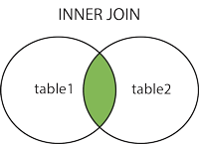
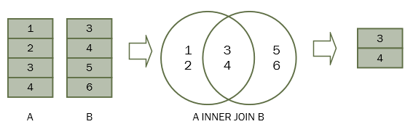
Inner Joins(Simple Join)
The INNER JOIN keyword selects records that have matching values in both tables (intersection)

Slide 59
Inner Joins(Simple Join)
Inner Join by using ON clause
Syntax:
SELECT columns FROM table1 INNER JOIN table2 ON table1.column = table2.column;
Inner Join by using Using clause Syntax:
SELECT columns FROM table1 INNER JOIN table2 USING(common_column_name);

Slide 60
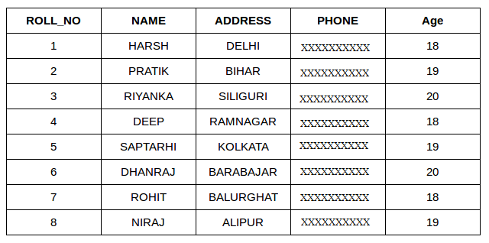
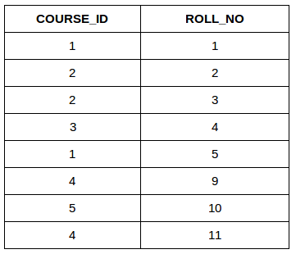

Slide 61
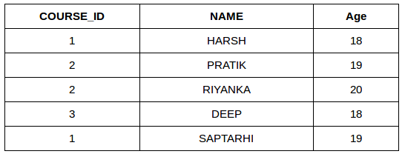
Inner Joins(Simple Join)
SELECT StudentCourse.COURSE_ID, Student.NAME, Student.AGE FROM Student
INNER JOIN StudentCourse
ON Student.ROLL_NO = StudentCourse.ROLL_NO;

Slide 62
CROSS JOINS (Cartesian Products)
It specifies that all rows from first table join with all of the rows of second table
If there are x rows in table-1 and y rows in table-2 then cross join result set have x*y rows
It normally happens when no matching join columns are specified
Syntax:
SELECT column_name_list FROM table_name1 CROSS JOIN table_name2
OR
SELECT table1.column1 , table1.column2, table2.column1...
FROM table1
CROSS JOIN table2;

Slide 63
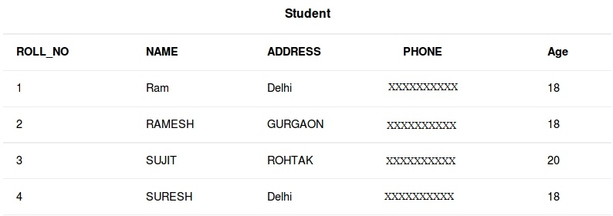
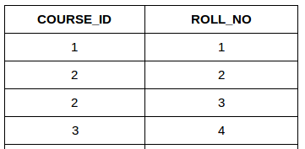
StudentCourse

Slide 64
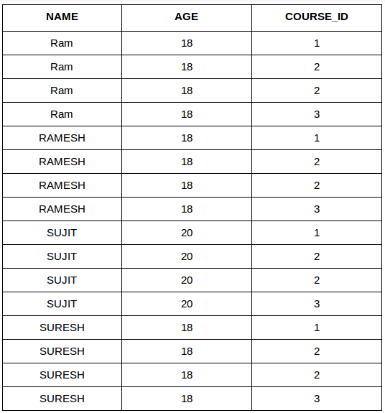
SELECT Student.NAME, Student.AGE, StudentCourse.COURSE_ID
FROM Student
CROSS JOIN StudentCourse;

Slide 65
SELF JOIN
Specific type of join, a table is joined with it self(Unary relationship)
Syntax:
SELECT a.column_name, b.column_name… FROM table1 a, table1 b where a.common_field = b.common_field;

Slide 66
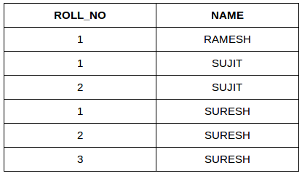
SELF JOIN
SELECT a.ROLL_NO , b.NAME
FROM Student a, Student b
WHERE a.ROLL_NO < b.ROLL_NO;

Slide 67
Department
Staff
Dept_id | Dept_name | Dept_block_no
1 | Computer | 100
2 | Mathematics | 200
3 | Economics | 300
4 | Account | 400
5 | Physics | 500
Staff_id | Staff_name | Dept_id
11 | Mohan | 1
22 | Pratima | 2
33 | Madan | 1
44 | Kamala | 3
55 | Sandhya | 4
66 | Umesh | 3
77 | Ramesh | 1
88 | Santosh | 6

Slide 68
NATURAL JOIN
Natural Join joins two tables based on same attribute name and datatypes.
The resulting table will contain all the attributes of both the table but keep only one copy of each common column.
Syntax:
SELECT a.column_name, b.column_name… FROM table1 a NATURAL JOIN table1 b;

Slide 69
OUTER JOIN
An outer join is similar to equijoin but it gets also the non-matched rows from the table
Category 1) Left Outer Join
2) Right Outer Join
3) Full Outer Join

Slide 70
Department
Staff
Dept_id | Dept_name | Dept_block_no
1 | Computer | 100
2 | Mathematics | 200
3 | Economics | 300
4 | Account | 400
5 | Physics | 500
Staff_id | Staff_name | Dept_id
11 | Mohan | 1
22 | Pratima | 2
33 | Madan | 1
44 | Kamala | 3
55 | Sandhya | 4
66 | Umesh | 3
77 | Ramesh | 1
88 | Santosh | 6

Slide 71
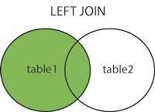
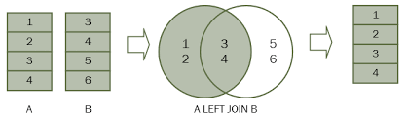
OUTER JOIN
Left Outer Join
The LEFT JOIN keyword returns all records from the left table (table1), and the matched records from the right table (table2).
The result is NULL from the right side, if there is no match

Slide 72
OUTER JOIN
Left Outer Join
Syntax:
SELECT column_name_list
FROM table_name1 LEFT OUTER JOIN table_name2
ON table_name1.column_name = table_name2.column_name;

Slide 73
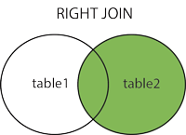
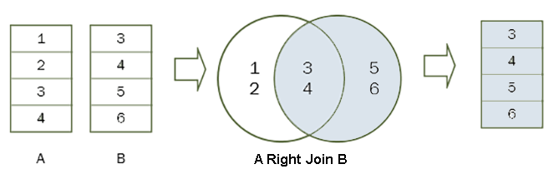
OUTER JOIN
2) Right Outer Join
The RIGHT JOIN keyword returns all records from the right table (table2), and the matched records from the left table (table1).
The result is NULL from the left side, when there is no match.

Slide 74
OUTER JOIN
2) Right Outer Join
Syntax:
SELECT column_name_list
FROM table_name1 RIGHT OUTER JOIN table_name2
ON table_name1.column_name = table_name2.column_name;

Slide 75
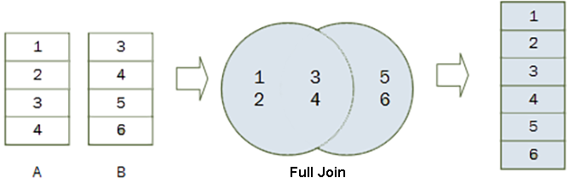
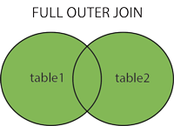
OUTER JOIN
3) Full Outer Join
The FULL OUTER JOIN keyword returns all records when there is a match in left (table1) or right (table2) table records.
Note: FULL OUTER JOIN can potentially return very large result-sets

Slide 76
OUTER JOIN
3) Full Outer Join
Syntax:
SELECT column_name_list
FROM table_name1 FULL OUTER JOIN table_name2
ON table_name1.column_name = table_name2.column_name;

Slide 77
VIEW
A view is a virtual table based on the result-set of an SQL statement
It is a logical representation of another table or combination of tables
All operations performed on a view actually affect the base table of the view
Advantage of VIEW
Database Security: view allows user to access only those sections of database that directly concern them
View provide data independence
Easier Querying
Views provide group of users to access the data acc. to their criteria

Slide 78
CREATE VIEW
CREATE VIEW statement is used to define view in SQL
Syntax:
CREATE VIEW view_name AS
SELECT columns
FROM tables
[WHERE conditions]

Slide 79
ALTER VIEW
A view can be updated with the CREATE OR REPLACE VIEW command
Syntax: CREATE OR REPLACE VIEW view_name AS SELECT columns
FROM table
WHERE conditions;

Slide 80
DROP VIEW
Syntax:
DROP VIEW view_name;

Slide 81
SET OPERATIONS IN SQL
The SQL Set operation is used to combine the two or more SQL SELECT statements
Set operators are used to join the results of two (or more) SELECT statements
Types of Set Operation
Union
UnionAll
Intersect
Minus

Slide 82
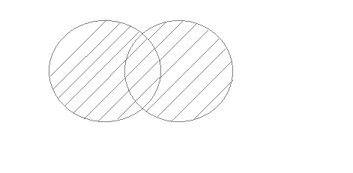
SET OPERATIONS IN SQL
UNION
UNION is used to combine the results of two or more SELECT statements. However it will eliminate duplicate rows from its resultset.
In case of union, number of columns and datatype must be same in both the tables, on which UNION operation is being applied.

Slide 83
SET OPERATIONS IN SQL
UNION
ID | Name
2 | adam
3 | Chester
ID | Name
1 | abhi
2 | adam
ID | NAME
1 | abhi
2 | adam
3 | Chester
SELECT * FROM First
UNION
SELECT * FROM Second;

Slide 84
SET OPERATIONS IN SQL
UNION
Syntax :
SELECT column_name FROM table1
WHERE CONDITIONS
UNION
SELECT column_name FROM table2
WHERE CONDITIONS;

Slide 85
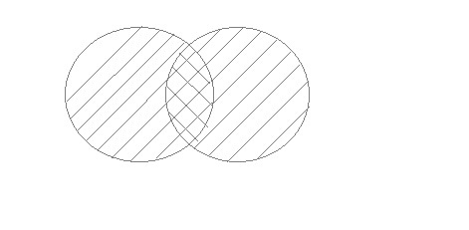
SET OPERATIONS IN SQL
UNION ALL
This operation is similar to Union. But it also shows the duplicate rows.

Slide 86
SET OPERATIONS IN SQL
UNION ALL
ID | Name
2 | adam
3 | Chester
ID | Name
1 | abhi
2 | adam
ID | NAME
1 | abhi
2 | adam
2 | adam
3 | Chester
SELECT * FROM First
UNION ALL
SELECT * FROM Second;

Slide 87
SET OPERATIONS IN SQL
UNION ALL
Syntax :
SELECT column_name FROM table1
WHERE CONDITIONS
UNION ALL
SELECT column_name FROM table2
WHERE CONDITIONS;

Slide 88
SET OPERATIONS IN SQL
INTERSECT
The Intersect operation returns the common rows from both the SELECT statements.
In the Intersect operation, the number of datatype and columns must be the same.
It has no duplicates and it arranges the data in ascending order by default.
Syntax
SELECT column_name FROM table1
INTERSECT
SELECT column_name FROM table2;

Slide 89
SET OPERATIONS IN SQL
Intersect
ID | Name
2 | adam
3 | Chester
ID | Name
1 | abhi
2 | adam
SELECT * FROM First
INTERSECT
SELECT * FROM Second;
ID | NAME
2 | adam

Slide 90
SET OPERATIONS IN SQL
Minus
Minus operator is used to display the rows which are present in the first query but absent in the second query.
It has no duplicates and data arranged in ascending order by default.
Syntax:
SELECT column_name FROM table1
MINUS
SELECT column_name FROM table2;

Slide 91
SET OPERATIONS IN SQL
MINUS
ID | Name
2 | adam
3 | Chester
ID | Name
1 | abhi
2 | adam
SELECT * FROM First
MINUS
SELECT * FROM Second;
ID | NAME
1 | abhi

Slide 92
Where clause
IN operator
The IN operator allows you to specify multiple values in a WHERE clause.
The IN operator is a shorthand for multiple OR conditions.
IN Syntax:
SELECT column_name(s)
FROM table_name
WHERE column_name IN (value1, value2, ...);
or:
SELECT column_name(s)
FROM table_name
WHERE column_name IN (SELECT STATEMENT);

Slide 93
Stu_id | Stu_name | Stu_address | Dept_id
10 | NIsha | Palpa | 1
11 | Anisha | Ktm | 1
12 | Ayushma | Ktm | 3
13 | Garima | Palpa | 2
14 | Kritika | Pokhara | 4
15 | Smriti | Banepa | 1
16 | Bishal | NULL | 3
17 | Paras | chitwan | 2
18 | Bibek | Pokhara | 5
19 | Aviket | Chitwan | 4

Slide 94
SELECT * FROM Stu_address WHERE ADDRESS IN (‘ktm’, ’Pokhara’, ’Banepa’);
Output:
SELECT * FROM Students WHERE ADDRESS NOT IN (‘ktm’, ’Pokhara’, ’Banepa’);
Output:

Slide 95
BETWEEN OPERATOR
The BETWEEN operator selects values within a given range. The values can be numbers, text, or dates.
The BETWEEN operator is inclusive: begin and end values are included.
BETWEEN Syntax
SELECT column_name(s)
FROM table_name
WHERE column_name BETWEEN value1 AND value2;

Slide 96
BETWEEN OPERATOR
SELECT * FROM STUDENTS
WHERE Dept_id BETWEEN 1 AND 2;
OUTPUT:
SELECT * FROM STUDENTS
WHERE Dept_id NOT BETWEEN 2 AND 3;
OUTPUT:

Slide 97
NULL Operator
A field with a NULL value is a field with no value.
If a field in a table is optional, it is possible to insert a new record or update a record without adding a value to this field. Then, the field will be saved with a NULL value.
How to Test for NULL Values?
It is not possible to test for NULL values with comparison operators, such as =, <, or <>.
We will have to use the IS NULL and IS NOT NULL operators instead.
IS NULL Syntax: SELECT column_names FROM table_name WHERE column_name IS NULL; | IS NOT NULL Syntax: SELECT column_names FROM table_name WHERE column_name IS NOT NULL;

Slide 98
BETWEEN OPERATOR
SELECT * FROM STUDENTS
WHERE Stu_address IS NULL;
OUTPUT:
SELECT * FROM STUDENTS
WHERE Stu IS NOT NULL;
OUTPUT:

Slide 99
LIKE OPERATOR
The LIKE operator is used in a WHERE clause to search for a specified pattern in a column.
There are two wildcards often used in conjunction with the LIKE operator:
The percent sign (%) represents zero, one, or multiple characters
The underscore sign (_) represents one, single character
LIKE Syntax:
SELECT column1, column2, ...
FROM table_name
WHERE columnN LIKE pattern;

Slide 100
LIKE OPERATOR
LIKE Operator | Description
WHERE CustomerName LIKE 'a%' | Finds any values that start with "a"
WHERE CustomerName LIKE '%a' | Finds any values that end with "a"
WHERE CustomerName LIKE '%or%' | Finds any values that have "or" in any position
WHERE CustomerName LIKE '_r%' | Finds any values that have "r" in the second position
WHERE CustomerName LIKE 'a_%' | Finds any values that start with "a" and are at least 2 characters in length
WHERE CustomerName LIKE 'a__%' | Finds any values that start with "a" and are at least 3 characters in length
WHERE ContactName LIKE 'a%o' | Finds any values that start with "a" and ends with "o"

Slide 101
LIKE OPERATOR
Example:
SELECT * FROM STUDENTS WHERE Stu_address LIKE ‘P’ AND Dept_id >2;
SELECT * FROM STUDENTS WHERE Stu_address LIKE ‘%a’ AND Stu_name LIKE ‘ % K % ’;
SELECT * FROM STUDENTS WHERE Stu_name LIKE ‘_ _ _ _ _’
SELECT * FROM STUDENTS WHERE Stu_name Like ‘A % a’
SELECT * FROM STUDENTS WHERE Stu_name Like ‘G _ r % a’

Slide 102
Multiple Row Subqueries
Return more than one row
Use multiple-row comparison operator
ANY/SOME and ALL operators are used with WHERE or HAVING.
ANY /SOME and ALL operate on subqueries that return multiple values.
ANY /SOME – Compare value to each value return by subquery.
ALL - Compare value to every value return by subquery
IN – The IN operator allows you to specify multiple values in a WHERE clause.

Slide 103
Data Control Language (DCL)
A Data Control Language is a syntax similar to a computer programming language used to control access to data stored in a database (Authorization).
Examples of DCL c ommands :
GRANT: allow specified users to perform specified tasks.
REVOKE: cancel previously granted or denied permissions.

Slide 104
Transaction Control Language(TCL)
Transaction Control Language commands are used to manage transactions in the database.
These are used to manage the changes made by DML-statements.
It also allows statements to be grouped together into logical transactions.

Slide 105
Transaction Control Language(TCL)
Examples of TCL commands –
COMMIT: - Commit command is used to permanently save any transaction into the database.
ROLLBACK: - This command restores the database to last committed state. It is also used with savepoint command to jump to a savepoint in a transaction.
SAVEPOINT: - Savepoint command is used to temporarily save a transaction so that you can rollback to that point whenever necessary.

Slide 106
Stored Procedure
A stored procedure is a prepared SQL code that you can save, so the code can be reused over and over again.
So if you have an SQL query that you write over and over again, save it as a stored procedure, and then just call it to execute it.
You can also pass parameters to a stored procedure, so that the stored procedure can act based on the parameter value(s) that is passed.
Stored Procedure Syntax:
CREATE PROCEDURE procedure_name
AS
sql_statement
GO;
Execute a Stored Procedure:
EXEC procedure_name;

Slide 107
Stored Procedure
Example
CREATE PROCEDURE SelectStudents
AS
SELECT * FROM Students
GO;
Execute the stored procedure above as follows:
Example
EXEC SelectStudents;

Slide 108
QBE (Query By Example)
Query by example is a query language used in relational databases that allows users to search for information in tables and fields by providing a simple user interface where the user will be able to input an example of the data that he or she wants to access.
The principle of QBE is that it is merely an abstraction between the user and the real query that the database system will receive.
In the background, the user's query is transformed into a database manipulation language form such as SQL, and it is this SQL statement that will be executed in the background.

Slide 109
Student (studentId, firstName, lastname) Exam (examId, name, date) Grade (gradeId, studentId, examId, grade)
Solutions: SELECT student.firstname, exam.name, grade.grade FROM Student INNER JOIN Grade ON grade.studentId = student.studentId INNER JOIN exam ON exam.examId = grade.examId ORDER BY exam.date

Slide 110
Student (Sid, Sname) Course (Cid, Cname) Bridge (Sid,Cid)
Solutions:
SELECT Student.Sname, Course.Cname FROM Student , Bridge , Course WHERE Bridge.Sid= Student.Sid and Bridge.Cid = Course.Cid;
SELECT Student.Sname, Course.Cname FROM Student INNER JOIN Bridge ON Bridge.Sid= Student.Sid INNER JOIN Course ON Course.Cid = Bridge.Cid

