Slide 1
Architecture Implementation in Vivado HLS
Presented By:
Samiksha Agrawal (2018SIY7505)
Garima Modi (2018CSZ8010)

Slide 2
Configurations
Image: 3x256x256 (CxHxW)
Kernel: 20x3x3x3 (MxKxKxC)
Output: 20x256x256 (MxHxW) (padding of size K-1 used)
FPGA: Kintex 7
BRAM: 650
LUT: 101,400
DSP: 600
FF: 202,800
AXI port used

Slide 3
Methodology followed
There are 2 functions in our code:
PREFETCH()
COMPUTE()
Our goal was to parallelize prefetching of an extra image row, while the first output row computation takes place.
In order to parallelize both the operations, we coded them as individual functions.
However, Vivado was still scheduling them sequentially. Post analysis, we found that there was a data dependency of the variable “local_image” as prefetch() was writing onto local_image and compute() was reading from “local_image”.
Although they were writing to, and reading from different rows of input image, still Vivado was unable to resolve the dependency.
Use of pragma #HLS dependence variable local_image intra false

Slide 4
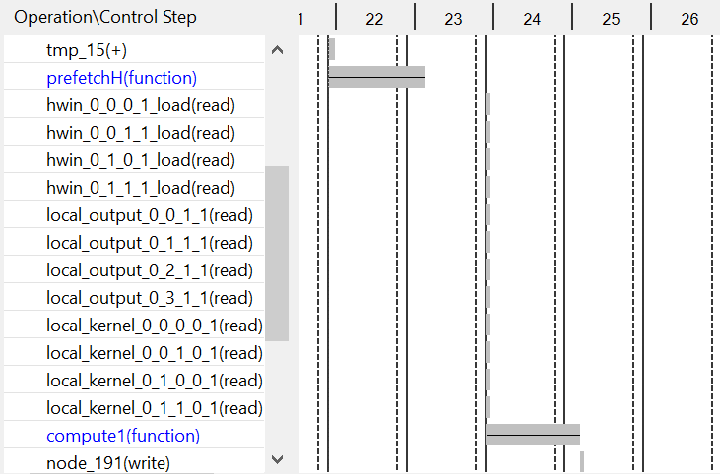
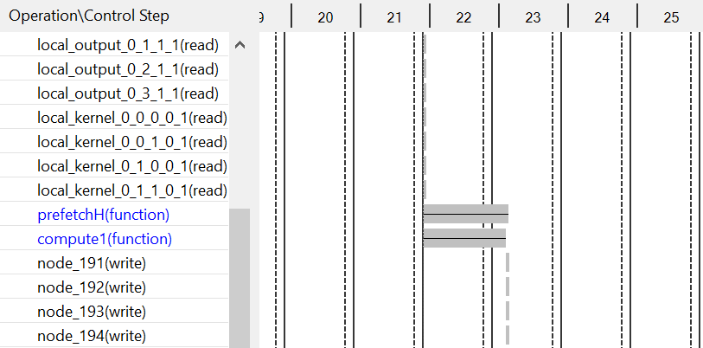
Scheduling of functions
Without PRAGMA “dependence”
With PRAGMA “dependence”

Slide 5
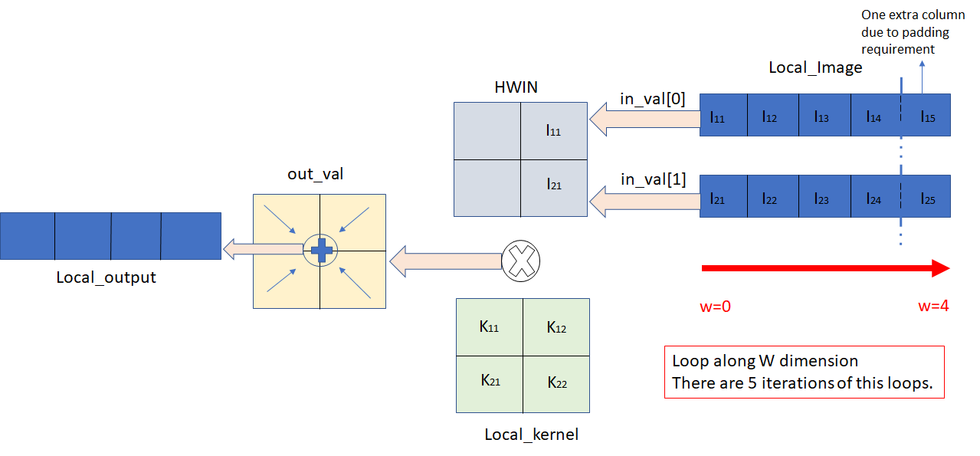
Implementation of Computation Structure:
Notes:
For the “compute” func, Local_Image and Local_Output are ports...hence no BRAM instantiation can be seen @ Compute level

Slide 6
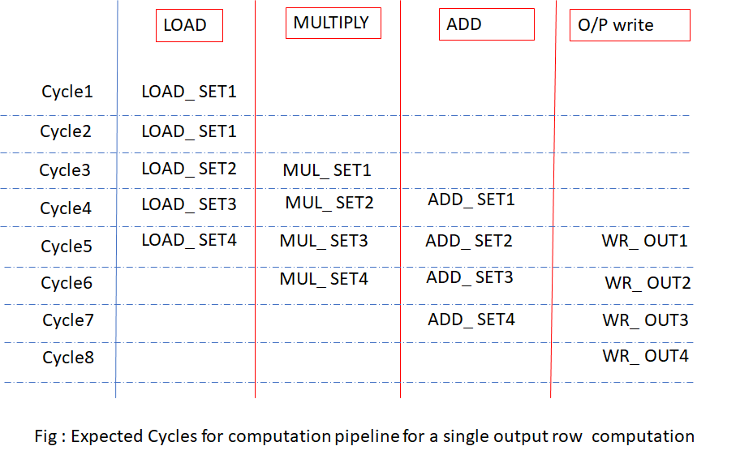
Implementation Analysis

Slide 7
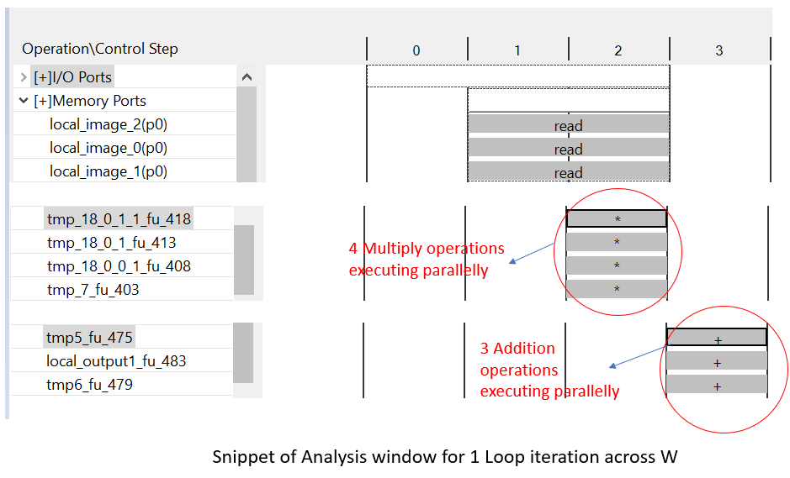
Vivado Results
Notes:
Initially out_val was not an array. Then, we were seeing that all multiplications were not getting scheduled in the same cycle. After making out_val as an array, we could see that all multiplications were getting scheduled in same cycle, and all additions are getting scheduled ins same cycle.

Slide 8
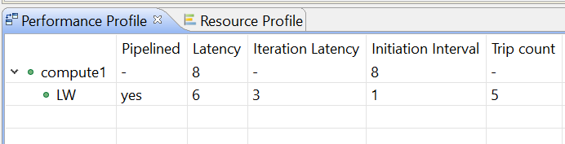
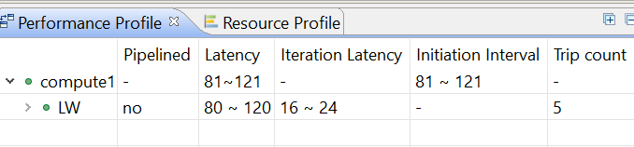
Impact of #pragma HLS pipeline
Without pipeline, total latency = Trip count * Iteration Latency
In case of pipeline, total latency = Trip count + Latency
Pipeline pragma also unrolls all sub-loops, whereas without pragma, the sub-loops are not unrolled, hence every iteration takes much longer.
With pipeline pragma
Without pipeline pragma

Slide 9
Impact of increasing M and C on “Compute” function
In Case2, loop is fully unrolled across dimension C due to the pipeline pragma. Thus, instead of 4 multiplications, 12 multiplications happen in parallel and 11 additions happen in parallel. Thus, no increase in computation latency.
#pragma HLS array_partition local_image block factor=C dimension 1
#pragma HLS array_partition local_output block factor=M dimension 1
#pragma HLS array_partition local_kernel complete dimension 0
 | Case1 [C=1] | Case2 [M=1, C=3] | Case 3 [M=3, C=3]
Computation Latency (for 1 output row) (in Clock Cycles) | 8 | 8 | 8
No of LUT | 876 | 1440 | 2773
No change in computation cycles as parallel computation
Notes:
In Case2, the cycles for writing into local_output is not increasing (whereas it should) is because due to small array sizes, the local_output is not being inferred as BRAM , but being inferred as LUTs.

Slide 10
On-chip data storage
Local Image: CxK+TLxW+K-1 (partitioned on C (3) and K+TL (3+1))
Prefetch
Row=0
Row=4
Row=0
Row=4
Row 1
Row 1
Row 2
Prefetch
Row 2
Row 3
Row 3
Row 3
Row 3
h= 1
C=0
h=0
C=2

Slide 11
Proposed Architecture: On-chip data storage
2. Local Image: W+K-1 factor stores W rows and K-1 0’s for padding
3. Local Kernel: TmxKxKxC ( Tm defines the unrolling factor of M) (complete partitioned, as local to each PE element)
4. Local Output: TmxW (As convolution of an image row with one kernel results in one output row, so convolution with Tm kernel results in Tm layers one row)
5. 17 BRAM division:
Image: 3 channels, each channel 4 rows: 12 BRAMs
Kernel: 0 BRAMs
Output: 5 layers rows: 5 BRAMs
6. Off-chip read cycles (9 cycles): read request: 7 cycles, port to on-chip: 1 cycle, write data to local memory: 1 cycle

Slide 12
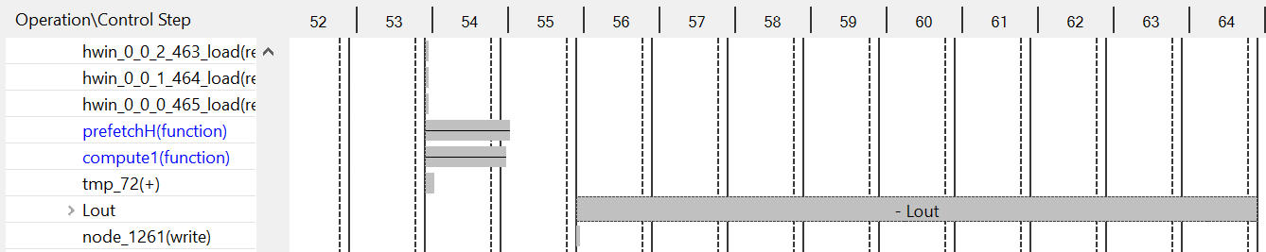
Analysis on Proposed Input Size
After compute phase, the local output produced is to be written back to off-chip memory, so combined latency of compute+output writing phase is comparable to prefetch phase.
As the proposed architecture does not perform parallelism across the rows(H), that’s why Tl=1 is selected, as loading of Tl=2 makes no difference to the computation(and unnecessarily increase BRAM resources).
Function | Latency
compute1 | 262
prefetch | 778

Slide 13
Baseline vs Proposed
Architecture 1: Given algorithm, all data off-chip access
Architecture 2: Given algorithm, all data on-chip access
Architecture 3: Proposed architecture, systolic array implementation
 | Architecture 1 | Architecture 2 | Architecture 3
Latency | 424,644,821 | 147,509,677 | 19,732,867(max)
BRAM | 0 | 514 | 17 (2%)
DSP | 1831 | 2510 | 82 (13%)
LUT | 3 | 3 | 10,820 (10%)
FF | 1250 | 1513 | 30378 (14%)

Slide 14
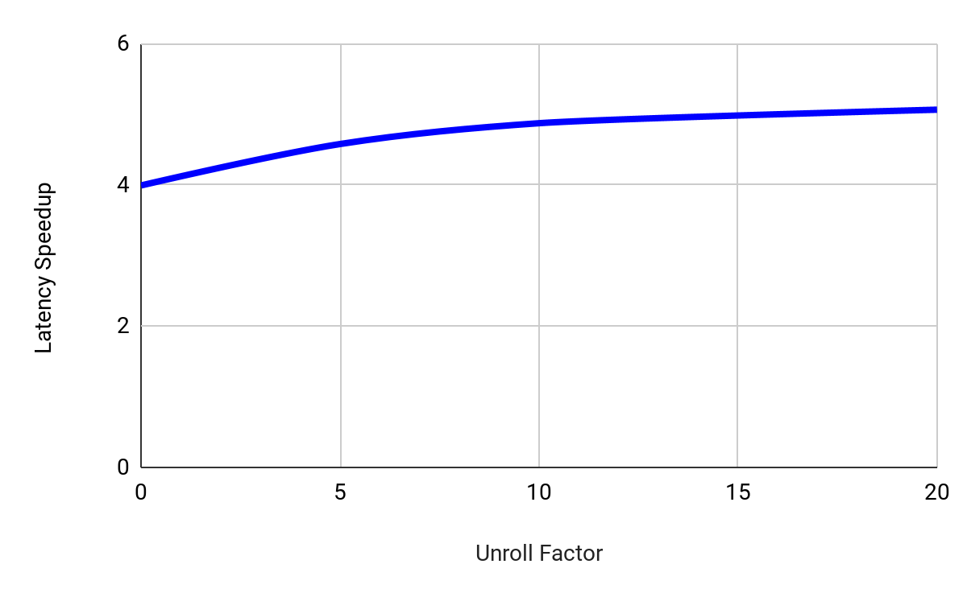
Unrolling M (Latency Speedup vs Unroll Factor)

Slide 15
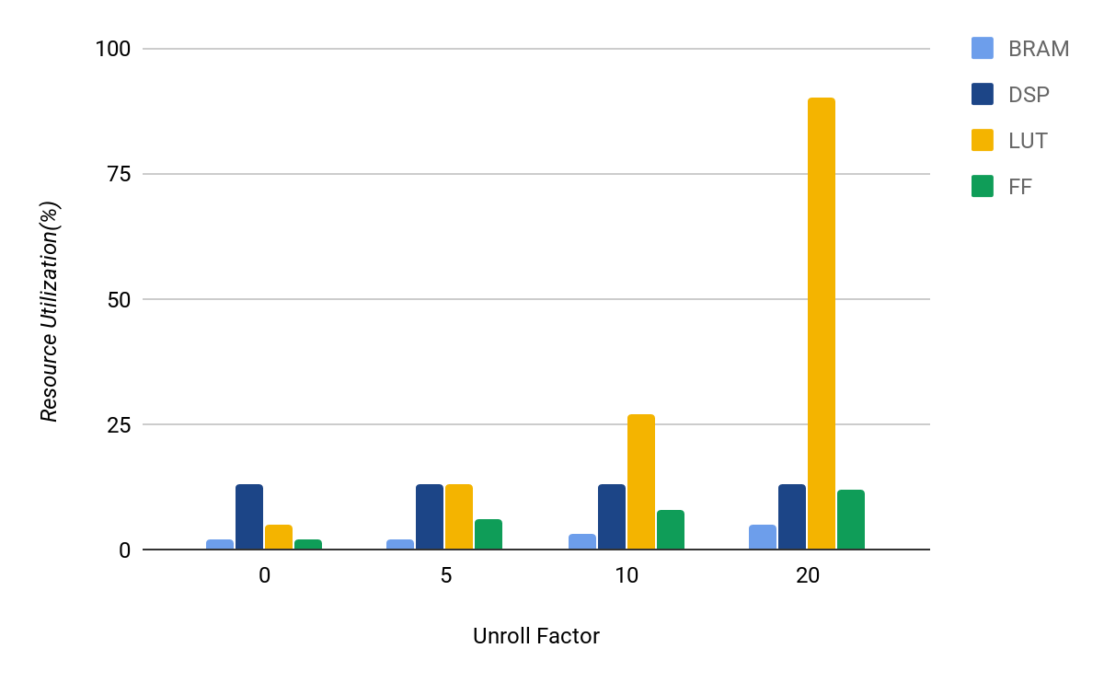

Slide 16
Appendix

Slide 17
Pictorial representation of algorithm
M=4
M=4
H=9
H=9
y=3
C=3
C=3
W=9
x=3
W=9
Assumption: Every pixel is 8-bits wide

Slide 18
Block Diagram : On-chip memory architecture
Control Logic
Output buffer
BRAM array 1
WDATA
ADDR
PE array
External
DRAM
WEN
Input buffer
Kernel on-chip storage
CLK
BRAM array 1
PE registers

Slide 19
Structure of a Kernel Registers array
PE register array –Channel 1
PE register array –Channel 1
Kernel Registers
(inside PEs)
K11
K12
K13
K11
K12
K13
K21
K22
K23
K21
K22
K23
K31
K32
K33
K31
K32
K33
PE register array –Channel 2
PE register array –Channel 2
We try to achieve some parallelism across M dimension.
This parallelism would come at the cost of:
More no of PE registers used for storing kernels
More no of output BRAM, as simultaneously we are able to generate more outputs.
K11
K12
K13
K11
K12
K13
K21
K22
K23
K21
K22
K23
K31
K32
K33
K31
K32
K33
PE register array – Channel 3
PE register array – Channel 3
K11
K12
K13
K11
K12
K13
K21
K22
K23
K21
K22
K23
K31
K32
K33
K31
K32
K33
M=1
M=2

Slide 20
Structure of a single BRAM array of Image
Row 1 BRAM
I12
I13
I14
I18
I11
I15
I16
I17
I19
Row 2 BRAM
I21
I22
I23
I24
I25
I26
I27
I28
I29
Row 3 BRAM
I32
I33
I34
I38
I39
I31
I35
I36
I37
BRAM array 1
Row 1 BRAM
I12
I13
I14
I18
I19
I11
I15
I16
I17
Row 2 BRAM
I21
I22
I23
I24
I25
I26
I27
I28
I29
Row 3 BRAM
I32
I33
I34
I38
I39
I31
I35
I36
I37
Row 1 BRAM
I12
I13
I14
I18
I11
I15
I16
I17
I19
Row 2 BRAM
I21
I22
I23
I24
I25
I26
I27
I28
I29
Row 3 BRAM
I32
I33
I34
I38
I39
I31
I35
I36
I37

Slide 21
Structure of a single PE
PE Register
PE Register
PE Register
Single Processing Element
K11
K11
K11
K11
I11
I11
I11
From BRAM
port
From BRAM port
From BRAM port
Every PE in the systolic array stores 3 kernel weights(1 for each channel) and 1 partial sum.
This register also pipelines the complete O11 computation
Partial Sum register
(inside PE)
P11

Slide 22
Architecture of Systolic Array of PEs
Row 1 BRAM
I12
I13
I14
I18
I11
I15
I16
I17
I19
M=1
K12
K13
Row 2 BRAM
I21
I22
I23
I24
I25
I26
I27
I28
I29
K11
Row 3 BRAM
I32
I33
I34
I38
I39
I31
I35
I36
I37
K21
K22
K23
I11
I12
I13
I14
I15
I16
I17
I18
I19
K31
K32
K33
Row 1 BRAM
Row 2 BRAM
I21
I22
I23
I24
I25
I26
I27
I28
I29
M=2
Row 3 BRAM
I32
I33
I34
I38
I39
I31
I35
I36
I37
K11
K12
K13
Row 1 BRAM
I12
I13
I14
I18
I11
I15
I16
I17
I19
K21
K22
K23
Row 2 BRAM
I21
I22
I23
I24
I25
I26
I27
I28
I29
K31
K32
K33
Row 3 BRAM
I32
I33
I34
I38
I39
I31
I35
I36
I37

Slide 23
Dataflow for computation of output for M=0, C = 1
Address = Addr1
M=1
I11
K11
K12
K13
I11
I12
I13
I14
I15
I16
I17
I18
I19
Row 1 BRAM
I21
K23
I21
I22
I23
I24
I28
I29
Row 2 BRAM
K21
K22
I25
I26
I27
I31
K31
K32
K33
Row 3 BRAM
I31
I32
I33
I34
I35
I36
I37
I38
I39
CYCLE 1

Slide 24
Dataflow for computation of output for M=0, C = 1
Address = Addr2
M=1
I11
I12
K11
K12
K13
I11
I12
I13
I14
I15
I16
I17
I18
I19
Row 1 BRAM
I21
I22
K23
I21
I22
I23
I24
I28
I29
Row 2 BRAM
K21
K22
I25
I26
I27
I31
I32
K31
K32
K33
Row 3 BRAM
I31
I32
I33
I34
I35
I36
I37
I38
I39
CYCLE 2

Slide 25
Dataflow for computation of output for M=0, C = 1
Address = Addr3
M=1
I11
I12
I13
K11
K12
K13
I11
I12
I13
I14
I15
I16
I17
I18
I19
Row 1 BRAM
I21
I22
I23
K23
I21
I22
I23
I24
I28
I29
Row 2 BRAM
K21
K22
I25
I26
I27
I31
I32
I33
K31
K32
K33
Row 3 BRAM
I31
I32
I33
I34
I35
I36
I37
I38
I39
CYCLE 3
3 cycles 🡺 pipeline filling latency
At the end of 3rd cycle, the computation for the O11 begins.

Slide 26
Dataflow for computation of output for M=0, C = 1
Address = Addr4
M=1
I12
I13
I14
K11
K12
K13
I11
I12
I13
I14
I15
I16
I17
I18
I19
Row 1 BRAM
I22
I23
I24
K23
I21
I22
I23
I24
I28
I29
Row 2 BRAM
K21
K22
I25
I26
I27
I32
I33
I34
K31
K32
K33
Row 3 BRAM
I31
I32
I33
I34
I35
I36
I37
I38
I39
CYCLE 4
Pipeline is filled. From Cycle 4 onwards, a computation happens every cycle.
Thus, 9 computation happen in 9 cycles 🡺 1st phase of computation completes.
The pipeline-filling latency easily got hidden as we reuse the data present inside the PEs, which are overlapping among 2 adjacent tiles.

Slide 27
Computing the final output
P11
P11
P11
Partial Sums
P11
P11
P11
P11
P11
P11
Pipelined Adder
To Output On-chip Buffer

Slide 28
Next Phase of Computation
PING BRAM array
Phase 1
Row 1
Row 2
Phase 2
K11
K12
K13
Phase 1
Row 3
Phase 3
Row 4
Phase 2
K21
K22
K23
MUX
Phase 4
Phase 3
Row 5
K33
Phase 4
Row 6
K31
K32
PONG BRAM array
SEL
Control Logic FSM for reading image from IMAGE BRAM array into PE Array

