Slide 1
DDBS FINAL Project
Wentao Guo Haoshen Li

Slide 2
Project Requirements
Basic
Bulk data loading with data partitioning and replica consideration
Efficient execution of data insert, update, and queries
Monitoring the running status of DBMS servers, including its managed data(amount and location), workload, etc

Slide 3
Primary node
Secondary node
Secondary node
Manager
Arbiter
Router
Redis
Config sever
Config sever
Config sever
DBMS1 / DBMS2

Slide 4
Efficient execution of data insert, update, and queries
Bulk loading
Improve query efficiency
Populate be-read table
Popular rank

Slide 5
Bulk loading
Fixed size array

Slide 6
Improve query efficiency
DBMS1
DBMS2
Parallel operations (filtering, etc.)
Serial operations (sorting, join, etc.)
Pipeline
π

Slide 7
Populate be-read table
Bulk insertion Handler for DBMS1
Read table
Redis
Bulk insertion Handler for DBMS2
AID in DBSM1 or 2

Slide 8
Popular rank
For a single DBMS
Daily
Weekly
Monthly
Aid:
Time: visited time

Slide 9
Popular rank
Merge and select
Daily
Weekly
Monthly
aid ->
(timeKey, reads count)
DBMS1
Merge result
Daily
Weekly
Monthly
DBMS2

Slide 10
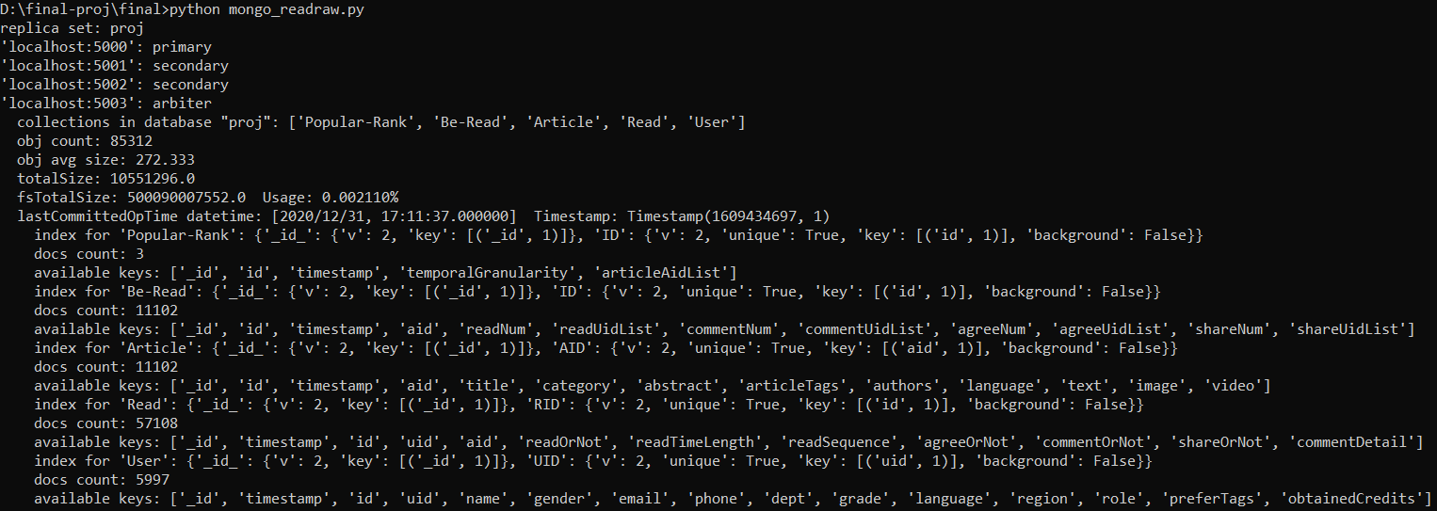
Monitoring the running status of DBMS server
Server status
Database status
Collection status

Slide 11
Advanced Functions
Data migration
Drop server at will
Server status
Add new servers

Slide 12
Data migration
Start new mongo node
Check server status
Combine the original 2 sites' data -- User, Article, Read, Popular-Rank, Be-Read
Bulk insert to the new site
Let new site report its status
DBMS1
New site
DBMS2

Slide 13
Drop server at will
Primary node Secondary node
Secondary node
Arbiter
Drop secondary node at will
Drop primary node with the help of arbiter (drop two servers at most)
Router
Config sever
Config sever
Config sever

Slide 14
Add new servers
Start a new server
Add configuration in the old primary node
Report status of the new server
Primary node
Secondary node
Secondary node

