Slide 1
Dispute with Sellers? SUB Helps You
Smart Contract Payment: MINIMIZE your loss
Arbitration: UNBIAS judgment by general users
Best Suggestion: the OPTIMAL solution for you

Slide 2

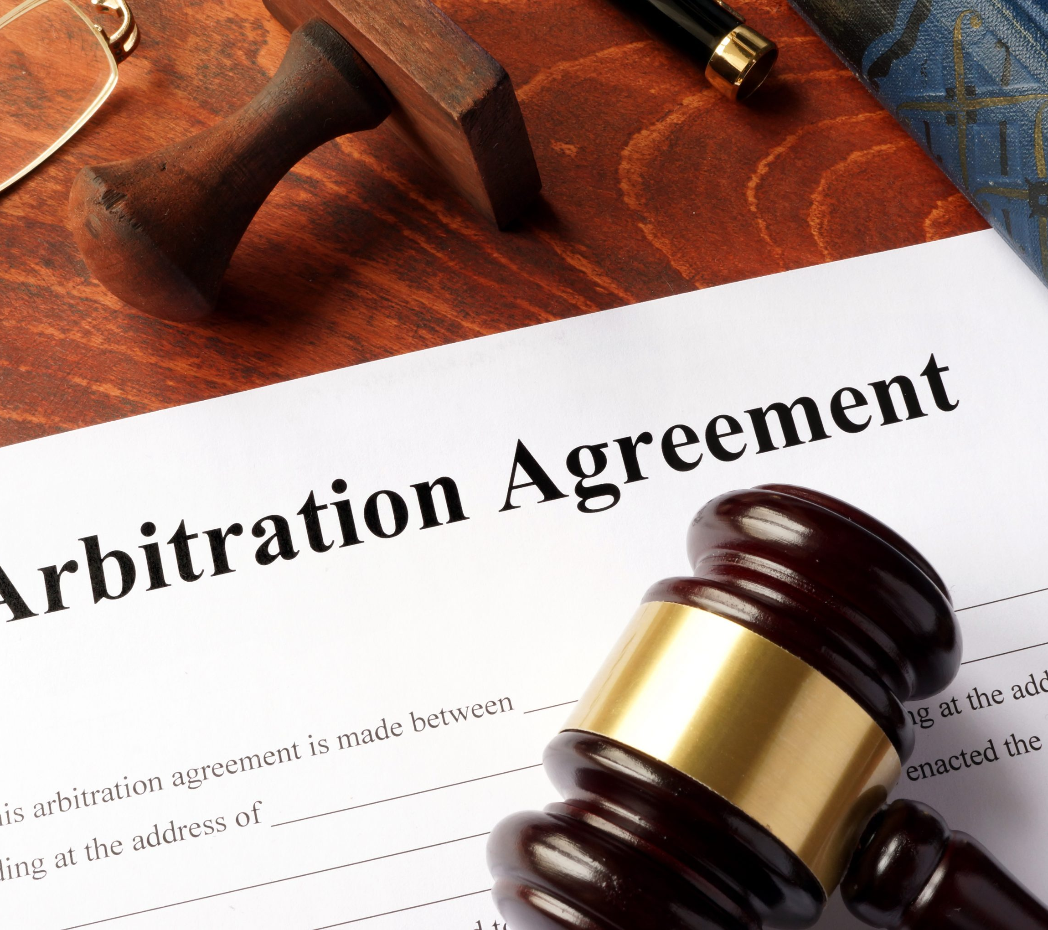
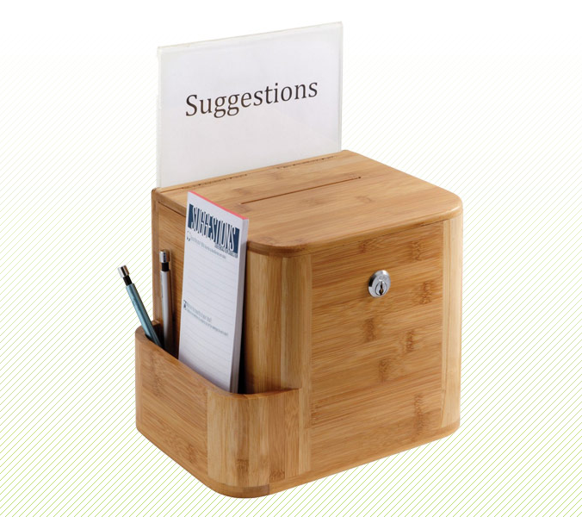
Meet up SUB System
Once the buyer purchased a product from the seller face to face, then the buyer will transfer 50% of the original price to the seller, which is no refundable, because this is buyer’s duty to check before they buy it. Another 50% will be hold in the smart contract, and sent to the seller in next a few days. Each day, the seller will receive a portion of the rest of coins, so this gives the buyer’s some day to check the product and enforces them to check it as soon as possible.
General users vote to a side that they support, and the party that gets majority votes win the dispute. If the seller wins the debate, then the smart contact will send the rest of coins to them. Otherwise, the buyer keeps the remaining coins in the contact. To encourage general users to vote, every voter stakes some coins on one side, and those voters who lost will give away their cryptocurrency to reward the majority of voters.
Ideally, we hope general users can help the buyer to fix or replace their broken items at no further cost. Therefore, the system allows public users to provide their suggestions; the buyer can pick the best solution for them, and reward that person with all remaining coins in the smart contract.

Slide 3
Thank You!

