Slide 1


ASSIGNMENT FOR A POSITION AS HARDWARE ASIC ENGINEER AT
E.ON FUTURE LAB
Gergely Levai
03.08.2023

Slide 2



System Design
Mains Connection
(~230V-50Hz/~115V-60Hz)
Power and processing
Communication
Cloud
Power Supply
Microprocessor
Power Source
A
Other appliances
APP
TV
Current signal
E.ON Future Lab
Gergely Levai
03.08.2023

Slide 3
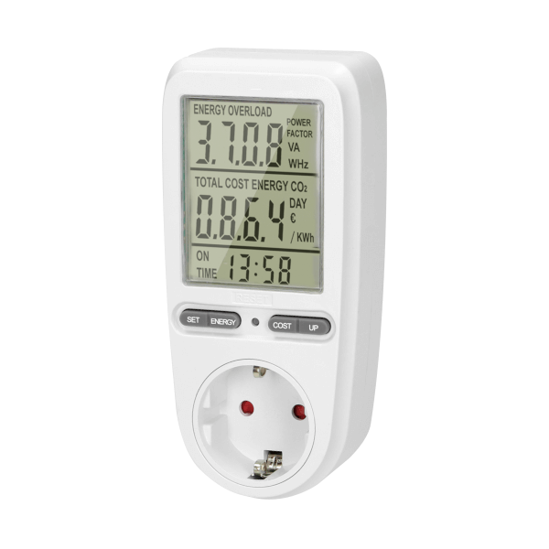
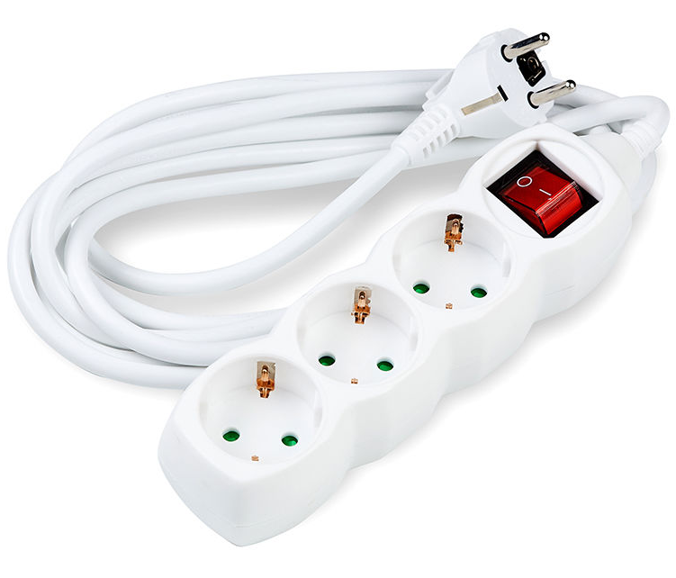
Current state of technology and improvement areas
Single usecase
Low UX
Limited connectivity
Not practical
Multi-purpose
High UX
Smart device
Modular
E.ON Future Lab
Gergely Levai
03.08.2023

