Slide 1
Software Engineering
Graphhopper API

Slide 2
Project Goals

Slide 3
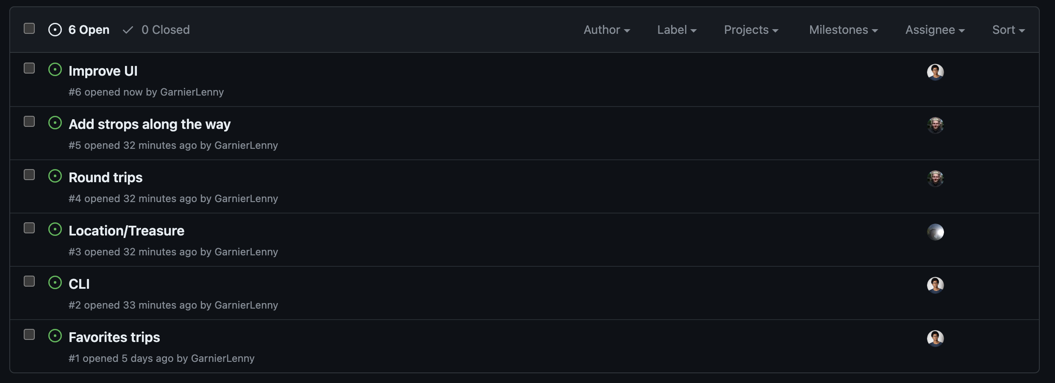
Organization

Slide 4
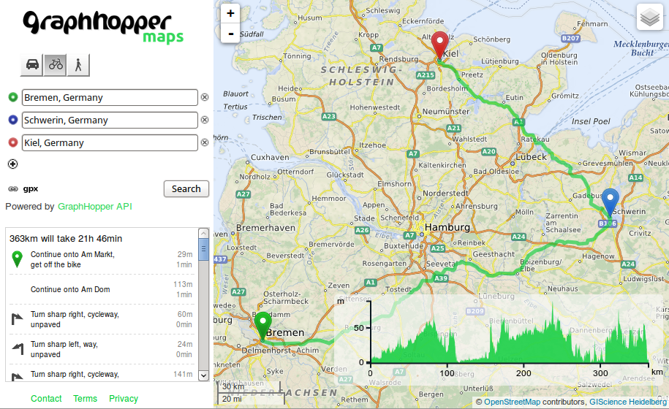
What's Graphhopper?

Slide 5
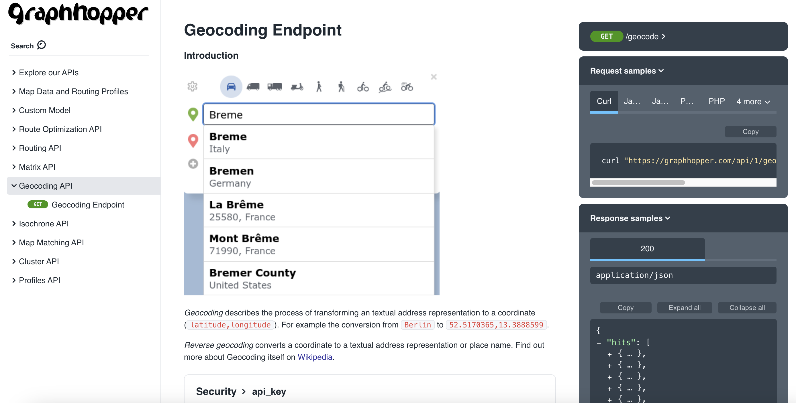
API Usage

Slide 6
API Usage
graphhopper.com/api/1/geocode?q=Washington
{'lat': 38.8950368, 'lng': -77.0365427}

Slide 7
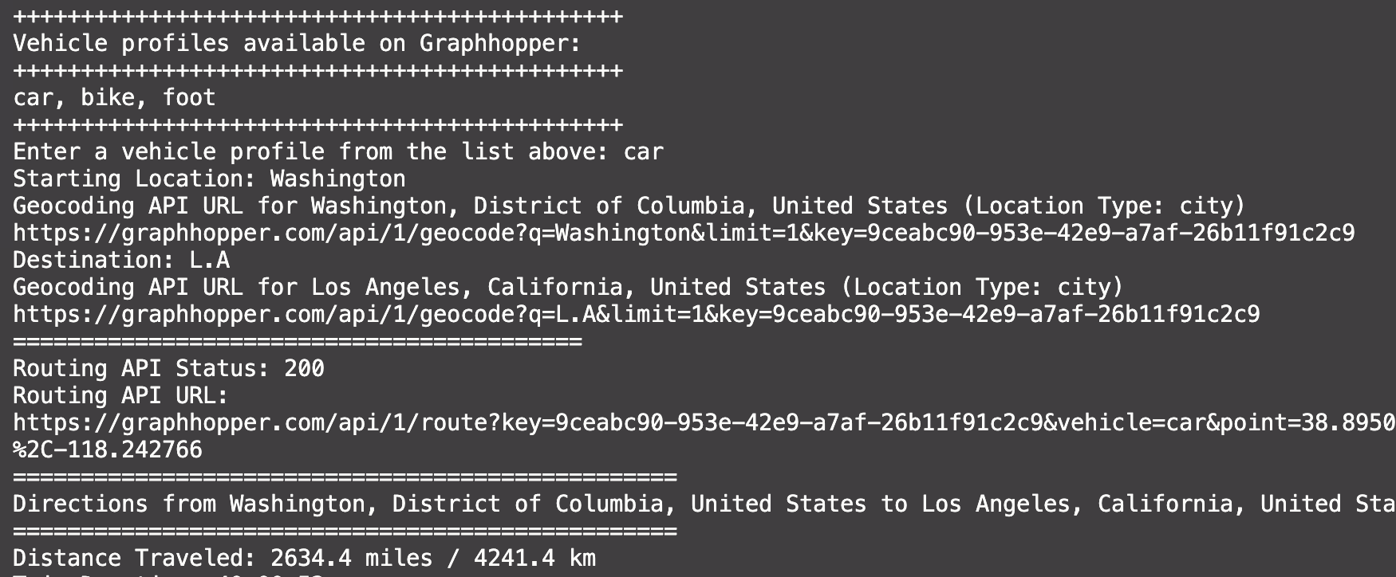
UI

Slide 8
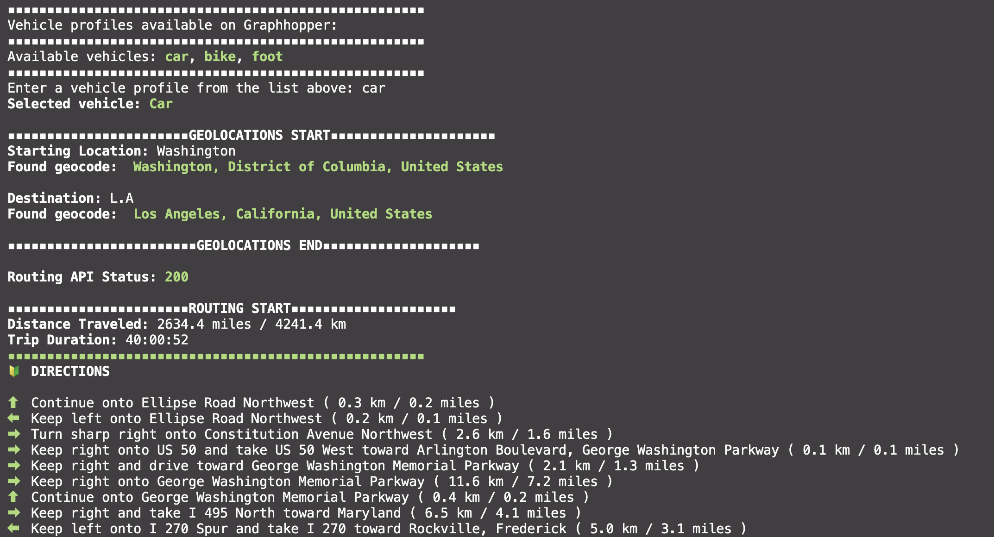
UI

Slide 9
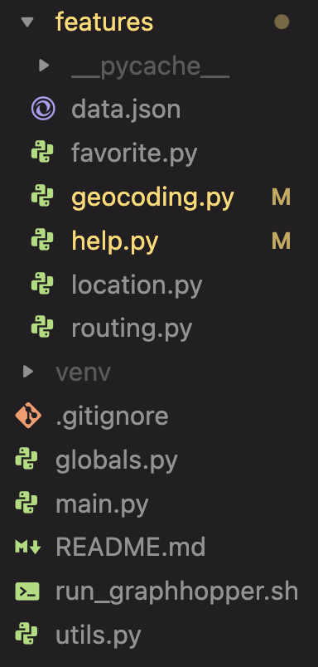

Structure

Slide 10
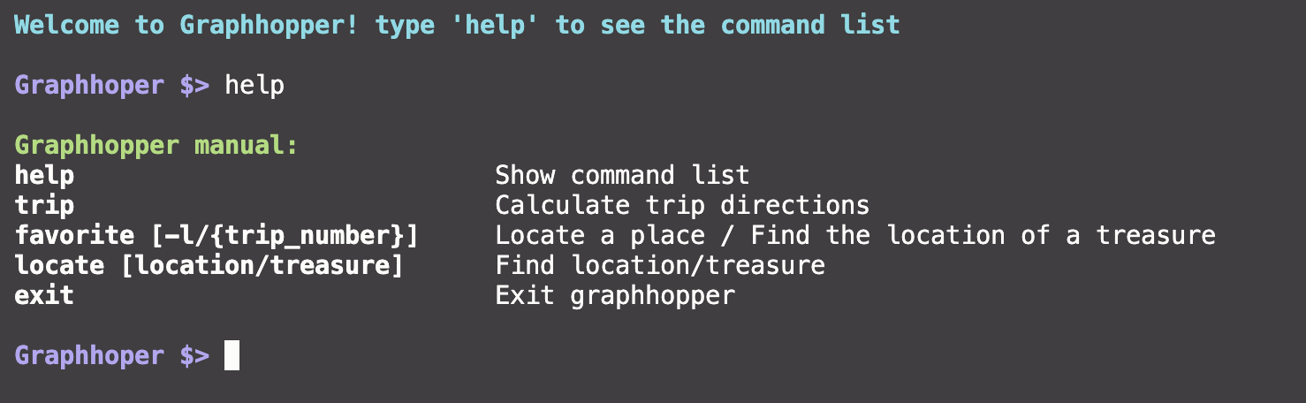
CLI

Slide 11
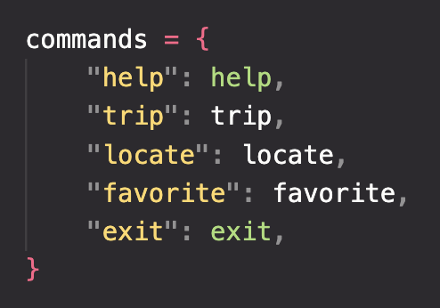
CLI

Slide 12

Favorites

Slide 13

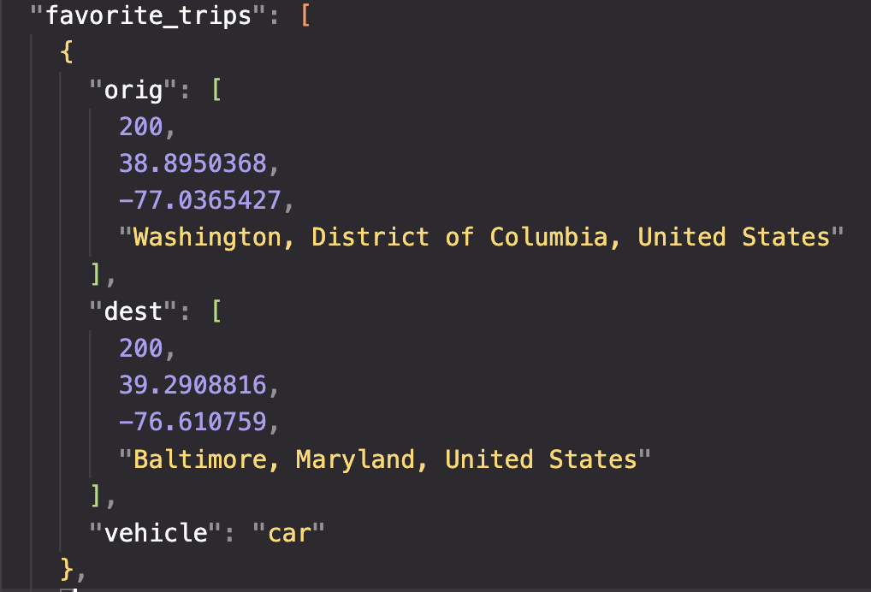
Favorites

Slide 14
Favorites

Slide 15
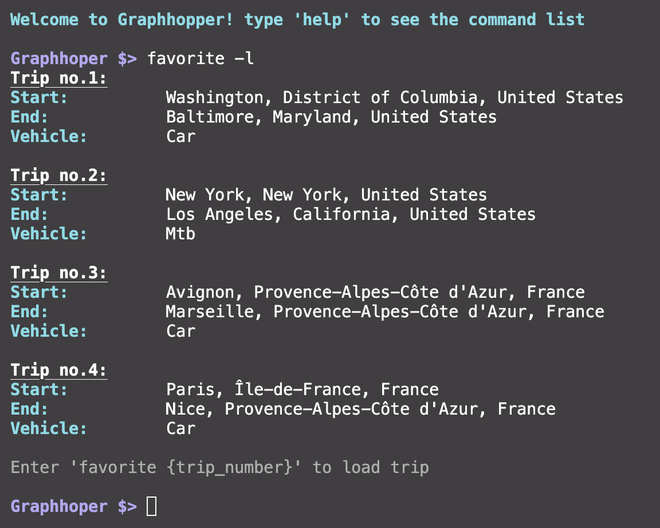
Favorites

Slide 16
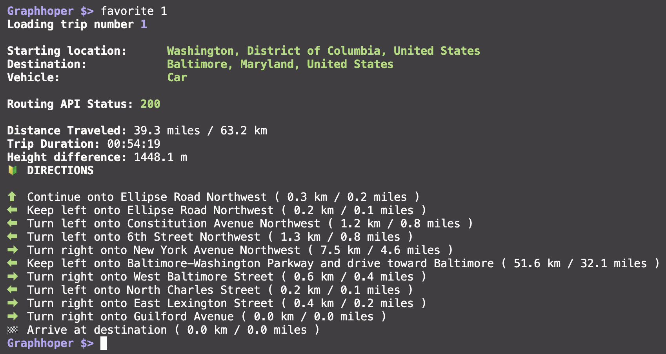
Favorites

Slide 17
Stops

Slide 18
Round trips

Slide 19
Location Treasure

Slide 20
Future enhancements

Slide 21
What we learned

Slide 22
Conclusion

Slide 23
Thank you

